Slide 1
Taj Mall
Saleh sawafta ,Aysar Mosallam, Lutfi Azhari
Supervisor: Dr. Sofian samara
Dr. Mohannad al-jabi

Slide 2
Outlines:
What is Taj Mall ?
Problems.
Solution.
Tools.
Constrains.
Future Work.

Slide 3
What is Taj Mall?
software that helps traders to…
    offer products , discounts and add advertisement. Also can participate in auction.
software that helps customers to…
    browse and search for products that they want easily and communicate with traders.

Slide 4
Problems?
Its not easy for customers to find products that they want.
Traders can’t find appropriate place to offer and promote their products.
Locally e-commerce is not a popular business
No online auction in Palestine
Local traders don’t have any means of communications
Individuals don’t have an easy way selling products

Slide 5
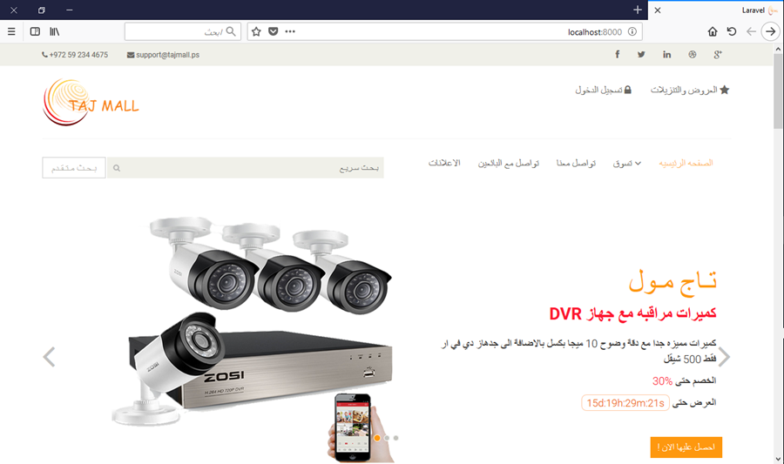
Solution.

Slide 6








Tools:

Slide 7
Constrains
Local banks didn’t cooperate with us to apply an online payment method
Not enough time to implement all features we’ve wanted

Slide 8
Future Work
Online payment method through a local bank
Free shipment through the website
Expand to other areas ex.: Gaza, Jordan…

Slide 9
تم بحمد الله

