Slide 1
Optimizing Biowaste Material Mixing for Efficient Biogas Production via Airlift Pump-Equipped Digesters
Graduation Project 2
Prepared by
Tariq Malhis
Supervisor Dr. Ihab Surakji | Co-Supervisor Prof. Wael Ahmad Dr. Amjad El-Qanni

Slide 2
Outline
2/42
Introduction and Background
Research Objectives
Literature review
Methodology
Results
Conclusion

Slide 3
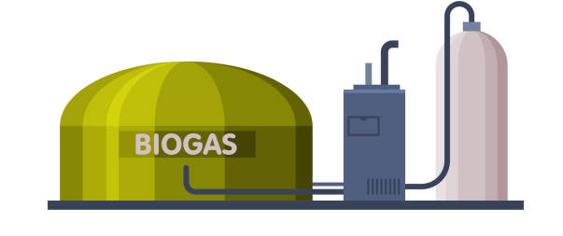
How is Biogas Produced
3/42
Biogas is produced via the anaerobic digestion process
The biogas consists of CH₄, CO₂ and other impurities.

Slide 4
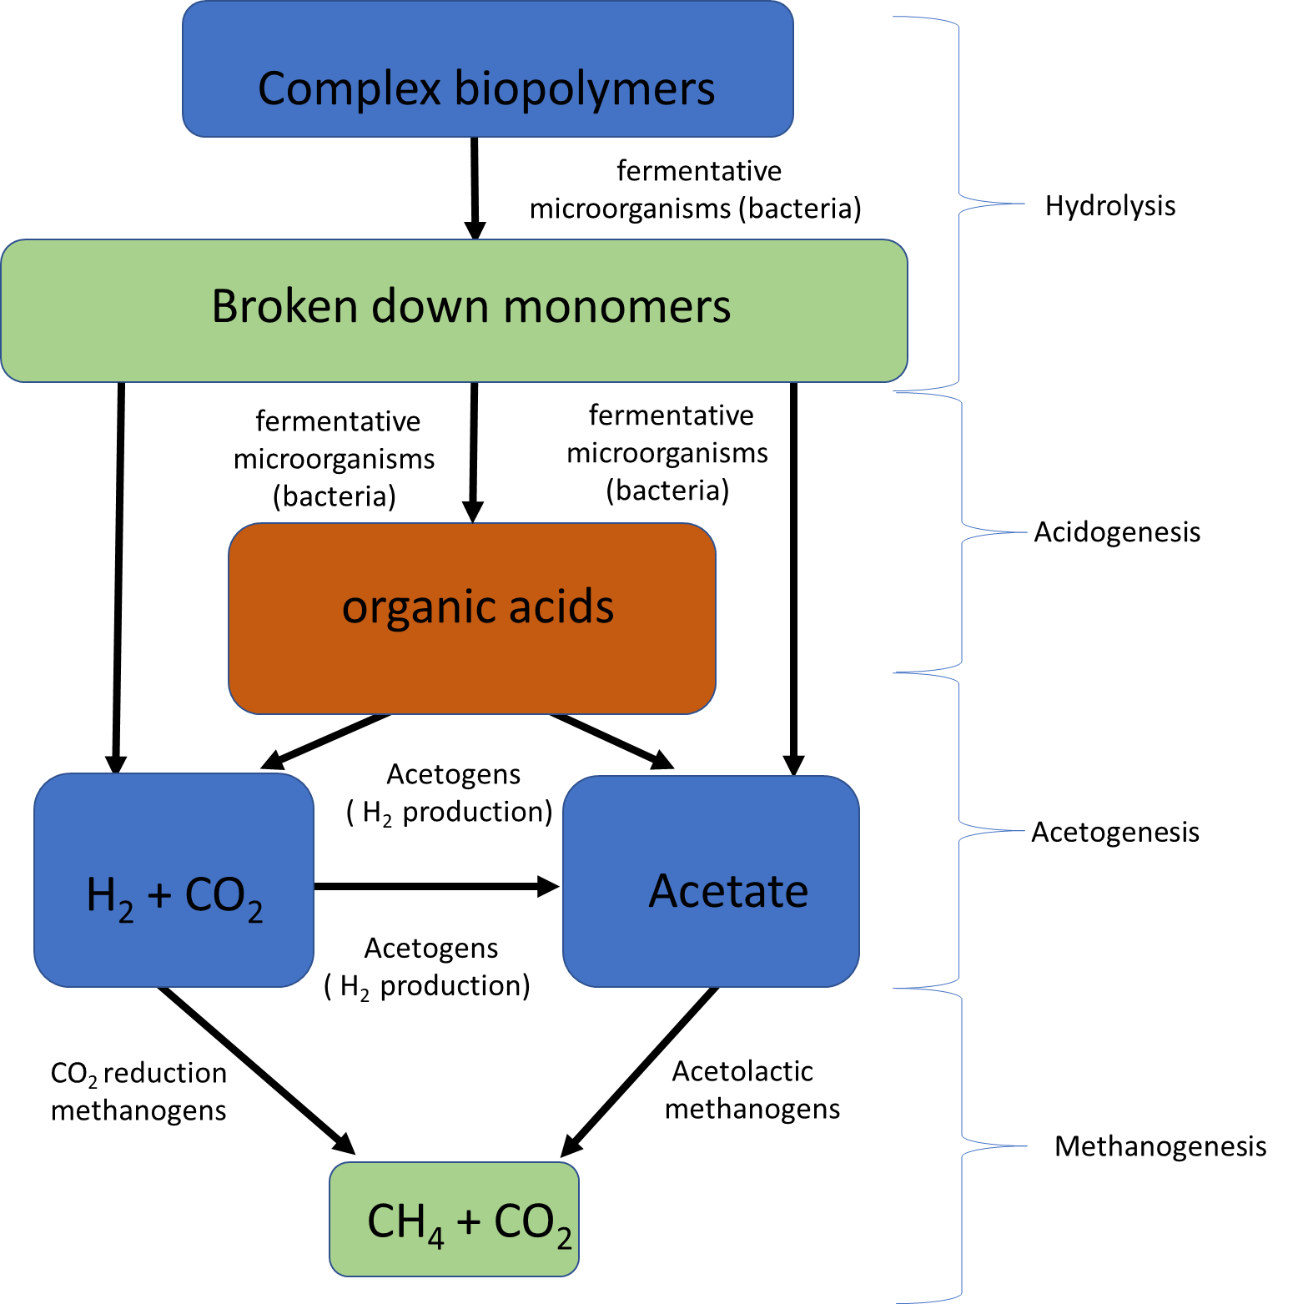
Phases of the
Anaerobic Digestion Process
Sources:
Myint, M., N. Nirmalakhandan, and R.E. Speece, Anaerobic fermentation of cattle manure: Modeling of hydrolysis and acidogenesis. Water Research, 2007. 41(2): p. 323-332.
Enzmann, F., et al., Methanogens: biochemical background and biotechnological applications. AMB Express, 2018. 8(1): p. 1.

Slide 5

5/42
Research Objectives

Slide 6
Research Objectives
6/42
This study aims to evaluate an effective method for extracting biogas from food waste (liquid sludge)using a bioreactor or digester. This is achieved by modifying the mixing methods employed in these digesters, based on evaluating the mixing rate, average velocity, and velocity contours for both liquid and gas phases within the digester.
The new method involves using Airlift pumps for mixing the liquid and gas phases within the digester.

Slide 7
Achieving the Research Objectives
7/42
In order to achieve the objectives, the following tasks have been done:
A survey on all theory regarding the different used mixing methods.
Assessing the most ideal riser design among the Standard, Tapered, and Step designs.
Utilize the air-water flow rate results obtained by Flonergia for airlift pumps.
Carry an experimental work to get the best ratio between the gas and liquid phases.
Comparing and evaluating the mixing rate of liquid sludge versus biogas with that of water versus air.
Evaluating the rheological property of Liquid sludge at different liquid and gas flowrates.
Conclude how implementing airlift pumps inside the digester would affect the mixing rate and yield product of biogas.

Slide 8

8/26
8/26
8/42
Literature Review

Slide 9
Structure of the Literature Review
9/42
For the clarity of presentation, the literature review is divided into the following aspects:
The different types of mixing methods for the liquid and gas phase.
Compare the different types of mixing methods and conclude which is the most convenient and would result in the highest yield product of biogas.
Distinguishing between the various multiphase flow regimes within the riser.
Analyze which flow regime would result to the highest mass flowrate of liquid phase.

Slide 10
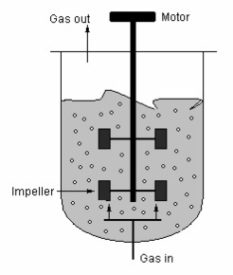
Continuous Stirred Tank Reactors (CSTRs)
This type of reactor consists of a mechanical impeller or other mechanical means to ensure maintain a good mixing rate within the digester .
Advantages:
  Moderate mixing rate
  Good initial yield product
  Easy to operate
Disadvantages:
  In adequate mixing in regions far from the digester
  High maintenance cost
Sources:
Sağır, E. and P.C. Hallenbeck, Chapter 6 - Photofermentative Hydrogen Production, in Biohydrogen (Second Edition), A. Pandey, et al., Editors. 2019, Elsevier. p. 141-157.
Stockar, U., Biothermodynamics of live cells: A tool for biotechnology and biochemical engineering. Journal of Non-equilibrium Thermodynamics - J NON-EQUIL THERMODYN, 2010. 35: p. 415-475.

Slide 11
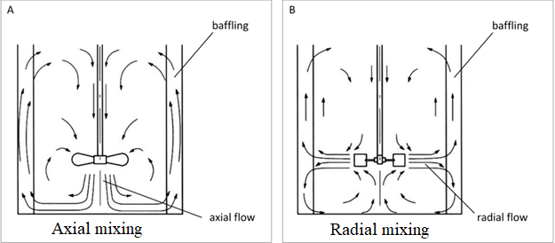
Types of CSTR
Axial Mixing
Radial Mixing
Sources
Schwedhelm, I., A non-invasive microscopy platform for the online monitoring of hiPSC aggregation in suspension cultures in small-scale stirred tank bioreactors. 2019.

Slide 12
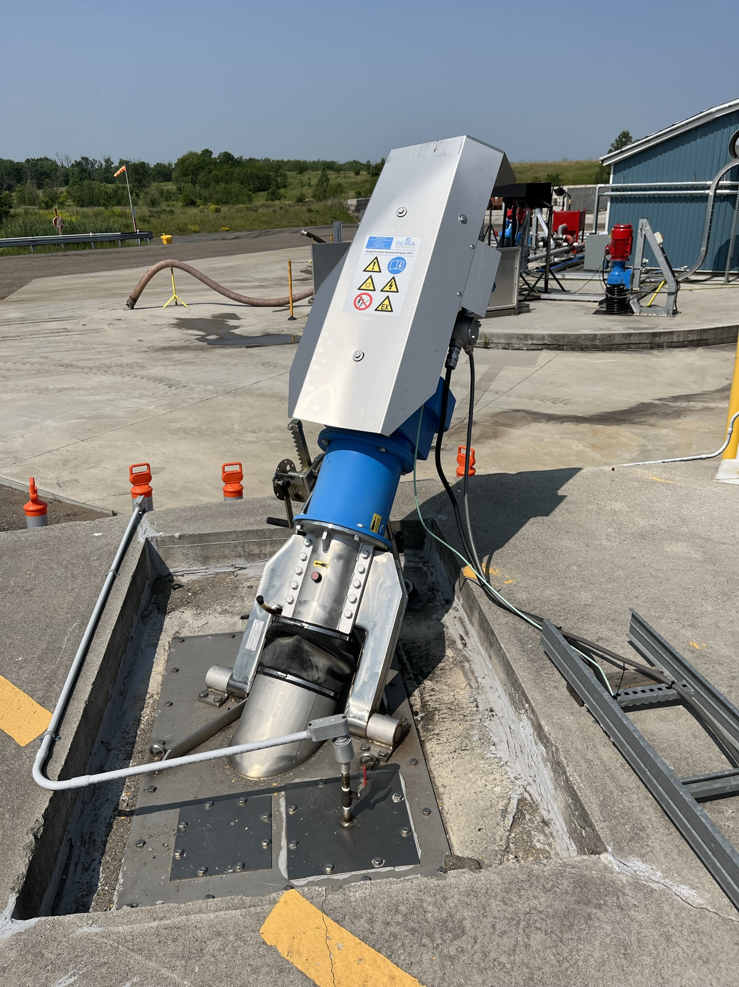
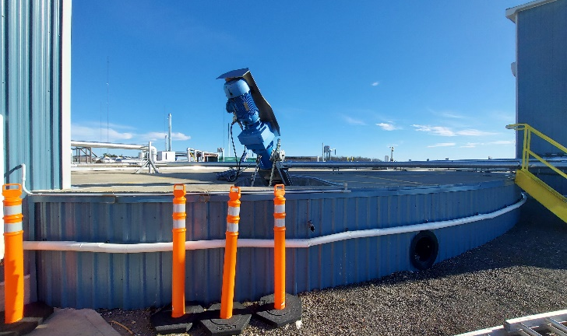
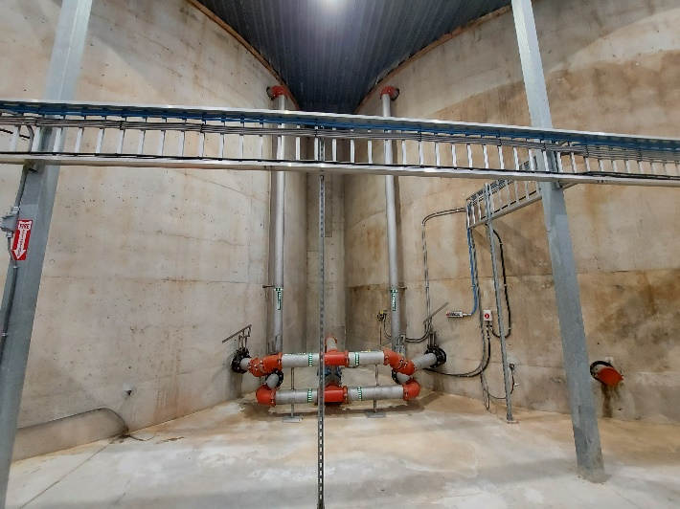
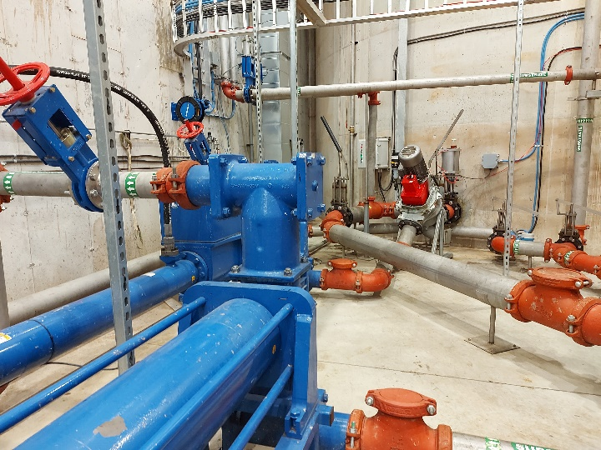
Escarpment Renewables
Digester tank and the mixer (CSTRs)
Outer walls of underground digester tank

Slide 13
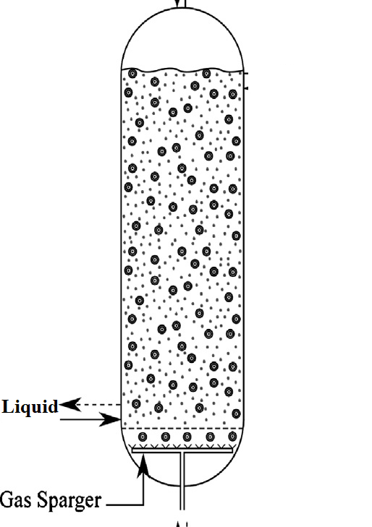
Pneumatic Bioreactors
Pneumatic bioreactors are a type of bioreactors in which medium stirring is accomplished through gas bubbling.
Compressed air or gas mixture is introduced at the bottom of a cylindrical column or tank using nozzles, perforated plates, or a ring sparger.
The two main types are the Bubble column reactor and the Airlift reactor.
Sources:
Angeles, M., et al., ChemInform Abstract: A Review of Experimental Procedures for Heavy Oil Hydrocracking with Dispersed Catalyst. Catalysis Today, 2013. 220.

Slide 14
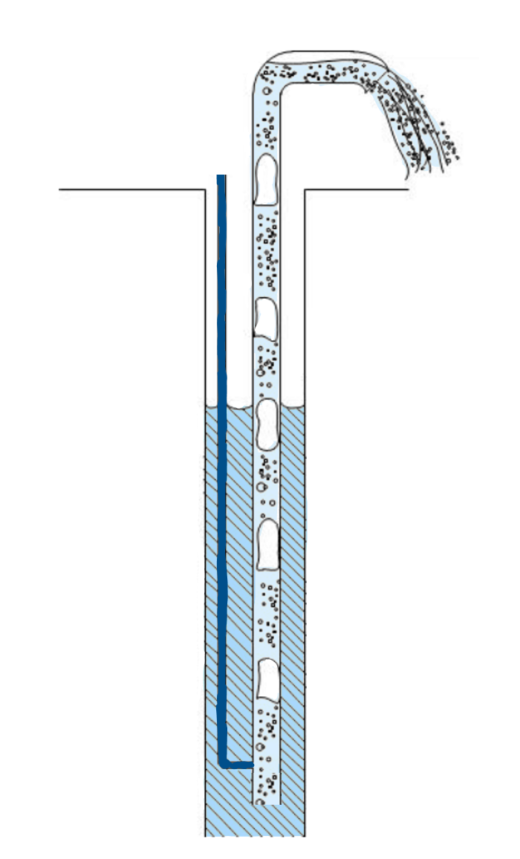
Airlift Pumps
Special effect pumps that use injected compressed air to lift the liquids
Operates under the buoyancy effect (Catrawedarma et al., 2020)
Advantages:
  Simplistic design
  No moving parts
  Low maintenance
Air Inlet
Riser pipe
Partially submerged riser pipe
Injection Point
Suction pipe
Source:
S. Bukhari, “Improving the Airlift Pump Prediction Model for Aquaculture Applications,” the University of Guelph, 2018.
G. N. B. Catrawedarma, Deendarlianto, and Indarto, “The performance of airlift pump for the solid particles lifting during the transportation of gas-liquid-solid three-phase flow: A comprehensive research review,” Proc. Inst. Mech. Eng. Part E J. Process Mech. Eng., no. 2, 2020, doi: 10.1177/0954408920951728.
Airlift pump schematic (Bukhari, 2018)

Slide 15
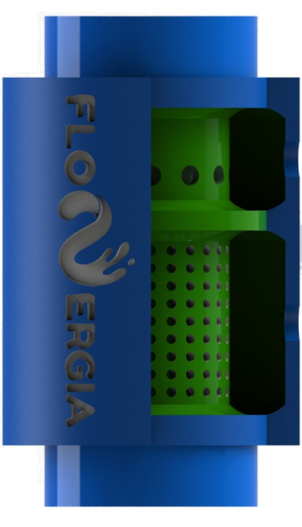
Dual Injector Airlift Pump
Dual injector airlift pump designed by Ahmed and Badr, 2016
It is called a dual injection as gas phase is injected in both radial and axial directions
Holes are evenly distributed for both the radial and axial injection.
Axial gas phase Injection
Enhanced liquid phase lifting
Radial gas phase Injection
Enhanced penetration of gas phase
W. H. Ahmed, A. M. Aman, H. M. Badr, and A. M. Al-Qutub, “Air injection methods: The key to a better performance of airlift pumps,” Exp. Therm. Fluid Sci., vol. 70, pp. 354–365, 2016, doi: 10.1016/j.expthermflusci.2015.09.022.

Slide 16
The Advantages of Pneumatic Reactors over Continuously Stirred Tank Reactors
Quick mixing time, which is the time to reach a specific degree of homogeneity.
high level of homogeneity across the fluid.
maximum biomass transfer takes place at the pneumatic reactors compared to the stirred tank bubble reactor at the same adequate environmental aspects.
no moving parts Vs moving parts.
Sources:
Zhong, J.-J., Bioreactor Engineering. 2011. p. 257-269.
Kress, P., et al., Effect of agitation time on nutrient distribution in full-scale CSTR biogas digesters. Bioresource Technology, 2017. 247.

Slide 17
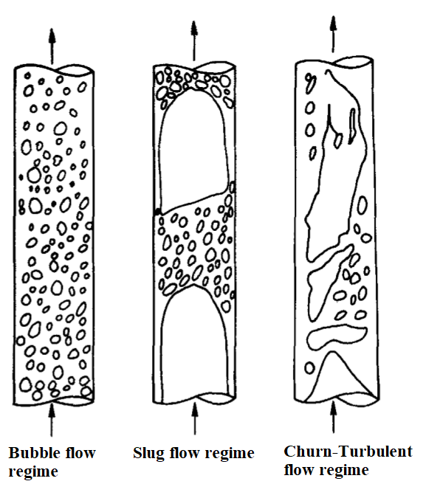
Types of Flow Regime
Source:
Dang, C., et al., SPECTRAL AND EIGENVALUES ANALYSIS OF ELECTRICAL IMPEDANCE TOMOGRAPHY DATA FOR FLOW REGIME IDENTIFICATION. 2019.

Slide 18
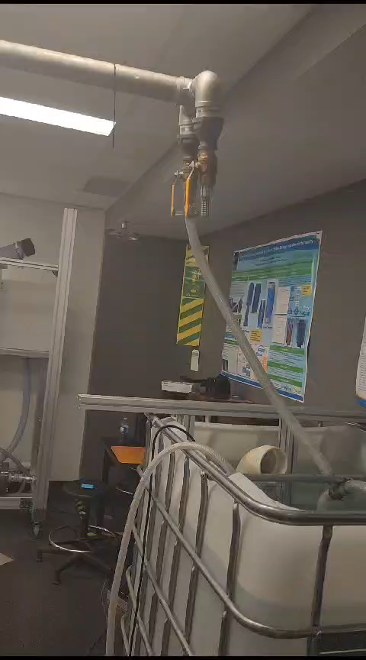
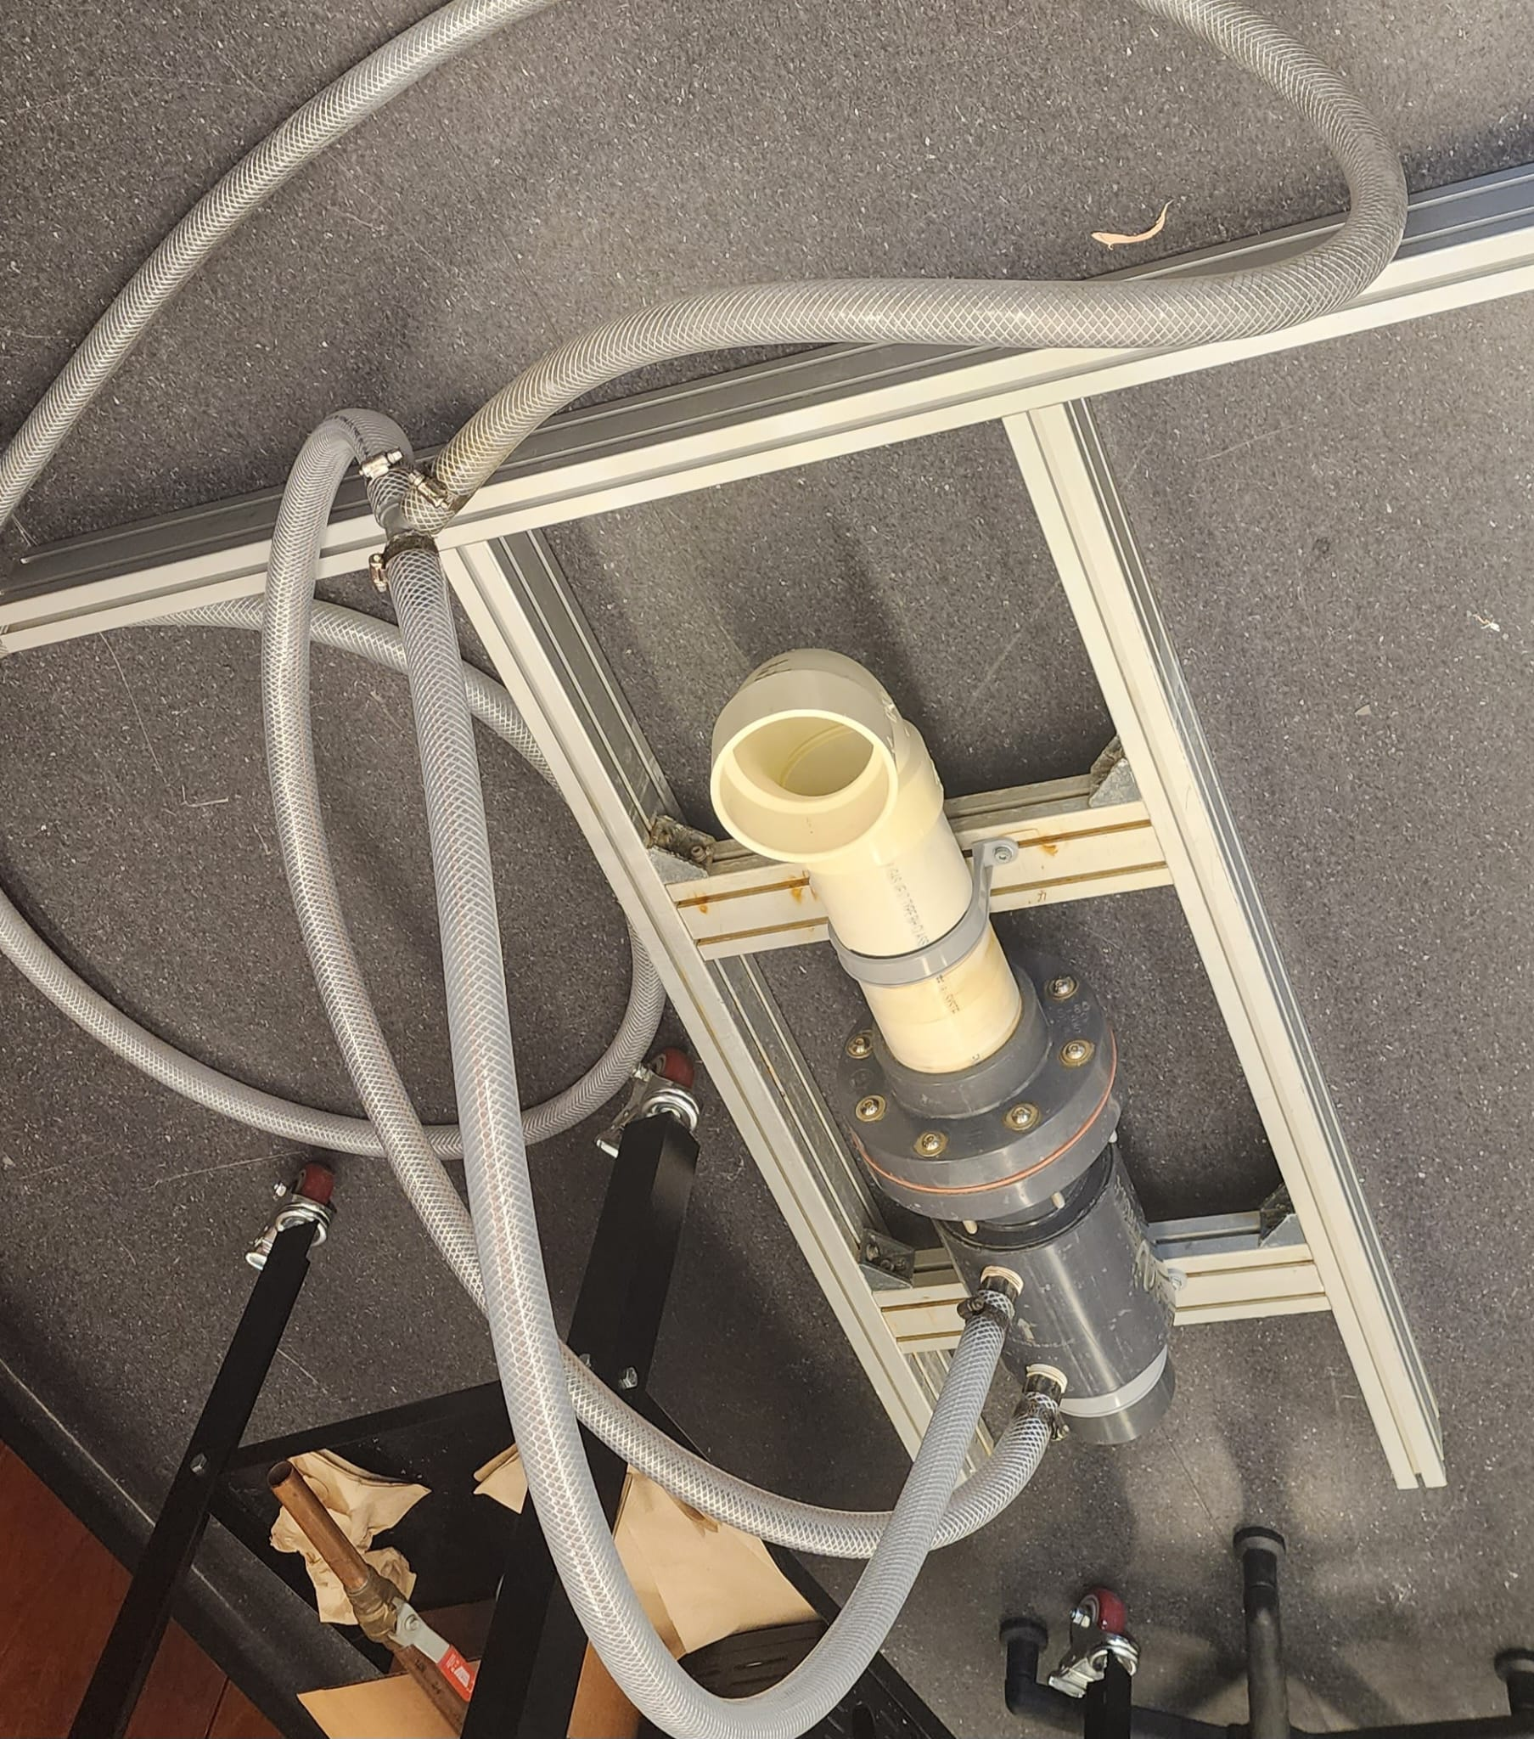
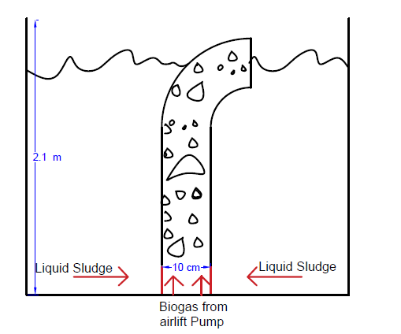
The Riser Design
Design: Standard Riser.
The Riser is 4-inch in diameter and 1.9 m in height.
This design enables both churn turbulent and slug flow regime.
Slug flow regime can improve mixing and reduce dead zones, due to the concave shaped bubbles.
Source:
Ahmed, W.H. and H.M. Badr, Dual-Injection Airlift Pumps: An Enhanced Performance. Particulate Science and Technology, 2012. 30(6): p. 497-516.
.

Slide 19

19/42
Methodology

Slide 20
Understanding CFD Simulation
CFD (Computational Fluid Dynamics) simulation is a computer-based tool.
Simulation software such as ANSYS is used for testing the validity of proposed digester design.
Optimizing the manufacturing process
Enhance the product formation
Decrementing the tests running time and initial costs
Sources:
Hussein, A., Chapter 12 - Flow Assurance Solids Prediction and Modeling, in Essentials of Flow Assurance Solids in Oil and Gas Operations, A. Hussein, Editor. 2023, Gulf Professional Publishing. p. 503-577.
Tillman, D.A., D.N.B. Duong, and N.S. Harding, Chapter 7 - Modeling and Fuel Blending, in Solid Fuel Blending, D.A. Tillman, D.N.B. Duong, and N.S. Harding, Editors. 2012, Butterworth-Heinemann: Boston. p. 271-293.

Slide 21
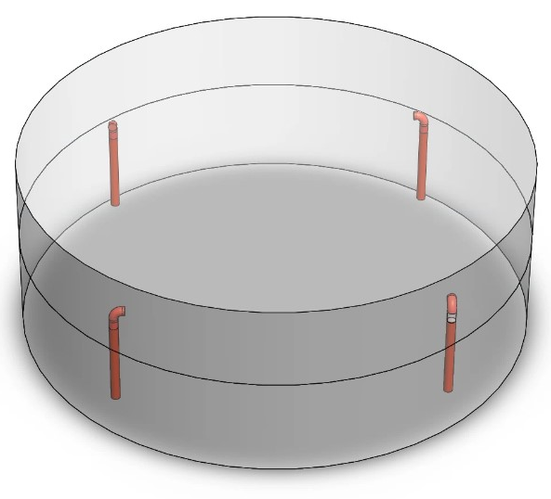
Geometry
Full Size Digester
The analyzed digester has a diameter of 6 m and a height of 2.1 m.
The total volume is 59.38 m³.
2 m of the digester’s total height is submerged by the liquid phase.
The active or working volume is equal to 56.5 m³.

Slide 22
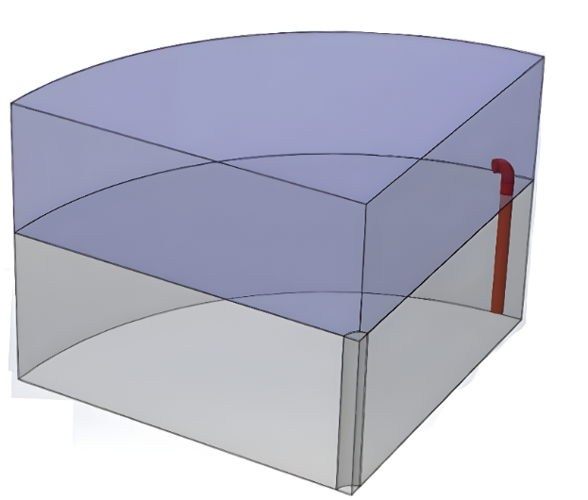
Modifying the Geometry
Quarter-size Digester
Reduction in the size of the digester to quarter its original size.
Decreasing the computational time required by the CPU.
using the symmetry option when carrying out the meshing and fluent setup process.
Eliminating the uncertainty in the results.

Slide 23
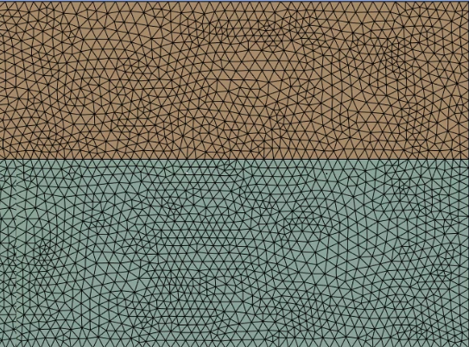
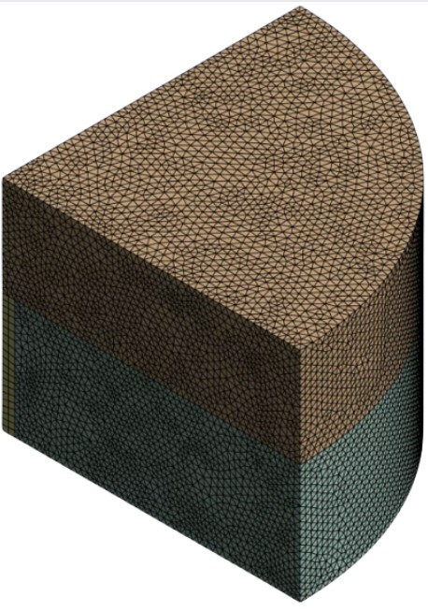
Meshing
Side View
Isometric View
Tetrahedral meshing was carried out.
elements size of 0.070 mm
Total of 409,163 elements.
Hurtado, F.J., A.S. Kaiser, and B. Zamora, Fluid dynamic analysis of a continuous stirred tank reactor for technical optimization of wastewater digestion. Water Research, 2015. 71: p. 282-293.

Slide 24
Mesh Independence Test
Element sizes range from 0.0775 mm down to 0.0700 mm, decreasing by 0.0025 mm with each step.
The CFD simulation results for average velocity of the liquid sludge across the digester was evaluated.
The simulation results for the liquid sludge for all element sizes were within the range of 0.03m/s.
The complexities of multiphase flow in CFD simulations cause fluctuations in results, even during steady flow analysis.
Mesh Independence Test
Element size (mm) | 0.0775 | 0.0750 | 0.0725 | 0.0700
Number of Elements | 302,585 | 336,268 | 371,391 | 409,163
Average Velocity (m/s) | 0.0357 | 0.0346 | 0.0326 | 0.0378
0.0700
409,163
0.0378
The complexities of multiphase flow in CFD simulation, even steady flow analysis won’t be able to stabilize the average velocity values.

Slide 25
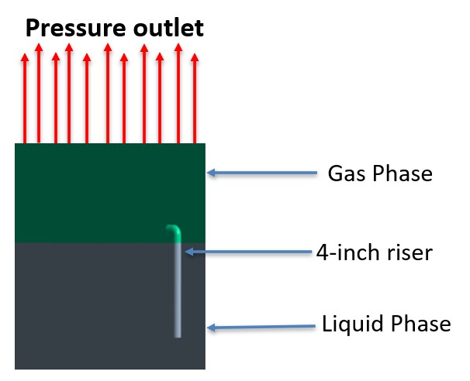
Digester Boundary Conditions
The digester was divided to three main bodies.
Pressure outlet at the top of the gas phase, has its liquid and mixture phase categorized as default.
The backflow value in the gas phase settings was set to 1, preventing the over flow of liquid phase.

Slide 26
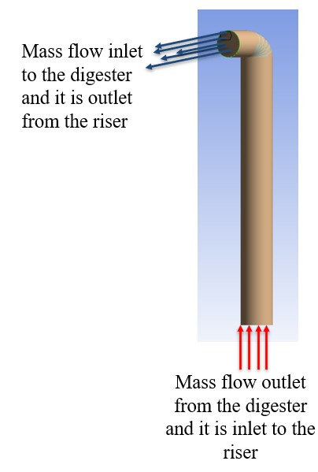
Riser Boundary Conditions
Mass flow inlet to the digester set for both liquid and gas phases.
Mass flow outlet from the digester set for the liquid phase.
The mixture phase boundary condition set as default for both mass flow inlet and outlet.

Slide 27
Fluent Setup
(Volume of Fluid) VOF versus Eulerian Model.
Differences between hybrid and Standard initialization process.
Running the simulation at a steady state.

Slide 28

28/42
Results and Discussions

Slide 29
Input values for liquid and gas phases
Five random point from the Flonergia results of water versus air flowrates for the 4-inch standard riser were used as input values for examining and testing water-air and liquid sludge-biogas, within the digester.
Random points were utilized to cover the minimum and maximum range of flow rates for both tested liquid and gas phases.
Test | Liquid phase |  | Gas phase |  | Ratio of Liquid phase to Gas phase
 | (L/min) | (Kg/s) | (L/s) | (kg/s)
1 | 60 | 0.998 | 0.50 | 0.000613 | 2.00
2 | 103 | 1.713 | 0.70 | 0.000858 | 2.45
3 | 216 | 3.593 | 1.00 | 0.001225 | 3.60
4 | 451 | 7.502 | 5.14 | 0.006297 | 1.46
5 | 510 | 8.483 | 5.50 | 0.006738 | 1.55
Source:
Flonergia. FloMov: Efficient Pumping Technology. 2023 29 December 2023]; Available from: https://www.flonergia.com/.

Slide 30
Results
Conducted simulation for water versus air.
Conducted simulation for liquid sludge versus biogas.
Used same consistent liquid and gas flow rates for each test.
The average velocity of liquid sludge was analyzed and compared to that of water.
Then the velocity contours for each liquid and gas phases was examined.
Test | Average velocity (m/s)
 | Water | Liquid sludge
1 | 0.0144 | 0.0052
2 | 0.0182 | 0.0114
3 | 0.0378 | 0.0269
4 | 0.1149 | 0.0752
5 | 0.3165 | 0.0942

Slide 31
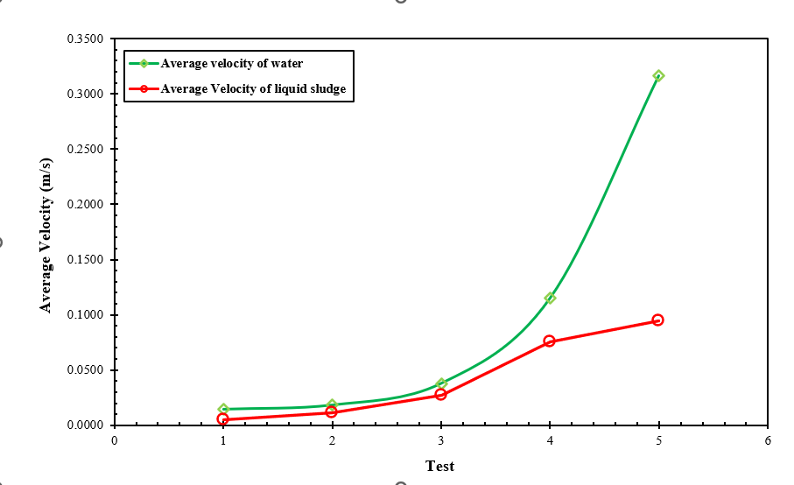
Average Velocity Trend
The same average velocity trend of water.
The higher viscosity and density of liquid sludge.
The rheological behavior, Newtonian and/or non-Newtonian, of liquid sludge.
The increase in shear rate, leads to an increase in the viscosity of the fluid.

Slide 32
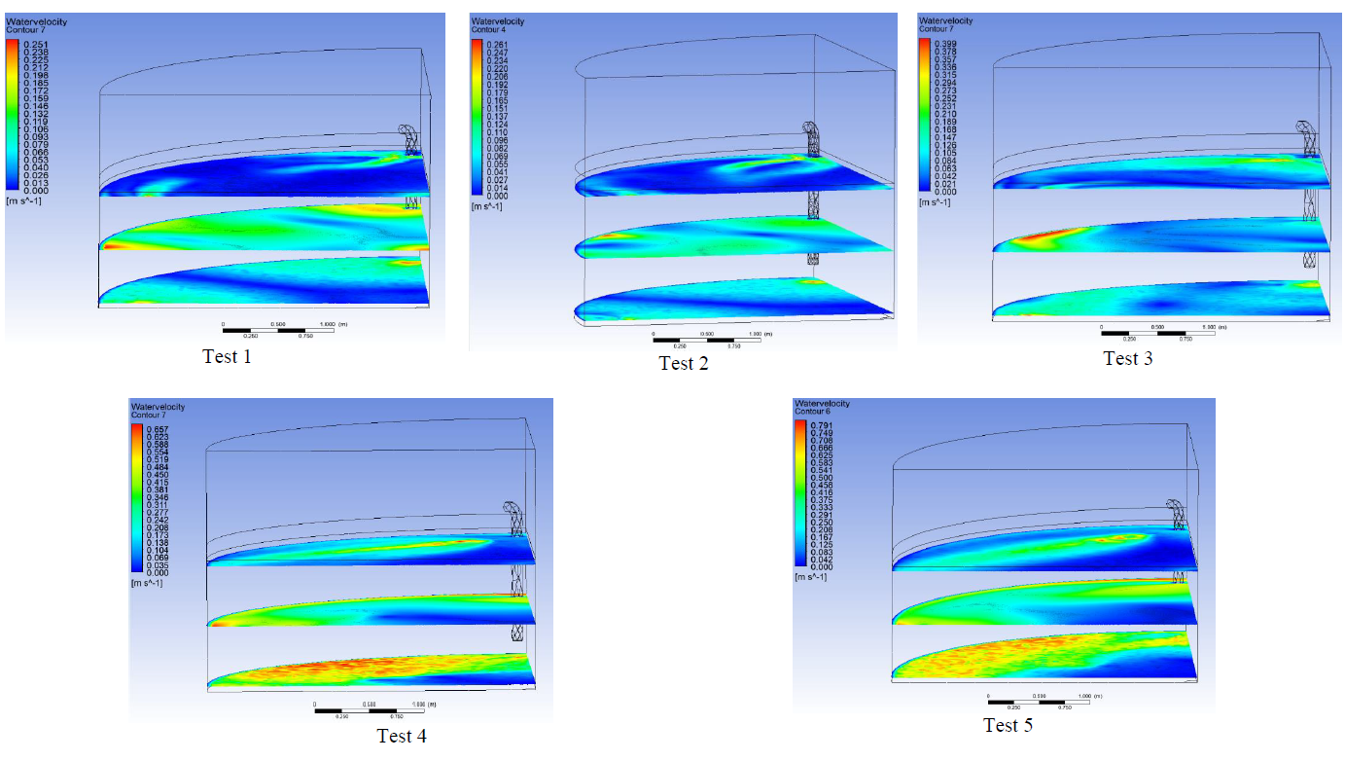
Velocity Contours for Water versus Air
Velocity Contours for water versus air at 4000 timesteps

Slide 33
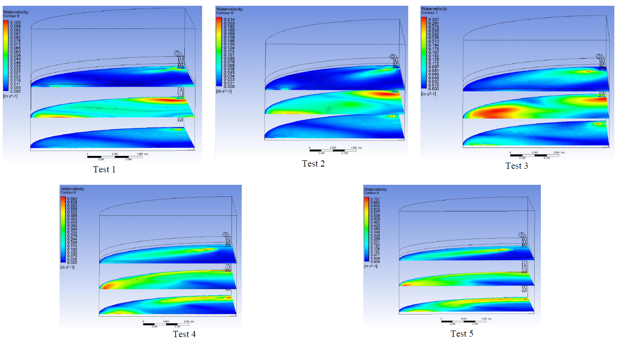
Velocity Contours for Liquid Sludge versus Biogas
Velocity Contours for Liquid sludge versus biogas at 4000 timesteps

Slide 34
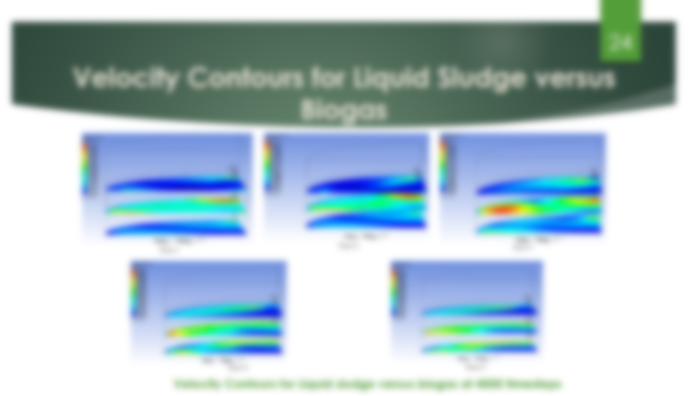
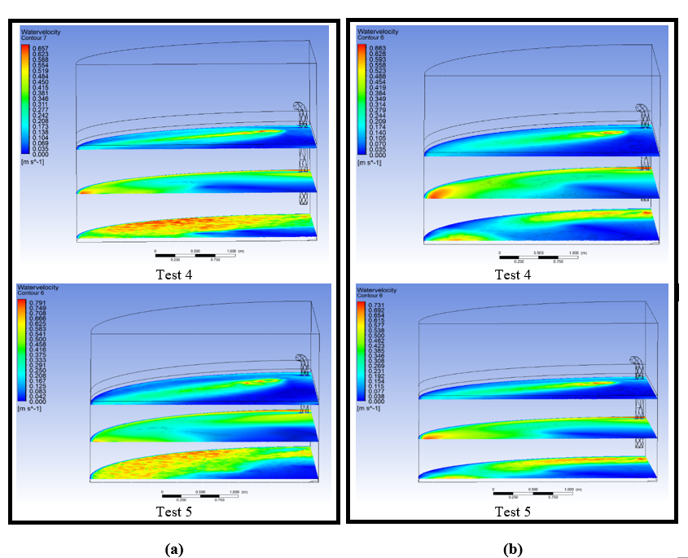
Velocity contours of the top view for tests No. 4 and 5: (a) Water versus air (b) liquid sludge versus biogas

Slide 35
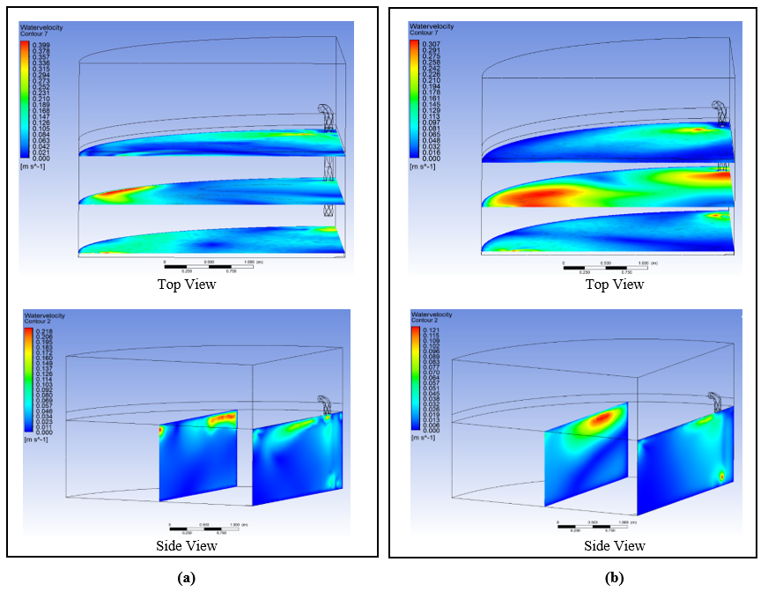
Velocity Contours for the Initial Tests
Dominance of yellow and red velocity contours close to the outlet of the 4-inch riser.
Higher viscosity and density of liquid sludge.
More time is required for the liquid sludge to uniformly mix within the digester.
Velocity contours of the side and top view at 4000 timesteps, for Test No.3: (a) water versus air (b) liquid sludge versus biogas.

Slide 36
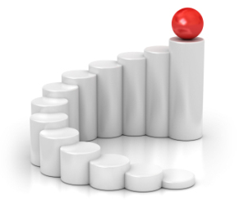
36/42
Conclusion

Slide 37
Conclusion
The rheological behavior, Newtonian and/or non-Newtonian, of liquid sludge, at various flow rates for both liquid and gas phases.
During the intervals when the airlift pump undergoes a rest period, if the fluid exhibits a non-Newtonian behavior, residuals will start to accumulate.
Having a velocity contours and Newtonian fluid behavior at digester’s bed decreases the accumulation of residuals.
Emphasis the efficiency of Airlift pumps over CSTRs, in enhancing the yield product of biogas.

Slide 38
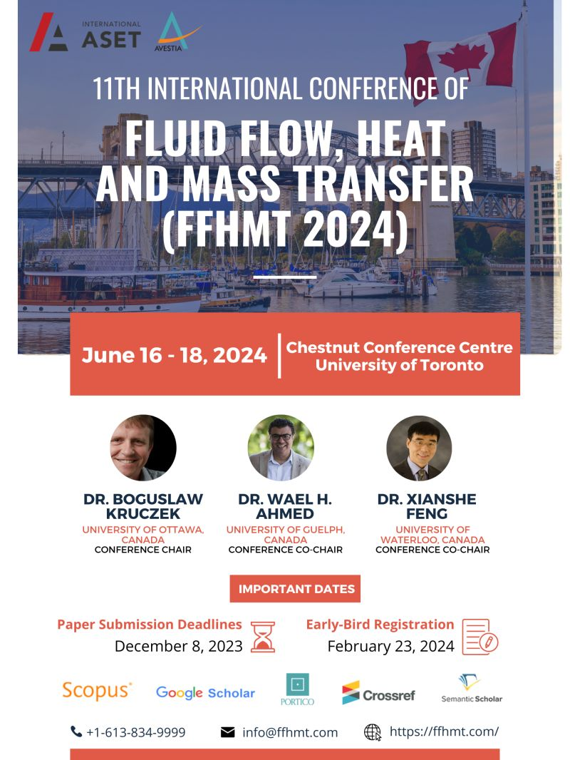
Accepted Publication
“Optimizing Biowaste Material Mixing for Efficient Biogas Production via Airlift Pump-Equipped Digesters”

Slide 39

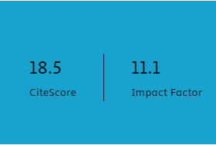
Submitted Manuscript for Publication
“Brief review of Biowaste Material Mixing for Efficient Biogas Production”

Slide 40



Acknowledgements
40/42

Slide 41



Acknowledgements
Dr. Ihab Surakji
Head of Mechanical and Mechatronics Engineering
An-Najah University , Palestine
Prof. Wael Ahmed
Full Professor
University of Guelph, Canada
Dr. Amjad El-Qanni
Assistant Professor
An-Najah National University

Slide 42
Questions
Thank you!

Slide 43
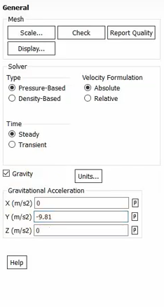
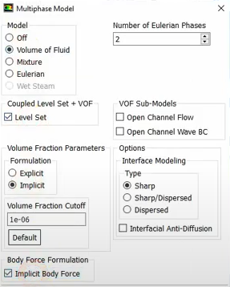
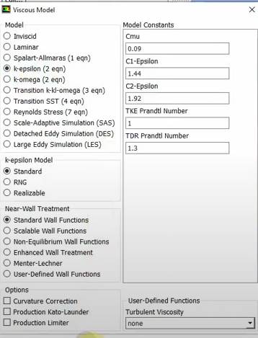
Fluent Setup Steps
1
2
3

Slide 44
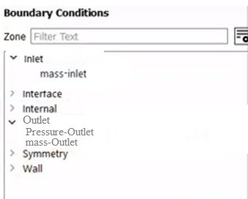
Boundary Conditions

Slide 45
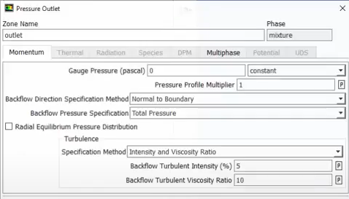
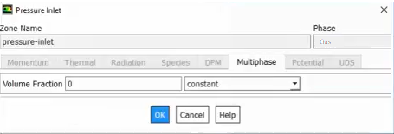
Pressure Outlet
Mixture Phase
Gas Phase

Slide 46
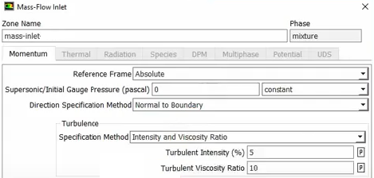
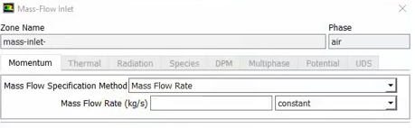
Mass flow inlet
Mixture Phase
Gas and liquid Phase

Slide 47
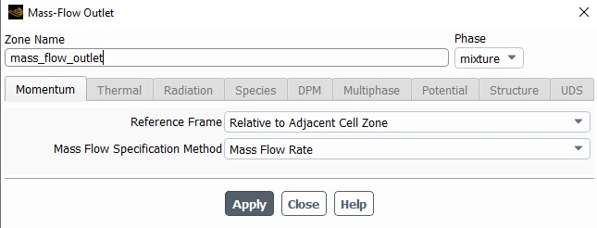
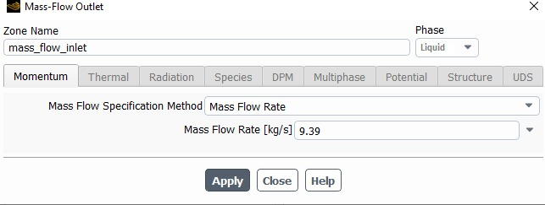
Mass flow outlet
Mixture Phase
Liquid Phase

Slide 48
Objectives
48/42
Evaluate a new effective method for extracting biogas from food waste using a bioreactor or digester.
integrate an airlift pump.
Proposed design of the digester
Carrying a CFD simulation
Evaluating the Rheological property of Liquid sludge
Examining the mixing rate within the designed digester.

Slide 49
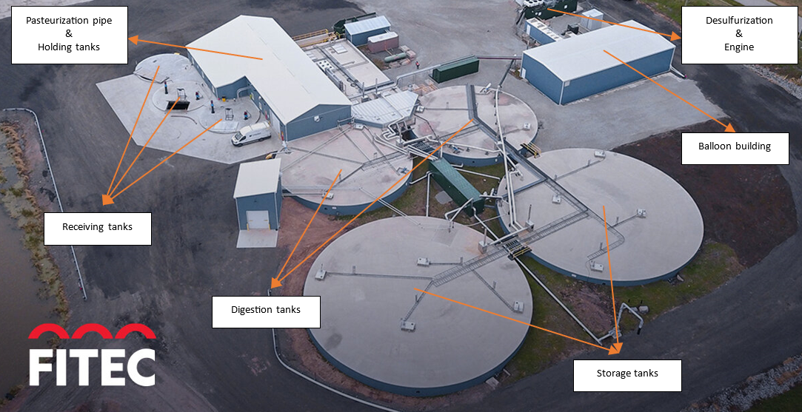
Overall View of the Escarpment Renewables Plant

Slide 50
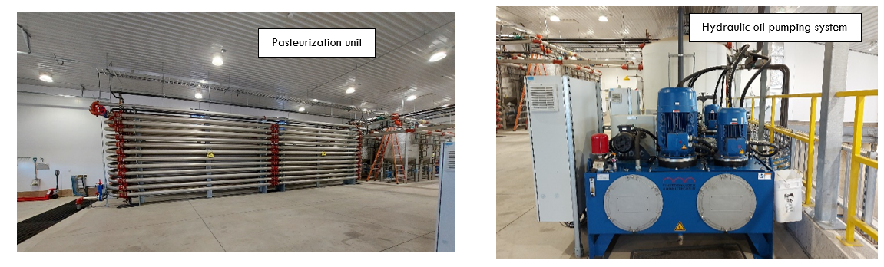
Overall View of the Escarpment Renewables Plant

Slide 51
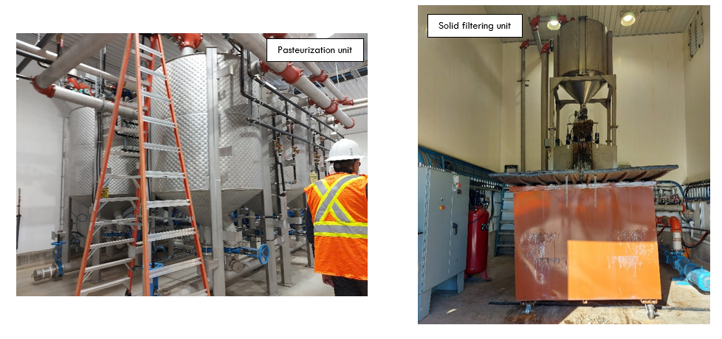
Overall View of the Escarpment Renewables Plant

Slide 52
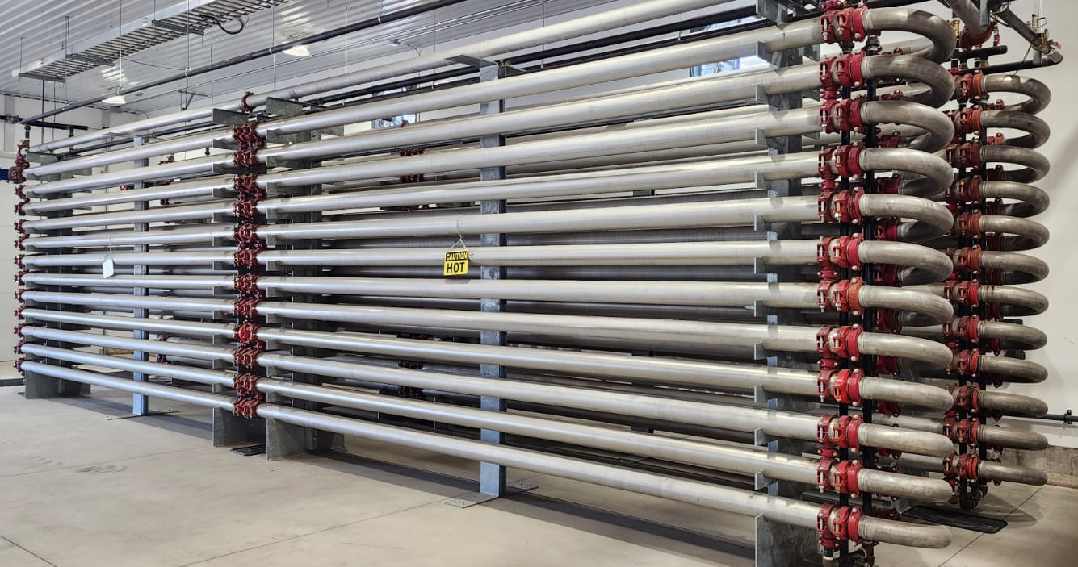
Overall View of the Escarpment Renewables Plant
Shell and Tube Heat Exchangers

Slide 53
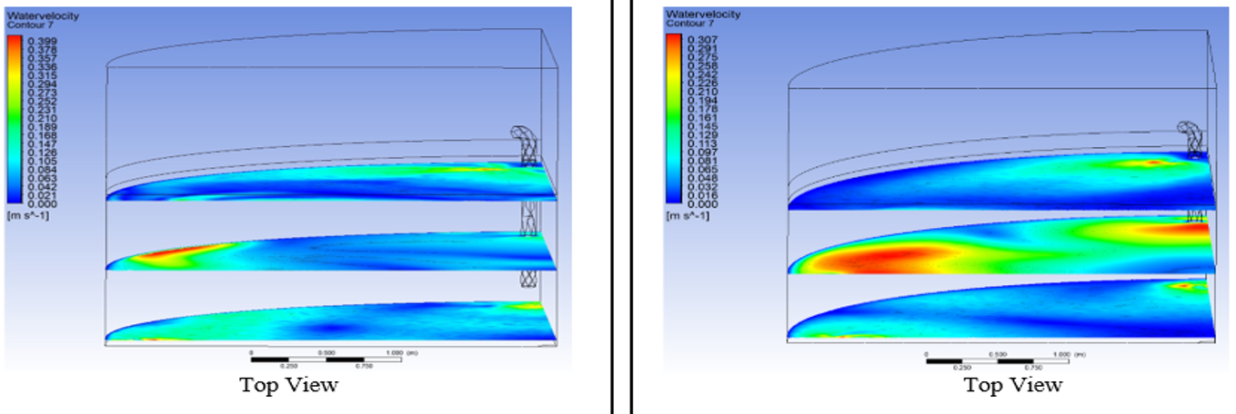
0-0.399
0-0.307

Slide 54
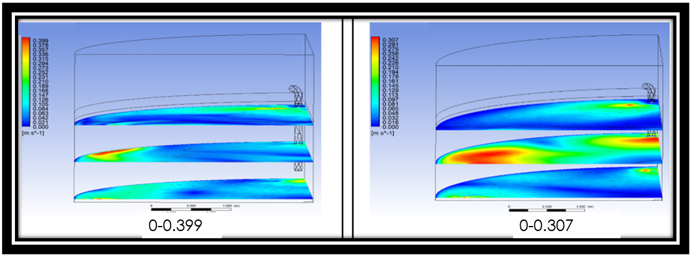
Rheological Property

Slide 55
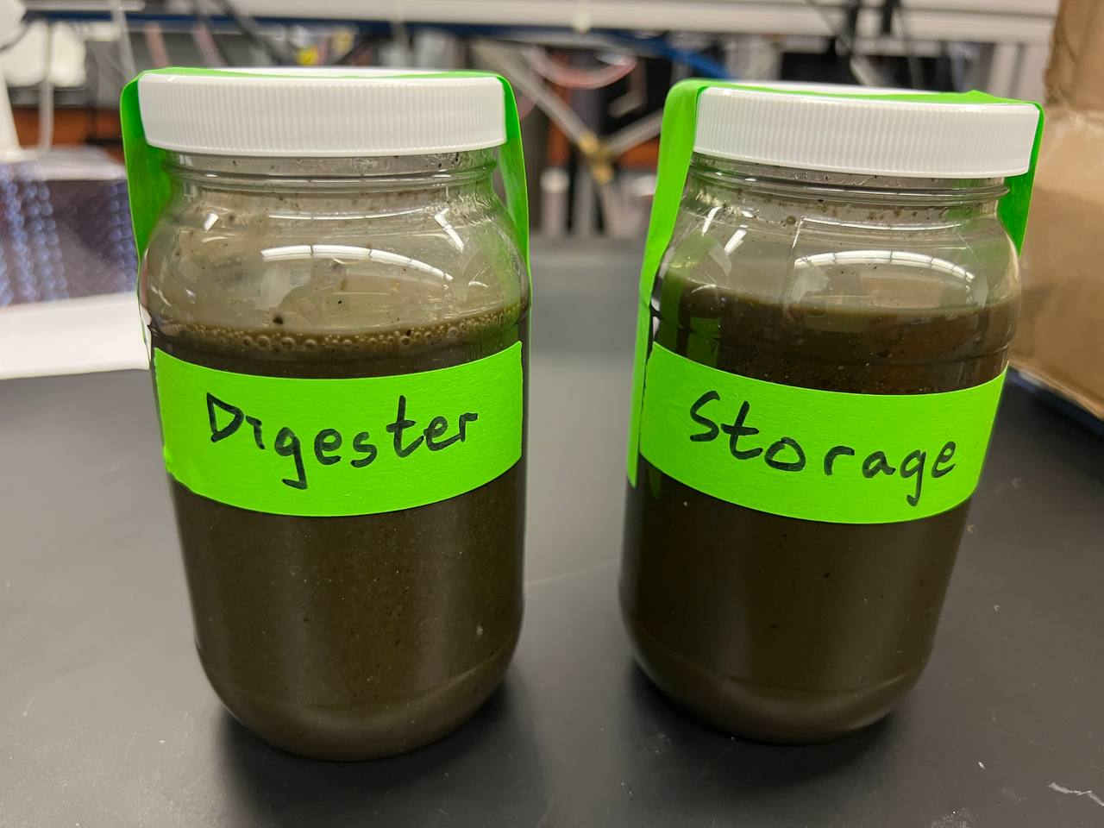
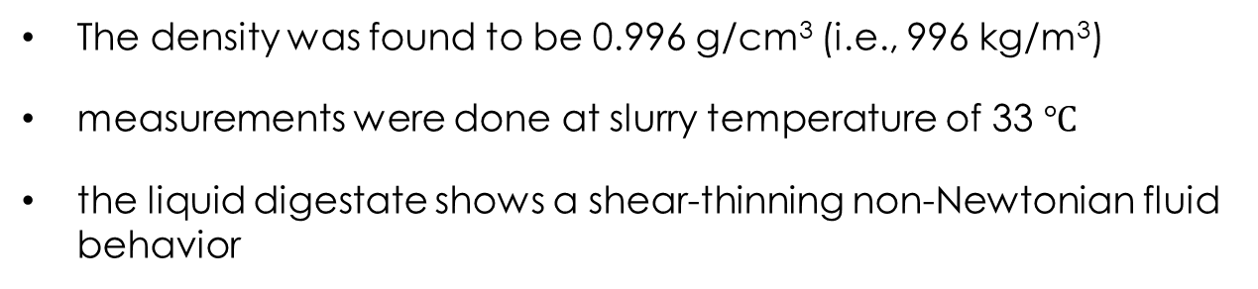
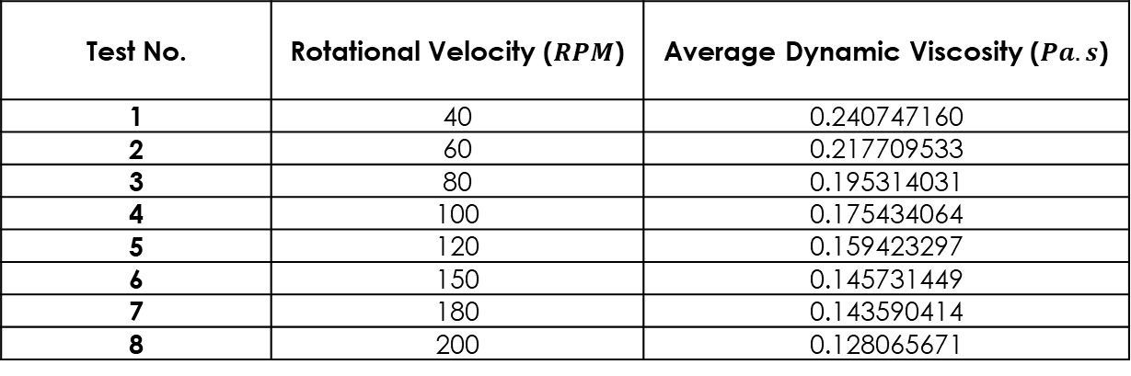
Viscosity Measurements for liquid sludge
The density was found to be 0.996 g/cm³ (i.e., 996 kg/m³)
measurements were done at slurry temperature of 33 $℃$
the liquid digestate shows a shear-thinning non-Newtonian fluid behavior
Test No. | Rotational Velocity ($RPM$) | Average Dynamic Viscosity ($Pa.s$)
1 | 40 | 0.240747160
2 | 60 | 0.217709533
3 | 80 | 0.195314031
4 | 100 | 0.175434064
5 | 120 | 0.159423297
6 | 150 | 0.145731449
7 | 180 | 0.143590414
8 | 200 | 0.128065671

