Slide 1
Active Filter
Eng. Sarah Alkouni
Eng. Noura Abu Ghosh
Eng. Reem Baker
Supervisor: Dr. Kamel Saleh

Slide 2
Content
Introduction
Methods
Simulation Design
Hardware Design
Discussion

Slide 3
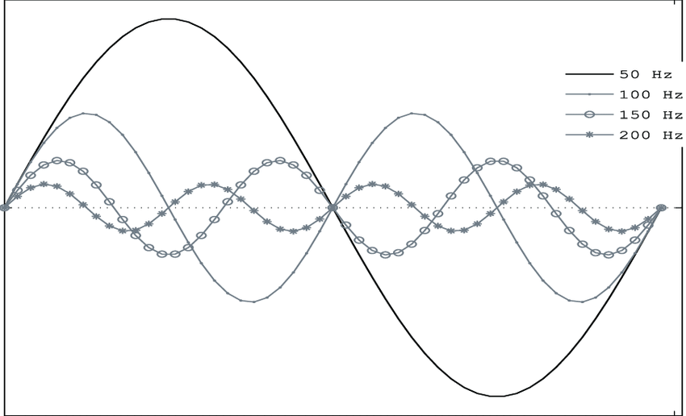
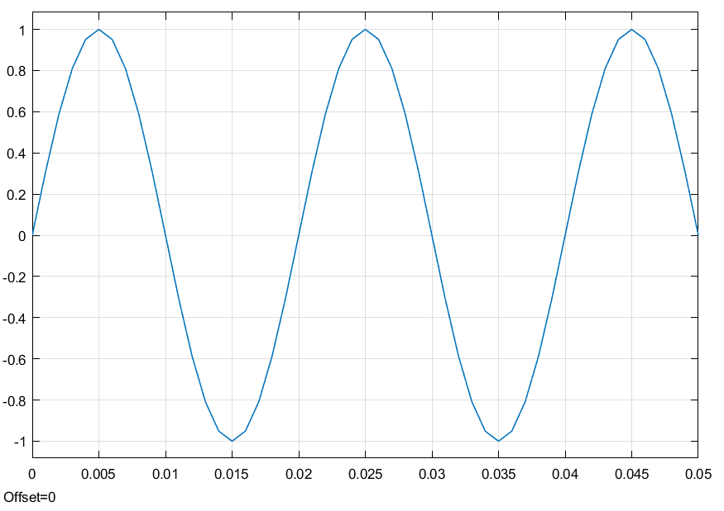
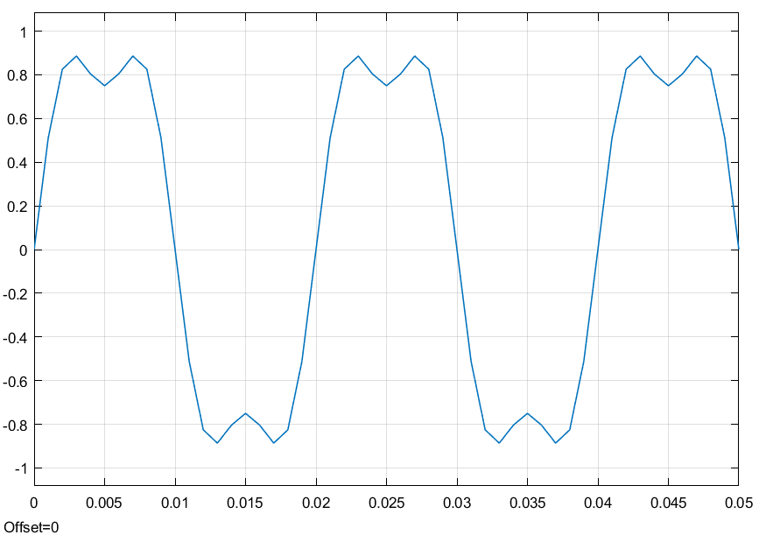
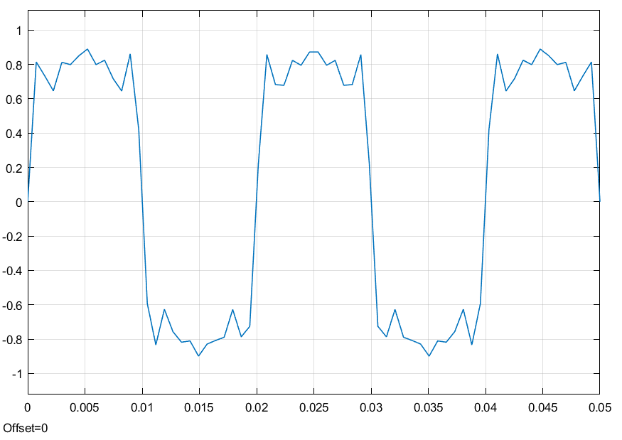
Introduction
Harmonic distortion is brought about mainly by nonlinear loads.
Integer–multiple frequencies of the fundamental frequency.
Harmonics limit a power system’s ability to perform optimally.
Pure AC signal.
Distorted due to a 3rd harmonic.
Distorted due to a many harmonics.

Slide 4
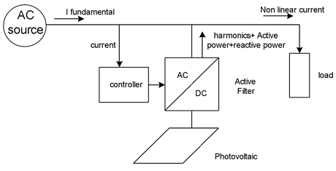
Introduction
Active power filters can be used to eliminate supply current harmonics.
This is done by extracting the harmonics and making the inverter inject them into system.
Increased power quality.
Real and reactive power compensation.
Improved power factor.

Slide 5
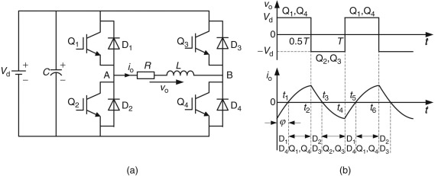
Methods
H–Bridge in Active Filtering
  An electronic circuit composed of semiconductor devices; act like switches.
  Controlled by a PWM signal.
  Used to inject current harmonics into the power system.
  Produces harmonic current in reverse order as required by the nonlinear load.
  Results in a purely sinusoidal source current.

Slide 6
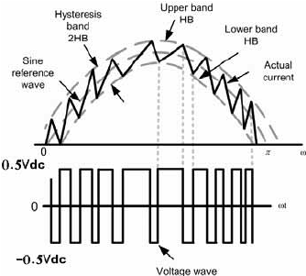
Methods
Hysteresis Control
A hysteresis comparator compares reference (demand) current with measured (actual) current.

Slide 7
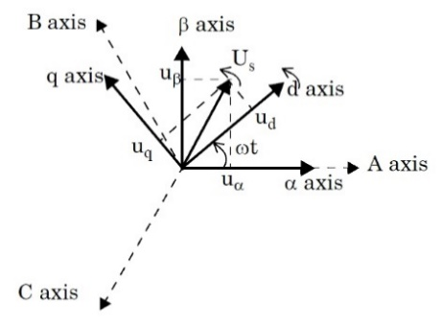
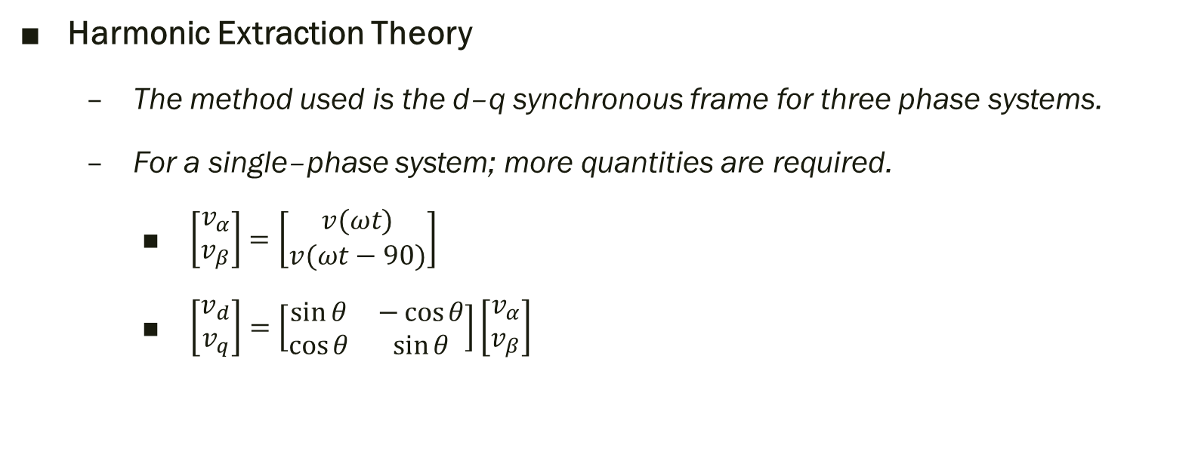
Methods
Harmonic Extraction Theory
  The method used is the d–q synchronous frame for three phase systems.
  For a single–phase system; more quantities are required.
    $\left[\begin{matrix}v_{α} \\ v_{β}\end{matrix}\right]=\left[\begin{matrix}v(ωt) \\ v(ωt−90)\end{matrix}\right]$
    $\left[\begin{matrix}v_{d} \\ v_{q}\end{matrix}\right]=\left[\begin{matrix}\sin{θ} & −\cos{θ} \\ \cos{θ} & \sin{θ}\end{matrix}\right]\left[\begin{matrix}v_{α} \\ v_{β}\end{matrix}\right]$

Slide 8
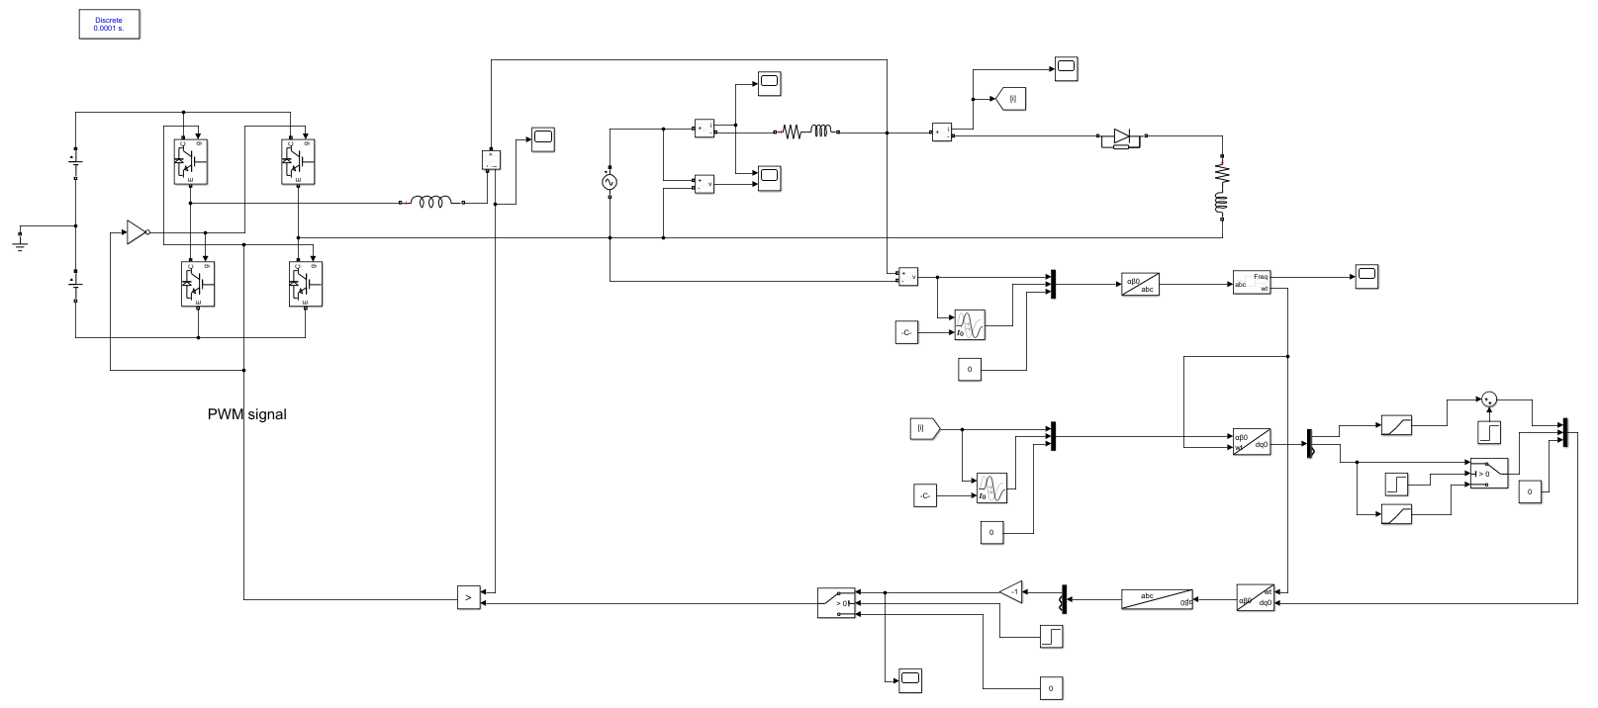
Simulation Design

Slide 9
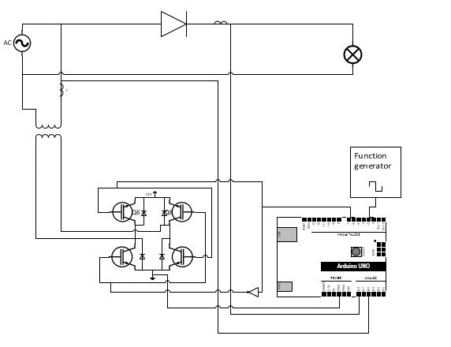
Hardware Design
Sensor testing
H–bridge Testing
Comparison of Two Loads
Closed Loop System

Slide 10
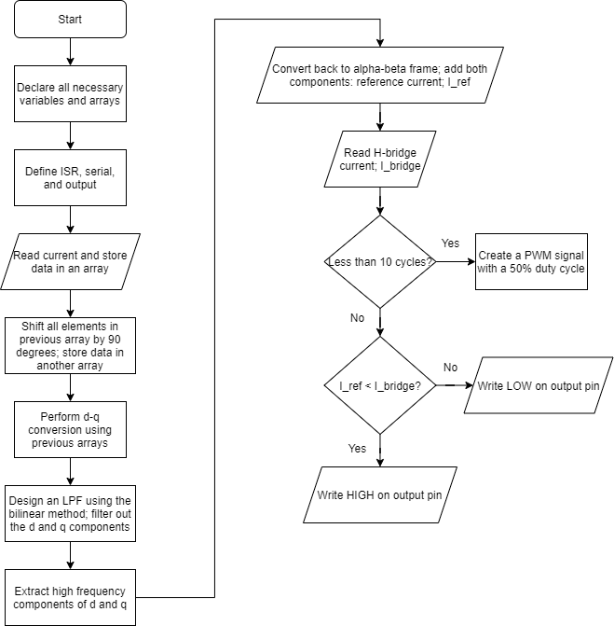
Code Flowchart

Slide 11
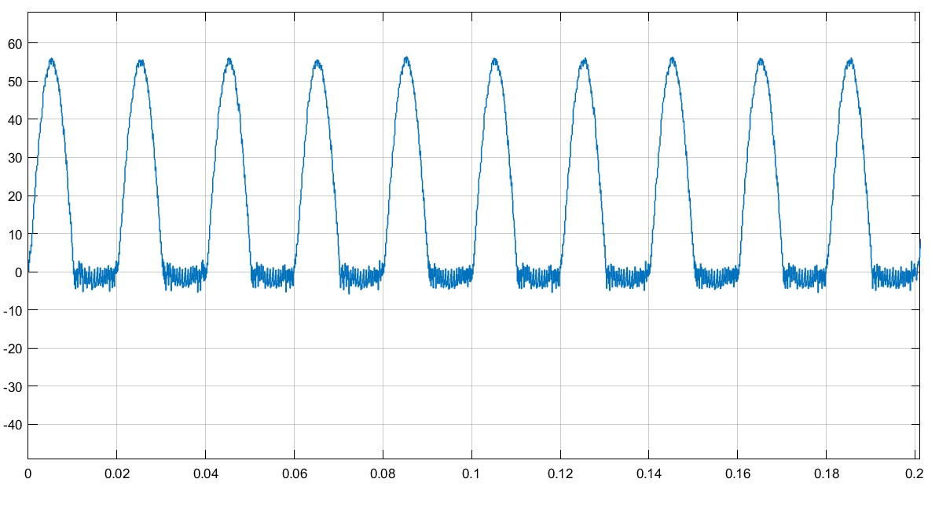
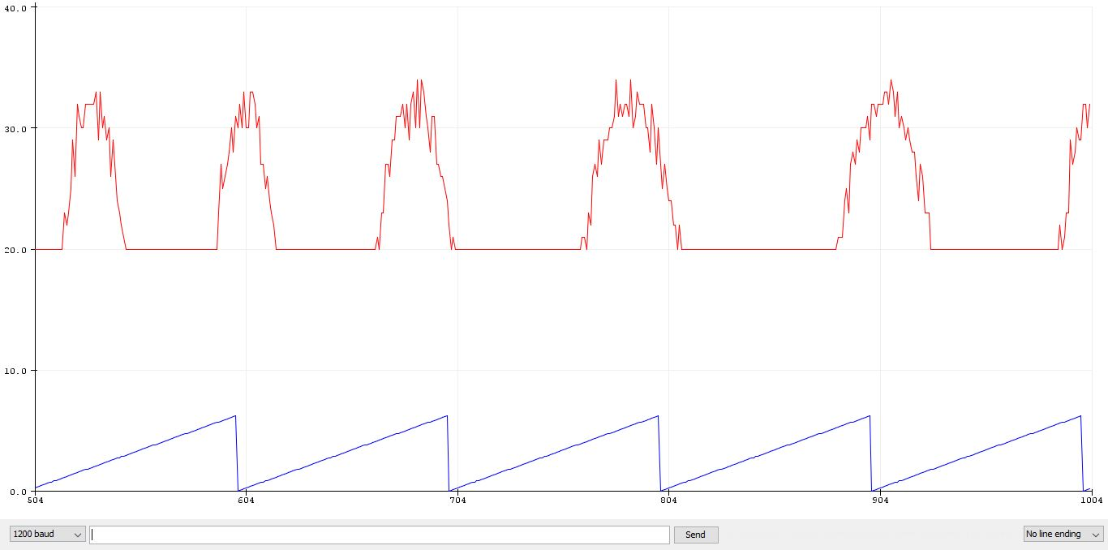
Discussion
Source current before inverter in MATLAB.
Real–time source current before inverter (alpha) in hardware.

Slide 12
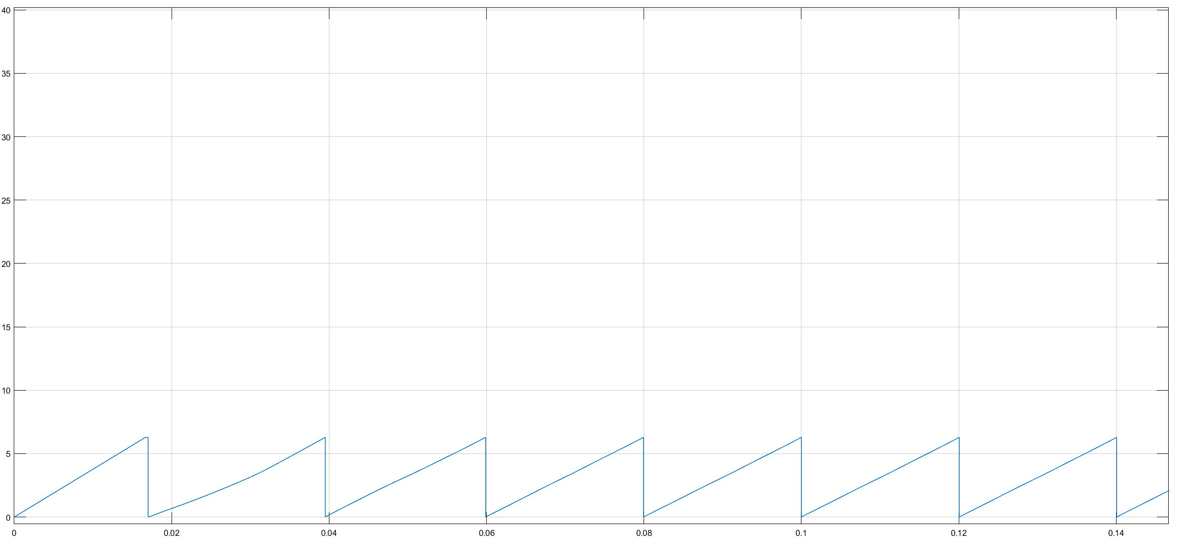
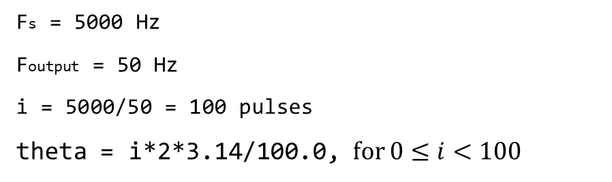
Discussion
Fs = 5000 Hz
Foutput = 50 Hz
i = 5000/50 = 100 pulses
theta = i*2*3.14/100.0, for $0≤i<100$
Theta obtained in MATLAB.
Theta obtained in hardware.

Slide 13
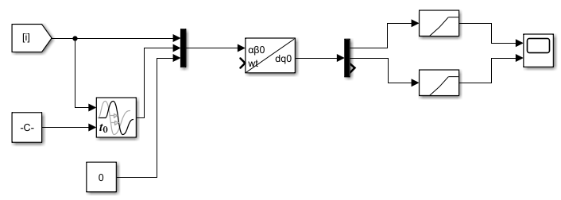
Discussion
Obtaining alpha and beta components:
Alpha and beta in MATLAB.

Slide 14
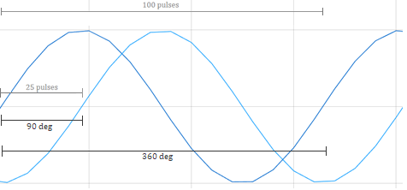
Discussion
Obtaining alpha and beta components:
if(r>=0 && r<76) {
beta[r] = alpha[r+24];
}
else if(r>=76 && r<100) {
beta[r] = alpha[r-75];
}
Alpha and beta in hardware.

Slide 15
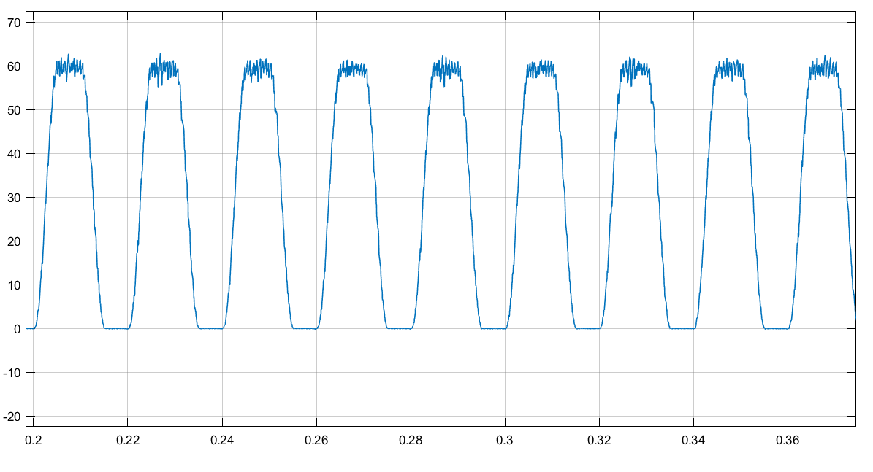
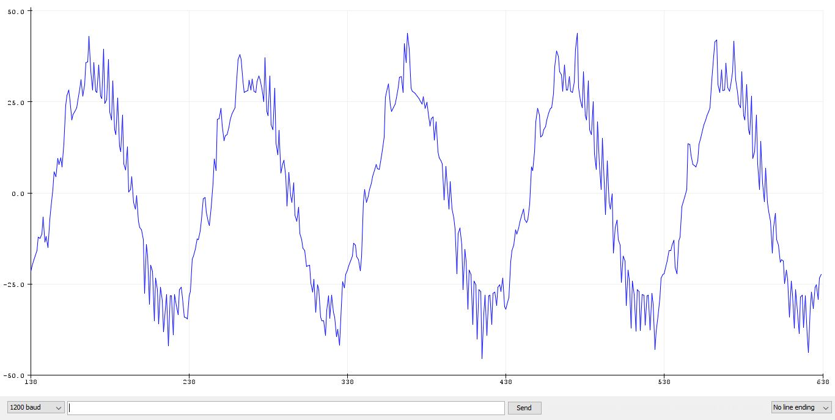
Discussion
To convert to d–q frame in Arduino:
d_current = alpha[i]*sin(theta) - beta[i]*cos(theta);
q_current = alpha[i]*cos(theta) + beta[i]*sin(theta);
Unfiltered d–component in MATLAB.
Real–time unfiltered d–component in hardware.

Slide 16
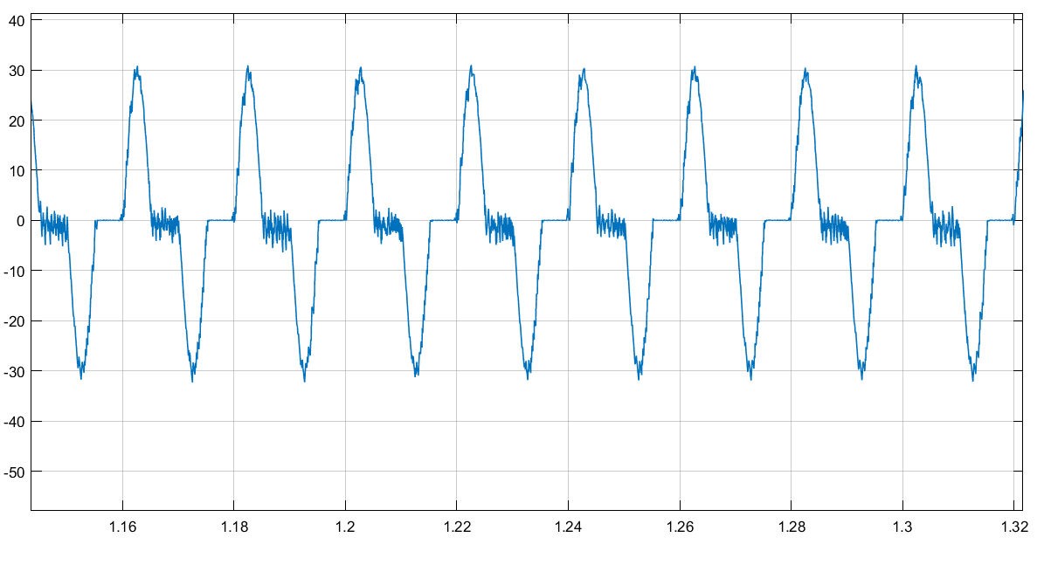
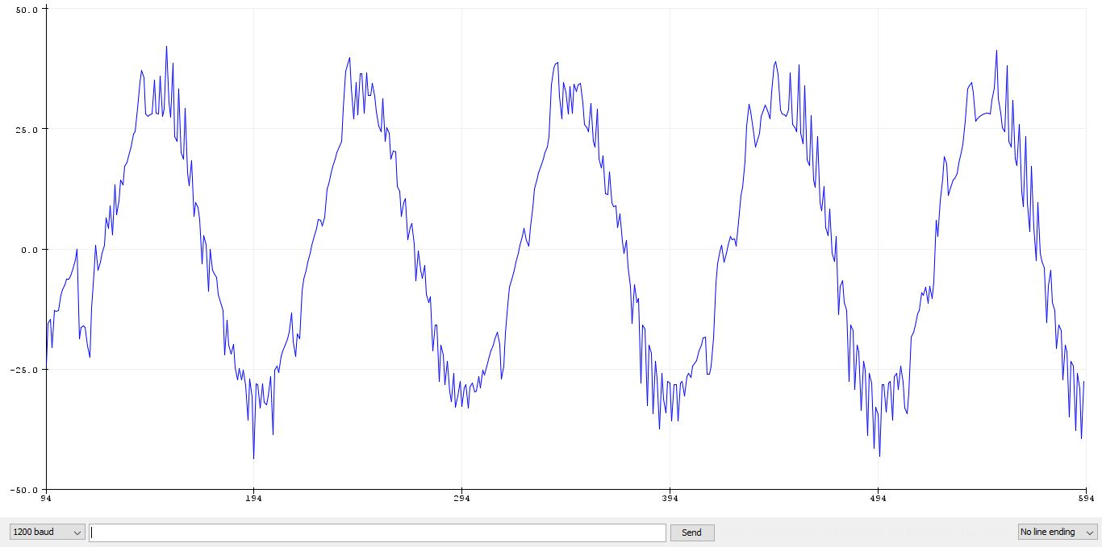
Discussion
Unfiltered q–component in MATLAB.
Real–time unfiltered q–component in hardware.

Slide 17
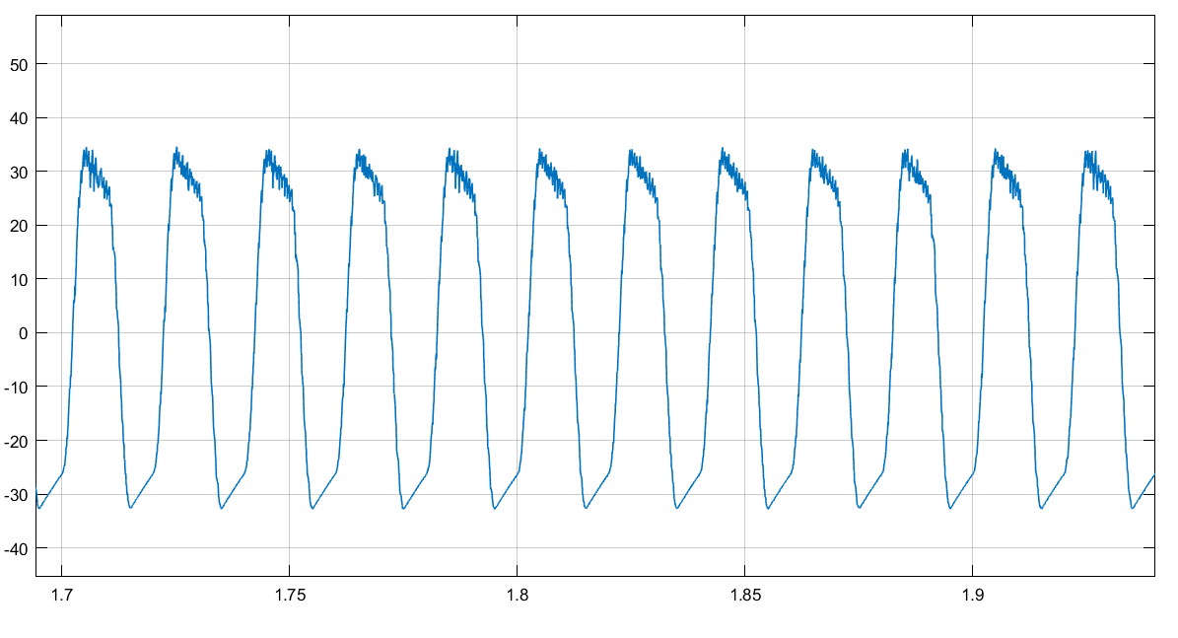
Discussion
Harmonic Extraction
High frequency extraction using an HPF.
High frequency component of d–component in MATLAB.

Slide 18
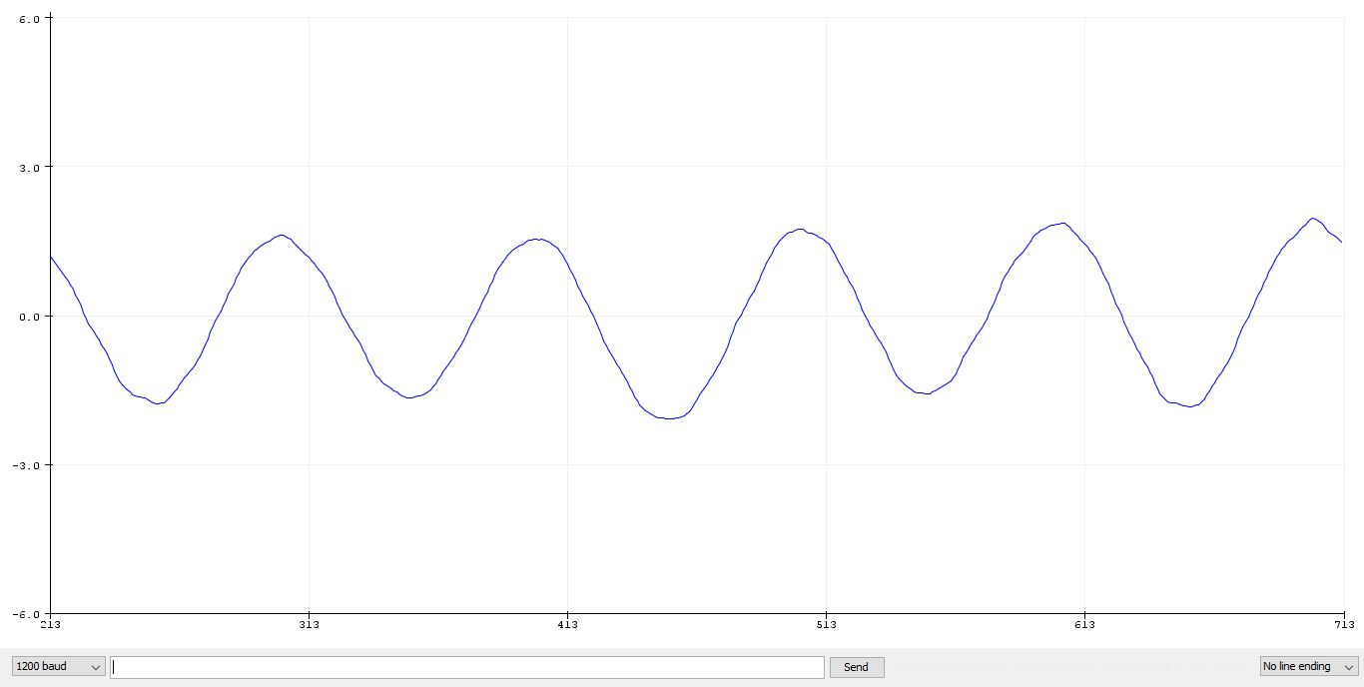
Discussion
Harmonic Extraction
Using an LPF in discrete form (using the bilinear method) in Arduino:
d_f_current = d_f_previous*(C-10)/(C+10)+ 10*d_current/(C+10)+ 10*d_previous/(C+10);
q_f_current = q_f_previous*(C-10)/(C+10)+ 10*q_current/(C+10)+ 10*q_previous/(C+10);
Real–time fundamental frequency of d–component.

Slide 19
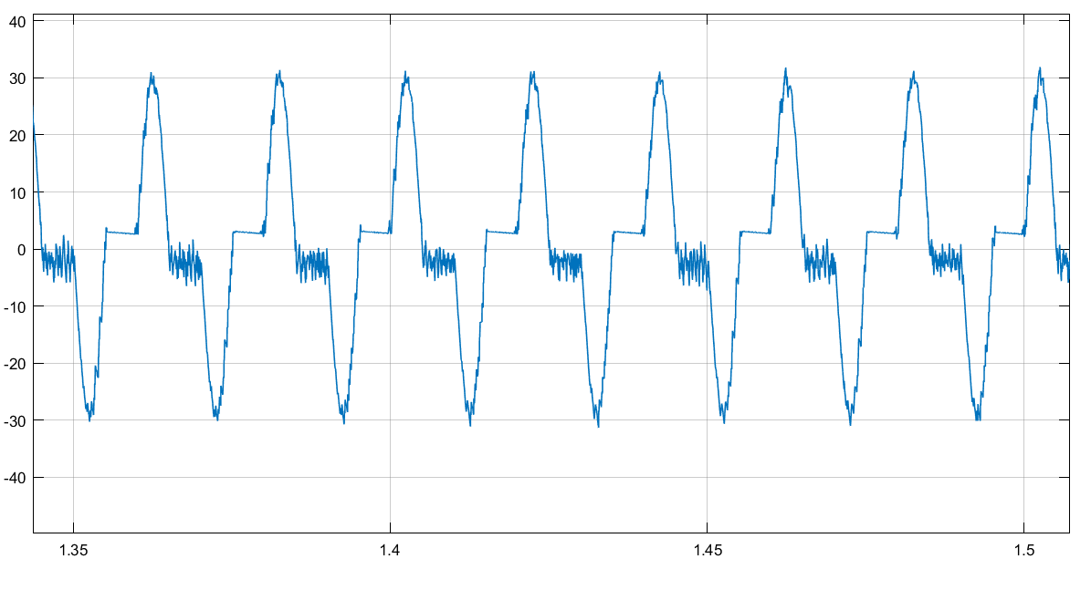
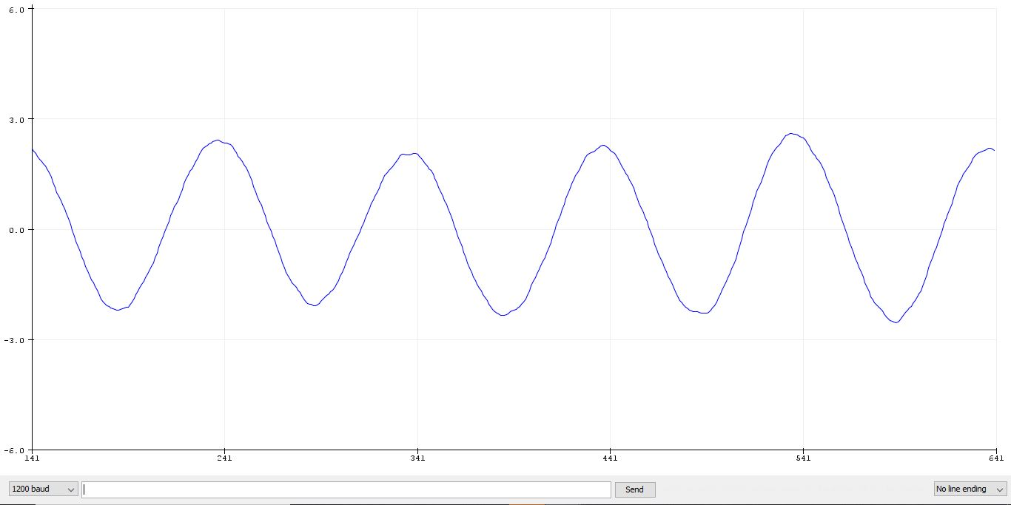
Discussion
Harmonic Extraction
High frequency component of q–component in MATLAB.
Real–time fundamental frequency of q–component.

Slide 20
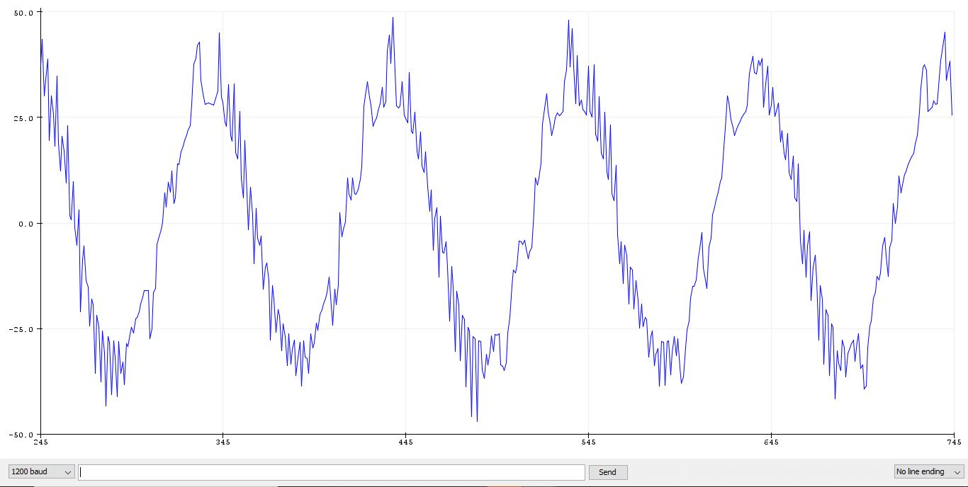
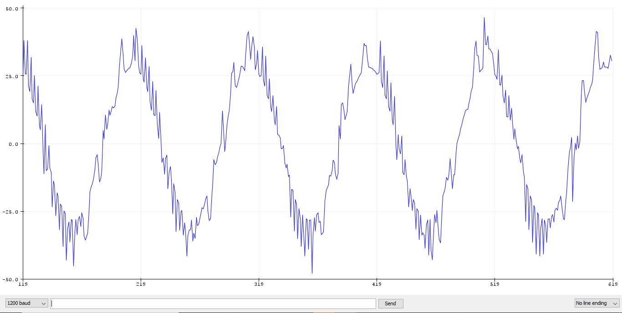
Discussion
Harmonic Extraction
Id_ref = d_current - d_f_current;
Iq_ref = q_current - q_f_current;
High frequency component of d–component in Arduino.
High frequency component of q–component in Arduino.

Slide 21
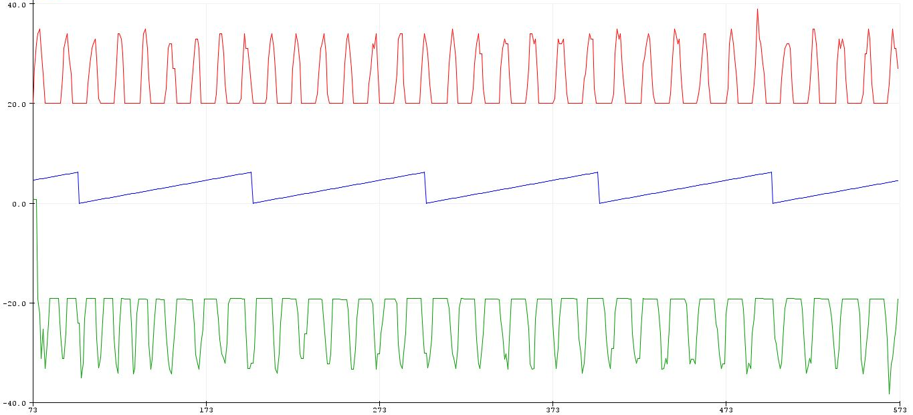
Discussion
Harmonic Extraction
I_alpha = Id_ref *cos(theta) - Iq_ref*sin(theta);
Reference Current in green.

Slide 22
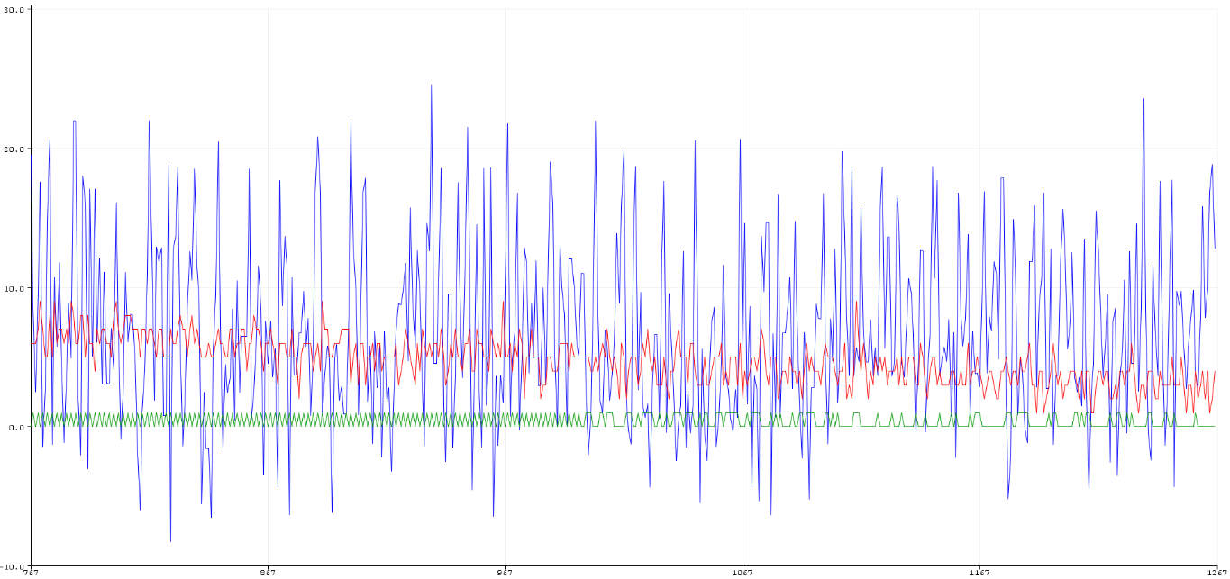
Discussion
Hysteresis Control
if(I_alpha > I_bridge) {
bridge_pwm = 1;
}
else
bridge_pwm = 0;
PWM signal in green.

Slide 23
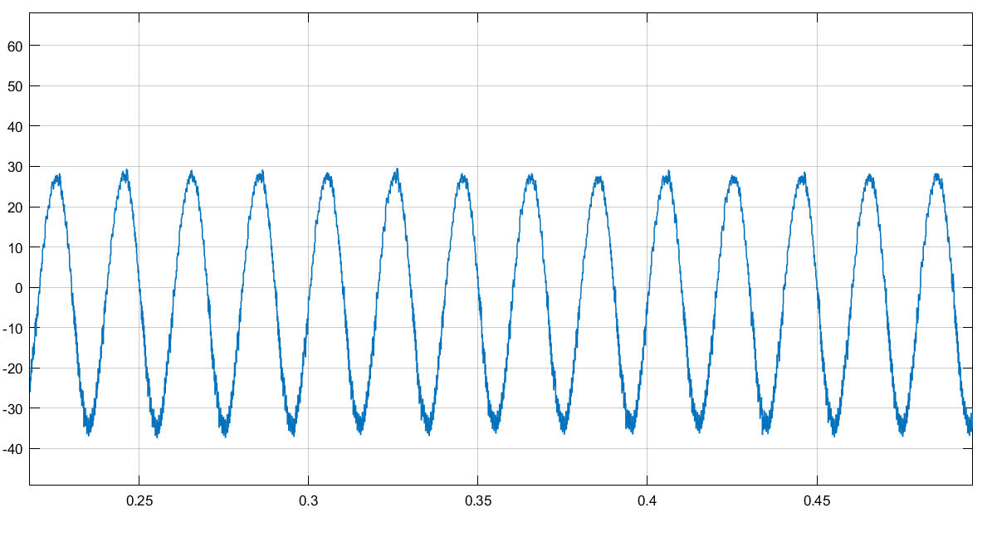
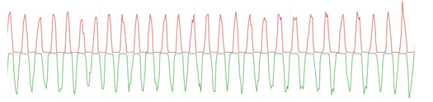
Discussion
Real–time source current after H–bridge operation.
Source current after H–bridge operation in MATLAB.

Slide 24
Thanks for Your Attention

