Slide 1
Health Mate
Because Your Health Deserves More Than Guesswork
Israa Issa
Yaser Kharouf
Dr.Asmaa Afeefi

Slide 2
1)INTRODUCTION​
​
2) OBJECTIVES​
​
3)TOOLS,METHODS,​
Programming Languages​
​
4)FEATUERS​
​
5)FUTURE WORKS​
​
AGENDA:

Slide 3
Introduction
Health Mate is a smart and helpful app for people who want to improve their health. It helps users track everything in one place — like food, water, exercise, and sleep.
But Health Mate is more than just a tracker. It lets users talk to real nutritionists, book appointments, and join challenges to stay active and motivated. Nutritionists can see the user’s progress and give advice that fits their needs.
The app also uses AI to scan meals and estimate calories automatically from pictures. This makes healthy eating easier and faster.
Health Mate is not just an app — it’s a partner that supports a healthy and balanced lifestyle.

Slide 4



Types of Users ::
Admin
Nutritionists
Members

Slide 5





TOOLS, METHOS, PROGRAMMING LANGUAGES:

Slide 6
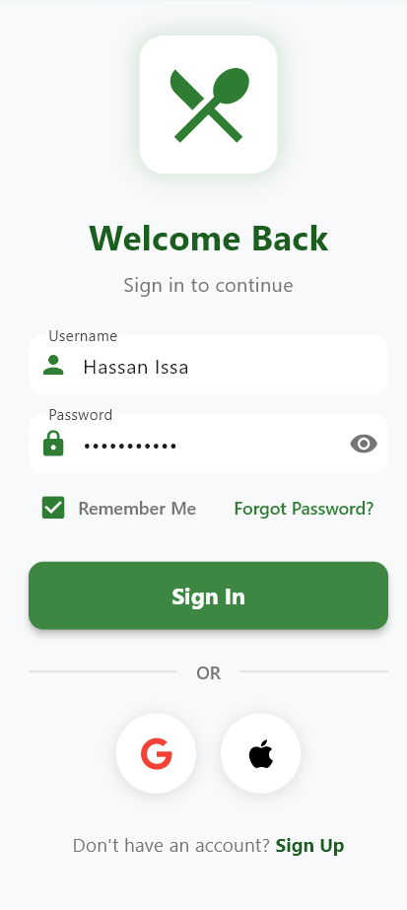
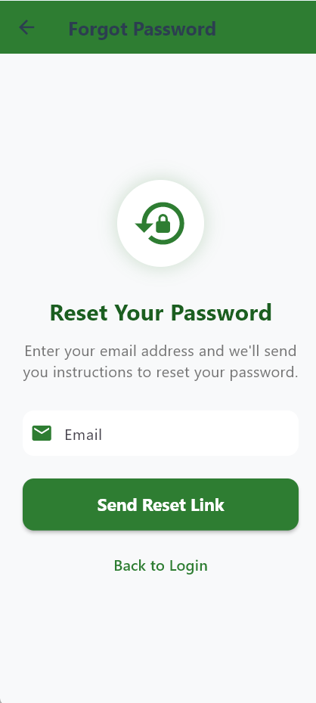
Sign in:

Slide 7
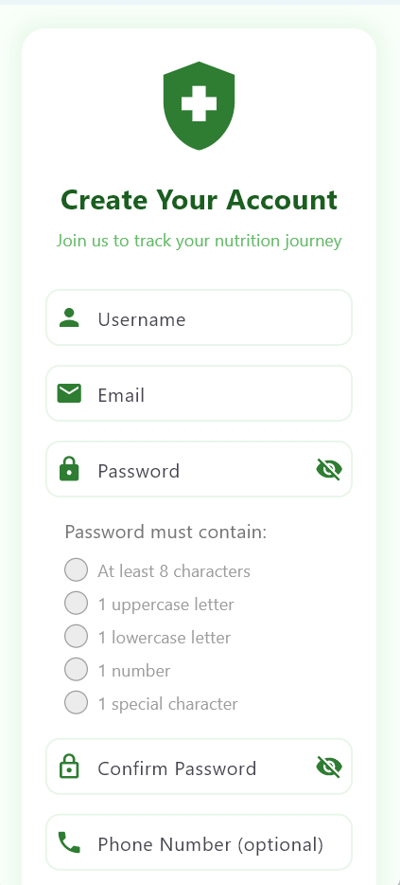
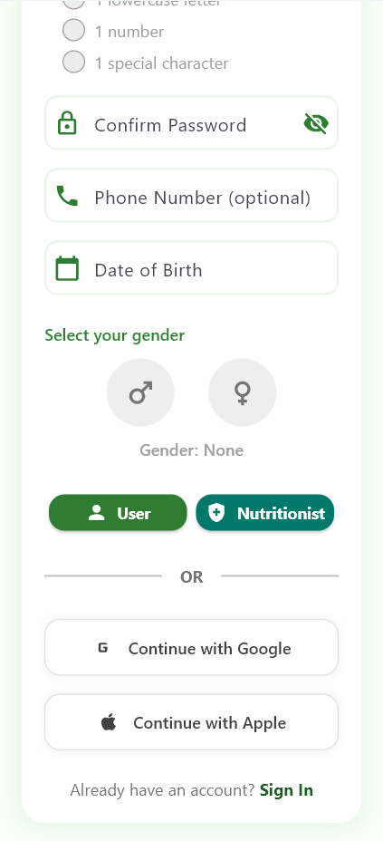
Sign up

Slide 8
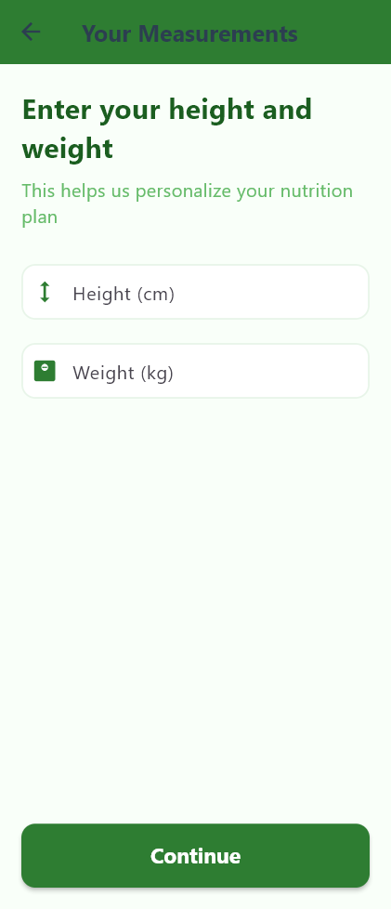
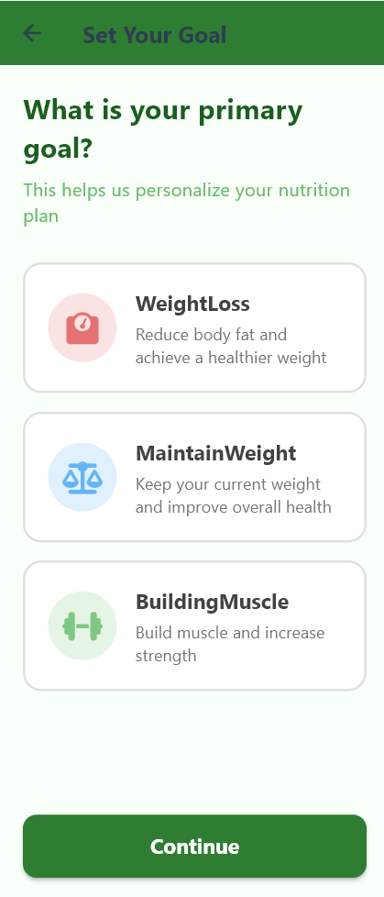
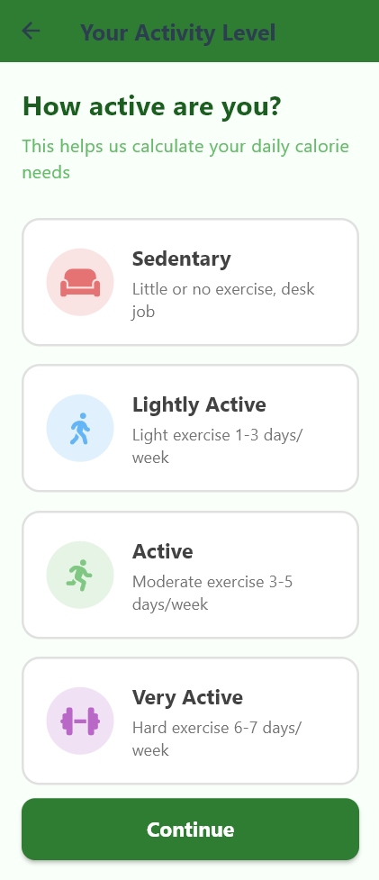

Goals and measurements

Slide 9
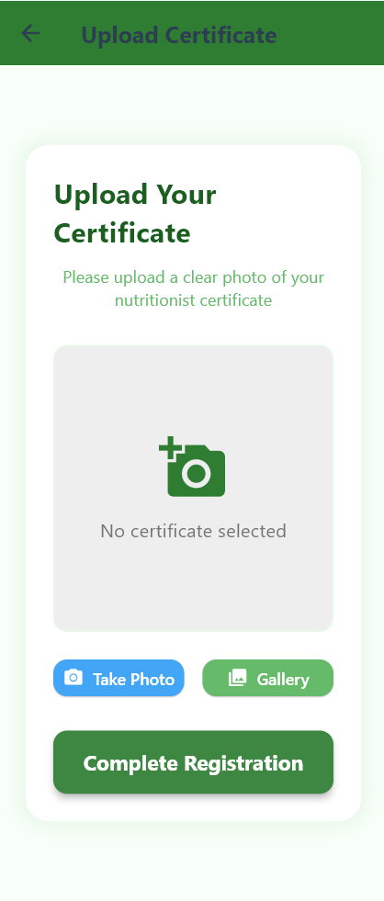
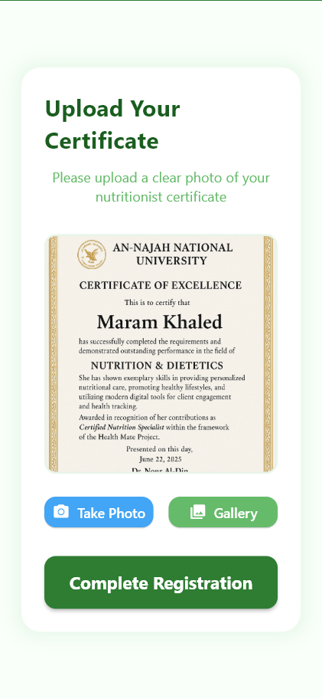
Certificateupload

Slide 10
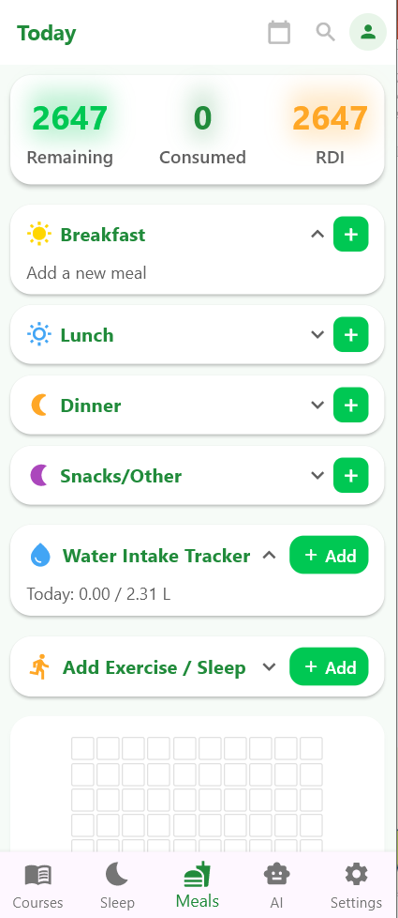
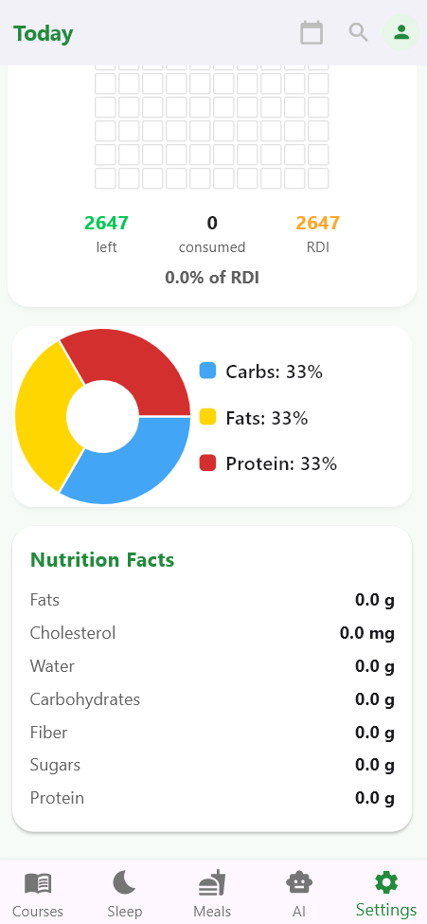
Home page

Slide 11
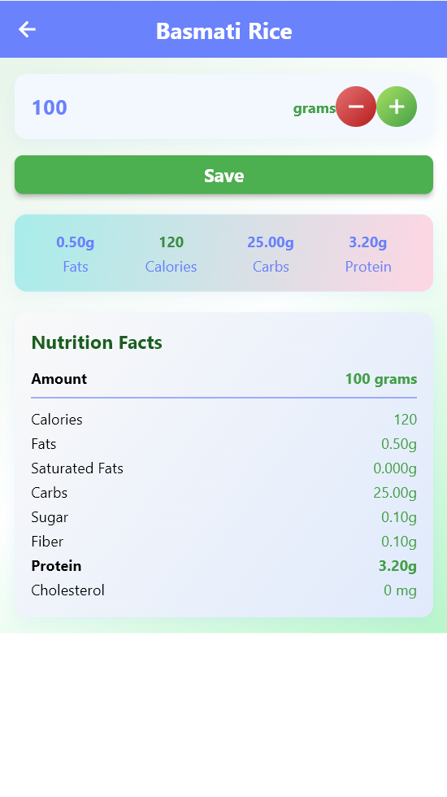
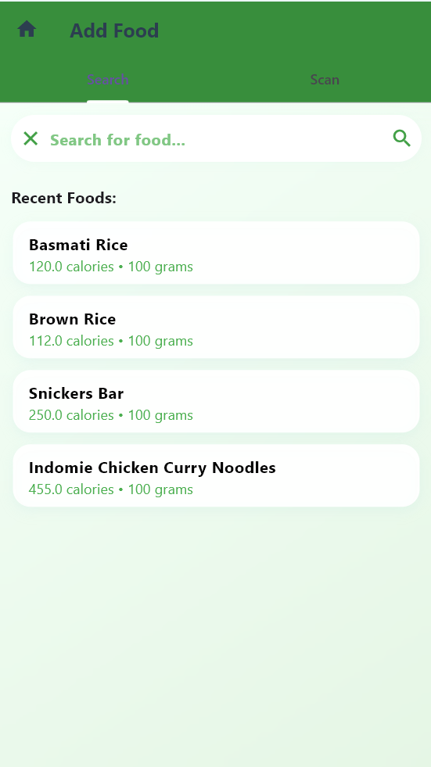
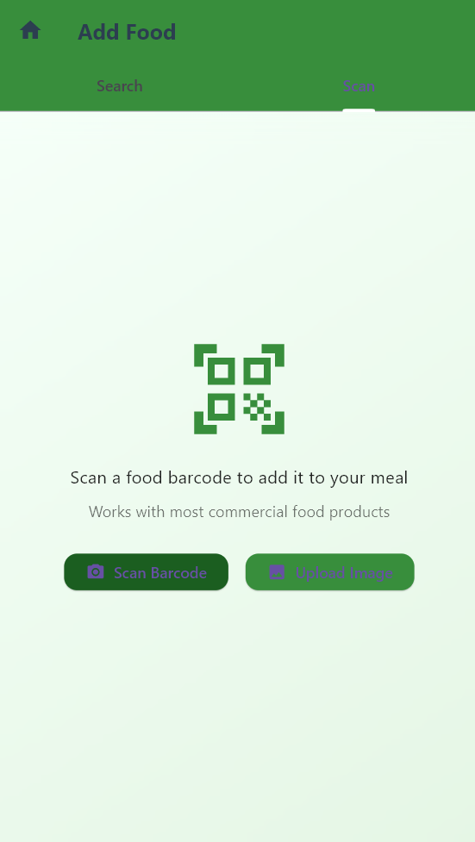
Add food page

Slide 12
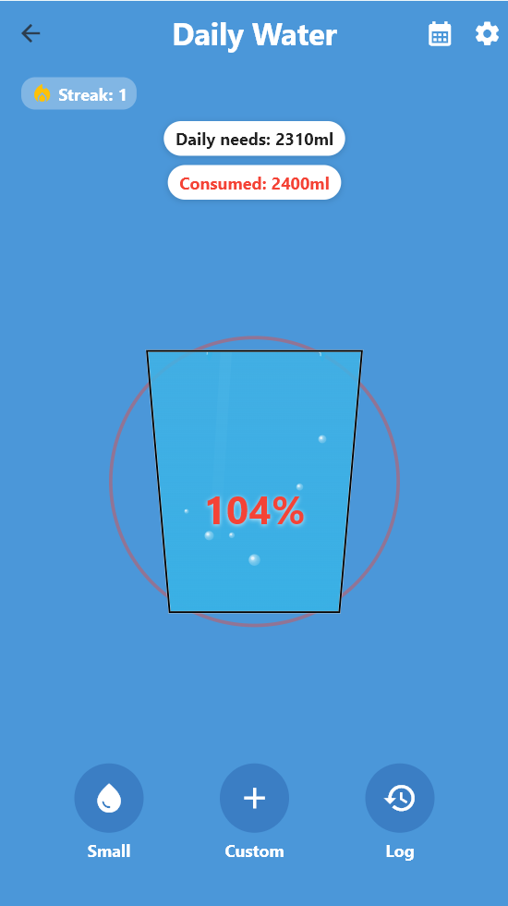
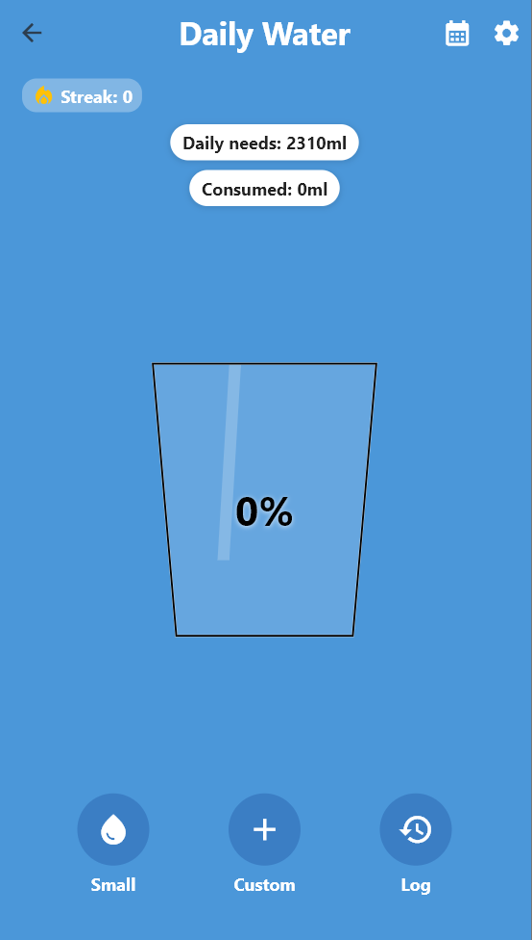
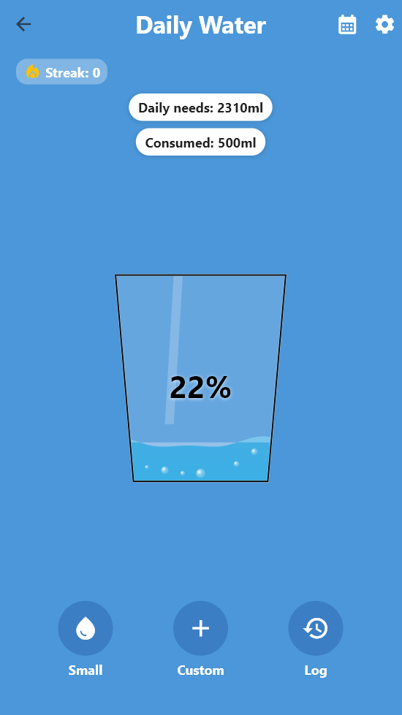
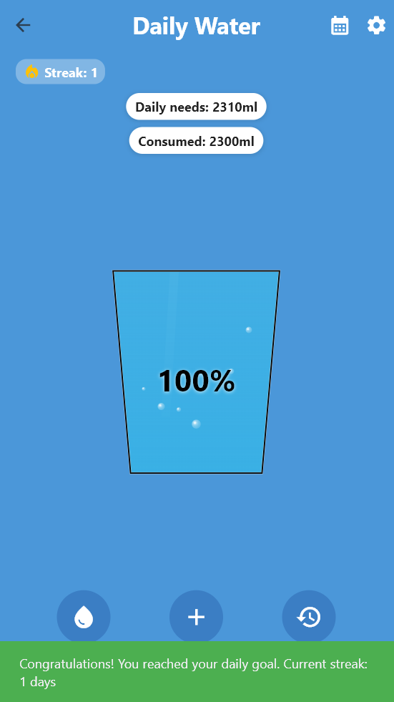
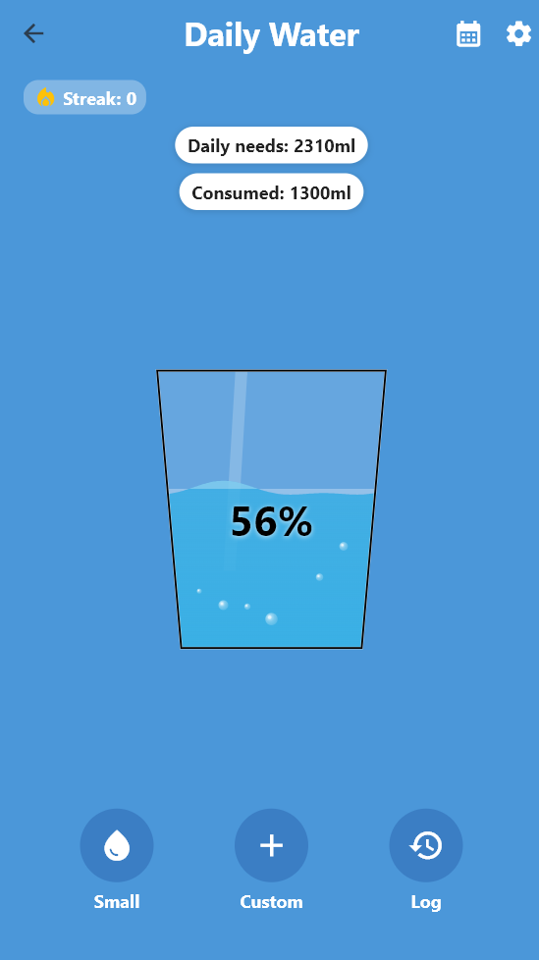
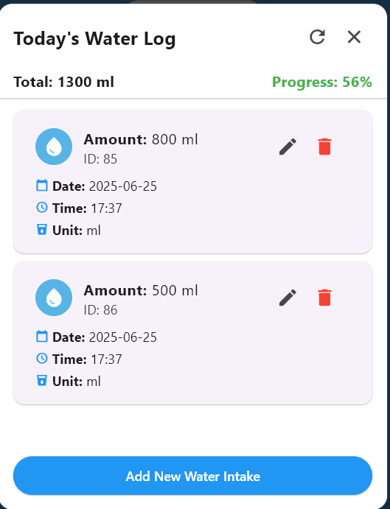
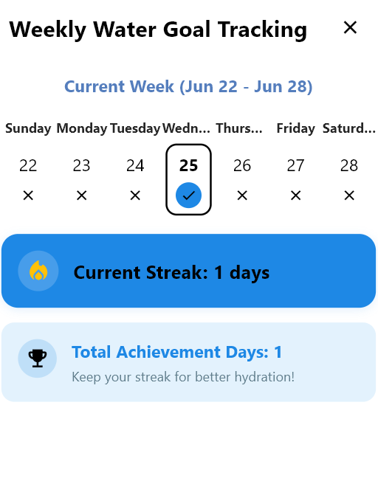
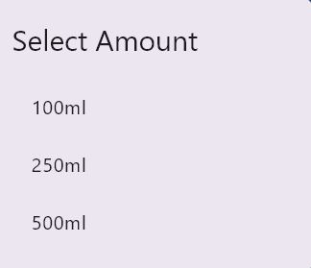
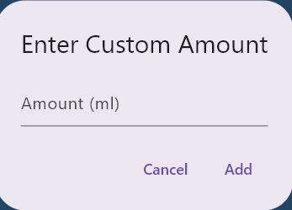
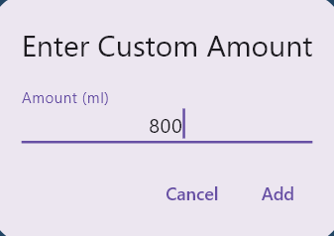
Water tracking page:

Slide 13
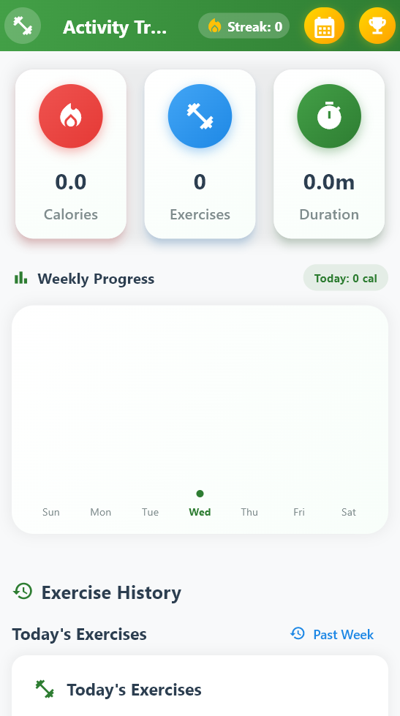
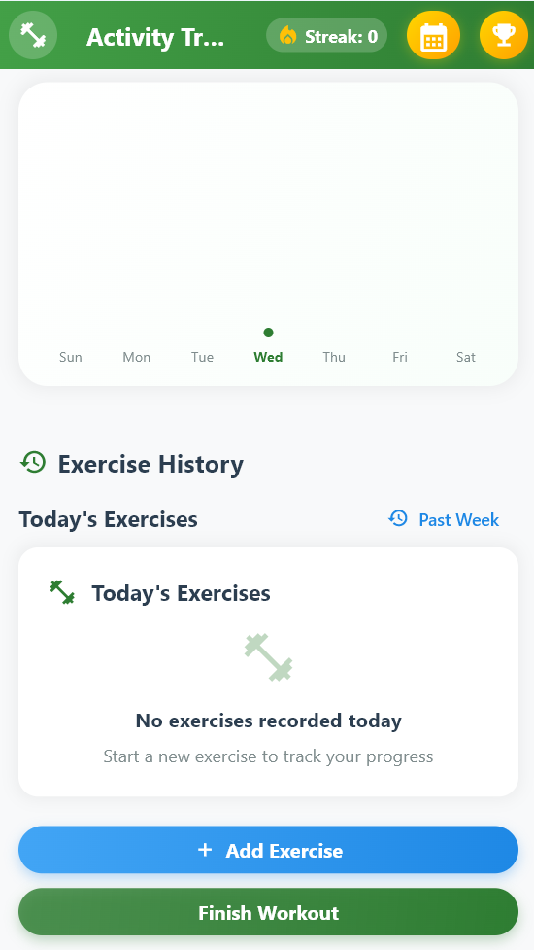
Excise tracking page

Slide 14
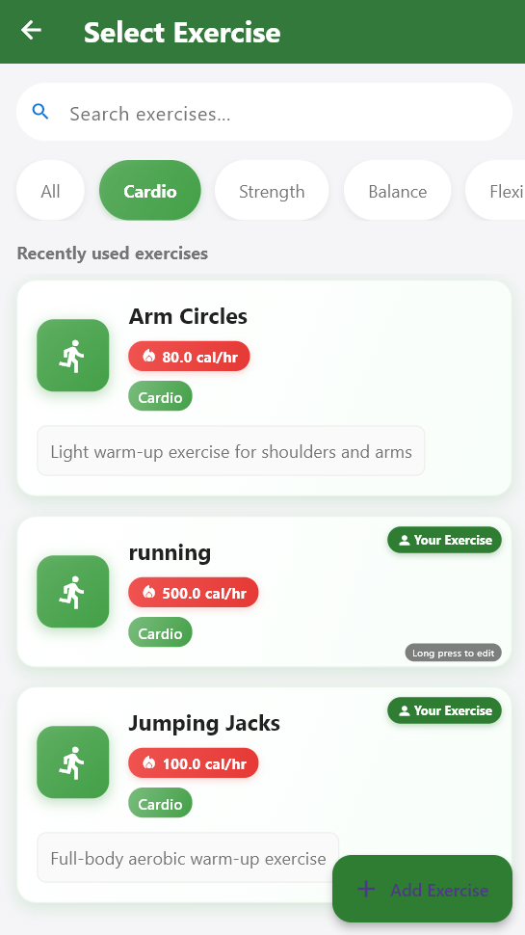
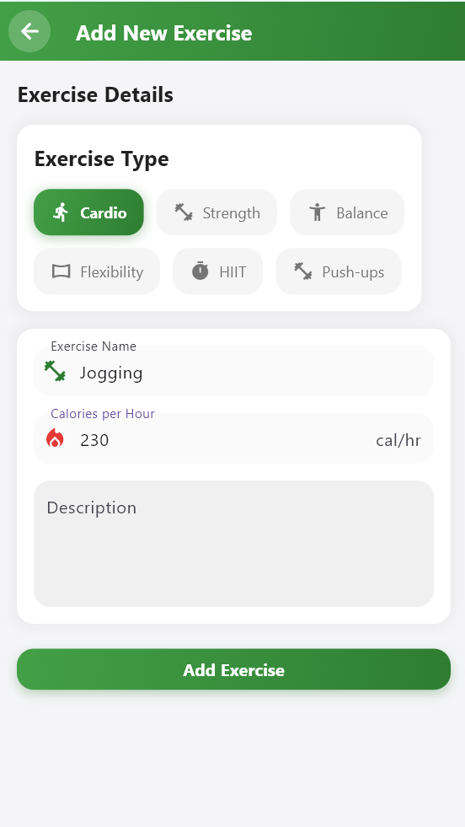
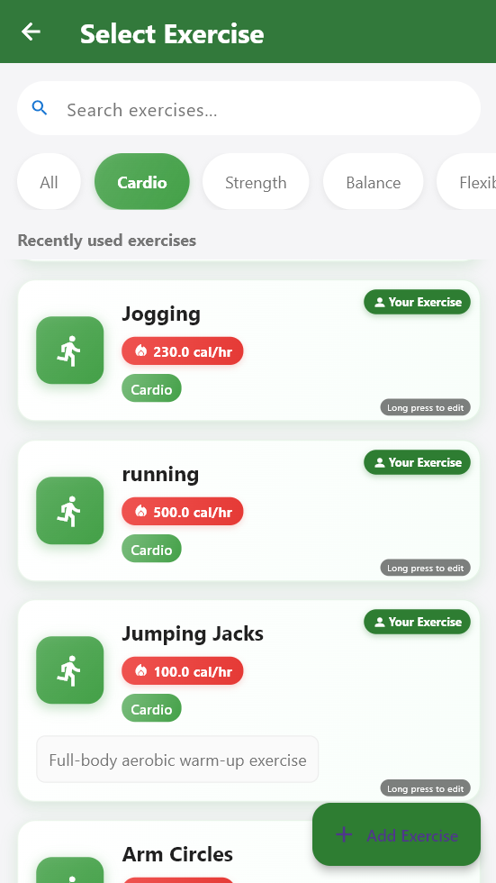
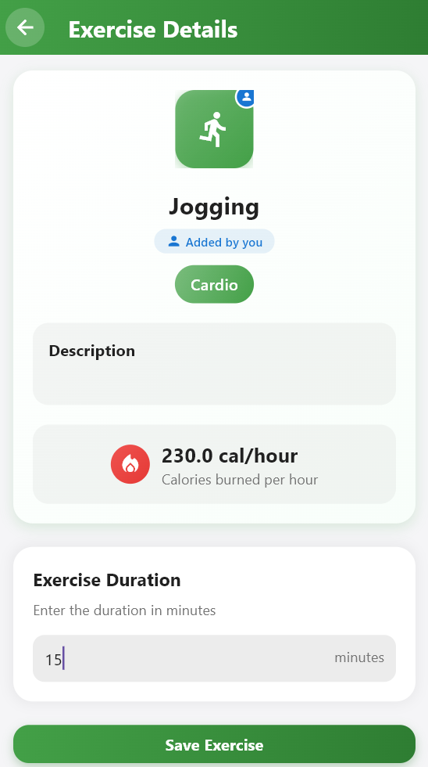
Exercise add and log

Slide 15
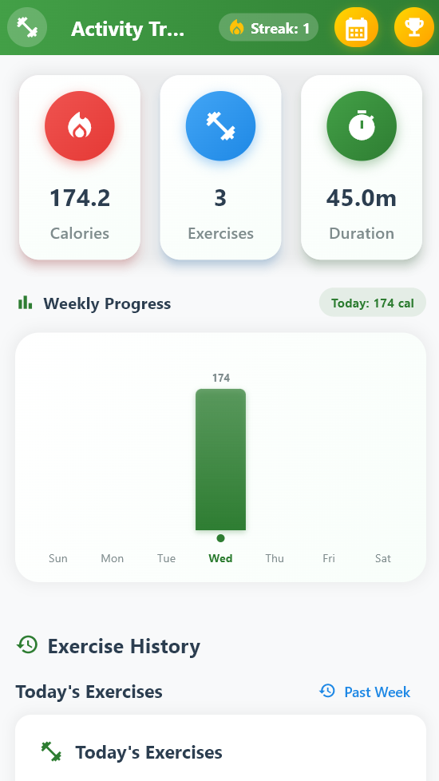
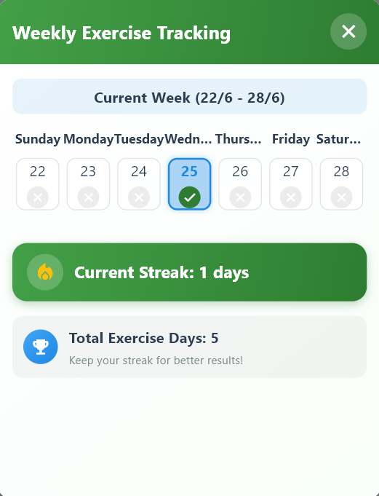
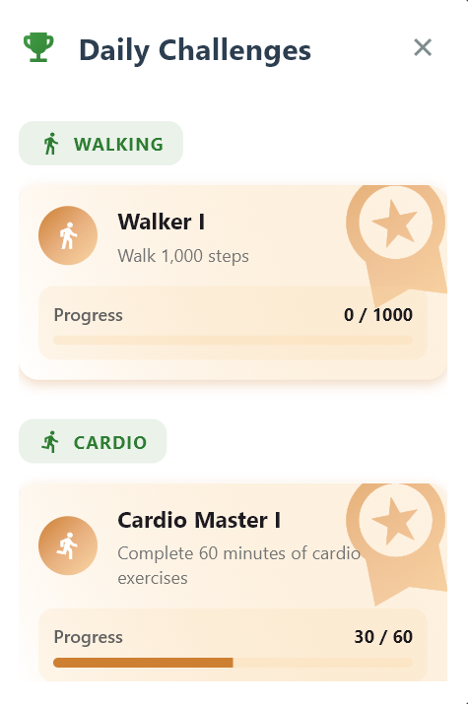
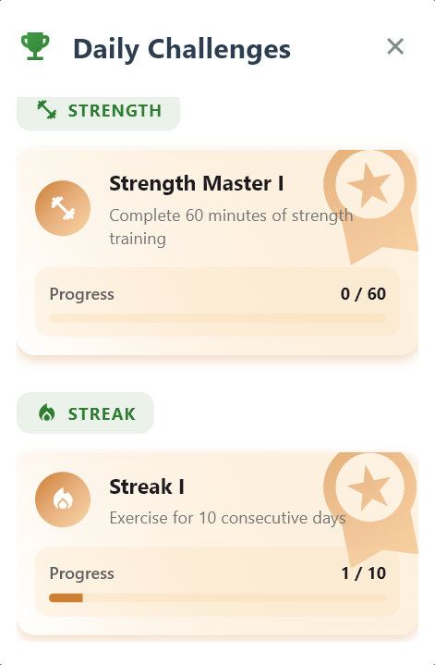
Exercise streak and achievements

Slide 16
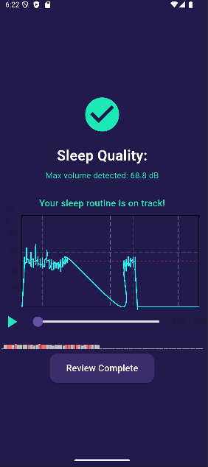
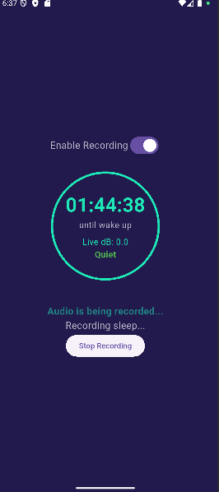
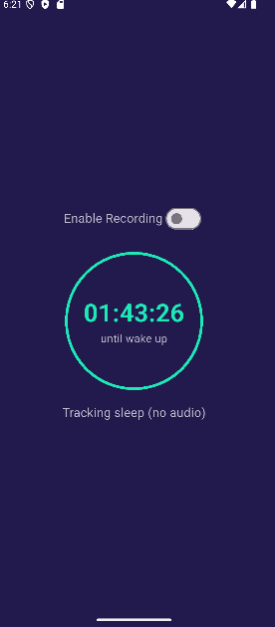
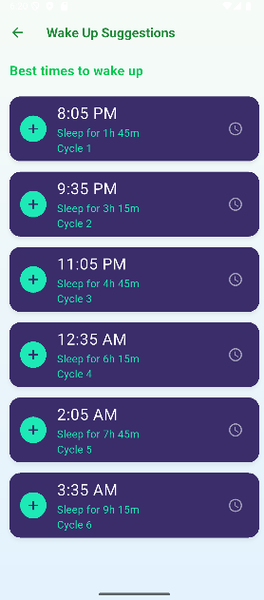
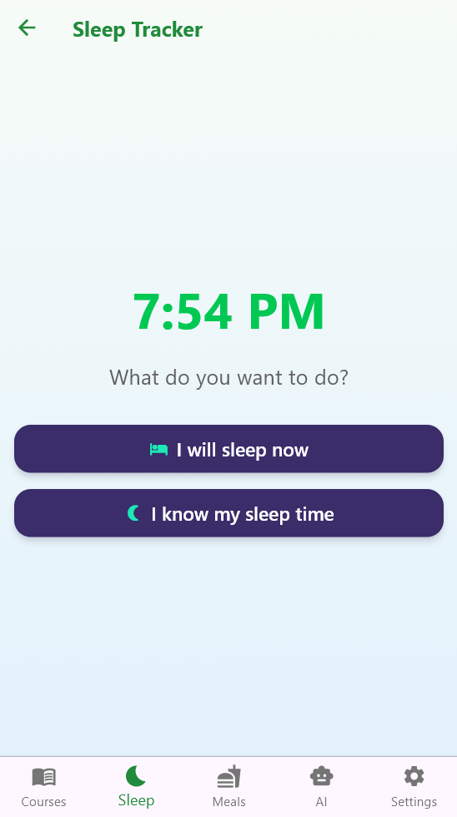
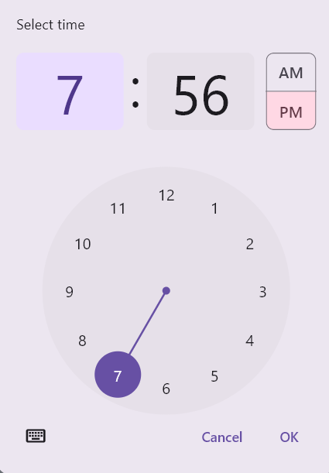
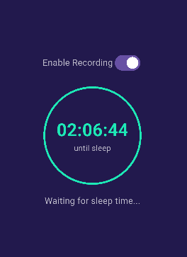
Sleep tracking

Slide 17
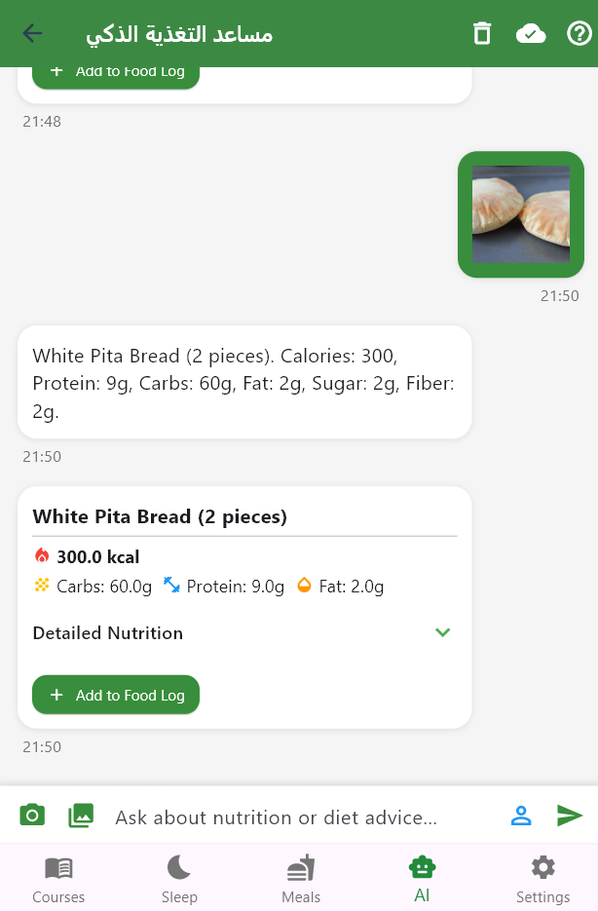
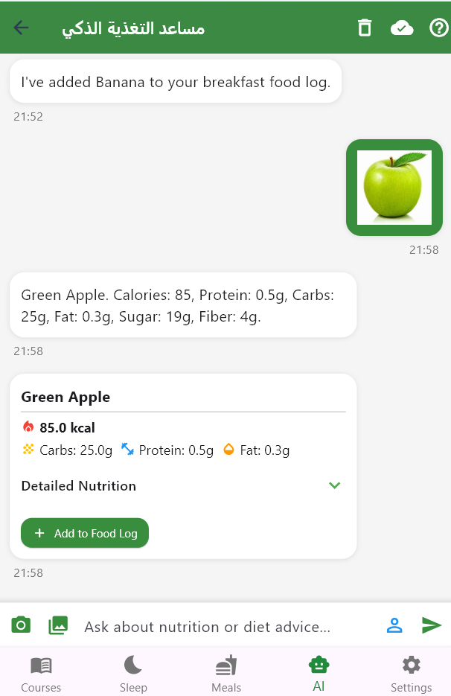
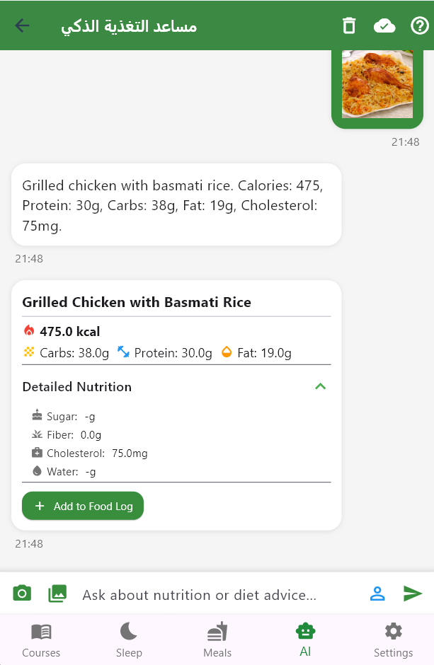
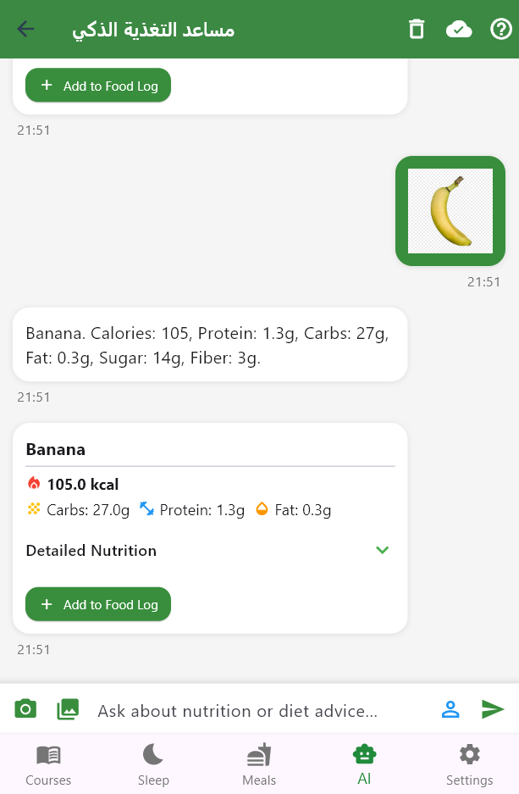
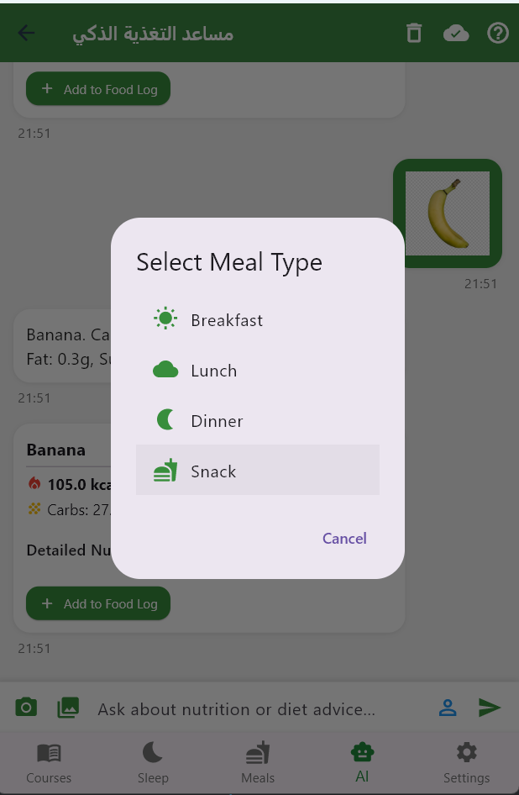
Ai chat bot

Slide 18
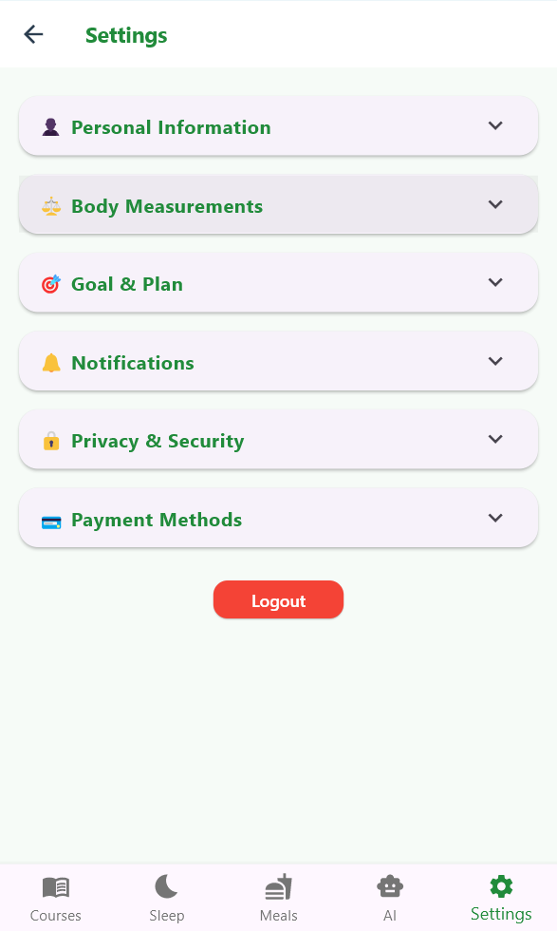
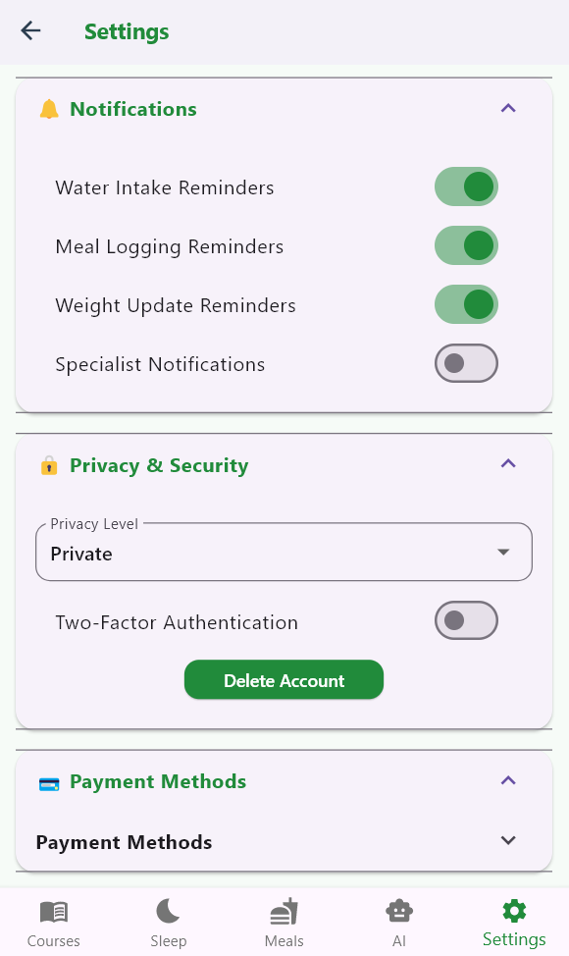
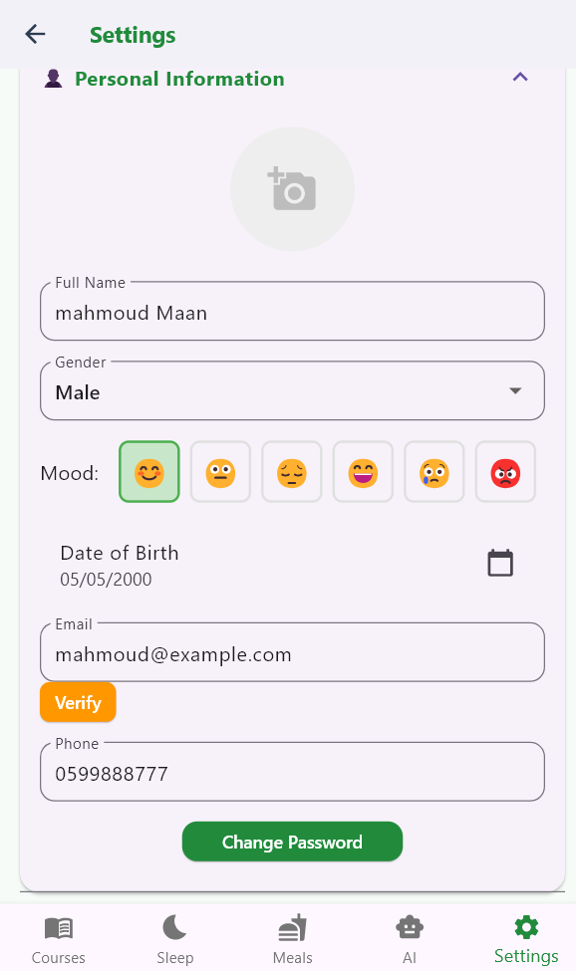
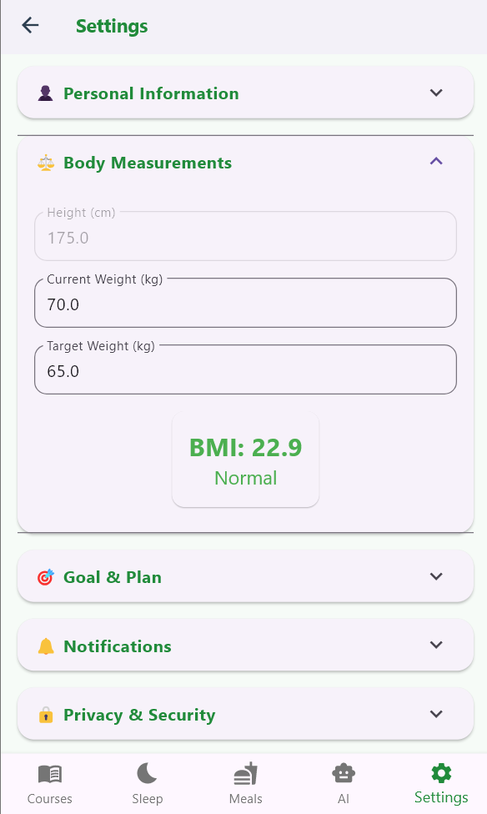

Settings page

Slide 19






Courses content
and appointment
booking

Slide 20







Slide 21


Chatting and group chat

Slide 22






Nutritionist
appointments page

Slide 23





Course chatting group

Slide 24




Nutritionist
tracking
patients

Slide 25



Nutritionist feedback

Slide 26










adding and logging courses

Slide 27





Slide 28









Admin dashboard

Slide 29
FUTURE WORK :
1-Wearable Device Integration
2-Voice Assistant Integration
3-Gamification and Social Features
4-Mental Health Companion
5-Offline Mode with Sync

Slide 30
Thank you

