Slide 1

بسم الله الرحمن الرحيم
Design of waste water collection system for Al-Attarah Village
Prepared by
Abdel-Rahman Rawajbeh Hisham Yaseen
Noor Al-Din Rabaya Sameh Nofal
Supervisor
Dr. Hamees Tubeileh

Slide 2
Methodology used in Graduation Project I
Collect Data
Analyze Data
Estimate Future Demand
Look for New Resource
Cost of the Project
Visit the Village
Design of Water Distribution Network

Slide 3
After we collected the questionnaire data from the villagers who live in Al-Attarah
We got this information

Slide 7

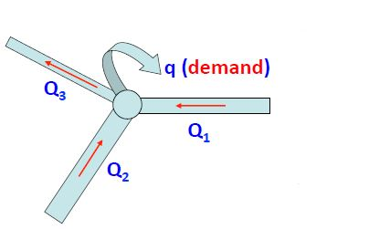

Equation Used in WaterCAD
    Energy Equation
    $\frac{P_{1}}{γ}+ \frac{V_{1}^{2}}{2g}+ Z_{1}= \frac{P_{2}}{γ}+ \frac{V_{2}^{2}}{2g}+ Z_{2}$
    Darcy-Weisbach Equation
    Continuity Equation
Q1 + Q2 = Q3 + demand

Slide 8
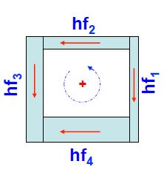

Hazen-William Equation
$hf=K \frac{Q^{1.852}}{{(CHW}^{1.852})∗(D^{4.87})} L$
Energy Conservation
- hf1– hf4 + hf3 + hf2 =0

Slide 9
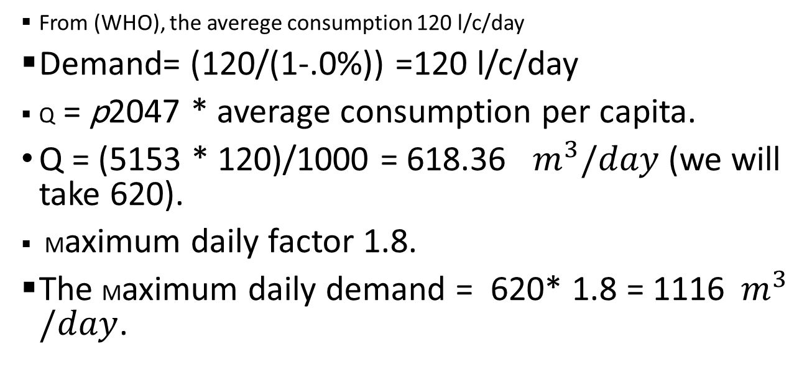
Data of the Demand used
From (WHO), the averege consumption 120 l/c/day
Demand= (120/(1-.0%)) =120 l/c/day
Q = p2047 * average consumption per capita.
Q = (5153 * 120)/1000 = 618.36 $m^{3}/day$ (we will take 620).
Maximum daily factor 1.8.
The Maximum daily demand = 620* 1.8 = 1116$m^{3}/day$.

Slide 10
We used pipes material of ductile iron.
We did not need any pump.
Design Criteria used:
Pressure criteria from 20 to 100 m H2O.
Velocity criteria from 0.3 to 3 m/sec.

Slide 11
After we supplied WaterCAD with these data (contour map, structural road network, distribution of building ) . We did these steps :
Draw the networks (pipes and junctions)
Add reservoir to network
We put the pipes diameter
calculate the demand on each node by thiesson polygon method .
Run the program
Finally we calculated the cost which was 364,200 Dollar.

Slide 12
The results was :

Slide 14
Graduation Project II Content
INTRODUCTION
DESCRIPTION OF THE STUDY AREA
DESCRIPTION OF THE SEWERCAD SOFTWARE
WASTEWATER COLLECTION SYSTEM AND CALCULATIONS

Slide 15
Content
DESIGN METHODOLOGY
MODELING, ANALYSIS AND DESIGN
RESULTS AND DISCUSSION
COST OF THE PROJECT

Slide 16
Objectives
Study the sewer situation in the study area.
Design the sewer collection system.
Calculate the quantities and the types of the materials required and used
Calculate the full project price.

Slide 17
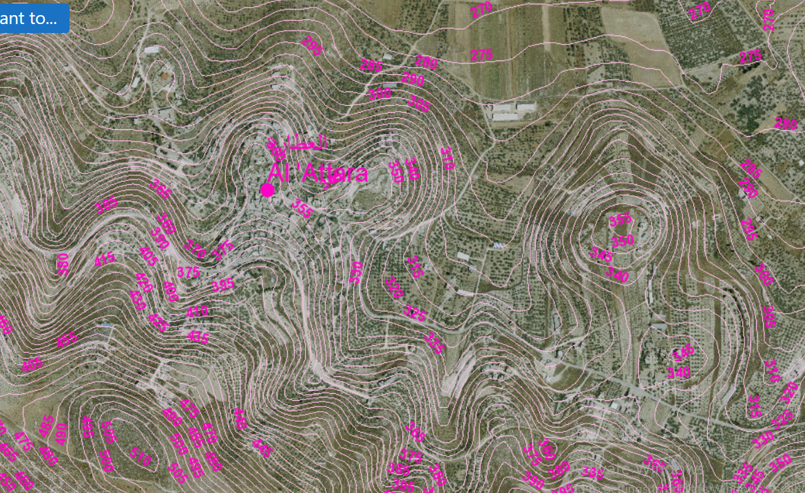
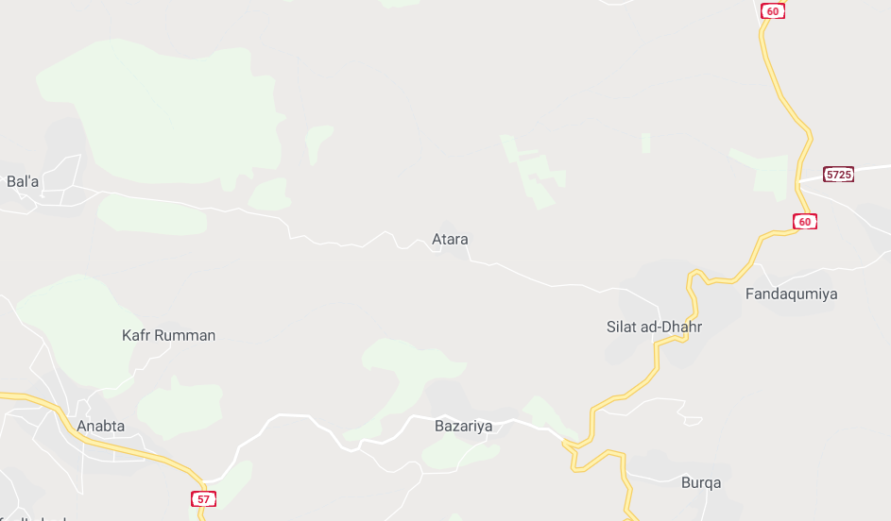
INTRODUCTION
Location
Geography & Topography

Slide 18
Temperature
The annual mean temperature varies between 14 and 33 ºC
Humidity
Average of humidity 68.91%.
Rainfall
Avg. rainfall depth is 570 mm

Slide 19
Methodology
Collect Data
Analyze Data
Estimate the future population and the future demand of wastewater generated.
Search about near-area wastewater network outfall.
Design of sewer collection system using Sewer CAD software.
Cost of the project

Slide 20
Data Collection
  Contours map to extract the elevations, and understand the topography of the area..
  The road network to know the path of the pipes to connect manholes together.
  Building map to know how the population distributed.
  Boundary of the study area.

Slide 21
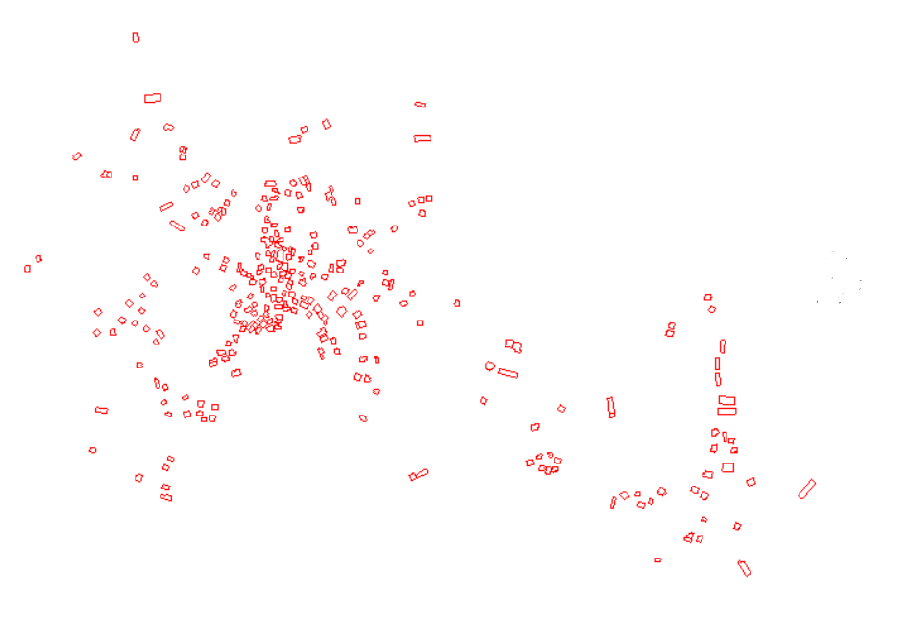
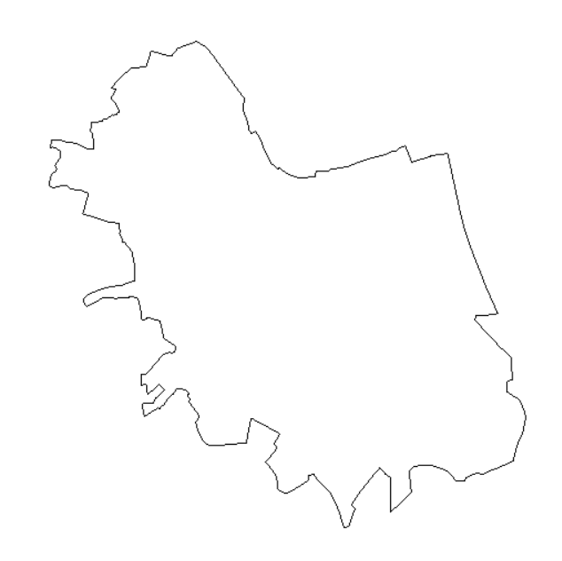
Distribution of Buildings
Boundary Map

Slide 22
Design Criteria
Velocity
Slope
Cover depth

Slide 23


Equation Used in sewer CAD
    Energy Equation
    $\frac{P_{1}}{γ}+ \frac{V_{1}^{2}}{2g}+ Z_{1}= \frac{P_{2}}{γ}+ \frac{V_{2}^{2}}{2g}+ Z_{2}$
Manning’s Equation

Slide 24
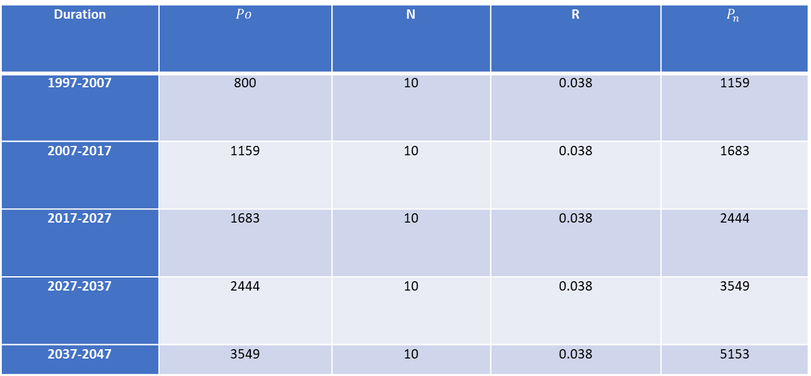
Data of Future Population
Table ‎4.1 Future population estimation
Duration |  | N | R
1997-2007 | 800 | 10 | 0.038 | 1159
2007-2017 | 1159 | 10 | 0.038 | 1683
2017-2027 | 1683 | 10 | 0.038 | 2444
2027-2037 | 2444 | 10 | 0.038 | 3549
2037-2047 | 3549 | 10 | 0.038 | 5153

Slide 25
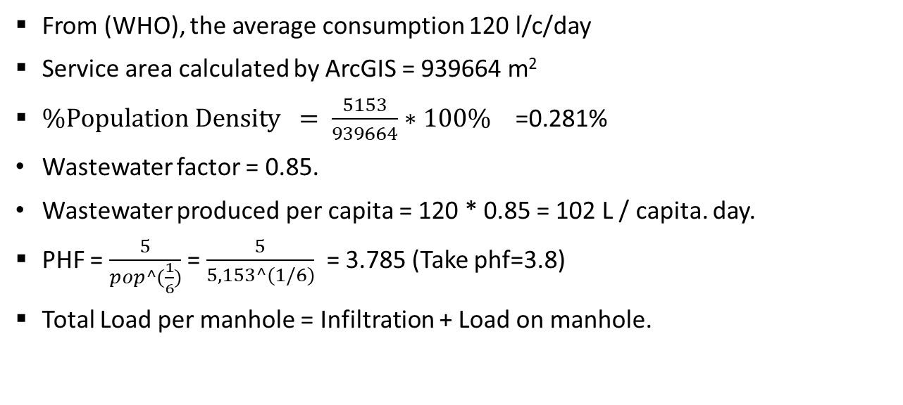
Demand calculation
From (WHO), the average consumption 120 l/c/day
Service area calculated by ArcGIS = 939664 m²
$\%Population Density = \frac{5153}{939664}∗100\%\text{ =}\text{0.281}\text{\%}$
Wastewater factor = 0.85.
Wastewater produced per capita = 120 * 0.85 = 102 L / capita. day.
PHF = $\frac{5}{pop^(\frac{1}{6})}$ = $\frac{5}{5,153^(1/6)}$ = 3.785 (Take phf=3.8)
Total Load per manhole = Infiltration + Load on manhole.

Slide 26
Load on Manholes
Estimate the population after 30 years
Estimate area covered per each manhole is evaluated using GIS (approximately).
Estimate the population density = Pop(2047)/Service Area coverd by manholes
Area *population denstiy =Pop/manhole
The load per manhole values imported from Excel to SewerCAD.
Unit load per manholes and set it in sewerCAD

Slide 27
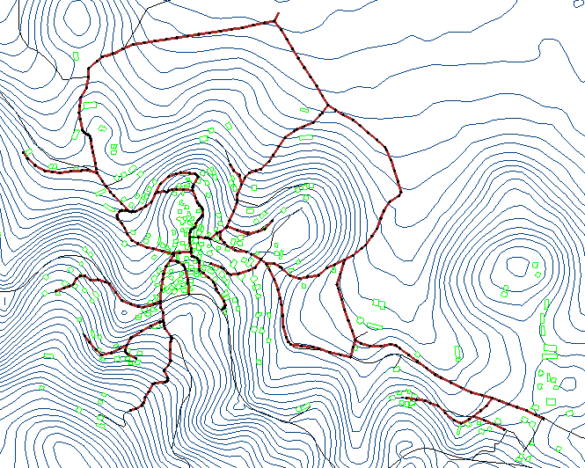
Modeling, analysis and design
Constructing the Network

Slide 28
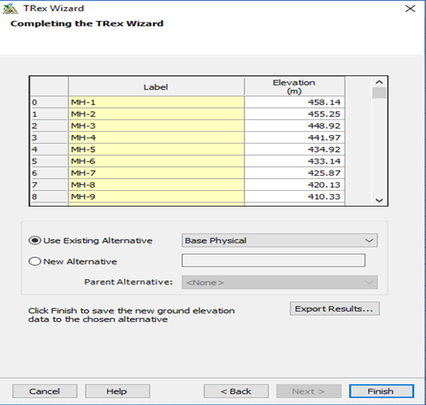
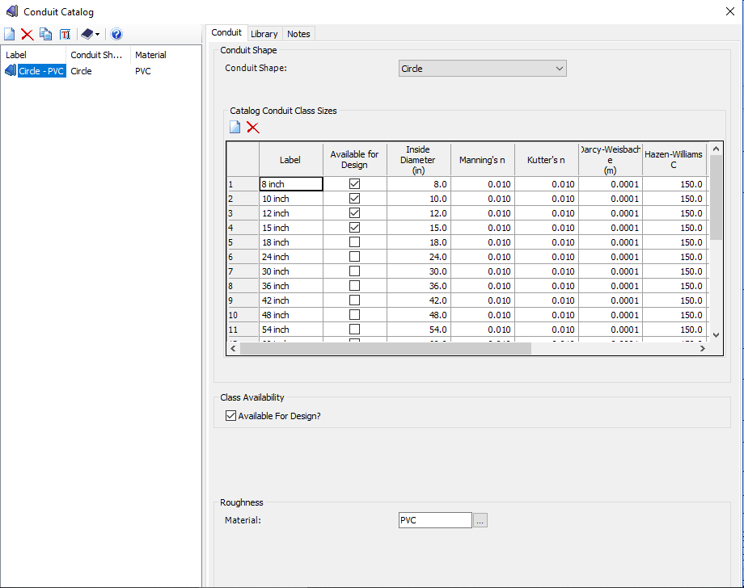
Modeling, analysis and design
2. Input Data

Slide 29
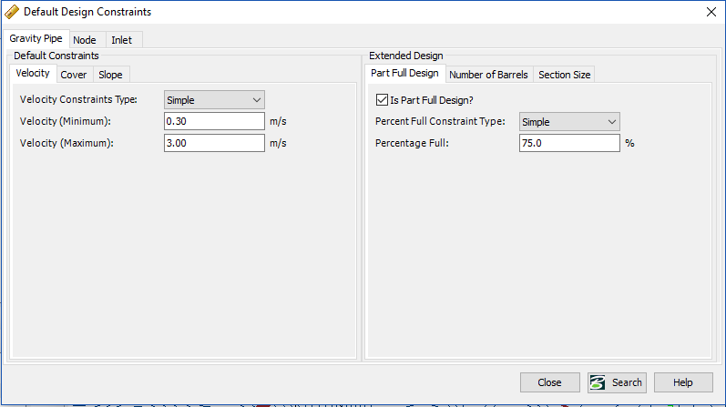
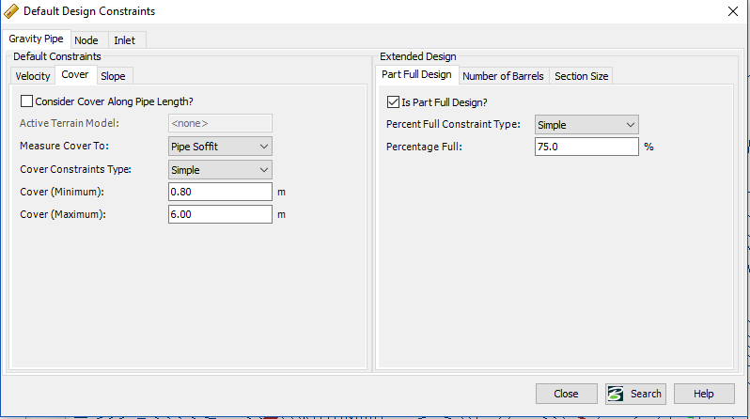
Modeling, analysis and design

Slide 30
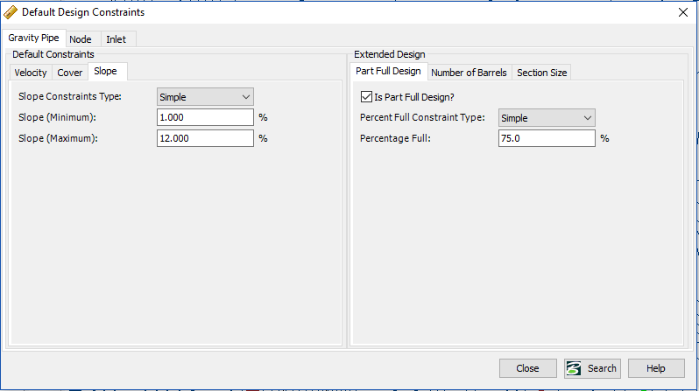
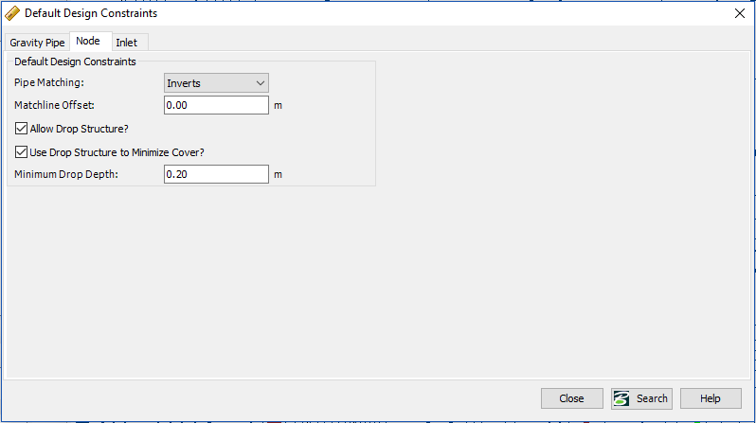

Slide 31
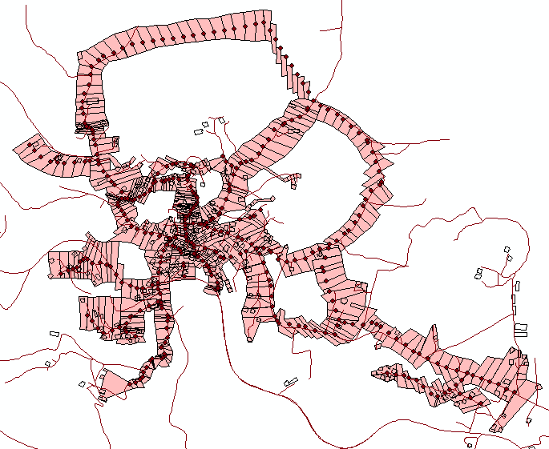
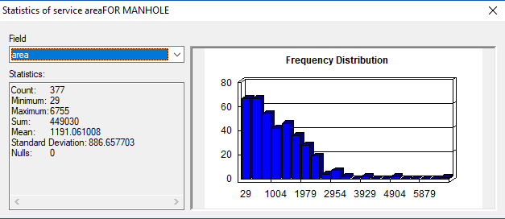

Slide 32
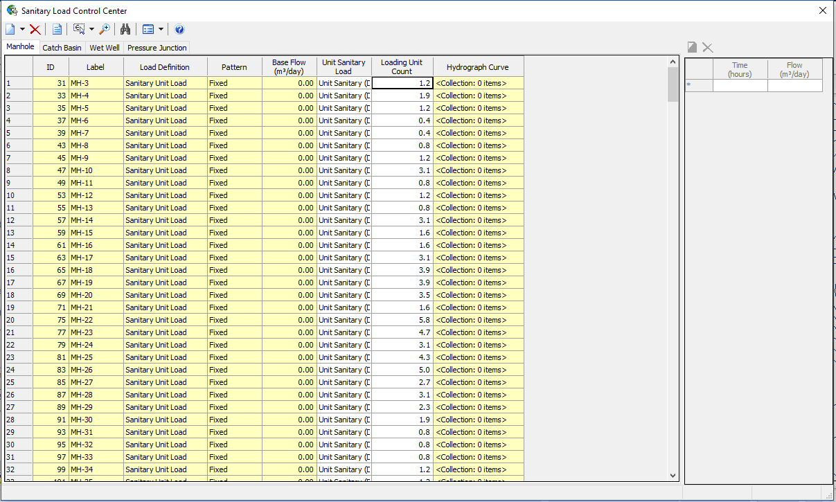
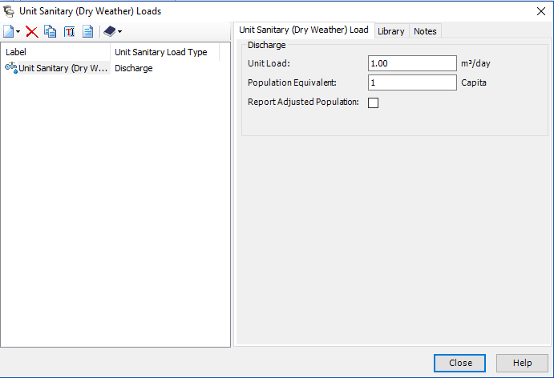

Slide 33
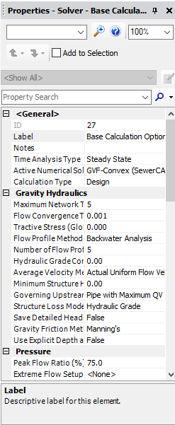
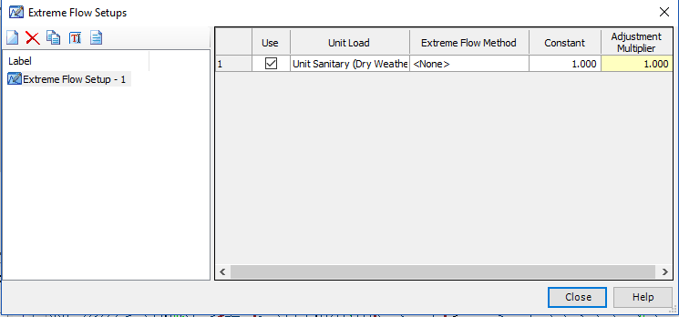

Slide 34
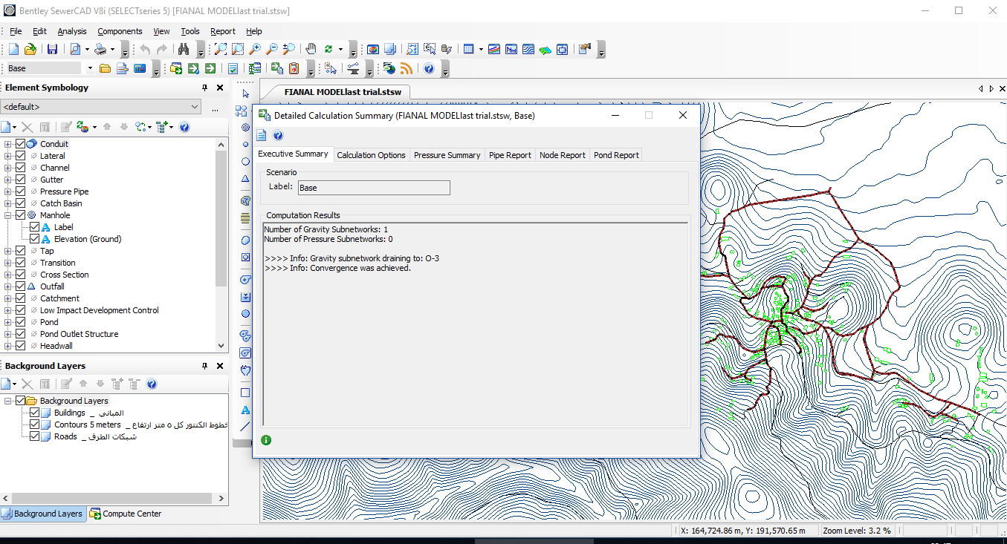

Slide 35
Results and discussion
velocity

Slide 36
Results and discussion
Slope

Slide 37
Results and discussion
Cover Depth

Slide 38
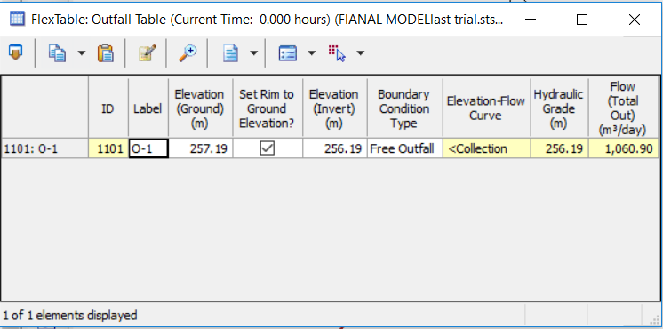
Results and discussion
Outfall

Slide 39
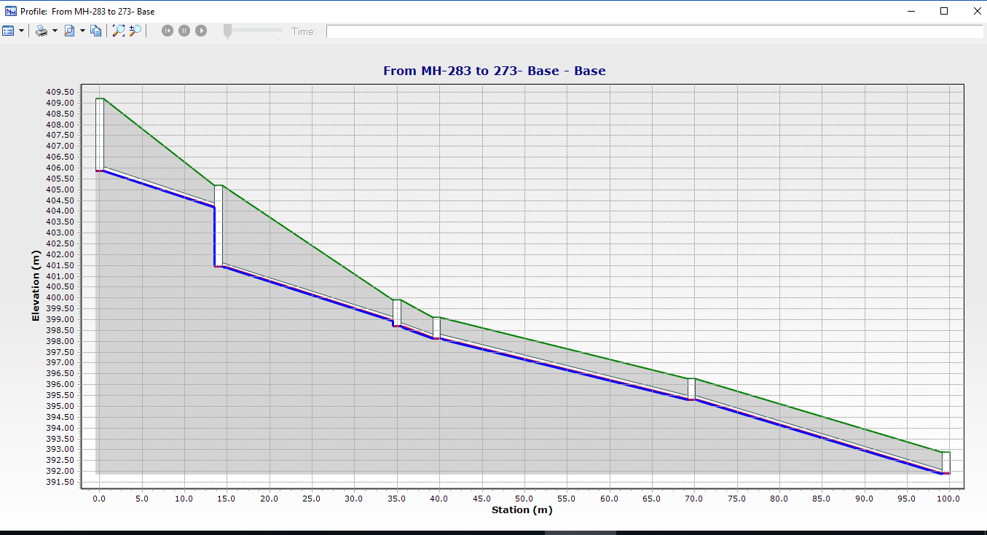
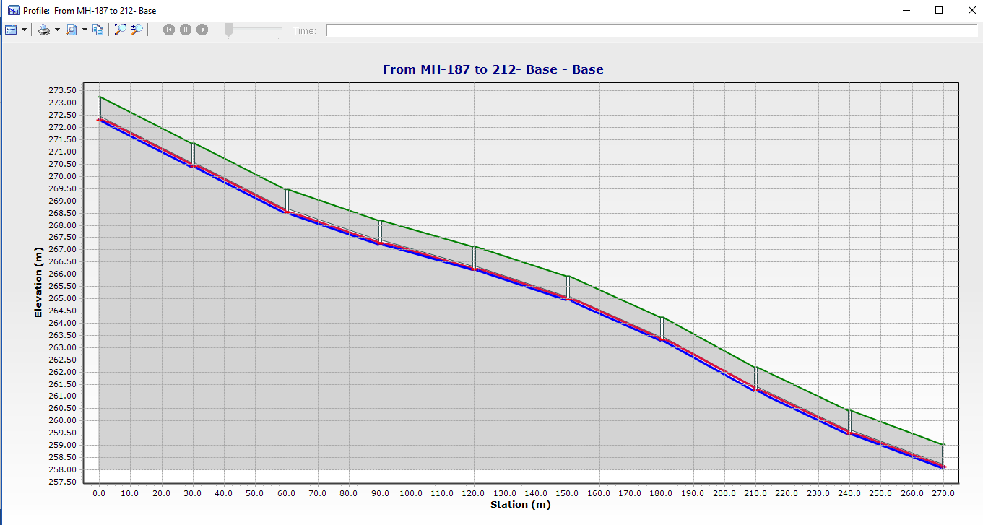
Profiles

Slide 40
cost of the project
We use only 8 inch conduits and its unit price is = 8 $.
The unit price of meter length excavation = 9 $.
We assumed that the taxes equal 20% of the total cost.
The unit price of a manhole (D = 1m) including cover and all elements = 350 $.
Cost summary:
Total cost of cut = 54,714 $.
Total cost of conduits = 58,126 $.
Total cost including taxes = 135,410 $.
Total cost of manholes = 374 * 350 = 130,900 $.
Total project cost = 266,310 $.

Slide 41
  Conclusions
The network ends with one outfall.
The network includes 374 manholes and 374 conduits.
All conduits have a diameter of 8".
Slopes of pipes are within a range of (1 - 12%).
Cover depths varies from (0.8 – 5.69 m).
Velocities through conduits varies from (0.3 - 1.96m/s).

Slide 42
  Discussion and Recommendations:
The design of WWCN of al-attarah Village is a primary design since the village don’t have a sewer network and the design that we made can apply in reality because the values of velocity and cover depth meet the constraints, So as we see we don’t have any problem so we can apply it, And the cost of the WWCN it’s also suitable.

Slide 43


