Slide 1

An-Najah National University
Faculty of Engineering
Civil Engineering Department
Graduation Project ||
Structural analysis and design for static and seismic loads of Nihad AL-Bezreh building in Nablus city
supervisor
Dr. Mahmoud Dweikat
Prepared by:
Ahmad Halaweh
Asem Al-Nouri
Muslem Al-jubeh
Tariq Alwaneh

Slide 2
Outline
Project description
Analysis & Design Principles
ETABS modeling
Dimensional Analysis
Design

Slide 3
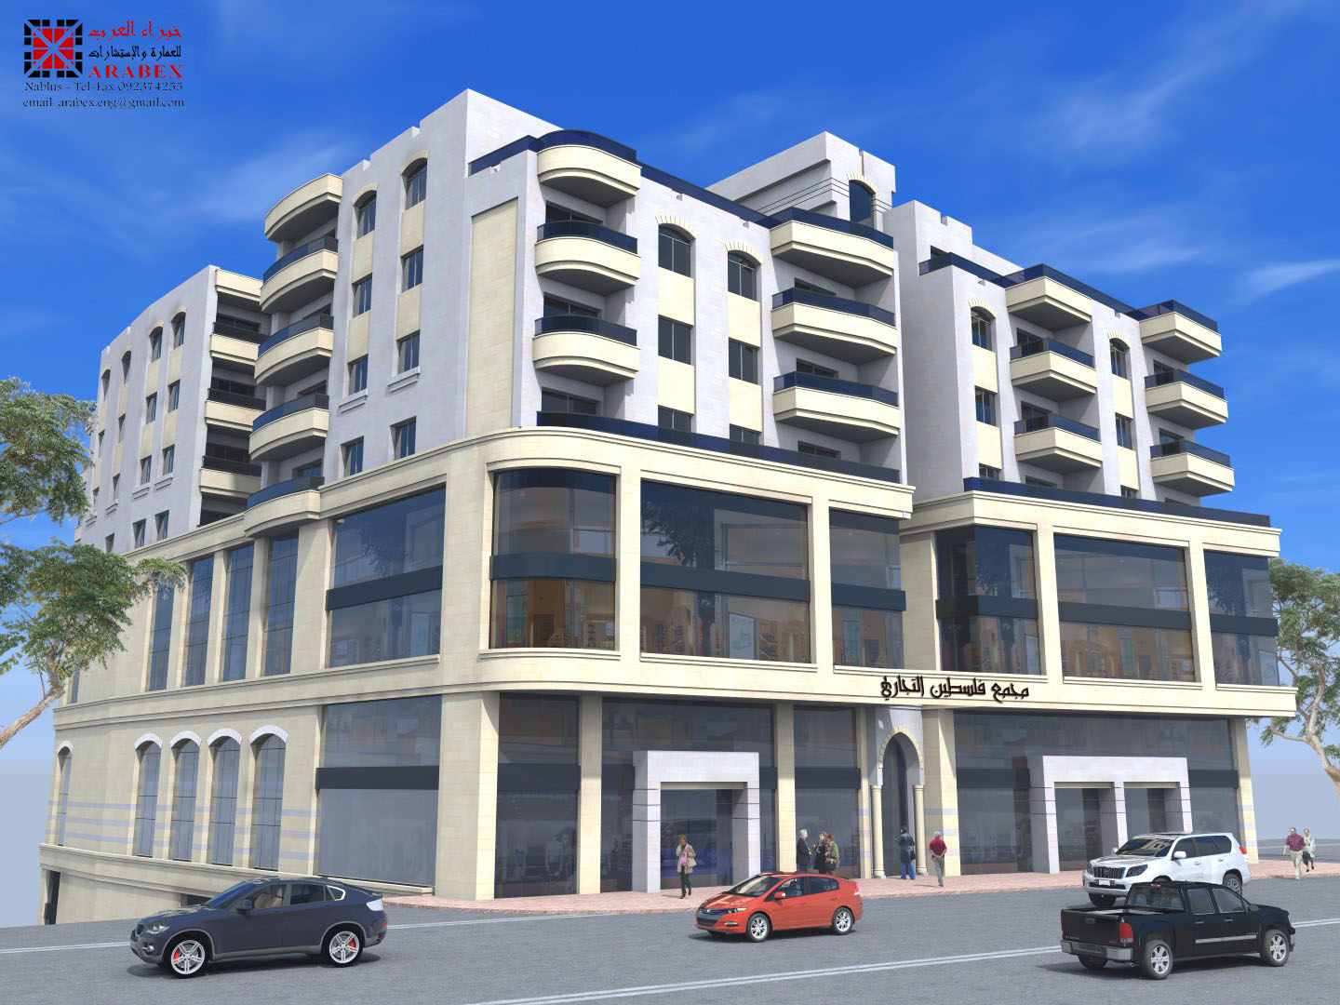

Slide 4
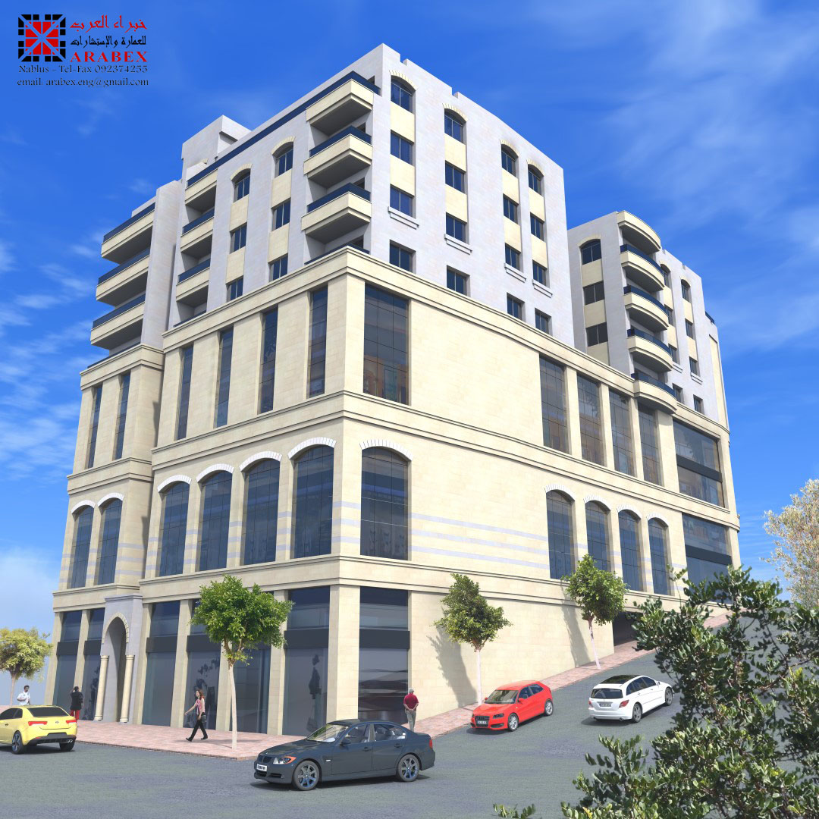
Notes:
This project is commercial and residential building located near AL Bizreh Complex, Nablus Tulkarm Main Street, Nablus, Palestine. The proposed building will have 1300m2 plan area and will consist most of 12 stories (4 basements) and have a total area of 14,476 m2

Slide 5
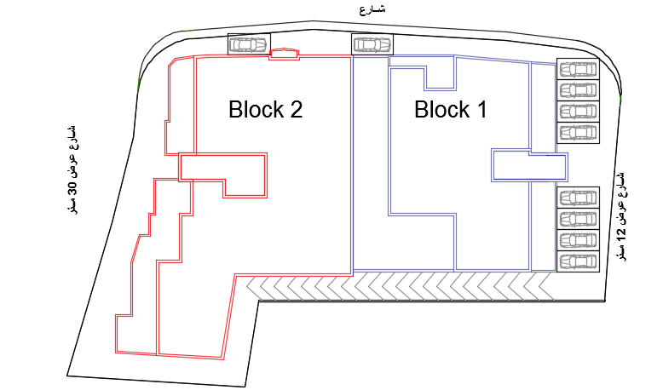

Slide 6
The function and area for each floor:
Floor | Function | Area of block 1 (m²) | Area of block 2 (m²) | Total area (m²)
B4 | Garage | 731 | 322 | 1053
B3 | Storage | 731 | 738 | 1469
B2 | Warehouse | 615 | 738 | 1353
B1 | Warehouse | 615 | 738 | 1353
G | Commercial | 615 | 662 | 1277
Shed | Commercial | 460 | 550 | 1010
F1 | Commercial | 615 | 662 | 1277
F2 | Residential | 454 | 707 | 1161
F3 | Residential | 454 | 707 | 1161
F4 | Residential | 454 | 707 | 1161
F5 | Residential | 454 | 707 | 1161
F6 | Residential | 389 | 592 | 981

Slide 7
Architectural Drawings

Slide 8
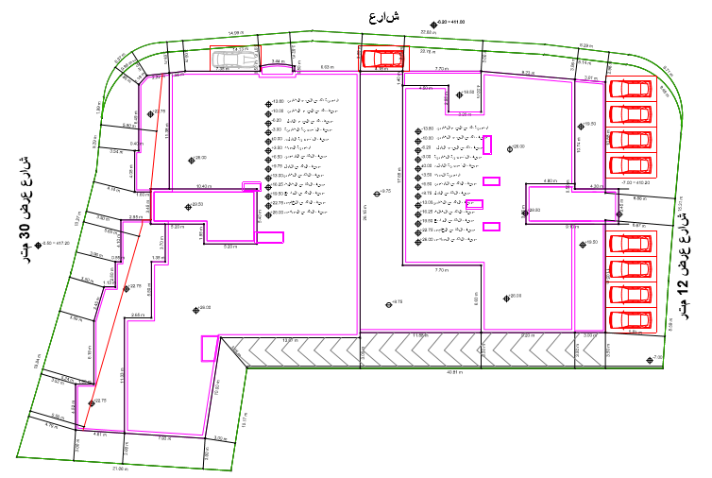
Site plan

Slide 9
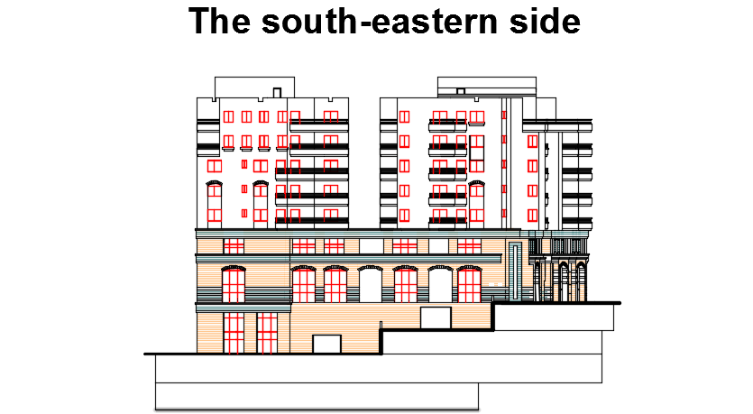
Notes:
الطوابق المختلفه والارتفاعات

Slide 10
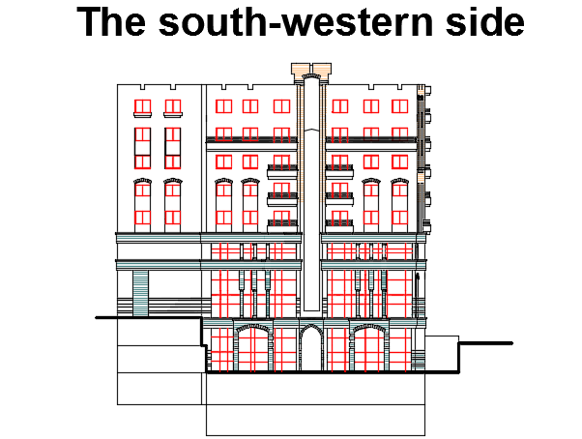

Slide 11
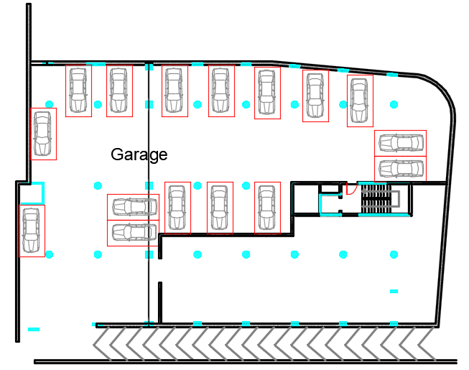
Basement B4

Slide 12
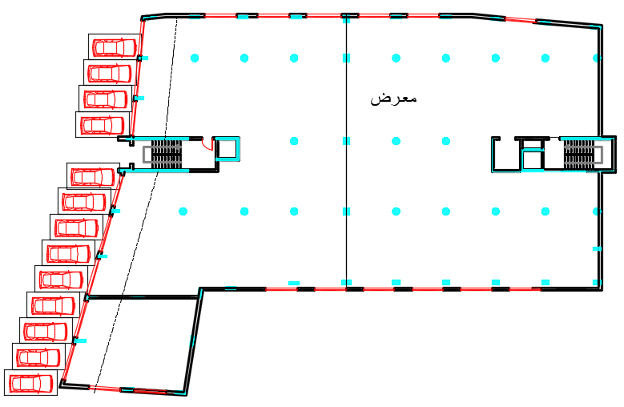
Ground Floor G

Slide 13
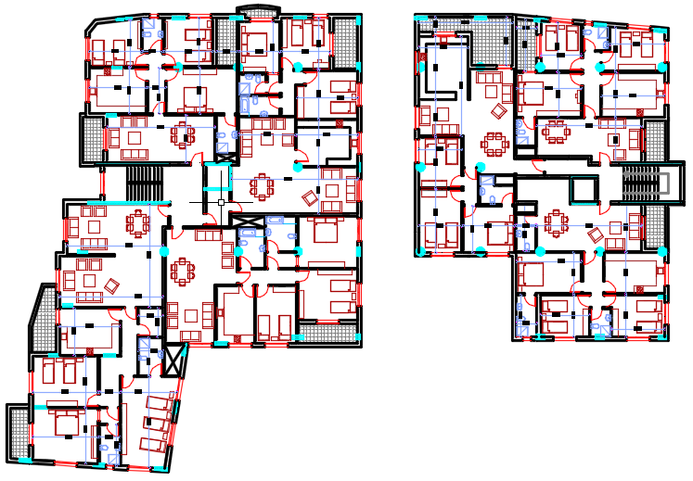
Floor 2-5

Slide 14
Soil properties:
The site from geotechnical point of view can be described as follows:
Layer No. | Location | Description | Shear Wave Velocity (Vs) m/sec | (P-wave) m/sec | Soil Profile Type
1 | Northern part of the site BLOCK 1 | Soft chalky Marlstone formation | 700 | 1400 | SD
2 | Southern Part of the site BLOCK 2 | Silty clay mixed with boulders | 300 | 600 | SC
The allowable bearing is 250 kN/m²
Mat foundation is recommended to be used for this site.

Slide 15
Analysis and Design Principles
  Three dimensional model is used to model the building using ETABS V16.0.0 program.
  The footings are considered as fixed supports (MAT Foundation) .
  Codes and Standards:
    ACI 318-11 : American Concrete Institutes Building Code Requirements for design of concrete elements.
    UBC-97 : Uniform Building Code.
    ASCE : American Society of Civil Engineers.

Slide 16
Material
Concrete
Structural element | Compressive strength(fc’) (Mpa)
Slab, beam | 24
Column, footing, shear wall, Stair | 28
Reinforcement steel:
Yielding strength (Fy) = 420MPa
Modulus of elasticity (Es) = 200GP

Slide 17
Material
Materials unit weight
Material | Unit weight, γ (KN/m³)
Plain concrete | 23
Reinforced concrete | 25
Tiles | 26
Filling material | 23

Slide 18
Loads
Gravity
Dead
Live
Lateral
Wind
Seismic

Slide 19
Gravity Loads
Dead load
  Slab own weight for solid= 5 KN/m2
  Superimposed dead load= 3.9 KN/m2
  Wall load= 6.30 KN /m2
Live load “according to ASCE code”
Floor | Function | uniform live load (KN/m²)
B4 | Garage | 1.92
B3 | Storage | 4
B1-B2 | warehouse | 6
G-F1 | Commercial | 4
F2-F6 | Residential | 4

Slide 20
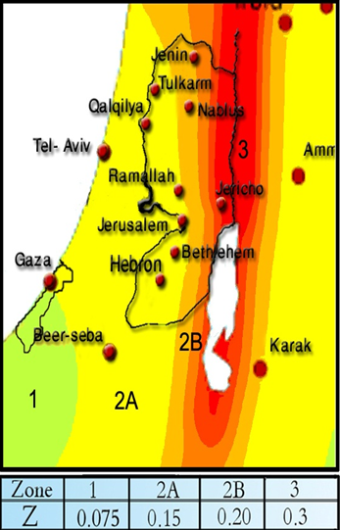
Lateral Loads
Seismic Load
  For Nablus City, seismic zone is 2B.
  Seismic zone factor, Z = 0.2
  Importance factor, I = 1
  Over strength factor, R = 5.5
  Acceleration & Velocity seismic coefficient:
 | Block 1 | Block 1
Soil type | SD | SC
Ca | 0.28 | 0.24
Cv | 0.4 | 0.32

Slide 21
Load Combinations
The Ultimate load combinations used in design are:
  1.4D
  1.2D + 1.6L
  1.2D + 1.6L + 0.5(Lr or S or R)
  1.2D + 1.6(Lr or S or R) + (1.0L or 0.5W)
  1.2D + 1.0W + 1.0L + 0.5(Lr or S or R)
  1.2D + 1.0E + 1.0L + 0.2S
  0.9D + 1.0W
  0.9D + 1.0E
Notes:
According to ACI 318-11

Slide 22
Load Combinations
The service load combinations used in checks are:
  D
  D +L
  D +0.75L
  D +0.7E
  D +0.75L +0.75(0.7E)
  0.6D+0.7E
Notes:
According to ACI 318-11

Slide 23
Computer programs
ETABS
Word and Excel
AutoCAD
SAFE
SAP2000

Slide 24

PRELIMINARY DESIGN
Notes:
Preliminary Design is the first phase of the design process. In this stage of the project a preliminary dimensions was selected in order to build the 3-D model. To check the validity of 3D model, three verification checks will be made which are compatibility, equilibrium and stress-strain relationships. After studying the 3D model and results, a change of these dimensions could be occurred to get the most suitable dimension that will achieve the strength needs.

Slide 25
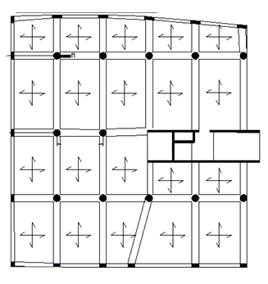
Slab
BLOCK
1
The structural system used is two way solid slab
Notes:
Determine the slab structural system and slab thickness

Slide 26
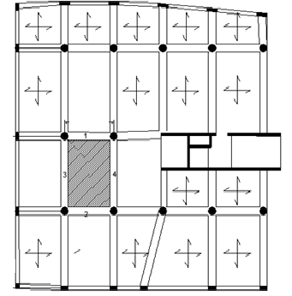
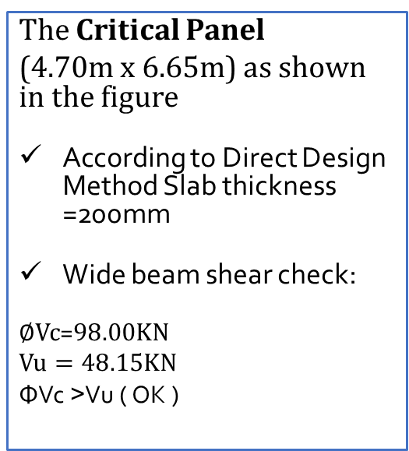
Slab thickness
BLOCK
1
The Critical Panel
(4.70m x 6.65m) as shown in the figure
According to Direct Design Method Slab thickness =200mm
Wide beam shear check:
$∅Vc$=$98.00KN$
$$Vu=48.15KN$$
ΦVc ˃Vu ( OK )
Notes:
Slab thickn$Own weight=0.2∗25=5 KN/m2$
$$Superimposed dead load =3.2 KN/m2$$
$$Live load =4.00 KN/m2$$
$$Ultimate load(Wu) =1.2\left(5+3.2\right)+1.6\left(4.00\right)=16.24 KN/m2$$
$∅Vc=∅\frac{1}{6}\sqrt{fc }bw∗d$ =$\left(0.75\right)\frac{1}{6}\sqrt{24 }\frac{1000}{1000}∗\left(200−40\right)=98.00KN$
$$Vu=Wu\left(\frac{l}{2}−\frac{B}{2}−d\right)=16.24\left(\frac{6.65}{2}−\frac{0.4}{2}−0.16\right)=48.15KN$$
Since ΦVc ˃Vu, Slab thickness is adequate for resisting shear (OK). So use h= 200 mm and there is no need for shear reinforcement.

Slide 27
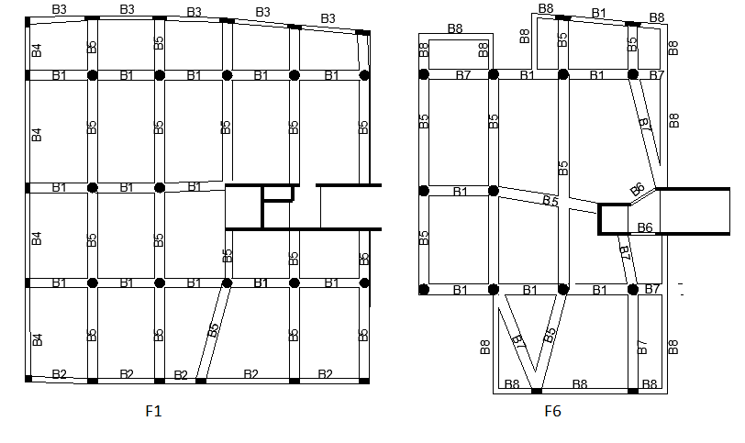
Beams
BLOCK
1
The distribution of beams for F1 and F6 shown below:

Slide 28
The preliminary sections of beams
According to ACI 318-11, Table 9.5(a), the thickness of beams can be obtained based on the deflection limit:
Member | Simply supported | One end continuous | Two end continuous | Cantilever
Beams | L/16 | L/18.5 | L/21 | L/8

Slide 29
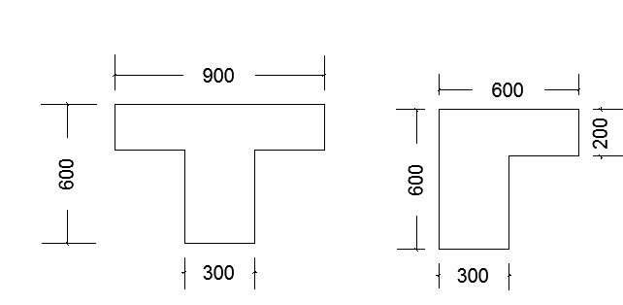
Beams
BLOCK
1
The preliminary sections of beams:
Beam | Dimensions (mm)
B1 | 400*400
B2 | 400*400
B3 | 300*400
B4 | 300*600
B5 | 600*600
B6 | 200*400
B7 | T
B8 | L

Slide 30
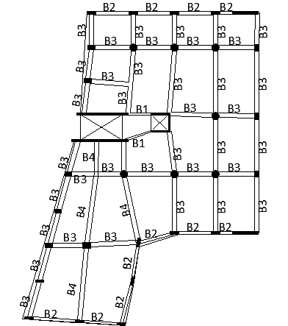
BLOCK
2
Beams
The distribution of beams for F1 shown below:

Slide 31
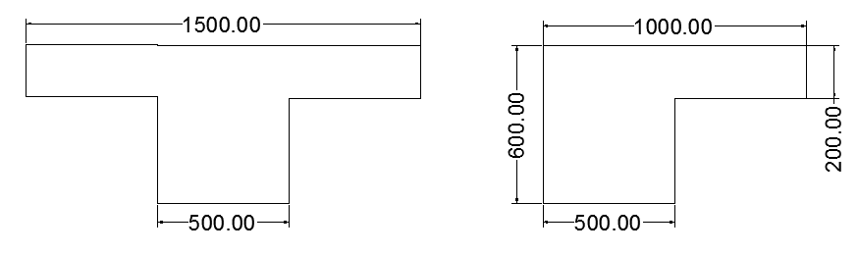
Beams
BLOCK
2
The preliminary sections of beams:
Beam | Dimensions (mm)
B1 | 200*600
B2 | 300*600
B3 | 500*600
B4 | 800*500
B5 | T
B6 | L

Slide 32
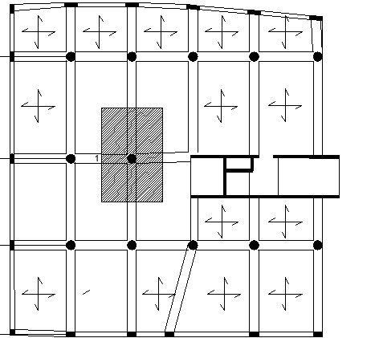
    Columns
BLOCK
1
By using tributary area method, we found the ultimate load and determine the dimensions of columns
Notes:
$$8351∗E3=0.75∗0.85(0.85∗28\left(Ag−0.01Ag\right)+420∗0.01Ag)$$

Slide 33
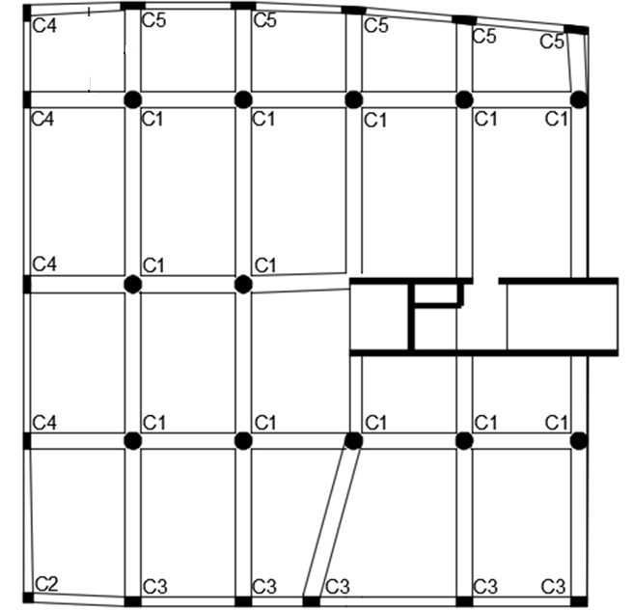
    Columns layout
BLOCK
1

Slide 34
BLOCK
1
Columns dimensions are shown in table:
 | original dimensions (mm) | preliminary design dimensions (mm)
C1 | D700 | D800
C2 | 400*400 | 400*400
C3 | 400*700 | 400*700
C4 | 700*300 | 700*300
C5 | 300*1000 | 300*1000

Slide 35
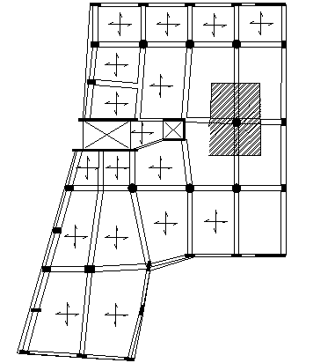
    Columns
BLOCK
2
By using tributary area method, we found the ultimate load and determine the dimensions of columns

Slide 36
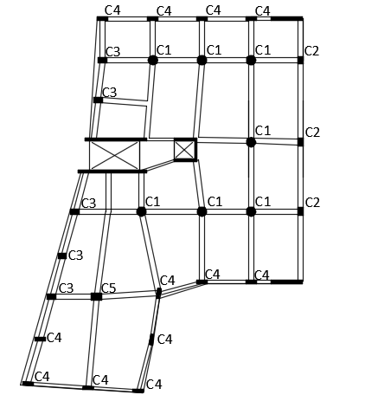
    Columns layout
BLOCK
2

Slide 37
BLOCK
2
Columns dimensions are shown in table:
 | Original dimensions (mm) | Preliminary design dimensions (mm)
C1 | D 700 | D 850
C2 | 300*700 | 500*700
C3 | 300*800 | 400*800
C4 | 300*1000 | 300*1000
C5 | 300*1000 | 650*1000

Slide 38
    Shear Wall
Wall | Thickness (mm)
Wall 1 | 250
Wall 2 | 300

Slide 39
    Bracing
Objective
  Bracing in the model expresses the effect of masonry walls, they may increase stiffness In the building and reduce the period.
Section
  Bracing dimensions were calculated as following:
  Depth=200mm.
  Width=diagonal length/5
Material:
  Using a modulus of Elasticity = 0.1 of concrete modulus of Elasticity to represent the average value of concrete, masonry and blocks.

Slide 40
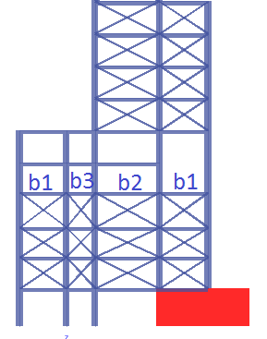
Bracing
Bracing dimensions in BLOCK 1
Bracing number | L (m) | Dimensions (mm)
b1 | 6.00 | 1200*200
b2 | 7.40 | 1500*200
b3 | 4.50 | 900*200
Bracing dimensions in BLOCK 2
Bracing number | L (m) | Dimensions (mm)
b1 | 5.6 | 1200*200
b2 | 7.40 | 1500*200
b3 | 8.50 | 1700*200

Slide 41

Structural Modeling

Slide 42
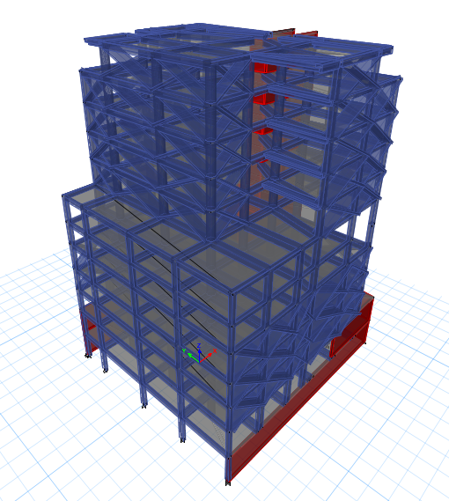
3D model for block 1

Slide 43
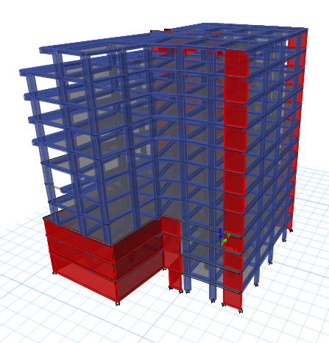
3D model for block 2

Slide 44
Modifiers for area structural element
Modifiers/Section | Slab | Shear walls
Membrane f11 Direction | 1 | 1
Membrane f22 Direction | 1 | 1
Membrane f12 Direction | 1 | 1
Bending m11 Direction | 0.25 | 0.35
Bending m22 Direction | 0.25 | 0.35
Bending m12 Direction | 0.25 | 0.35
Shear v13 Direction | 1 | 1
Shear v23 Direction | 1 | 1
Mass | 1 | 1
Weight | 1 | 1

Slide 45
Modifiers for frame structural element
Modifiers/Section | beams | Columns | Bracing
Cross Section(axial) Area | 1 | 1 | 1
Sheer Area in 2 direction | 1 | 1 | 0
Sheer Area in 3 direction | 1 | 1 | 0
Torsional Constant | 0.35 | 0.7 | 0
Moment of Inertia about 2 axis | 0.35 | 0.7 | 0
Moment of Inertia about 3 axis | 0.35 | 0.7 | 0
Mass | (Depth-200)/200 | 1 | 0
Weight | (Depth-200)/200 | 1 | 0

Slide 46
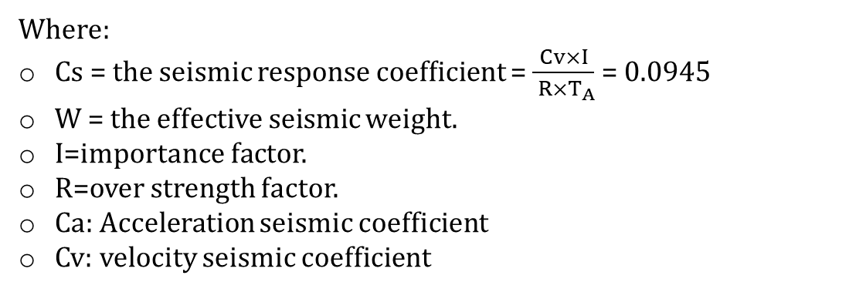
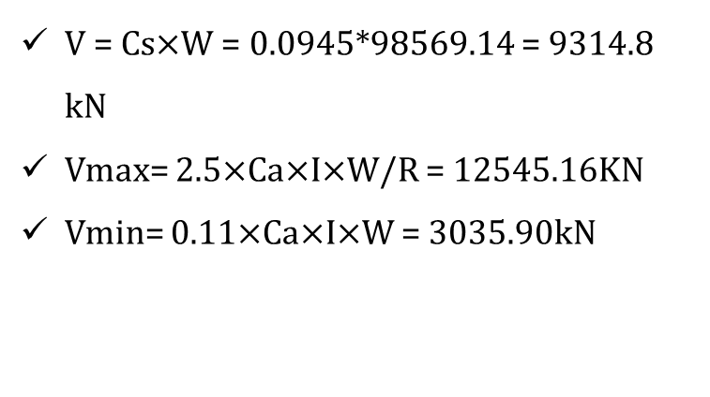
seismic Loads
BLOCK
1
Equivalent static:
W (kN) | Cv | Ca | I | R | Ta
98569.14 | 0.4 | 0.28 | 1 | 5.5 | 0.77
V = Cs$×$W = 0.0945*98569.14 = 9314.8 kN
  Vmax= 2.5$×$Ca$×$I$×$W/R = 12545.16KN
  Vmin= 0.11$×$Ca$×$I$×$W = 3035.90kN
Where:
Cs = the seismic response coefﬁcient = $\frac{Cv×I}{ R×T_{A}}$ = 0.0945
W = the effective seismic weight.
I=importance factor.
R=over strength factor.
Ca: Acceleration seismic coefficient
Cv: velocity seismic coefficient

Slide 47
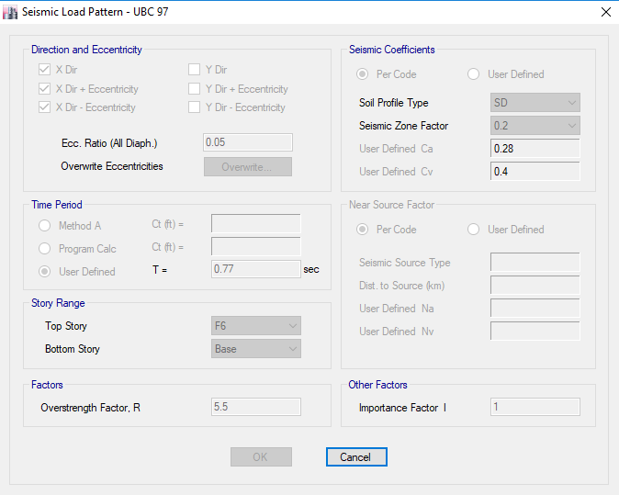
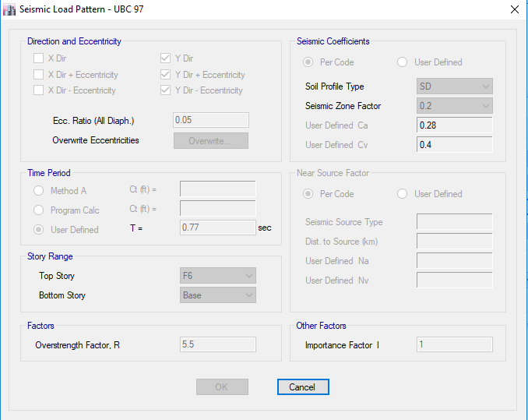
Loads assignments:
BLOCK
1
Earthquake Assignment in X-Direction with Positive Eccentricity

Slide 48
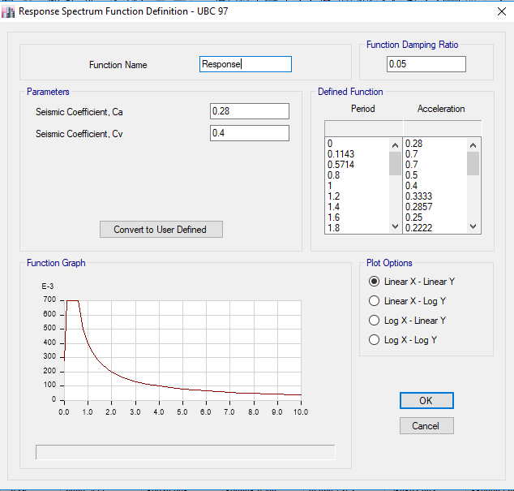
BLOCK
1
  Functions:
  Response Spectrum Function Definition:

Slide 49
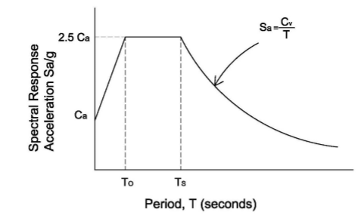
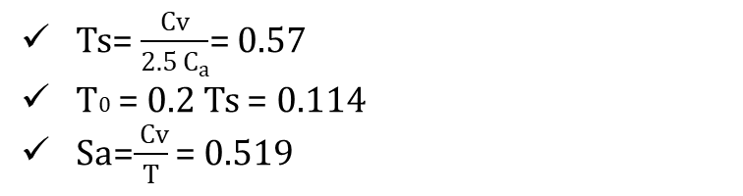
BLOCK
1
Response spectrum curve:
Ts=$\frac{Cv}{2.5 C_{a}}$= 0.57
T0 = 0.2 Ts = 0.114
Sa=$\frac{ Cv}{T}$ = 0.519

Slide 50
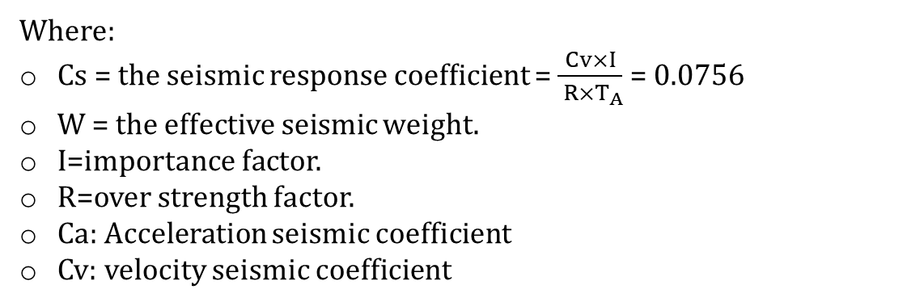
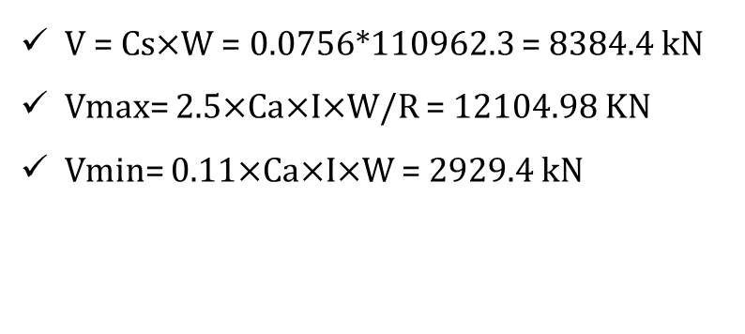
seismic Loads
BLOCK
2
Equivalent static:
W (kN) | Cv | Ca | I | R | Ta
110962.3 | 0.32 | 0.24 | 1 | 5.5 | 0.77
V = Cs$×$W = 0.0756*110962.3 = 8384.4 kN
  Vmax= 2.5$×$Ca$×$I$×$W/R = 12104.98 KN
  Vmin= 0.11$×$Ca$×$I$×$W = 2929.4 kN
Where:
Cs = the seismic response coefﬁcient = $\frac{Cv×I}{ R×T_{A}}$ = 0.0756
W = the effective seismic weight.
I=importance factor.
R=over strength factor.
Ca: Acceleration seismic coefficient
Cv: velocity seismic coefficient

Slide 51
Checks
Model
Deflection
Structural period T
Drift
Structural Irregularity
Equilibrium
Stress strain
Participating mass ratio
Base Shear

Slide 52
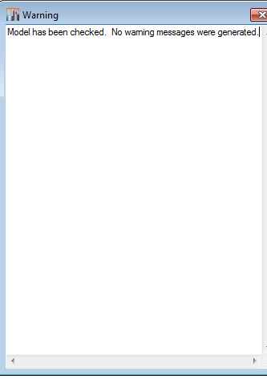
Model check
BLOCK
1

Slide 53
  Equilibrium check
BLOCK
1
Type | ETABS results (KN) | Hand calculation (KN) | Error%
Live | 26876.06 | 26898.40 | 0.08
Superimposed | 20396.27 | 20414.05 | 0.09
External wall | 8729.02 | 8497.64 | 2.72
Dead | 74375.12 | 74259.53 | 0.16

Slide 54
  Equilibrium check
BLOCK
2
Type | ETABS results (KN) | Hand calculation (KN) | Error%
Live | 33712.22 | 34574.48 | 2.49
Superimposed | 24647.70 | 25244.80 | 2.37
External wall | 7163.91 | 7099.26 | 0.91
Dead | 70369.88 | 70573.05 | 0.29

Slide 55
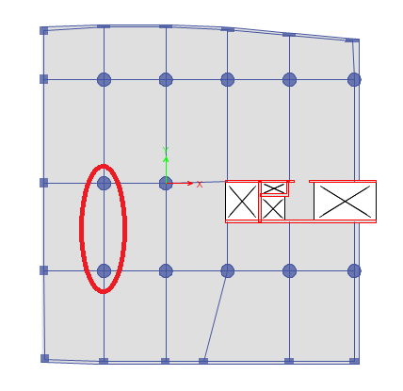
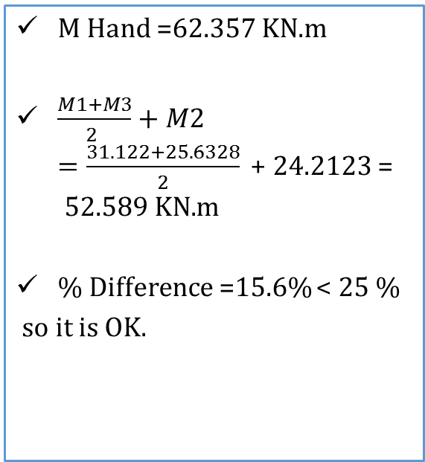
BLOCK
1
Stress strain check
We made the internal force check from live load for this beam as following in the figure:
M Hand =62.357 KN.m
$\frac{M1+M3}{2 }+M2=\frac{31.122+25.6328}{2}\text{ + }\text{24.2123 }\text{= }\text{52.589 }\text{KN}\text{.}\text{m}$
% Difference =15.6% < 25 %
so it is OK.

Slide 56
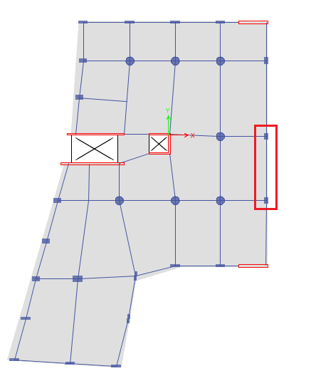
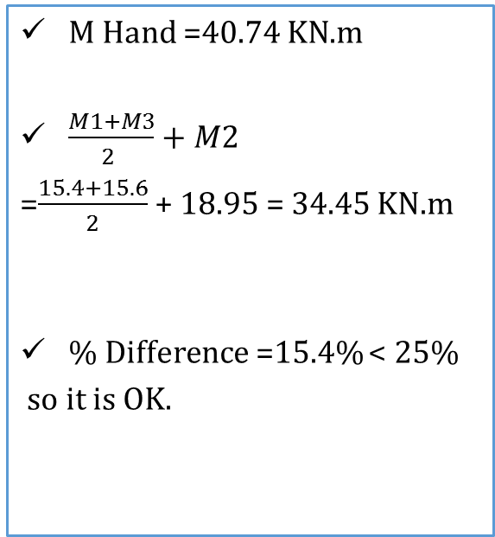
BLOCK
2
Stress strain check
We made the internal force check from live load for this beam as following in the figure:
M Hand =40.74 KN.m
$\frac{M1+M3}{2 }+M2$
=$\frac{15.4+15.6}{2}$ + 18.95 = 34.45 $\text{KN}\text{.}\text{m}$
% Difference =15.4% < 25%
so it is OK.

Slide 57
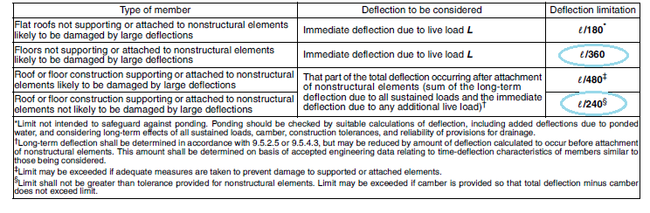

Deflection check
ACI code limitations on immediate and long term deflections
Long term deflection
$$ΔLT=ΔL + λ∞ ΔD + λ t ΔLS$$

Slide 58
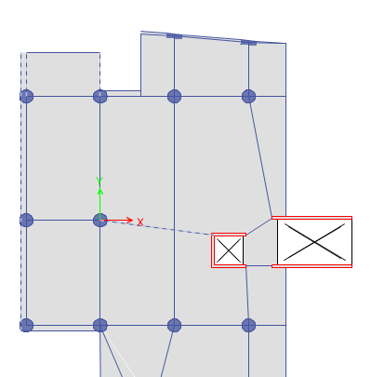
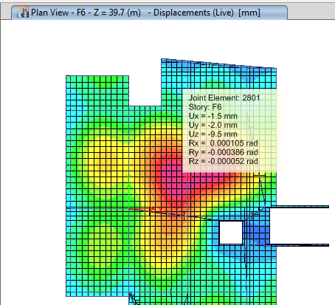
BLOCK
1
Deflection check
Immediate deflection due to live load:

Slide 59
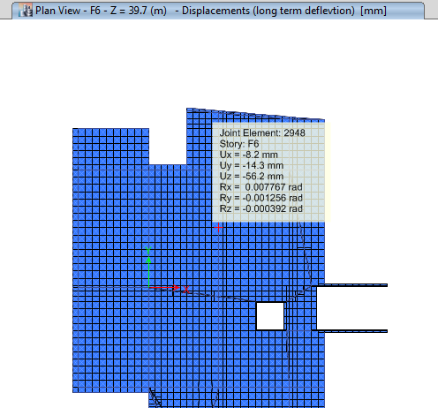
BLOCK
1
Deflection check
Long term deflection
Results:
L=8.00m | Relative deflection (mm) | Allowable deflection mm)
Live | 3.40 | 22.20 | OK
Long term | 31.40 | 33.33 | OK

Slide 60
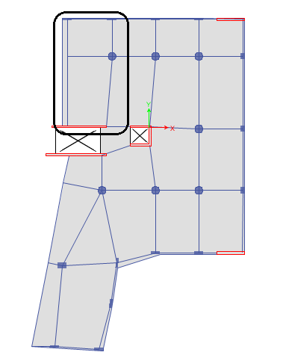
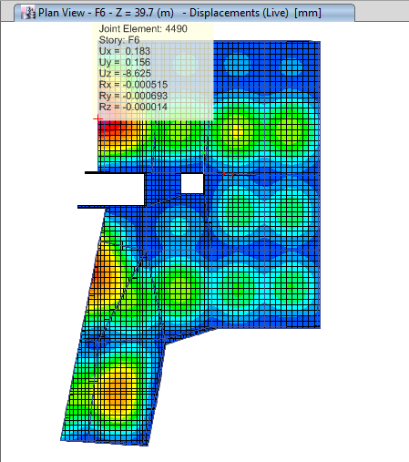
BLOCK
2
Deflection check
Immediate deflection due to live load:

Slide 61
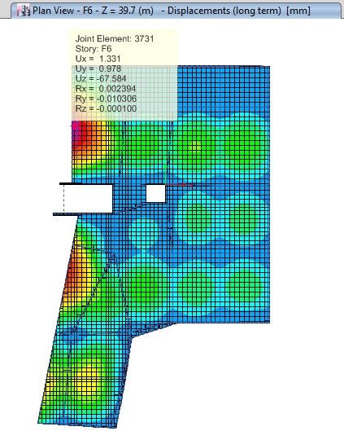
BLOCK
2
Deflection check
Immediate deflection due to live load:
Results:
L=4.85 m | Relative deflection (mm) | Allowable deflection (mm)
Live | 4.94 | 13.47 | OK
Long term | 19.26 | 20.21 | OK

Slide 62
Structural period T check
Modifiers for area structural element
Modifiers/Section | Slab | Shear walls
Membrane f11 Direction | 1 | 1
Membrane f22 Direction | 1 | 1
Membrane f12 Direction | 1 | 1
Bending m11 Direction | 1 | 1
Bending m22 Direction | 1 | 1
Bending m12 Direction | 1 | 1
Shear v13 Direction | 1 | 1
Shear v23 Direction | 1 | 1
Mass | 1 | 1
Weight | 1 | 1

Slide 63
Structural period T check
Modifiers for frame structural element
Modifiers/Section | beams | Columns | Bracing
Cross Section(axial) Area | 1 | 1 | 1
Sheer Area in 2 direction | 1 | 1 | 0
Sheer Area in 3 direction | 1 | 1 | 0
Torsional Constant | 1 | 1 | 0
Moment of Inertia about 2 axis | 1 | 1 | 0
Moment of Inertia about 3 axis | 1 | 1 | 0
Mass | (Depth-200)/200 | 1 | 0
Weight | (Depth-200)/200 | 1 | 0

Slide 64
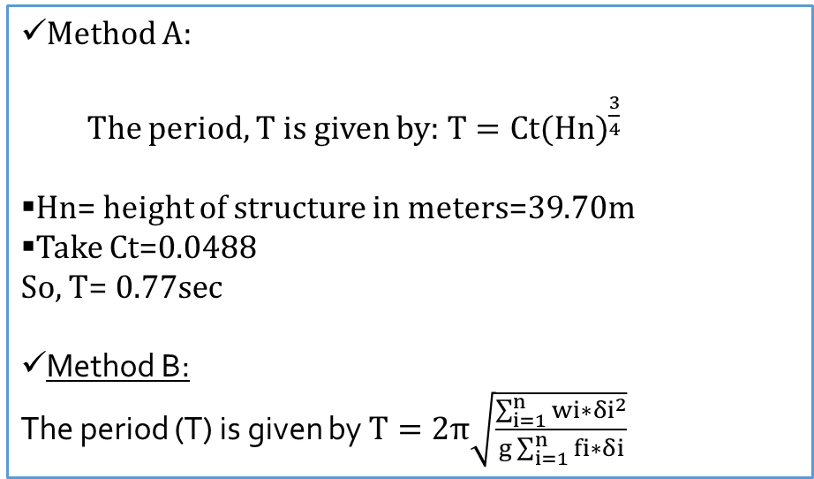
Structural period T check
The structure period shall be determined from one of the following methods
(UBC_97 section 1630.2.2):
Method A:
The period, T is given by: $T=Ct{(Hn)}^{\frac{3}{4}}$
Hn= height of structure in meters=39.70m
Take Ct=0.0488
So, T=$0.77sec$
Method B:
The period (T) is given by $T=2π\sqrt{\frac{\sum_{i=1}^{n}{wi∗{δi}^{2}}}{g\sum_{i=1}^{n}{fi∗δi}}}$

Slide 65
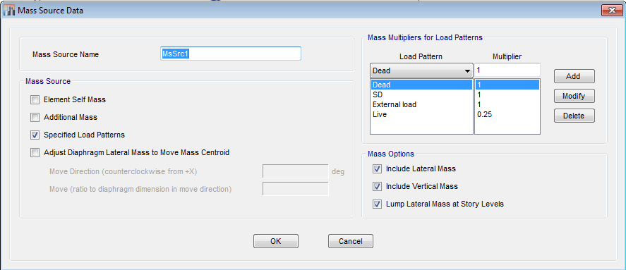
Structural period Method B
We defined a Mass source as shown below to convert all additional mass into load
wi=0.25 WLi + W Deadi + WSDi + W Eternal walli
+ 0.5 (W columns + W shear wall) above and below the floor

Slide 66
Structural period
No Torsion
Before starting, it’s important to insure that there is no torsion in mode 1 in the structure, so
one of the mass displacements in X direction or in Y direction must be larger than 50% of the total mass displacement
the rotation about Z direction must be smaller than (20-30)%.

Slide 67
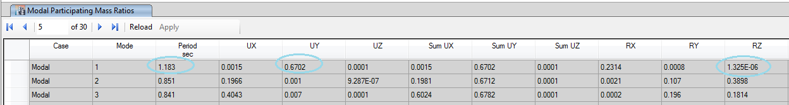
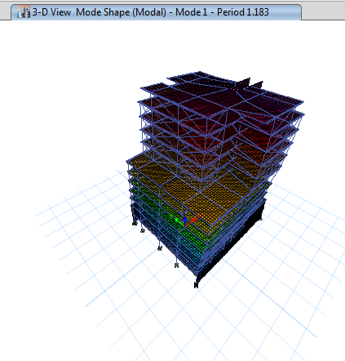
BLOCK
1
Structural period
From the figure we can see most of mass displacement in Y direction with 67% and Rz is <<30%. So there is no torsion in this block
ETABS results:
the period from ETABS T=1.183 sec

Slide 68
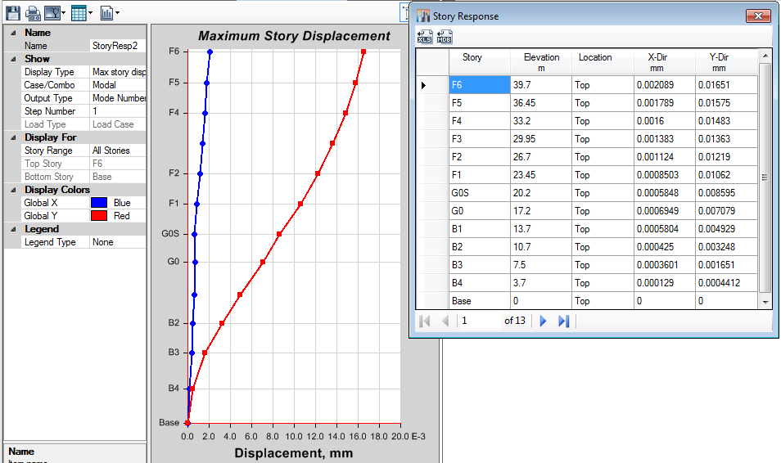


Structural period Method B
$$T=2π\sqrt{\frac{\sum_{i=1}^{n}{wi∗{δi}^{2}}}{g\sum_{i=1}^{n}{fi∗δi}}}$$

Slide 69
Structural period Method B
 | fi (KN) | 𝛅i (mm) | fi* 𝛅i | Wi (KN) | Wi* 𝛅i2
F6 | 391.36 | 19.70 | 7709.79 | 6328.57 | 2456053.04
F5 | 432.48 | 18.90 | 8173.89 | 8024.23 | 2866334.82
F4 | 407.22 | 17.80 | 7248.49 | 8118.27 | 2572193.23
F3 | 374.27 | 16.40 | 6137.99 | 8118.27 | 2183490.37
F2 | 334.35 | 14.70 | 4920.48 | 8118.27 | 1754277.35
F1 | 395.46 | 13.10 | 5180.55 | 10086.85 | 1731004.83
G0S | 320.06 | 11.20 | 3584.62 | 7959.61 | 998452.98
G0 | 263.60 | 9.20 | 2425.15 | 8955.48 | 757992.24
B1 | 183.54 | 6.40 | 1174.68 | 8649.27 | 354273.99
B2 | 120.95 | 4.20 | 507.98 | 10182.15 | 179613.10
B3 | 73.01 | 2.20 | 160.62 | 12069.28 | 58415.34
B4 | 19.52 | 0.60 | 11.71 | 10050.01 | 3618.01
Total |  |  | 47235.96 |  | 15915719.29

Slide 70
BLOCK
1
Structural period Method B
Final results :
 | T ETABS=1.183 Sec
Method | Method A | Method B
T (Sec) | 0.770 | 1.164
Error% | 34.91 | 1.61
 | less than 40 % | less than 10 %

Slide 71


BLOCK
2
Structural period Method B

Slide 72

BLOCK
2
Structural period Method B

Slide 73

BLOCK
2
Structural period Method B
ETABS results:
the period from ETABS T=0.708 sec
Final results :
 | T ETABS=0.708 Sec
Method | Method A | Method B
T (Sec) | 0.770 | 0.653
Error% | 8.757 | 7.768
 | less than 40 % | less than 10 %

Slide 74

BLOCK
1
Participating mass ratio check
“Modal Analysis”
Modal analysis was done and the modal mass participating ratio for a mode provides a relative measure of how important the mode is for computing the response to the Acceleration loads in each of the three global directions. Thus it is useful for determining the accuracy of response-spectrum analyses. Ritz method is used for the modal analysis.

Slide 75

BLOCK
1
Base Shear check
“Equivalent Static”
V = 9314.8 kN
OK

Slide 76
BLOCK
1
Base Shear check
“Response Spectrum”
TABLE: Base Reactions
Load Case/Combo | FX | FY | FZ | MX | MY | MZ
Unit | kN | kN | kN | kN-m | kN-m | kN-m
EQ x Max | 9811.4 | 2980.2 | 3079.4 | 51365.9 | 220549.0 | 74680.1
EQ y Max | 3226.3 | 9926.7 | 3796.3 | 239332.6 | 48945.5 | 73167.4
 | ETABS | manual
V Eq x | 9811 | 9812 | OK
V Eq y | 9927 | 9812 | OK
V Eq x in Y | 2980 | 2943.6 | OK
V Eq Y in x | 3226 | 2943.6 | OK

Slide 77
BLOCK
1
Drift check
The design story drift (Δ) shall not exceed the allowable story drift (Δall) as obtained from Table 12.12-1 in ASCE 7-10 for any story which is ≤0.02hx.
X - Direction
floor# | story height (m) | Horizontal deflection for each floor (ETABS) (mm) | Inter story drift (mm) | max Inelastic deflection (0.7×R×∆)(mm) | Allowable deflection (mm) | result
GF | 3.5 | 11.33 | 4.13 | 15.9 | 70 | OK
B1 | 3 | 7.2 | 3.034 | 11.7 | 60 | OK
B2 | 3.2 | 4.166 | 2.636 | 10.1 | 64 | OK
B3 | 3.8 | 1.53 | 1.23 | 4.7 | 76 | OK
B4 | 3.25 | 0.3 | 0.3 | 1.2 | 74 | OK
… | … | … | … | … | … | …
All values of drift are less than 0.02hx, so it is OK.

Slide 78
Structural Irregularity check
BLOCK
1

Slide 79


Slide 80
Members
Slabs
Shear walls
Beams
Columns
Staircase
Footing

Slide 81
Design of Slab

Slide 82


Design of Slab
BLOCK
1
Check wide beam shear:
$ΦVc$ =$Φ$ × $\frac{1}{6}$ × λ×$\sqrt{f′c}$×bw × d= 98 kN
From ETABS, the result of V₁₃ and V₂₃ within the range of(-98)and(98).
$ΦVc$ < Vu

Slide 83


Design the slab for flexure:
Asmin = ρ b h= 0.0018 X 1000 X 200 = 360 mm2 (use 1 $Φ$ 12/250mm)
ΦMn=26.6 kN.m /m

Slide 84


      Design the slab for Tension and compression:
T= Φ× As ×fy
For floor F1, the value of Tension and compression was 450kN in both directions.
So, the area of steel required to resist this force equal:
As = $\frac{450X 1000}{0.9X 420}=1190 mm2$
Use (6 Φ 16/m)

Slide 85
BLOCK 1
 | Steel requirement/m
 | Due to moment |  |  |  | Due to tension & compression
 | X-direction |  | Y-direction |  | X-direction |  | Y-direction
Floor | Top | Bottom | Top | Bottom | Top(C) | Bottom(T) | Top(C) | Bottom(T)
F6 | 4 Φ 12 | 4 Φ 12 | 4 Φ 12 | 4 Φ 12 | No need | No need | No need | No need
F2-F5 | 4 Φ 12 | 4 Φ 12 | 4 Φ 12 | 4 Φ 12 | No need | No need | No need | No need
F1 | 4 Φ 12 | 4 Φ 12 | 4 Φ 12 | 4 Φ 12 | 6 Φ 16 | 4 Φ 16 | 6 Φ 16 | 7 Φ 16
Shed | 4 Φ 12 | 4 Φ 12 | 4 Φ 12 | 4 Φ 12 | No need | No need | No need | No need
GF | 4 Φ 12 | 4 Φ 12 | 4 Φ 12 | 4 Φ 12 | 6 Φ 16 | 6 Φ 16 | 4 Φ 16 | 4 Φ 16
B1 | 4 Φ 12 | 4 Φ 12 | 4 Φ 12 | 4 Φ 12 | No need | No need | No need | No need
B2 | 4 Φ 12 | 4 Φ 12 | 4 Φ 12 | 4 Φ 12 | No need | No need | No need | No need
B3 | 4 Φ 12 | 4 Φ 12 | 4 Φ 12 | 4 Φ 12 | 4 Φ 16 | 4 Φ 16 | 6 Φ 16 | 6 Φ 16
B4 | 4 Φ 12 | 4 Φ 12 | 4 Φ 12 | 4 Φ 12 | 5 Φ 16 | 6 Φ 16 | 5 Φ 16 | 5 Φ 16

Slide 86
BLOCK 2
 | Steel requirement/m
 | Due to moment |  |  |  | Due to tension & compression
 | X-direction |  | Y-direction |  | X-direction |  | Y-direction
Floor | Top | Bottom | Top | Bottom | Top(C) | Bottom(T) | Top(C) | Bottom(T)
F6 | 4 Φ 12 | 4 Φ 12 | 4 Φ 12 | 4 Φ 12 | No need | No need | No need | No need
F2-F5 | 4 Φ 12 | 4 Φ 12 | 4 Φ 12 | 4 Φ 12 | No need | No need | No need | No need
F1 | 4 Φ 12 | 4 Φ 12 | 4 Φ 12 | 4 Φ 12 | No need | No need | No need | No need
Shed | 4 Φ 12 | 4 Φ 12 | 4 Φ 12 | 4 Φ 12 | No need | No need | No need | No need
GF | 4 Φ 12 | 4 Φ 12 | 4 Φ 12 | 4 Φ 12 | No need | No need | No need | No need
B1 | 4 Φ 12 | 4 Φ 12 | 4 Φ 12 | 4 Φ 12 | No need | No need | 6 Φ 14 | 6 Φ 14
B2 | 4 Φ 12 | 4 Φ 12 | 4 Φ 12 | 4 Φ 12 | No need | No need | No need | No need
B3 | 4 Φ 12 | 4 Φ 12 | 4 Φ 12 | 4 Φ 12 | No need | No need | No need | No need
B4 | 4 Φ 12 | 4 Φ 12 | 4 Φ 12 | 4 Φ 12 | No need | No need | No need | No need

Slide 87


      Notes For Reinforcement of slabs:
According to ACI315-04code, the spacing between bars:
$S=min\left\{\begin{aligned}3h \\ 380 ( \frac{280}{fs}) – 2.5 Cc \\ 300 (\frac{280}{fs} )\end{aligned}\right\}=min\left\{\begin{aligned}600 \\ 280 \\ 300\end{aligned}\right\}$
where:
  cc=clear cover to bars=40 mm.
  $fs$ =stress in steel at service load
=$\frac{2}{ 3}$×fy =280 MPa
So using S =250 mm is OK.

Slide 88

Beams distribution and Slab Reinforcement of Floor 1 :
BLOCK
1

Slide 89
Design of Beams

Slide 90



      Reinforcement of Beams:
BLOCK
1

Slide 91


      Notes For Reinforcement of Beams:
S1= $min\left\{\begin{aligned}h/4 \\ 8db \\ 24ds \\ 300 mm\end{aligned}\right\}$
s2 = min $\left\{\begin{aligned}h/2 \\ 12db \\ 300 \end{aligned}\right\}$
Notes:
Bottom steel at face of joint ≥ 1/3 top steel at face of joint
Bottom or top steel at any section ≥ 1/5 top steel at face of joint

Slide 92
Design of columns

Slide 93

      Column axis Layout:

Slide 94


      Reinforcement of Columns:

Slide 95


      Notes For Reinforcement of Beams:
S0=$min\left\{\begin{aligned}least column dimension/2 \\ 8db \\ 24ds \\ 300 mm\end{aligned}\right\}$
S1=$min\left\{\begin{aligned}least column dimension \\ 16db \\ 48ds\end{aligned}\right\}$
l₀=$max\left\{\begin{aligned}clear height of column/6 \\ maximum column dimension \\ 450 mm\end{aligned}\right\}$

Slide 96
Design of Shear Walls

Slide 97

      Distribution and Reinforcement of Shear Wall:
 | Vertical reinforcement/m | As/2 | Reinforcement | Horizontal reinforcement/m | Reinforcement
SW1, SW2, SW4 | 750 | 375 | 1φ12/200mm | 750 | 1φ12/200mm
SW3 | 750 | 375 | 1φ12/200mm | 1070 | 1φ14/200mm
SW5 | 2025 | 1013 | 1φ18/200mm | 1300 | 1φ16/200mm

Slide 98

 | Vertical reinforcement/m | As/2 | Reinforcement/m | Horizontal reinforcement/m | Reinforcement
SW6 | 3144 | 1572 | 1φ20/200mm | 625 | 1φ10/200mm
SW7 | 1731 | 866 | 1φ16/200mm | 625 | 1φ10/200mm
SW8 | 1179 | 590 | 1φ12/200mm | 625 | 1φ10/200mm
SW9 | 750 | 375 | 1φ10/200mm | 625 | 1φ10/200mm

Slide 99
Design of Foundation

Slide 100

Type of Foundation
BLOCK
1
The area of footing = $\frac{\text{total} \text{envelope} \text{service} \text{load}}{\text{soil} \text{capacity} }$
= $\frac{\text{117496.93}}{\text{250}}$ = 470 m²
The ratio of area of footing to area of basement = $\frac{\text{470}}{\text{739.14}}$*100% = 63.6 %
The ratio is larger than 50%.
So, the type of footing will be Mat foundation.

Slide 101

BLOCK
1
      Plan of Mat Foundation:

Slide 102



      Material, Mat Section and Soil property Definition:

Slide 103
Checks
Bearing capacity
Shear capacity
Deflection

Slide 104

      Bearing capacity of soil
The maximum soil pressure is less than 250 kN/m²
So it is OK

Slide 105

      Deflection check
From SAFE the largest displacement (U3) = 8.2 mm which is less than 10 mm.
So it is OK

Slide 106


      Shear capacity check
      (punching)
When the ratio of punching shear$\frac{Vu}{ΦVcp}$ < 1, it means that there is no punching shear occurs.
We noticed that all values are less than 1.
So the thickness of mat is OK.

Slide 107

Design of mat foundation
Asmin = ρ b h = 1800 mm² Use 4 Ø25/m
Asmin = ρ b h
= 0.0018 × 1000 × 1000 = 1800 mm² (use 12 $Φ$ 14mm )
So, As = 12×153.86= 1846.3 mm²
ΦMn= 0.9×As×fy× (d-d’)
= 0.9×1846×420× (920-(32.58/2)) ×10⁻⁶ = 630.6 kN.m /m
By making range between (-630.6 to 630.6) kN.m/m in M11 and M22 as shown in the following Figures:

Slide 108


M11 and M22 of the mat foundation from ETABS
For regions those need a min steel, Use
4 Ø25/m as a top and bottom steel in both Direction.
For all other areas that do not meet minimum area of steel (dark purple and dark blue) have a reinforcement of column strip as follows:

Slide 109

Distribution of column strip

Slide 110
Frames in X directions:
Frames in X-direction
Frame | Top steel (mm2) | Bottom steel (mm2)
Frame A | 4 Ø25/m | 4 Ø32/m
Frame B | 4 Ø25/m | 7 Ø32/m
Frame C | 7 Ø25/m | 7 Ø32/m
Frame D | 9 Ø25/m | 7 Ø32/m
Frame E | 5 Ø25/m | 6 Ø32/m
Frame F | 5 Ø25/m | 5 Ø32/m

Slide 111
Frames in Y directions:
Frames in Y-direction
Frame | Top steel (mm2) | Bottom steel (mm2)
Frame 1 | 5 Ø25/m | 4 Ø25/m
Frame 2 | 6 Ø25/m | 7 Ø32/m
Frame 3 | 7 Ø25/m | 8 Ø32/m
Frame 4 | 7 Ø25/m | 7 Ø32/m
Frame 5 | 10 Ø25/m | 8 Ø32/m
Frame 6 | 7 Ø25/m | 7 Ø32/m
Frame 7 | 7 Ø25/m | 6 Ø32/m
Frame 8 | 8 Ø25/m | 6 Ø32/m
Frame 9 | 7 Ø25/m | 7 Ø32/m
Frame 10 | 8 Ø25/m | 6 Ø32/m

Slide 112
Design of Stairs

Slide 113


Design of Stairs
The thickness of stair slab is assumed based on ACI 318-11 ,which equal 150 mm (landing and flight)
Loads:
  The own weight of stairs = 3.75 kN/m2
  Live load (LL) = 5 kN/m2
  Superimposed dead live ($W_{SD}$) =~ 4.2 kN/m2

Slide 114

Deflection Checks:
A𝑙𝑙𝑎𝑤𝑎𝑏𝑙𝑒 𝐿𝑜𝑛𝑔 𝑡𝑒𝑟𝑚 deflection, ∆𝐿 ≤ 11.25 mm
The long term deflection from SAP found approximately = 2.00 mm
which means that is smaller than the allowable deflection
So, Its OK

Slide 115



Check for shear:
$ɸ$ VC= 72.8 kN
Vu13 and Vu23= 56.20 & 67.00 kN respectively.
$Vu< ɸV_{c}$
So, The slab thickness is OK

Slide 116



Design for flexural:
For landing:
Mu max =8 kN.m
As= 0.00236 × 1000×110 =260 ${mm}^{2}$
${As}_{min}$ =0.0018×1000×150=270 ${mm}^{2}$ (Consider it as slab)
As >${As}_{min}$
$So,$Use As= 270 ${mm}^{2}$(4ɸ10/m in two direction)
For Flight:
$$As shrinkag=Asmin=270 mm2$$
$$in both face$$
$(Use 4 ∅10 /m for each layer$)
Mu22 max =8.6 kN.m
As=0.00191× 1000×110 =210 ${mm}^{2}$
${As}_{min}$ =0.0018×1000×150=270 ${mm}^{2}$
As <${As}_{min}$
$So,$Use As= 270 ${mm}^{2}$(4ɸ10/m in two direction)

Slide 117

Design for flexural:
For Beam:
Depth= 200 mm
Width= 200 mm
Effective depth= 160 mm
Mu = 1.5 kN.m
ρ>>> 0.0033
As min= 0.0033 ×1000×200 = 660 mm <<< 6ɸ12/m
$So,$Use As= 660 ${mm}^{2}$(6ɸ12/m)

Slide 118

Stair Reinforcement:

Slide 119

References
Nilson, Arther H., David Darwin, Charles W. Dolan.” Design of Concrete Structure. Fourteenth edition”. New York: McGraw-Hills Companies, Inc., 2010.
ASCE Committee, “American society of Civil Engineers, Minimum Design loads for Buildings and other Structures” American Society of Civil Engineers, Virginia 20191, 2010.
ACI Committee 318 “Building Code Requirements for Structural Concrete
(ACI 318M-11)” American Concrete Institute, Michigan, 2011.
Reinforced concrete ($І,ІІ.ІІІ$) notes.

