Slide 1

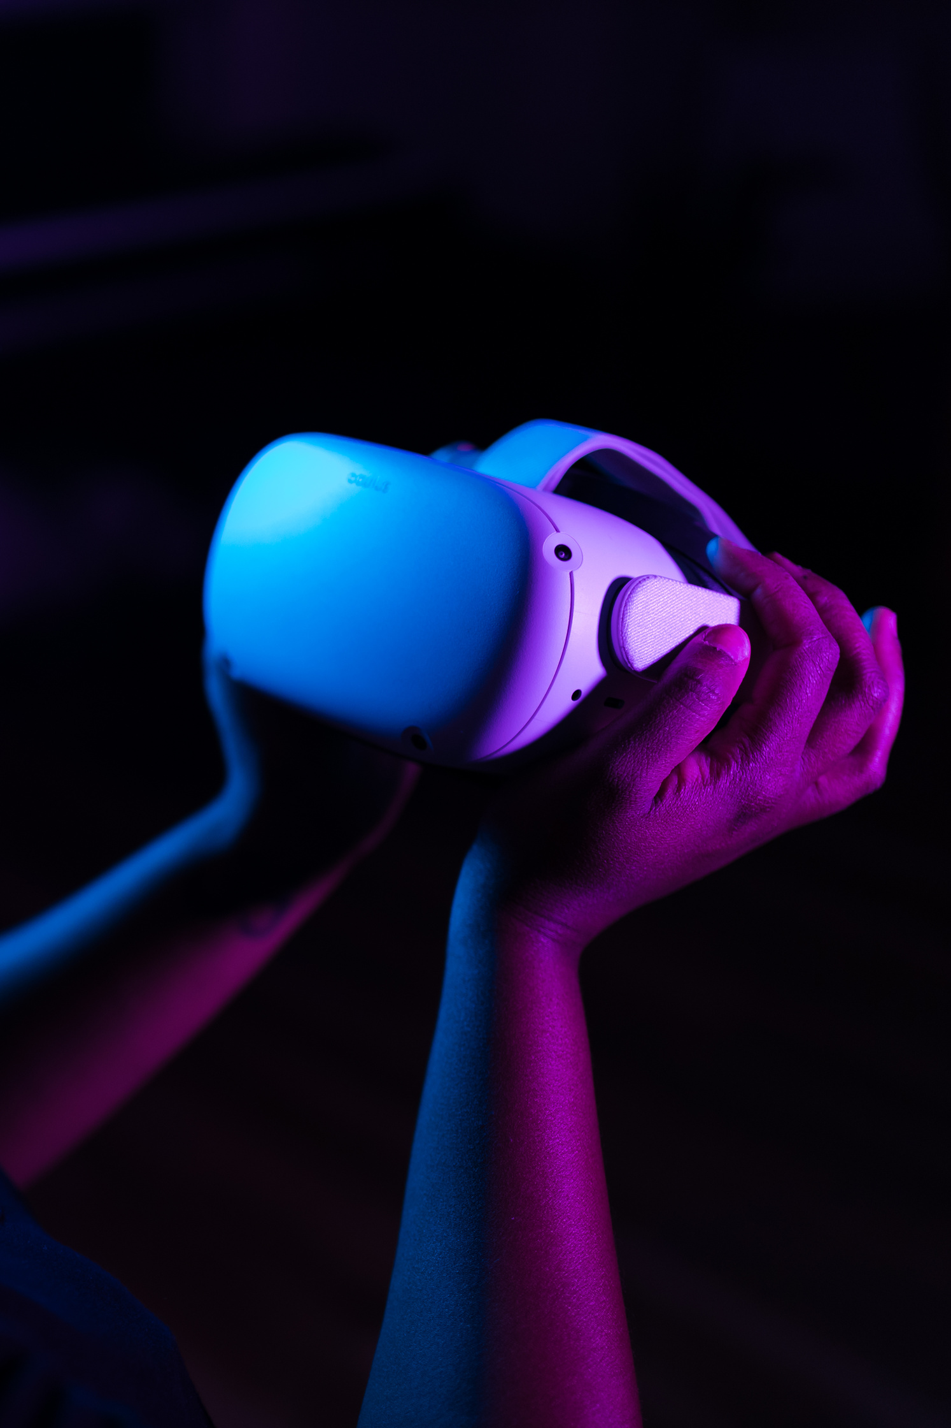
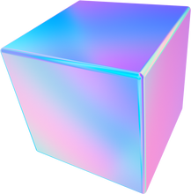



Heritage Memory
VIRTUAL
REALITY

Slide 2
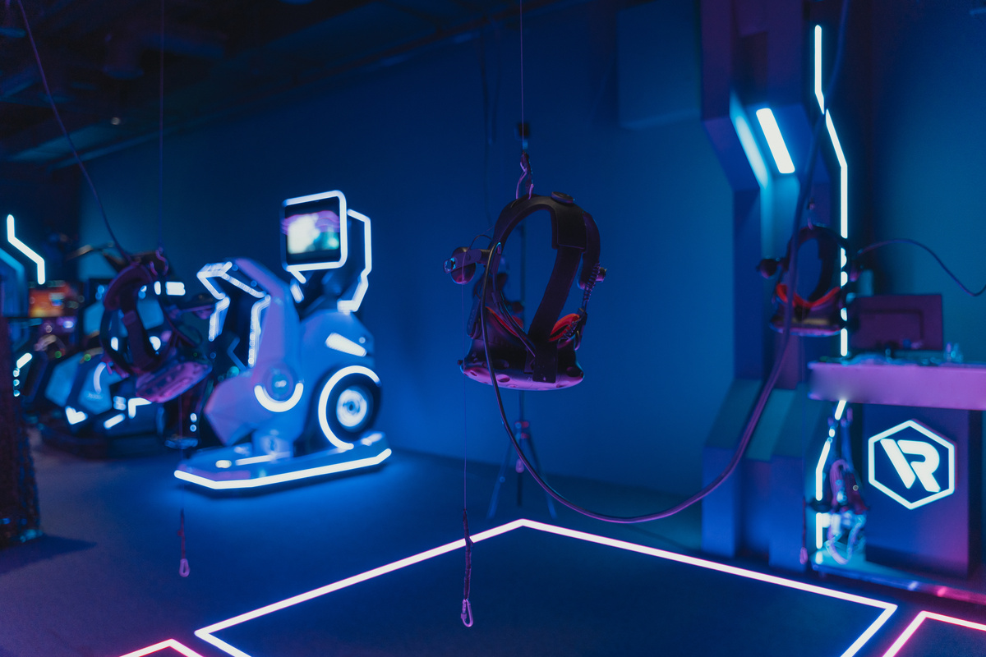
Table of
Content
Heritage Memory
Abstract
Problem Statement
Introduction
Methodology
Results
Conclusion

Slide 3
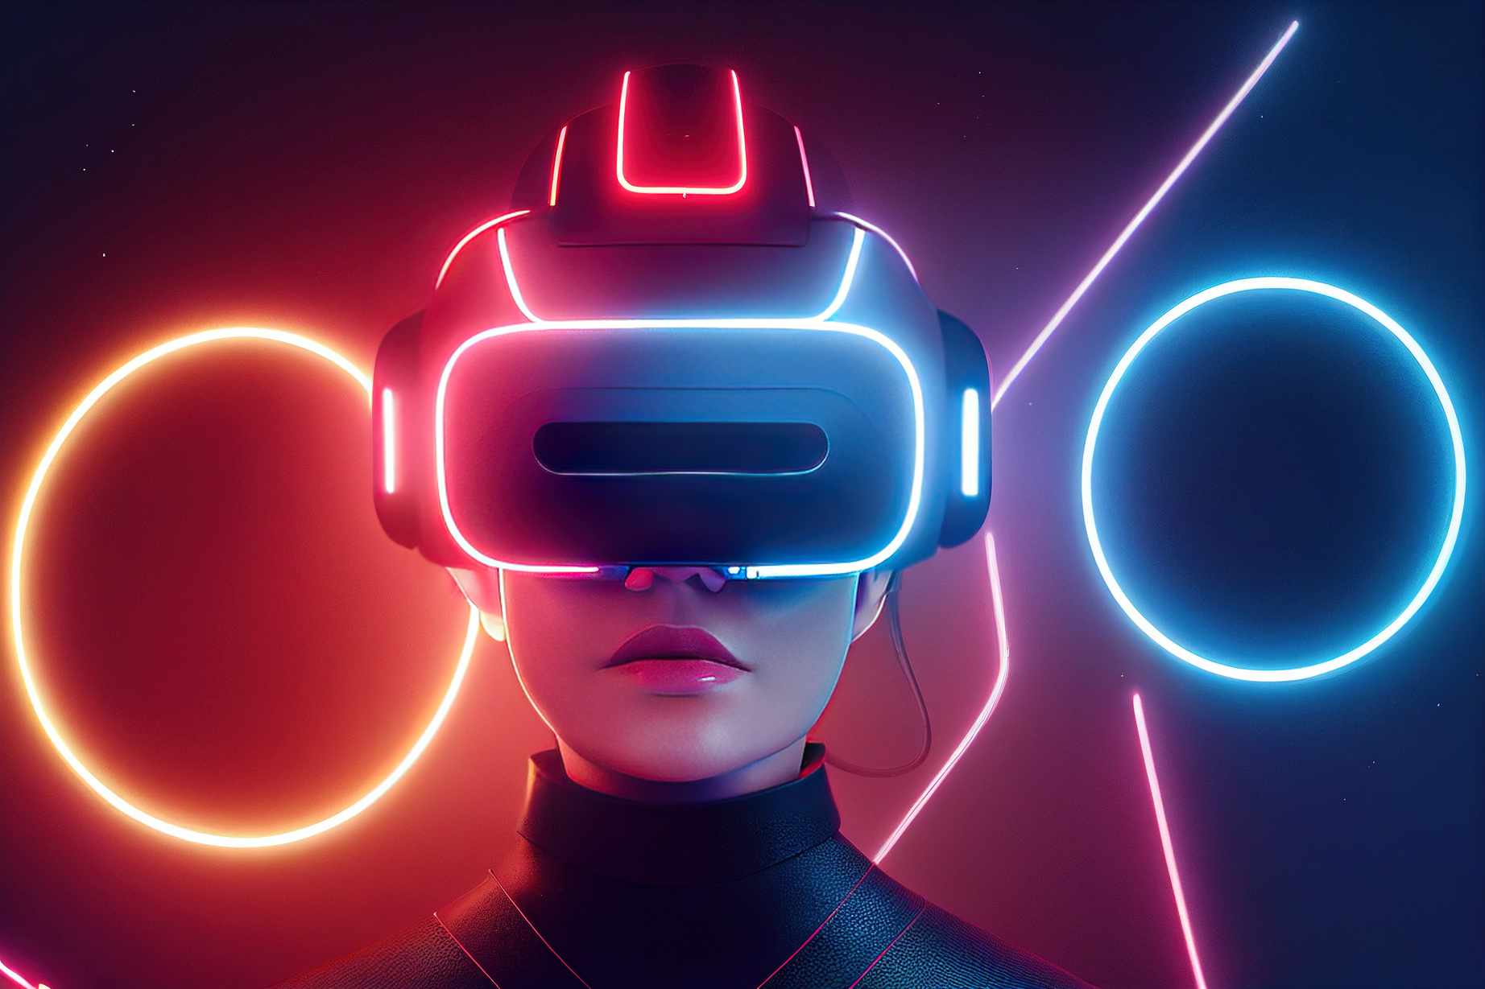
Abstract
Heritage Memory
The "Virtual Reality of the Palestine Museum" project aims to create a global digital platform for exploring Palestinian architectural heritage and interacting with Palestinian history. It provides global access to Palestinian heritage, raises cultural and educational awareness, and allows interaction with impactful pieces, traditional costumes, and Palestinian arts. The project aims to strengthen Palestinian identity and trace its historical evolution. The use of virtual reality in Palestinian museums can address challenges such as limited physical access, preservation of cultural heritage, education, and inclusivity. Collaborations with international cultural institutions, educational platforms, and digital archives can expand the initiative globally, promoting cross-cultural understanding and preserving history for future generations.

Slide 4
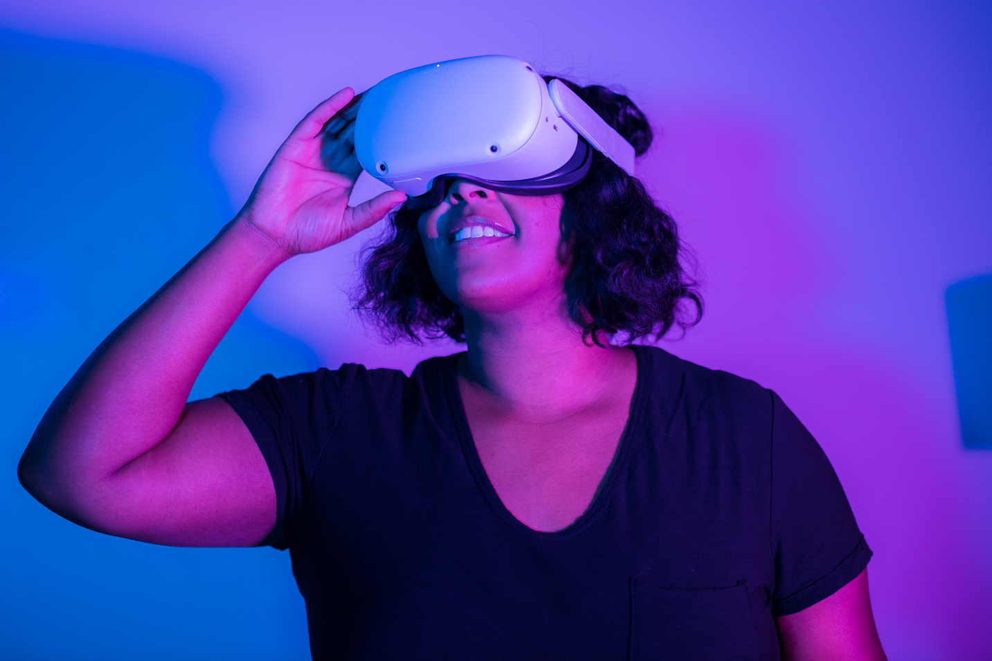
Heritage Memory
Problem
Statement
Preserving and displaying cultural heritage digitally is challenging due to the lack of a reference for artifacts and traditional platforms that often underrepresent history. Cultural history is at risk of inequitable preservation, inaccessibility, misinformation, and threats from climate change and natural disasters. Virtual reality (VR) offers a solution to this issue by preserving digital copies of artifacts. VR can protect cultural assets, promote inclusive travel, and offer authentic heritage experiences. It enables everyone, regardless of location, physical ability, or economic circumstances, to access places, artifacts, and benefit from information. Digital public infrastructure in cities can contribute to a more resilient and equitable future. The virtual museum provides immediate and flexible access to educational and cultural experiences, eliminating the need for long-term bookings.

Slide 5
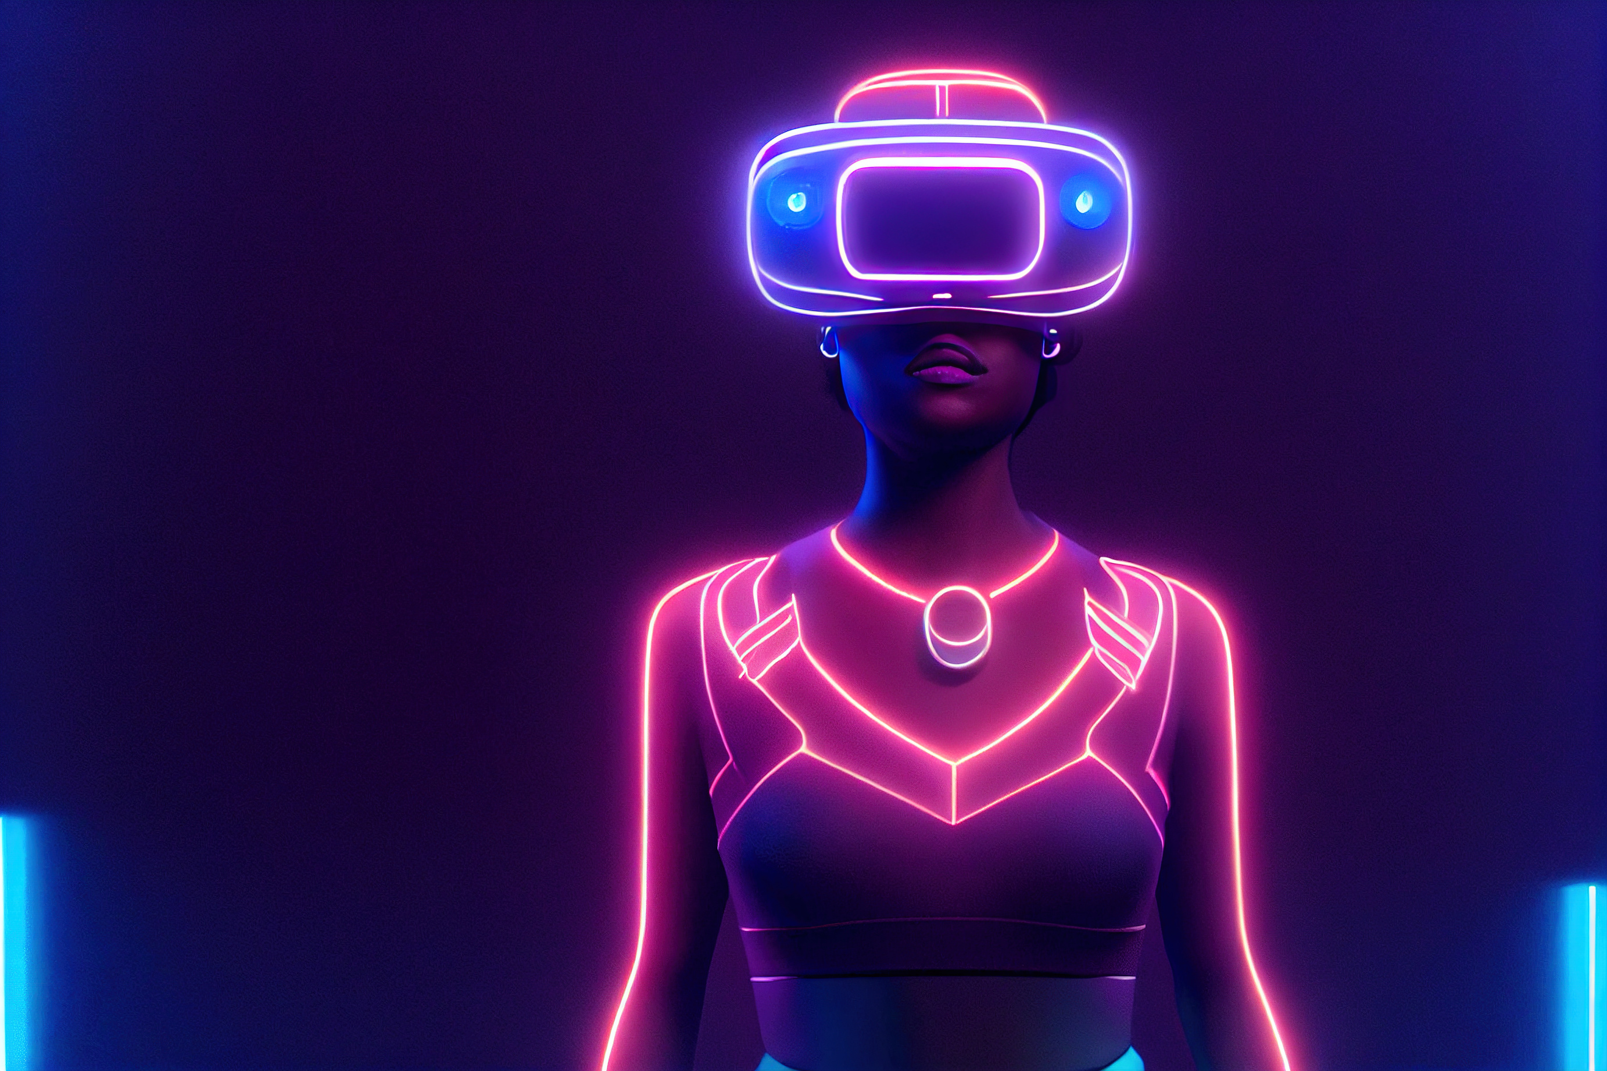
Heritage Memory
Strategic Foundations for Developing a Global Virtual Museum Experience
Scalable
Accessible
Sustainable
Applicable
The project aims to preserve and promote Palestinian cultural heritage through a scalable platform that utilizes flexible technologies like cloud services, APIs, and virtual reality design. This allows for a user-friendly experience and promotes global accessibility.
The platform is accessible to everyone, including those with limited resources or disabilities, offering free experiences, low-cost devices, real objects, online tours, multilingual support, and 24/7 access to educational materials and cultural assets.
The project promotes social sustainability by removing geographical barriers, providing inclusive experiences, and fostering cultural understanding. It also addresses the issue of unequal representation in cultural heritage preservation.
The platform is applicable to diverse groups, offering multiple language options and an easy-to-use interface.
Introduction

Slide 6
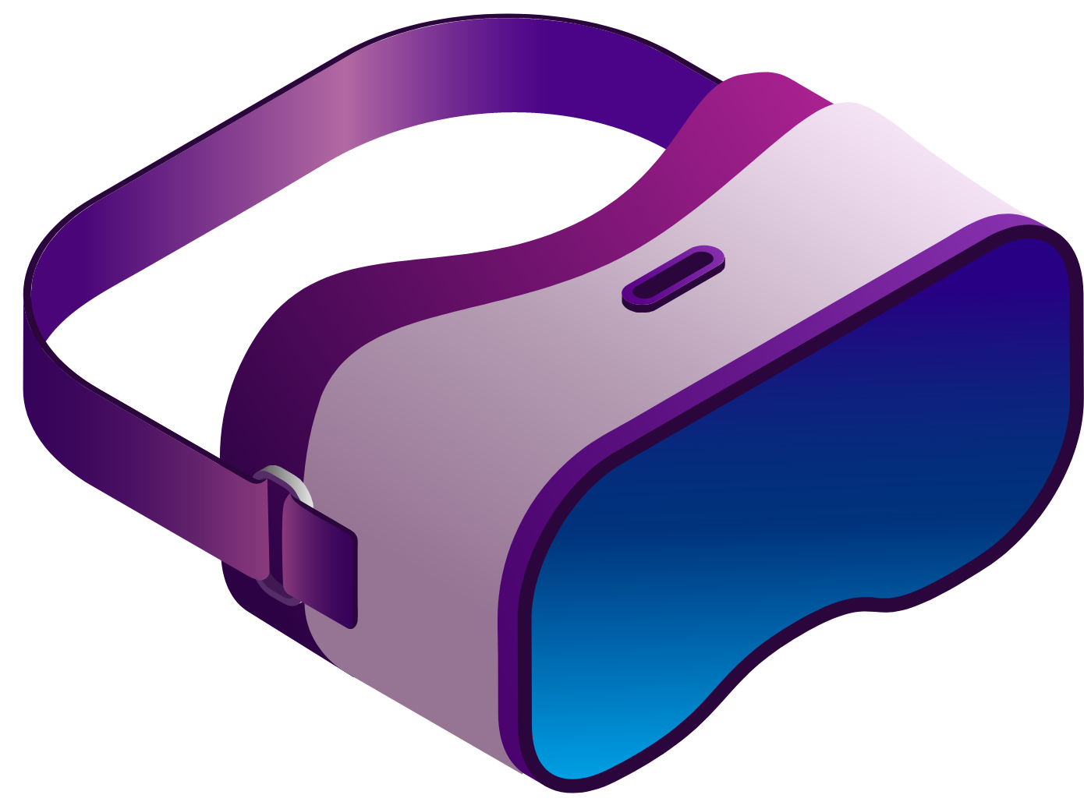
Heritage Memory
Methodology
After completing the requirements for the first project, including designing the environment, scanning the objects, and adding them to the environment, we set goals to develop and enhance user interaction to transition to a full virtual reality experience. These goals include:
Enabling the user to view and grab objects in a 360-degree view, unlike real museums that prohibit touching objects for preservation.
Creating an effective and attractive way to display textual information about objects, unlike real museums, which inefficiently display information on paper.
Adding an AI-powered tour guide to explain some information about the objects.

Slide 7
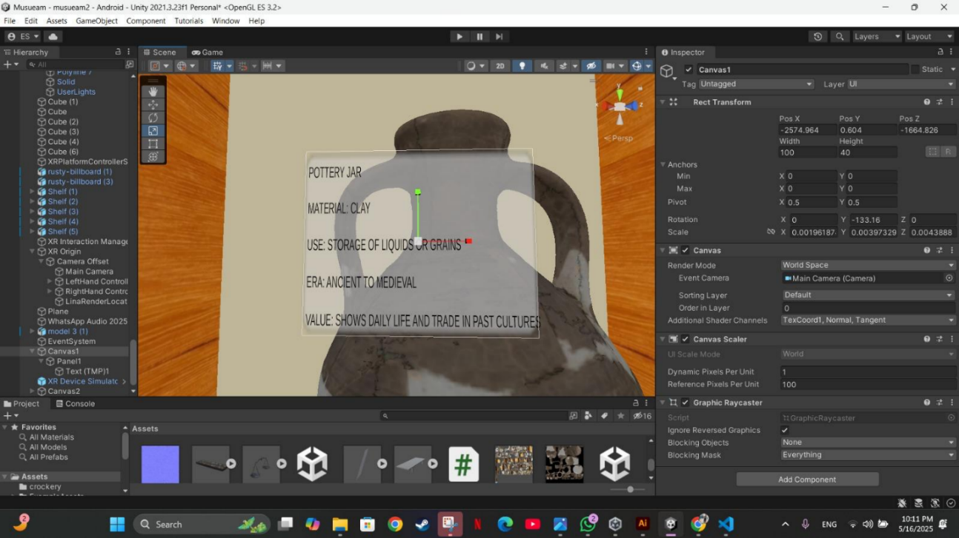
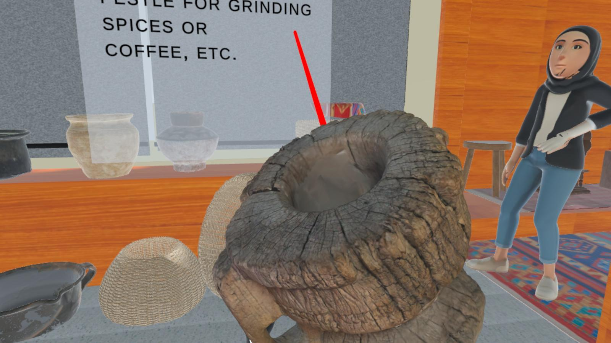
Heritage Memory
Results:
The result of UI on Jarra
The result of Grabbing Objects

Slide 8
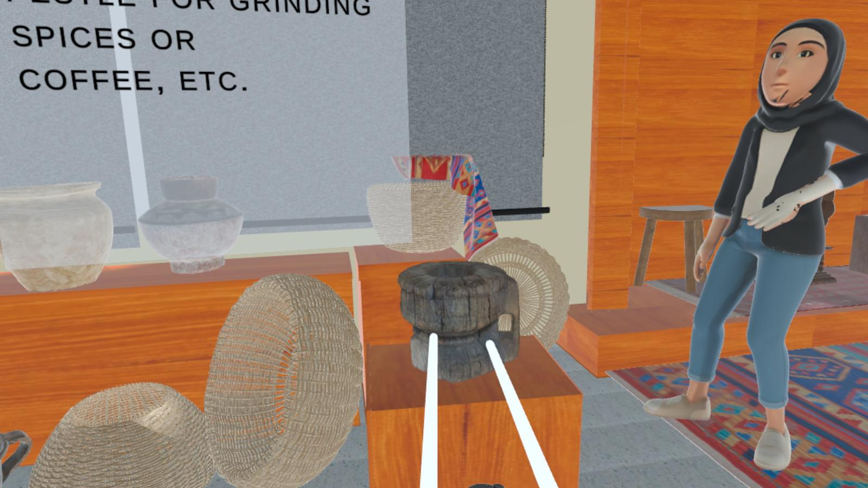
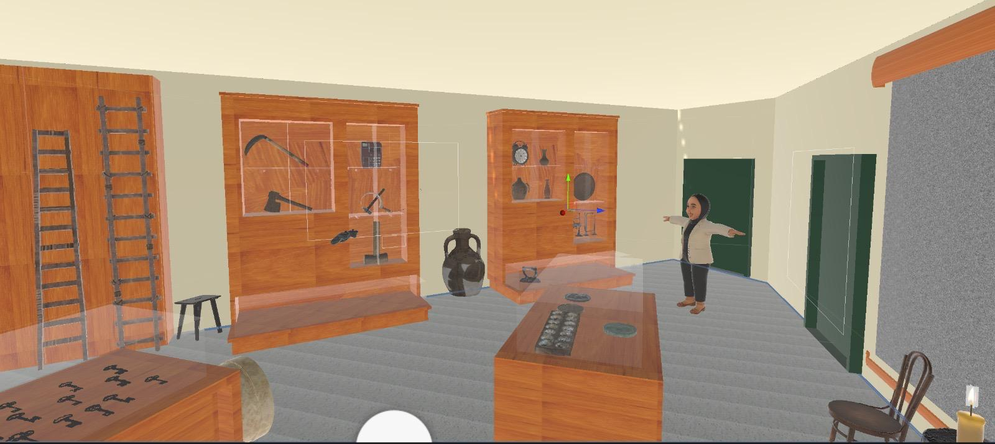
Heritage Memory
Results:
The result of the AI guide to explain the data in Arabic
The final result of our museum

Slide 9
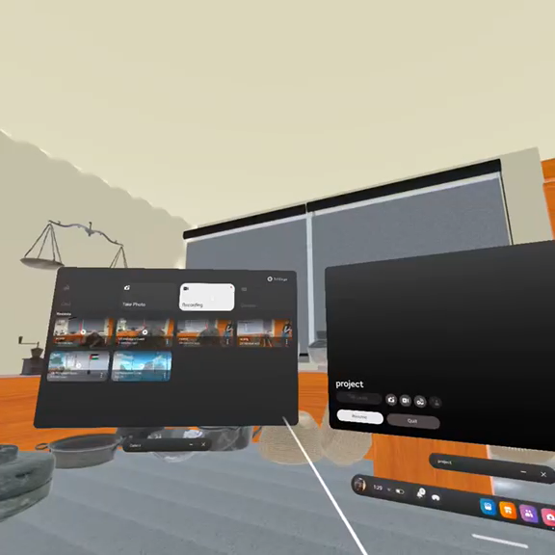
Heritage Memory
Results:
Using Unity, this video demonstrates the interaction with objects, including:
Displaying user interface (UI) data in English on the objects.
Grabbing and manipulating objects.
An AI assistant providing explanations of the data in Arabic.

Slide 10
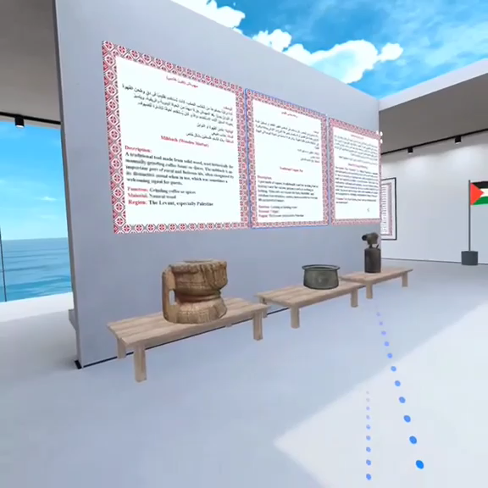
Heritage Memory
Results:
Using Spatial, this video demonstrates the following:
Collaboration and engagement with other users.
Interaction with virtual objects, including object manipulation
(e.g., grabbing).
Presentation of object data in both Arabic and English.

Slide 11
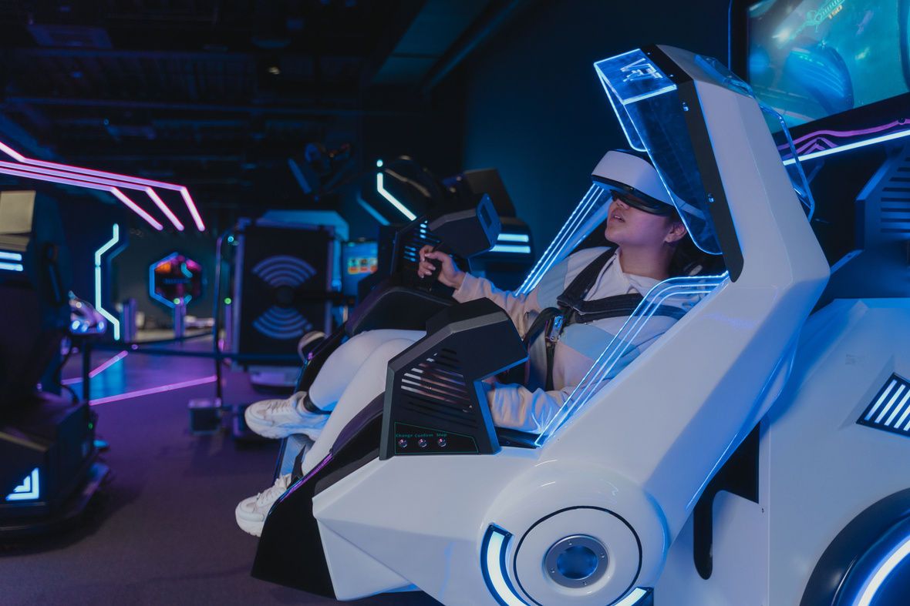
Heritage Memory
Conclusion & IMPACT
OF the project
The societal impacts of the project centering on enhancing democratic access to Palestinian cultural heritage, which allows global audiences the opportunity to engage with a rich virtual environment previously inaccessible to them. It seeks to achieve digital preservation through high-resolution records of cultural assets, ensuring their sustainability amidst potential threats from disasters or conflicts. Additionally, the project will contribute to public digital infrastructure, promoting global dialogue by showcasing diverse narratives and facilitating interactions among users from various backgrounds. Environmentally, the project stands to diminish the carbon footprint of traditional heritage tourism by offering a sustainable alternative that enables virtual exploration of cultural landmarks, thus promoting eco-friendly practices.

Slide 12
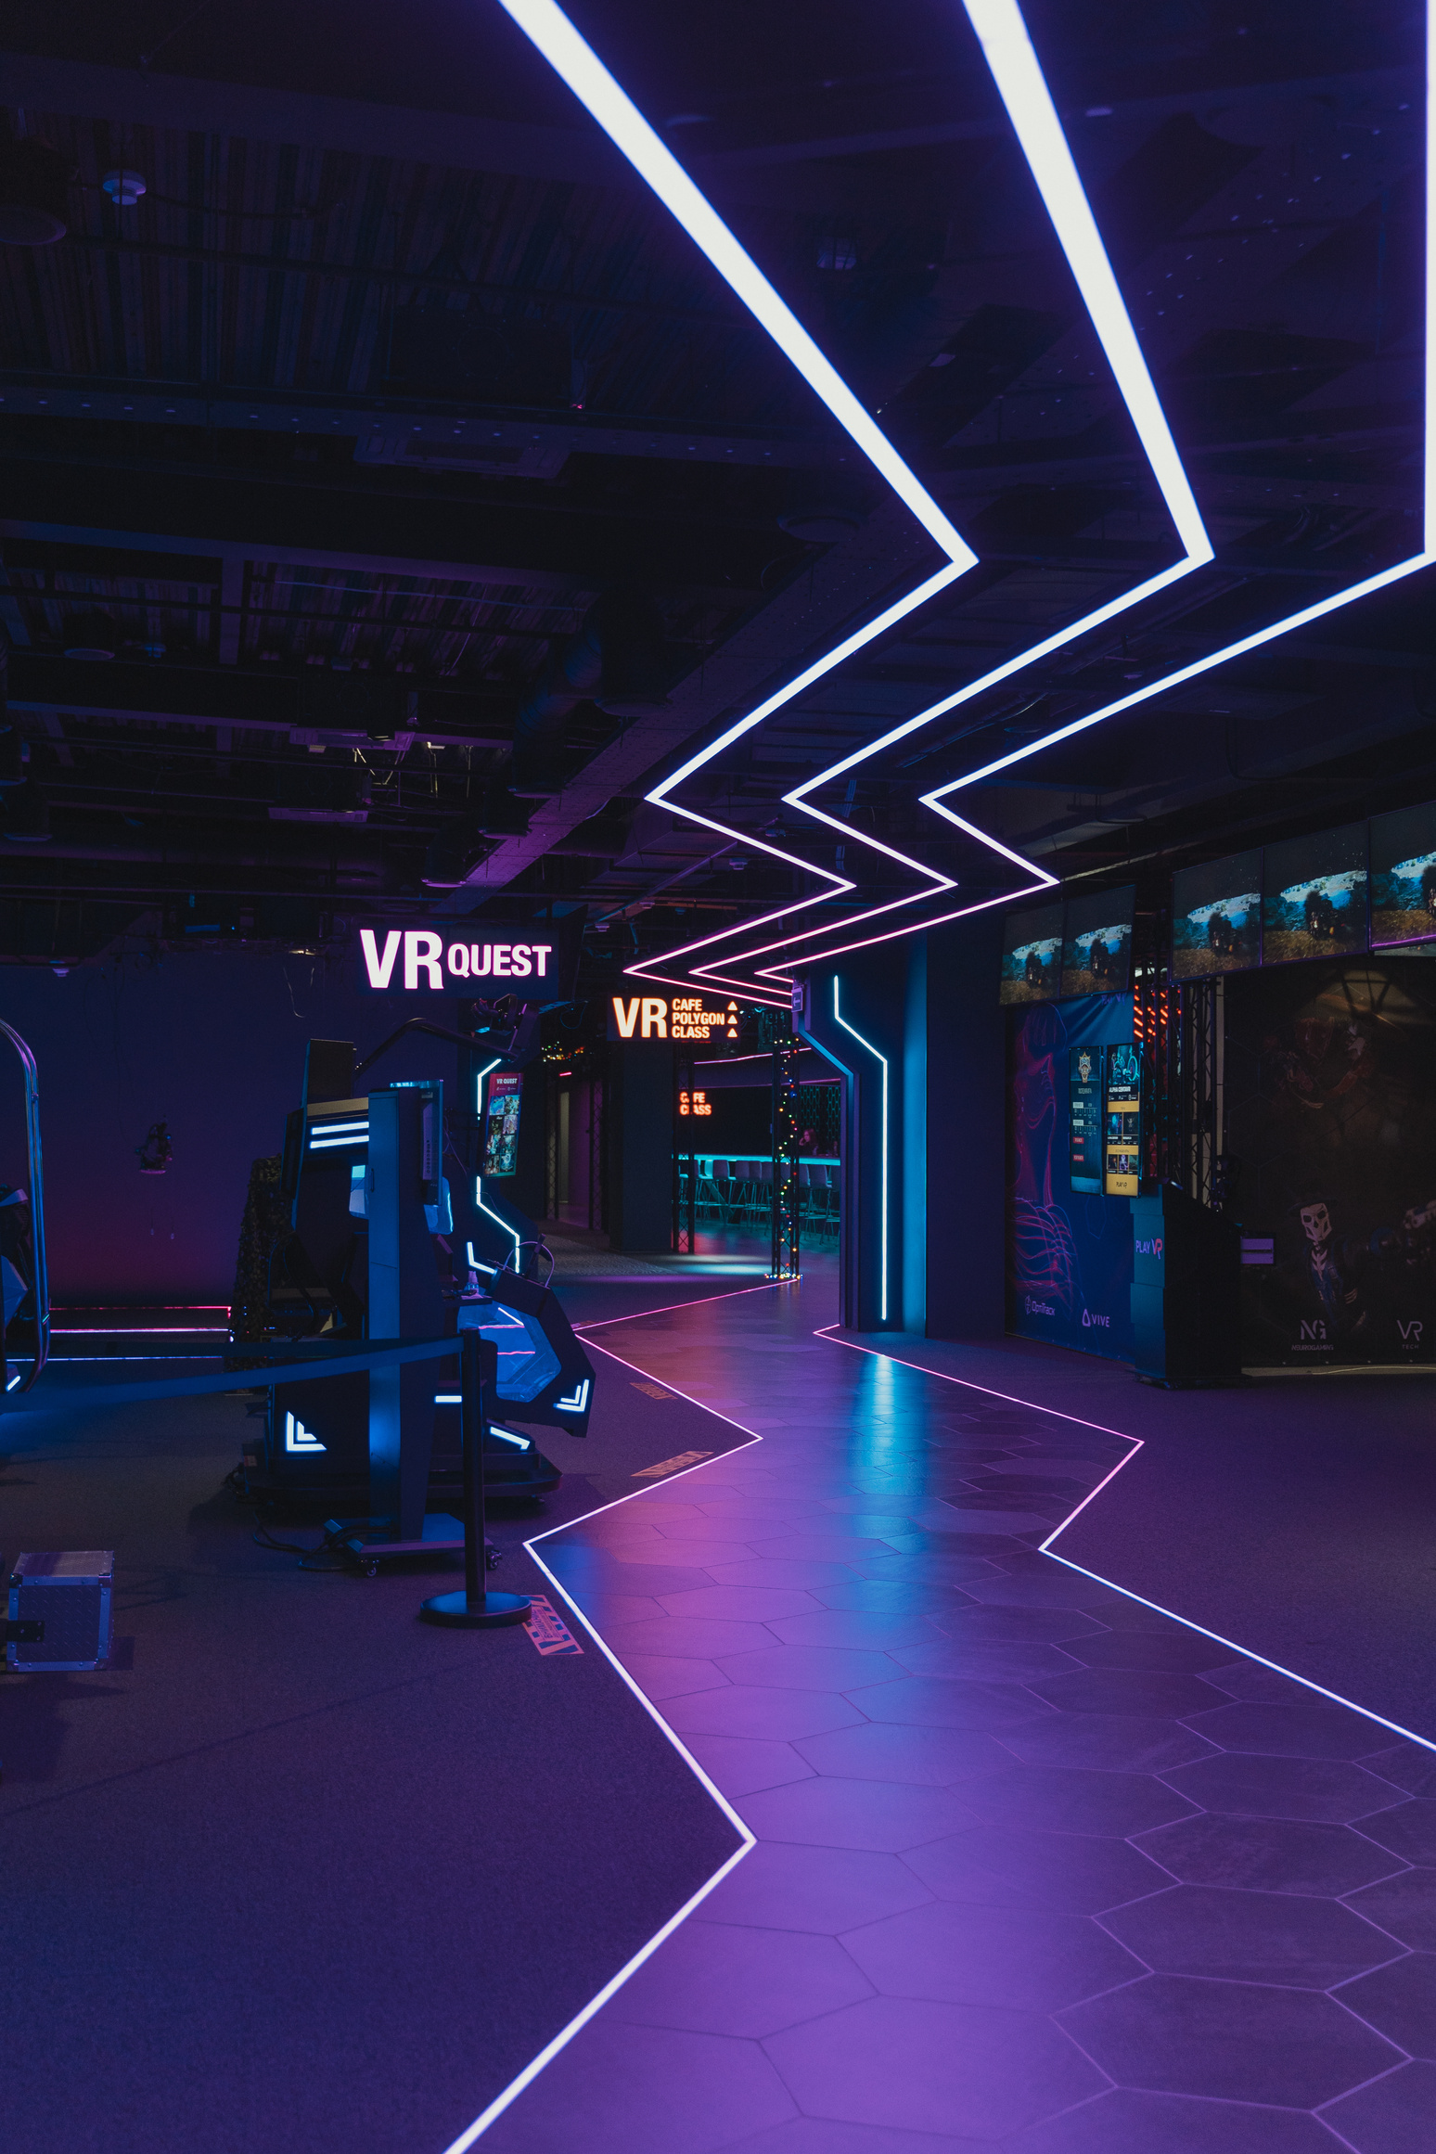
Heritage Memory
Prepared by:
Farah Yousef Abu Nimah
Rahaf Mazen Harb
Supervisor: Prof. Allam Mousa
THANK
YOU.

