Slide 1
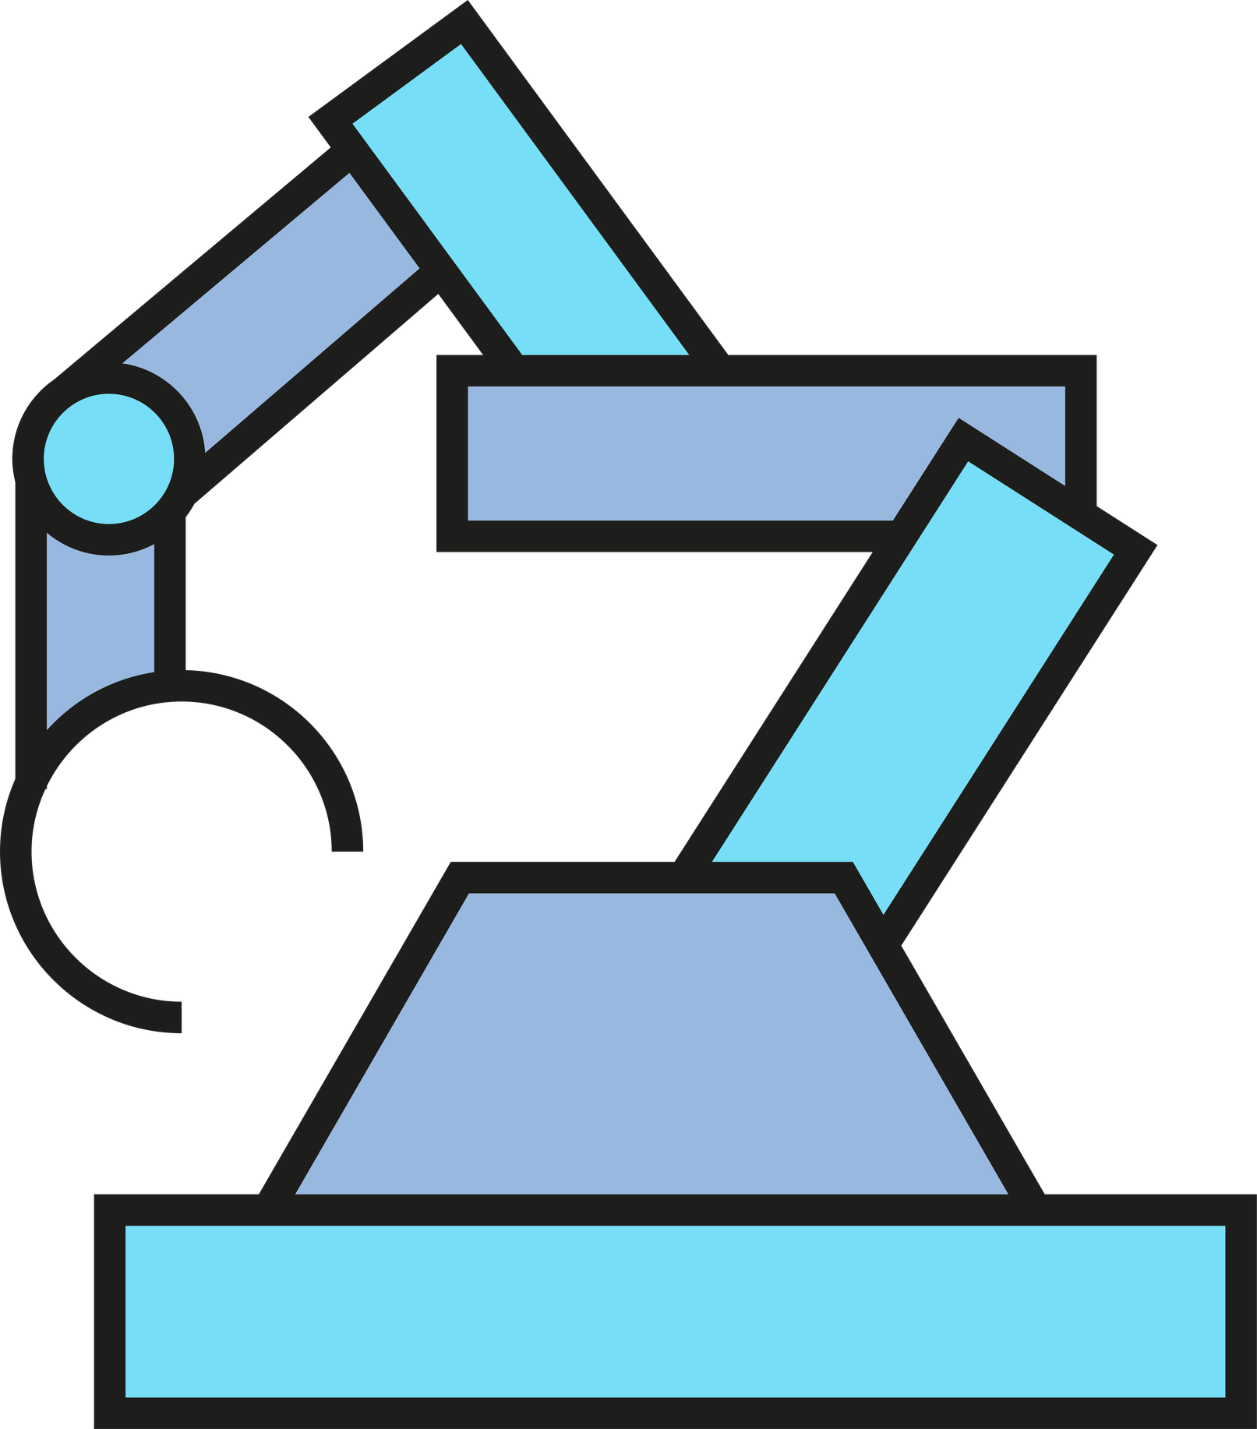


Presentation

Slide 2
Table of Contents:
1-Introduction
4-Features
2-Objectives
5-Challenges & solutions
3-Hardware
Components
6-Conclusion

Slide 3
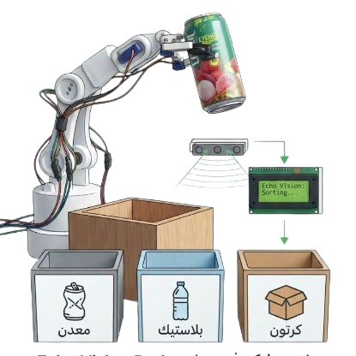
Introduction & problem statement
Problem: Traditional waste sorting (like cans) requires human intervention, which may result in:
  Serious health risks from pollution by bacteria and other pathogens.
  Significant physical fatigue as the work requires hours of standing.
  Human error in sorting.
Solution: A fully automated sorting system that:
  Operates completely without human intervention.
  High accuracy in sorting and identifying canned types.
  Increased productivity due to faster operation speed.

Slide 4

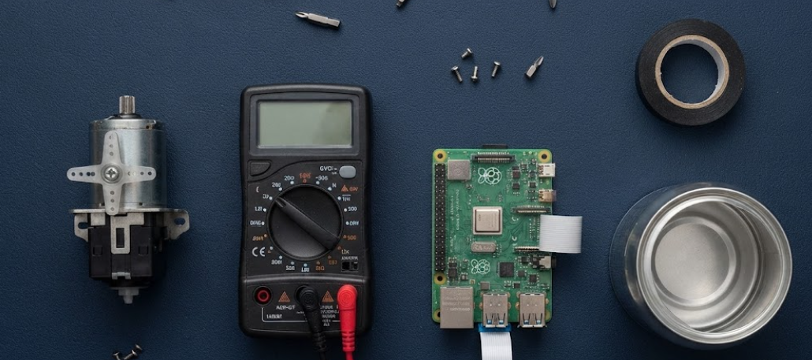
Project Objectives
  Automatically drop the can onto the conveyor belt so that each can passes through multiple stages.
  Identify the material type by stopping the can in front of the camera (Raspberry Pi Camera).
  Move the robotic arm with high precision to place the can in the appropriate box.
  Implement a mechanism to check whether the boxes are full or not.

Slide 5
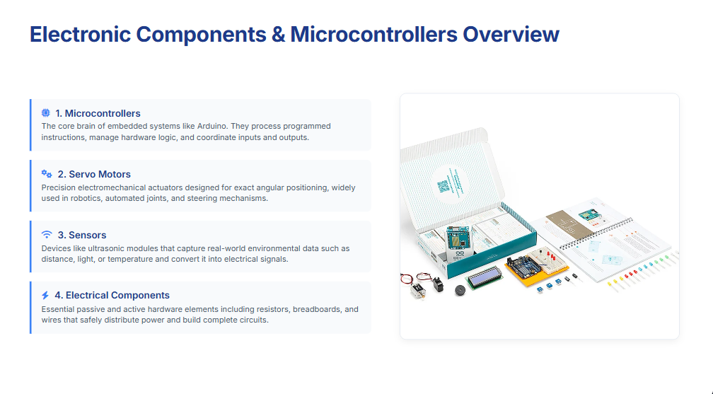

Slide 6
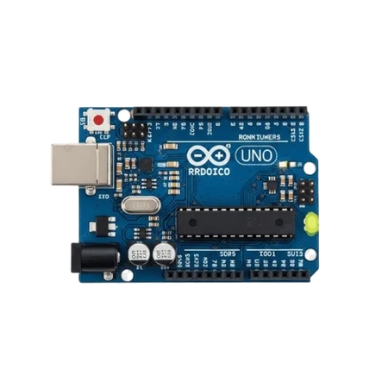
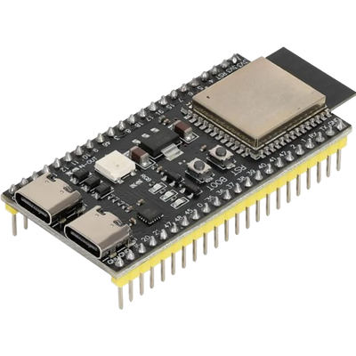
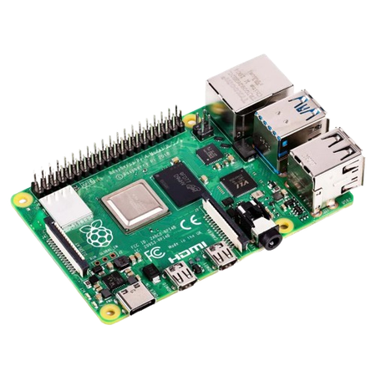
1-microcontrollers & control units
Arduino Uno used to drive a conveyor belt based on ultrasonic distance readings. It controls the dc motor on or off .
ESP32 is used to control the robotic arm due to its high capability in handling the I2C protocol, and it is also responsible for reading the ultrasonics connected to the boxes. It also controls the LCD.
Raspberry Pi is connected to the Raspberry Pi Camera and is responsible for running the custom model to detect the material type, and then sending the type to the ESP32.

Slide 7
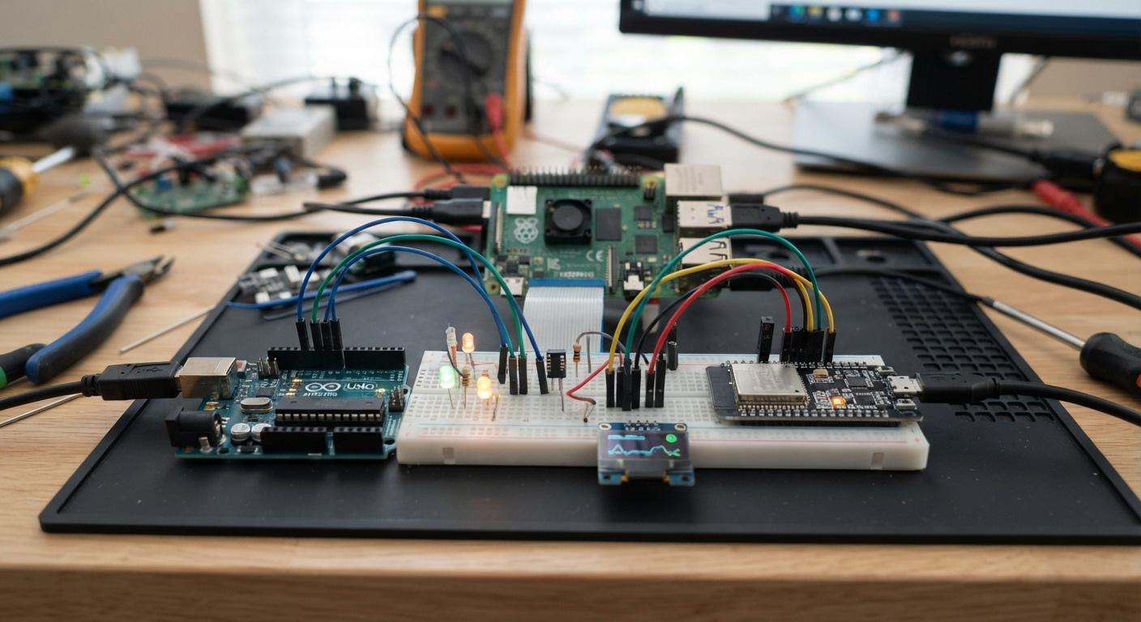
How They Connect
tx esp to rx uno
tx pi4 to rx esp

Slide 8
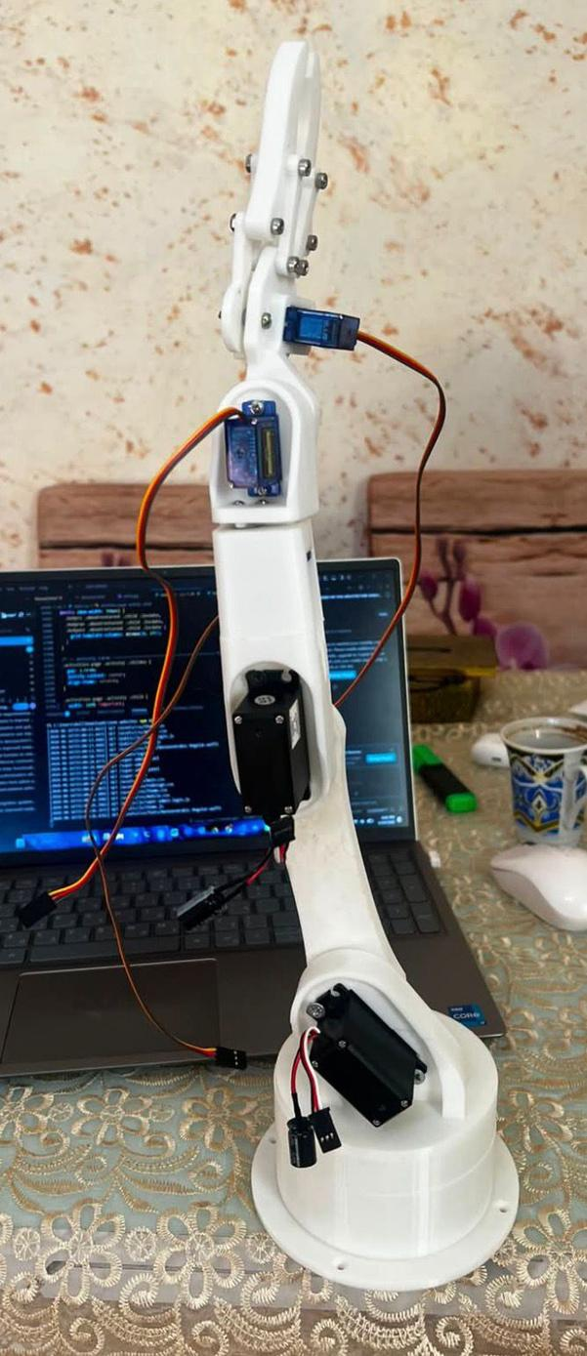
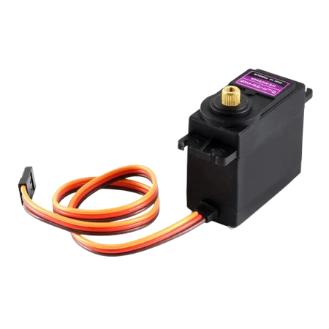
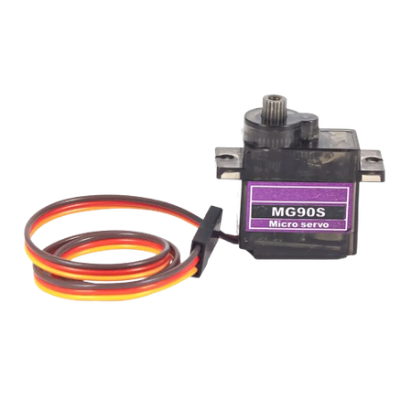

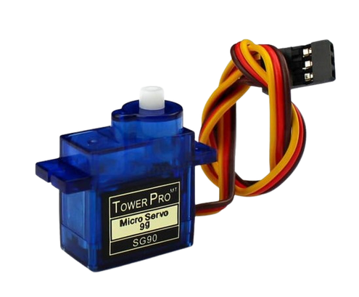
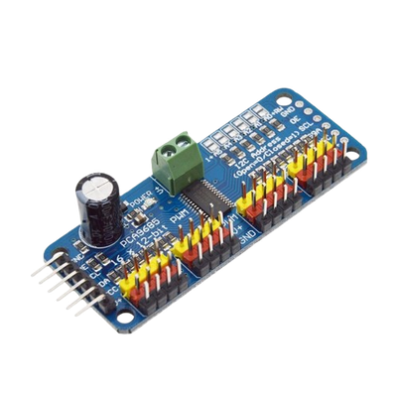
Motors : 1-Servo
mg996r
sg90-metal gear
sg90
Different types of motors, each tailored to suit the applied load.
Note:Pca9685 driver used to handle servos
5-axis arm

Slide 9
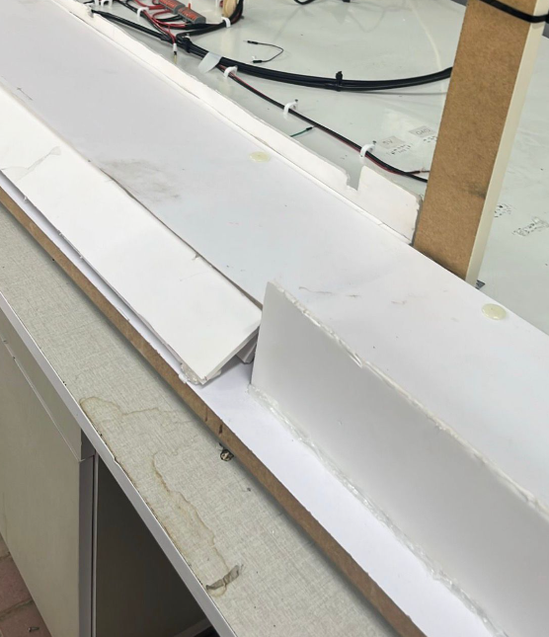
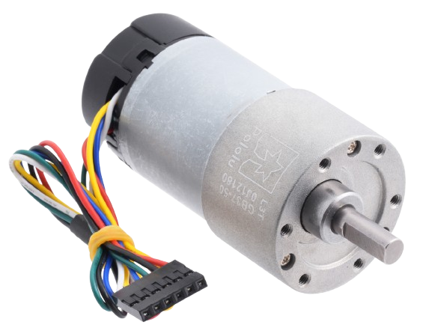
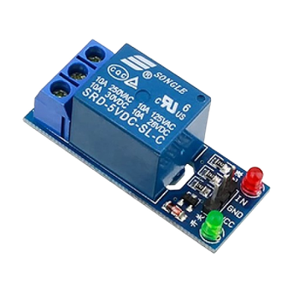
Motors : DC Motor
"A 12V DC motor used to drive the conveyor belt smoothly."
12 volt dc motor
Conveyor belt
Note:5 volt relay used to controll the dc motor

Slide 10
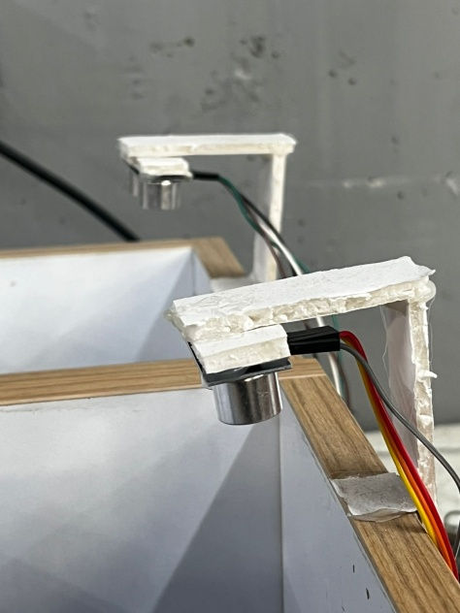
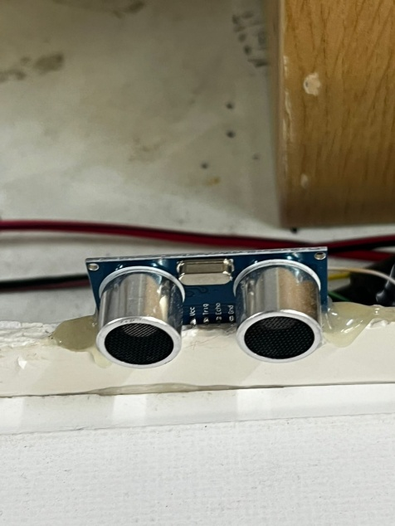
3-Sensors
Ultrasonic Sensor (HC-SR04) measures distance by emitting an ultrasonic pulse and timing its echo. Connects via VCC, Trig, Echo, and GND.
Conveyor Positioning: ultrasonic sensors are mounted along the belt to stop each container precisely at the camera and arm stations.
Bin Capacity Monitoring: another ultrasonic sensor sits above each box, detecting fill level and preventing the arm from placing items into a full bin.

Slide 11
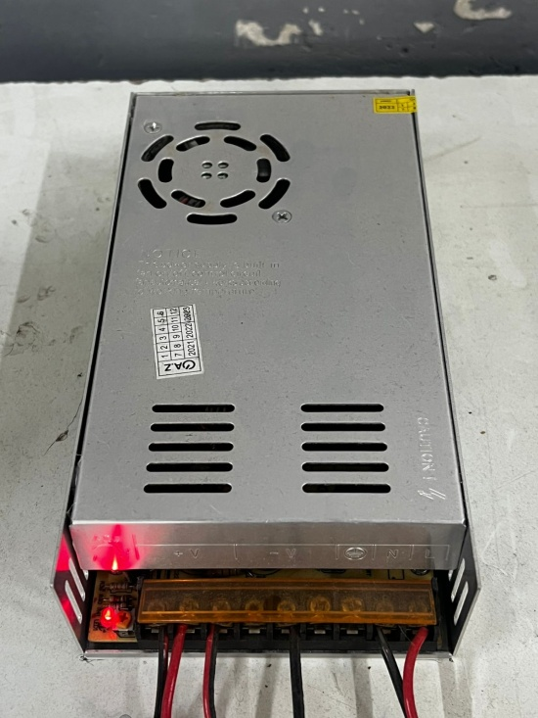
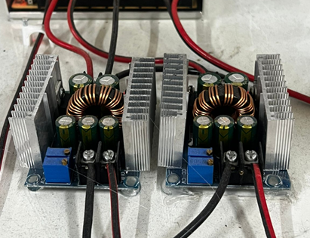
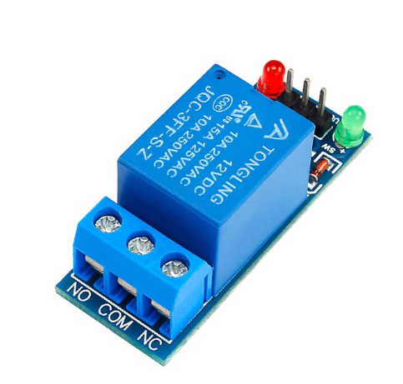
4-Electrical & Power Components
Power Supply: an isolated external power source delivers the current needed for all servos, motors, and modules.
DC-DC Buck Converter: steps down voltage safely for the microcontrollers and sensors, protecting them from the high-current supply line.
Relay Module & Rocker Switch: the relay safely switches the conveyor's DC motor, while the illuminated switch powers the whole system on and off.

Slide 12
System Workflow — Dispensing & Classification (1/2)
① Drop New Can
Motor 11 releases a can; the ultrasonic sensor confirms it dropped, retrying automatically if not.
② Open Gate & Run Belt
After a 1s delay, Motor 6 opens to 180° and the conveyor runs 3s toward the camera.
③ Classify Material
Raspberry Pi captures the can and classifies it as metal, plastic, or cardboard.
④ Check Bin Capacity
ESP32 checks the target bin's ultrasonic sensor before continuing.
⑤ Bin Full?
If full → the can is discarded and a new cycle starts. If not → sorting continues.
⑥ Move to Arm Station

Slide 13
System Workflow — Sorting & Arm Control (2/2)
⑦ Arm Ready
ESP32 signals readiness; Raspberry Pi sends a sequence of MOVE:a,b,c,d,e,f commands.
⑧ Execute Pick & Place
ESP32 drives the 5-axis arm through the PCA9685 driver to grip and sort the can.
⑨ Check Grip Result
On ARM_DONE, ESP32 verifies whether the pick-and-place actually succeeded.
⑩ Success → Log It
Count and weight for that material increase; the LCD shows a success message.
⑪ Failure → Discard
LCD shows “Arm Failed”; the conveyor runs 8s to clear the can, no count added.
⑫ New Cycle
Arduino immediately drops the next can and the whole sequence restarts automatically.

Slide 14
Key Features
Automation & Sorting:
  Fully automated container dispensing and conveyor transport.
  Real-time material classification using YOLOv8.
  5-axis robotic arm for precise pick-and-place sorting.
Safety & Monitoring:
  Depth sensors detect full bins before placement.
  Fallback routing for failed robotic grips.
  Live LCD display of system status.
📷 [: شاشة الـ LCD وهي شغالة وعم تعرض الحالة]

Slide 15
Challenges & Solutions
Challenge: Building the robotic + AI pipeline surfaced three hurdles:
  Robotic arm motion jitter from PWM interference.
  Unreliable Wi-Fi/Bluetooth links between boards.
  Sourcing stable 25A power for all motors.
Solution:
  Custom Python calibration for precise motion.
  Switched to wired Serial communication.
  Isolated power supply with buck converters.
📷 [ التوصيلات/الأسلاك أثناء التجربة والتصليح]

Slide 16
Conclusion
Echo Vision delivers a working automated sorting prototype that:
  Integrates vision, embedded systems, and robotics.
  Reliably sorts plastic, metal, and cardboard.
  Handles full bins and failed grips gracefully.
Future Work:
  Upgrade to industrial-grade power and motors.
  Add IoT connectivity for remote monitoring.
  Expand the AI model to more materials.
📷 [ النظام الكامل جاهز على الطاولة / الفريق مع الجهاز]

Slide 17
Thank You

