Slide 1
Take Care
Drug ocr scanner & And Drug scheduler – android application

Slide 2
introduction
Each house now a days have a cabinet or a box of random drug.
Hospital and Elderly Home have a lot of patient and a nurse response of it.

Slide 3
Quick overview
Android Application, help to identify popular drug by just open the camera that built in the application and scan the name of drug.
Drug scheduler, help to notify user when drug is must taken.
Contain list of patient drug
First Arabic app to serve Arabic community.

Slide 4
Is there any Alternatives?
There is no app that can scan drug’s name and give you information, the current app make you type the drug name to search in google to find any information about that drug.
And there is some application that just notify the user when dose is must taken.

Slide 5
motivation
Help old people to identify their drugs and to know more about what they are taken
When you back from hospital or clinic with bag of drugs without tray or pharmaceutical bulletin, just slice of drugs, it’s hard to identify what the drug is used to and what is for. And its hard to remember when you must take the pill.

Slide 6
Motivation, cont.
When you search for drug online is not guaranteed to be correct and maybe there is no full information about that drug.
For nurse in (Hospital, Elderly Home, etc.) its much easier to remind when some patients needs to take the drug.
Pharmacist usually identify drugs and they are not available all the time.

Slide 7
Getting the data
One of the problem that we face in project is the drug data, and data source. There is no direct source for drug information and especially “Arabic drug information”, we ask form local and global drug resource, unfortunately we got a negative response.

Slide 8
Our data
To accomplish our project mission, we collect 100 drug information form WebTeb.com to be our work data for the project. That is garneted to be correct and trustworthy to our app user. And we hope if we got a fund or support to collect more and more data to increase our base of information.

Slide 9
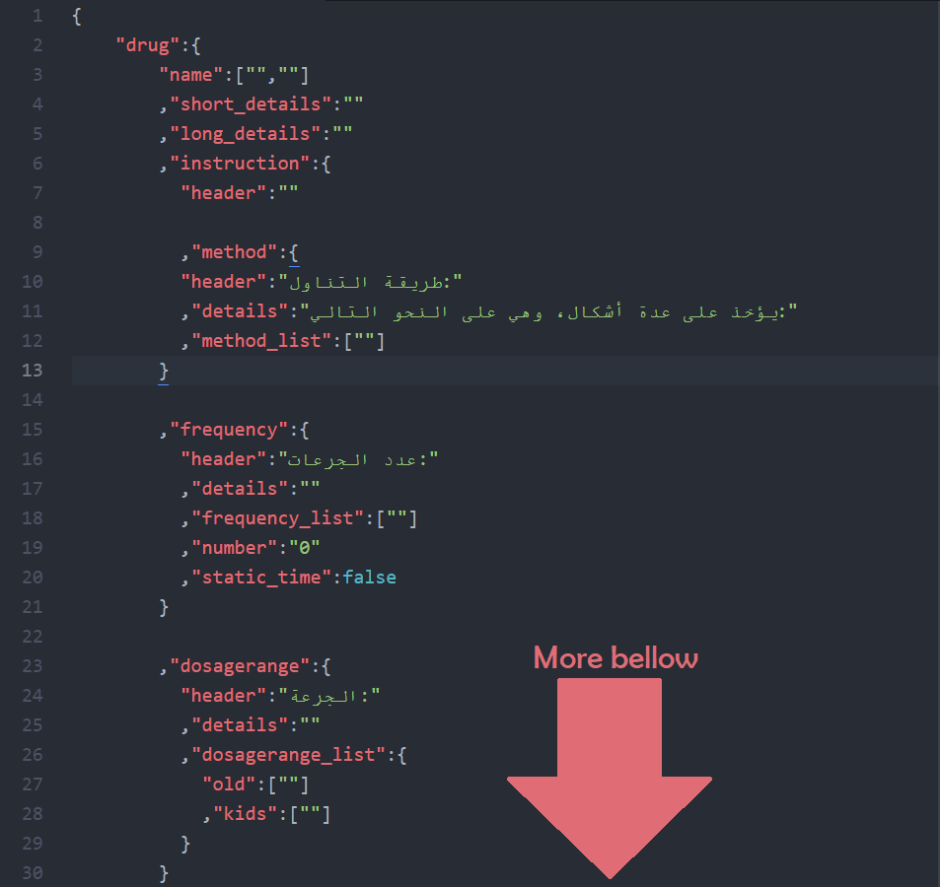

Data shape – use of data
We collect drug in JSON file, and put each attribute inside JSON object to make use of it.
We create a JSON Template, so the data be consistent and unified

Slide 10
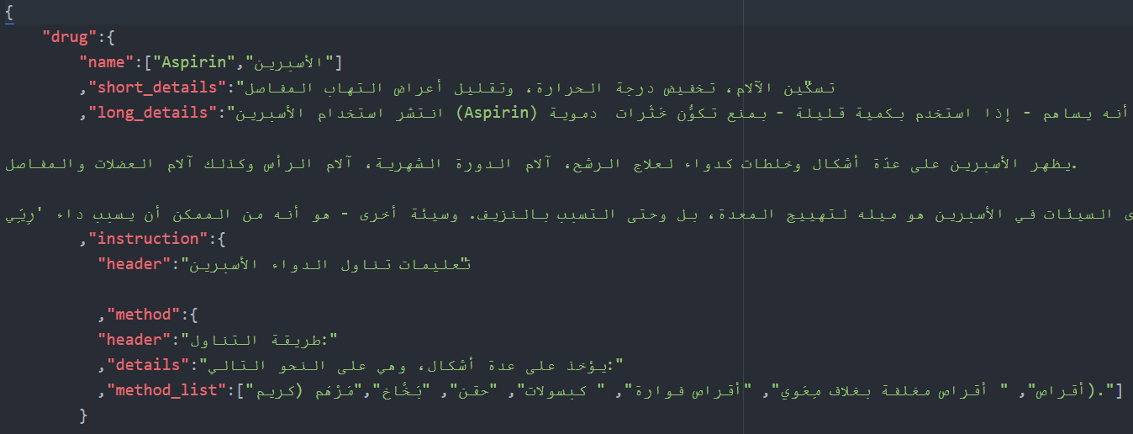
Data Shape – Aspirin example

Slide 11
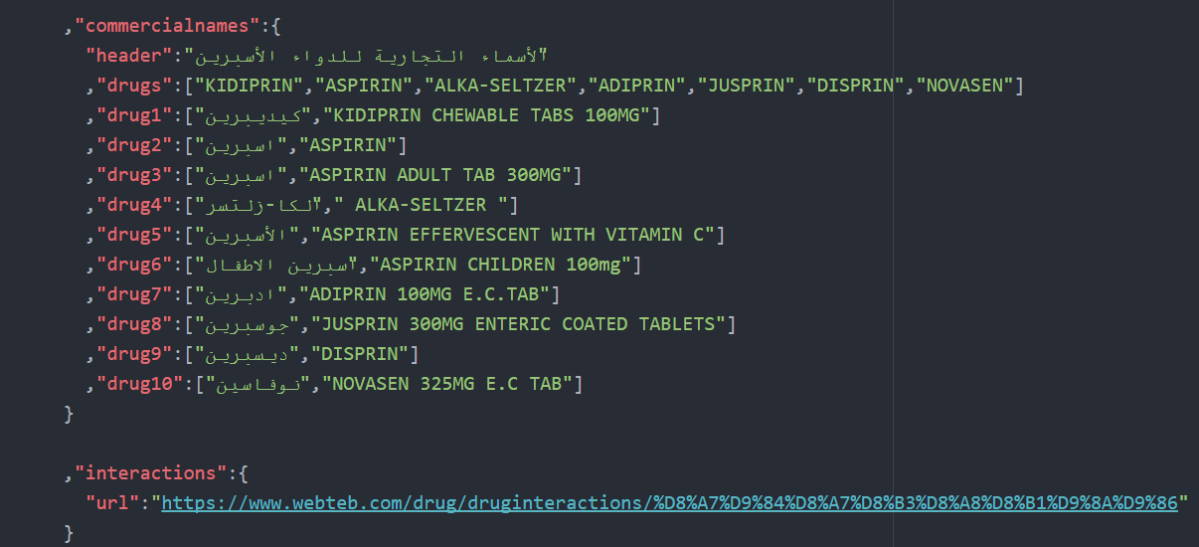
Data Shape – Aspirin example

Slide 12


Drug search
From previous file we use “Lucene Search Engine” and implement Lucene in Java Server that take query, “in our app: drug name or Tray Text” and send back the relevant JSON File if there is match with indexing file.

Slide 13
Drug search
Our search method that use fuzzy search (`query`+~) so that if the OCR Couldn’t catch some letter or there is no lack of clarity in the Camera View. By doing this method we make use of any word that appear in the view like (250mg, tabs …).
“We use live image scan, the app will keep search until it found result”

Slide 14
Why Lucene ?
faster than SQL Query search
Support for fuzzy search (One of its future)
Open source.
Java-based indexing and search technology, as well as spellchecking, hit highlighting and advanced analysis/tokenization capabilities.
Score the result based on it relevancy.

Slide 15
SEARCH ACCURECY
Every Query must have a single relevant document, because this, the first rank (Precision = Recall).
Number of test data | Precision | Recall | F-Measure
First Document is Relevant
100 query | 93% | 93% | 93%
Second Document is Relevant
100 query | 50% | 100% | 67%

Slide 16

Challenge: lack of date
One of problem we face, Lack of drug data, One of the solution that we come up, is to make a RESTful API so that allow the drug and medicine company to upload there medicine and stick with our JSON Template so keeping the consistency of the drug base. We will make a web interface so its easy to upload drugs.

Slide 17

Challenge: lack of date
One of the benefit of making API, that anyone can pull the data from it for any reason he want to, also make a drug base reference for Arabic drug information.
The data will store in JSON file and any new upload file will notify the Search engine to add new file to index group.

Slide 18
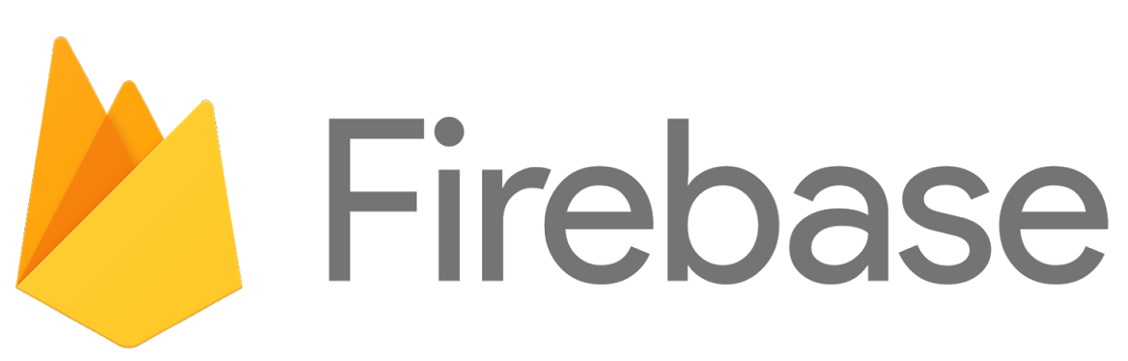
Challenge: lack of date
Google Firebase: Firebase provides a real-time database and backend as a service. This service provides application developers an API that allows application data to be synchronized across clients and stored on Firebase's cloud.

Slide 19
Process Pipeline
API
Lucene
Send JSON
Indexing
Searching
Fuzzy OCR Text
Android
QUERY
Network
JSON File
Network
Parsing
Android
Data Collection
Fill & Organize Data – JSON
Indexing
Lucene (Ready for searching)
Received JSON File
Print and parse the content

Slide 20
After search
Stage I: The Application Will take picture for the view image (Drug image) so we can make use of this picture when the user decide to add the retrieve drug to his scheduler drug, so we display this picture in notification menu to make easy to the user finding the drug.

Slide 21
After search
Stage II: New Activity open that display all drug information and if there is any warring in the page it will appear in the activity.
After that, the user could add the drug to it’s list drug.
“Note: If he decide to add the drug, he will choose the time that he will be notify in.”

Slide 22
Use the application just for notification
The user can add drugs manually and also receive notification for that drug, but the will sacrifice drug information cause it’s add manually but still have all other future like take photo to added drug.
User could move any drug to history list if they finish taken it, or they want to stop receive notification.

Slide 23
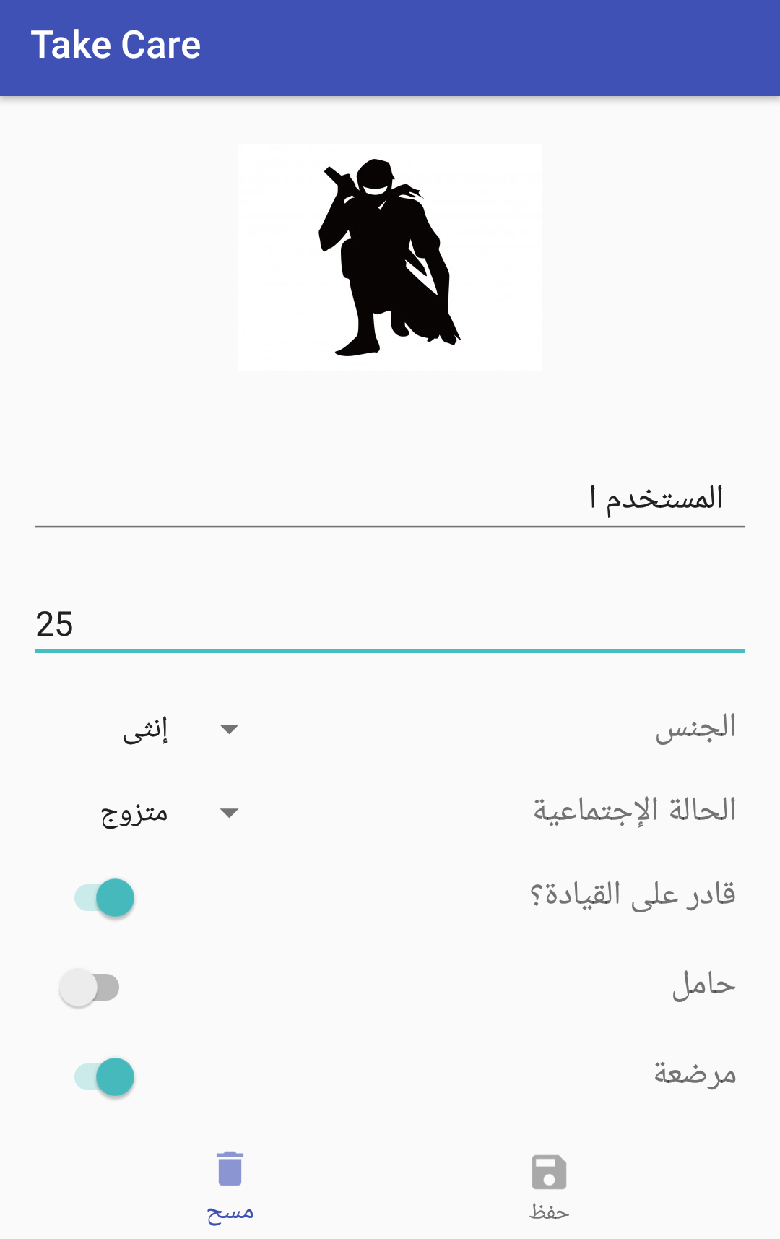
Personal account
Each user install the app will prompt to enter there information. So they receive the wanted information from the app

Slide 24
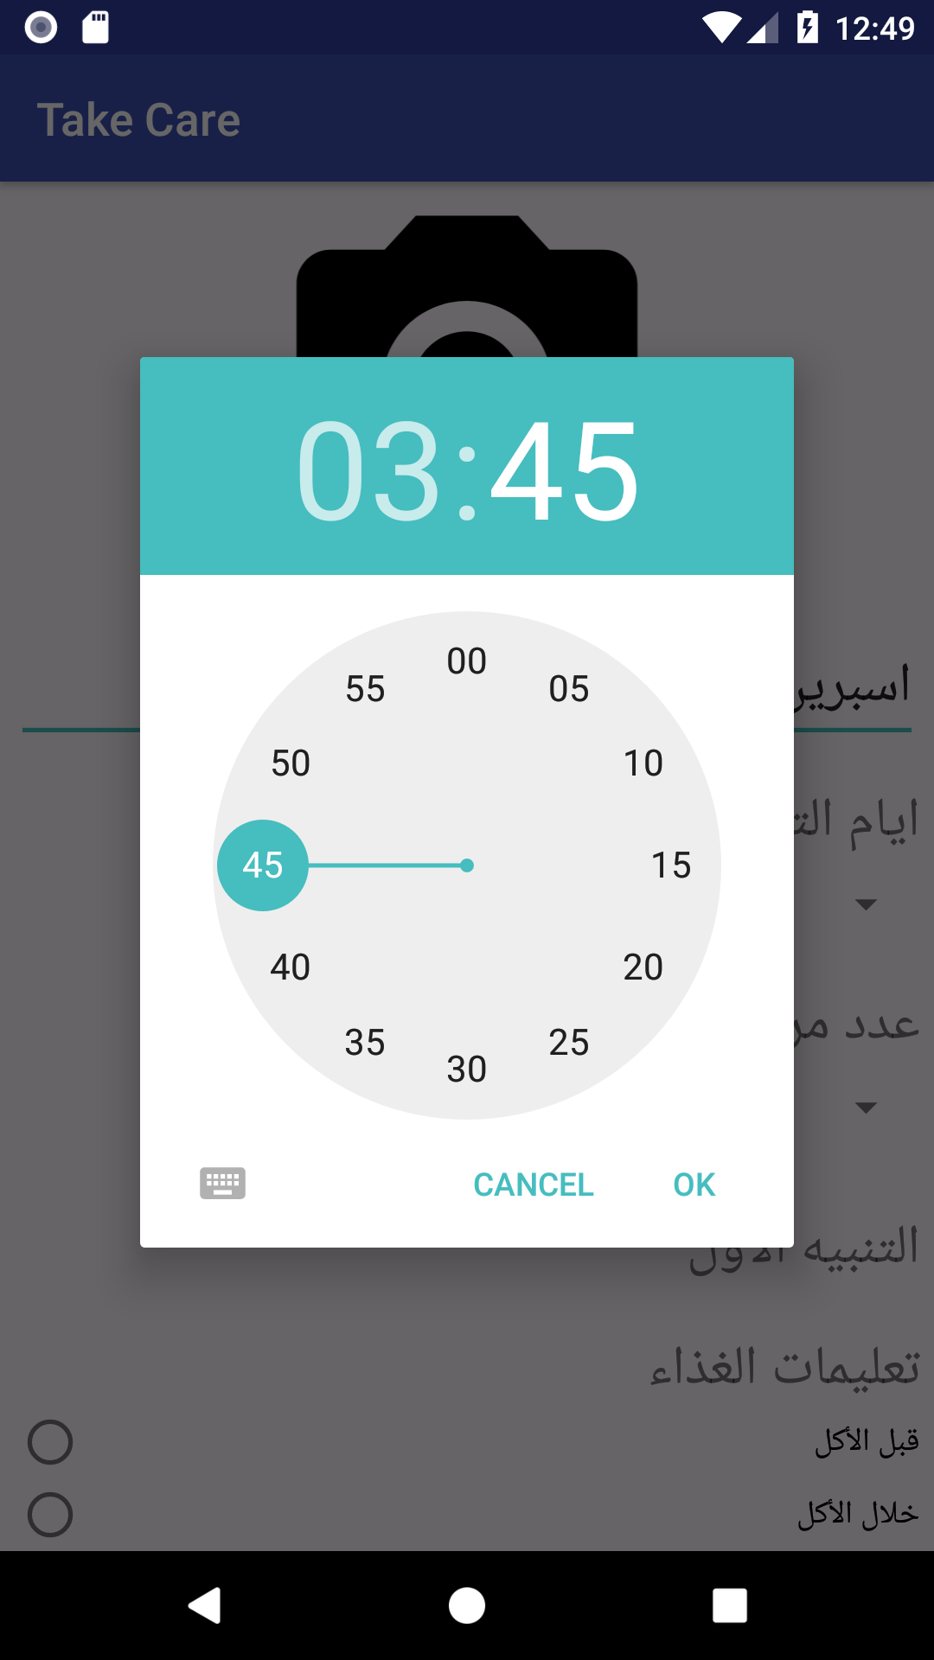
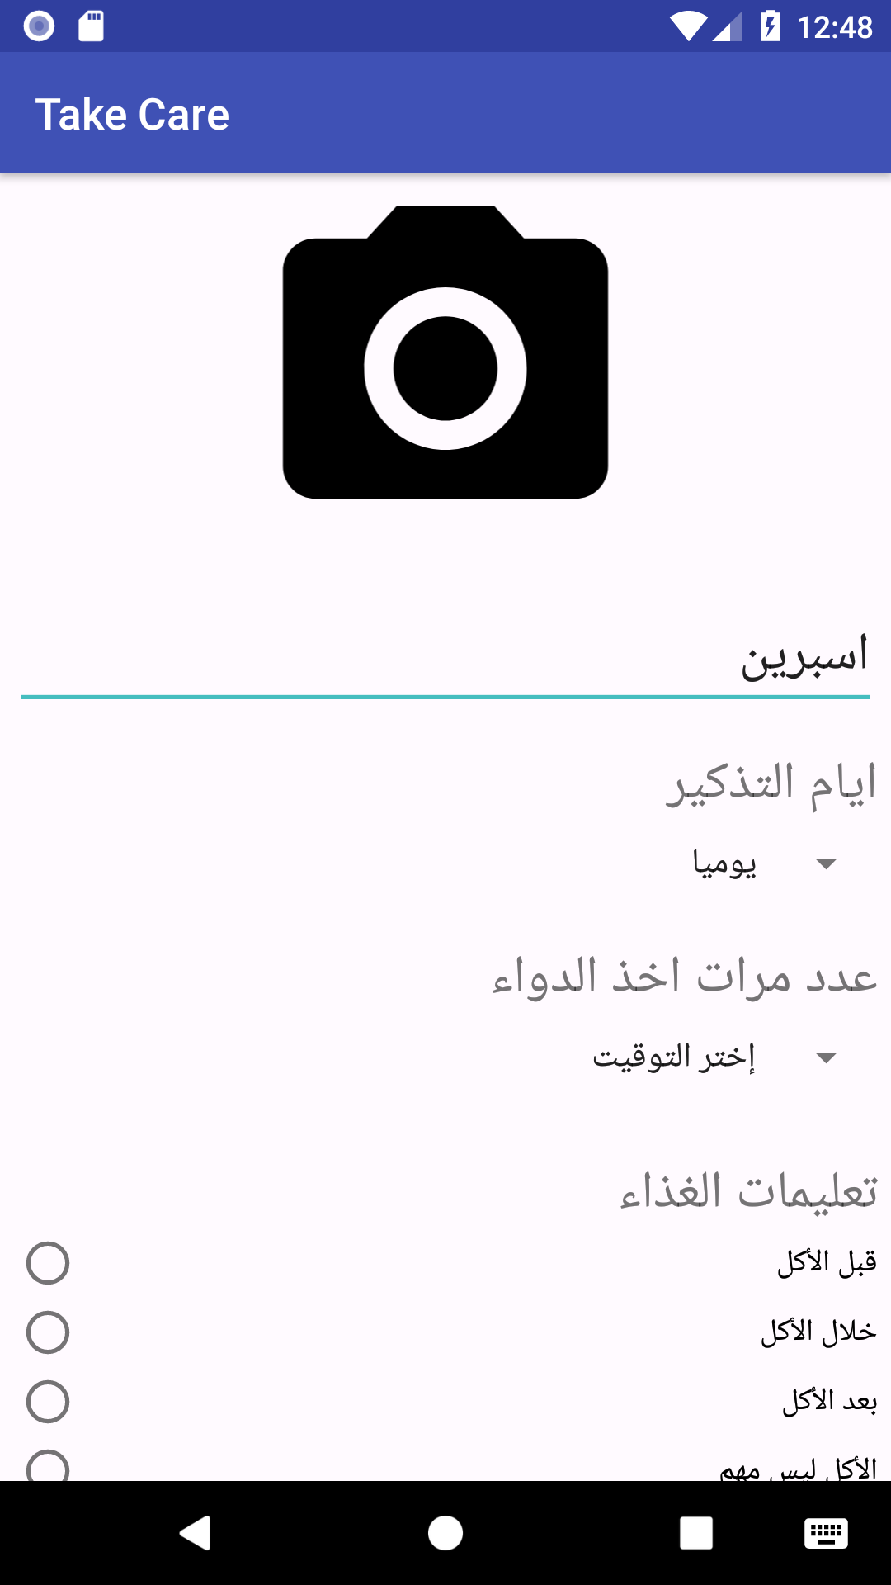
Add drug
Choose name for the drug or if it come from the OCR it will take the retrieved Drug name.
Choose the interval.
Choose time, up to 4 different time.
Food instruction
Alert if the user want to continuous using the drug.

Slide 25
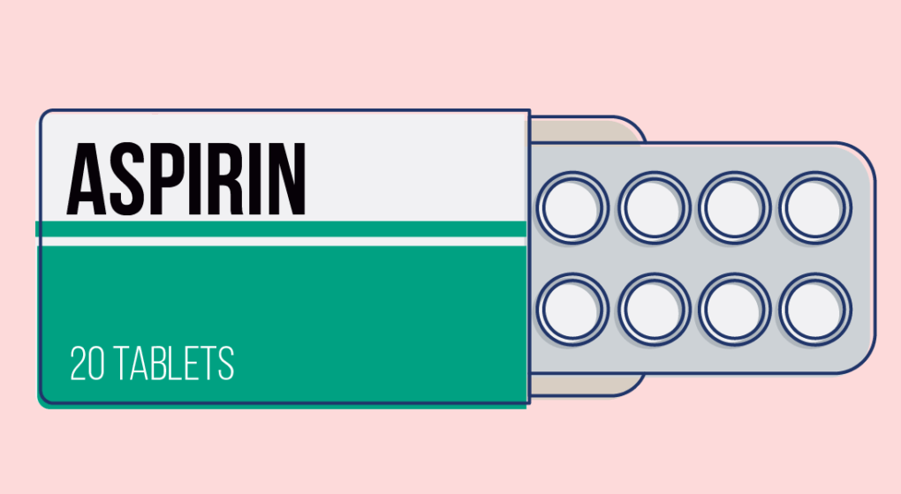

Slide 26
