Slide 1
Solar tracking and cleaning system
Students:
Sujood aqraa.
Aseel samoudi.
Supervisor:
Dr.Hanal Abu Zant
Dr.Haya samaaneh.

Slide 2
Outline
Introduction .
Objective
Working .
Constraint .
Future Work.
Demo.

Slide 3
introduction
Today’s time solar cells are becoming extremely popular for utilizing solar energy to use in different ways such as producing electricity, transportation , cooking etc.
They are installed in the direction of maximum radiation of sunlight,
Now the problem arises that the sun is moving .So we cannot use maximum radiation of sun all the time.
.

Slide 4
The objective
In this project we designed an automatic tracking system, which can locate position of the sun.
solar tracker it, will keep the panels pointed toward the sun to ensure they always operate at maximum performance.
, in addition we take advantage of this energy in order to design a cleaning system that clean the solar panel automatically.

Slide 5
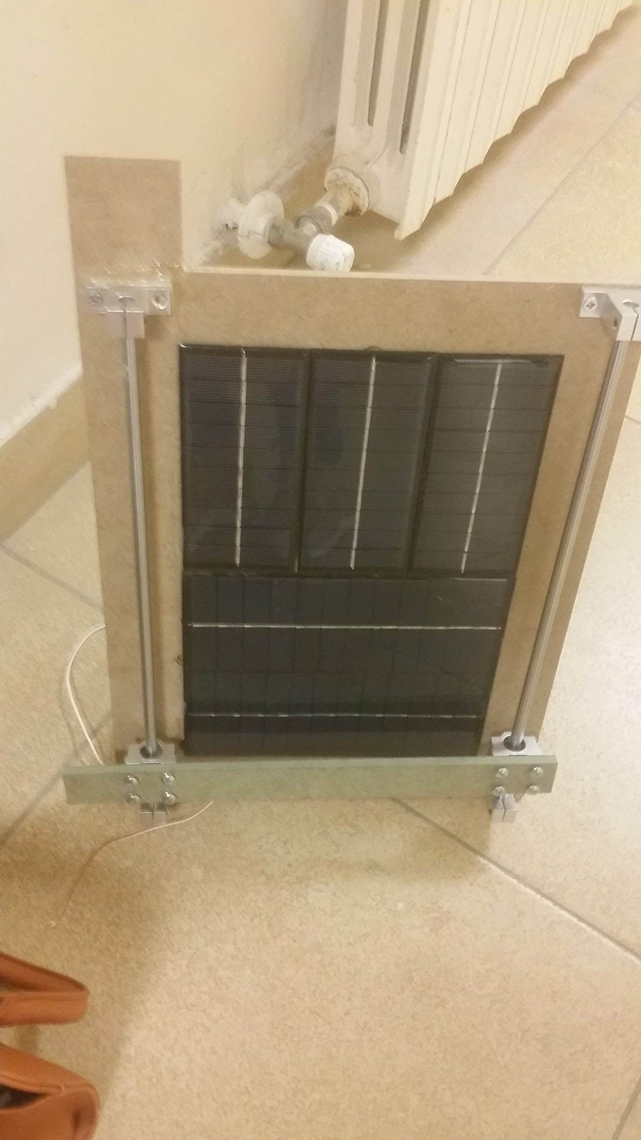
Working :
1.Tracking system
hardware design

Slide 6
Tools :
Tracking system
Arduino Uno.
Servo motor.
Photo transistors (LDR).
12v Solar panels.
Solar Regulator .
12 v Lead acid Battery .

Slide 7
Methodology :
This project contain a system with one axis solar tracker i.e 180°
LDRs sense the amount of sunlight falling on them. Two LDRs are divided into top, bottom .
the analog values from the top LDR and the bottom LDR are compared and if the top LDR receive more light, the servo will move in that direction , Else the servo moves to other direction.

Slide 8
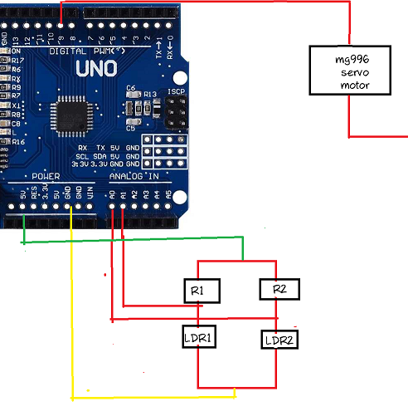
Cct :

Slide 9
Working :
2.Cleaning system
This system have save you from risks comes through manually cleaning of solar panels , and In the case of large stations they haven't need to hire a large staff of people to do this , as it's known these stations often constructed in isolated areas

Slide 10
Hardware design
wiper mechanism :
wipes the Solar cell panel in a linear motion, the wiper mechanism consists of an 8mm linear rail, an 8mm support for rail, and the wiper bar is connected at the rail and stretches on both sides of the cell panel frame driven by a stepper motor.

Slide 11
Tools :
Cleaning system:
Stepper motor
Soil Moisture sensor
Water Pump
Relays
Photo resister
ااااااااSENSOOOOR DDDDDDDDDDDDUSST

Slide 12
Hardware design(cont..)
The spray mechanism
consists of a pipe stretched along one side of the panel.
The source of water is a separated system that consist of a rectangular box under the panel frame to collect rain water which has a pipe attached to the pump to pump water to a closed tank located at the top of the panel frame, and during the pumping process it will purified water to keep in the tank using filter.

Slide 13
Methodology
it consists of two sensors one reference (dust sensor), and the other is real this should be clean. As for the reference sensor is connected with Servo Motor which has a small wiper that clean the sensor every specific period of time .
By comparing the reading of the real sensor with the reference we can determine if there’s a dust or not, if the readings are the same this mean no dust (clean panel), in the case of different readings its mean a dust.

Slide 14
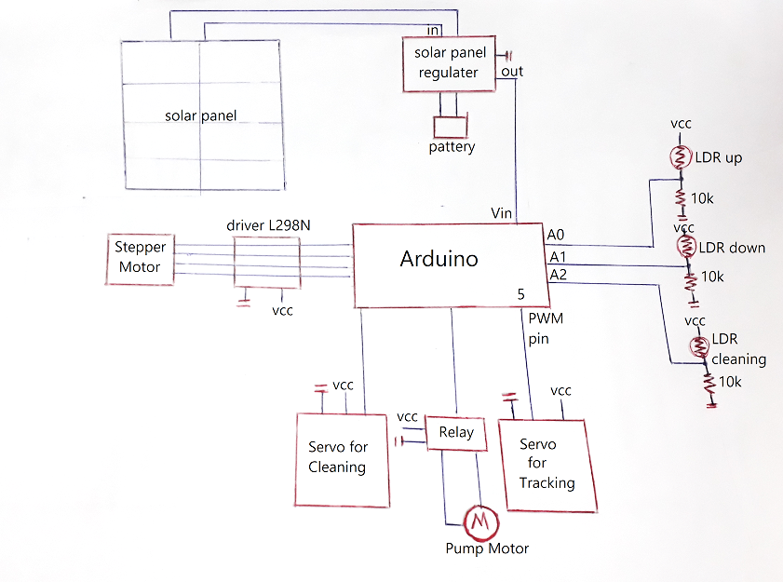
Cct :

Slide 15
Constraint’s
Hardware problem.
The hardware takes some time to arrive, so we wasted time waiting for it .

Slide 16
Future work !
We hope that we are able to continue with this project, the list of our future work is as follow:
Improve the tracker to be dual axis .
Design an application to get an on -time feed back about the statues of the whole system and if need any maintenance .

Slide 17
Demo

Slide 18
Any Questions?
Thank you!

