Slide 1

An-Najah National University
Engineering Faculty
Building Engineering Department
An Integrated Redesign For Tulkarm commercial complex
Prepared by: Anas Sami Ahmad
Mohammad Allam Herzallah
Mohannad Ali Qwareeq
Supervised by: Dr. Ahmad Al - Haj Saleh

Slide 2

Contents
Architectural Design
Environmental Analysis
Structural Design
Electro-Mechanical Design
Quantity Surveying

Slide 3
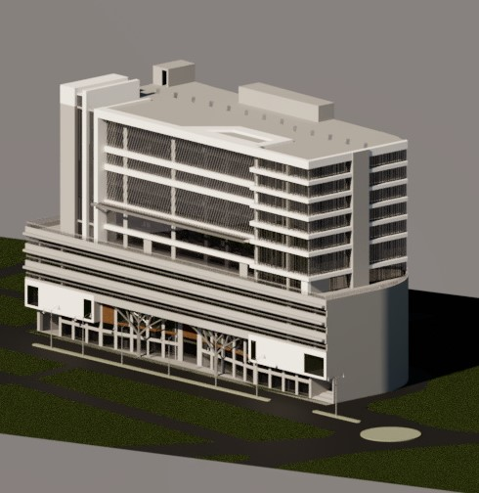
Introduction
This project is an integrated design for Tulkarm commercial complex it located in the city of Tulkarm, 1 km from the city center, next to Thabet Thabet Square.
The mall consists of 14 floors
The area of each floor (2200-2800) square meters

Slide 4
Architectural design

Slide 5
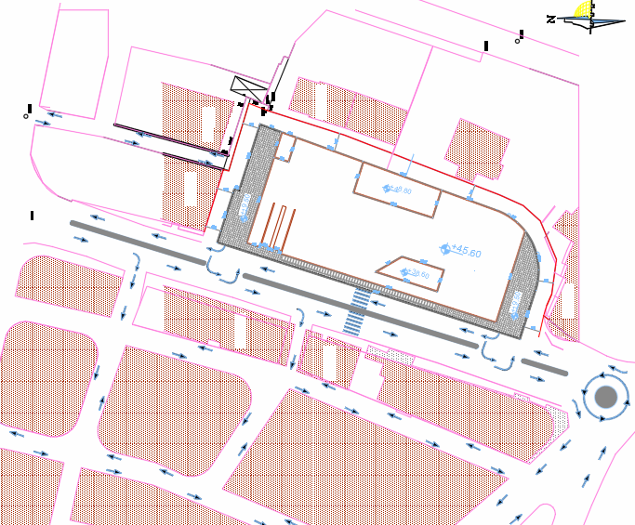
Site plan:

Slide 6
Architectural Plans before and after modification

Slide 7
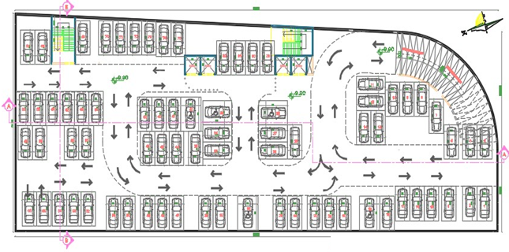
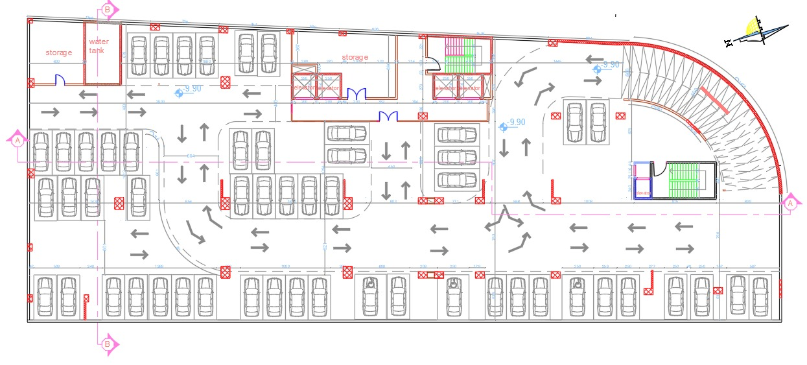
Basement 3 ,2
Area = 2631 m².
Floor height = 3.3 m.
Before Modifying
Ramp slope =13%
`
After Modifying

Slide 8
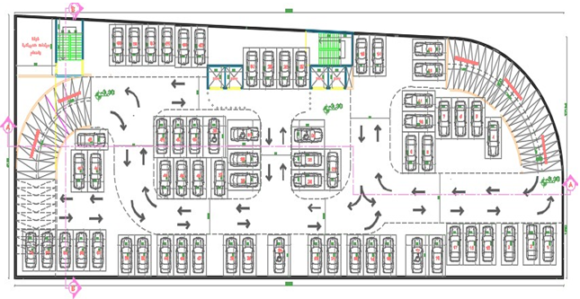
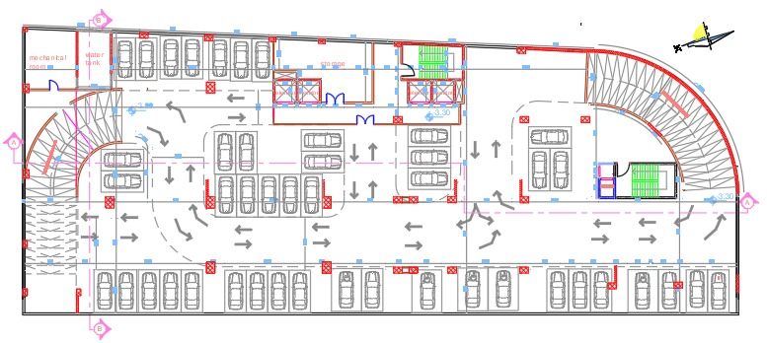
Basement 1
Area = 2631 m².
Floor height = 3.3 m.
Before Modifying
Ramp slope =13%
Ramp slope =12%
After Modifying

Slide 9
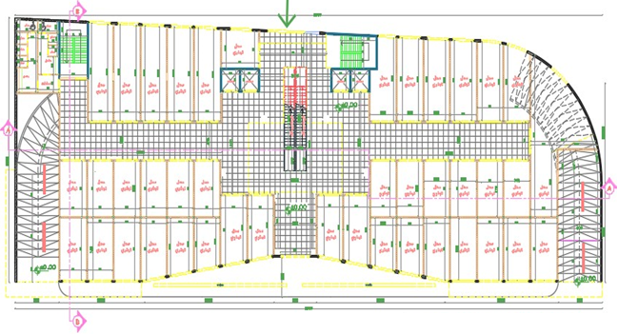
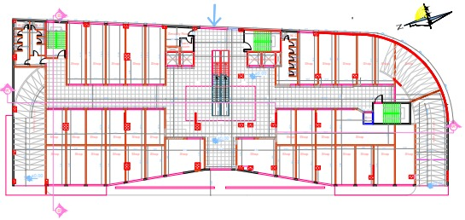
Ground and 1st Floor
Area = 2631 m².
Floor height = 5.3 m.
Before Modifying
After Modifying

Slide 10
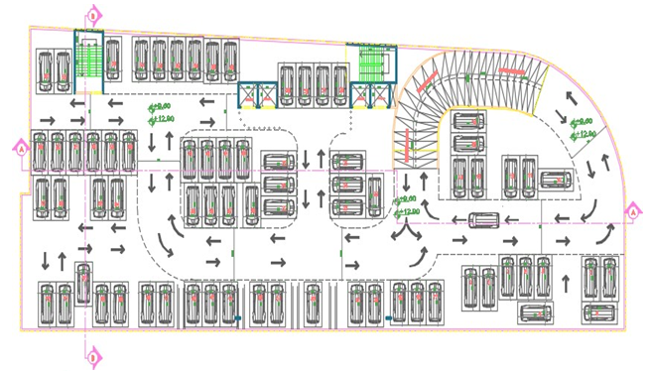
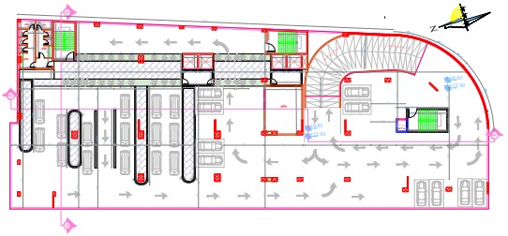
2nd - 4th Floor
Area = 2631 m².
Floor height = 3.3 m.
Before Modifying
After Modifying

Slide 11
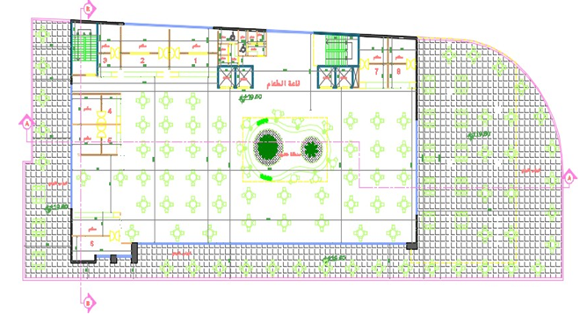
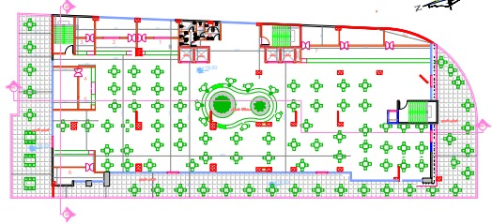
Fifth Floor
Area = 2631 m².
Floor height = 3.8 m.
Before Modifying
After Modifying

Slide 12
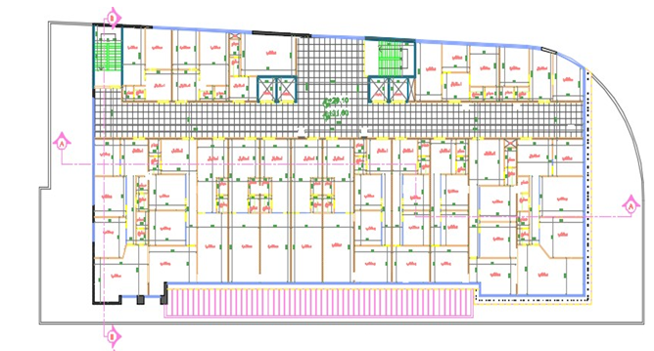
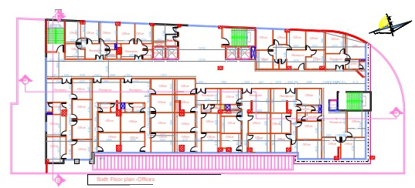
6th - 10th floor
Area = 2228 m².
Floor height = 3.5 m.
Before Modifying
After Modifying

Slide 13
Elevations before and after modification

Slide 14
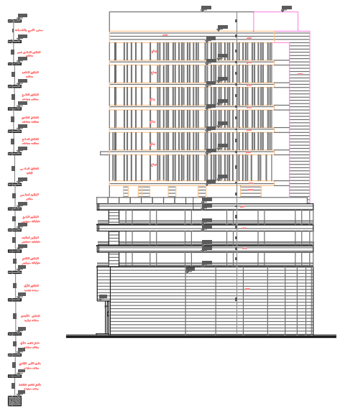
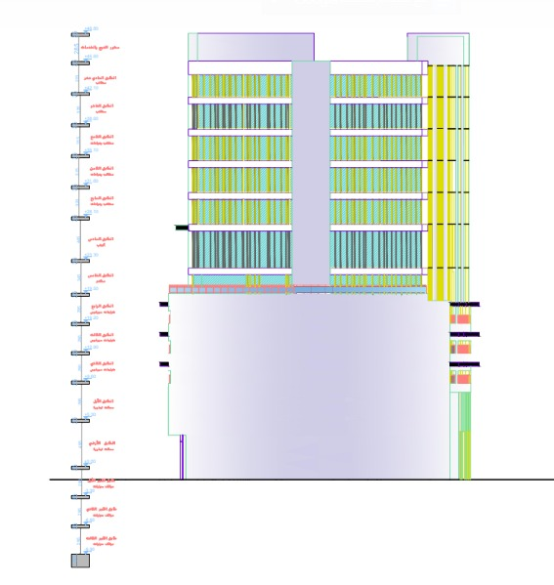
South elevation
After
South elevation
Before

Slide 15
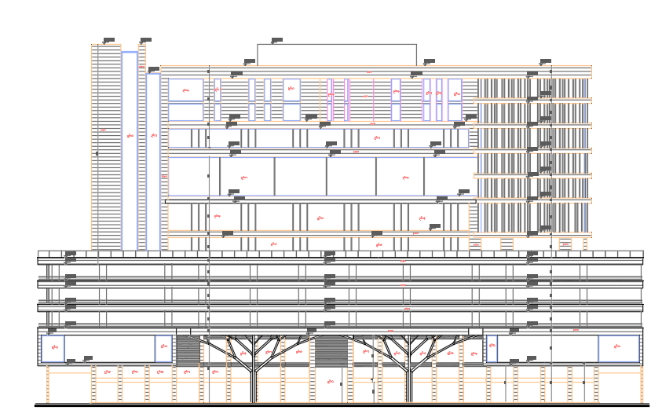
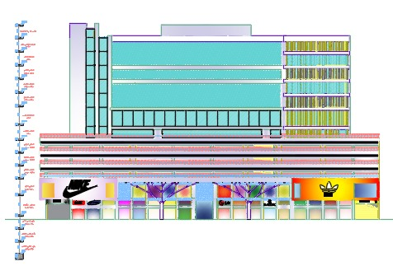
West elevation
After
West elevation
Before

Slide 16
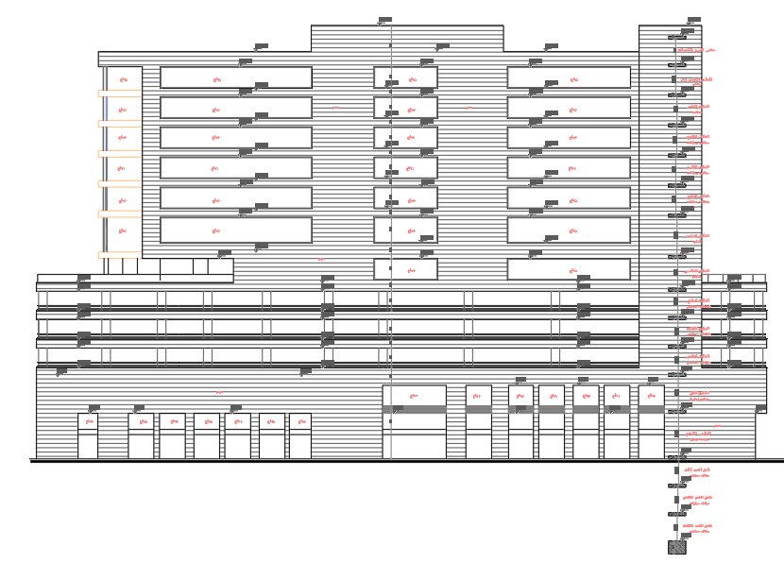
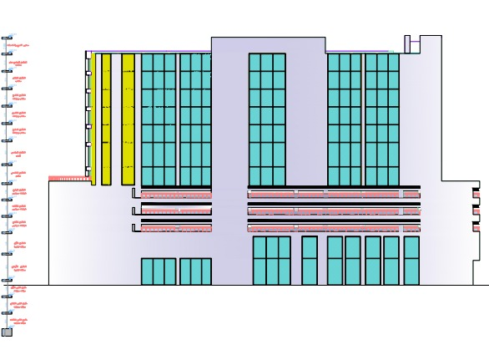
East elevation
After
East elevation
Before

Slide 17
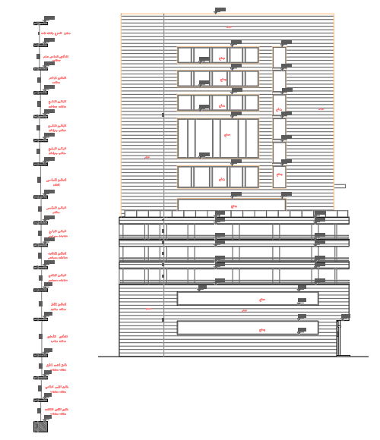
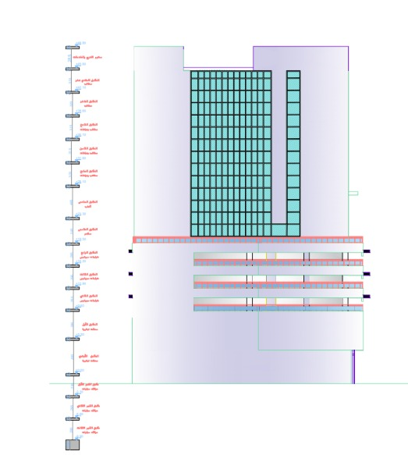
North elevation
After
North elevation
Before

Slide 18
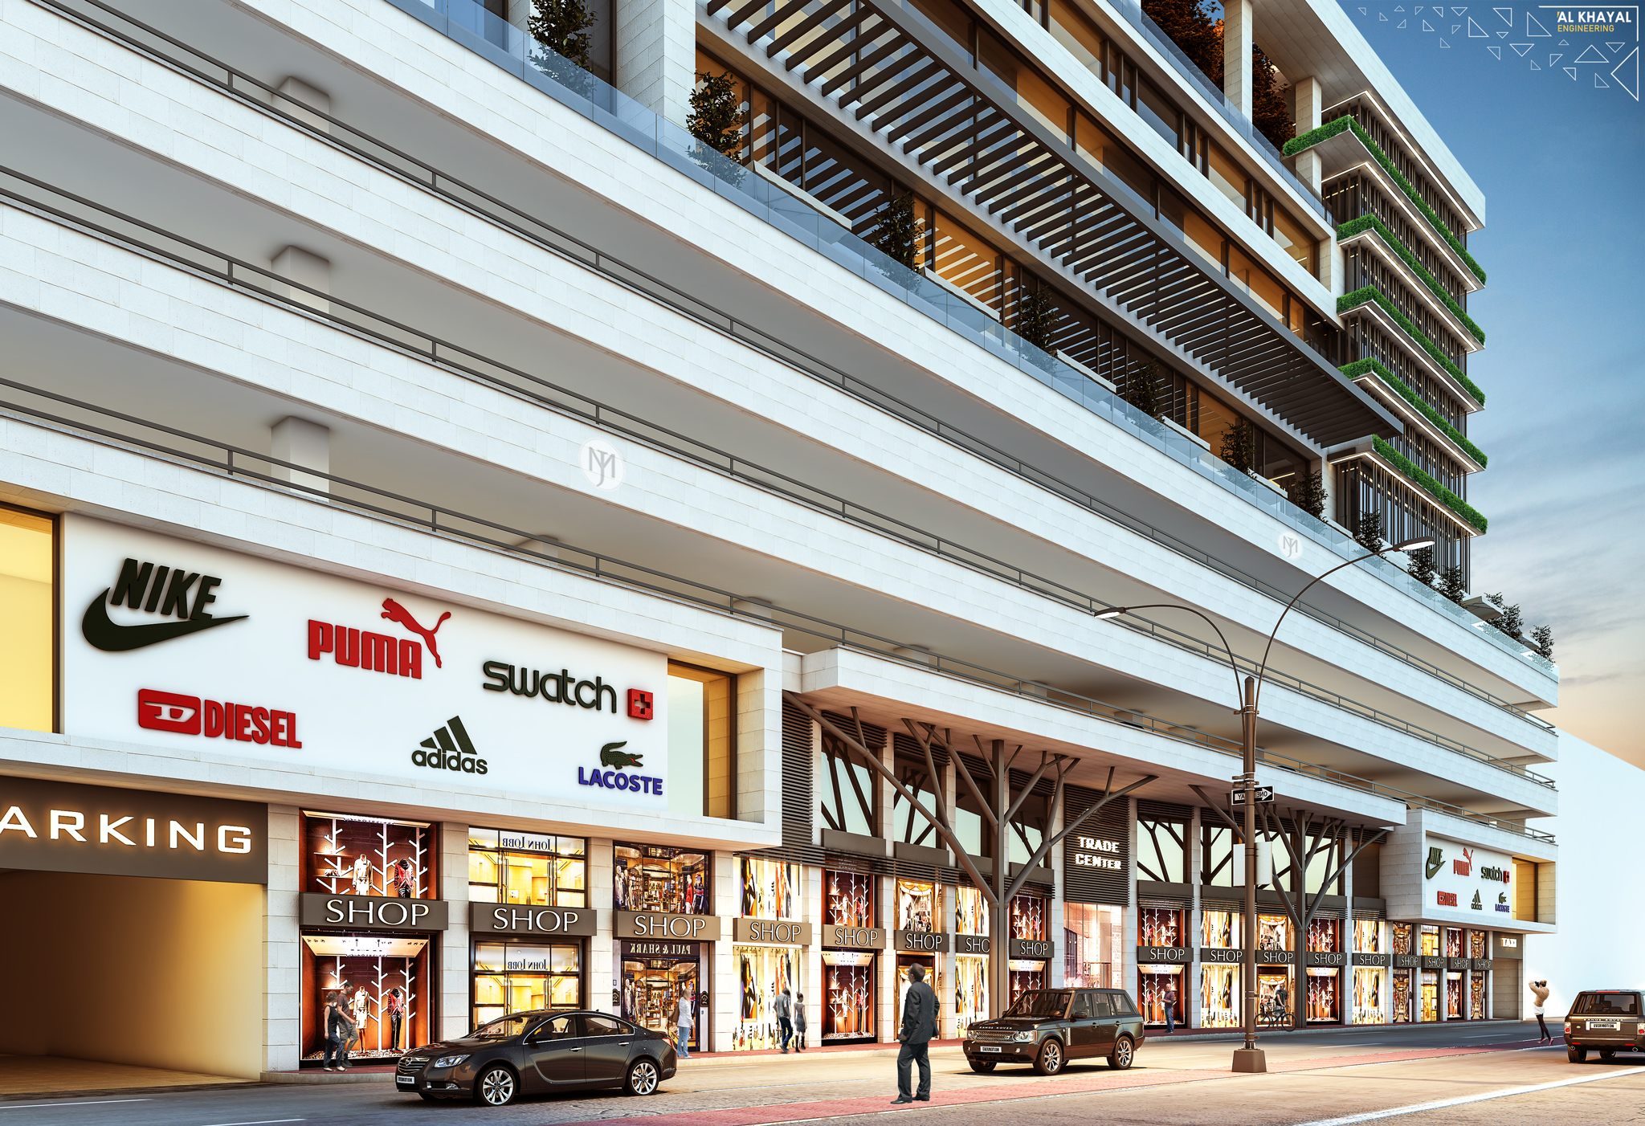

Slide 19
environmental analysis

Slide 20
Environmental analysis
1
Shading Analysis
2
Daylight Factor
3
Thermal Analysis

Slide 21
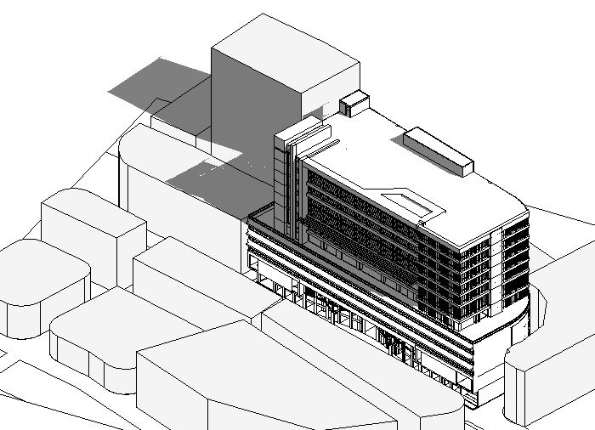
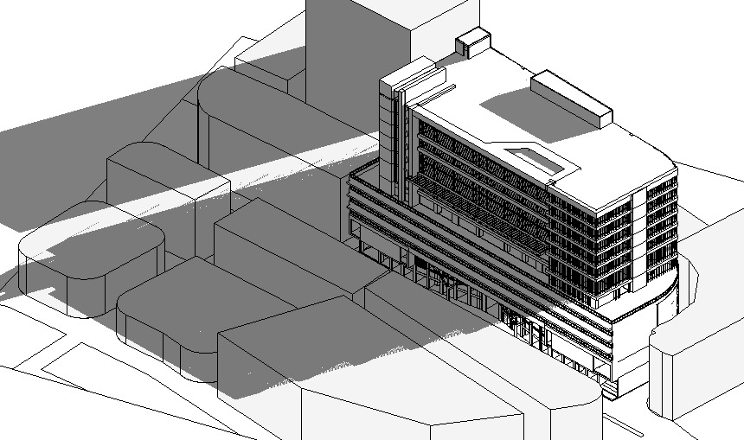
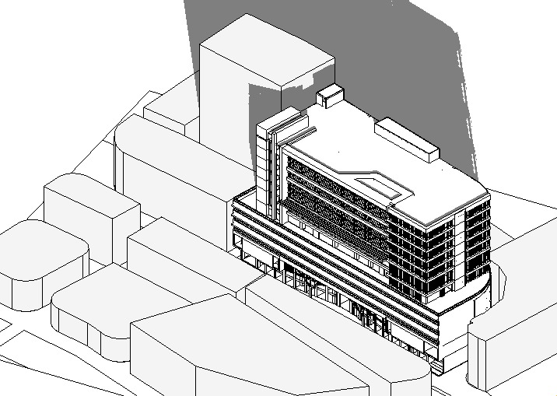
Shading and over shadowing
In Winter:
At 8:00 AM
At 12:00 PM
At 4:00 PM

Slide 22
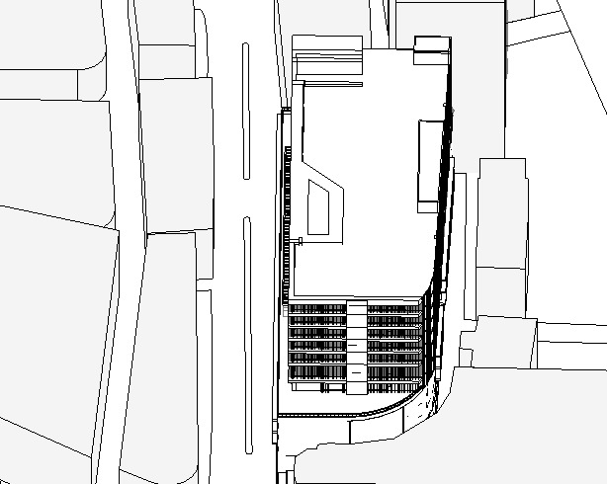
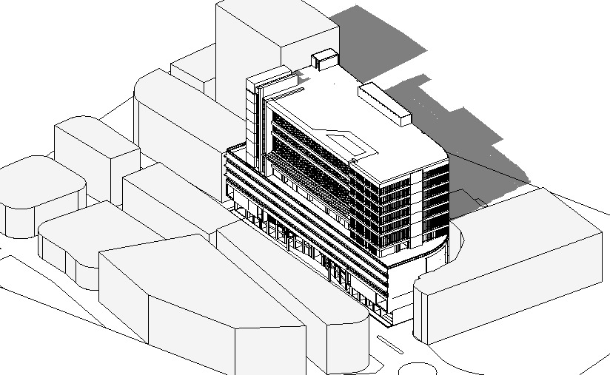
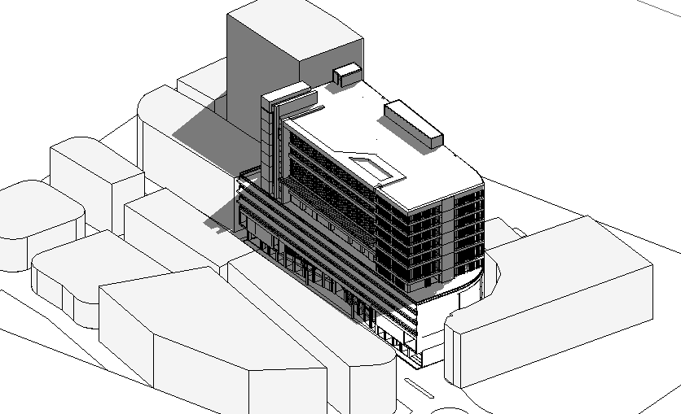
Shading and over shadowing
In Summer:
At 8:00 AM
At 12:00 PM
At 4:00 PM

Slide 23
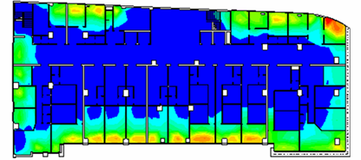
Daylight factor
Before treatments

Slide 24
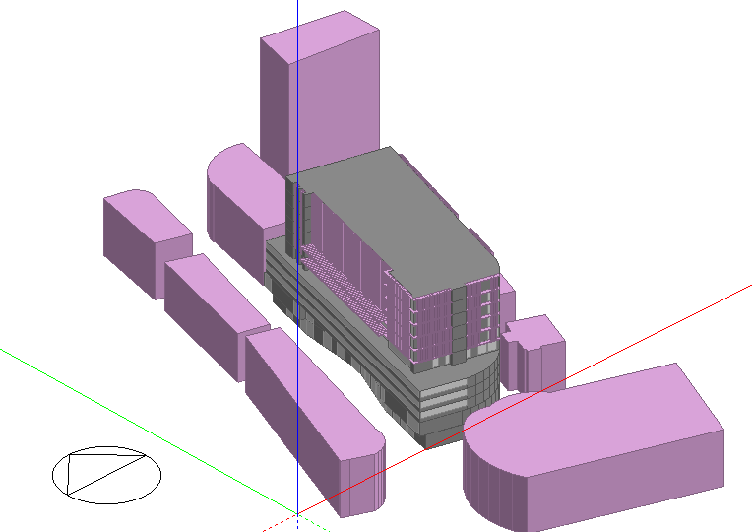
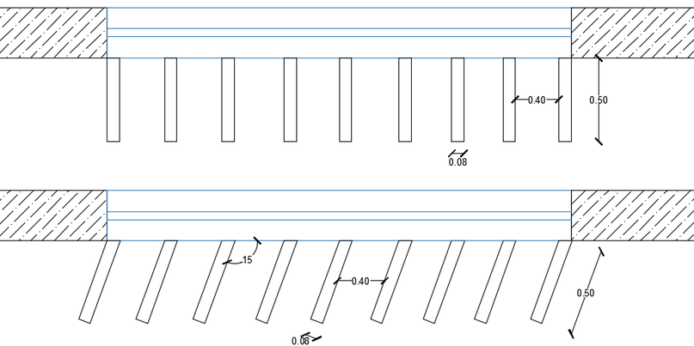
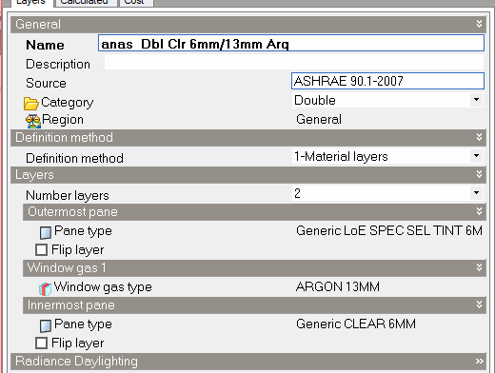
Treatments used

Slide 25
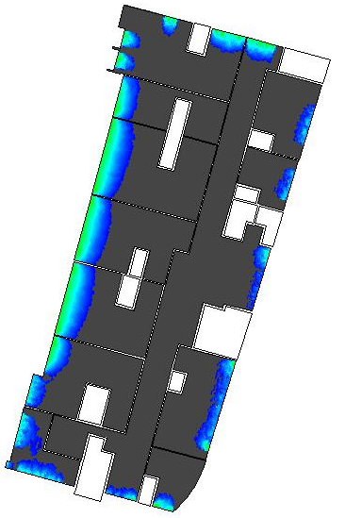
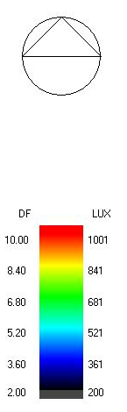
Daylight factor
after treatments

Slide 26
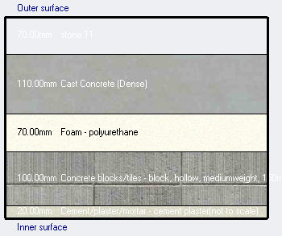
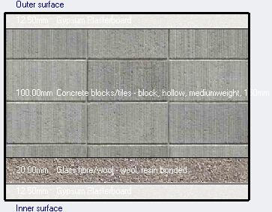
Construction layers and U-value
For External wall
For internal wall
U-value = 0.337 W/m².K
U-value = 0.929 W/m².K

Slide 27
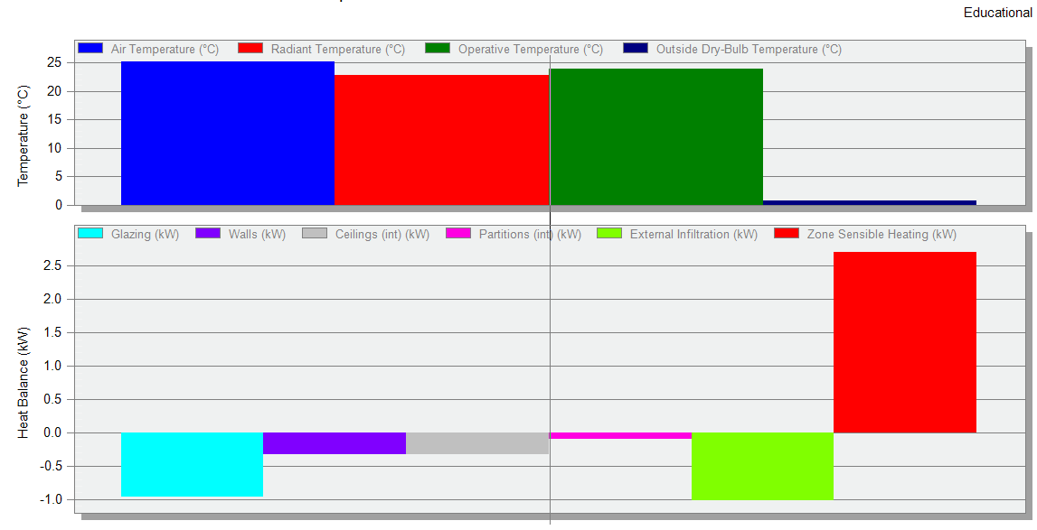
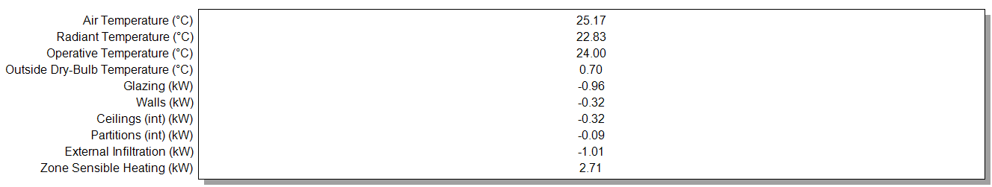
Heating load
Total design heating capacity = 290.31 KW

Slide 28
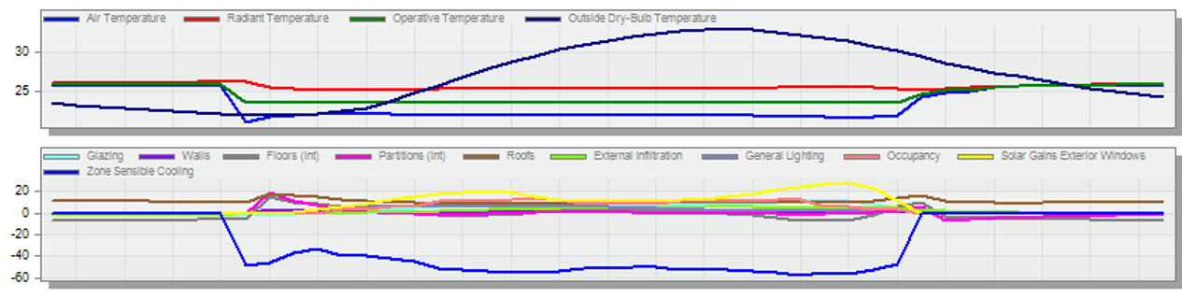
cooling load
Total design cooling capacity = 479.96KW

Slide 29
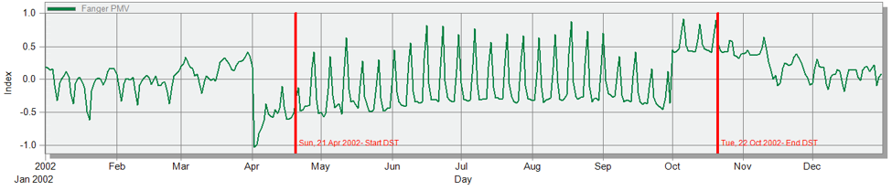
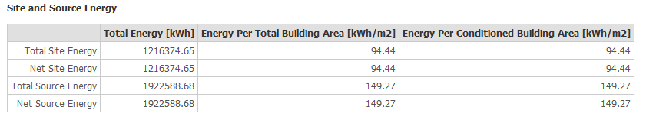
Simulation output
PMV – Set
energy portfolio manager standard for mixed use property is 295.2 KWh/m2

Slide 30
Structural analysis and design

Slide 31
Structural analysis and design
Codes
Material Properties
Section
Checks
Seismic Checks
Design and Detailing

Slide 32
ANALYSIS AND DATA COLLECTION
Codes
Section
ACI 318M-14
UBC 1997
ASCE-16
  Beam (1m × 0.5m).
  Special beam (0.5m × 1 m).
  External beam (0.8m × 0.5m).
column (0.5m * 0.5m)
column (0.5m * 0.8m).
column (0.7m * 1m).
column (0.25m * 2 m).
column (1 * 1.3m).
Material Properties
Reinforced Concrete
28 MPa (used for slabs and beams)
32 MPa (used for columns, shear walls and foundation)
  wall1 (0.25m).
  wall2 (0.2m).
slab thickness =0.45m
Reinforcing Steel with yielding strength = 420 MPa

Slide 33
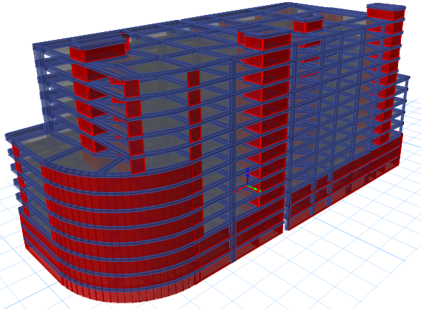
Structural building

Slide 34
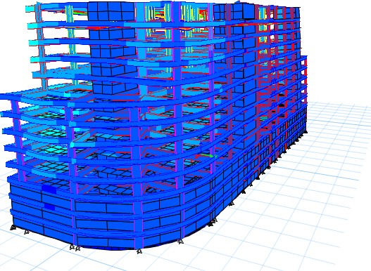
checks
Compatibility Check
Deflection Check
Equilibrium Check
Stress – Strain Check

Slide 35
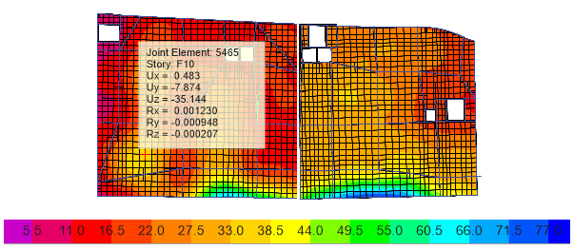
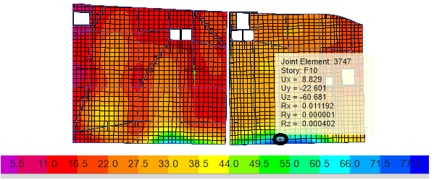


checks
Compatibility Check
Deflection Check
Equilibrium Check
Stress – Strain Check
the permissible deflection slab = $\frac{l}{240}$
the permissible deflection Cantilever = $\frac{l}{120}$

Slide 36
checks
Compatibility Check
Deflection Check
Equilibrium Check
Stress – Strain Check
Building | SID Load | Live Load
Manual | 175589 | 120243
ETABS | 173009 | 114388
%Error | 2% | 5%
%Error should be less than 5%

Slide 37
checks
Compatibility Check
Deflection Check
Equilibrium Check
Stress – Strain Check
 | Hand calculation | Etab | Error%
Corner column | 43.93 | 40.02 | 9%
Internal column | 7159 | 6241 | 14%
Edge columns | 252 | 230 | 9%
beam | 105 | 112 | 6%

Slide 38
Seismic inputs
Seismic Zone Factor (Z) (Peak Horizontal Ground Acceleration in study site as a percentage of gravity) | 0.15
Soil Profile Type (Site Class) | C
Mapped Maximum Considered Earthquake MCE spectral response accelerations for Short period (0.2 sec.) S_{S} | 0.32
Mapped Maximum Considered Earthquake MCE spectral response accelerations for long period (1.0 sec.) S_{L} | 0.09
Site Class Coefficient (Fa) | 1.2
Site Class Coefficient (Fv) | 1.7
Design Short Period Acceleration S_{mS} | 0.38
Design Long Period Acceleration S_{m1} | 0.15

Slide 39
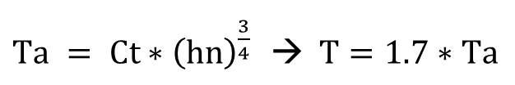
Seismic checks
Period and modal participation ratio check
$Ta = Ct∗{\left(hn\right)}^{\frac{3}{4}}$ $→ T=1.7∗Ta$
Case | Mode | Period sec | UX | UY | Sum UX | Sum UY
Modal | 1 | 1.596 | 0.1977 | 0.0296 | 0.1977 | 0.0296
Modal | 2 | 1.521 | 0.0474 | 0.2056 | 0.2451 | 0.2352
Modal | 3 | 1.411 | 0.0134 | 0.2338 | 0.2585 | 0.469
Modal | 4 | 1.341 | 0.2017 | 0.0457 | 0.4602 | 0.5147
Modal | 5 | 0.979 | 0.0063 | 0.0151 | 0.4664 | 0.5299
Modal | 6 | 0.704 | 0.0006 | 0 | 0.467 | 0.5299
Modal | 7 | 0.625 | 0.0364 | 0.0154 | 0.5034 | 0.5453
Modal | 8 | 0.598 | 5.54E-06 | 0.0015 | 0.5034 | 0.5468
Modal | 9 | 0.416 | 2.33E-05 | 9.48E-06 | 0.5034 | 0.5468
Modal | 10 | 0.4 | 0.0253 | 0.0031 | 0.5287 | 0.5499
Modal | 11 | 0.394 | 0.0433 | 0.0056 | 0.572 | 0.5555
Modal | 12 | 0.357 | 0.0093 | 0.1023 | 0.5812 | 0.6578
Modal | 39 | 0.101 | 0.0002 | 0.0194 | 0.9431 | 0.9186

Slide 40
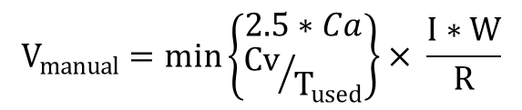
Seismic checks
Base – Shear check
$$V_{manual}=min\left\{\begin{aligned}2.5∗Ca \\ {Cv}/{T_{used}}\end{aligned}\right\}× \frac{I∗W}{R}$$
AXIS | T ETAPS | Cu * Ta | T used (small) | Cs1 | Cs2 | Cs3 | Cs final | V | V ETABS
x | 1.596 | 2.7115 | 1.596 | 0.057 | 0.036 | 0.011 | 0.036 | 23661.62 | 23662.65(SF=5839)
y | 1.411 | 2.7115 | 1.411 | 0.057 | 0.040 | 0.011 | 0.040 | 26763.96 | 26765.19(SF=6529)

Slide 41
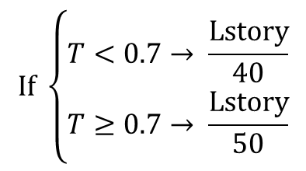
Seismic checks
Drift check
Story | Load Case/Combo | Direction | Drift | Label | X | Y | Z | Drift * R
F3 | ENV ALL Max | X | 0.002178 | 226 | -35.5 | -4.1 | 18 | 0.009801
F3 | ENV ALL Max | Y | 0.000784 | 248 | 7.5131 | 9.4031 | 18 | 0.003528
F3 | ENV ALL Min | X | 0.002081 | 226 | -35.5 | -4.1 | 18 | 0.009365
F3 | ENV ALL Min | Y | 0.001501 | 242 | 8.8326 | -8.2109 | 18 | 0.006755
$$If \left\{\begin{aligned}&T<0.7→ \frac{Lstory}{40} \\ &T≥0.7→ \frac{Lstory}{50}\end{aligned}\right.$$
We noticed that the results from the ETAP analysis for the value of Drift (δM) are very suitable, as it does not exceed the value of the code ASCE 7-10 (0.20), and the highest value was (0.009) in floor 3.

Slide 42
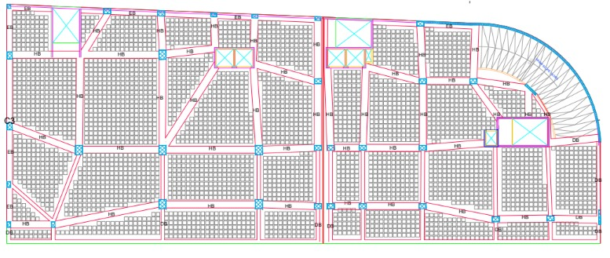

Slabs system AND detailing
Voided slab H=45 cm.

Slide 43

Beams
Beam |  | Section Width | Section Depth | Reinforcement area | Bar diameter | Top | Bottom
ex beam 800*500 | 800 |  | 500 | 2201 | 25 | 5 | 5
beam 1000*500 | 1000 |  | 500 | 3204 | 25 | 7 | 7
beam 500*1000 | 500 |  | 1000 | 1200 | 25 | 3 | 3

Slide 44


Beams

Slide 45

Columns design

Slide 46



Columns design
Column | length | width | reinforcement | stirps
CR1 | 0.5 | 0.5 | 12Ф16 | 1Ф10/100mm at End
CR2 | 0.8 | 0.5 | 16Ф18
CR3 | 1 | 0.7 | 24Ф20 | 1Ф10/150mm at Middle
CR4 | 1.3 | 1 | 42Ф20

Slide 47

Shear walls design
Shear wall | thickness (m) | Total length (m) | L boundary | Reinforcement / 1 m each direction (web) | Reinforcement / 1 m each direction (web) | reinforcement boundary | reinforcement boundary
 |  |  |  | each layer | each layer | strips | S5Ф10 /m
SW1 | 0.2 | 2.9 | 0.3 | 500 | 6Ф12 | 580 | 4Ф14
SW2 | 0.2 | 5.6 | 0.6 | 500 | 6Ф12 | 1120 | 8Ф14
SW3 | 0.2 | 6.6 | 0.7 | 500 | 6Ф12 | 1320 | 8Ф14
SW4 | 0.2 | 4.2 | 0.4 | 500 | 6Ф12 | 840 | 6Ф14
SW5 | 0.2 | 7.3 | 0.7 | 500 | 6Ф12 | 1460 | 8Ф16
SW6 | 0.25 | 2 | 0.2 | 625 | 6Ф12 | 500 | 4Ф14
SW7 | 0.25 | 6.6 | 0.7 | 625 | 6Ф12 | 1650 | 8Ф16
SW8 | 0.25 | 14.6 | 1.0 | 625 | 6Ф12 | 2500 | 10Ф18

Slide 48

foundation design
GENERAL INFORMATION
  Material :- F'c =32 Mpa
  Soil profile:- 220 KN/m²
CHECKS
Wide beam shear check
Punching shear check

Slide 49


foundation design

Slide 50




Sheet pile

Slide 51

Stair section

Slide 52
Electro-Mechanical Design

Slide 53



Mechanical systems
Water System
Drainage System
HVAC System

Slide 54


Water System
 | Vertical Feeder | Water Meter | Horizontal Feeder | Critical Branch
Diameter (ft) | 2" | 1" | 1" | 3/4"
Pressure Loss (Psi) | 5.02 | 1.3 | 0.035 | 0.105
 | Vertical Feeder | Water Meter | Horizontal Feeder | Critical Branch
Diameter (ft) | 3" | 3" | 3" | 3/4"
Pressure Loss (Psi) | 4.98 | 1.3 | 0.0043 | 0.97

Slide 55


Drainage System

Slide 56

Drainage System

Slide 57

Drainage System

Slide 58




HVAC System
Outdoor unit
Indoor unit
Fan coil unit from FUJITSU Company
Split unit from Daikin
Outdoor unit from Mitsubishi
Total Heating | Total Cooling
290.31 | 479.96

Slide 59

HVAC System
Diffuser unit
Diffuser unit from Air TROX TECHNIK Company
Square diffuser

Slide 60

Split unit distribution

Slide 61

Diffuser and duct distribution

Slide 62

Diffuser and duct distribution

Slide 63



Electrical systems
Artificial lighting design
Sockets distribution
Acoustical design

Slide 64



Artificial lighting design
Office:

Slide 65



Artificial lighting design
Reception room:

Slide 66



Artificial lighting design
Shop:

Slide 67

Lighting distribution

Slide 68


Sockets distribution

Slide 69

Distribution board

Slide 70

Lighting distribution

Slide 71


Sockets distribution

Slide 72

Distribution board

Slide 73


Acoustical design
Cafeteria design

Slide 74



Acoustical design
Cafeteria design
TOT SPL
RT60

Slide 75


Acoustical design
Cafeteria design
Articulation Loss
STI

Slide 76


Acoustical design
Office design

Slide 77



Acoustical design
Office design
RT60
TOT SPL

Slide 78


Acoustical design
Shop design
Articulation Loss
STI

Slide 79



Acoustical design
STC
STC for internal wall | ≥ 50
STC for internal glass wall | ≥ 40
IIC for internal floor | ≥ 60

Slide 80


Acoustical design
IIC

Slide 81
Quantity surveying and cost analysis

Slide 82
Quantity Surveying and cost analysis
The budgeted cost of the project is 104208000 ILS.
The unit cost of the project is 2200 ILS.
The budgeted cost of structural system is 61573600 ILS.
The budgeted cost of mechanical system is 3900700 ILS.
The budgeted cost of electrical system is 11636100 ILS.

Slide 83


