Slide 1
The network characteristics of disease-associated genes across different protein-protein interaction networks
Asim Saleh & Dawoud Younis
Supervised by: Samer Arandi

Slide 2
Outline
Context
I
II
III
IV
V
The Problem
Objectives
Our Solution
Results
and Discussion
Conclusion
What are we trying to solve ?
Why are we doing this ?
How we are going to achieve our objective ?
Then what ?
What did we get ?

Slide 3
The Problem
The network characteristics of disease-associated genes across different protein-protein interaction networks

Slide 4
The Problem
Interactome
1940s - 2000s.
Set of PPI in human cells.
Contains 24,000 proteins.
Incomplete.
Introduction
Background
Statement

Slide 5
The Problem
Disease
Abnormal interactions between proteins.
Pathway is a system of interacting proteins whose produces that disease.
Introduction
Background
Statement

Slide 6
The Problem
Network characteristics
Bipartite Network.
Real Networks are Supercritical
Real Networks are Not Random
are Scale-free.
Ultra-Small Property
Introduction
Background
Statement

Slide 7
The Problem
Identify proteins and other molecules associated with the disease.
But discovery is a challenging computational task.
Inter-connectivity of a pathway implies the impact of altering one protein.
Network-based methods for disease protein discovery such as LCC.
jhgfghjkhjh
Introduction
Background
Statement

Slide 8
The Problem
Statement
The disease-associated genes reveal certain characteristics on human interactome
In this project our goal was to investigate to see the robustness of these characteristics across different networks.
Notes:
Do we have the same observations from one network to another?

Slide 9
Objectives
Test the robustness of Multiple PPIs based on the
predefined network characteristics
Generate one large network from multiple PPI
sources.

Slide 10
Our Solution
Data Collection and preconditioning
05
Integrated network and case study
01
04
Steps
Random edge removal
Data representation (RAW to Graph)
02
03
Metric Testing

Slide 11
Our Solution
Data Collection and preconditioning
05
Integrated network and case study
01
04
Steps
Random edge removal
Data representation (RAW to Graph)
02
03
Metric Testing

Slide 12
Our Solution
Data Collection and preconditioning
05
Integrated network and case study
01
04
Steps
Random edge removal
Data representation (RAW to Graph)
02
03
Metric Testing

Slide 13
Our Solution
Data Collection and preconditioning
05
Integrated network and case study
01
04
Steps
Random edge removal
Data representation (RAW to Graph)
02
03
Metric Testing

Slide 14
Our Solution
Data Collection and preconditioning
05
Integrated network and case study
01
04
Steps
Random edge removal
Data representation (RAW to Graph)
02
03
Metric Testing

Slide 15

Tools Used
Python 3.6
Packages:
  networkX
  Pickle
  Pandas
  Scipy
  XlsxWriter

Slide 16
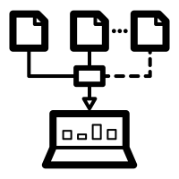
Data Collection and preconditioning
Data Collection and preconditioning
Data representation (RAW to Graph)
Metric Testing
Random edge removal
Integrated network and case study
14 different source
PPIs
Different formats
Data Collected
Diseases
299 Diseases
Challenges:
- file formats for raw data
Pandas, xlxsWriter
- protein format
Online converter (www.uniprot.com)

Slide 17

Data representation (RAW to Graph)
Data Collection and preconditioning
Data representation (RAW to Graph)
Metric Testing
Random edge removal
Integrated network and case study
Each network is represented as a Graph
  From different file formats to pickle
Maintaining Error and consistency
  Converting all interactors to GeneID
Studying the overlapping between the networks
  Two tests were used :
    1. Hypergeometric test
    2. Jaccard index

Slide 18
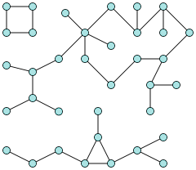
Metric Testing
Data Collection and preconditioning
Data representation (RAW to Graph)
Metric Testing
Random edge removal
Integrated network and case study
Node
⇓
Protein
LCC
Edge
⇓
Interaction
z_score =
( lcc_observed - l_mean) / l_std

Slide 19
Random edge removal
Data Collection and preconditioning
Data representation (RAW to Graph)
Metric Testing
Random edge removal
Integrated network and case study
Why ?
Edges contribution
Noise effects
How?
Choosing random subset of edges (5%,10%,15%,20%) and removing them from the original graph.
Challenges:
- Running time ?

Slide 20

Random edge removal
Data Collection and preconditioning
Data representation (RAW to Graph)
Metric Testing
Random edge removal
Integrated network and case study
Challenges:
- Running time ? very high
Solution:
- (High Throughput Computing (HTC)
 | Time
Task | PCs*3 | Cluster
Random edge removal | 36 - 45 hours | 3 hours

Slide 21
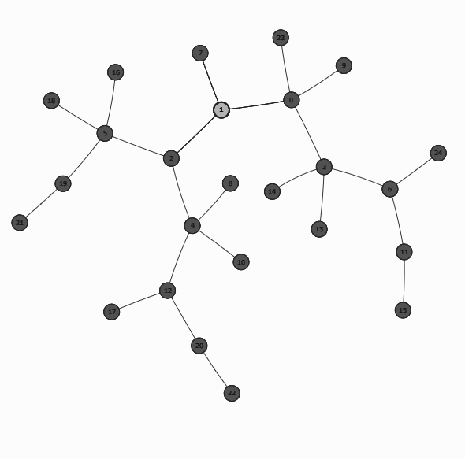
Integrated network and case study
Data Collection and preconditioning
Data representation (RAW to Graph)
Metric Testing
Random edge removal
Integrated network and case study
+
=
N : node , K : node evidence , t : threshold
N is taken only if K > t

Slide 22
Results and Discussion

Slide 23
Network Analysis
Degree distribution should follow power law.
Calculated by finding the degree for each node.
Six degrees of separation.
Implemented using networkx and multiprocessing packages.
Degree distribution
Six degrees of separation

Slide 24
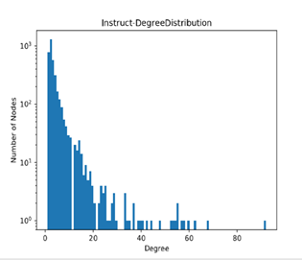
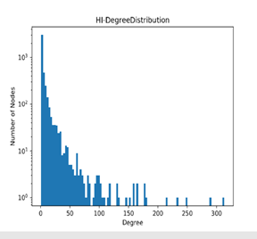
Degree distribution

Slide 25
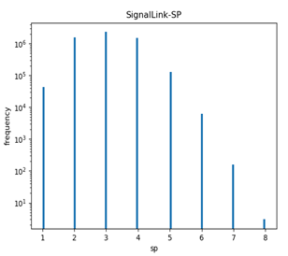
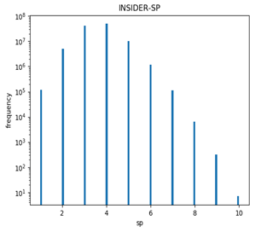
Shortest Path for networks

Slide 26
Genes Overlap
Jaccard-index : Smaller for edges than nodes.
Implemented using sets, finding intersection and union
Jaccard-index= Intersection/Union
Jaccard-index
Hypergeometric test

Slide 27
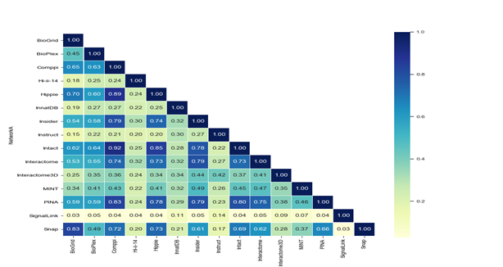
Jaccard-index for genes

Slide 28
Genes Overlap
Hypergeometric : Small values with respect to population.
Implemented using scipy, matplotlib and numpy packages.
Returns Very small numbers.
Results indicate overlapping with respect to all population.
Jaccard-index
Hypergeometric test

Slide 29
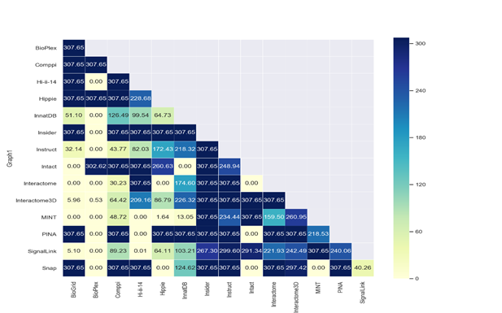
Hypergeometric test for edges

Slide 30
Diseases mapping
299 diseases.
Randomize proteins and distribute them.
Repeating this process 100,000 times.
Z-score > 1.65
Most of 299 diseases more than 100. ( 30 - 245 )

Slide 31
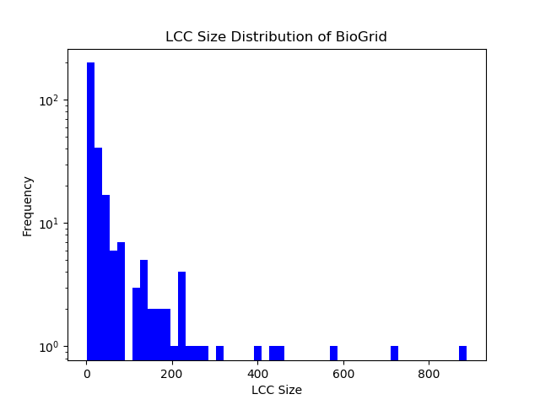
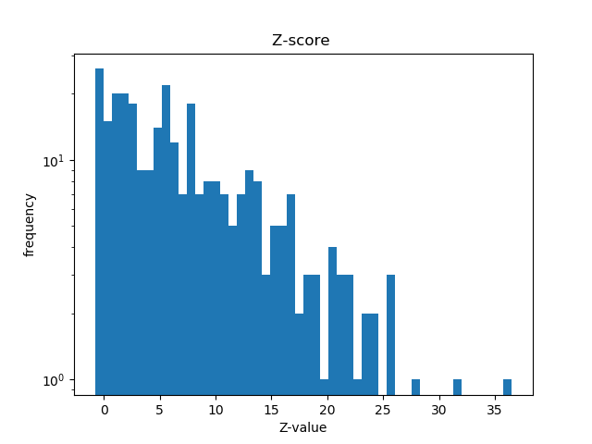
Max = 889.0 Min = 1.0 Mean = 38.515 Median = 9.0
Max = 36.534 Min = -0.80 Mean = 7.572 Median =5.726

Slide 32
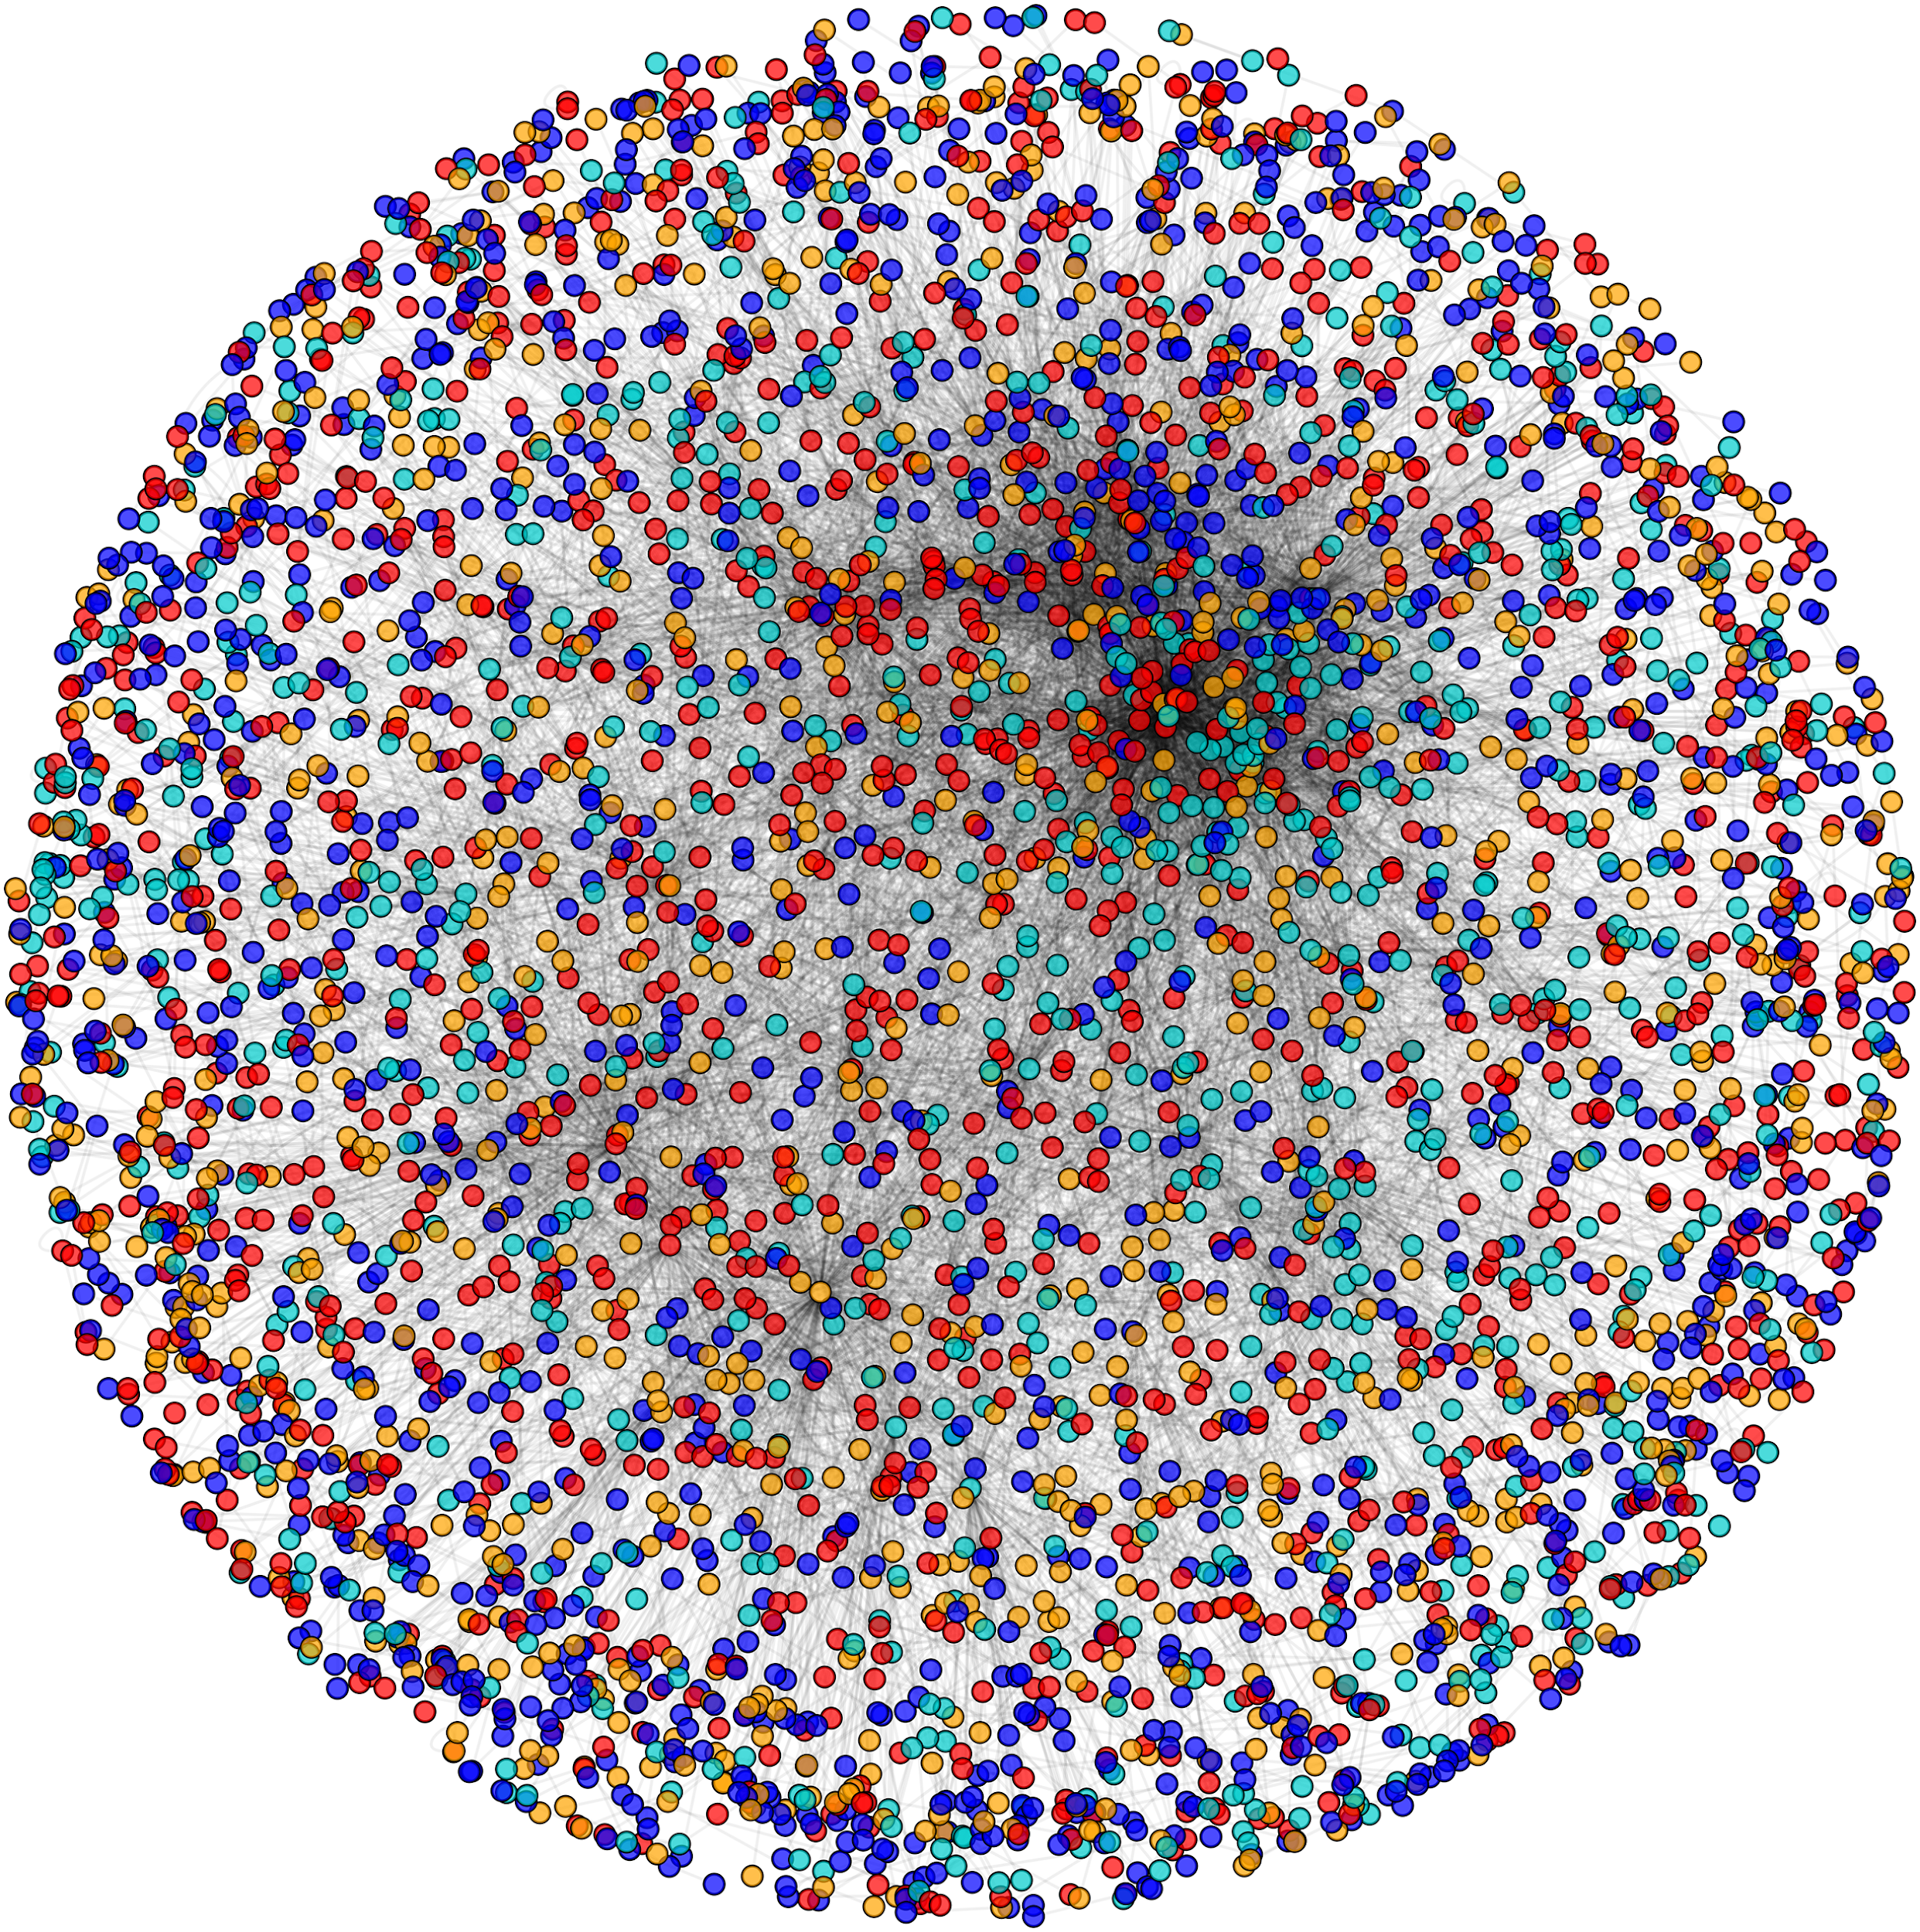
Random Edge Removal
Four different percentages.
High throughput programming.
Each iteration 100,000 * (get random N > 10).
Using Condor.
Study the robustness of edges.

Slide 33
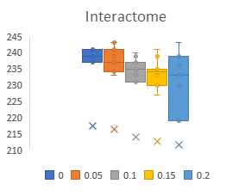
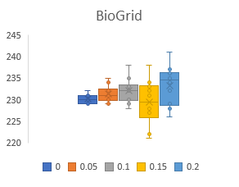
Behaviour of Networks with Random Edge Removal

Slide 34
Edge removal results
Predictive power of the connectivity significance should decrease.
Very different behavior !!
Remains roughly constant as the network completeness decreases .
Affects links between disease proteins to the same extent as links to other proteins.

Slide 35
Achieve high performance with limited resources
Generate a network can save, call it whenever need .
This help to produce some re-generatable and robust results and save time.
To calculate LCC z-scores, perform some pre-calculations first, save it.
For a given network, randomly choose some nodes (iterate from 1 to 2000), perform this 1000 times and calculate the average LCCs and the standard deviation of LCCs.

Slide 36
Achieve high performance with limited resources
Make a dictionary in which key is the size of nodes and the value is the average LCC and the standard deviation of LCC.
So dictionary should have 2000 keys and 2000 pairs of values.
To calculate the LCC Z-score of a disease, find the LCC of the disease and then calculate the z-score by calling the corresponding average LCC and standard deviation of the LCCs that you have pre-calculated before.

Slide 37
Integrated Network
Combining networks based on edge evidence.
Implemented by union all 14 sources using
Count edge evidence by dictionaries.

Slide 38
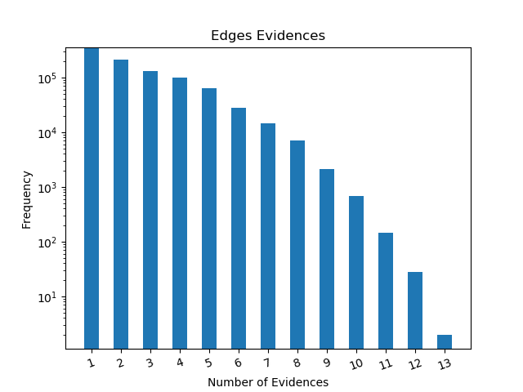
Integrated Network

Slide 39
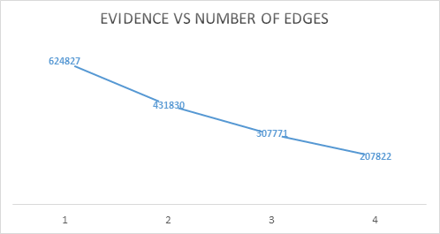
Integrated Network

Slide 40
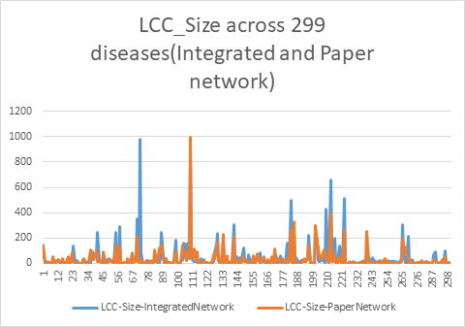
Confirmation of paper results

Slide 41
Gastrointestinal disease
Disease module has 270 nodes (proteins) with 341 edges (interactions)
Disease is 316 proteins.
LCC 195.
Sorting nodes by degrees and remove them one by one.
Case Study

Slide 42
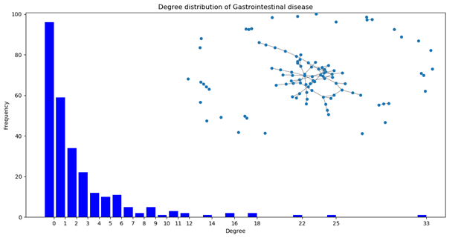

Slide 43
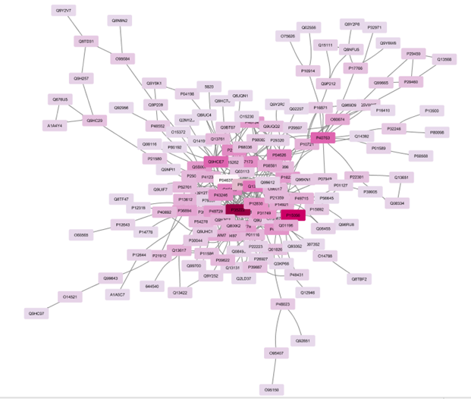

Slide 44
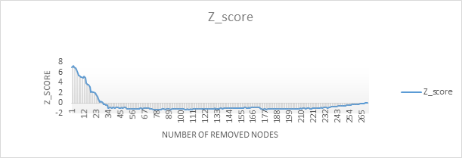
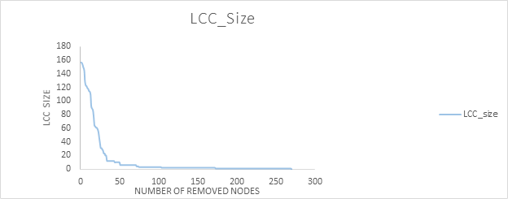
LCC Size changes with node removal of gastrointestinal diseases from highest to lowest

Slide 45
Case study results
Most seed proteins can be removed without considerably changing the result such as Q15831.
Small number of nodes whose removal results in a drastic change of the final outcome such as P40763 .
Observed that crucial nodes whose removal will be most destructive are generally not part of the largest connected component of the initial seed set.

Slide 46
Conclusion

Slide 47
Identification of modules is at the core of many current analysis in biomedical research.
Could confirm paper results since no one did that before.
Studying the robustness of disease genes.
Altering some proteins yield to significant changes of disease modules and some don’t change the module.

Slide 48
Thank You

