Slide 1

Design of a bioreactor for
anaerobic digestion
Faculty of Engineering
Mechanical Engineering Department
GRADUATION PROJECT II
2018/2019
Presented by: Fares Y. Khrashi
Oday O. Hantoly
Ahmad A.Eshtayeh
Thesis Advisor:
Dr. Mahmoud asad
Committee members:
Dr. Ihab Surakji
Dr. Abd Elfatah Al-malah

Slide 2
Outline
introduction and Background
Research Objectives
Methodology
Literature Review
Conclusion
11
1
2
3
4
5

Slide 3

Research Objectives

Slide 4
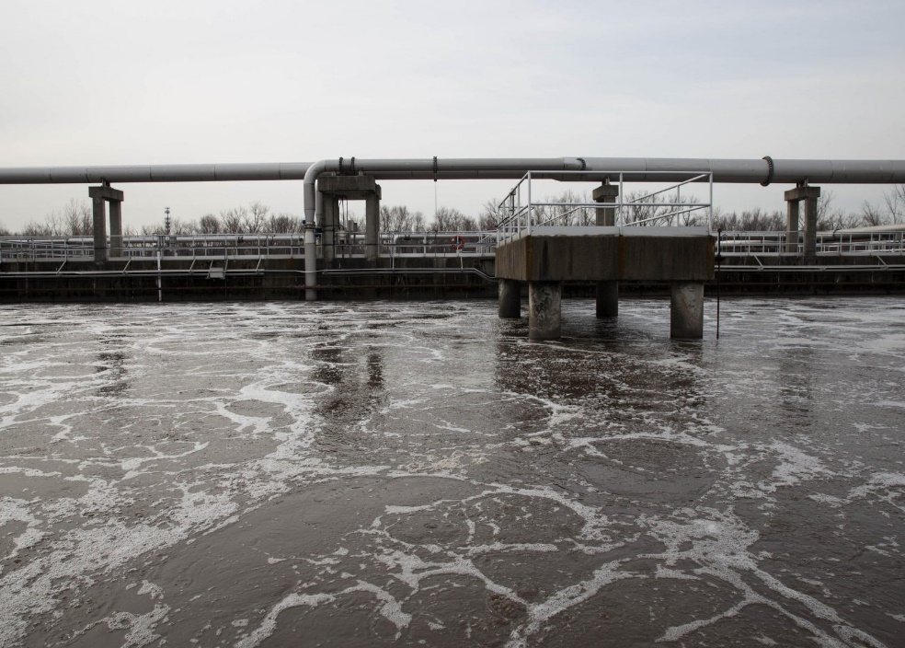
Research Objectives
Literature Review
Methodology
Introduction
Conclusions
Problem Statement
1/2
The world suffers from waste water problem, which causes a lot of harmful effect to environment and human, such as chronic disses and damage of agriculture lands. There are many methods are used to get rid of the waste water. One of the famous effective methods is the biological water treatment.

Slide 5
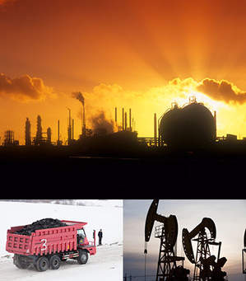
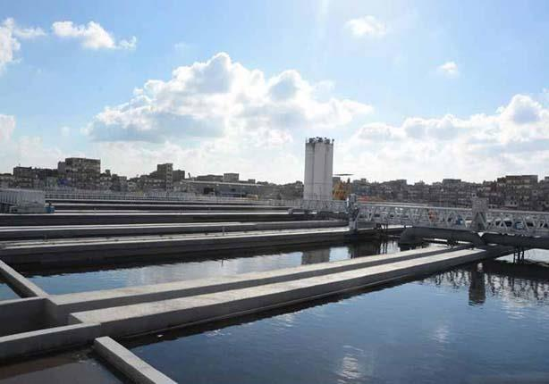
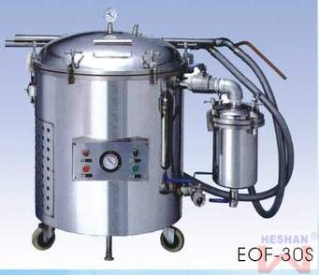
Research Objectives
Literature Review
Methodology
Introduction
Conclusions
This project aims to
Produce methan and compost
Get use of sludg
Manufacture of local machine
2/2

Slide 6

Introduction

Slide 7
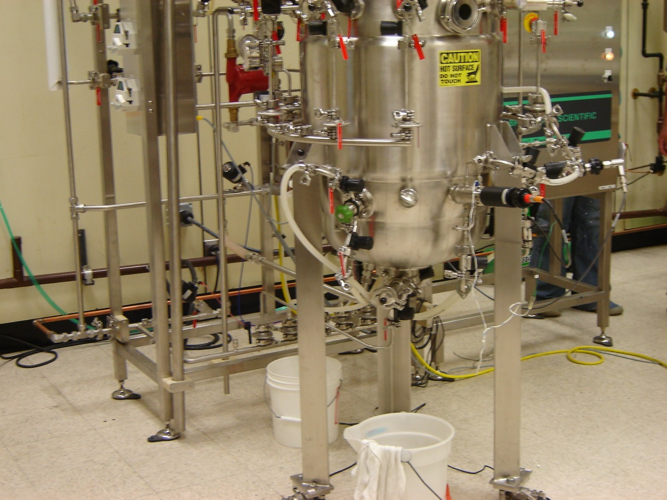
Research Objectives
Literature Review
Methodology
Introduction
Conclusions
What is bioreactor
1/6
A bioreactor is a container in which the chemical process is performed which includes organisms or biochemically active materials taken from such organisms. This process can be aerobic or anaerobic.

Slide 8
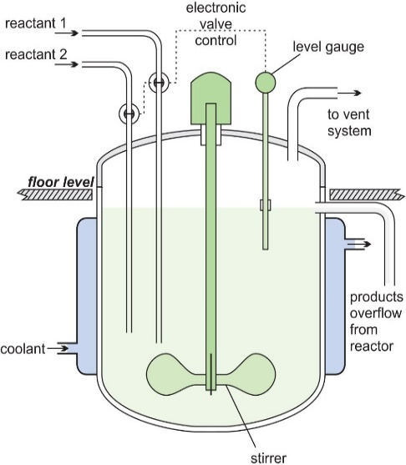
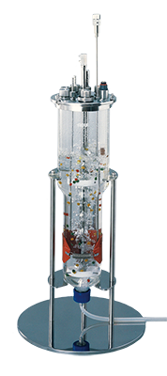
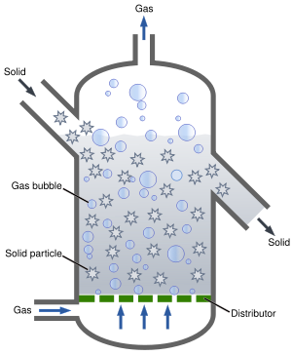
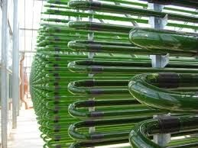
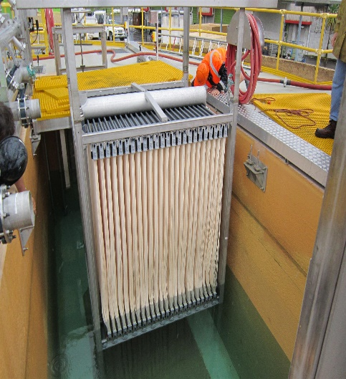
Types of bioreactor
Airlift Bioreactor
Fluidized Bed Bioreactor
Membrane Bioreactor
Photobioreactor
Continuous Stirred Tank Bioreactor
Research Objectives
Literature Review
Methodology
Introduction
Conclusions
2/6
8
Design of a bioreactor for anaerobic digestion

Slide 9
Research Objectives
Literature Review
Methodology
Introduction
Conclusions
Process For Treatment In Bioreactor
(Biological Treatment)
Aerobic Digestion
Anaerobic Digestion
3/6
9
Design of a bioreactor for anaerobic digestion

Slide 10
Research Objectives
Literature Review
Methodology
Introduction
Conclusions
Anaerobic digestion
4/6
The anerobic system lacks gaseous o2 because it is not allowed to enter the system through the closed tankless. anaerobes obtain o2 from places other than atmospheric air. The source of o2 can be organic substances or given by inorganic oxides, where o2 is taken from organic substances, the main intermediate in the products are alcohols, aldehydes, organic acids and co₂ .
10
Design of a bioreactor for anaerobic digestion

Slide 11
Research Objectives
Literature Review
Methodology
Introduction
Conclusions
Conditions for Anaerobic Digestion
5/6
Environmental conditions: Neutral pH (actually between 6.8- 7.2)
Below 6: the volatile unionized acids turns toxic to methane farmers.
Above 8: unionized ammonia becomes toxic.
Alkalinity 2,000 –5,000 mg/L
Volatile acids 50 – 300 mg/L
Volatile acid/alkalinity ratio Range: 0.2 –0.3 (Increase above 0.3 – 0.4 indicate upset)
11
Design of a bioreactor for anaerobic digestion

Slide 12
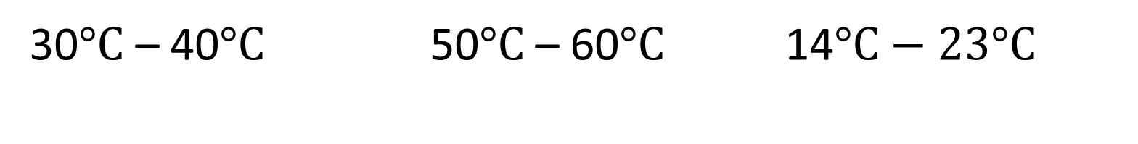
Research Objectives
Literature Review
Methodology
Introduction
Conclusions
Types of Anaerobic Digestion Due To Temperature
Mesophilic AD.
Thermophilic AD.
Psychrophilic AD.
6/6
30$°C$ – 40$°C \text{50}°C \text{–} \text{60}°C$ 14$°C−23°C$
12
Design of a bioreactor for anaerobic digestion
12

Slide 13
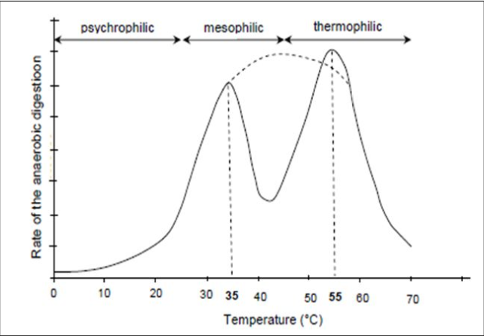
Optimum temperature for
mesophilic around 30 – 40 °C
and for thermophilic 50 – 60 °C

Slide 14

Literature Review

Slide 15
Research Objectives
Literature Review
Methodology
Introduction
Conclusions
1/5
Anaerobic digestion stages
Fermentation or acidogenesis
Hydrolysis
Acetogenesis
Methanogenesis

Slide 16
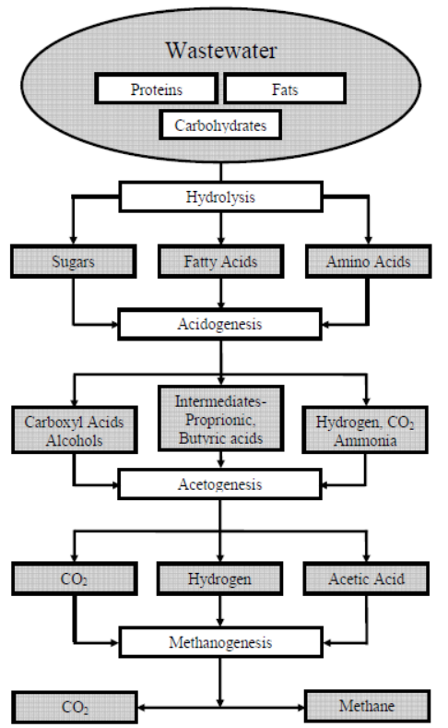
2/5

Slide 17

Research Objectives
Literature Review
Methodology
Introduction
Conclusions
Chemical equation for stages anaerobic digestion
3/5
Hydrolysis
$$C_{6}H_{10}O_{4} +2H_{2}O →C_{6}H_{12}O_{6} + H_{2}$$
Acidogenesis
$$C_{6}H_{12}O_{6} ↔ 2CH_{3}{CH}_{2}OH + 2{CO}_{2}$$
Acetogenesis
$$C_{6}H_{12}O_{6} +2H_{2}O ↔2CH_{3}COOH+ 2CO_{2}+4H_{2}$$
Methanogenesis
$$CH_{3}COOH ↔ {CH}_{4} + {CO}_{2}$$
17

Slide 18
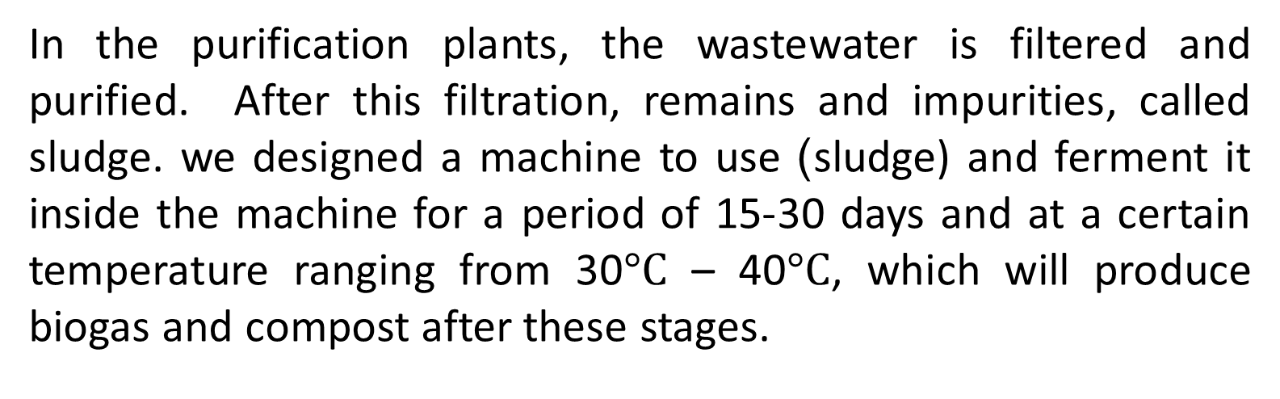
Research Objectives
Literature Review
Methodology
Introduction
Conclusions
Biogas And Compost Production From Sludge
4/5
In the purification plants, the wastewater is filtered and purified. After this filtration, remains and impurities, called sludge. we designed a machine to use )sludge) and ferment it inside the machine for a period of 15-30 days and at a certain temperature ranging from 30$°C$ – 40$°C$, which will produce biogas and compost after these stages.
18
Design of a bioreactor for anaerobic digestion

Slide 19
Research Objectives
Literature Review
Methodology
Introduction
Conclusions
Compound | Anaerobic Digestion biogas
Methane, CH₄ | 50-70 %
Carbon dioxide, CO₂ | 30-40 %
Water vapour, H₂O | 0.3 %
Nitrogen, N₂ | 1-2 %
Oxygen, O₂ | Traces
Hydrogen, H₂ | 5-10 %
Hydrogen sulphide, H₂S | Traces
Typical data on Composition of biogas produced from CSTR
5/5
19
Design of a bioreactor for anaerobic digestion

Slide 20
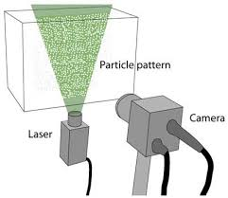
Methodology
Notes:
Visual observations showed that the polymer affected the flow within a few pipe diameters from the injection point. Thus, it was assumed that the polymer is well mixed with the water phase at the location where the recordings were taken

Slide 21
Research Objectives
Literature Review
Methodology
Introduction
Conclusions
First stage: Inserting (sludge) into the device through the slot dedicated to the introduction of these materials, which are at the top of the device.
Second stage: After inserting sludge, the water heater will be turned on, which is a special external pot that heats the water inside a cooling jacket. A constant temperature is maintained through the operation of the water cycle by the pump. The temperature is controlled by a controller system. This temperature will motivate the bacteria and increase its growing rate.
Third stage: After closing all the slots in the device, and connecting all the tubes, the motor is turned on to start the process of mixing through the blades to motivate the living organisms and bacteria to grow and move.
1/2

Slide 22
Research Objectives
Literature Review
Methodology
Introduction
Conclusions
1/2
Fourth stage: The growth of bacteria inside the bioreactor is achieved through the classical biological processes; hydrolysis, fermentation, acetogenesis and methanogenesis.
Fifth stage: During the process of fermentation, the gases are produced and flow out through the tube allocated at the top of bioreactor. At the end, the materials that remain after fermentation (compost) are used in agriculture, especially in fertilization.
22

Slide 23
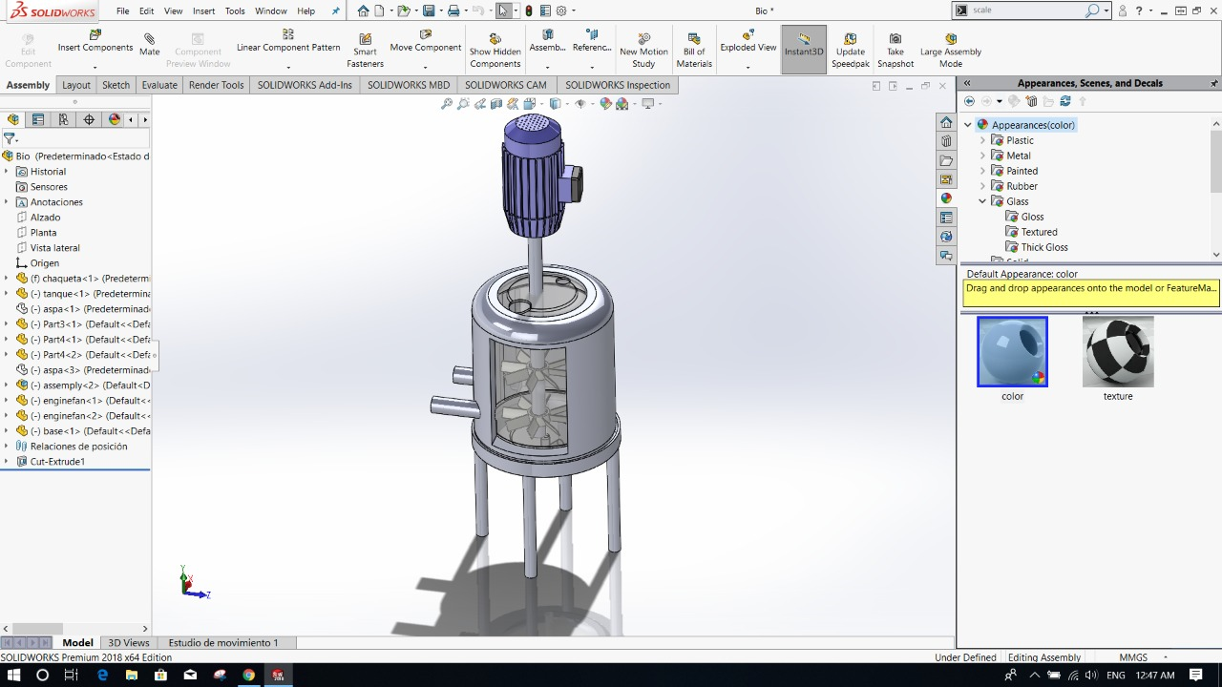
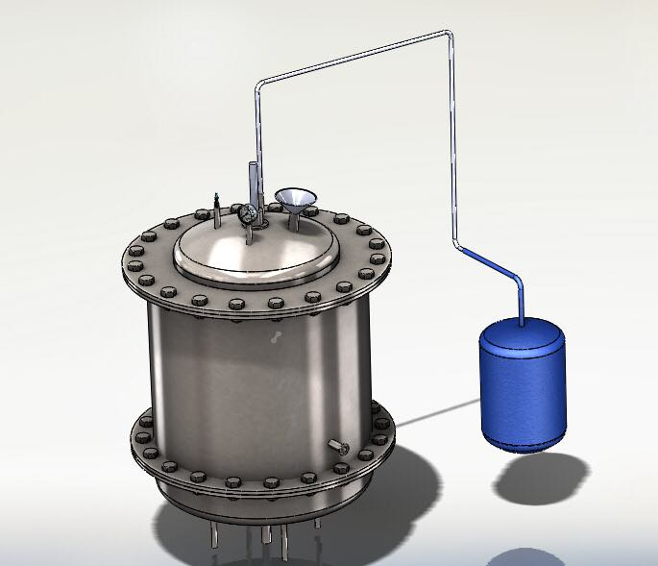
Research Objectives
Literature Review
Methodology
Introduction
Conclusions
Manufacturing Process
2/2
First design of machine
Final design of machine
23

Slide 24
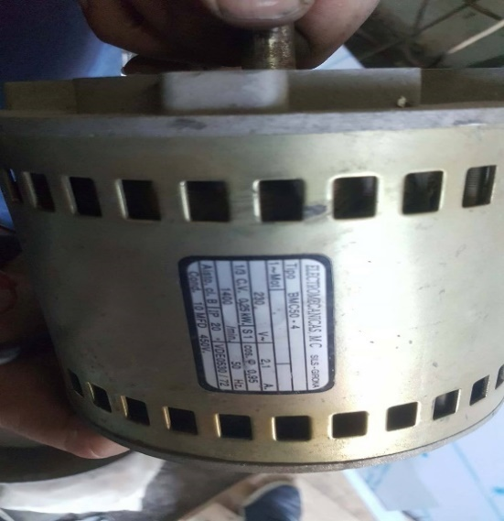
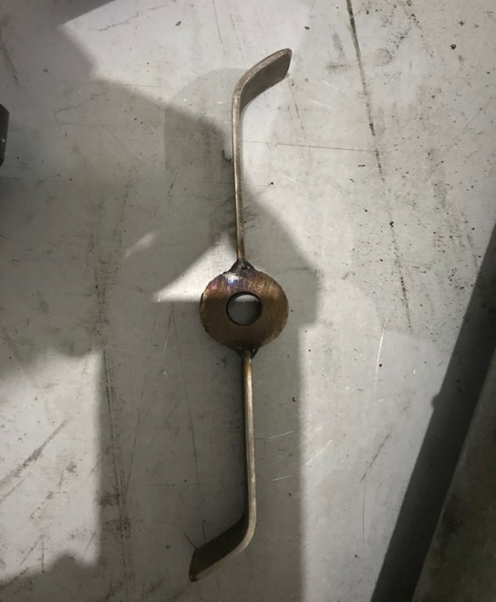
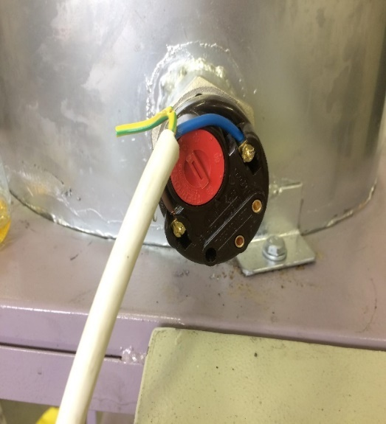
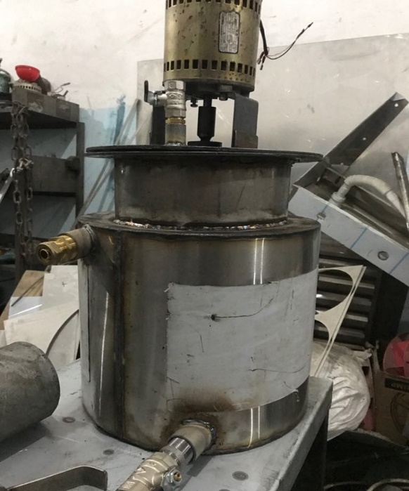

Research Objectives
Literature Review
Methodology
Introduction
Conclusions
manufacturing process
Select Quarter hp motor
Selected blades
2000-Watt Heater
Welded tanks
24

Slide 25
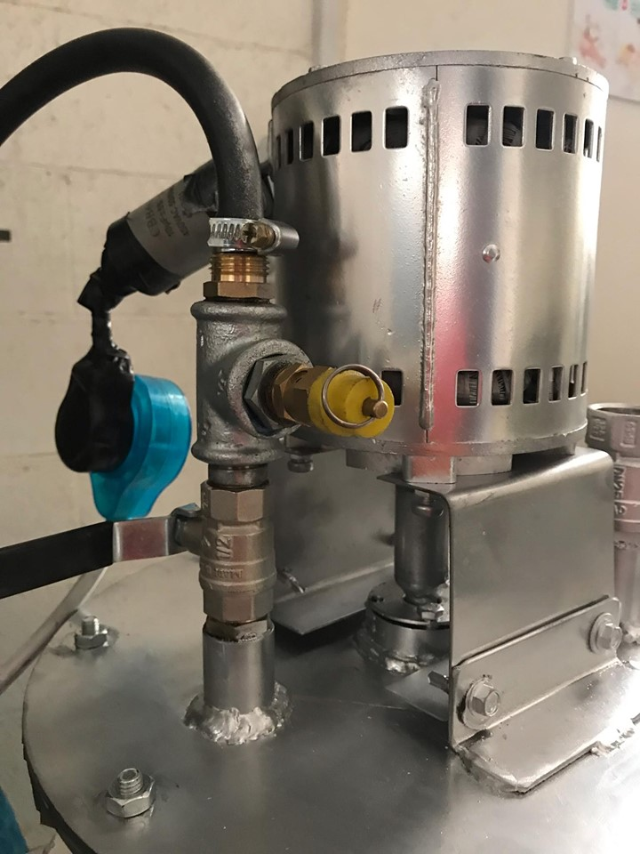
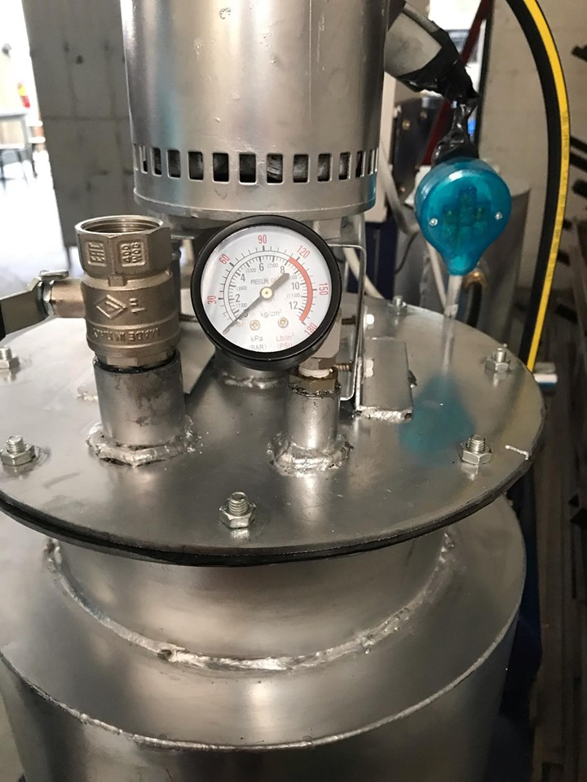
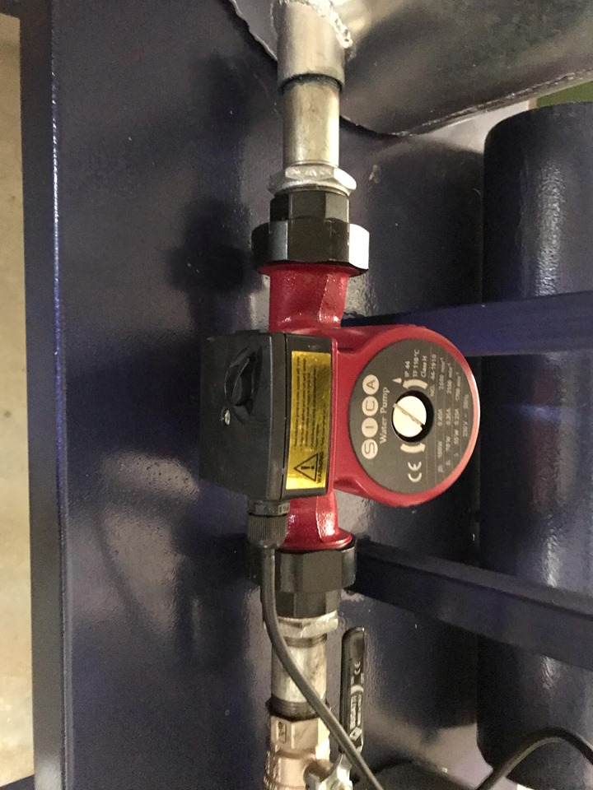
Research Objectives
Literature Review
Methodology
Introduction
Conclusions
Safety valve
Pressure gauge
Circulation pump
25

Slide 26
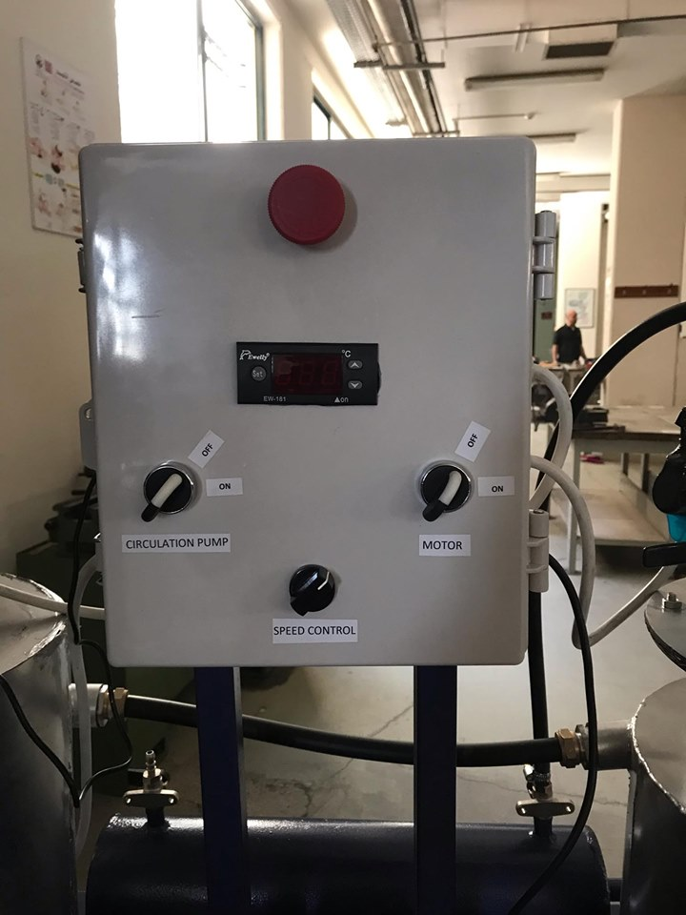
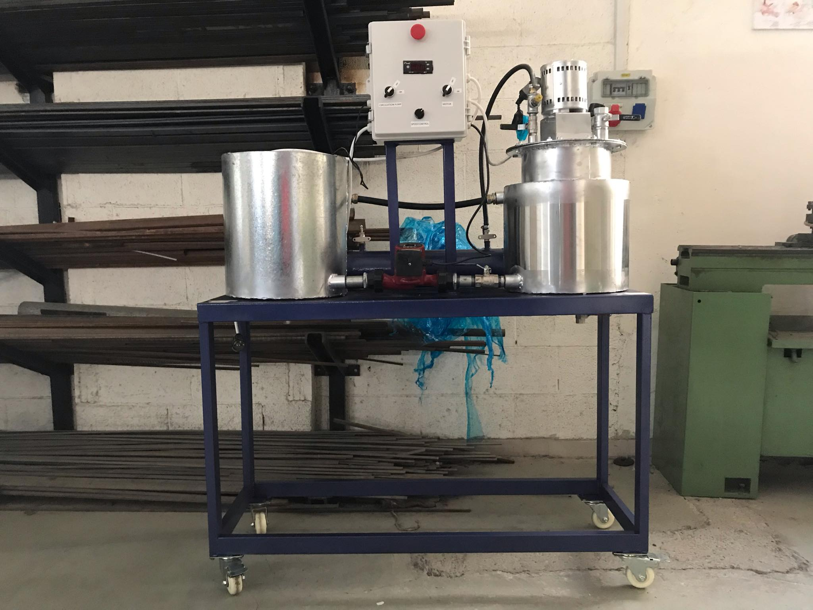
Research Objectives
Literature Review
Methodology
Introduction
Conclusions
manufacturing process
final shape
Control panel
26

Slide 27

Conclusions
Notes:
Visual observations showed that the polymer affected the flow within a few pipe diameters from the injection point. Thus, it was assumed that the polymer is well mixed with the water phase at the location where the recordings were taken

Slide 28
Research Objectives
Literature Review
Methodology
Introduction
Conclusions
In this project a bioreactor with 8-liter size is designed. The following priorities and the required procedures were taken into consideration to construct the bioreactor:
A detailed literature review was done and the benefit from the previous researches were considered about anaerobic digestion and the condition to do experiments on the anaerobic digestion process.
An initial design was done on solid work and we explained all parts on it.
After primary theoretical design, a number of workshops that are specialized in manufacturing such machines and some feedback were have taken in consideration about every possible choice which was helpful in taken the right decision required for this project.
28

Slide 29
In our project we face many challenges such as
Research Objectives
Literature Review
Methodology
Introduction
Conclusions
At first we planned to design the bioreactor from glass but it turned out that its difficult to design so we made it from stainless steel .
The size was not enough so we increased it to 8 L .
Problems in taking samples because there will be a gas leak.
Problems in controlling the speed of the motor.
Vibration and noise sounds come from motors.
No samples were taken because the narrow of time in finishing the machine.
29

Slide 30
Research Objectives
Literature Review
Methodology
Introduction
Conclusions
Our future vision is to
Carry out experiments on this device .
Perform parametrical study of the anaerobic digestion.
Using the produced gas in other applictions.
30

Slide 31


