Slide 1
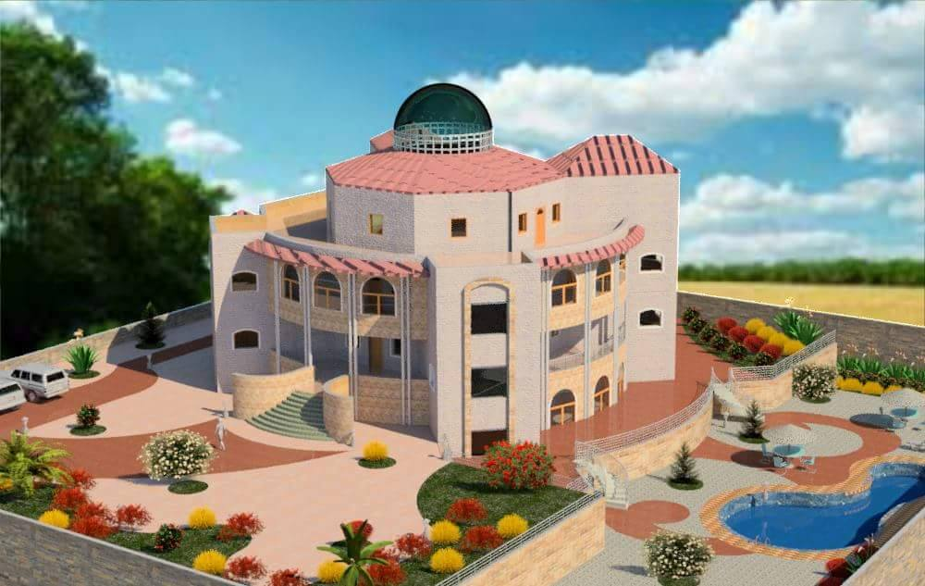

An-Najah National University
Faculty Of Engineering
Building Engineering Department
Environmental Friendly Villa
Prepared by:
Iyad Rawajbeh
Fayez Mahameed
Salah Aljammal
Shami Shami
Project Supervisor:
Dr. Aamir Al-Sharif

Slide 2
Outline:-
Site of the Project
Architectural design
Structural design
Environmental design
Mechanical design
Electrical design
Cost Estimation

Slide 3
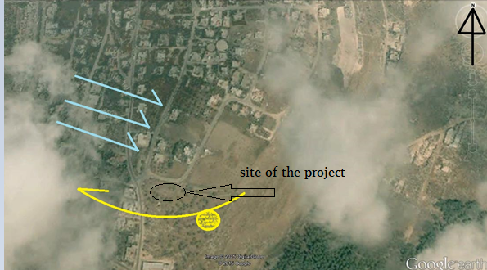
Site of the project

Slide 4
Architectural Design

Slide 5
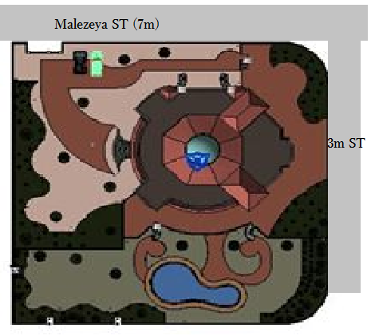
Site plan

Slide 6
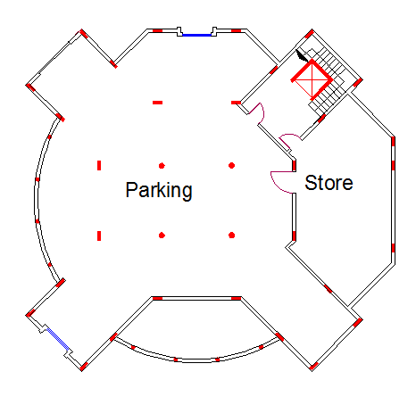
Basement floor: The basement floor has an area of 478 m².

Slide 7
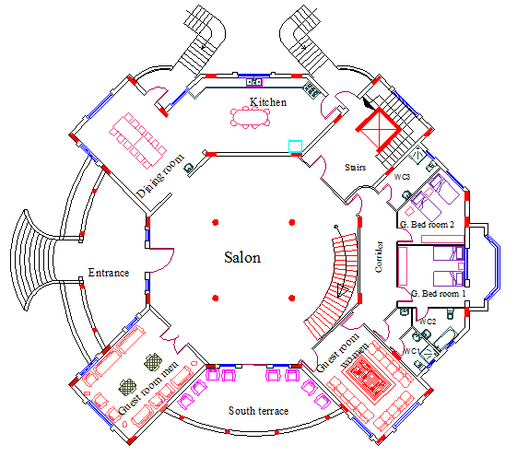
Ground floor: The ground floor has an area of 516 m²

Slide 8
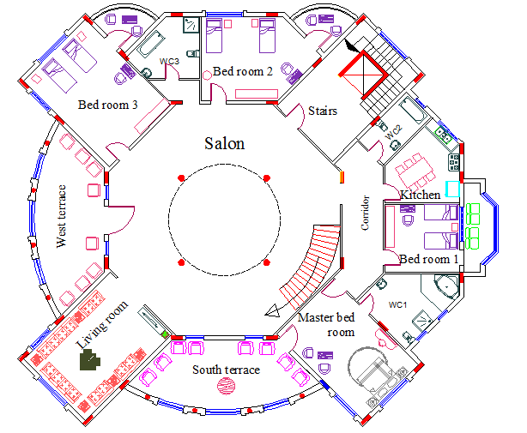
First floor: The First floor has an area of 476 m²

Slide 9
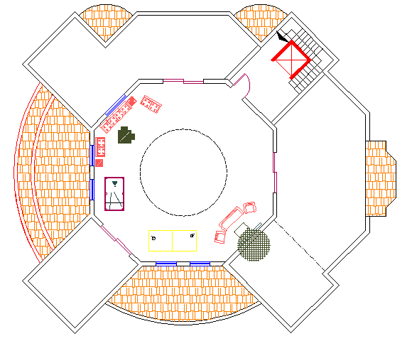
Roof floor: The roof has an area of 120 m²

Slide 10
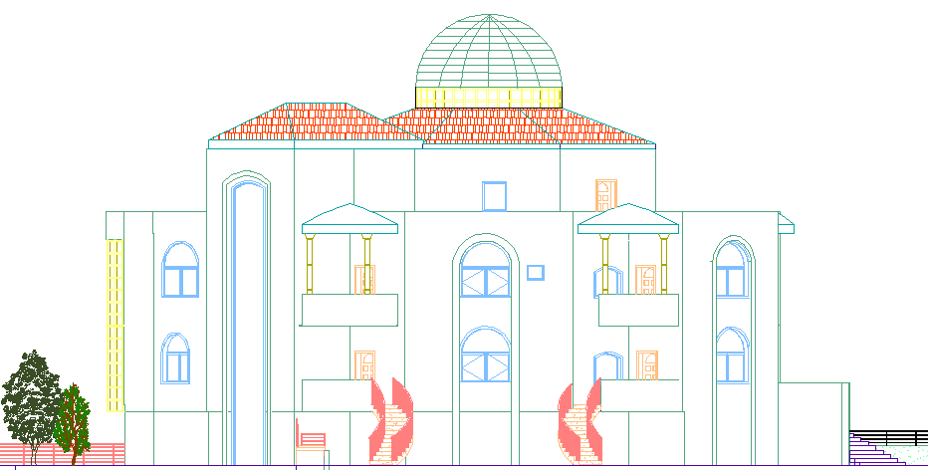
North elevation

Slide 11
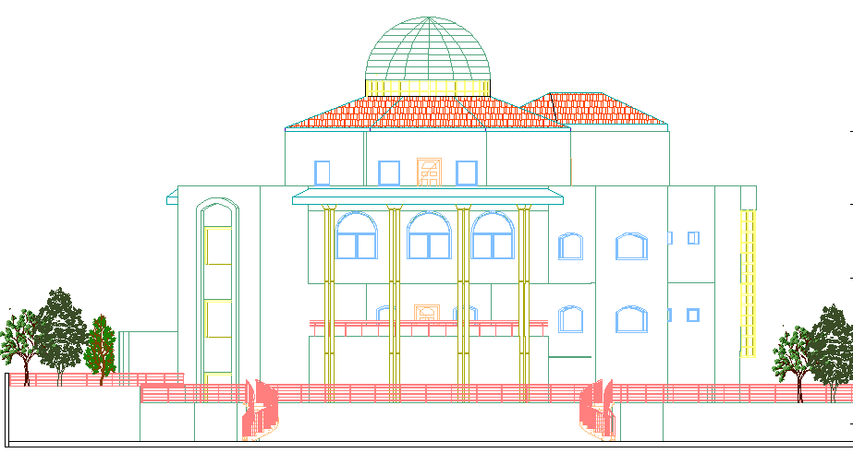
South elevation

Slide 12
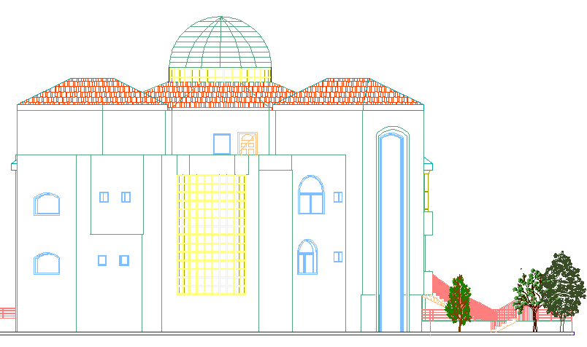
East elevation

Slide 13
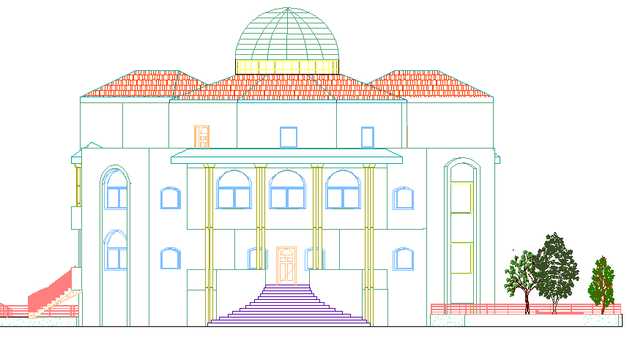
West elevation

Slide 14
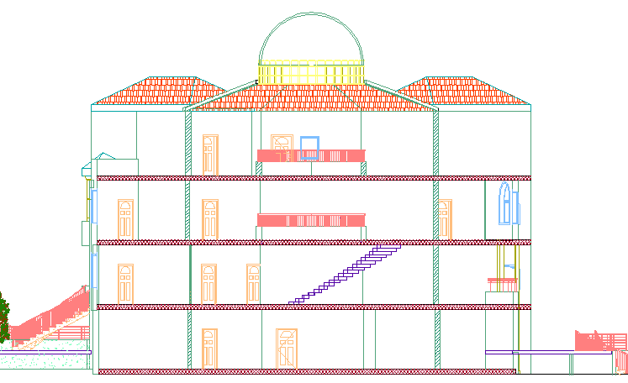
Section:1

Slide 15
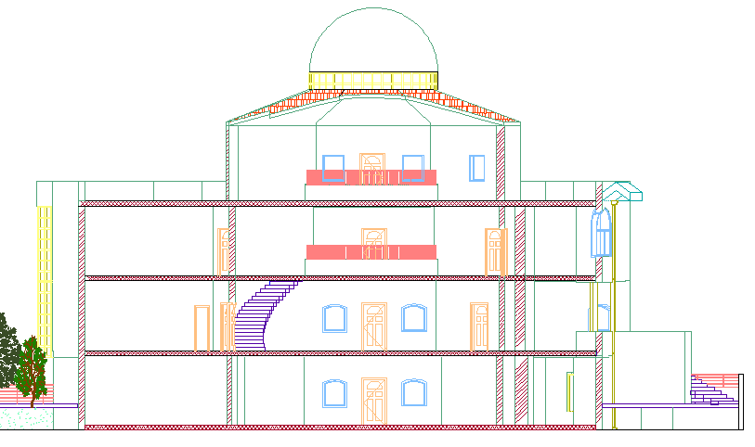
Section:2

Slide 16
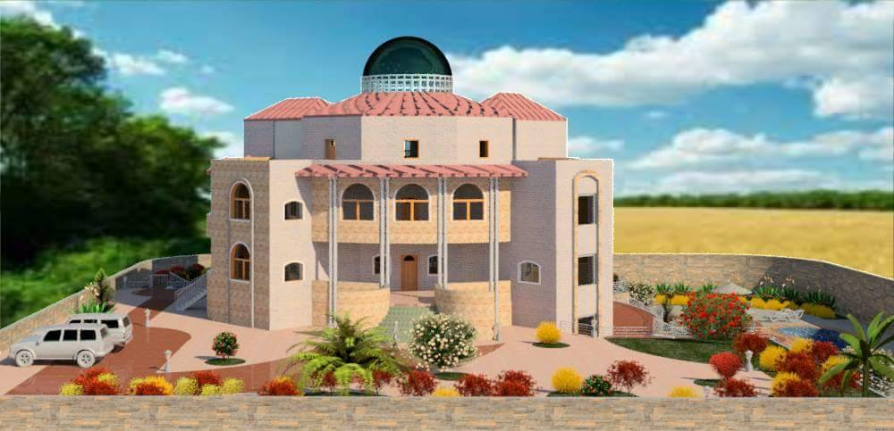
Architectural Design
3D model

Slide 17
3D model

Slide 18
Structural design

Slide 19
Design data:
1-Compressive strength of Concrete “ f′_{c}”.
For columns and slabs f′_{c} = 28 MPa.
For all other elements in structure such as blinding and bracing f′_{c} = 16 MPa
2-Yielding strength of steel f_{y} = 420 Mpa
3- Bearing capacity of soil = 300 KN/m2
4-Loads Used:-
Dead load (superimposed) = 4 KN/𝑚2
Live load = 3 KN/𝑚2

Slide 20
Structural systems :
One way ribbed slab in almost system.
Tow way ribbed slab in one area.
Slab thickness =30cm

Slide 21
Structural elements:
Beams :
2. Columns :
3. Footings :
Type | Dimensions(mm)
Main beam | (700*300)
Secondary beam | (500*300)
Type | Dimensions(mm)
Rectangular column | (300*600)
Circular column | D(400)
Type | Dimensions(m)
Center Footing | (2.20*1.80)
Edge footing | (1.20*1.50)

Slide 22
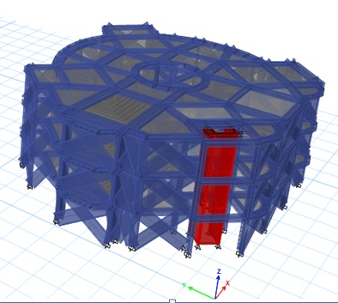
3D Model in Etabs

Slide 23
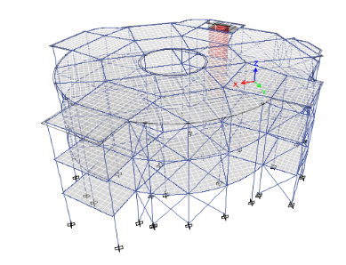
Checks :
1. Compatibility : By starting animation for the MODAL deformed shape, the whole structure was moving as one unit.

Slide 24
Checks :
2. Equilibrium :
3. Deflection: Maximum allowed deflection = 6.8/240=28 mm
Maximum deflection found by ETAPS = 5.6 mm < 28 mm.
 | Manual | Etabs | % Error
Dead load | 23912 | 22137 | 7.4 %
Live load | 4140 | 4302 | 3.7%

Slide 25
Checks :
4. Check of internal forces:
Number | ETAPS moment (kN.m) | Manual moment (kN.m) | % Error
Slabs | 13 | 14.3 | 9
Beams | 183.5 | 168 | 9.2

Slide 26
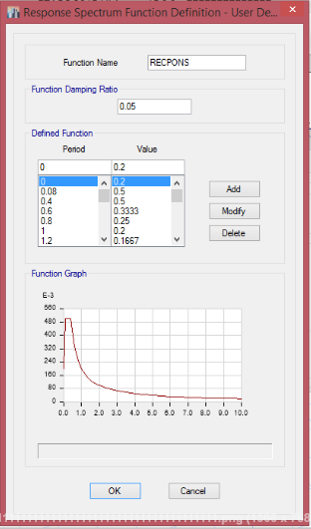
Seismic design Using response spectrum
W= 23269 KN , Include D.L+S.D+0.25LL
I = 1
R= 5.5
Ca=0.2
Cv=0.2
T = 0.5 sec
V = 1692.3 KN

Slide 27
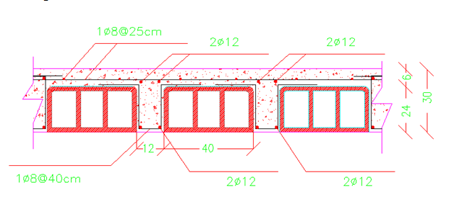
Design for flexure moment
Slab reinforcement :

Slide 28
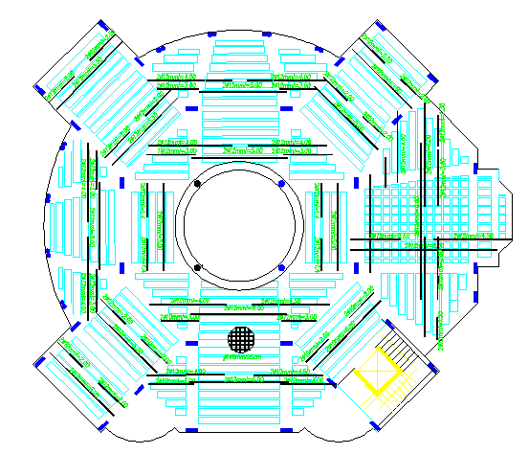
Design for flexure moment
Slab reinforcement :

Slide 29
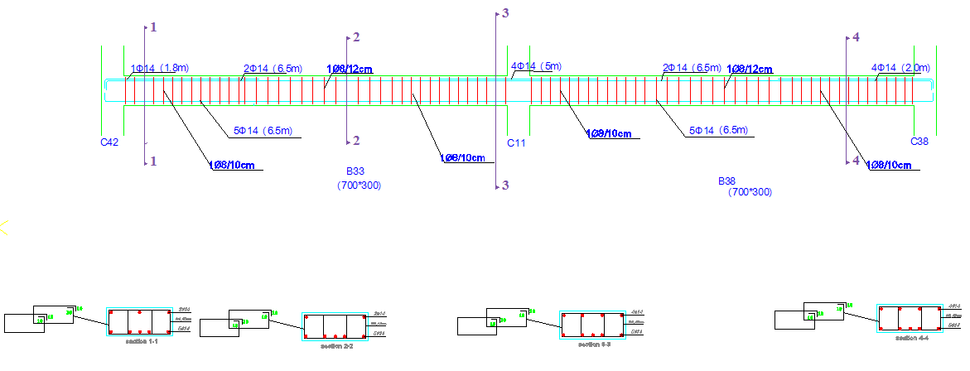
Beams reinforcement:

Slide 30
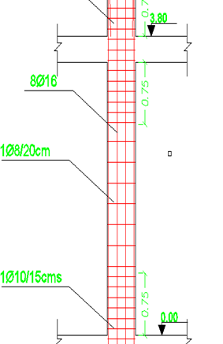
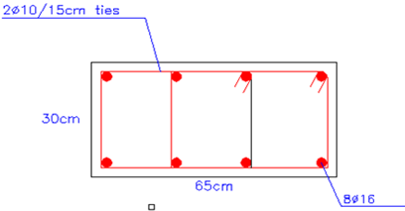
Columns reinforcement:

Slide 31
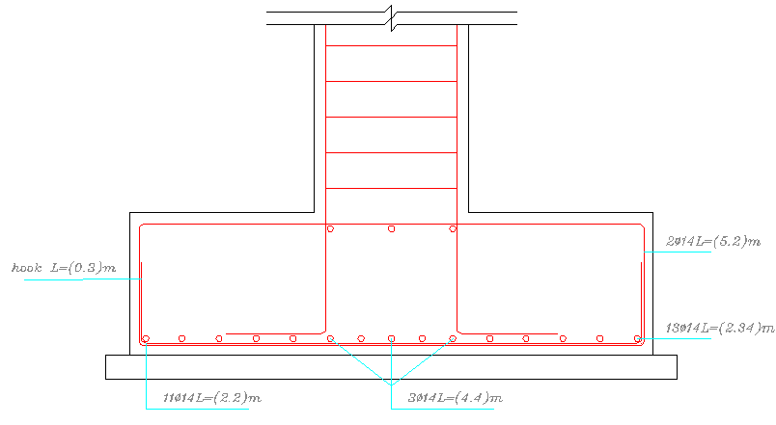
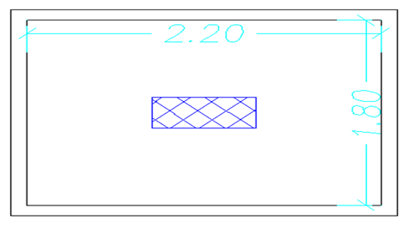
Footing reinforcement:

Slide 32
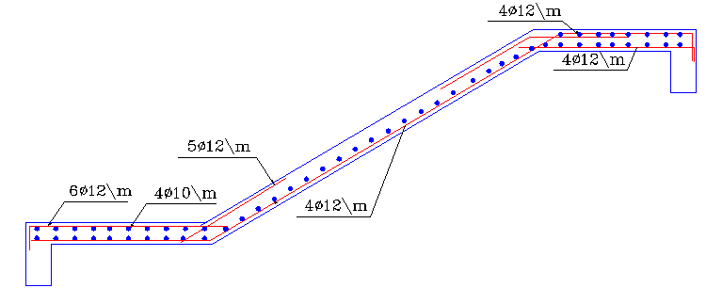
Stair reinforcement:

Slide 33
Environmental design

Slide 34
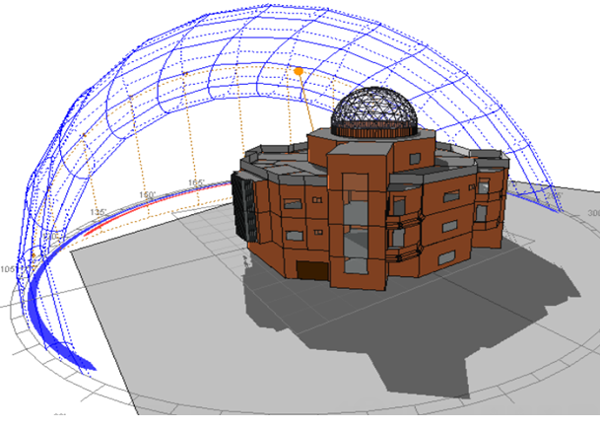
Ecotect analysis – Annual sun path

Slide 35
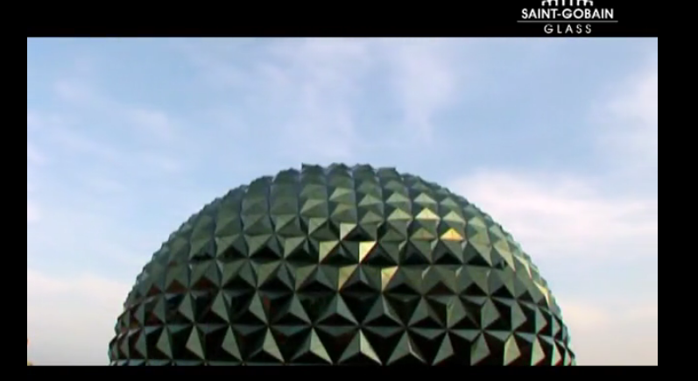
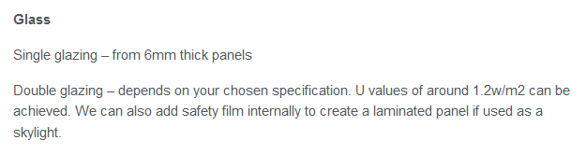
Glass Geodesic dome

Slide 36
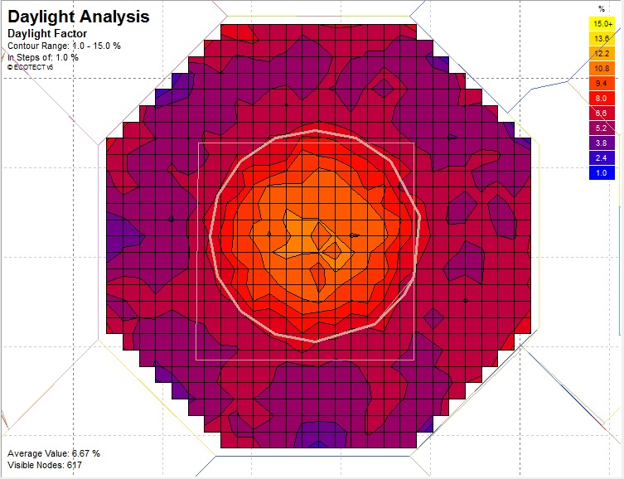
Daylight factor:
The average day light factor for the salon equal 6.67%

Slide 37
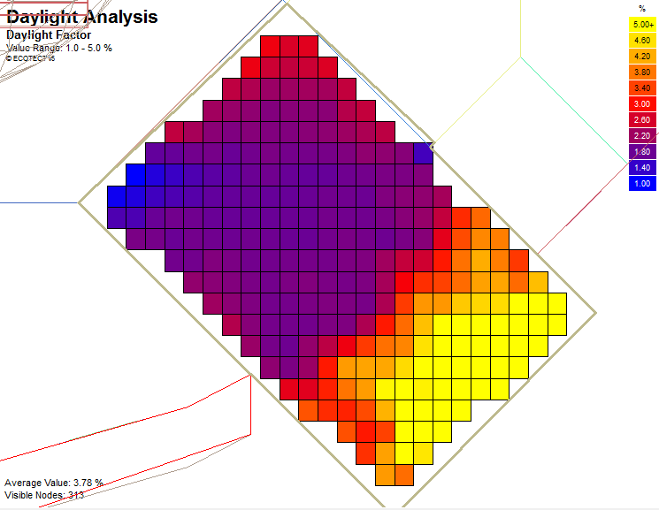
Daylight factor:
The average day light factor for the bed room equal 3.78%

Slide 38
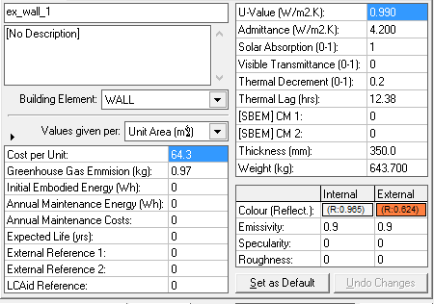
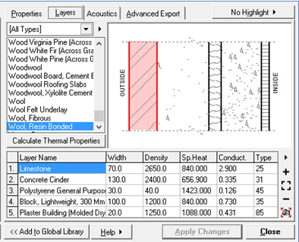
Layers of external walls:

Slide 39
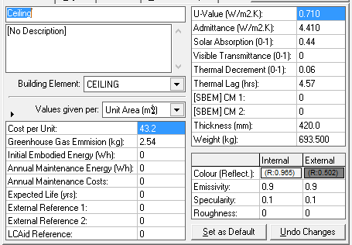
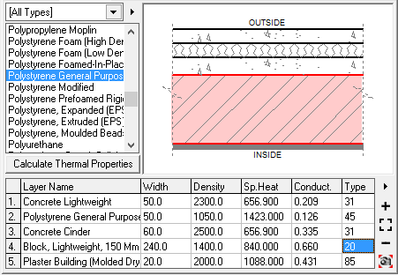
Layers of ceiling:

Slide 40
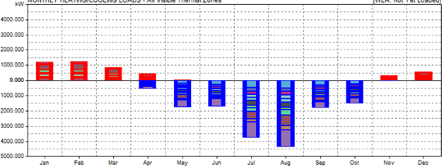
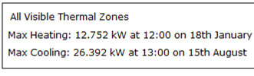
Thermal Loads for salon

Slide 41
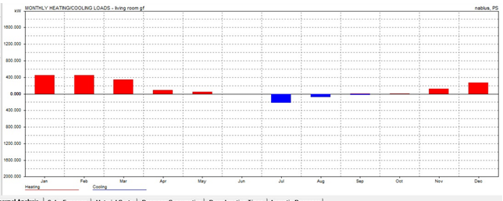

Thermal Loads for living room

Slide 42
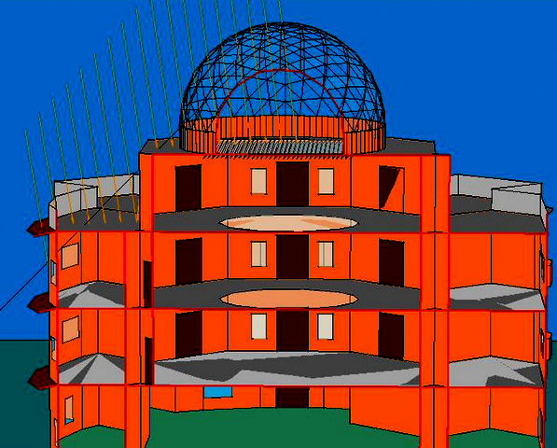
Solar design in summer:

Slide 43
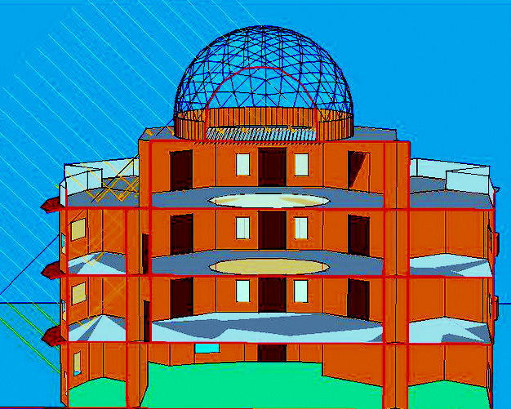
Solar design in winter:

Slide 44
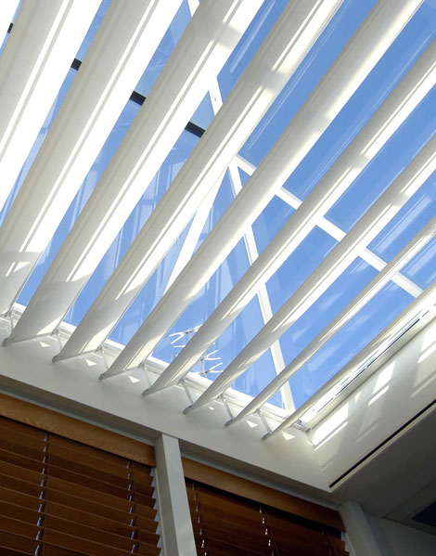
Shading device

Slide 45
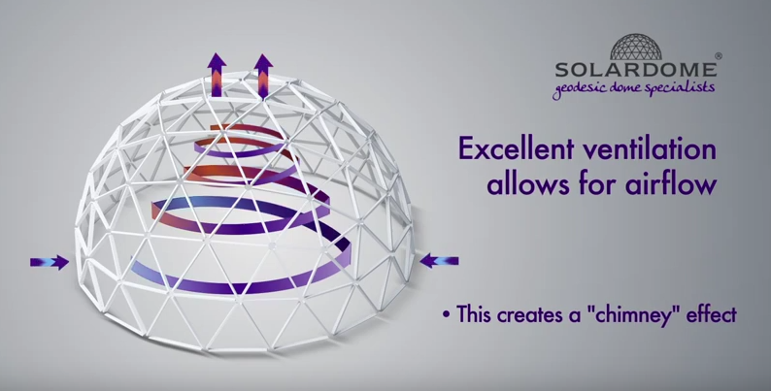
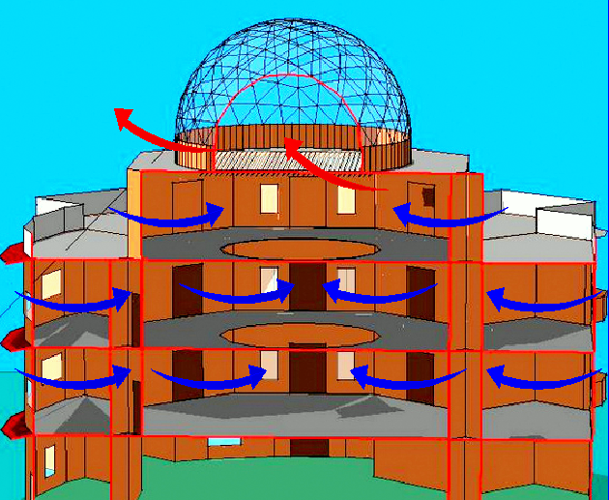
Natural ventilation

Slide 46
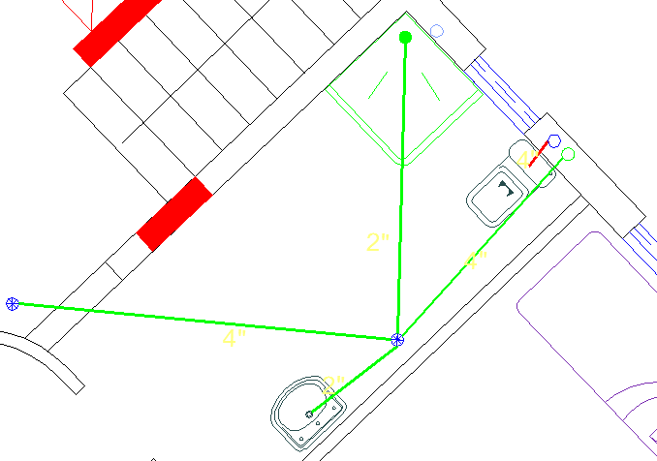
Water treatment:

Slide 47
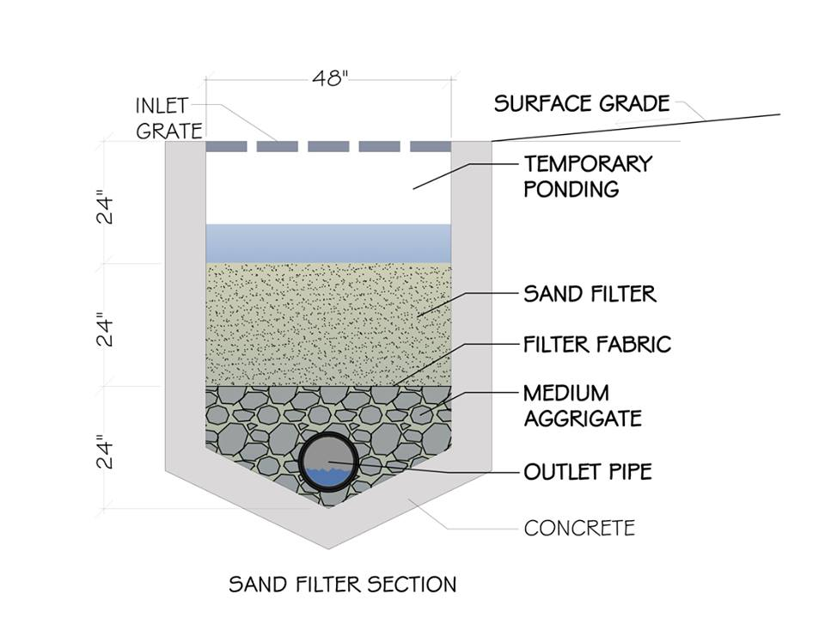
Water treatment:

Slide 48
Electrical Design

Slide 49
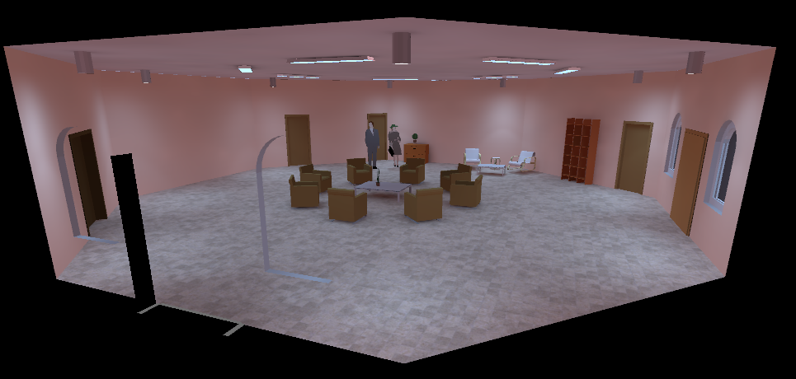
Artificial lighting using “Dialux”

Slide 50
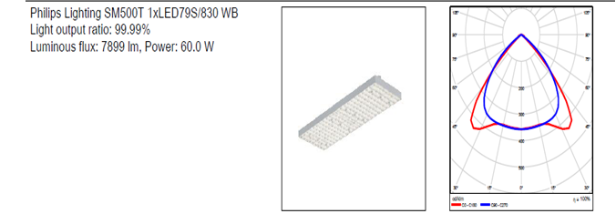
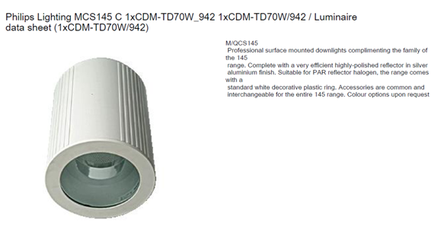
Luminaires used:

Slide 51
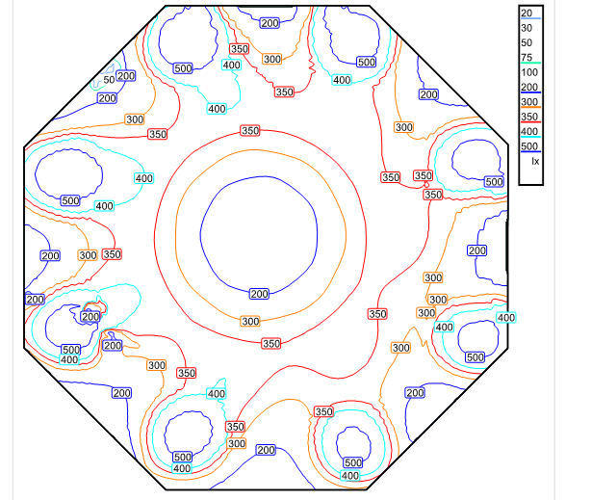
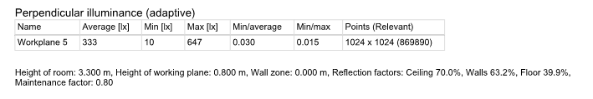
Dialux analysis- Salon

Slide 52
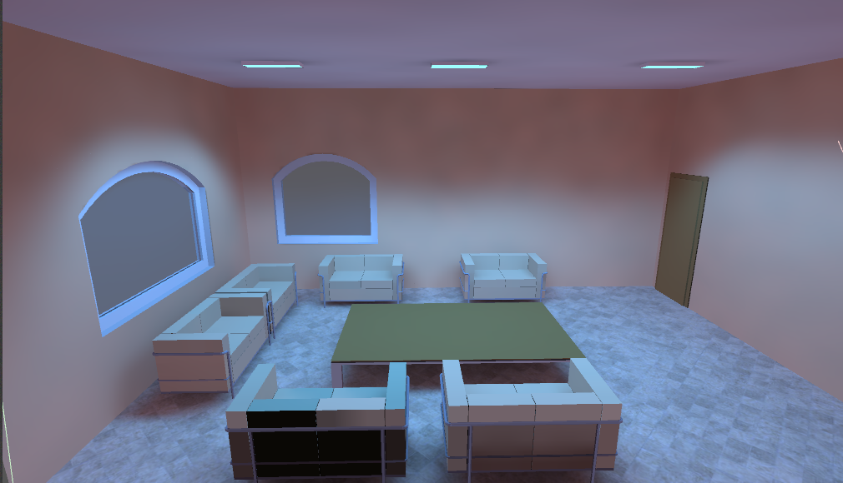
3D Model Guest room:

Slide 53

Luminaires used:

Slide 54


Dialux analysis- Guest room

Slide 55

Lighting Distribution :

Slide 56

Lighting Distribution :

Slide 57
Mechanical design

Slide 58

1- water supply system

Slide 59

1- water supply system

Slide 60

2- drainage system
The drainage system divided into two types:
Black water
Gray water

Slide 61

2- drainage system

Slide 62

3-Rain water

Slide 63

4- H-VAC system

Slide 64

4- H-VAC system

Slide 65
Cost
The total cost is 2400000 NIS
The cost for 1m² is 1500 NIS

Slide 66


