Slide 1



An-Najah National University
Faculty of Engineering
Civil Engineering Department
Water Distribution Networks and WasteWater Networks of Tammon Town
Prepared by:
Ahmad AL-Qanni Hassan Mhamed
Emran Bsharat Mohammad Fuqaha
Supervisor:
Dr. Amal Al-Hudhud
may 2012

Slide 2
Introduction

Slide 3
Presentation Layout
Introduction
Objectives
Plan
Description of the location
Design WDN & Sewer net work
Conclusion

Slide 4
INTRODUCTION
Importance of water
قال الله تعالى :{ وجعلنا من الماء كل شئ حي} صدق الله العظيم. سورة الأنبياء الآية 30
Importance of Water Distribution Networks (WDNs)
People who live in different locations, whom their homes are not located in the same area and there is considerable distance between them they need to have water distribution networks (WDNs).

Slide 5
Objectives
Apply the theoretical background which we have learned through the last four years with the reality and practical life.
Design the water distribution net work of Tammon by using WATERCAD software.

Slide 6
Secondary Goals
Studying and analyzing the water consumption and estimating the losses.
cost estimating for the project .
Design wastewater net work.

Slide 7
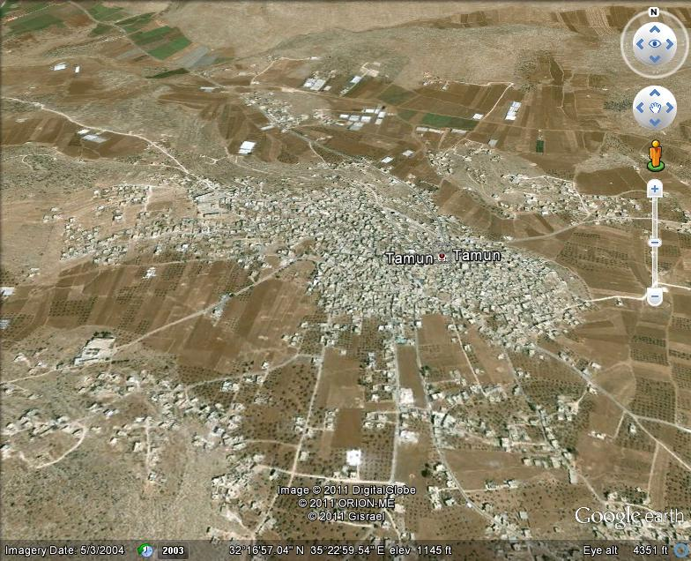
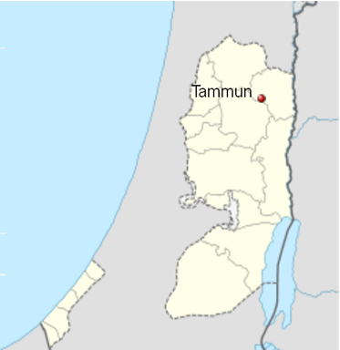
Study area

Slide 8
DESCRIPTION OF THE STUDY AREA
Location
Tammon is a Palestinian town in the Tubas governorate, located 23 kilometers northeast of Nablus and five kilometers south of Tubas in the northeastern Wes Bank.
Population
The number of the population, according to the statistics in 2007 is about 10,687 persons.

Slide 9
DESCRIPTION OF THE STUDY AREA
Rain
Average annual rainfall in Tammon = 350 mm.
The average number of rain days = 40-60 days./year
Temperature
Rates of temperature in summer about (25° – 35°) C.
Rates of temperature in winter about (12° – 14° ) C.

Slide 10
DESCRIPTION OF THE STUDY AREA
From question area :
Per capita consumption of water 64 L/capita/day.
Average number of persons per family 6.

Slide 11
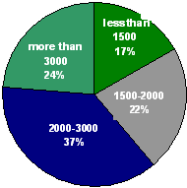
DESCRIPTION OF THE STUDY AREA
Monthly per capita income:
Notes:
This diagram shows the monthly income per capital in Tammoun. We got theses numbers after analyzing the questionnaires we already distributed in Tammoun city.

Slide 13
Methodology
Site Investigation
زيارة الموقع
Collecting Data
جمع المعلومات للمشروع
Jenin Municipality
بلدية جنين
Tammon Council
مجلس قروي طمون
Working with Data
معالجة المعلومات
Supply
التزويد
AutoCAD map
AutoCAD
Software
Question area
Analyze the WDN
تحليل الشبكة
Demand
Consumption
الاستهلاك
Pipes and Nodes
WaterCAD
Software
Pump
Results
النتائج
GIS

Slide 14
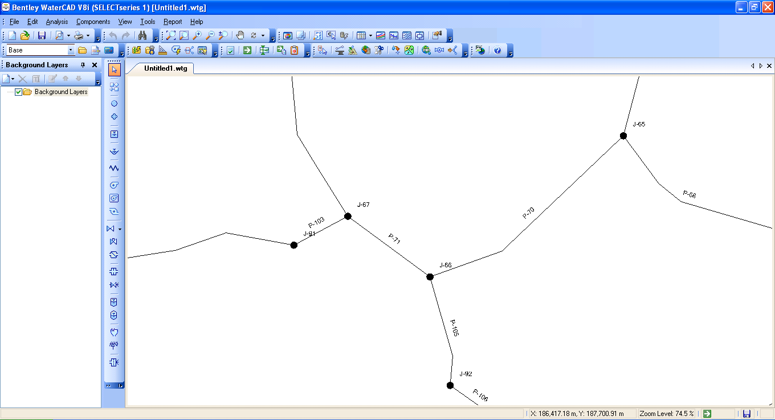
WATER CAD Software
Water CAD
Water CAD is a computer software used for analyze the water distribution networks. It can be used for different types of application in the distribution system analysis such as a simple network design.
Water CAD analysis output are : the flow for each pipe in the network and the velocities, the pressure for each node and the total head, the head loss in each pipe and more of hydraulic output analysis.

Slide 15
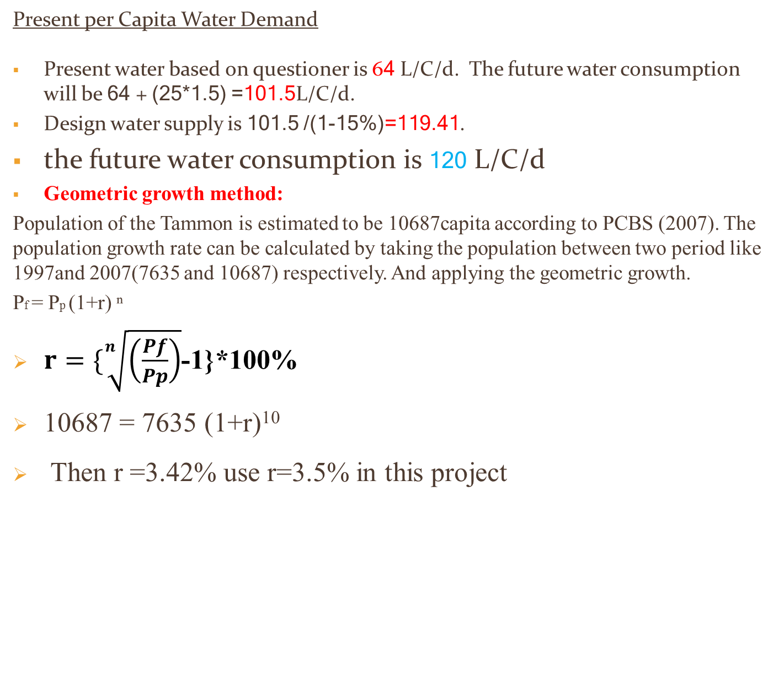
wdn analysis
Present Per Capita Water Demand & estimate growth rate
Present per Capita Water Demand
Present water based on questioner is 64 L/C/d. The future water consumption will be 64 + (25*1.5) =101.5L/C/d.
Design water supply is 101.5 /(1-15%)=119.41.
the future water consumption is 120 L/C/d
Geometric growth method:
Population of the Tammon is estimated to be 10687capita according to PCBS (2007). The population growth rate can be calculated by taking the population between two period like 1997and 2007(7635 and 10687) respectively. And applying the geometric growth.
Pf = Pp (1+r) ⁿ
$r=\{\sqrt[n]{\left(\frac{Pf}{Pp}\right)}$-1}*100%
10687 = 7635 (1+r)¹⁰
Then r =3.42% use r=3.5% in this project

Slide 16
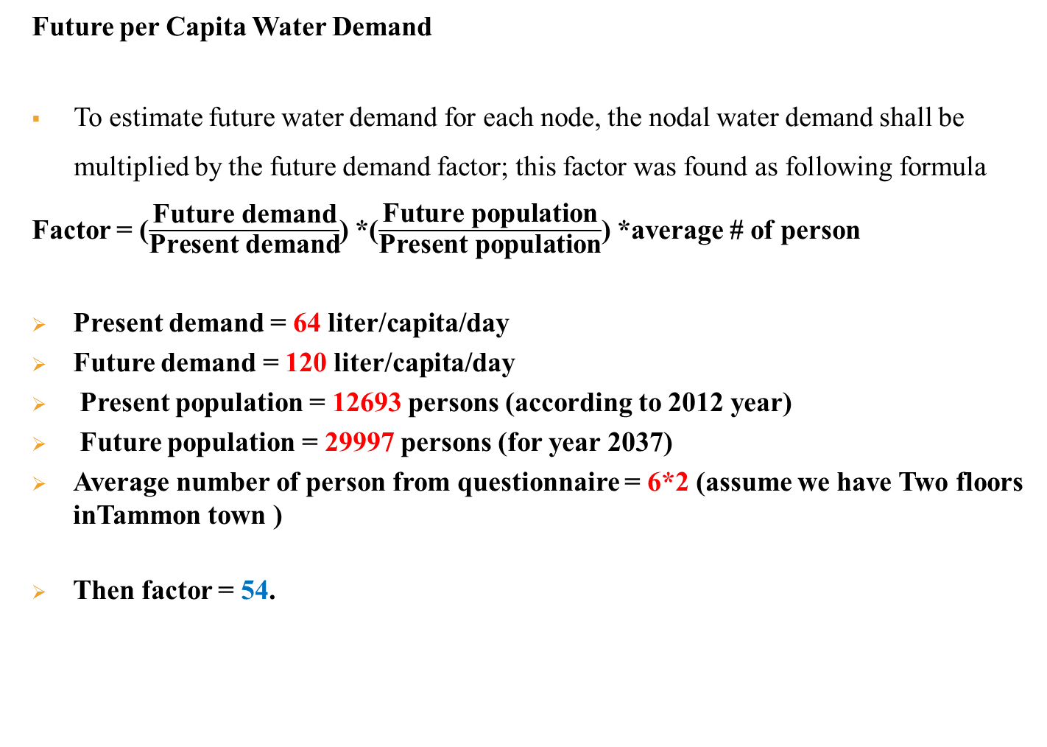
wdn analysis
Present vs. Future Per Capita Water Demand
Future per Capita Water Demand
To estimate future water demand for each node, the nodal water demand shall be multiplied by the future demand factor; this factor was found as following formula
Factor = ($\frac{\text{Future} \text{demand}}{\text{Present} \text{demand}}$) *($\frac{\text{Future} \text{population}}{\text{Present} \text{population}}$) *average # of person
Present demand = 64 liter/capita/day
Future demand = 120 liter/capita/day
Present population = 12693 persons (according to 2012 year)
Future population = 29997 persons (for year 2037)
Average number of person from questionnaire = 6*2 (assume we have Two floors inTammon town )
Then factor = 54.

Slide 17
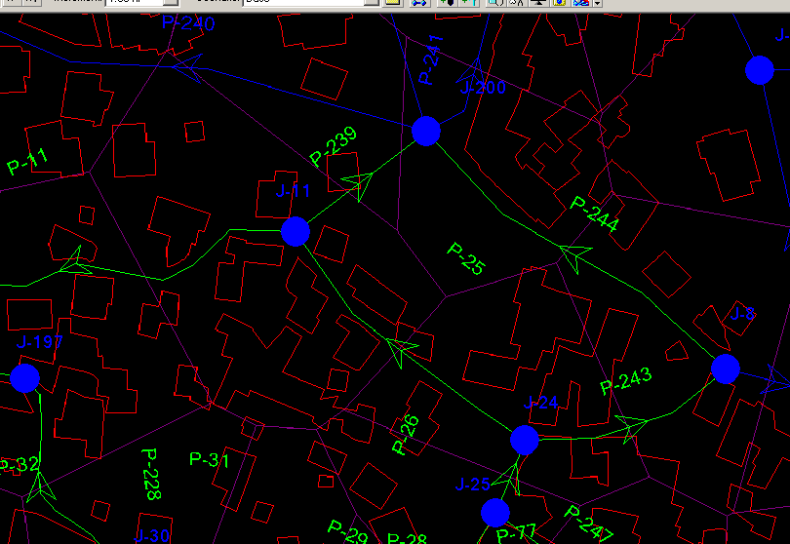
WDN Analysis
Calculate the demand for each node:
J-11: Number of houses=12
Demand= .12*54*12=78 m³/day

Slide 18
Design wdn
TAMMOUN WDN
172 nodes
207 Pipes
36Loops
Reservoir = 406

Slide 19
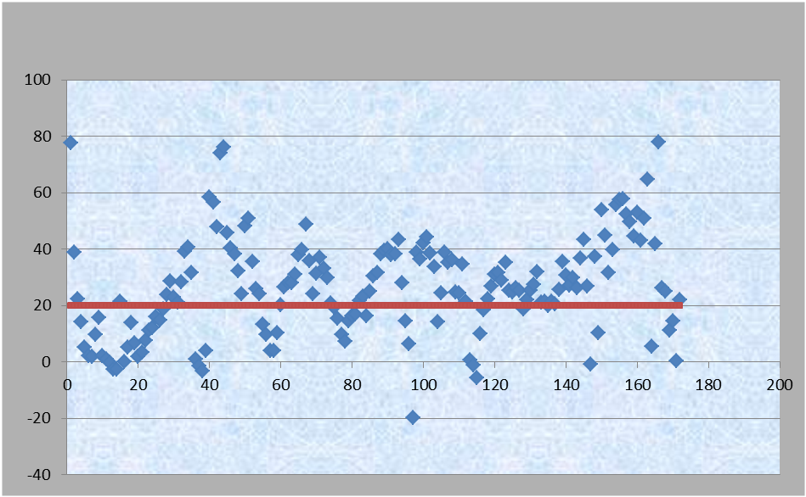
Output data description:
Figure : the pressure head at nodes before raising the reservoir.

Slide 20
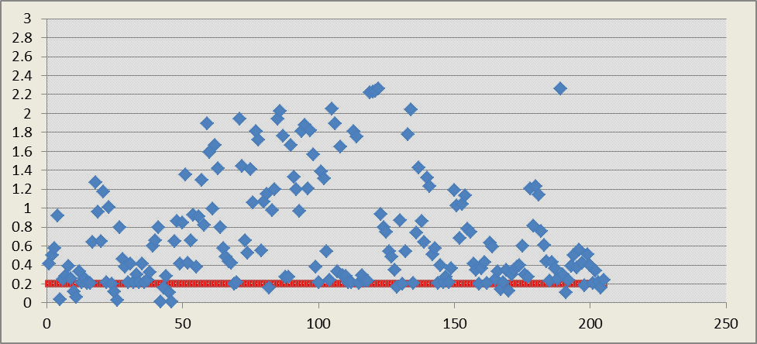
Output data description:
Figure 6.5: velocity for each pipe before raising the reservoir

Slide 21
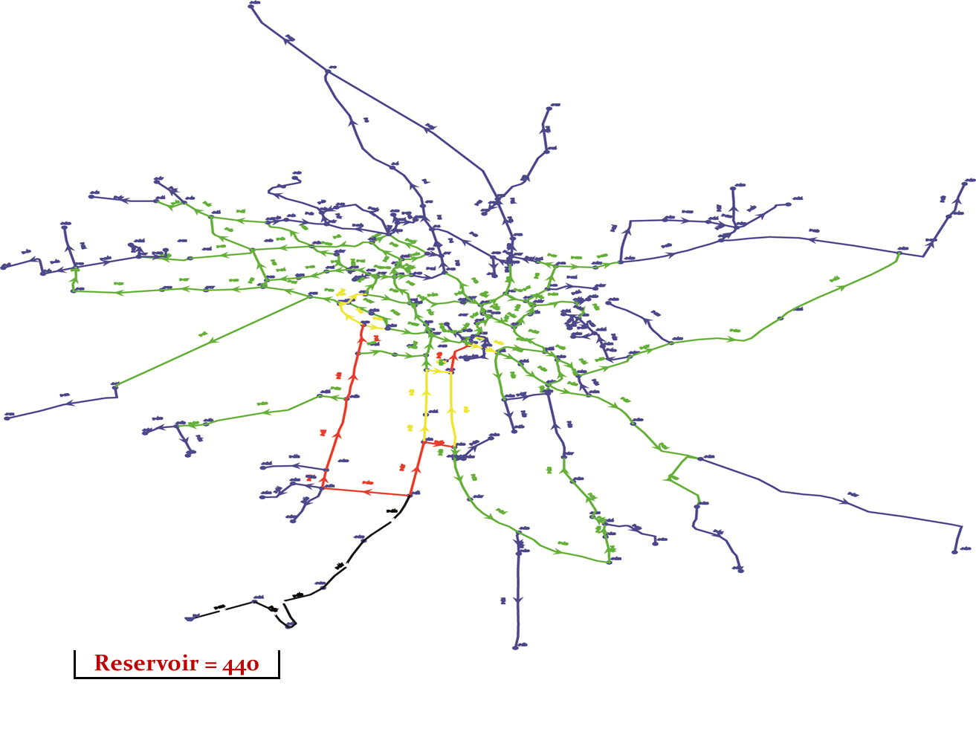
Design wdn
8 inch
6 inch
4 inch
3 inch
2 inch
Reservoir 440m
Reservoir = 440 m

Slide 22
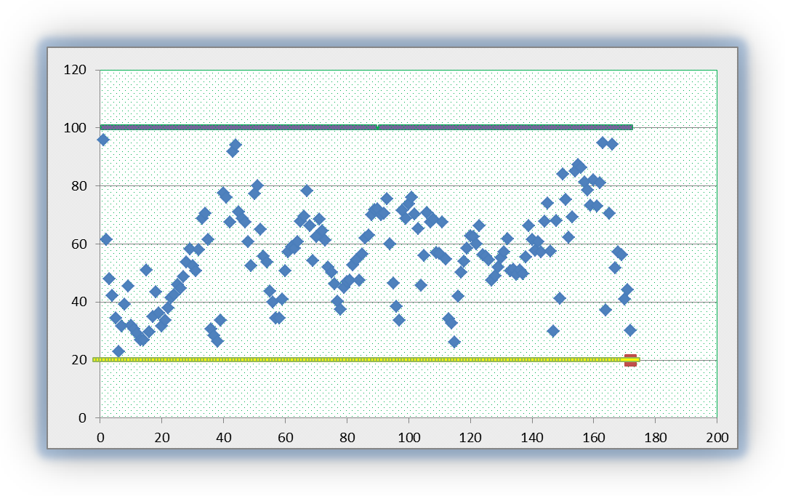
Output data description:
Figure : the pressure head at nodes after raising the reservoir

Slide 23
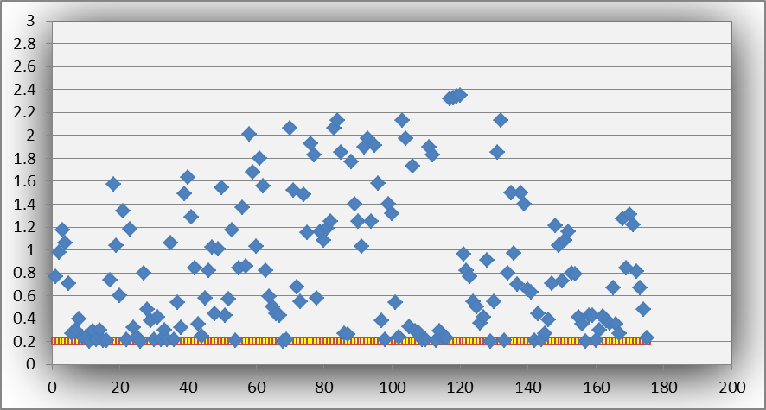
Output data description:
Figure 6.6: Velocity for each pipe.

Slide 25
Recommendation and conclusion
In Tammon there is no WDN so we recommended starting in implementation WDN as soon as possible.
The maximum difference in node elevations is about 122.11 m.
Maximum velocity in the network equal 2.36 m/s and the minimum velocity 0.2 m/s.
I choose a pump give a head (35 m) to give at least 20m pressure head at nodes to reach all citizens.

Slide 26
Design Of Tammon Waste Water Network

Slide 27
Objectives:
To design a wastewater network collection system for Tammon town.
There is no wastewater collection system in the town, so people get red of the wastewater by using cesspits.
This way of disposal is not good because:
Bad smell especially during pumping.
Economical problems since it cost them (pumping process).
Its location near the collection wells.

Slide 28
Layout of The System:
The lay out of the system is made by drawing the manhole along the streets take into consideration that the flow is by gravity.
We use Excel Program to design wastewater collection system.

Slide 29
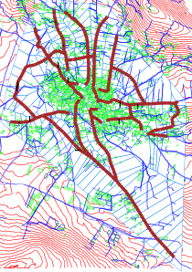
Design of sewer network

Slide 30
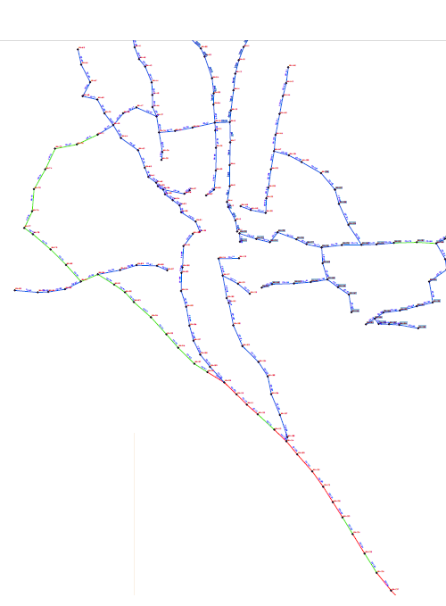
Design of sewer network
12 inch
10 inch
8inch

Slide 31
Sewer line and manholes for our project
Used 196 manholes totally of the collection system.
The total length of sewer line is approximately 11.11 kilometers (km).
The trunk main line sizes vary from (8 to 12) inch.

Slide 33
Drawing network using AutoCAD:
Manholes
Line
polygon

Slide 34
2. taking some information from the map in AutoCAD:
Number of person in each polygon.
Length of the pipe.
Elevation of each manholes.
3. Using Excel sheet to design:
Calculate maximum hourly flow
Slope
Velocity(use manning)

Slide 35
Procedure
Calculate the future population by the following equation:
P=p0 *(1+r)n
The population of Tammon in 2042 is35627 person
We assumed the water demand =(100) L/C/D.
80% of demand taken as waste water.
Using excel sheet to design.

Slide 36
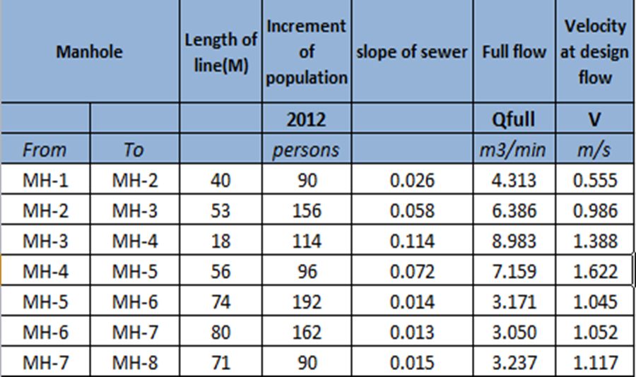
excel sheet for design

Slide 37
main characteristics for the design
Main characteristics for the design
Velocity (0.6-3.5)m/s.
Slope (0.008-0.17)m/m.
Distance between manholes: should not exceed 80 m.

Slide 38
Main characteristics for the design
Manning coefficient =0.01.
Full flow velocity= (1/n) x (R^{2/3}) * (S^{0.5})
From PWA the minimum size for pipe equal 8in.

Slide 40
Sewer lines
This table show length of diameter used:
Diameters of Pipe(in) | Length(m)
8 | 8411
10 | 1687
12 | 1011

Slide 41
Velocity for pipes

Slide 42
Problems of sewer in our project
On slope of sewer line dose not located with range (0.008-0.17). Used drop manhole.
In some pipes the velocity is small than minimum0.6 m/s because this pipes is sub pipe and there is a little flow income to it.

Slide 44
Conclusion and Recommendation
In Tammon there is no wastewater so we recommended starting in implementation wastewater as soon as possible.
In the design we depend on gravity to transport the wastewater and we didn't need any pump .
Maximum velocity in the network equal 3.5 m/s and the minimum velocity 0.278 m/s

Slide 45
THANKS FOR YOUR ATTENTION
Thank You…

