Slide 1

Zuhair AlSader & Karam Shawish
21/12/2016
Epoch 1482306300

Slide 2





Notes:
Technology fluency
Problem solving; stepwise
Collaboration

Slide 3

Notes:
Kinesenthetic

Slide 4


Slide 5
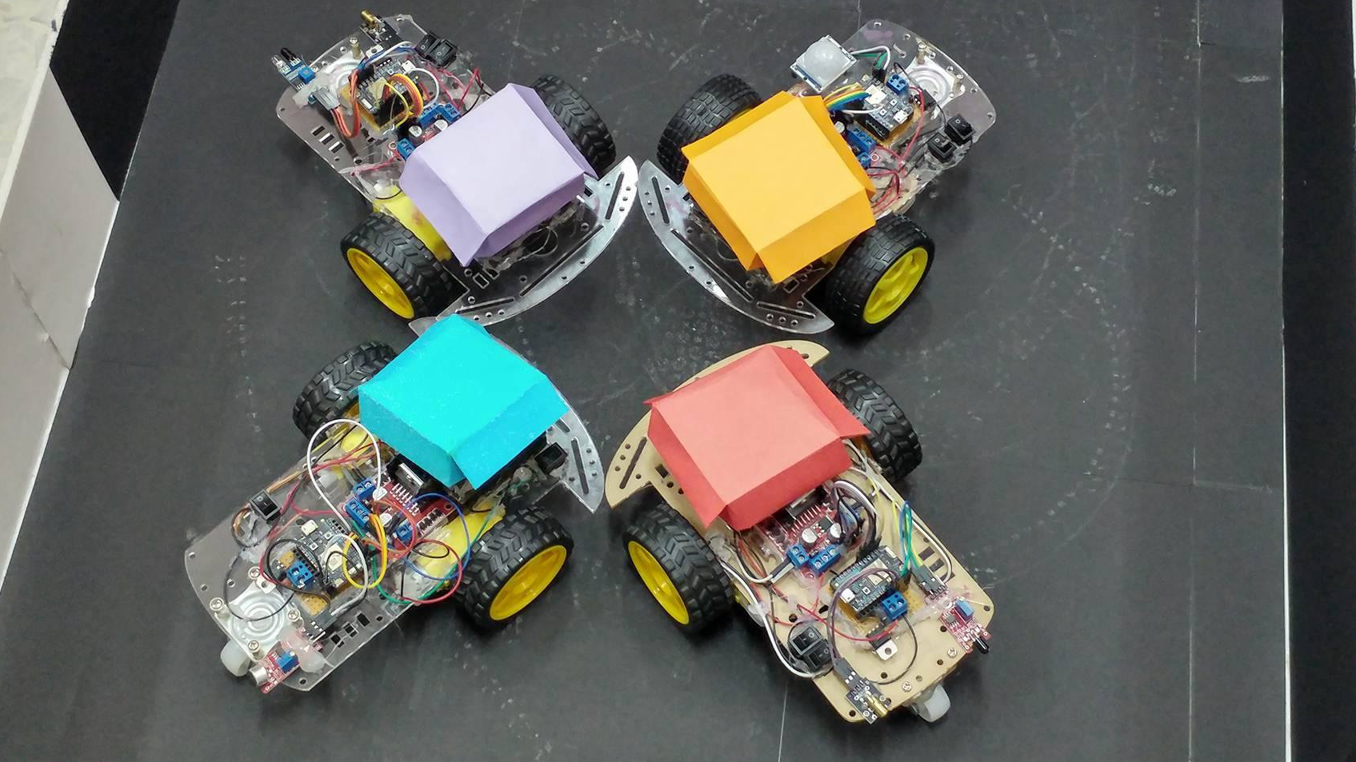


Slide 6
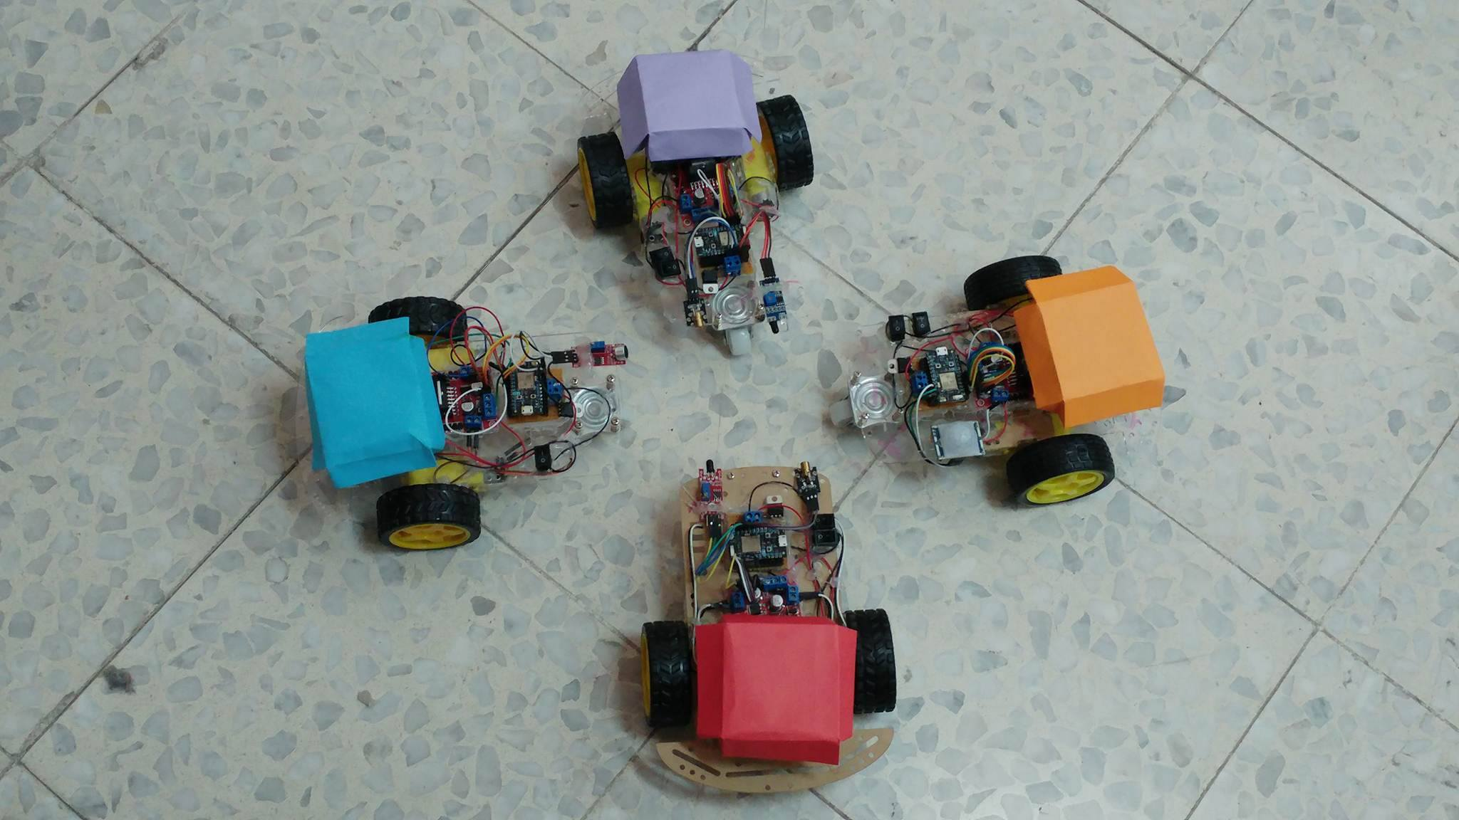

Slide 7
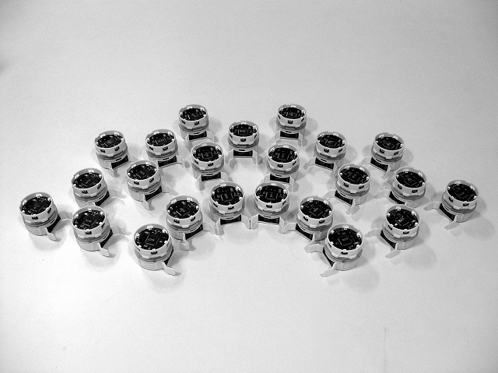
Swarm Robotics
Notes:
Swarm Intelligence
Loose adoption to allow for programmability
Awesome research: ASEBA, ePuck

Slide 8
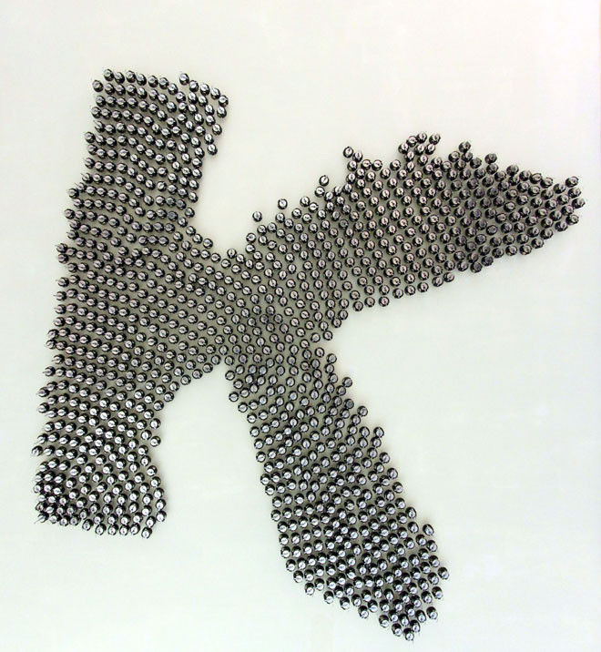
Why Swarm?
● Parallelism
● Robustness
● Scalability
● Heterogeneousness
● Flexibility
● Cheap Alternative
Notes:
ok

Slide 9
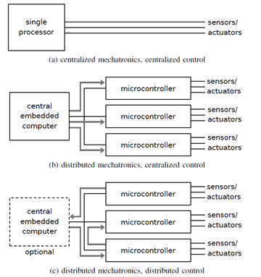
Ways to do Swarm Robotics

Slide 10
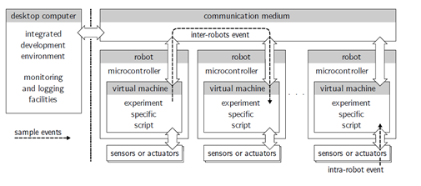
Event based swarm

Slide 11
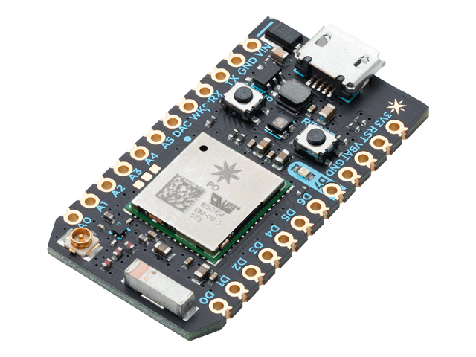
Particle Photon
Small and powerful
Wi-Fi connected
Open-source HW & SW
Cloud services out of the box
Programmed in C++
particle.io

Slide 12
Hardware

Slide 13
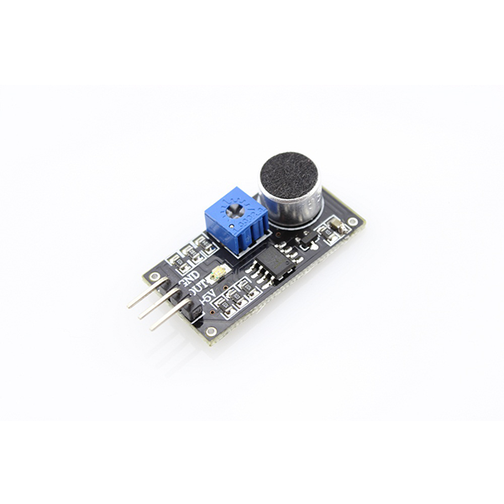
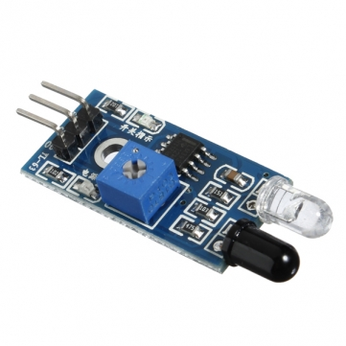
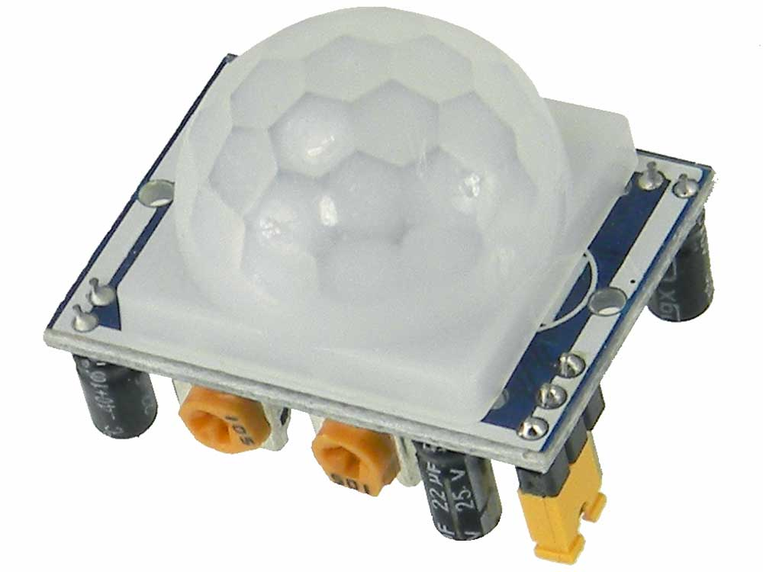
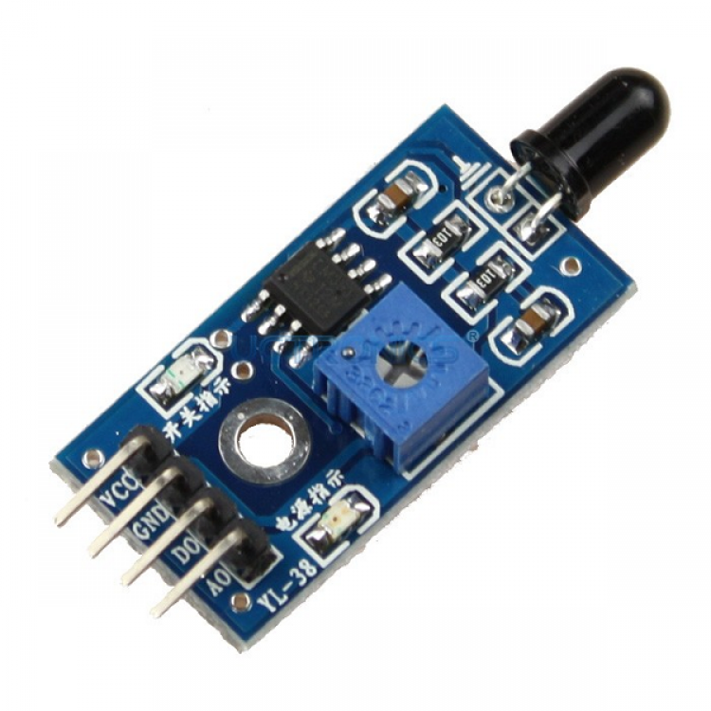
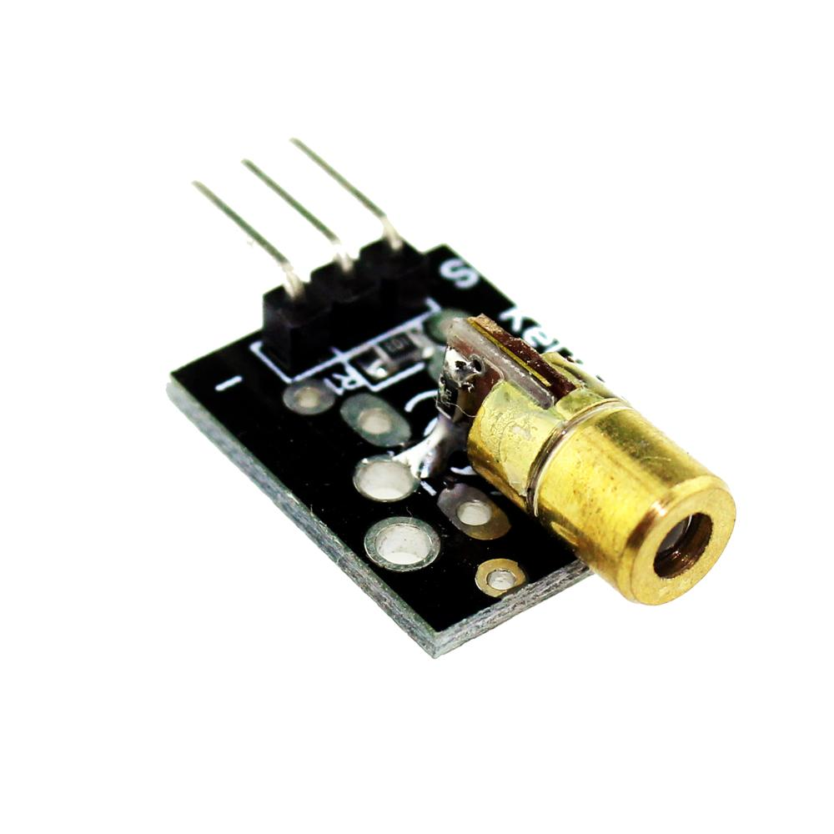
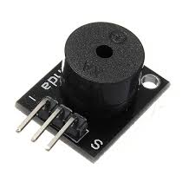
Sensors & Accessories
Sensors :
Sound Sensor
Flame Sensor
Motion Sensor
Obstacle Sensor.
Actuators :
Laser Head
Buzzer

Slide 14
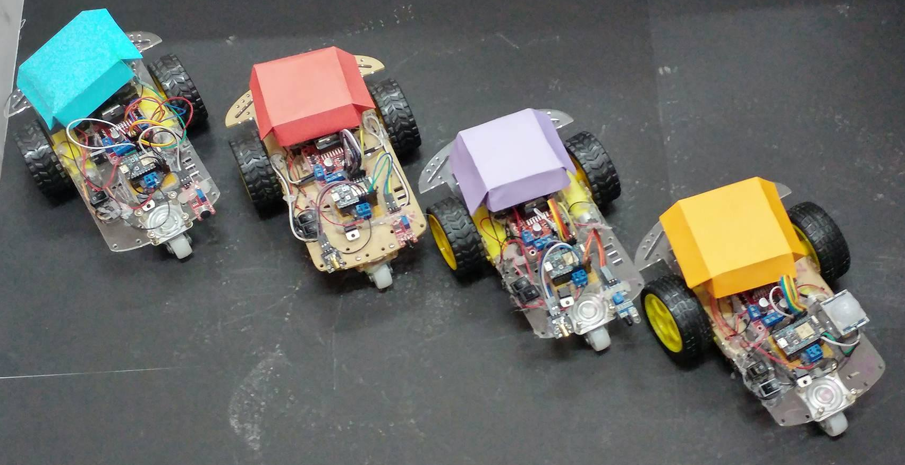
Our Turtles
Sensor
Accessory

Slide 15

Mobile App
Built for
Core features:
Cloud-based login and signup.
Swarmy Turtle setup.
Programming Single Swarmy Turtle.
Programming Parallel Swarmy Turtles.

Slide 16

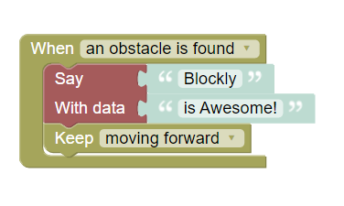
For
Visual Programming
Open source
Customizable
International
Translates neatly to JS, Python, PHP and others, not including Arduino C++
Build it!

Slide 17






Photon SDK for
Cloud SDK: wrapper for Photon cloud API
Device Setup Library: Easy setup wizard for devices powered by Photon.

Slide 18
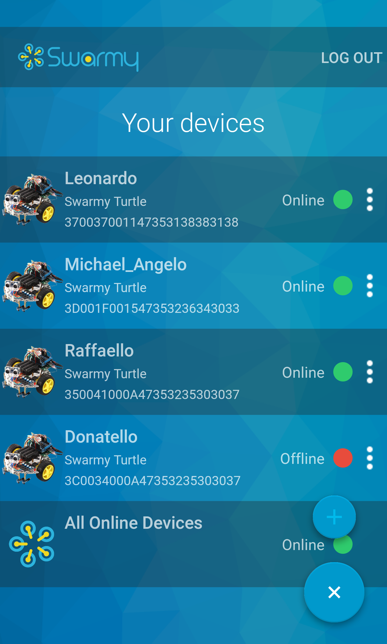
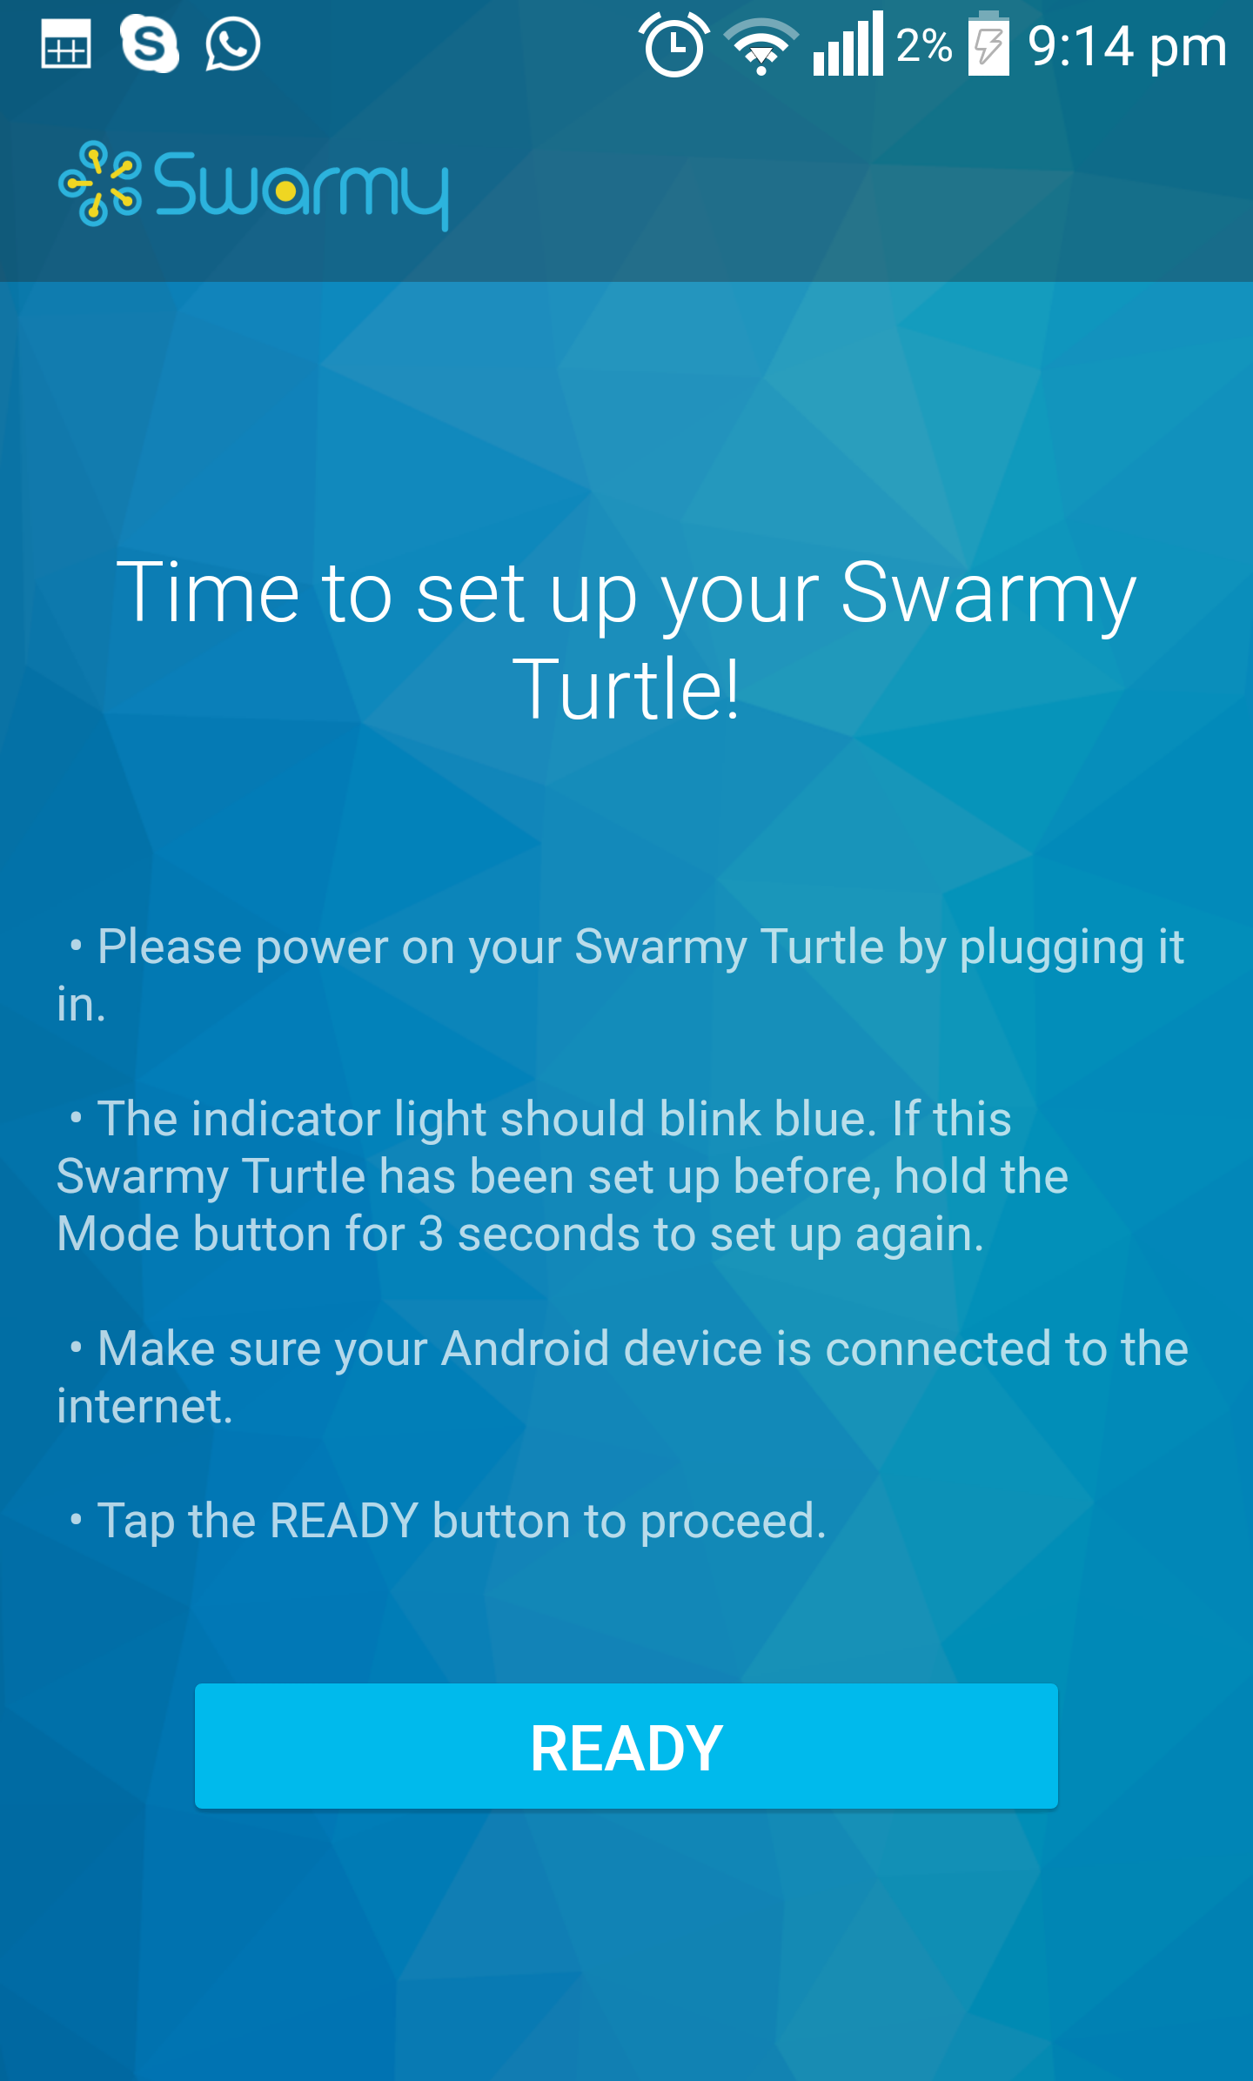
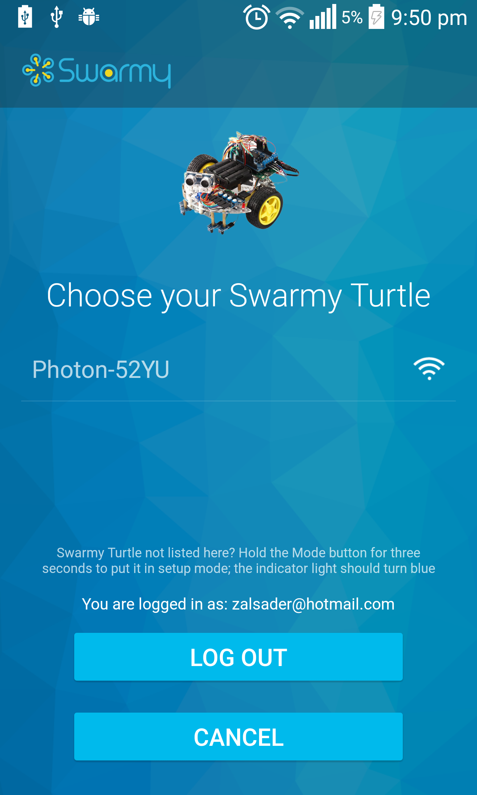
Device Setup

Slide 19
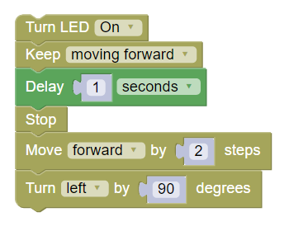
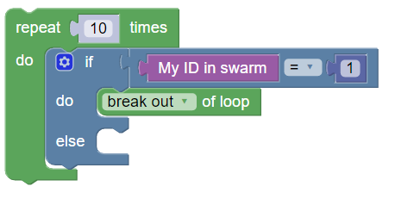
Programming Features

Slide 20
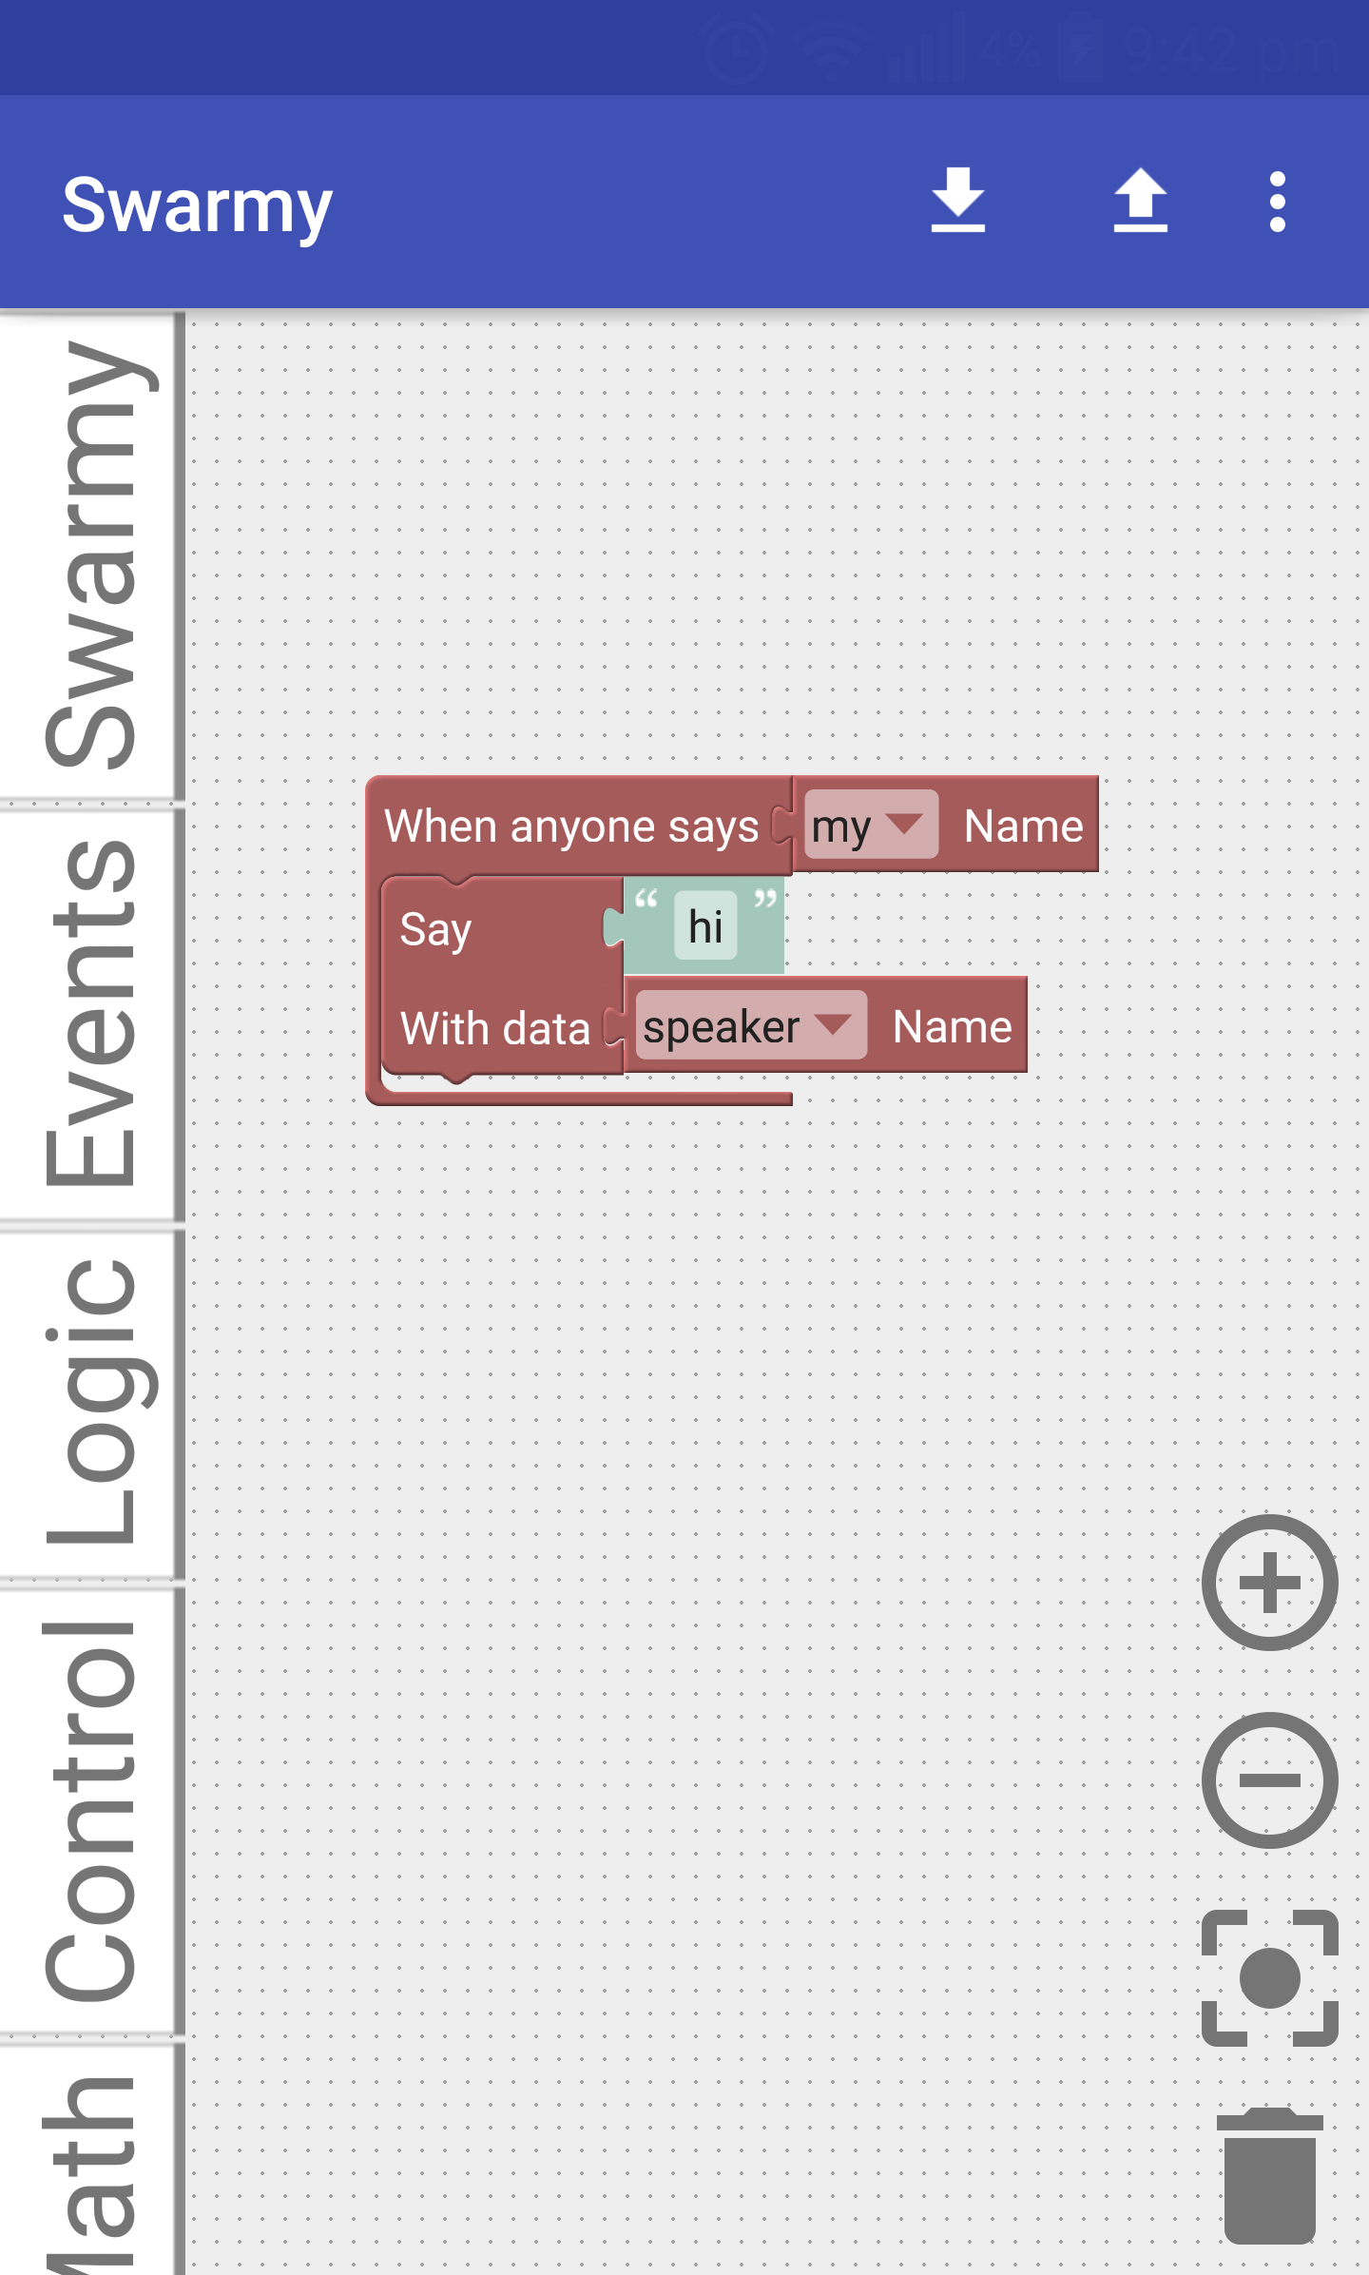
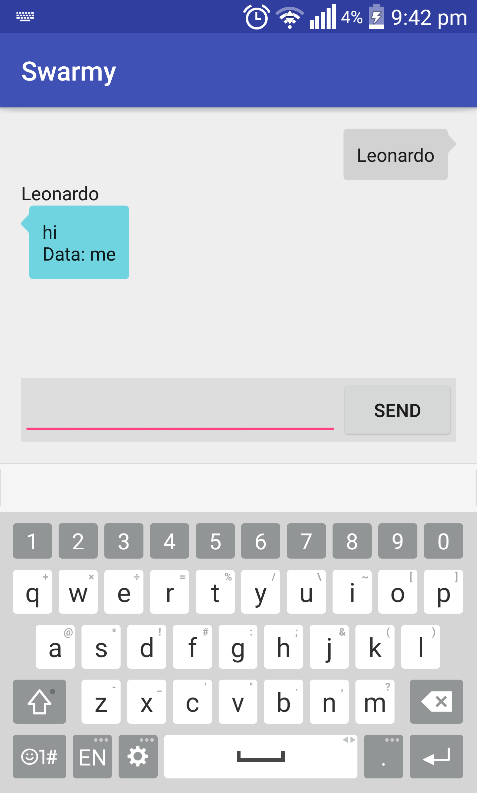
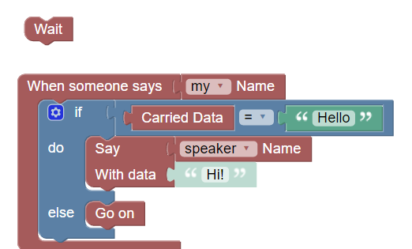
External Events
Shared between all Turtles and the mobile app
You can chat with robots:

Slide 21
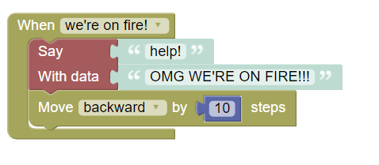
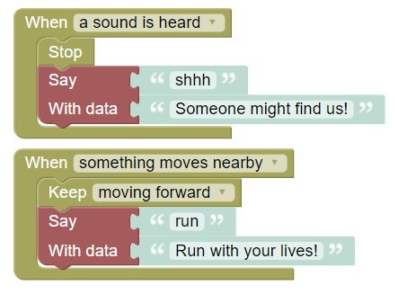
Internal Events
Interrupts by sensors, fire on change.
Problem: ISR must be very short (in µs)
Solution: set up a timer.
Good side effect: debouncing.

Slide 22
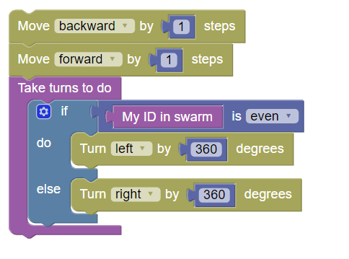
Parallelism
When programming all devices
All code is executed in parallel, except when taking turns.

Slide 23
Example

Slide 24
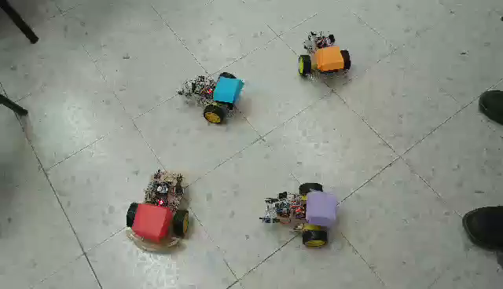


Slide 25
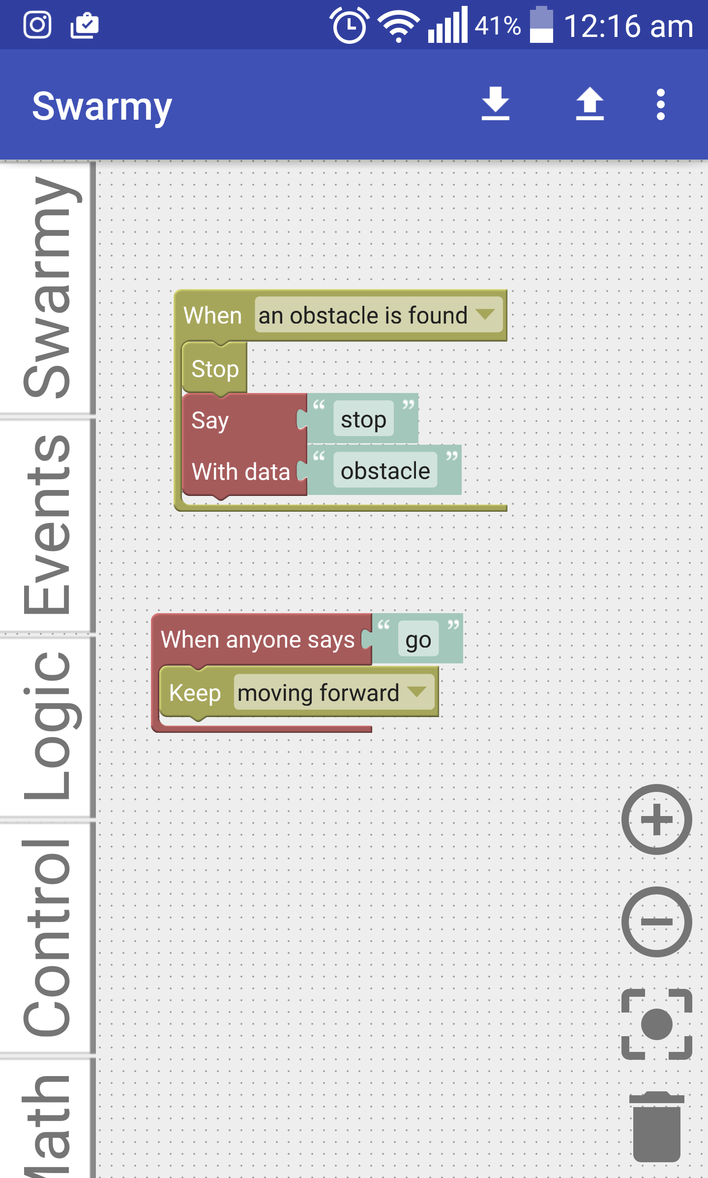
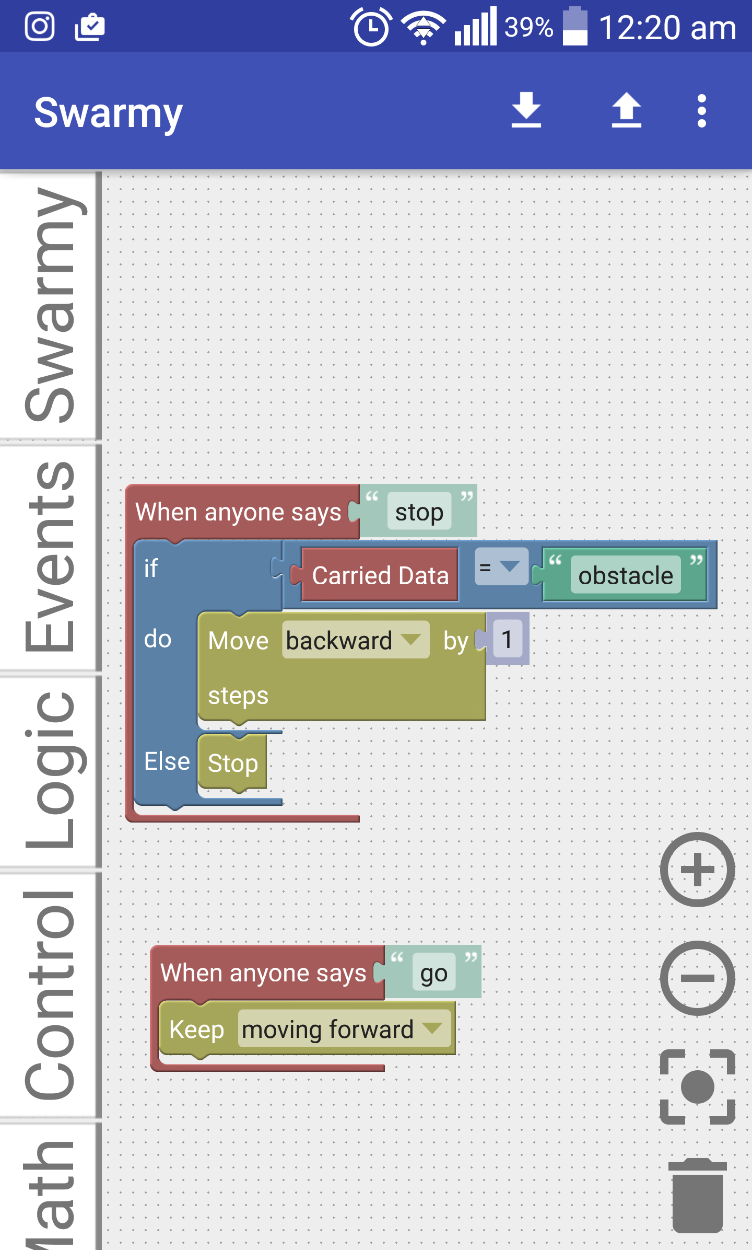
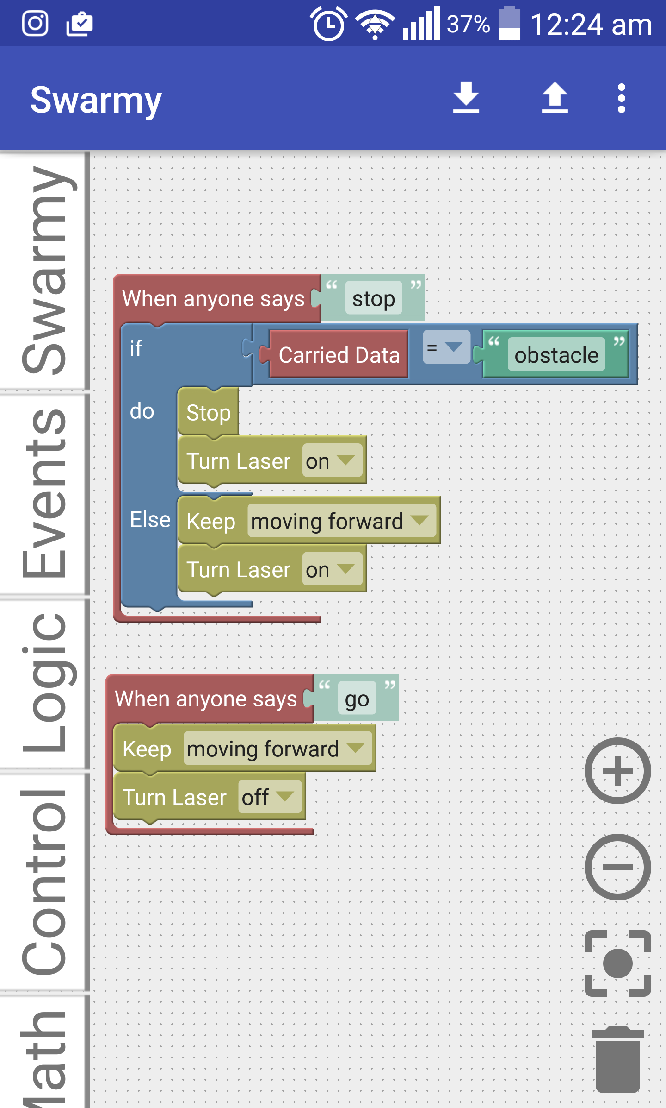
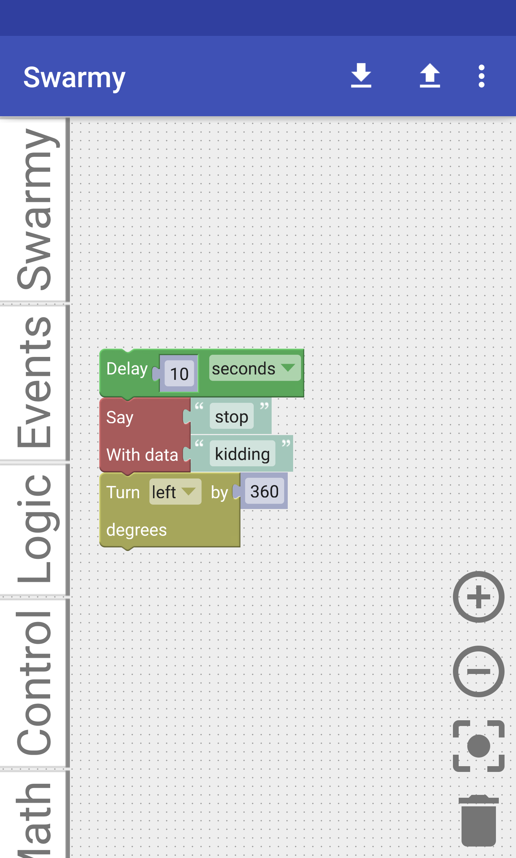
Another one

Slide 26
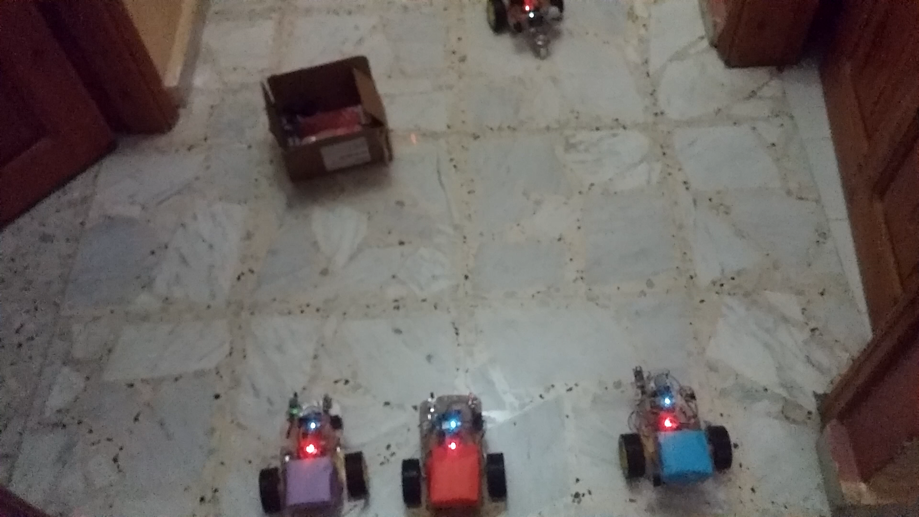

Slide 27

Positioning ( soon to be ready )
There are many local and global positioning techniques :
GPS
Mobile Positioning Technology.
WPS ( Wifi Positioning system ) :

Slide 28

Wifi Positioning System ( Distance Based )
ways to calculate the distance between the device and the access point :
ToA ( Time of Arrival ) :
RSSI ( Received signal strength indicator ) :
RSSI(d) = -10 n log(d) – c , n : path loss exponent, c : environment constant

Slide 29
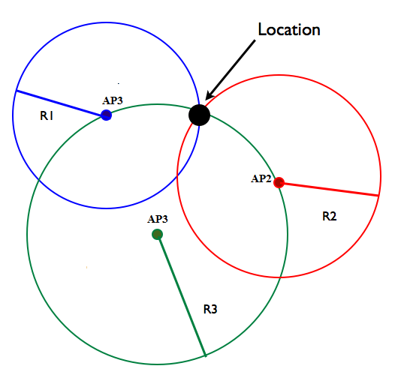
Wifi Positioning System ( Distance Based )

Slide 30
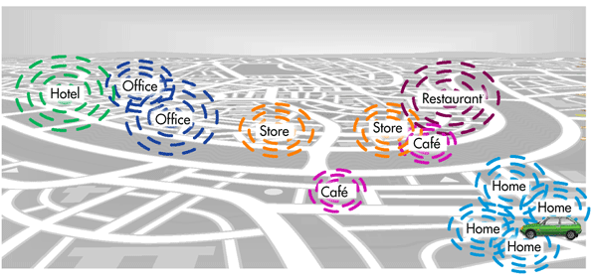
Also we can use Wifi fingerprint to Define a location
For more about this , see : schollz/find on githup

Slide 31
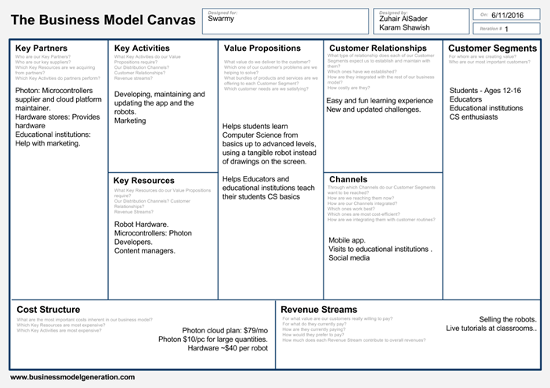

Slide 32
Constraints
Connectivity
Computational Power
Hardware Accuracy

Slide 33
Future Work
Enhancing app and Turtle UI and UX.
Translation to Arabic.
Adding iOS support.
Hardware upgrade.
In-app simulator
Fully implementing local positioning techniques.
Tutorials and challenges.

Slide 34


Slide 35
