Slide 1

Get There
Indoor Navigation with ArCore – Sceneform
Presented by:​
Lama Barri
Leen Abd Al-khaleq​
Supervisors :​
Ms.Haya Samahneh
Dr.Emad Natsheh​

Slide 2
(
)
Outlines

Slide 3
Introduction
Motivation​
Features
Methods and techniqies​
Technologies​
Future work & recommendation.​
​

Slide 4
(
)
Our Application

Slide 5
What is GetThere?​
​
_______________________________________________________________________
It's an Android mobile application that helps users find their desired destination in an indoor venue where the GPS can't be used using the power of
Augmented Reality. ​

Slide 6
(
)
Motivation​

Slide 7

Are you Lost ?
New comer may get lost
when he\she visit a new
building for the first time .​
Students frequently arrive
late for classes because they cant find the classroom or
laboratory

Slide 8

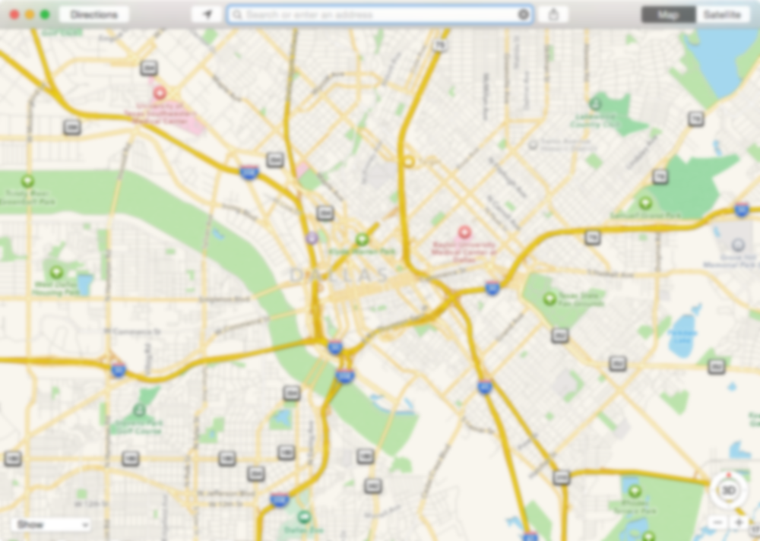
Outdoor navigation is available for all , built with Google Maps
, accurate , depends on GPS
Indoor Navigation is confusing , unreliable and does not supported by GPS

Slide 9
(
)
Features

Slide 10
The Ability to choose any map
Find the shortest path from src to destination ,and guid users to their destinations using AR arrows
Mark the destination with a special AR marker​.
Display the most common places using AR boards during the navigation .​
Track the user movement and display Distance from the destination during movement . ​

Slide 11
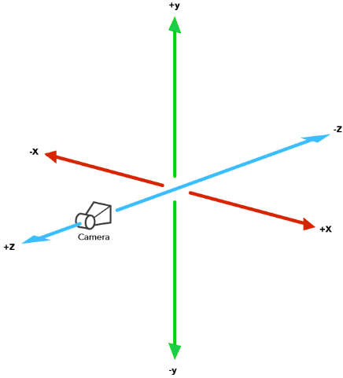
How To improve Augmented Reality for creating Indoor navigation?
3-D Cartesians

Slide 12
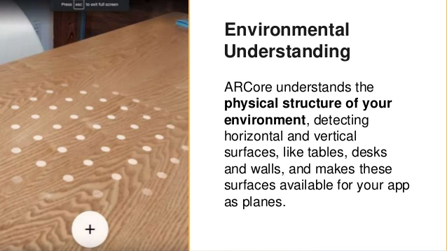
Environment Understanding

Slide 13
(
What Did we Build?
How GetThere Work?
(

Slide 14
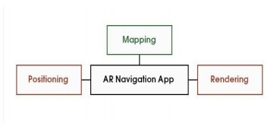
Our App contain three main parts:
( Mapping
( Positioning
( Rendering
​

Slide 15
( Mapping
The main process of our app is the Mapping which is the process to convert from 3d coordinates and 2d pixel in the Admin side and vice versa in the user side using references . ​

Slide 16
(
)
What makes a good Mapping ? ​

Slide 17
Choose custom 2d map to navigate in it with accurate scale from pixels to meters.
Choose reference point in 2D map close as possible as to its location in real indoor map
Try to understand the Environment good to make anchor poses accurate

Slide 18
( Positioning
Our approch to detect the user location in the physical enviroment , this technique is
Marker Based Localization using Augmented Images.
After succes image detection the resolved Anchor should be resolved in it's correct position
Image detection is a feature supported by Arcore-Secenform , it can be tapped to detect location and use this image as IMAGE TARGET.

Slide 19
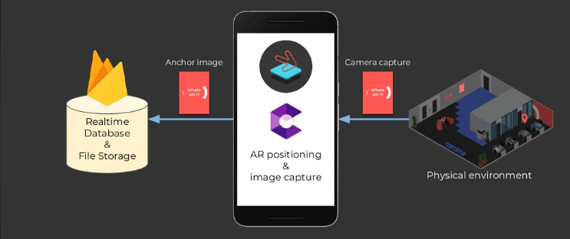
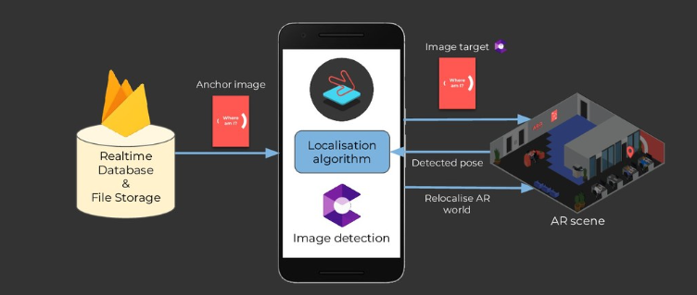

Slide 20
(
)
What makes a good image target? ​

Slide 21
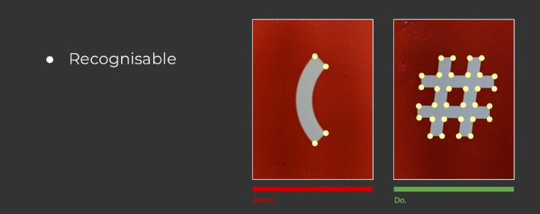

Slide 22
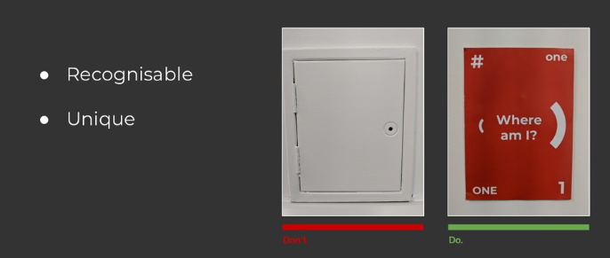

Slide 23
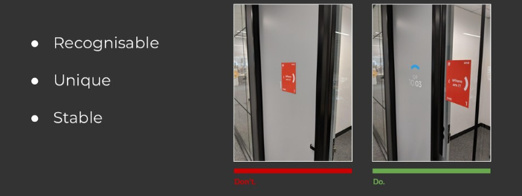

Slide 24
( Rendering
Retrieve 3d assets depends on its location in 2d

Slide 25
(
What Did we Build?
How GetThere Work?
(

Slide 26
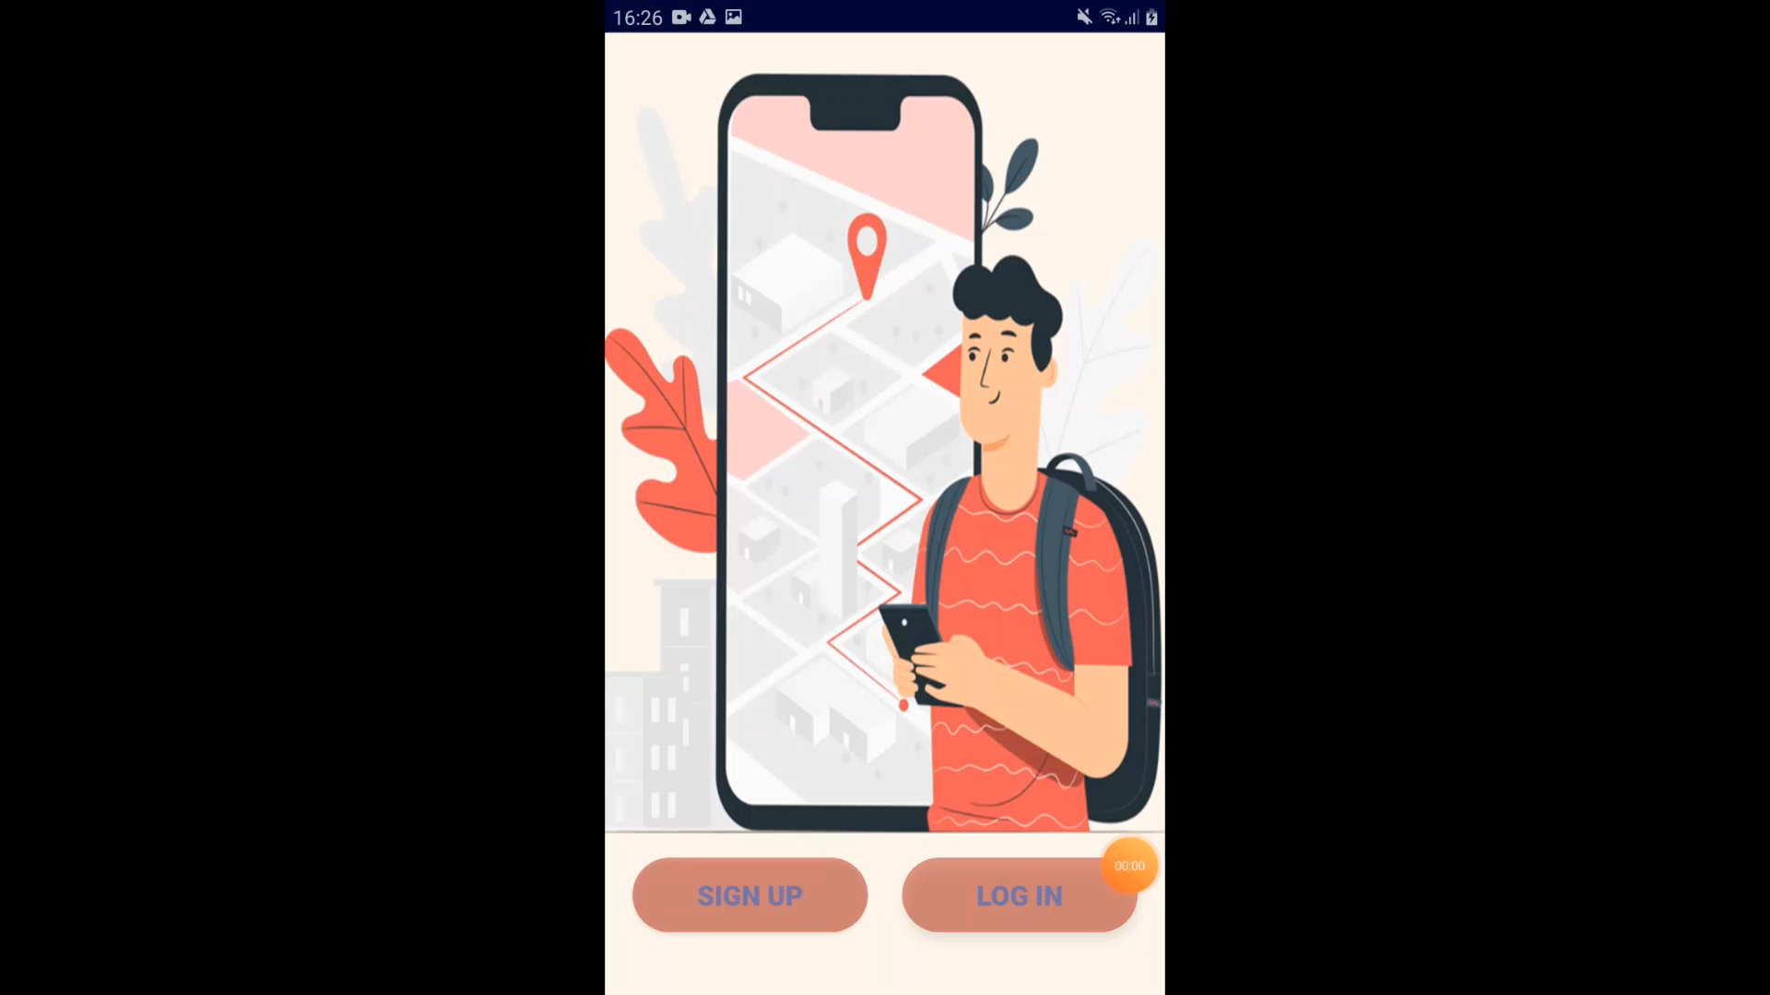

Slide 27
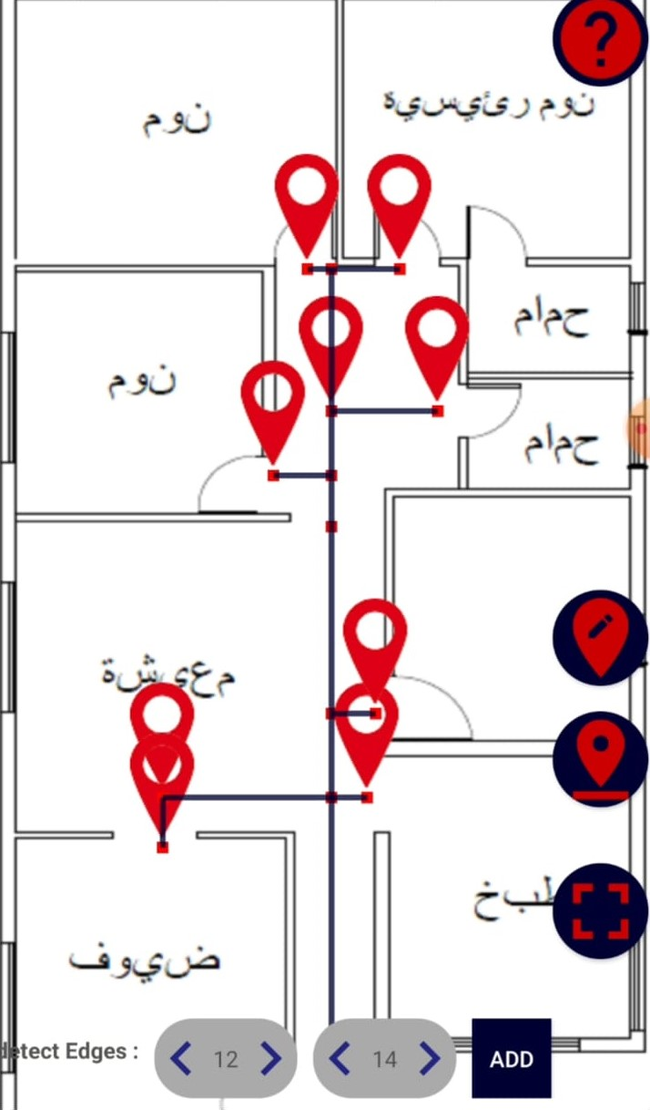
After Mapping

Slide 28
(
)
Tools & Technology

Slide 29









Slide 30
(
)
Limitation

Slide 31
The ARCore Just support the modern Devices , since it's a new technology ​
The navigation start from one point which is the referance ​
​
Self learning

Slide 32
(
)
Future Work

Slide 33
Web site design instead of mobile app so that Admin only deals with pixels .
​Using A* Algorithm to find the shortest path ​.
start the navigation from any point instead of one point
Track the user movement in the 2d map with a blue dot .​

Slide 34
Thank You for Listening !
We are waiting your Questions

