Slide 1

AN-NAJAH NATIONAL UNIVERSITY
FACULTY OF ENGINEERING
DEPARTMENT OF MECHANICAL ENGINEERING

Slide 2

Students name :
Abed Alkareem Alfanni
Ismat Fakhouri
Mohammad Hussein
Saleh Obead
Supervisor:
Ramiz Al Khaldi
AL BAHRAIN PEDIATRIC HOSPITAL
24/5/2010

Slide 3
MECHANICAL SYSTEMS IN BUILDINGS
AL BAHRAIN PEDIATRIC HOSPITAL
AL BAHRAIN PEDIATRIC HOSPITAL
24/5/2010
Notes:
Jyrtftrttdderedrrerwrererererter

Slide 4
The aim of this project is to design the Following Mechanical Systems to AL Bahrain Pediatric Hospital :
Heating Ventilation and air conditioning (HVAC).
Plumping system (Sanitary drainage system& potable water system).
Fire Fighting system.
AL BAHRAIN PEDIATRIC HOSPITAL
24/5/2010

Slide 5
HVAC System
This abbreviating stands for Heating Ventilation and Air Conditioning System
The main objective of air conditioning is to maintain the environment in enclosed space at conditions that induce the feeling of comfort to human.
AL BAHRAIN PEDIATRIC HOSPITAL
24/5/2010

Slide 6
WINTER INSIDE AND OUTSIDE DESIGN CONDITIONS
Outside temperature To=4.7 ˚C.
Inside temperature Ti=21 ˚C.
Outside Relative humidity Ф_{o}=71.7% .
Inside Relative humidity Ф_{i}=30%.
Outside Moisture content W_{o} =3.9g of water/ Kg of dry air.
Inside Moisture content W_{i} =4.7g of water/ Kg of dry air.
AL BAHRAIN PEDIATRIC HOSPITAL
24/5/2010

Slide 7
HEATING LOAD EQUATIONS
The following equations were used to calculated the heating load:
Qs,cond = U A (Tin – To) .
Q s,vent = 1.2 Vvent (Tin – To).
Q l,vent = 3 Vvent (Wi- W o).
Qtotal = Qs,cond + Qs,vent +Ql,vent
AL BAHRAIN PEDIATRIC HOSPITAL
24/5/2010
Notes:
HEATING LOAD EQUATIONS

Slide 8
HEATING LOAD RESULTS
Floor | Qs)cond. (w) | Qs) vent. (w) | Ql) vent. (w) | Q)total .(w)
Basement Floor | 3464.9072 | 19090.8 | 2232 | 23887.7072
Ground Floor | 21450.745 | 53389.02 | 6550.8 | 81390.57
First Floor | 50234.88477 | 30240.24 | 5712 | 86187.12
Second Floor | 27533.056 | 55491.72 | 6808.8 | 89833.58
Total | 102683.6 | 158211.8 | 21303.6 | 281299
AL BAHRAIN PEDIATRIC HOSPITAL
24/5/2010
Notes:
HEATING LOAD RESULTS

Slide 9
The boiler is the main source of heating process, selection of boiler depends on its capacity. selection of boilers from FERROLI COMPANY.
The total amount of heat in our project equal to 291.388 KW. Use catalog of boilers B.1 then the suitable boiler is that of type GN4 N 09
The GN4 N 09 has the following specifications:
Max. Heat input = 300 KW
Min. Heat input = 180KW
Combustion Chamber (Length = 1140mm, Diameter = 500 mm)
Working pressure = 4 bar
Width of boiler = 1300mm
Boiler gross weight = 1170 Kg
AL BAHRAIN PEDIATRIC HOSPITAL
24/5/2010

Slide 10
SUMMER INSIDE AND OUTSIDE DESIGN CONDITIONS
Outside temperature (To) be 30˚C.
Inside temperature (Ti) be 25 ˚C.
Outside Relative humidity (Ф_{o}) is 49.7%.
Inside Relative humidity (Ф_{i}) is 50%.
Outside Moisture content (W_{o}) is 13.5 g of water/ Kg of dry air.
Inside Moisture content (W_{i}) is 10 g of water/ Kg of dry air
AL BAHRAIN PEDIATRIC HOSPITAL
24/5/2010

Slide 11
COOLING LOAD EQUATIONS
Qs = U * A * CLTD corc. For Wall And Ceiling.
CLTD coro = ( CLTD + LM ) K +( Tin -25.5 ) + ( To – 29.4 ).
Qs) transmitted = A * SHG * SC * CLF . From glass
Qs) convection = U * A * ( CLTD ) correction. From glass
Qs) vent = 1.2 *A * ( To – T in ) .
Q latent = 3 * A ( W o –W in )
Qs) people = qs * n * CLF
Ql) people = ql * n
Qs) lighting = W * CLF
Qs) equipment = qs * CLF
Ql) equipment = ql
AL BAHRAIN PEDIATRIC HOSPITAL
24/5/2010

Slide 12
COOLING LOAD RESULTS
Floor. No | Q(Total) (Kw) | Q(Total) (Ton) | Q(Total) (CFM)
Basement floor | 33.1818 | 9.480515 | 3287.122
Ground floor | 110.9769 | 31.7077 | 13266.677
First Floor | 109.940 | 31.41143 | 14988.76
Second floor | 106.745 | 30.49857 | 13073.59
AL BAHRAIN PEDIATRIC HOSPITAL
24/5/2010

Slide 13
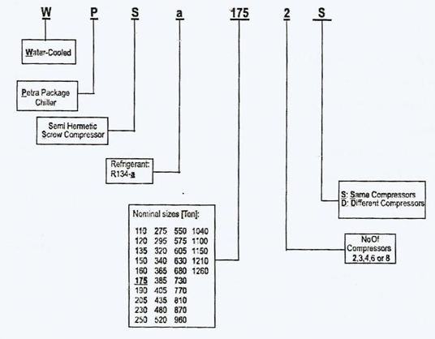
The chiller is the main source of cooling process, our selection depends on PETRA COMPANY.
The cooling load in our project is 102.43 Ton. . So we select 110 ton R 134-a chiller it's manufactured with Two compressors and with the same compressors type.
The Chiller Code is: WPS a 110 2 S
AL BAHRAIN PEDIATRIC HOSPITAL
24/5/2010

Slide 14
DUCT DESIGN
There are two methods for duct design :
Equal pressure drop method.
Velocity method.
All the results of duct design based on equal pressure drop method
AL BAHRAIN PEDIATRIC HOSPITAL
24/5/2010
Notes:
All the results of duct design based on equal pressure drop method

Slide 15
PIPES DESIGN
The total cooling load was calculated for the floor.
The mass flow rate for the water calculated (m).
The pressure head was estimated in (Kpa) .
The longest loop from the boiler to the farthest fan coil unit and return to the boiler was calculated multiplying by (1.5) due to fittings.
The pressure head per unit length is calculated and it should be between range from (200< ∆p/L<550).
Then the diameter of pipe entering to the floor is estimated .
AL BAHRAIN PEDIATRIC HOSPITAL
24/5/2010

Slide 16
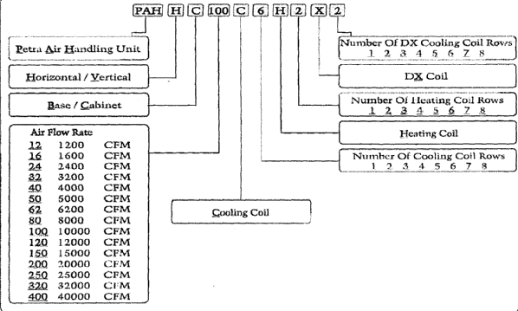
AIR HANDLING UNIT SELECTION
The Air Handling Units were selected from PETRA COMPANY using PETRA catalogue:
AL BAHRAIN PEDIATRIC HOSPITAL
24/5/2010
Notes:
AIR HANDLING UNIT SELECTION

Slide 17
The suitable A.H.U (AHU#2) for ground floor (4724.164 CFM) is:
PAH H C 50 C6 H3 X2
The suitable A.H.U(AHU#1) for (ground & second floor) (7301.165 CFM) is:
PAH H C 80 C6 H3 X2
The suitable A.H.U for first floor:
AHU# 1: Operation rooms (1407.188 CFM) PAH H C 16 C6 H3 X2
AHU #2: I.C.U room (555.745 CFM) PAH H C 8 C6 H3 X2
AHU #3: N.I.C.U room (1037.010 CFM) PAH H C 12 C6 H3 X2
AL BAHRAIN PEDIATRIC HOSPITAL
24/5/2010

Slide 18
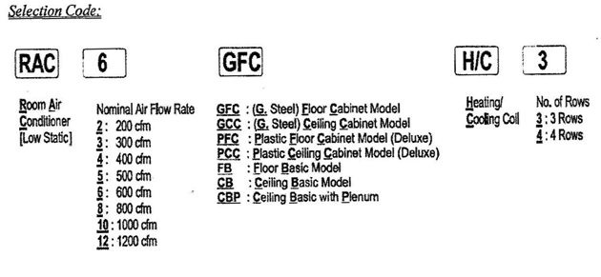
FAN COIL UNIT SELECTION
In Our project we need Ducted FCU and to ensure the high level of comfort we need the filtered FCU our selection from Petra catalogs is CBP type.
AL BAHRAIN PEDIATRIC HOSPITAL
24/5/2010

Slide 19
PLUMMPING SYSTEM IN BUILDINGS
The drainage fixture unit in building
Size of pipes (in) | No .of fixture | Type of fixture
4 | 6 | Water closet
1 1/2 | 3 | Kitchen sink
2 | 2 | Shower head
1 1/2 | 1 | Lavatory
2 | 3 | Floor drain
    Total No. of Fixture = (478) F.U
    The Main Building Drain = 5 in. 6in practical
AL BAHRAIN PEDIATRIC HOSPITAL
24/5/2010

Slide 20
Potable water fixture unit in building
Size of pipes (in) | No .of fixture | Type of fixture
1 | 10 | Water closet
1/2 | 4 | Kitchen sink
1/2 | 4 | Shower head
3/8,1/2 | 2 | Lavatory
1/2 | 3 | Service sink
    Total No. of Fixture = (633) F.U from table (appendix **)
    The total demand is 178 GPM
    Total cold water demand = 178 x 0.75 =133.5 GPM
    Total hot water demand = 178 x 0.25 = 44.5 GPM
AL BAHRAIN PEDIATRIC HOSPITAL
24/5/2010
Notes:
Total No. of Fixture = (633) F.U from table (appendix **)
the total demand is 178 GPM
Total cold water demand = 178 x 0.75 =133.5 GPM
Total hot water demand = 178 x 0.25 = 44.5 GPM

