Slide 1
HVAC SYSTEM

Slide 2
HVAC SYSTEM
BMS system
Heating, Ventilation, Air-Conditioning and Refrigeration Systems
Building management system
HVAC and BMS are two different services which are usually connected with each other.
HVAC is mainly concerned with maintaining the comfort environment in terms of temperature and humidity while BMS is the management system which can either monitor or control HVAC and many other services like Electrical, fire fighting and plumbing services through a computer interface or some other automatic mean.
Through BMS many service parameters are visible on computer like what is the temperature in which room or what is the level of water tank or which pump is not working having fault alarm etc

Slide 3
Why automation system
SAFTEY: TO ACHIEVE PROCESS SAFETY OPERATION
STABILITY: TO MAKE PROCESS WORK STEADILY WITHOUT WORRYING FLUCTATIONS OR COSTLY SHUTDOWNS
ACCURACY: MORE ACCURATE, THE INCREASED QUALITY AND COMFORT OF WORKING ENVIORENMENT. ( ECONOMIC SUCCESS )
ACHIEVE MAXIMUM POWER SAVING.

Slide 4
System behavior
1.Heat Losses and Gains.
2.System Lags.
3.System Time Constants.
4.Hunting
5.Rangeability.

Slide 5
Level of process
Field Level
Automation Level
Management Level

Slide 6
Field level :
Consist of sensors
electrical and mechanical parts affected by their reads

Slide 7
Sensors:
TEMPERATURE SENSORS
RELATIVE HUMIDITY SENSORS
PRESSURE TRANSDUCERS
VELOCITY / FLOW SENSORS
INDOOR AIR QUALITY SENSORS
CO2 SENSORS
Filter sensor

Slide 8
electrical and mechanical parts
boilers
chillers
valves
actuators
water pumps
ducts
air filters
dampers and fans

Slide 9
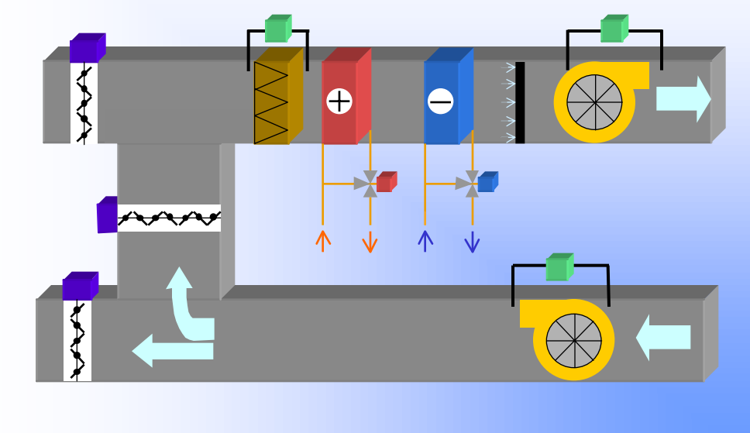

Slide 10
Two units are used in system
AHU: air handling unit
FCU: FAN Coil unit
Difference between them : that AHU uses in big hall, group of offices while FCU uses in small offices

Slide 11
2.automation
Open System : a system that allows components from different manufacturers to co-exist on the same network
Hardware
Software
Local Controllers
Programming Methods:
* Line By Line Programming
* Block Programming
* Application Programming

Slide 12
1. Management Level
Is the level that allow person to change anything in the process like change the plan temporary or permanently ,close lights, close pumps and it offer a schedule to read results and change it to consume less power
Following picture shows situation of system and how we can change them in a certain hotel

Slide 13
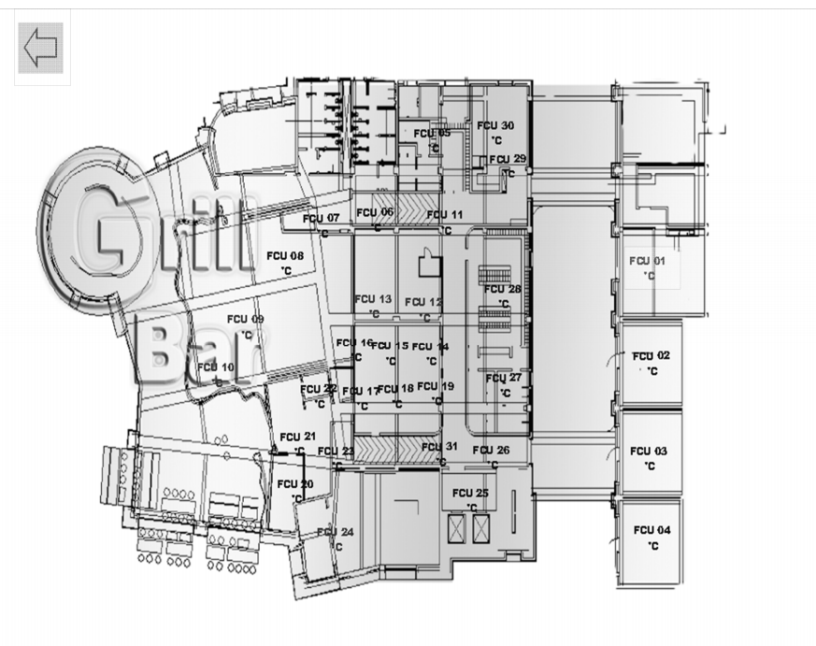

Slide 14
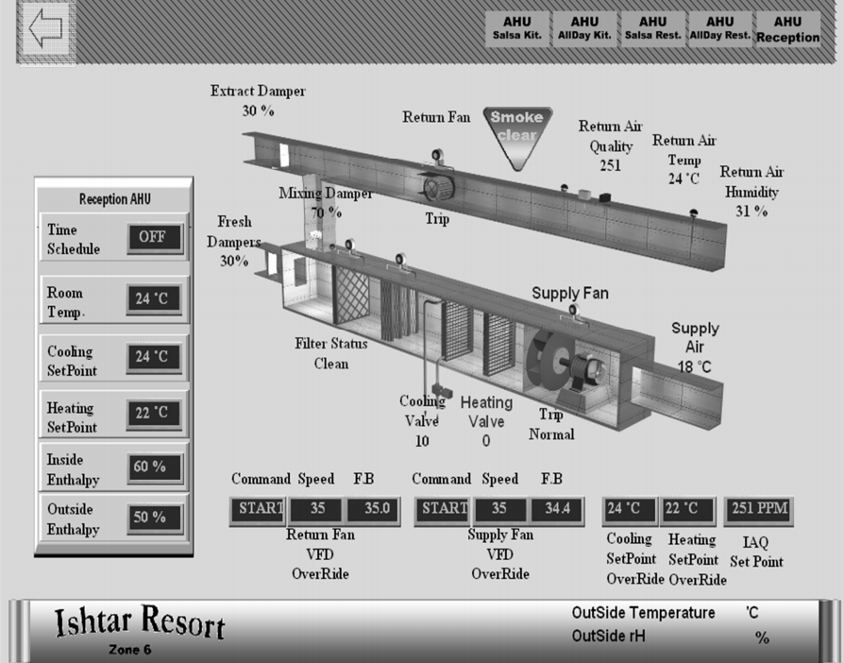

Slide 15
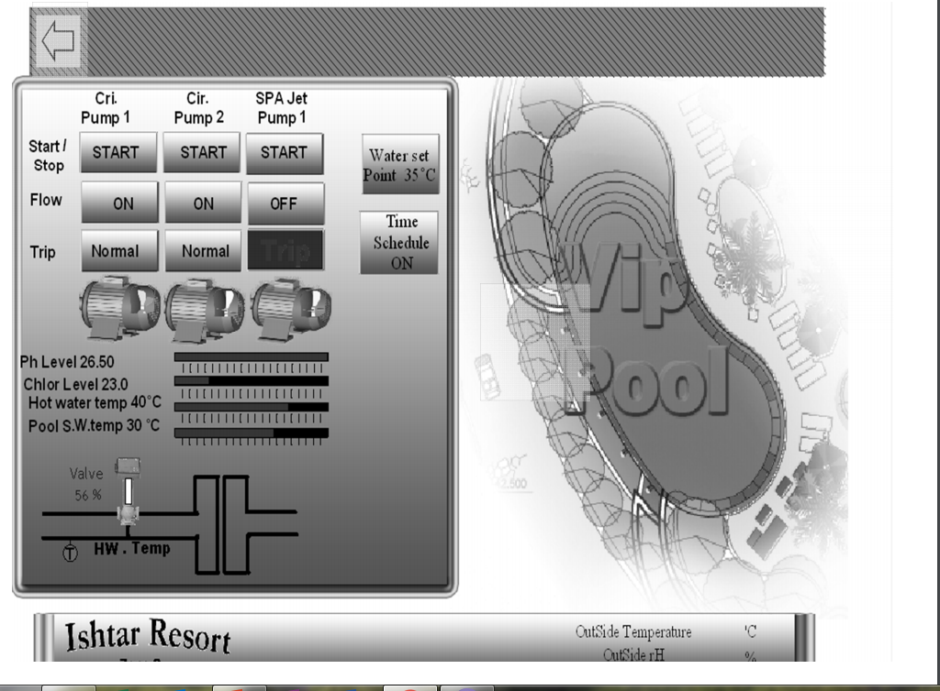

Slide 16
Since the system approved it effective it spread and has ben known to all companies , developing and Appling it .
Recently it has been applied in Palestine

Slide 17
FUTURE WORK
WE aim to build a prototype of the system in small model controlling HVAC, lighting and connecting to FFP.
Using PLC and it codes .

