Slide 1

Faculty of Engineering
Building Engineering Department
Modified Design of Zafer-03
(Graduation Project 2)
Supervisor : Eng.Alaa shaheen

Slide 2
Presentation outline
Introduction and Previous Studies
Architectural Design
Structural Design
Environmental Design
Mechanical Design
Electrical Design
Safety Design
Quantity Surveying and Cost

Slide 3
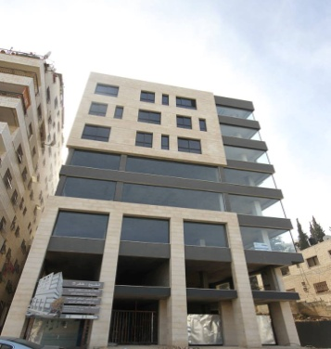
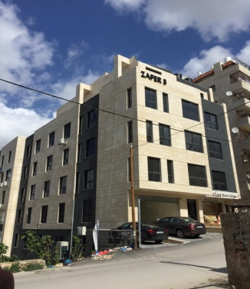

Slide 4
Introduction and earlier studies

Slide 5
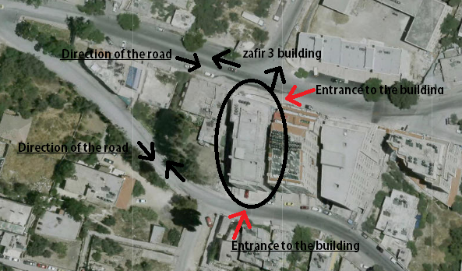
Site And Location
Zafer 3 building is located in Nablus city- Rafedia main Street, 6 stories . Located over two main streets

Slide 6
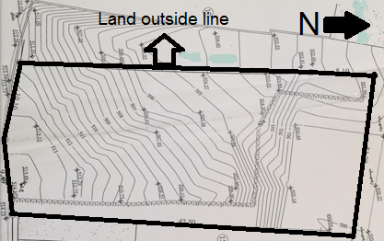
Site And Location
-Site has a total area of 912 m².
- Two Serviceable streets are Rafidea main 20m street & old compose street 10m.

Slide 7
Architectural design

Slide 8
Usage of the building:
The building is a commercial building.
All day working hours

Slide 9
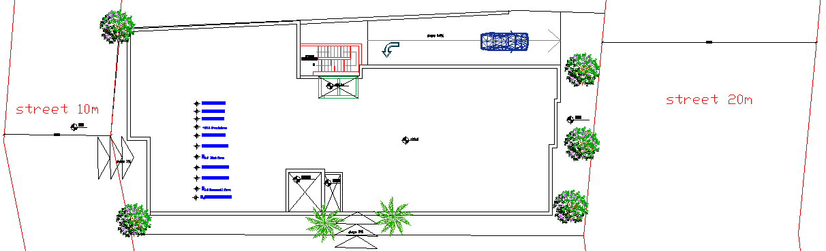
Site Drawning:

Slide 10
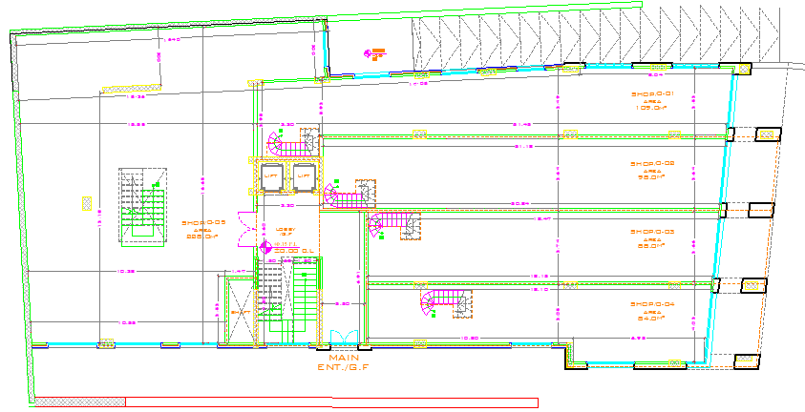
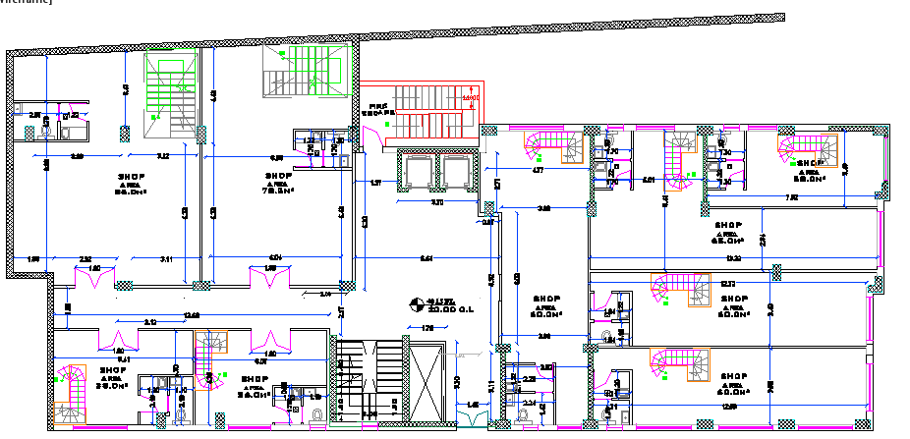
Old Design Plans:
Gf
New Design Plans:
Gf

Slide 11
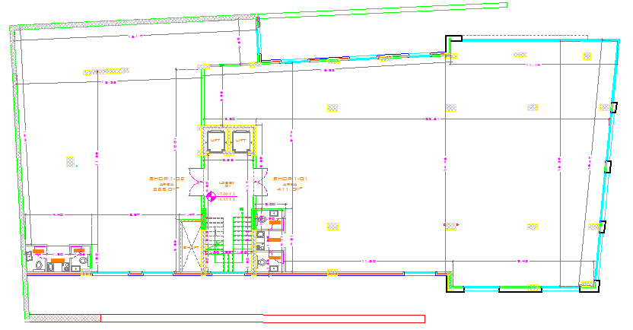
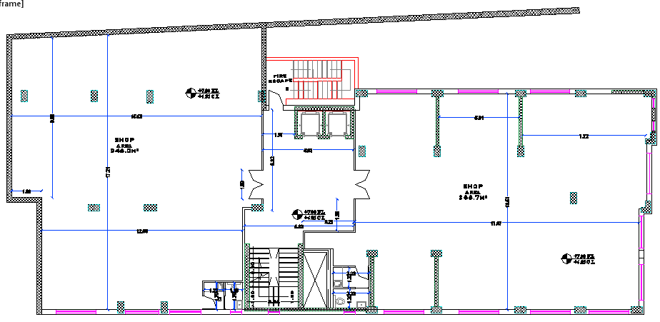
Old Design Plans:
1st & 2nd
New Design Plans:
1st & 2nd

Slide 12
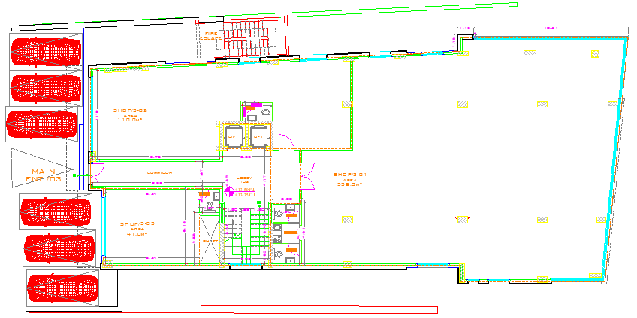
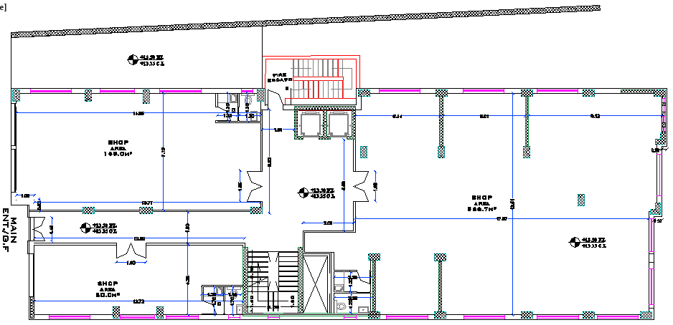
Old Design Plans:
3rd Floor
New Design Plans:
3rd Floor

Slide 13
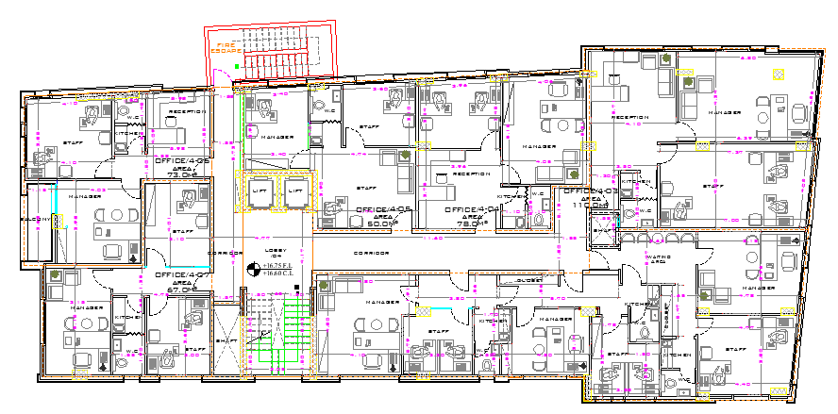
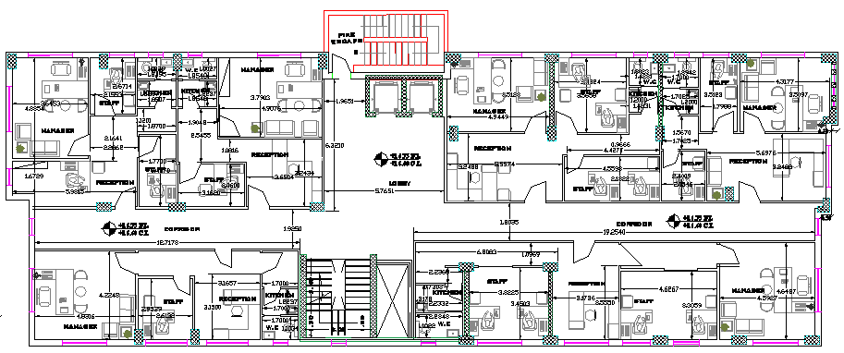
Old Design Plans:
4th floor
New Design Plans:
4th Floor

Slide 14
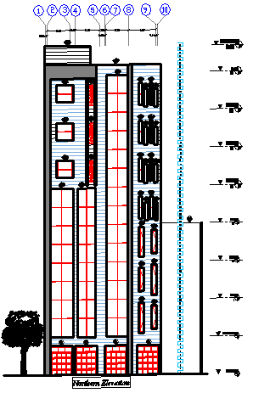
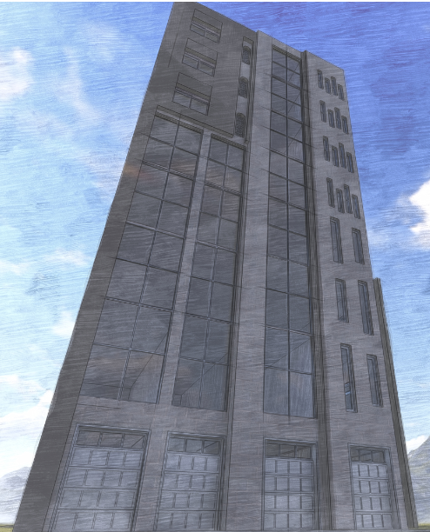
New Design Main Elevation

Slide 15
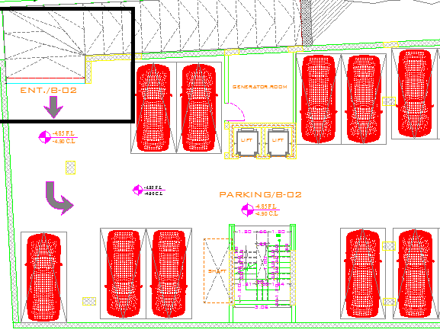
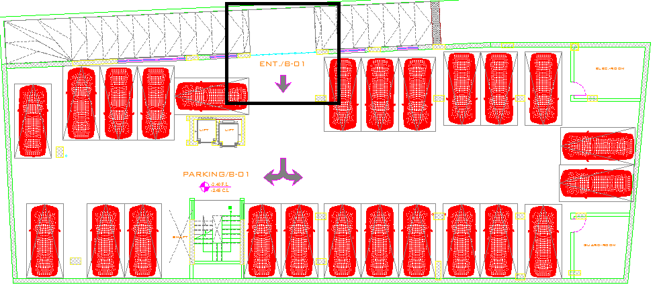
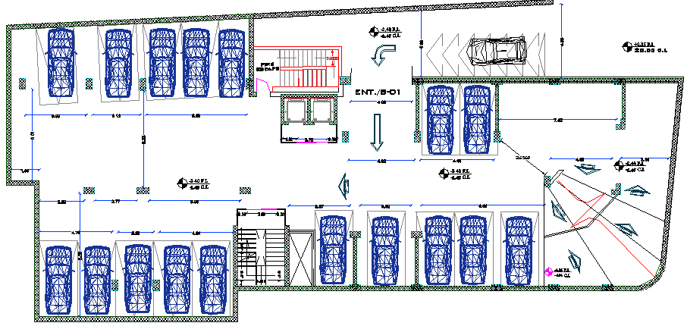
Design Modifications:
Old Design :
Parking level
New Design:
Parking level

Slide 16
Design Modifications:
2- protection for the users in the parking level

Slide 17
Design Modifications:
3- More story's with different areas in the ground floor

Slide 18
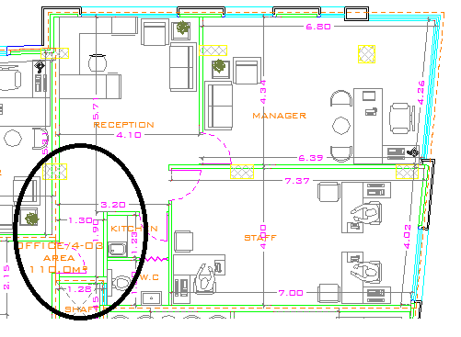
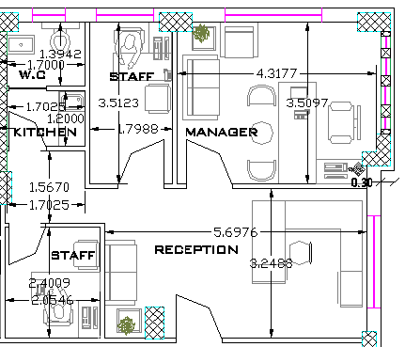
Design Modifications:
4- Get red of the box when entering the office :

Slide 19
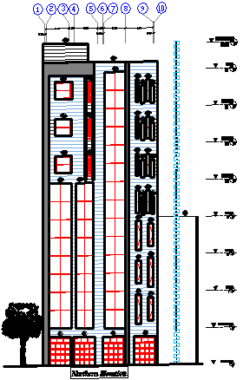
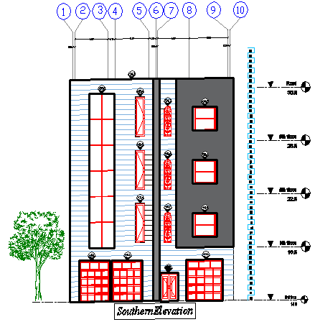
Elevations & sections:
North Elevation
South Elevation

Slide 20
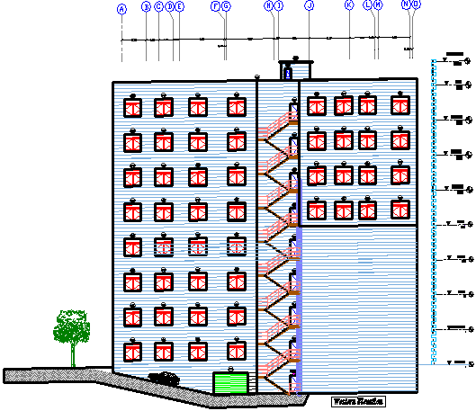
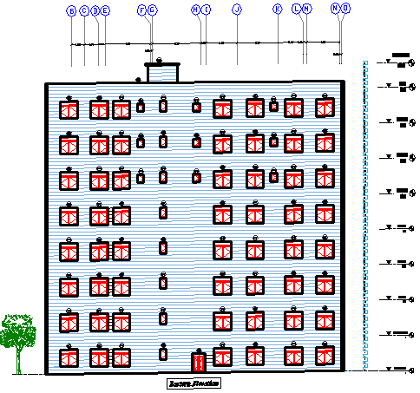
Elevations & sections:
West Elevation
East Elevation

Slide 21
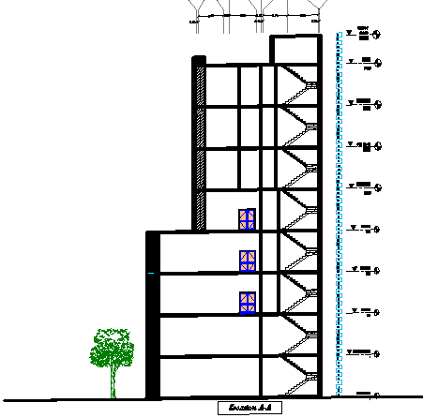
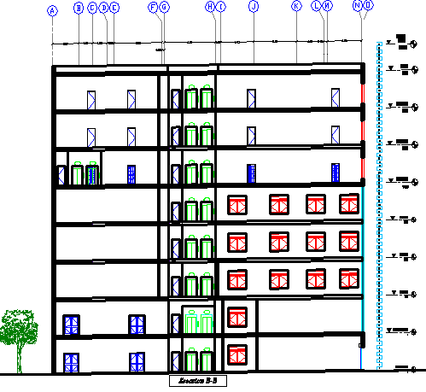
Elevations & sections:
Section A-A
Section B-B

Slide 22
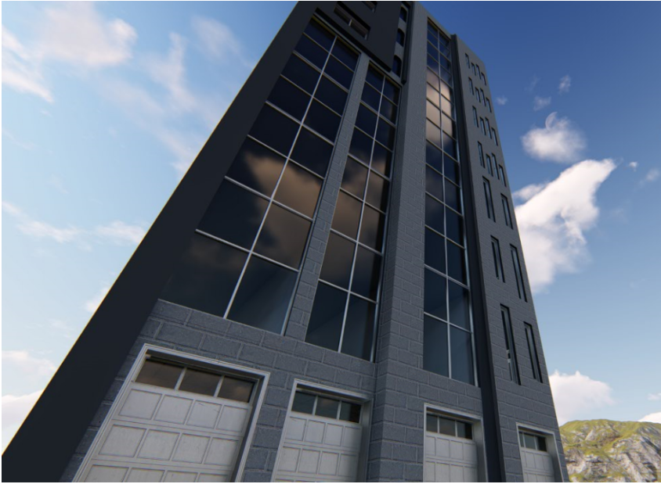
Final Design Photos:

Slide 23
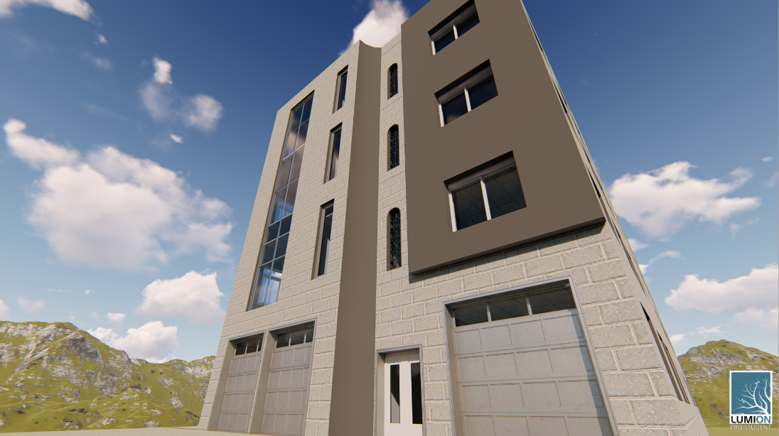
Final Design Photos:

Slide 24
4.
Structural Design

Slide 25
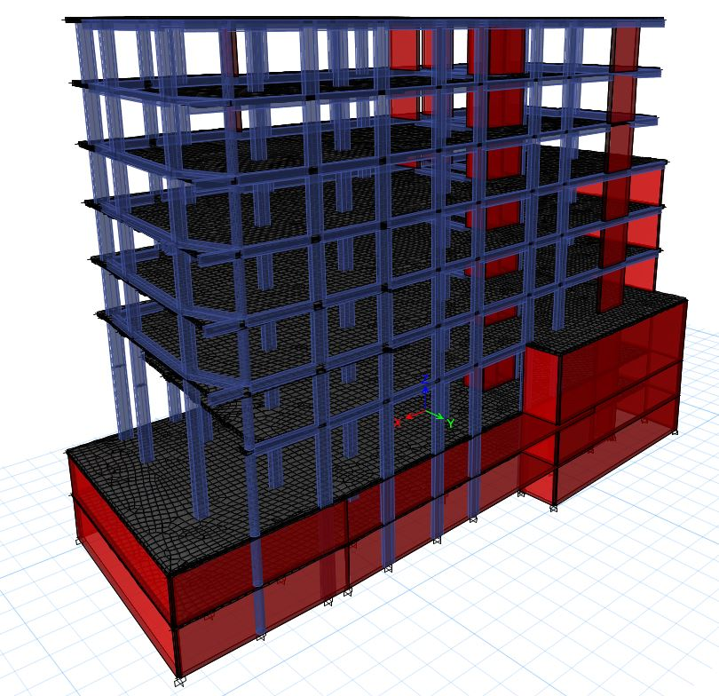
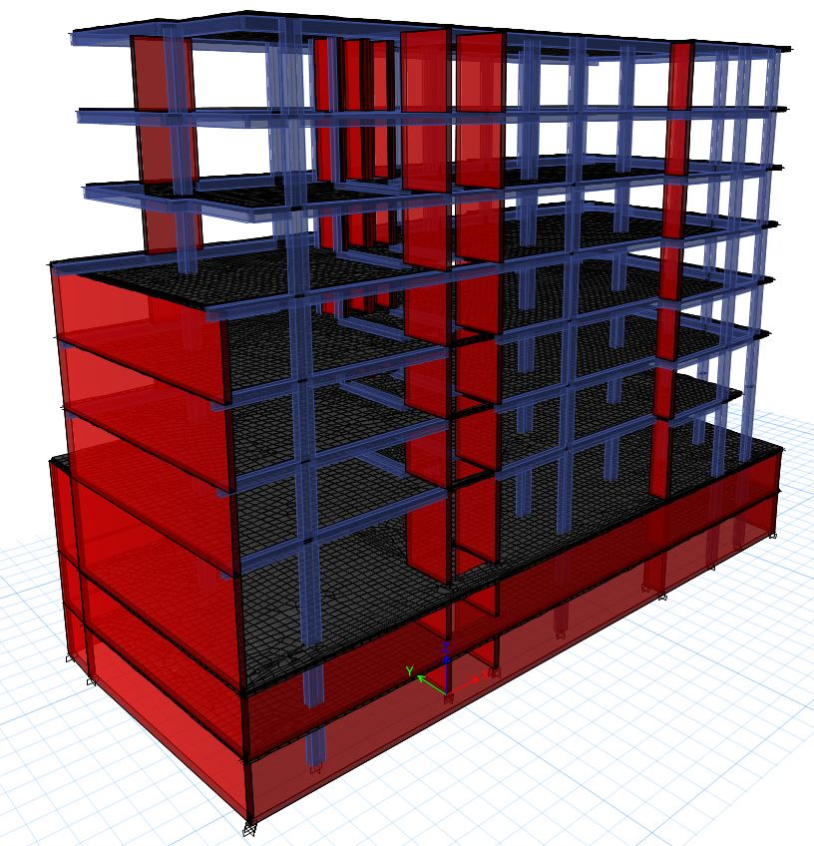
Previous study

Slide 26
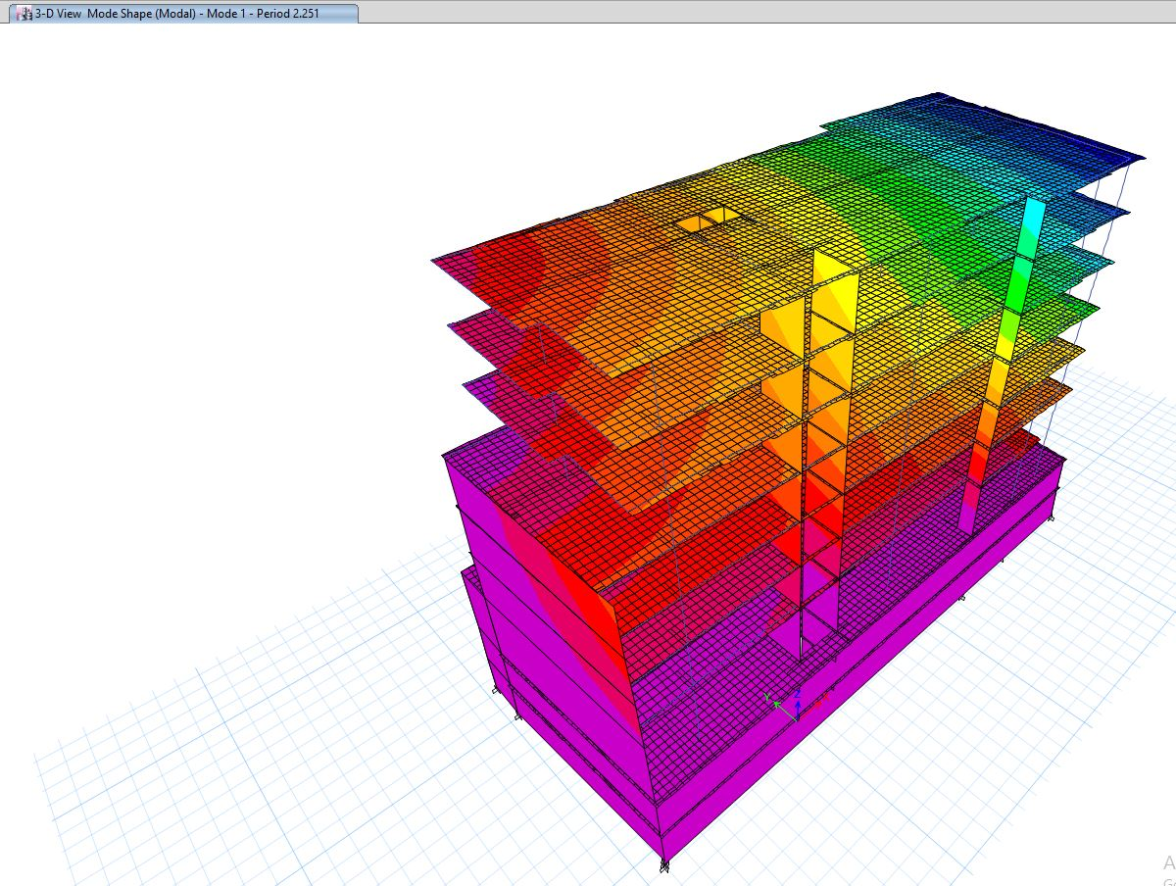
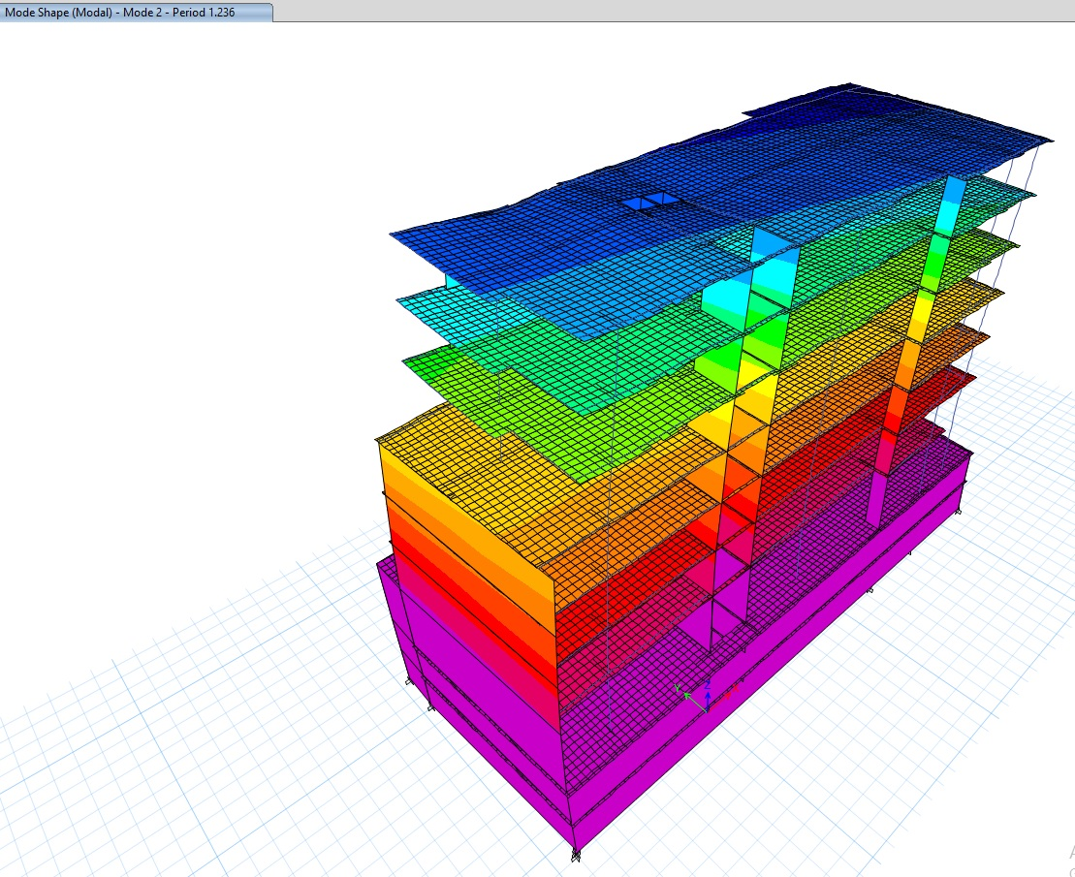
Previous study
The period for the building from ETABS in the first mode equals 2.251 seconds as shown above.
The period for the building from ETABS in the second mode equals 1.236 seconds as shown below.

Slide 27
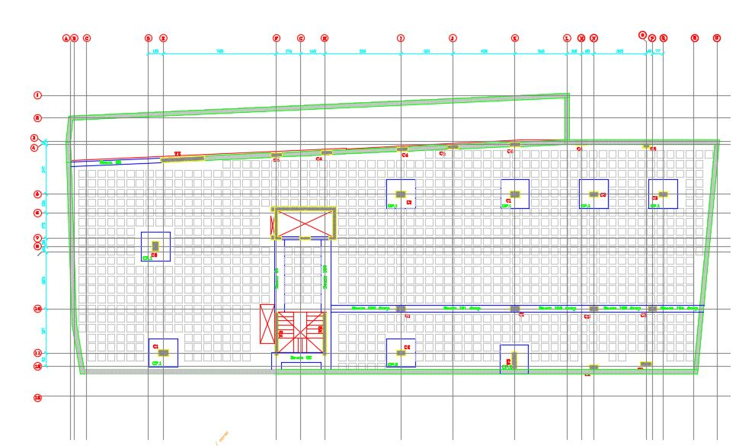
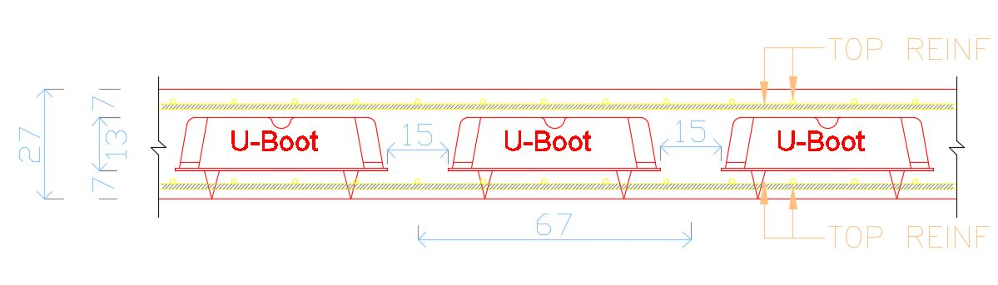
Previous study
As a result of the brief study, the structural components of the old design doesn’t fulfill the period check of the building which mainly depend on the structural items of the building and its dimensions. However, the new design will emphasis on improving this point.

Slide 28
Design Code
ACI -318-08 (American Concrete Institution) for reinforced concrete structural design.
UBC-97 (Uniform Building Code) for earthquake load computations.
ASCE (American Society Of Civil Engineers) for design loads.

Slide 29
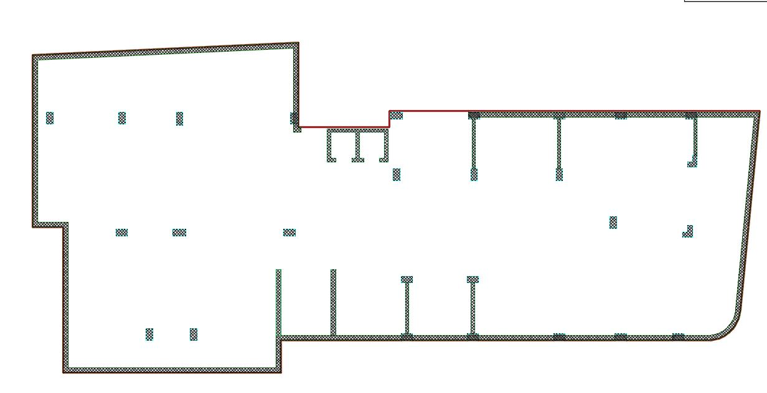
Building Layout in design
Consists of 7 Floors .

Slide 30
Structural Item | Compressive Strength
Slab, Beams & cantilever walls | (B350)
Columns, walls & Foundations | (B350)
Blinding | (B200)
Reinforced Concrete Compressive Strength (fc’)

Slide 31
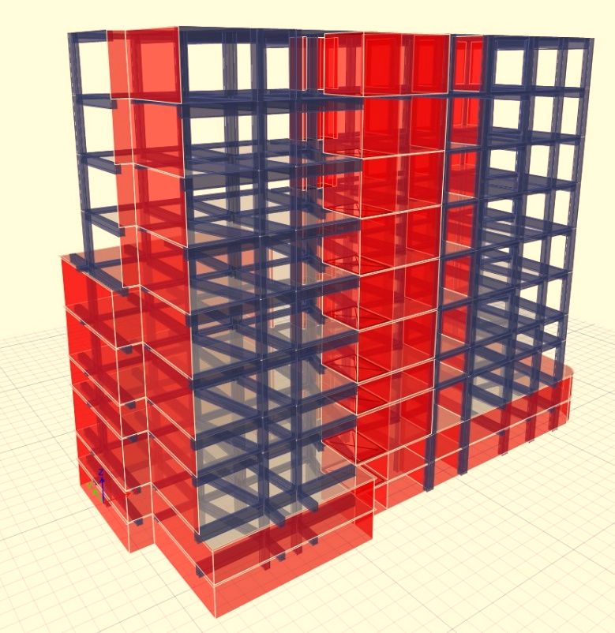
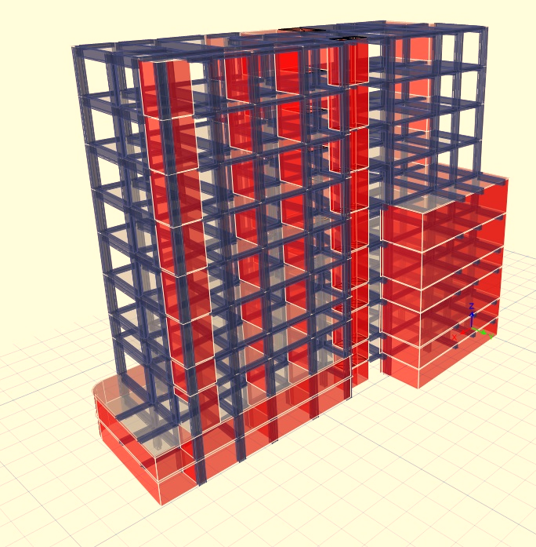
Building Modeling:

Slide 32
Loads:
Type of load | Load KN/m²
Live load (parking) | 5
Live load | 2.4
Super imposed dead load | 3
Exterior walls | 21 KN/m
Loads:
Structural Item | Modifier
Beams | 0.35
Slabs | 0.30
Walls | 0.70
Modifiers:

Slide 33
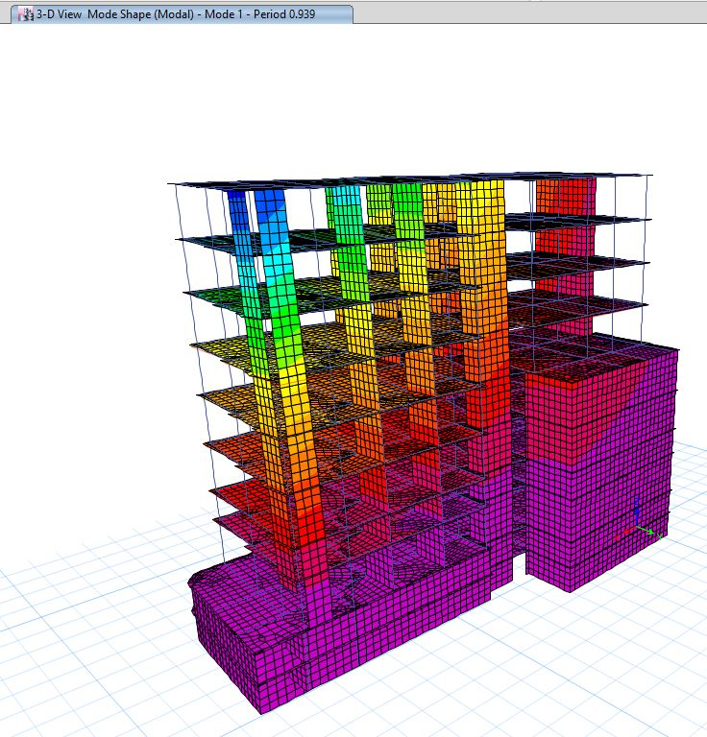
Model Validation Checks :
Compatibility Check :

Slide 34
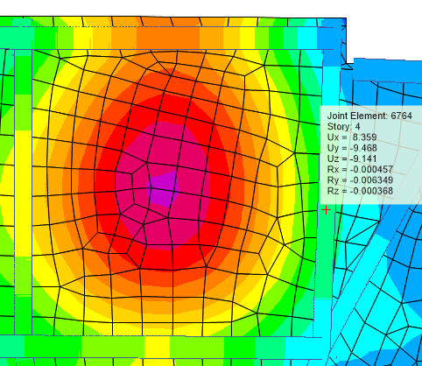
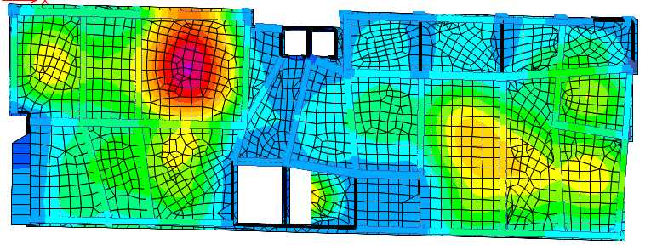
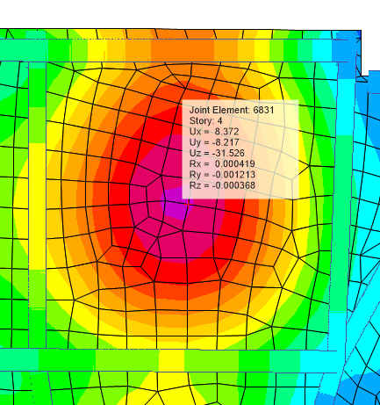
Model Validation Checks :
Deflection Check:
Deflection is accepted.

Slide 35
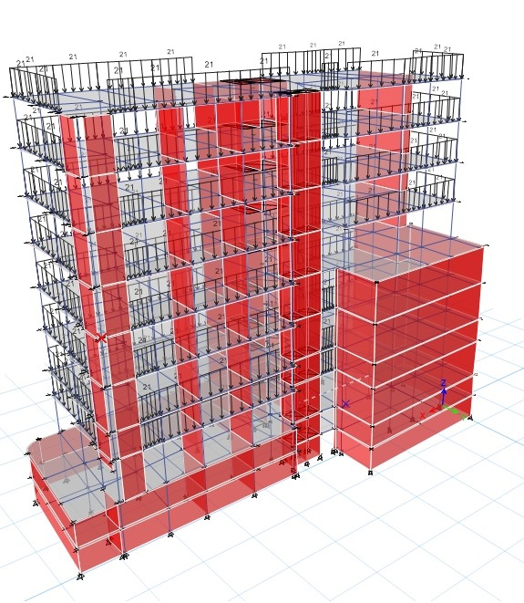
Model Validation Checks :
Base reaction Check :
Load | Manual | ETABS | Error
Dead load | 55031.4KN | 53066.2 KN | 3.57 %
Live load | 20343.4 KN | 20344.43 KN | 0 %
Super imposed | 45874.8KN | 45836.91 KN | 1 %

Slide 36
Model Validation Checks :
Internal Forces Check :
Element | Manual | ETABS | Difference
Beam 29 | 293.3 KN.m | 291.23 KN.m/m | 0.7 %
Beam 8 | 385 KN.m | 375.9 KN.m | 2.4 %
Beam 3 | 823 KN.m | 745.2 KN.m | 9.4%
Element | Manual | ETABS | Difference
Panel A | 29.4 KN.m | 27.9 KN | 5.1%
Panel B | 20.5KN.m | 20.7 KN | 1 %
Panel C | 45.4 KN.m | 50.3 KN | 9.5%
Element | Manual | ETABS | Difference
Column 2 | 5863 KN | 6418.8 KN | 8.6 %
Column 1 | 4716.8 KN | 4279KN | 9.2 %
Column 1 | 1485.2 KN | 1344 KN | 9.5%

Slide 37
Dynamic Analysis (Seismic design) :
Period Check
Modal Mass Participation Ratios (MMPR)
Base Shear Check
Drift Check

Slide 38
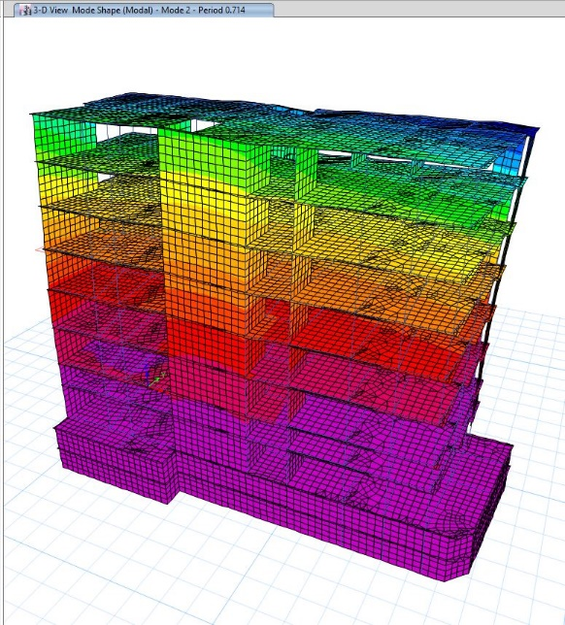
Period Check:
T(A) with 40% increase = 0.89 sec.
T(Bx) = 0.714 sec. , T(By) = 0.939 sec. --- %error = 5.5 %

Slide 39
Mode | Period sec | UX | UY | Sum UX | Sum UY
1 | 0.939 | 0.0183 | 0.394 | 0.0183 | 0.394
2 | 0.714 | 0.4116 | 0.0008 | 0.4299 | 0.3948
3 | 0.468 | 0.0376 | 0.1127 | 0.4675 | 0.5074
4 | 0.236 | 0.0132 | 0.1313 | 0.4807 | 0.6388
5 | 0.206 | 0.2034 | 0.021 | 0.684 | 0.6597
6 | 0.153 | 0.0169 | 0.0899 | 0.7009 | 0.7496
7 | 0.129 | 0.0354 | 0.0028 | 0.7363 | 0.7524
8 | 0.113 | 0.0202 | 0.0255 | 0.7565 | 0.7779
9 | 0.093 | 0.0019 | 0.0014 | 0.7584 | 0.7794
10 | 0.089 | 0.0181 | 0.0029 | 0.7765 | 0.7823
11 | 0.083 | 0.0064 | 0.0513 | 0.7829 | 0.8336
12 | 0.081 | 0.0028 | 0.0057 | 0.7857 | 0.8393
13 | 0.08 | 0.0063 | 0.0005 | 0.792 | 0.8398
14 | 0.073 | 0.0075 | 0.0001 | 0.7994 | 0.8398
15 | 0.064 | 1.99E-05 | 0.0001 | 0.7994 | 0.8399
16 | 0.063 | 0.0101 | 0.0022 | 0.8095 | 0.8421
17 | 0.061 | 0.0028 | 0.0049 | 0.8123 | 0.847
18 | 0.061 | 0.0003 | 0.0015 | 0.8126 | 0.8485
19 | 0.059 | 0.0013 | 0.0373 | 0.814 | 0.8858
20 | 0.058 | 0.0004 | 0.0002 | 0.8144 | 0.8861
21 | 0.057 | 0.004 | 0.0025 | 0.8184 | 0.8885
22 | 0.055 | 0.003 | 0.0002 | 0.8214 | 0.8887
23 | 0.053 | 0.0256 | 0.0024 | 0.847 | 0.8911
24 | 0.052 | 9.71E-06 | 0.0079 | 0.847 | 0.899
25 | 0.052 | 0.0001 | 0.0004 | 0.8471 | 0.8994
26 | 0.051 | 2.32E-05 | 0.0003 | 0.8472 | 0.8997
27 | 0.051 | 2.73E-06 | 0.0001 | 0.8472 | 0.8998
28 | 0.051 | 0 | 0.0045 | 0.8472 | 0.9043
29 | 0.05 | 0.0001 | 0.0016 | 0.8472 | 0.9059
30 | 0.05 | 0.0001 | 0.0096 | 0.8473 | 0.9155
31 | 0.049 | 0.0002 | 0.0005 | 0.8476 | 0.9161
32 | 0.049 | 0.001 | 0.0002 | 0.8486 | 0.9162
33 | 0.049 | 0.0007 | 0.0023 | 0.8493 | 0.9186
34 | 0.048 | 0.0001 | 0.0008 | 0.8494 | 0.9193
35 | 0.048 | 1.72E-05 | 0.0067 | 0.8495 | 0.926
36 | 0.048 | 0.0018 | 0.0009 | 0.8513 | 0.9269
37 | 0.047 | 0.0147 | 4.74E-05 | 0.866 | 0.927
38 | 0.047 | 0.0025 | 0.0053 | 0.8685 | 0.9323
39 | 0.046 | 0.0001 | 3.12E-05 | 0.8687 | 0.9323
40 | 0.046 | 3.14E-06 | 0.0028 | 0.8687 | 0.9351
41 | 0.045 | 0.0023 | 0.0062 | 0.8709 | 0.9413
42 | 0.045 | 0.0003 | 0.0005 | 0.8712 | 0.9418
43 | 0.044 | 0.0135 | 0.0016 | 0.8847 | 0.9434
44 | 0.044 | 0.0056 | 0.0009 | 0.8902 | 0.9444
45 | 0.044 | 0.0066 | 0.008 | 0.8968 | 0.9524
46 | 0.043 | 0.0063 | 3.56E-05 | 0.9032 | 0.9524
MMPR:
46 modes are needed to achieve 90% of MMPR.

Slide 40
Base Shear Check:
Load Case/Combo | FX | FY
 | kN | kN
EQX Max | 4789.89 | 1986.35
EQY Max | 1895.32 | 3570.57
Manual Base Shear Values :
Base shear (Vx) =4788 KN.
Base shear (Vy) = 3569.9 KN.

Slide 41
Drift Check:
∆mx = 11.55 < 80mm
∆my = 16.17 < 80 mm
The drift of the building stories is okay since ∆mx & ∆my are < the limitation value

Slide 42
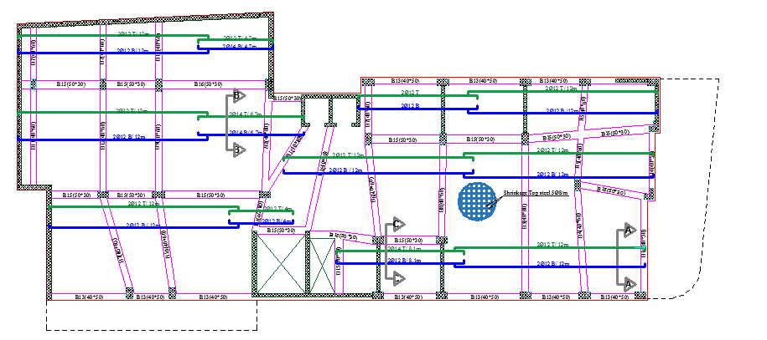
Slab Design

Slide 43
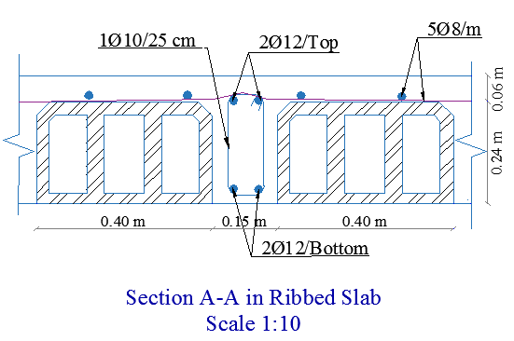
Slab Design

Slide 44
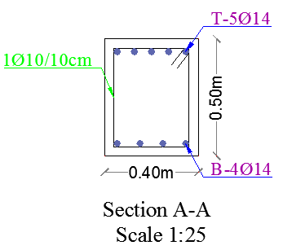
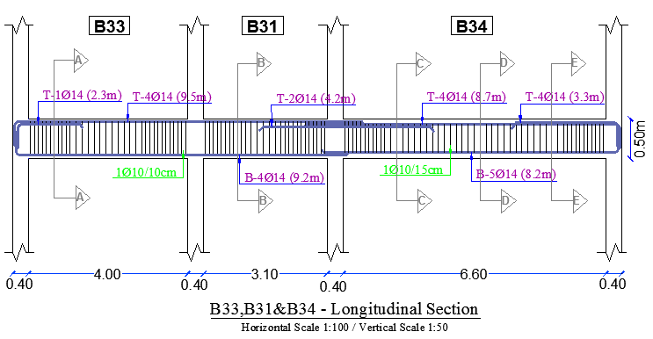
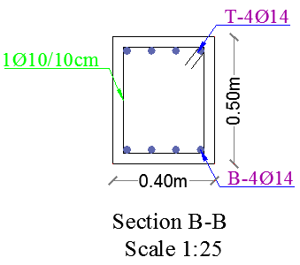
Beams Design

Slide 45
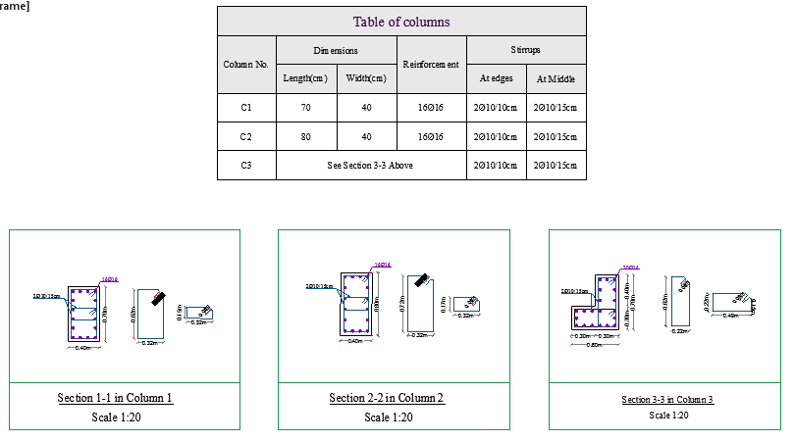
Columns Design

Slide 46
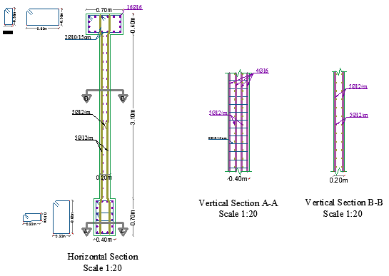
Shear Walls Design

Slide 47

Footing Layout:

Slide 48

Footing reinforcement

Slide 49


Stairs Reinforcement

Slide 50
Environmental Design

Slide 51


Thermal analysis:
Solar Analysis:-
In a Summer day:
Building Shadow at 8:00 am on 21th July
Building Shadow at 12:00 pm on 21th July

Slide 52


Solar Analysis
In A Winter day:
Building Shadow at 8:00 am on 21th January
Building Shadow at 12:00 pm on 21th January

Slide 53


Solar Analysis
Daylight factor & Shading:
Daylight Factor exceeds limit
Louvers or steel covering

Slide 54

U-value :
Part | U value before (W/m².K) | U value after (W/m².K)
External walls | 0.675 | 0.455
Floor | 1.90 | 0.478
Roof | 2.738 | 0.472
Window | 2.70 | 1.761
External wall section
Roof Section

Slide 55

Heating and Cooling Load
Total Heating Capacity = 72.80kW
Total Cooling Capacity = 147.59kW

Slide 56

Thermal Comfort
PMV Set

Slide 57

Energy Consumption:
Site Energy/ m2

Slide 58


Energy Consumption
Modification :
Lighting Load before :
Lighting Load After

Slide 59


Acoustical analysis (RT60):
- Manager office:
Acceptable range for Manager office= (0.6-1.3) sec .
empty space
RT60 at 500 Hz=0.59 s
RT60 at 250 Hz=0.94 s
RT60 at 125 Hz=0.84 s

Slide 60

Acoustical analysis (RT60):
- Staff office:
Acceptable range for staff office = (0.6-0.1.3) sec .
empty space
RT60 at 125 Hz=1 s
RT60 at 250 Hz=1.12 s
RT60 at 500 Hz=0.64 s

Slide 61

Acoustical analysis (RT60):
- Reception:
Acceptable range for Reception= (0.6-1.3) sec .
empty space
RT60 at 125 Hz=1.0 s
RT60 at 250 Hz=0.89 s
RT60 at 500 Hz=0.93 s

Slide 62


Acoustical analysis (STC):
- Manager office to reciption
STC shall be >45 dB to avoid unwanted noise in space
STC =46 dB

Slide 63



Acoustical analysis (STC):
- Manager office and external wall:
STC shall equal from45-55 dB or higher to avoid unwanted noise in space
STC =50 dB
Wall layers

Slide 64


Acoustical analysis (IIC):
Concrete Slab
IIC =61 dB
ceiling layers

Slide 65

Mechanical Design

Slide 66
Mechanical Design Includes:
1.Water Supply Systems.
2. Drainage Water Systems Design.
3. HVAC system.

Slide 67


Water Supply SYSTEM:

Slide 68


Drainage Systems design:

Slide 69

Drainage Systems design:
Storm Water:

Slide 70

HVAC System Design:
VRF System
Air flow (L/S) | Design capacity Cooling (Kw) | Design capacity Heating (Kw) | All floors
Varies from a space to another | 147.59 | 72.80
The dimensions of the out door unit (PETRA).

Slide 71

HVAC System Design:

Slide 72

HVAC System Design:

Slide 73
Electrical Design

Slide 74


Artificial Lighting:
- Manager office :
Lamp used: Philips Lighting Smart Bright Panel (RC099V)
E.avg and U0 are accepted.

Slide 75


Artificial Lighting:
- Staff office :
Lamp used: LED frameiess Panel Downlight Round
E.avg and U0 are accepted.

Slide 76

Artificial Lighting:
Lighting luminaries layout (Second Floor):

Slide 77
Quantity and Cost Estimation

Slide 78
B.O.Q :
Final BOQ
Item | Descriptions | Total (NIS)
Bill No.1 | Earth work | 238636.6
Bill No.2 | Concrete and steel | 3575070
Bill No.3 | Partitions | 188400
Bill No.4 | Finishing work | 3002229
Bill No.5 | Mechanical | 734202
Bill No.6 | Electrical | 112458
Bill No.7 | HVAC | 450500
Bill No.8 | Fire resisting | 73800
Grand Total (NIS) |  | 8375295.6
The total cost per meter square for the College is about 2314shekels. (462 JD)

Slide 79
Safety Considerations

Slide 80
-Emergency Stair Case:

Slide 81


Automatic sprinklers

Slide 82

-Fire Extinguishers and hose station
Selected Type :TYPE A (Dry Powder Extinguishers)

Slide 83


-Evacuation Paths

Slide 84
THANK YOU

