Slide 1

Sayyarti
On-Demand Car Services Platform
Graduation Project Presentation
Supervisor:Eng. Asmaa Afeefi
by:Ahmad Saad & Mohammad Abed Alhaq

Slide 2
Overview
  Introduction & Goals
  Problem Statement
  Technologies Used
  App & Features
  Conclusion & Future work
  Question and answer

Slide 3


Introduction
What is Sayyarati?
Sayyarati is a comprehensive mobile and web application designed to enhance the experience of car owners by providing easy access to essential car services and accessories. It acts as a platform that connects car owners with service providers, offering a wide range of on-demand automotive services.

Slide 4
Goals:
  Provide a one-stop solution for all car-related needs.
  Make Car Services Accessible and Efficient
  Enable Emergency Support
  Save Time and Reduce Stress
  Empower Service Providers to Grow Their Business:

Slide 5
Problem Statement
  Difficulty in finding reliable and nearby service providers.
  Lack of real-time communication between users and service providers.
  Inefficient booking and payment systems.
  Limited access to emergency roadside assistanc
  Sayyarati’s Solution:
    We created Sayyarati to solve these problems. It’s a platform that brings convenience, reliability, and peace of mind to car owners, making car care as simple as a few taps on your phone.

Slide 6







Technologies Used
01
02
03
Flutter
NODE JS &
EXPRESS JS
MY SQL
FRONT END
DATABASE
BACK END

Slide 7



Technologies Used
FIREBASE
AZURE MYSQL
Cloudinary
GOOGLE MAP

Slide 8


App & Features
Sayyarati is designed to cater to four main user roles, each with unique needs and functionalities.
User (Car Owner)
Employee (Service Provider)
Garage Owner
Admin

Slide 9

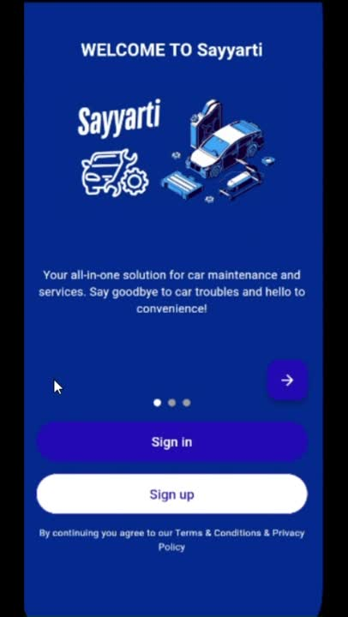
App & Features
Welcome Page

Slide 10
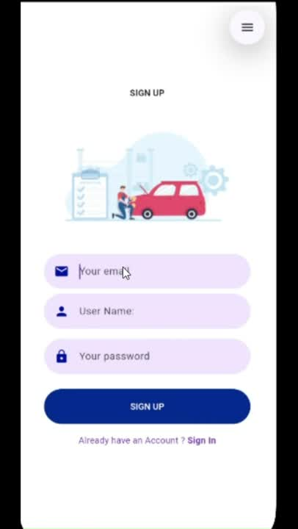
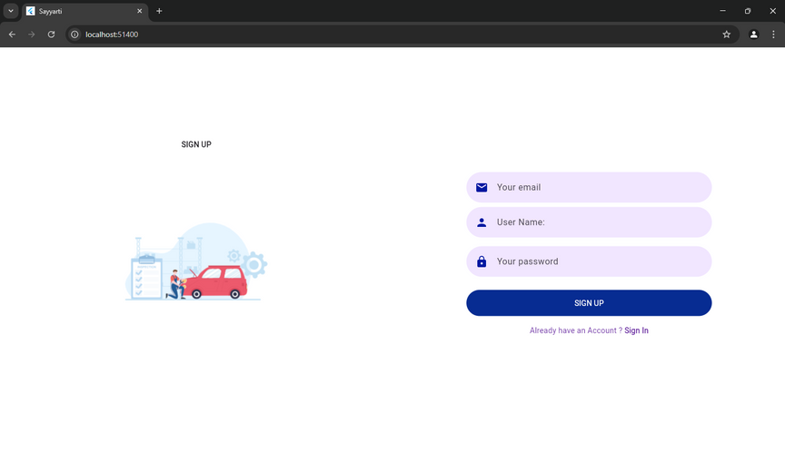
App & Features
Sign Up Page

Slide 11
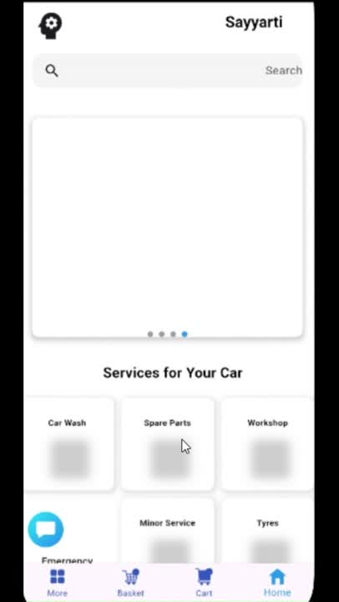
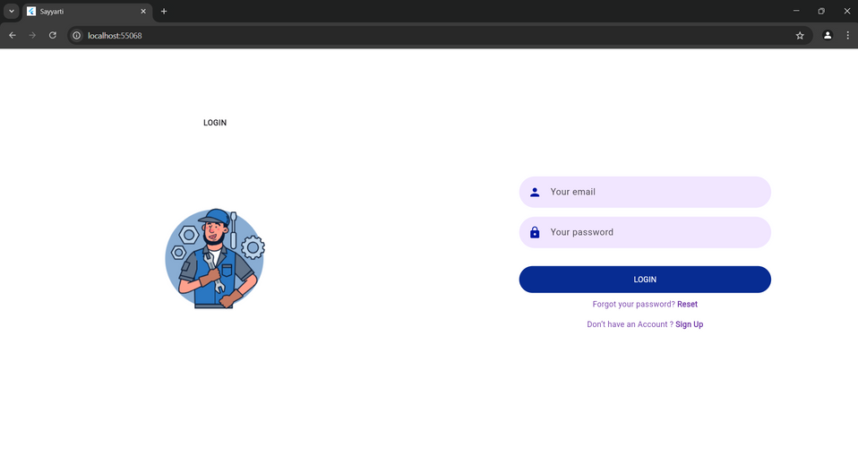
App & Features
Login Page & verification

Slide 12
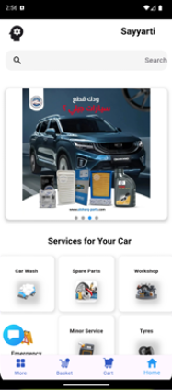
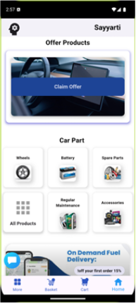
App & Features
Client home

Slide 13
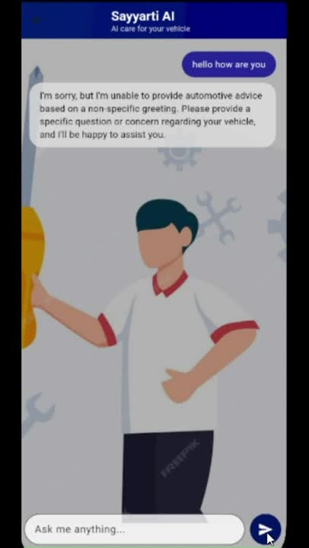
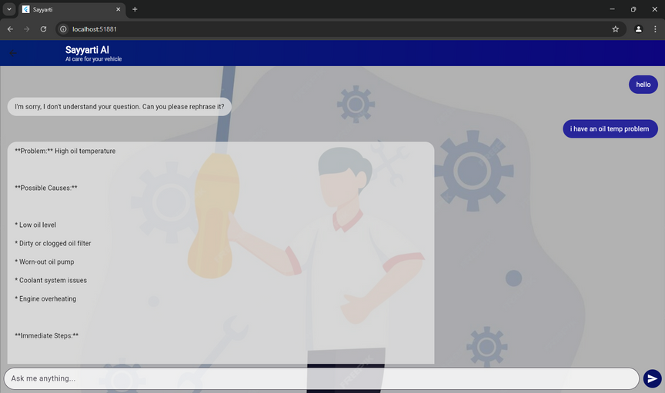
App & Features
Sayyarti AI assistant
a smart chatbot that helps users diagnose car problems, understand their causes, and provides step-by-step solutions and recommendations.

Slide 14
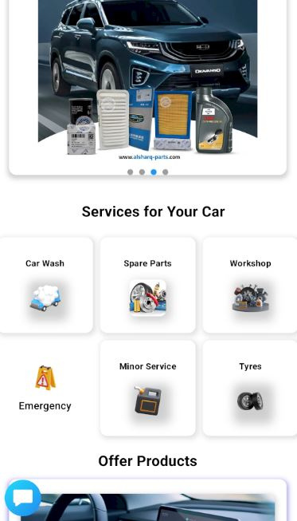
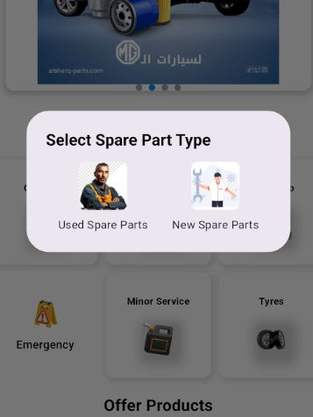
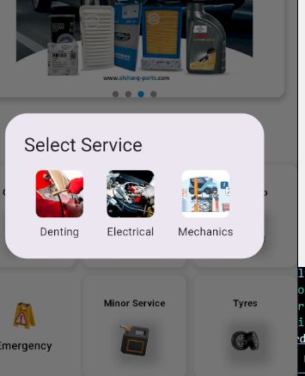
App & Features
Client side
Services

Slide 15
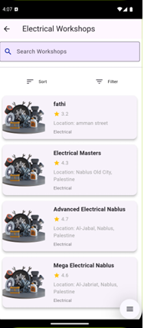
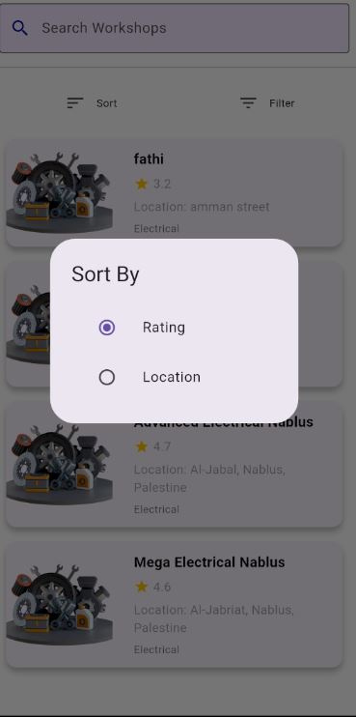
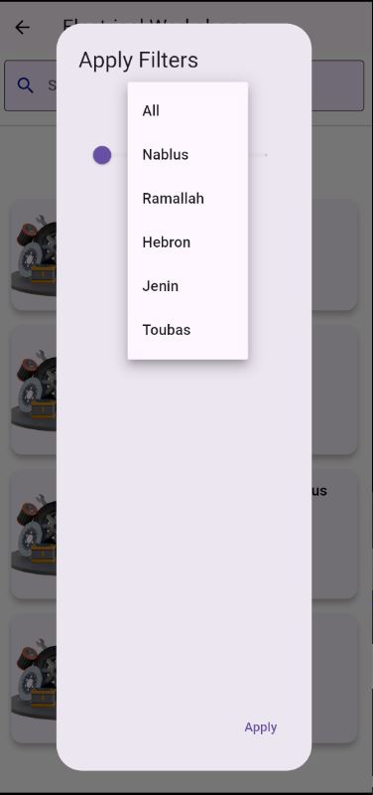
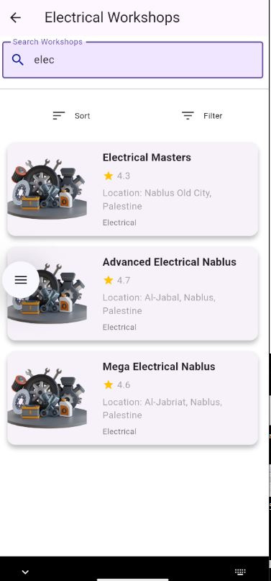
App & Features
Client side
workshop

Slide 16
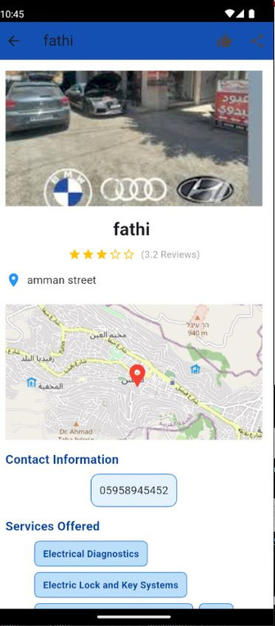
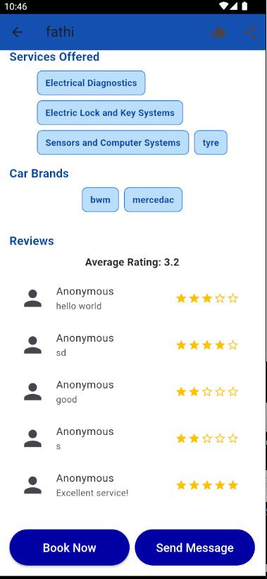
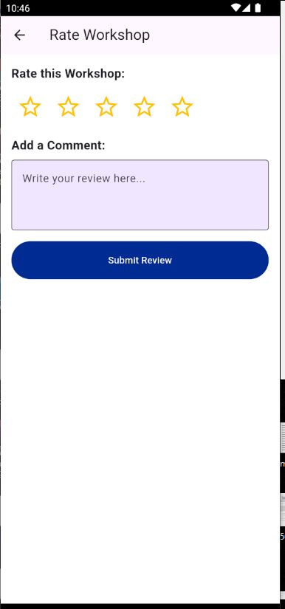
App & Features
Client side
workshop book page

Slide 17
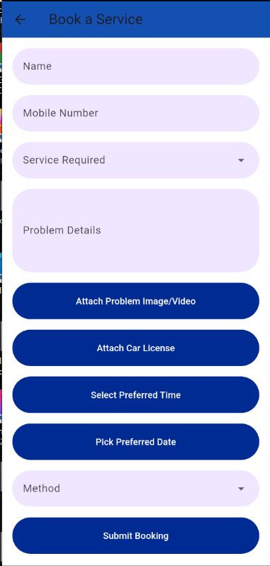
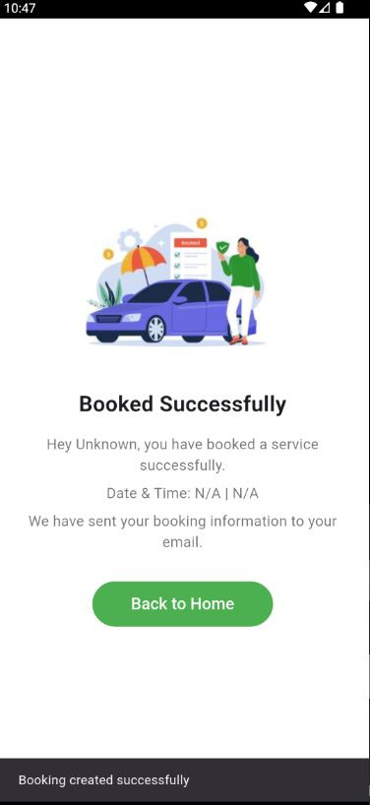
App & Features
Client side
workshop Details page

Slide 18
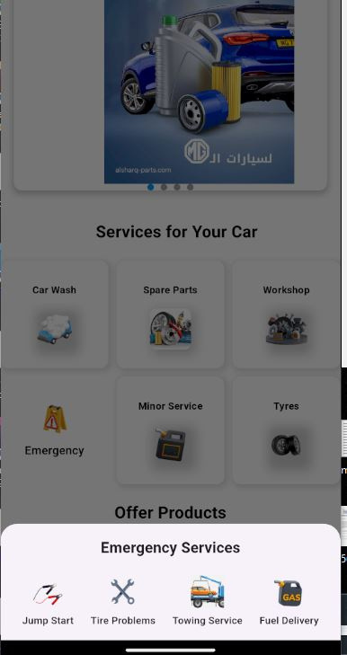
App & Features
Client side
Emergency Services

Slide 19
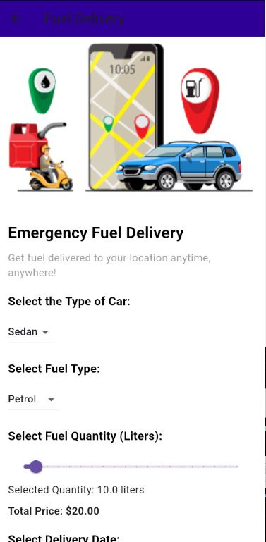
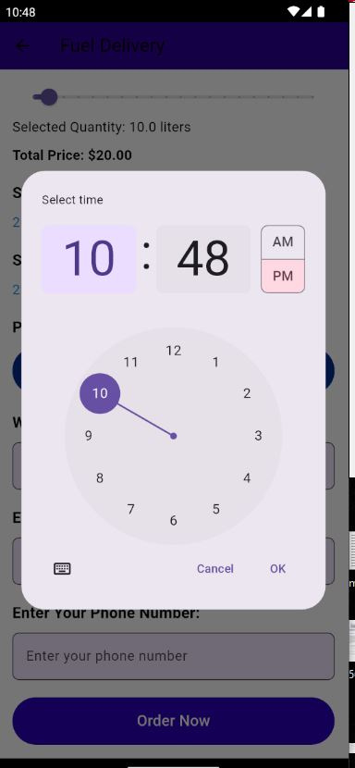
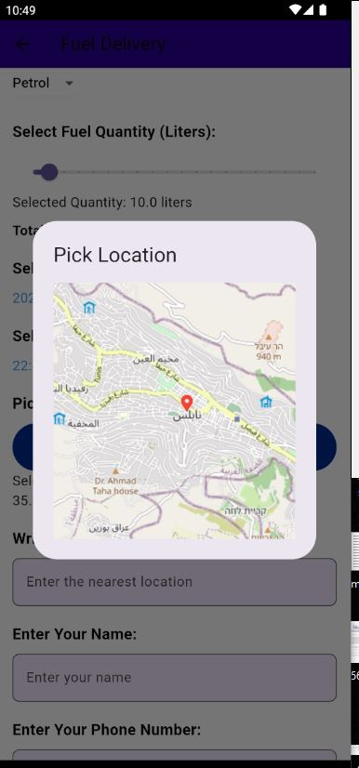
App & Features
Client side
Emergency Fuel Derlivery

Slide 20
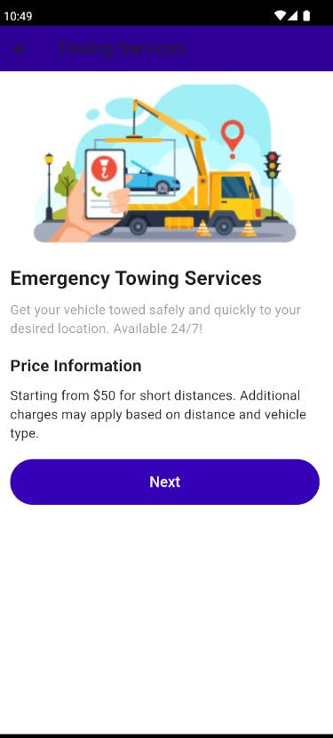
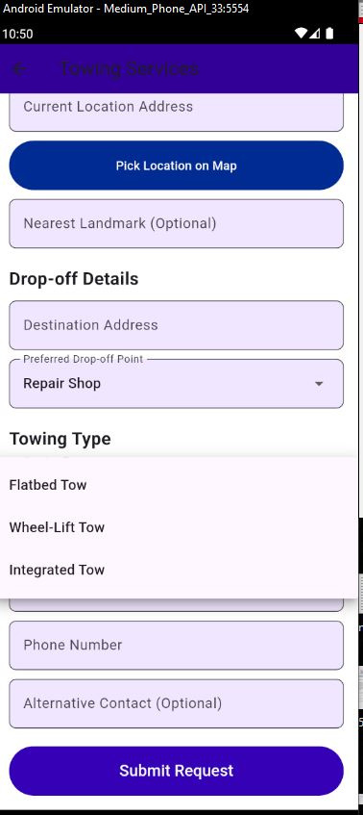
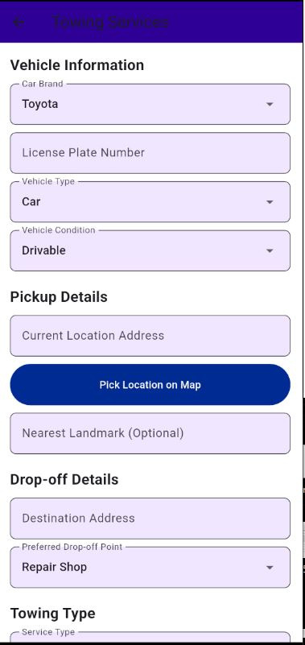
App & Features
Client side
emergency
towing

Slide 21
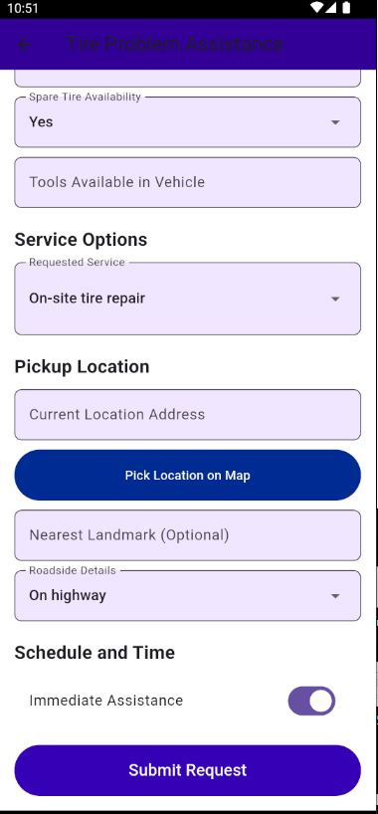
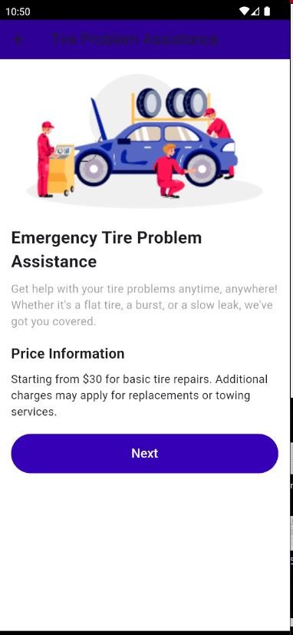
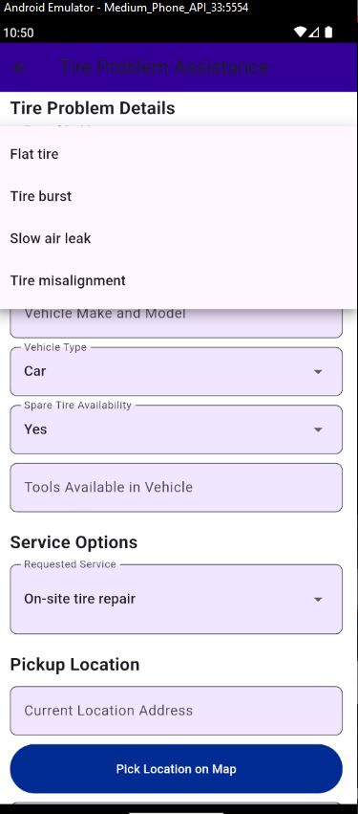
App & Features
Client side
Emergency
Tire Problem

Slide 22
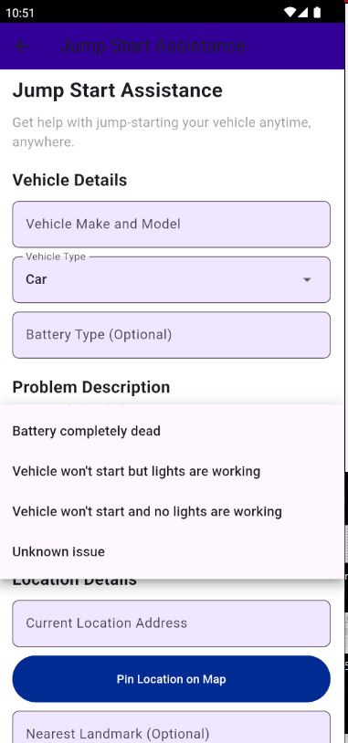
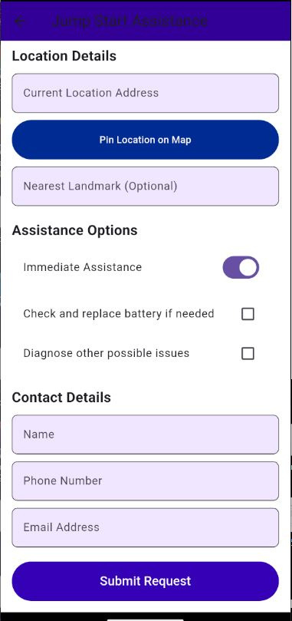
App & Features
Client side
jump start Assistance

Slide 23
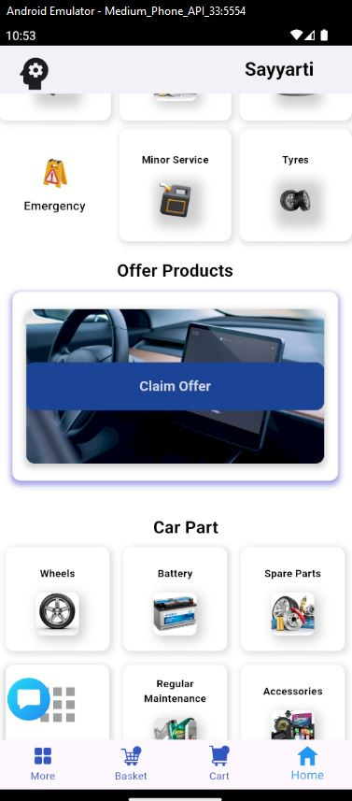
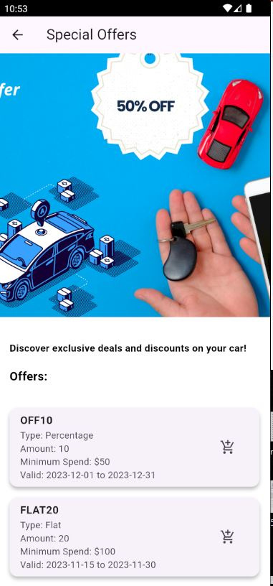
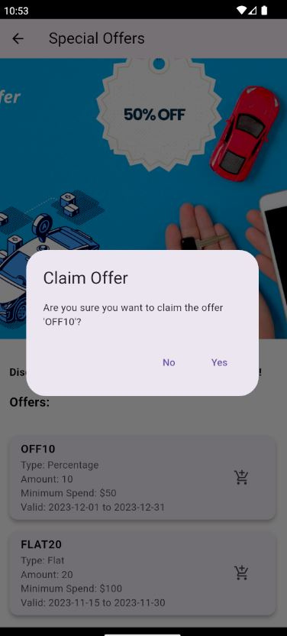
App & Features
Client side
Offer Page

Slide 24
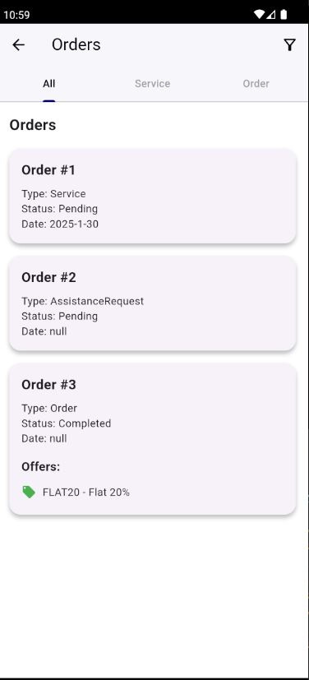
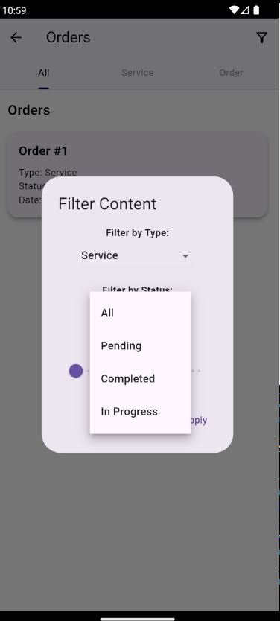
App & Features
Client side
Basket Page

Slide 25
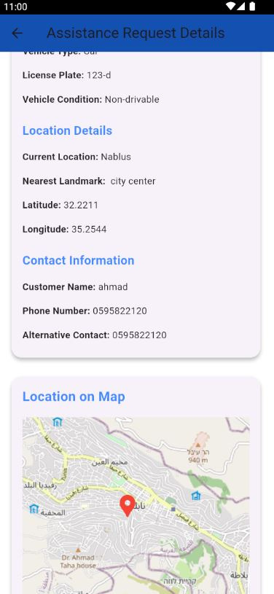
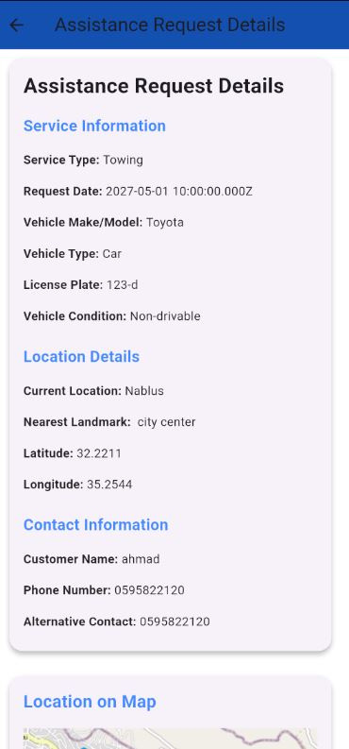
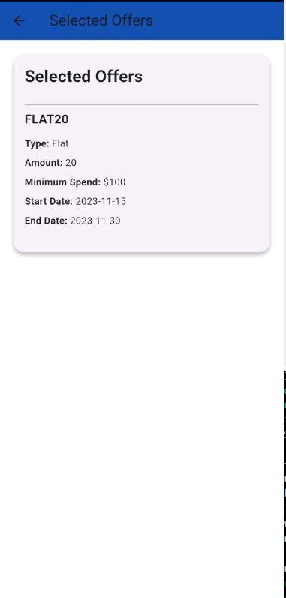
App & Features
Client side
Basket Details Page

Slide 26
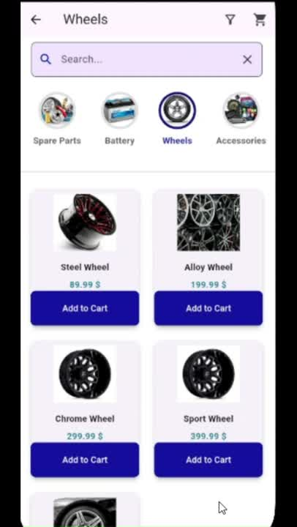
App & Features
Client side
Parts shop and checkout

Slide 27
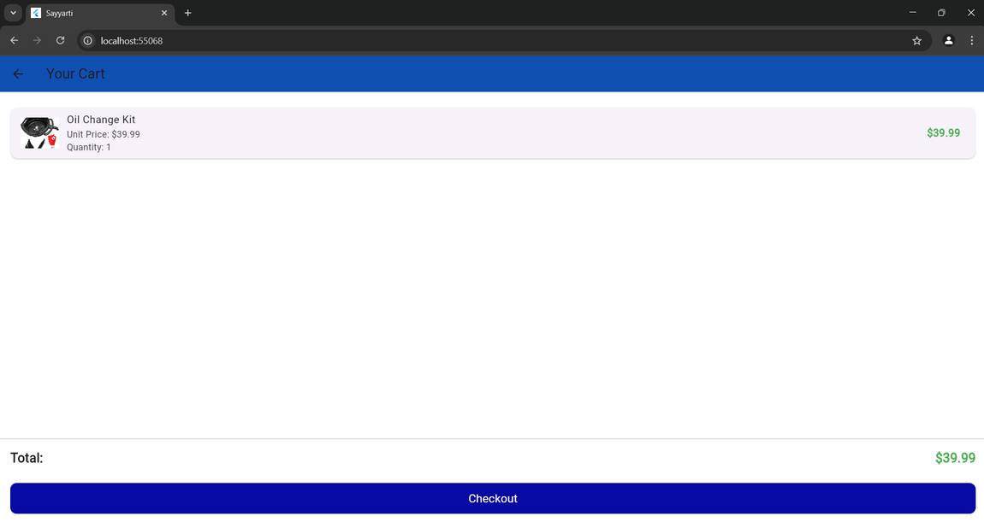
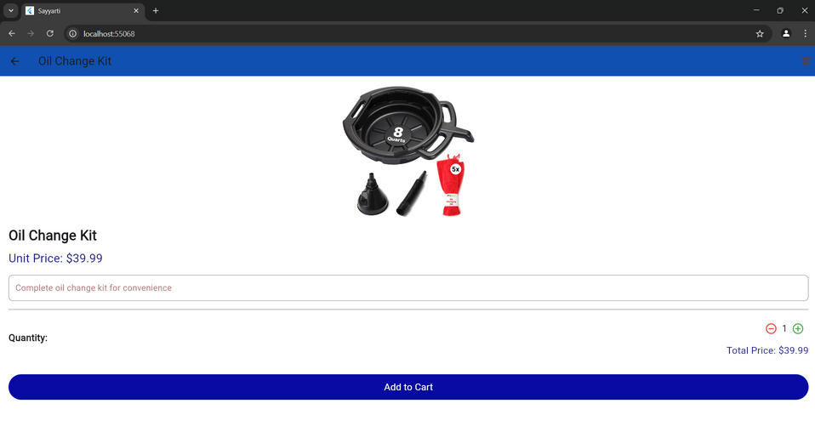
App & Features
Client side
Parts shop and checkout

Slide 28
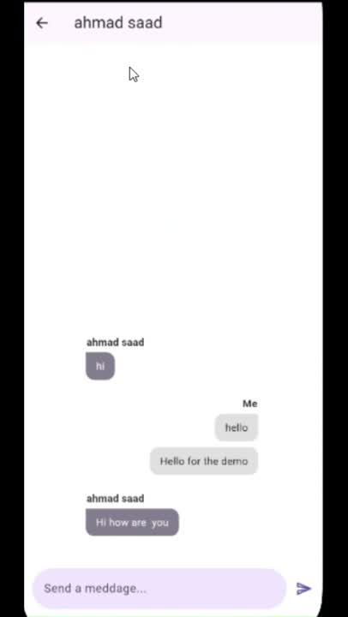
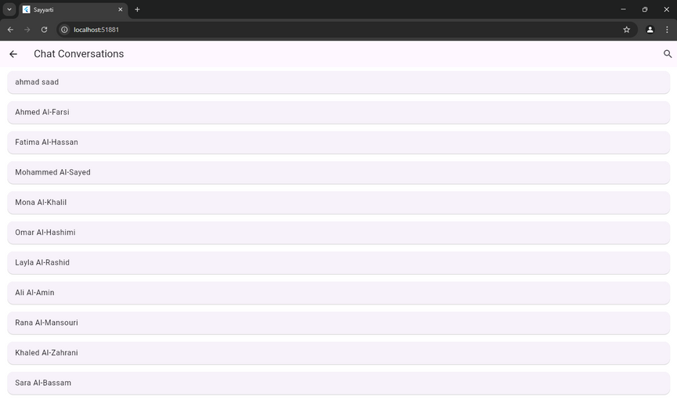
App & Features
Client side
messaging Page
&
notification

Slide 29
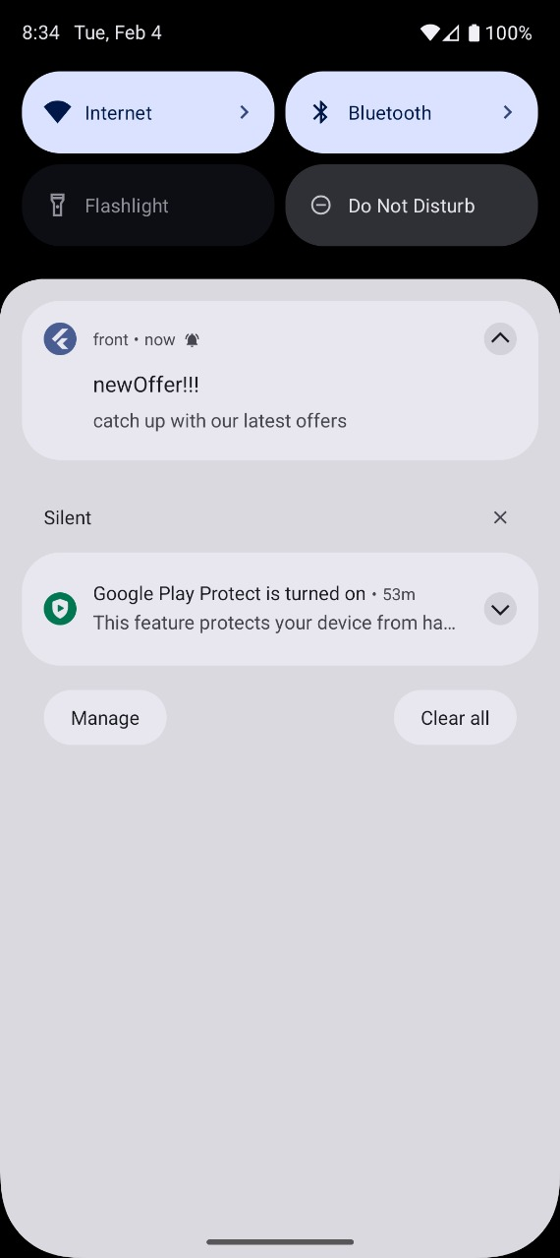
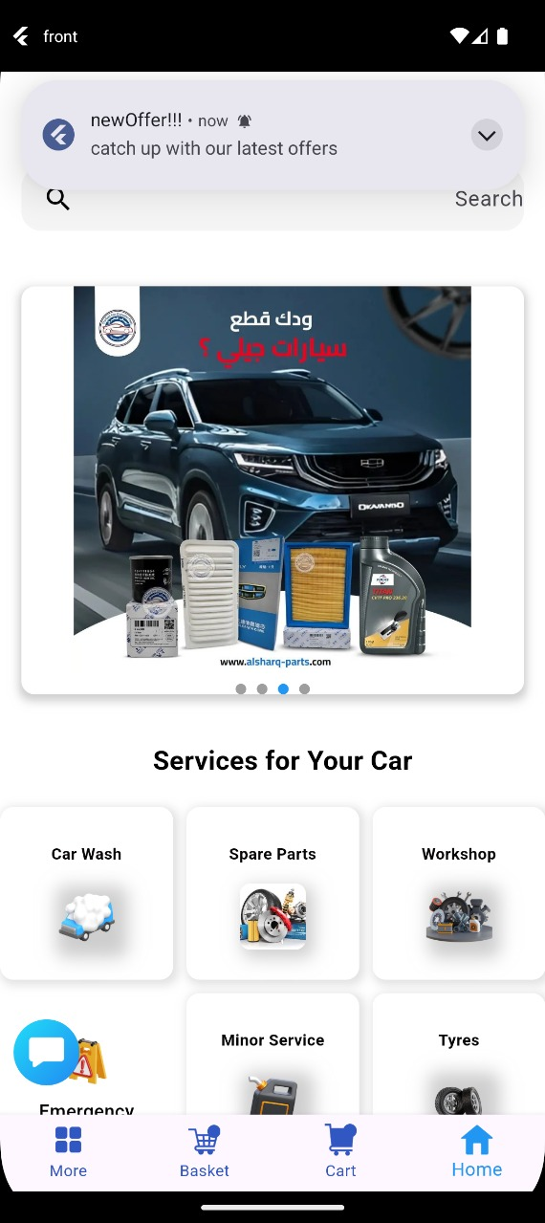
App & Features
Client side
messaging Page
&
notification

Slide 30
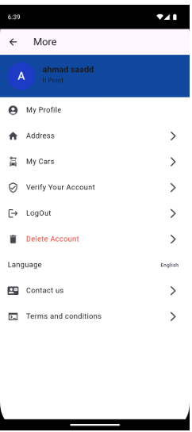
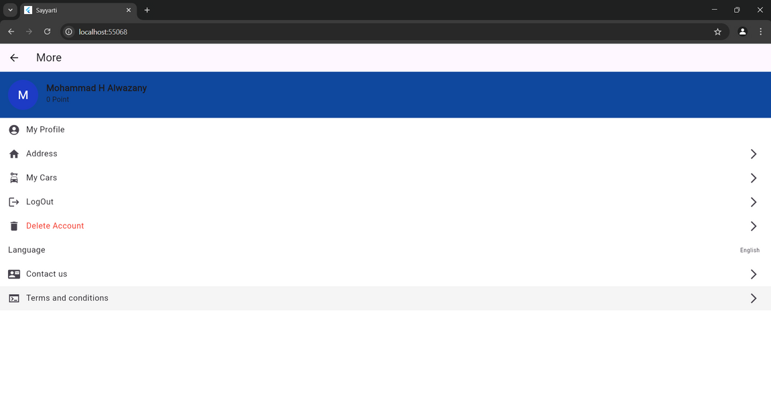
App & Features
Client side
More Page

Slide 31


App & Features
Client side
More Page
My Profile

Slide 32


App & Features
Client side
More Page
Address

Slide 33


App & Features
Client side
More Page
My Car

Slide 34



App & Features
Company Admin

Slide 35




App & Features
Company Admin

Slide 36



App & Features
Company Admin

Slide 37



App & Features
Company Admin

Slide 38



App & Features
Company Admin

Slide 39




App & Features
Company Admin

Slide 40





App & Features
Company Admin

Slide 41



App & Features
Company Admin

Slide 42



App & Features
Employee
(Service Provider)

Slide 43



App & Features
Employee
(Service Provider)

Slide 44


App & Features
System Admin
&
Verification

Slide 45

App & Features
System Admin
Create a company
&
Create Company
Admin

Slide 46


App & Features
System Admin
Create a company
&
Create Company Admin

Slide 47


App & Features
System Admin
Add a Product

Slide 48
Features
  Booking System
  Parts Shop
  AI Assistant
  Real-Time Communication
  Emergency Services
  User Feedback
  Admin Dashboards
  Grage Owner Dashboards

Slide 49
Future Work
Car Rental System
Car Buy & Sell Marketplace
Subscription-Based Memberships
Insurance Integration
AI-Powered Predictive Maintenance

Slide 50

Thank You

