Slide 1
Control over power line
Prepared by :-
Ra’fat Ghanem
Mostafa Atrash
Yahya Hamarshi
Supervisor :-
Dr. Samer Mayaleh

Slide 2
Content
Introduction.
What is our project?
Human interface.
Project concept and design.
MCU’s and programming.
Problems and recommendations.

Slide 3
Introduction :
What is PLC?
it’s a method using the power line to transfer data over it
Objective of PLC
It’s a telecommunication system use the existing power network to transfer data over it .
The aim of our project
To control devices using the PLC telecommunication system

Slide 4
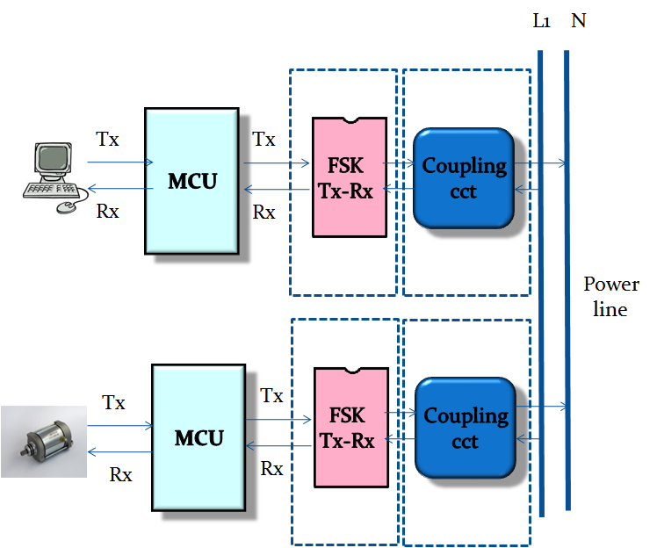
Block Diagram

Slide 5
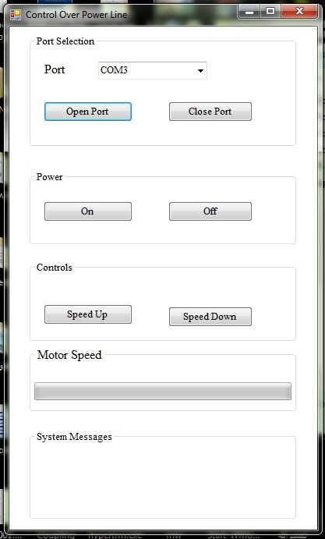
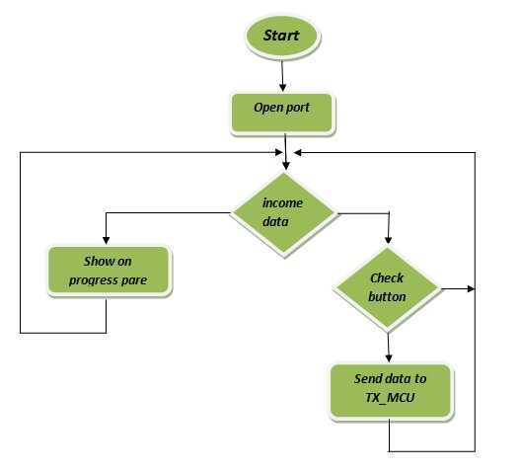
Human interface
C# interface
Flow chart

Slide 6
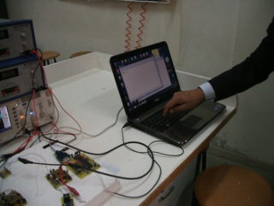
Video

Slide 7
Coupling circuit
- It’s used to inject the message over the power signal.
It construct from:
1- coupling transformer to inject the modulated message over power signal.
2- high pass filter to filter the message from the power signal.
3- low pass filter to filter the message from the harmonics of the modulated frequency.

Slide 8


Power line
LPF
HPF
Tx
PA
LPF
Rx
L1 N

Slide 9
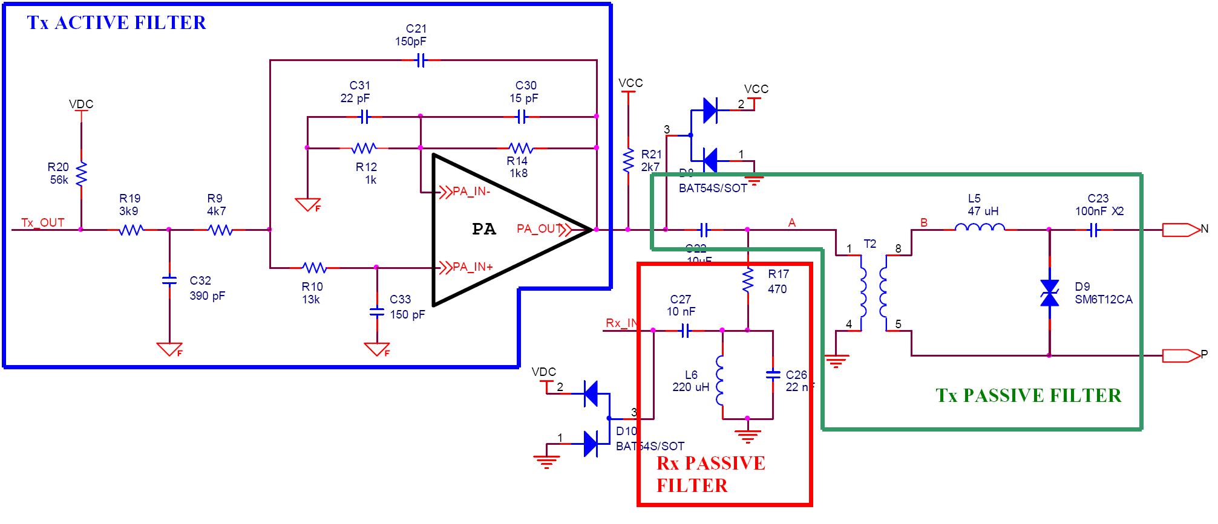

Slide 10
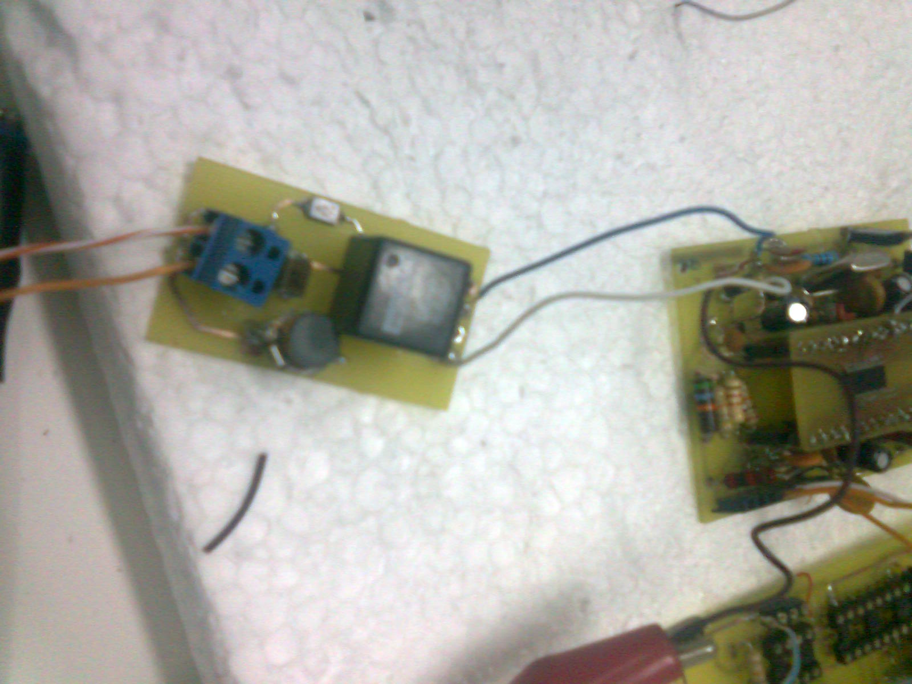
PCB Coupling cct

Slide 11
FSK transceiver
This part is implemented by FSK st7540 and use to modulate the out coming signal and demodulate the incoming signal.
It support 8 programmable frequency (132.5KHz)
baud rate up to 4800bps (2400bps)
the operating frequency
F(“0”)= Fcarrier +∆F/2 =131836Hz
F(“1”)= Fcarrier - ∆F/2 =133138Hz

Slide 12
FSK Block diagram
Serial interface
modulator
TxD
Tx-out
Reg/Data
RxTx
demodulator
RxD
Rx-in
PA
PA-out

Slide 13
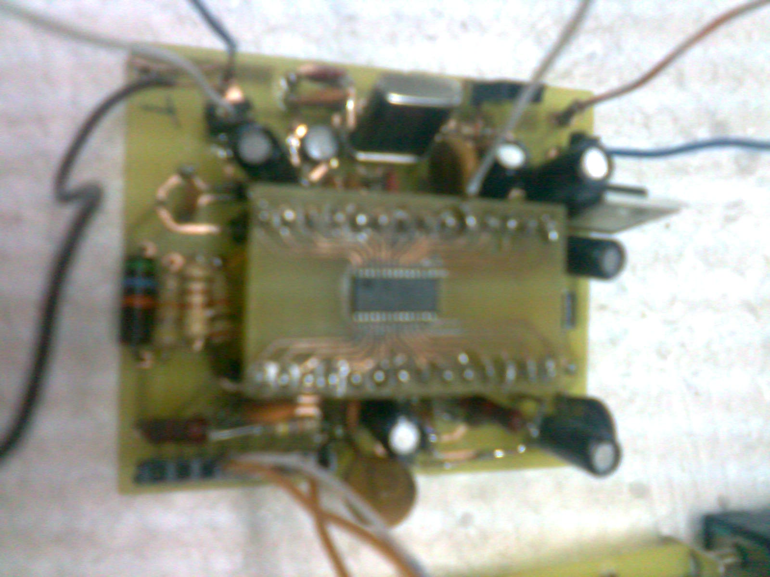
PCB FSK cct

Slide 14
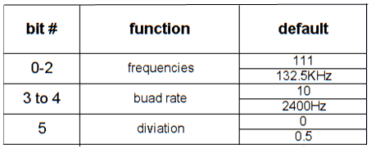
FSK can access in tow modes
2- Control access mode
access in synchronous mode only
construct from 24 bit programmed serially
1- Data access mode
Synchronous data access
Asynchronous data access

Slide 15
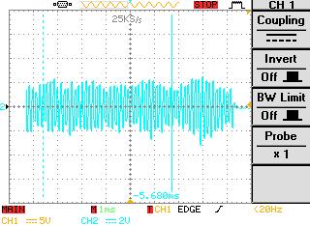
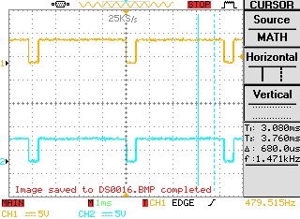
Transmuted received and modulated data

Slide 16
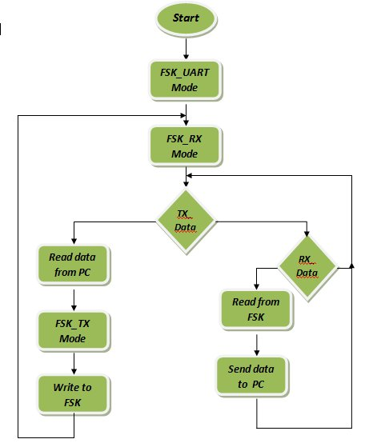
Transmitter MCU

Slide 17
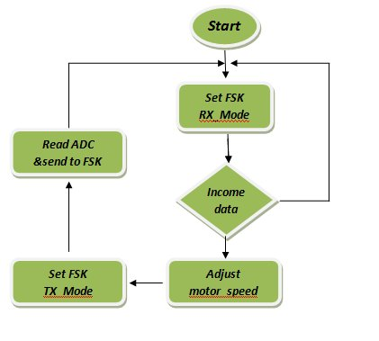
Receiver MCU

Slide 18
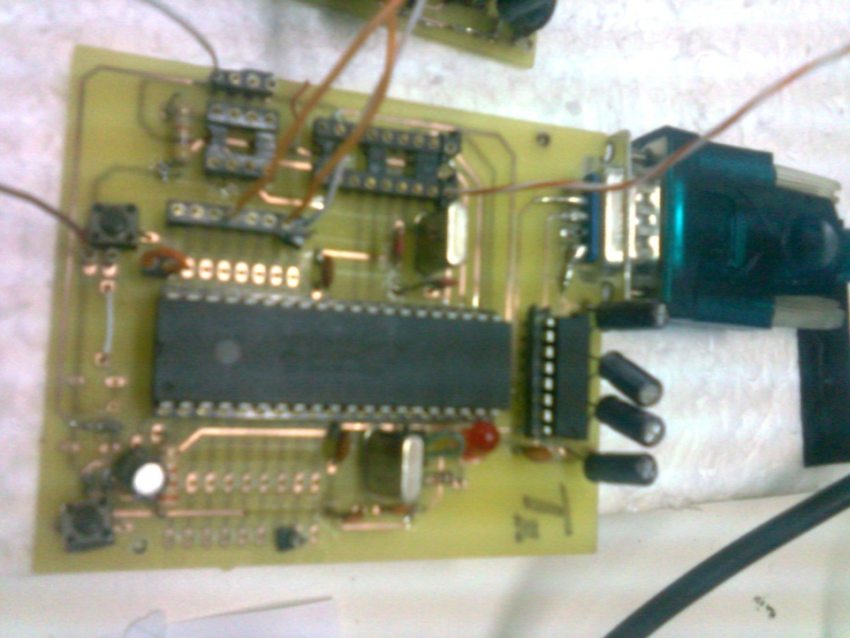
PCB MCU cct

Slide 19
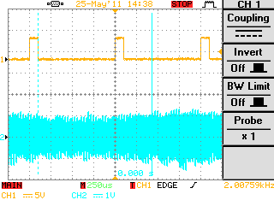
Controlling motor by PWM
Derived by H-bridge
Controlled by MCU over PL’s.

Slide 20
Additional tips
creating a network using can system
this system use can bus to exchange data between units.
this system use data link layer which consists from arbitration control and data field.
give each unit an ID
when two nodes are send at the same time the node that win the arbitration send its data over the bus.
this system use the SPI protocol to communicate with MCU
SPI test between two MCU will succeed

Slide 21
Problems and suggestions
No SPI response between can system and MCU
Try to use another MCU instead of PIC16 that support can system as PIC18Fxxx, or PIC18Cxxx.
The difficulty to obtain hardware components
  Make sure that all project components are available in the local market.
  Make sure you have backup.
The difficulty to deal with the mounted service components as FSK.

Slide 22

Thanks for your attention
Any question ?

