Slide 1

An-Najah National University
Engineering college
Building Engineering Department
Green Building Design
Submitted by :
Almotasem Tweir
Baha Banemonyeh
Mohammad Deryeh
Supervisor :Dr.Sameh Muna

Slide 2
Outline
1
Introduction
2
Architectural Design
3
Environmental Design
4
Structural Design
5
Electrical And Mechanical Design
6
Site Analysis and project program

Slide 3

1
Introduction
What is green building
High-performance building that reduces its environmental footprint through sustainable site selection and conservation of energy and resources, while improving the health and productivity of its occupants.

Slide 4
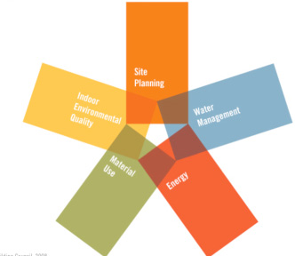
  According to Palestinian green buildings guide we have :
  6 Major Categories:

Slide 5
Site sustainability
Items | Situation |  | Point
 | Use | Not use
Construction activity pollution Prevention | X |  | Required
Site selection |  | X | 4
Building Accessibility | X |  | 3
Site development | X |  | 5
Outdoor thermal comfort | X |  | 4
Urban heat island | X |  | 4
Alternative transportation |  | X | 4
Storm water design | X |  | 4
Light pollution reduction | X |  | 2
Total Point |  |  | 30

Slide 6
Water efficiency
Items | Situation |  | Point
 | Use | Not use
EFFICINCY IN USING WATER | X |  | REQUIRED
Rain water harvesting & reuse | X |  | 4
Waste gray water recycling reuse | X |  | 8
Water system management, monitoring, metering &control | X |  | 6
Rationalization of cool water consumption | X |  | 16
Rationalization the production of hot water consumption | X |  | 16
Total point |  |  | 50

Slide 7
Materials and resources
Items | Situation |  | Point
 | Use | Not use
Construction and operation waste management program | X |  | REQUIRED
Hazardous materials elimination | X |  | REQUIRED
Non polluting materials | X |  | 3
Local materials | X |  | 4
Recycled materials | X |  | 3
Materials reuse | X |  | 2
Rapidly renewable materials | X |  | 2
Materials durability | X |  | 2
Building reuse | X |  | 2
Design for flexibility of use and disassembly | X |  | 2
Total point |  |  | 20

Slide 8
Indoor environment quality
Items | Situation |  | Expected score
 | Used | Not use
Minimum IAQ performance | X |  | Required
Smoking control | X |  | Required
Healthy ventilation delivery | X |  | 4
Material emission | X |  | 4
Car park air quality management | X |  | 2
Thermal comfort & controls | X |  | 7
High frequency lighting | X |  | 2
Daylight & glare | X |  | 3
View | X |  | 2
Indoor noise pollution | X |  | 3
Safe & secure Environment | X |  | 3
Total point |  |  | 30

Slide 9
Energy efficiency
Item | Situation |  | Expected score
 | Used | Not used
Energy system planning in building | X |  | REQUIRED
Achieve best energy consumption efficiency | X |  | REQUIRED
planning cooling system managing in building | X |  | REQUIRED
Achieve minimum energy consumption efficiency | X |  | 25
Renewable energy | X |  | 18
Use of energy efficient equipment | X |  | 12
Smart building | X |  | 5
Total |  |  | 60

Slide 10
Innovation & building integrated design
Items | situation |  | Expected score
 | used | Not used
Innovation in design | X |  | 4
Integrated design approach | X |  | 3
Using new technologies | X |  | 3
Total point |  |  | 10

Slide 11
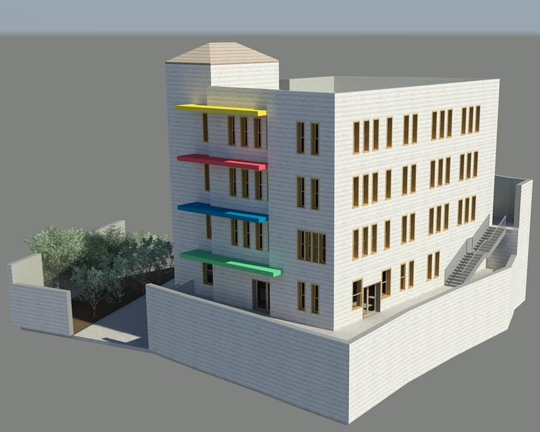

Slide 12
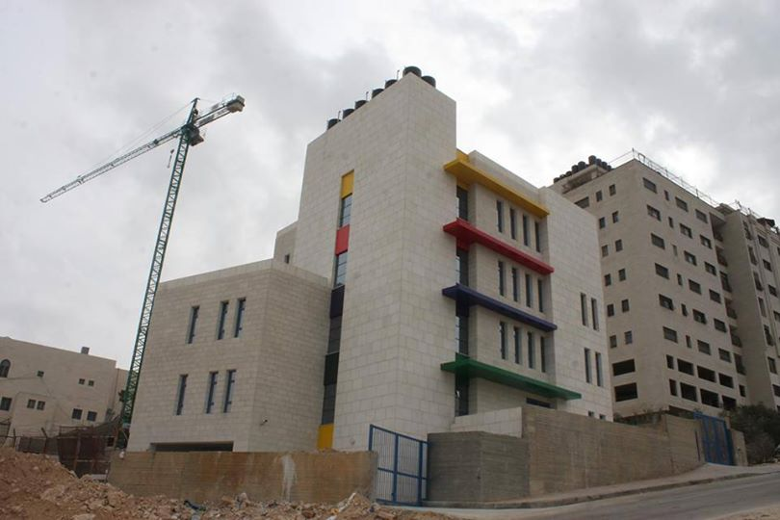
Our project is
Childhood Building :
Childhood building is a special building and provision for a special category of children, who have multiple problems of life, so they need special learning environment.
Some of them have health problems, educational problems, practical training.
So we looking for finding a good environment for these category to be able to doing their activities in Comfortably and safely ways.

Slide 13
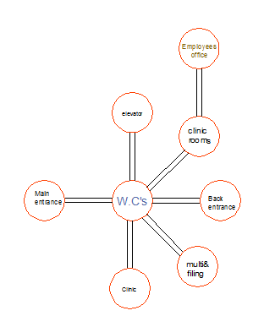
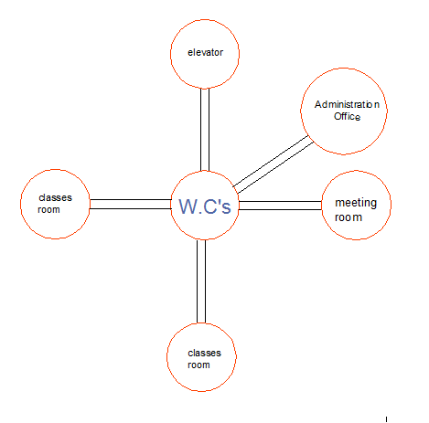
Architectural Design
2
Relationship and circulation:
1
2

Slide 14
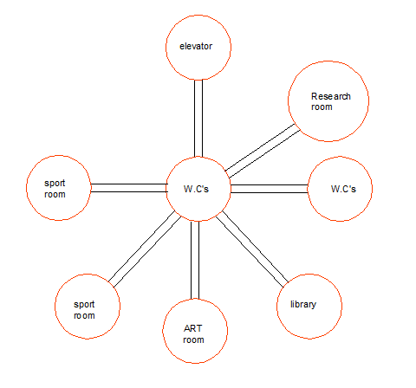
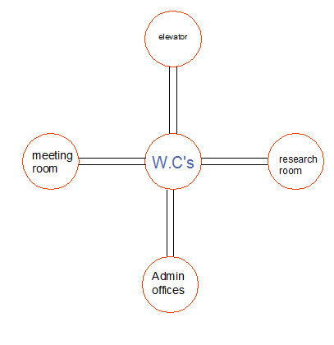
3
4

Slide 15
Dimension for spaces :
space | Area M²
Clinic | 15.75
Multisensory | 40.4
Filing room | 14
Employees office | 31
Staff W.C’s | 2.55
Elevator hole | 4.83
Classes | 26.4
Staff room | 32.7
Meeting room1 | 21.6
Administration office | 17.4
Secretary waiting | 17.5
Sport room | 31.9
ART room | 31.7
Library | 20.6
Music room | 20.3
Admin office | 17-19.5
Meeting room2 | 28.4
Research room | 16.4

Slide 16
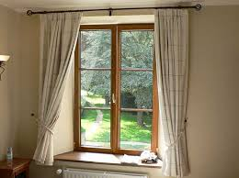
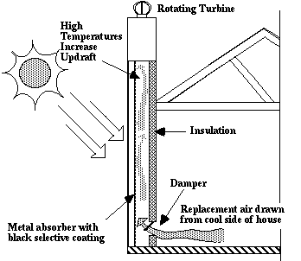
3
Environmental Design
Solar design systems
System of passive solar design
  Solar window
Solar Chimney

Slide 17
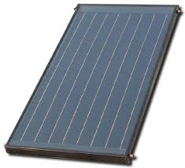
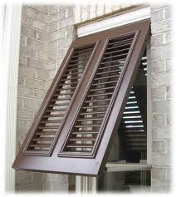
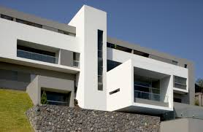
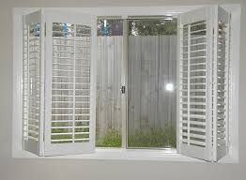
Active solar design
Collection
Solar Shading
Cantilevers &Balcony
Shutter

Slide 18
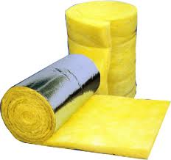
Thermal insulations
Materials like Foam, rubber and polystyrene.
Air space
Fiberglass

Slide 19
Ventilation
Space | Air change rates/hour
Classrooms | 8
Bathrooms (without shower) | 6 – 8
Bathrooms (with shower) | 15 - 20
Laundries - (with drier) | 10 - 30
Kitchens | 15 – 20
Garages | 6 – 8

Slide 20
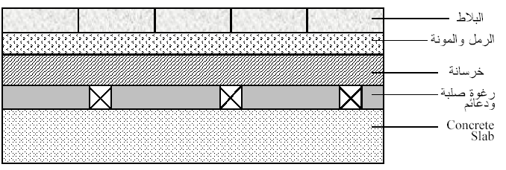
Sound insulation
Insulation between apartment
Floor slab

Slide 21
4
Structural Design
ACI-code
Recommendation :
Ribbed slab.
Dropped beam to resist earthquakes.
Short column.
Isolated

Slide 22
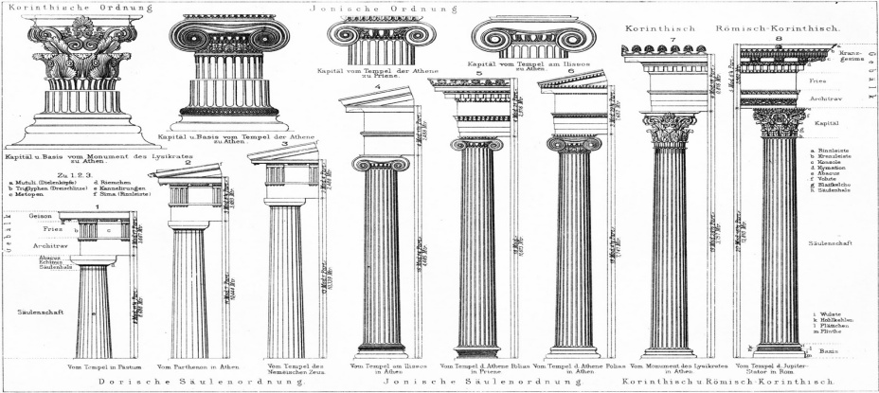
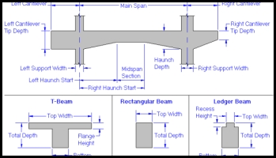
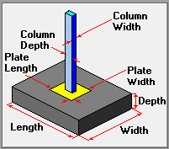
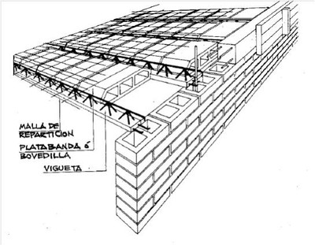

Slide 23
5
Electrical And Mechanical Design
Lighting
Space/Activity | Recommended min. luminance E (lux)
Office | 300
Team office | 500
Deep- plan office | 750
Technical drawing office | 750
Control room | 300
Corridor | 150
Staircase | 150
Waiting areas | 150
Bathroom, WC | 100
Reception | 300
5Laboratory | 500
Art ROOM | 500
Meeting room | 300
Space

Slide 24
Reflection factor of materials:
0.70–0.85 | Plaster, white
0.70–0.80 | Gypsum
0.60–0.70 | Enamel, white
0.40–0.50 | Mortar, light
0.30–0.50 | Concrete
0.10–0.30 | Granite
0.10–0.20 | Brick, red
0.05–0.10 | Glass, clear

Slide 25
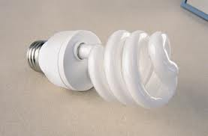
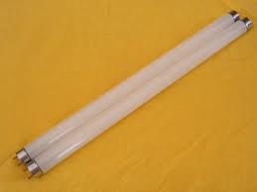
Lighting
Compact fluorescent lamp
Fluorescent tubes
Type
Compact fluorescent lamp | Bathrooms, corridor
Fluorescent Tubes | management, Kitchen
Space

Slide 26
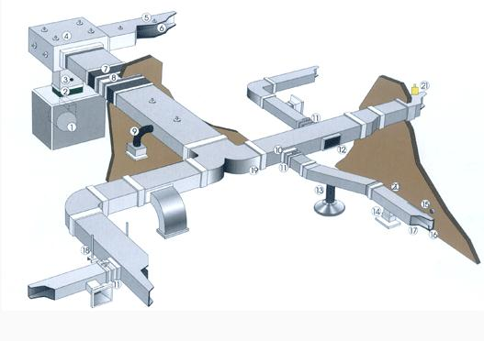
Mechanical Design
HVAC System
Duct system
Duct use air for heating and cooling

Slide 27
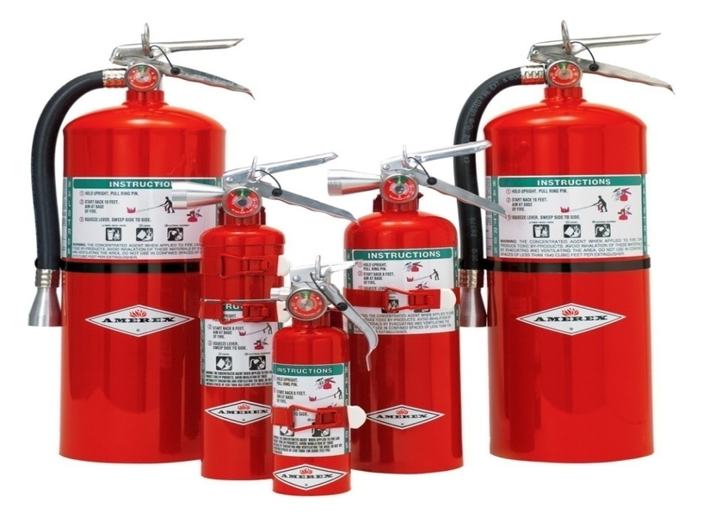
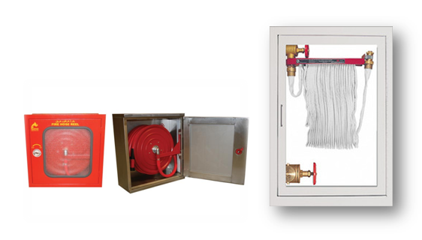
Fire risk and protective factors
Introduction
In this type of buildings there are many resources of risk, such as, fire in the building due to personal error, cooking and short cut in the electricity.
Fire protection and fighting
Fire extinguisher.
Manual -hose- system.

Slide 28
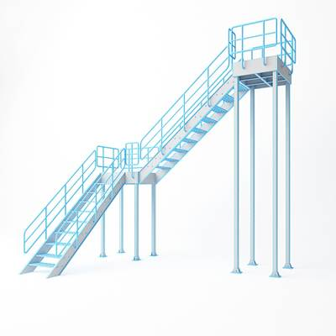
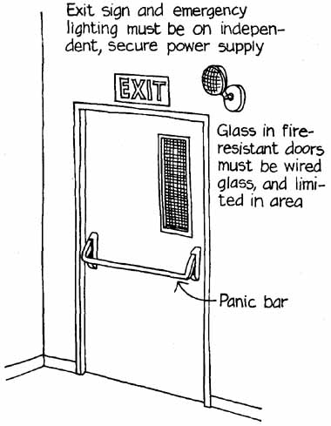
Emergency exits in building
Fire Door
Fire door must be in the fully closed position, the door should be automatic closing or self-closing (They return to closed position after being open), and the door should open to outside

Slide 29
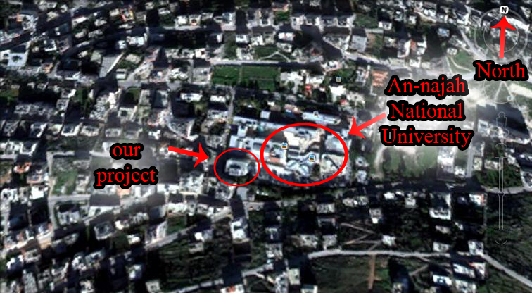
6
Site Analysis and project program
General information about the site
Area of each floor = 430 m2
#of floors = 5 ( including parking)

Slide 30
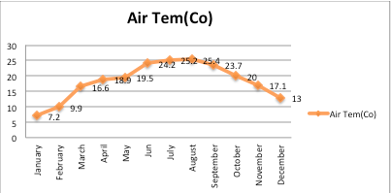
Geographical and climatic conditions of Nablus City
Air temperatures
Weather of Nablus City is wet and dry in summer; it is cold and rainy in winter.
Average air temperature =19.5(Co)
Air temperatures for each month
(Palestinian Statistics)

Slide 31
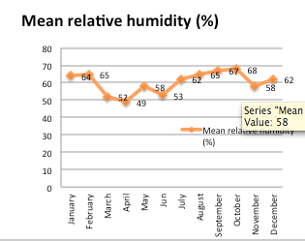
Relative humidity
As for the relative humidity in Nablus, the overall average annual up to (61%).
Relative humidity for each month

Slide 32
Future work
level | RATING | TOTAL POINTS
**** | Diamond | 160 or more
*** | Gold | 140-159
** | Silver | 120-139
* | Bronze | 100-119

Slide 33
The project will include a redesign of a current building, and it will take into consideration the every item on green building.
Lighting ( natural and artificial )
Shading and shadows.
Noise level (sound insulation using gypsum board)
Weather and wind direction.
Ventilation.
Thermal insulation using fiberglass…)
Solar design (solar window and solar chimney)
Grey water recycling

Slide 34

Thank You
All

