Slide 1

Developing evaluation method for Nablus Municipality Customer Service Center (CSC)
Prepared By:
Lara Anton Ghateet
Amr Tareq Abdallah
Isra’ Moa'yad Snober
Ahmad Fuad Mahmoud

Slide 2
Introduction
(CSC) is one of the most important facilities in any place because of the services that provide to the public in general.
Because of this importance these facilities should be well organized for the great goal which is Customer satisfaction
(CSCs) to insure their goals they use and develop various tools and methods to measure service satisfaction
In this project Kano method and Prior Matrix and some other techniqus

Slide 3
Project Objectives
Build evaluation tools and techniques for (CSC)
Improve the impact of performance for (CSC)
Improving the internal reporting system
Building and evaluating External attributes
Provide Recommendations and solutions

Slide 4
Methodology
Problem Definition
Research for evaluation tools and techniques
Data Collection
Data Analysis.
Improving and generating solutions
Results Presentation
Recommendations

Slide 5
Case study Description
and Results

Slide 6
Customer Service center General Description

Slide 7

Current Situation

Slide 8
Productivity Reporting
Internal Situation
Employees evaluation
Data screens

Slide 9
Productivity Reporting

Slide 10
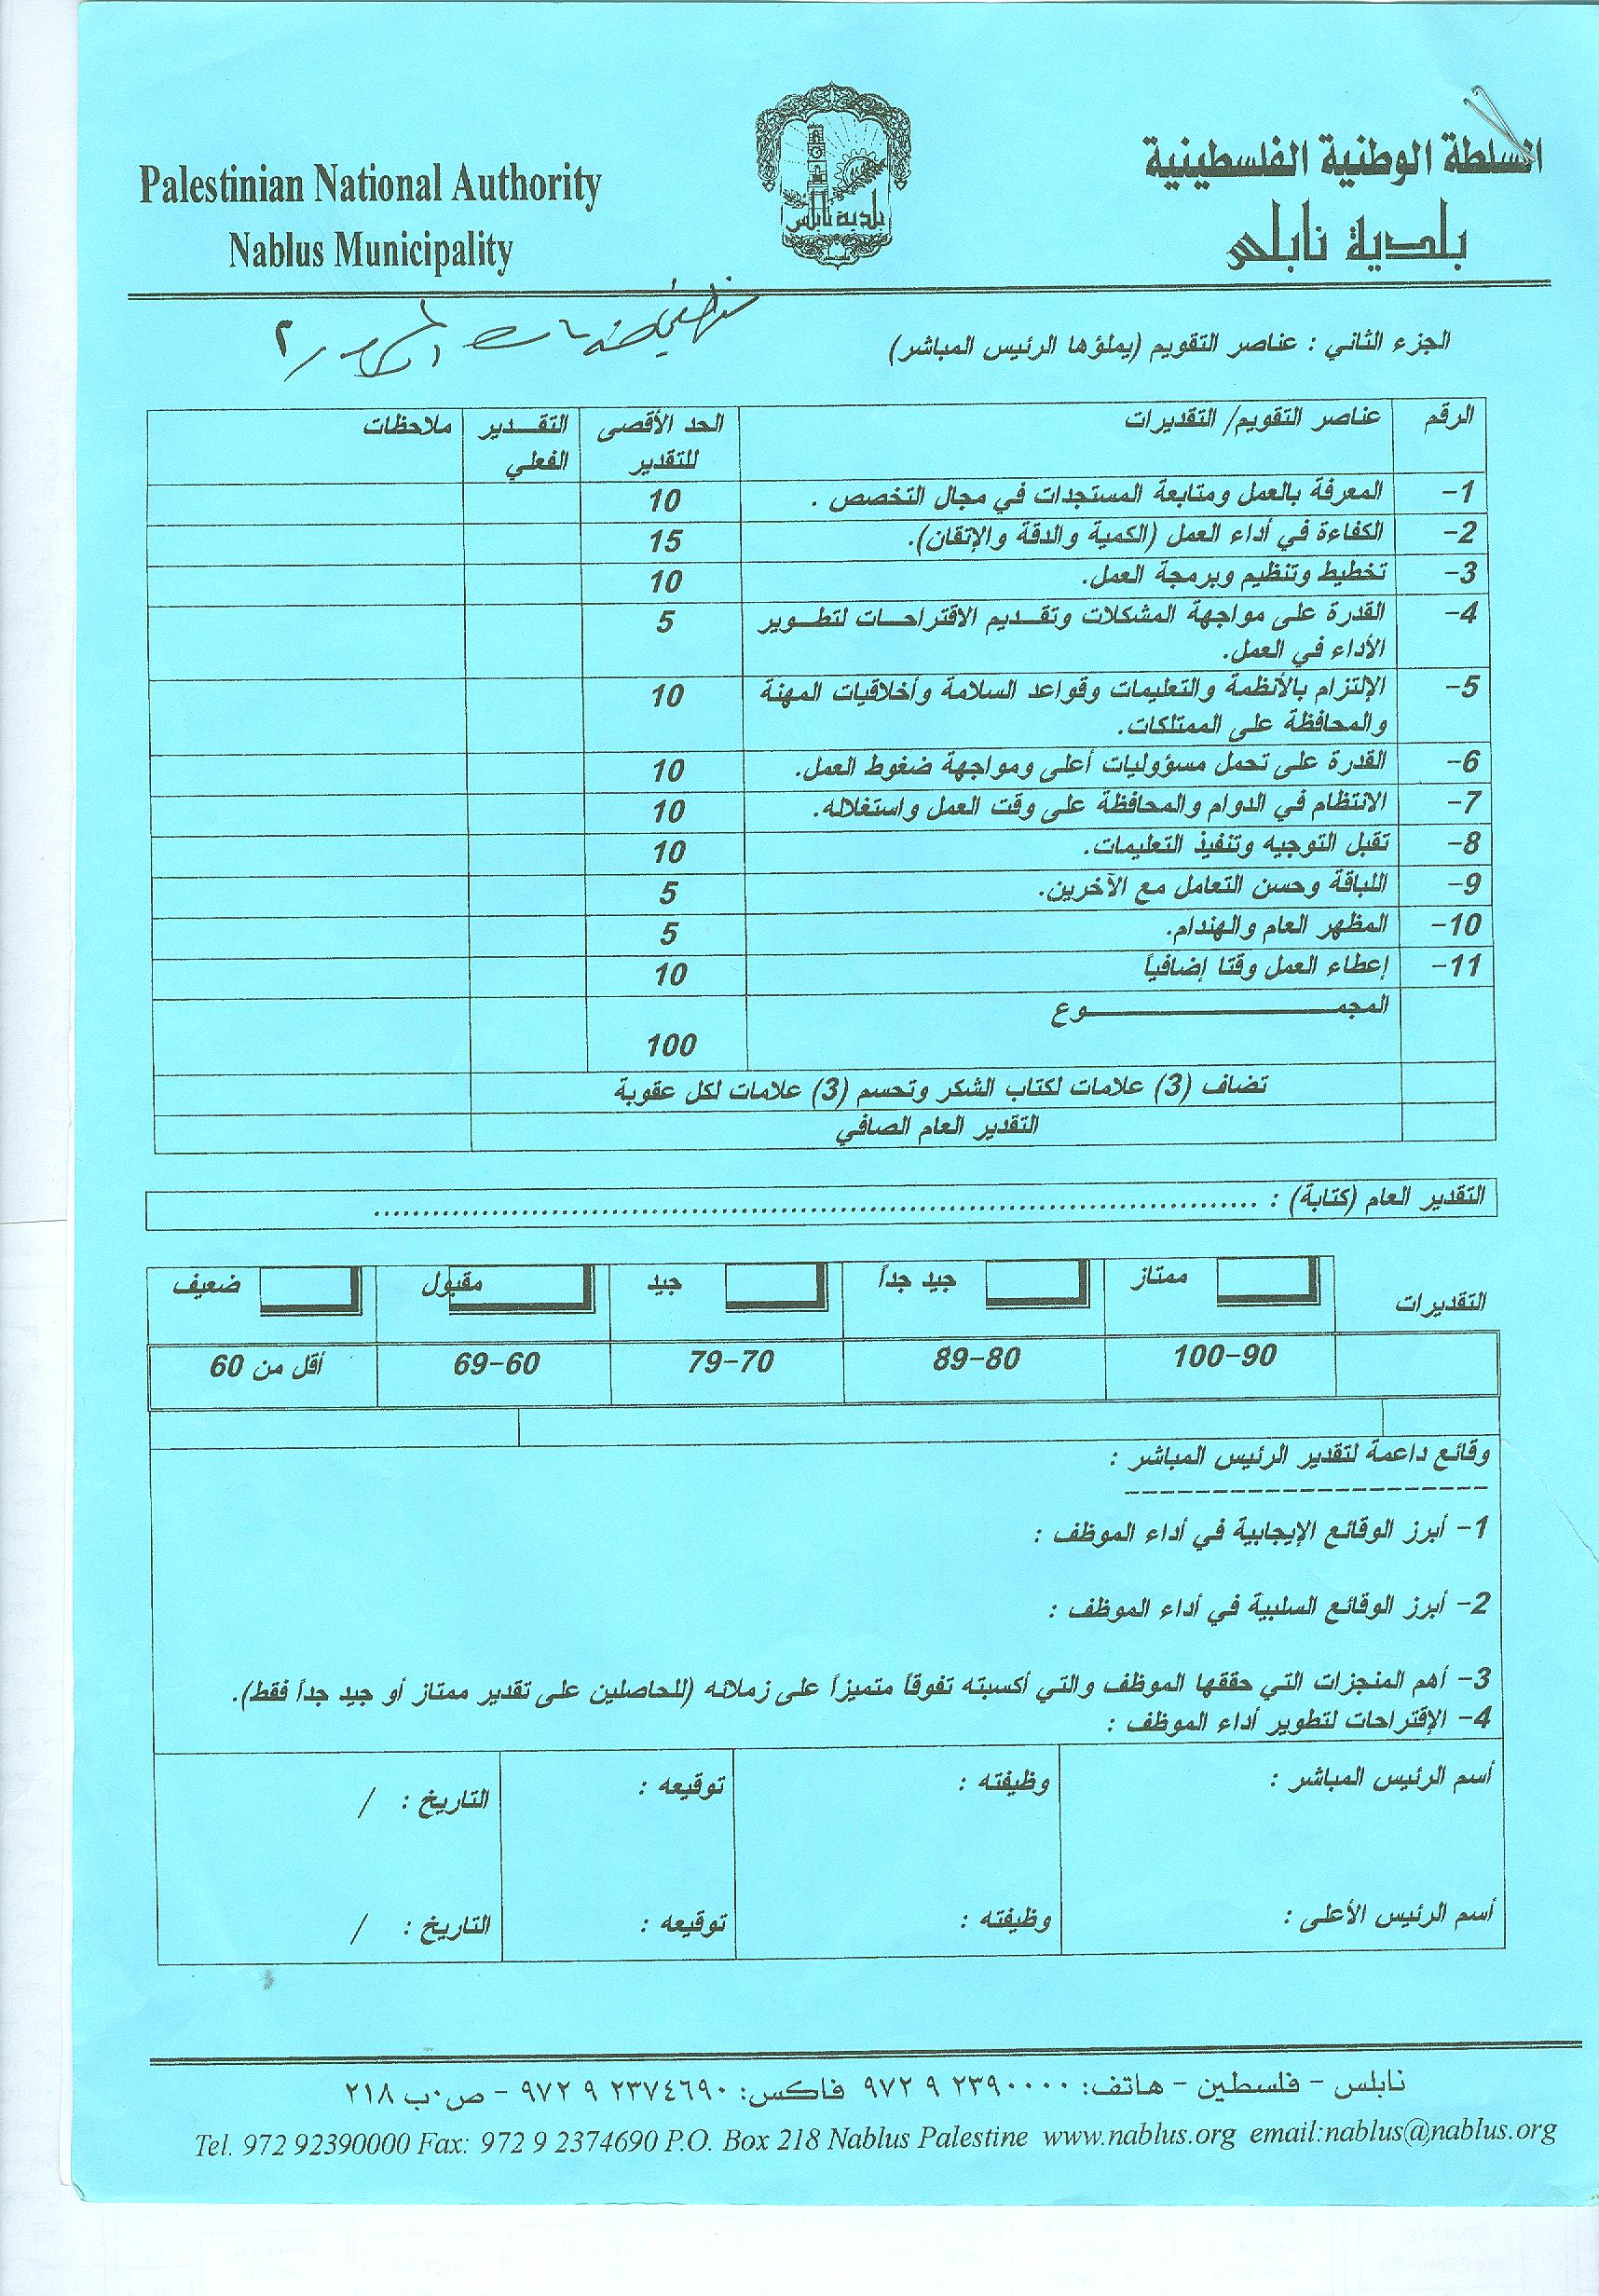
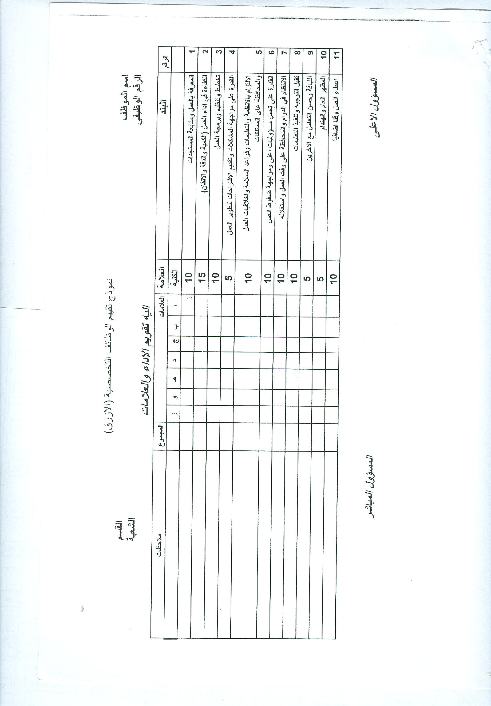
Employees Evaluation

Slide 11
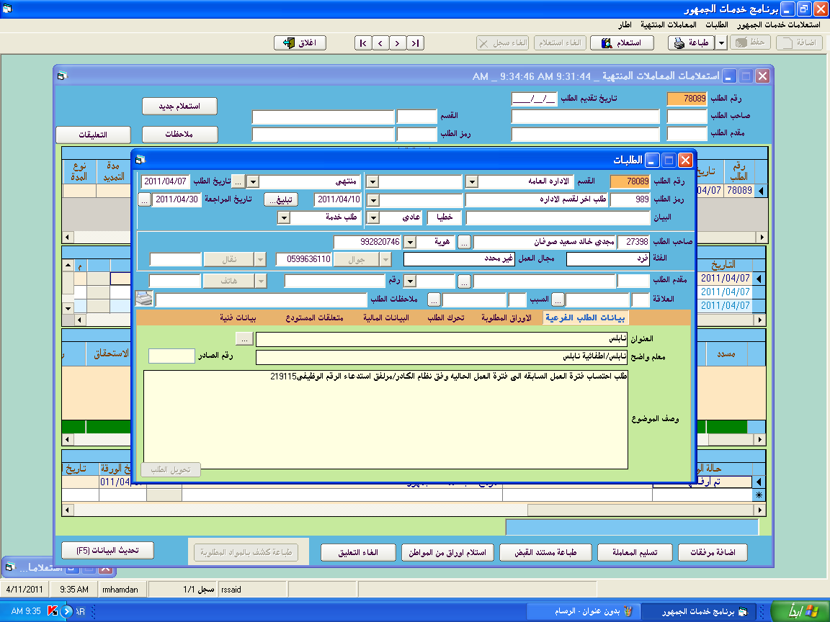
Input screen

Slide 12
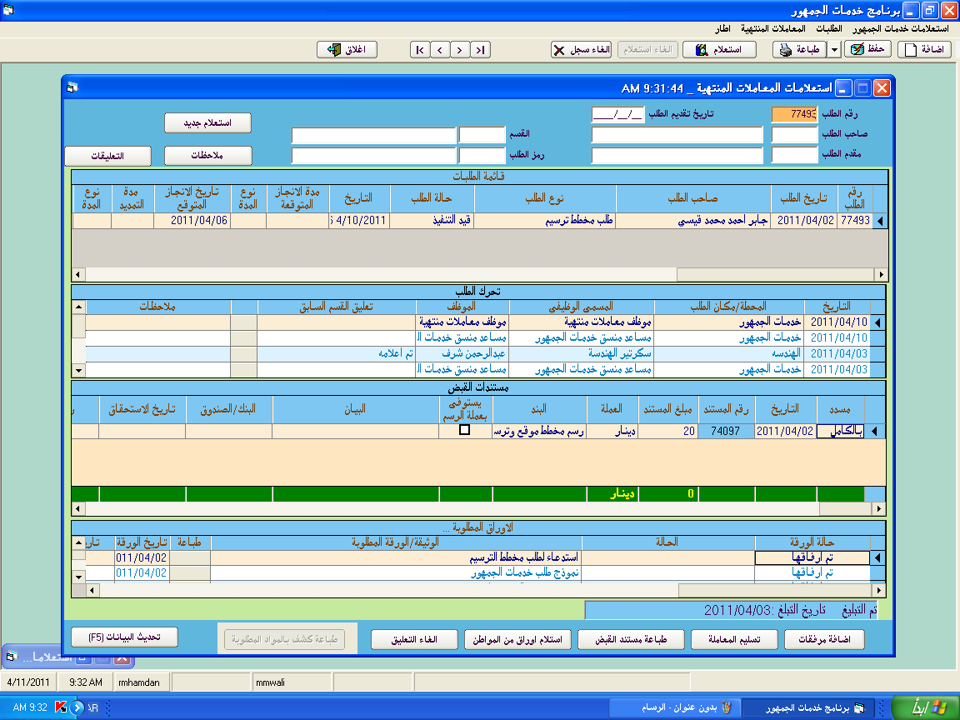
Output screen

Slide 13
External Situation
No Tools for external evaluation
External evaluation

Slide 14

Improvement

Slide 15
Improvement & Results
Internal
External

Slide 16
External Improvement
- Adopting Kano method and external evaluation has been done
- Prior Matrix tool is also used for the external evaluation

