Slide 1

Department of Electrical and Telecommunication Engineering wireless power transfer

Slide 2
Wireless Power Transfer
Presented by: Ahmad Antari
Ayham Odeh
Izzedden Habazi
Submitted to: Dr.ahmed masri

Slide 3
Overview
What is wireless power transfer (WPT)?
Why is WPT ?
History of WPT
Types of WPT
  Techniques to transfer energy wirelessly
Advantages and disadvantages
Conclusion

Slide 4
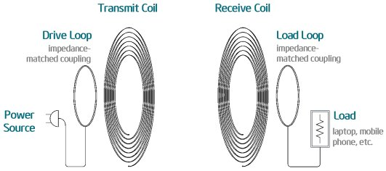
What is WPT?
The transmission of energy from one place to another without using wires
Conventional energy transfer is using wires
The wireless transfer is made possible by using various technologies

Slide 5

Why not wires?
Most of the energy loss is during transmission.
Risk of electrical hazards.
Complicated wiring structure.

Slide 6
Why WPT?
Reliable.
Efficient.
Fast.
Can be used for short-range or long-range.

Slide 7
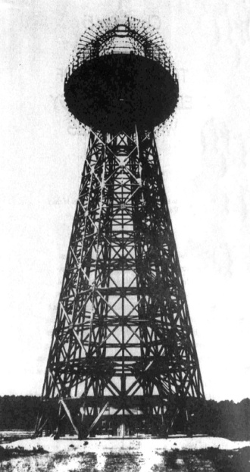
History
Nikola Tesla in late 1890s
His vision for “World Wireless System”
He construct a 187 feet tall tower to broadcast energy
All people can have access to free energy
Due to shortage of funds, tower did not operate

Slide 8
History (cont…)
Tesla was able to transfer energy from one coil to another coil.
He managed to light 200 lamps from a distance of 40km.
The idea of Tesla is taken in to research after 100 years by a team. The project is named as ‘WiTricity’.

Slide 9
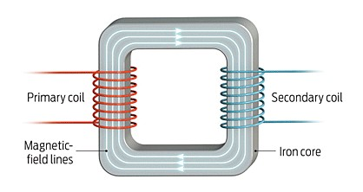
Energy Coupling
The transfer of energy
  Magnetic coupling
  Inductive coupling
Simplest Wireless Energy coupling is a transformer

Slide 10
Types and Technologies of WPT
Near-field techniques
  Inductive Coupling
  Resonant Inductive Coupling
  Air Ionization
Far-field techniques
  Microwave Power Transmission (MPT)
  LASER power transmission

Slide 11
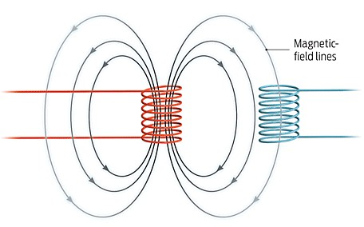
Inductive coupling
Primary and secondary coils are not connected with wires.
Energy transfer is due to Mutual Induction

Slide 12
Inductive coupling (cont…)
Transformer is an example.
Energy transfer devices are usually air-cored.
Wireless Charging Pad(WCP),electric brushes are some examples.
The primary coil and the secondary coil have to be kept very near to each other.

Slide 13
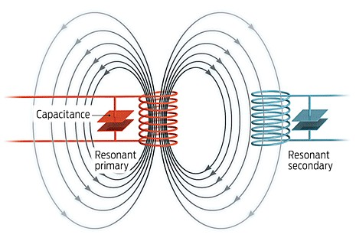
Resonance Inductive Coupling(RIC)
Combination of inductive coupling and resonance
Resonance makes two objects interact very strongly
Inductance induces current

Slide 14
How resonance in RIC?
Coil provides the inductance
Capacitor is connected parallel to the coil
Energy will be shifting back and forth between magnetic field surrounding the coil and electric field around the capacitor
Radiation loss will be negligible

Slide 15
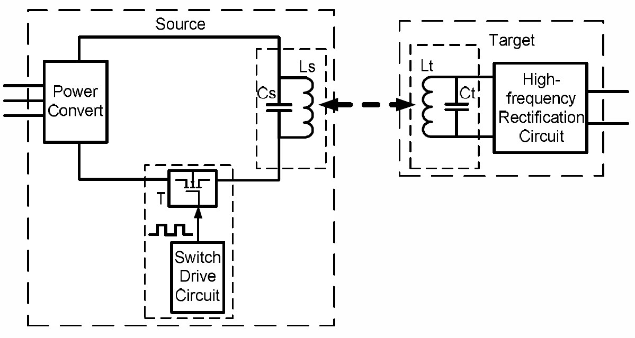
Block diagram of RIC

Slide 16
WiTricity
Based on RIC
Energy transfer wirelessly for a distance just more than 2m.
Coils were in helical shape
Efficiency achieved was around 40%

Slide 17
WiTricity… Some statistics
Used frequencies are 1MHz and 10MHz
At 1Mhz, field strengths were safe for human
At 10MHz, Field strengths were more than ICNIRP standards

Slide 18
WiTricity now…
No more helical coils
Companies like Intel are also working on devices that make use of RIC
Researches for decreasing the field strength
Researches to increase the range

Slide 19
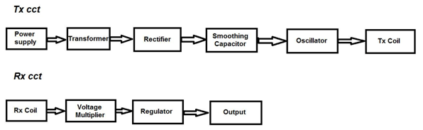
WPT blockdiagram

Slide 20
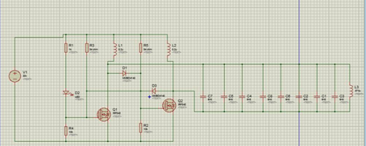
problems
The circuit wasn’t stable.
We implement an oscillator but it dose not work well.
.

Slide 21
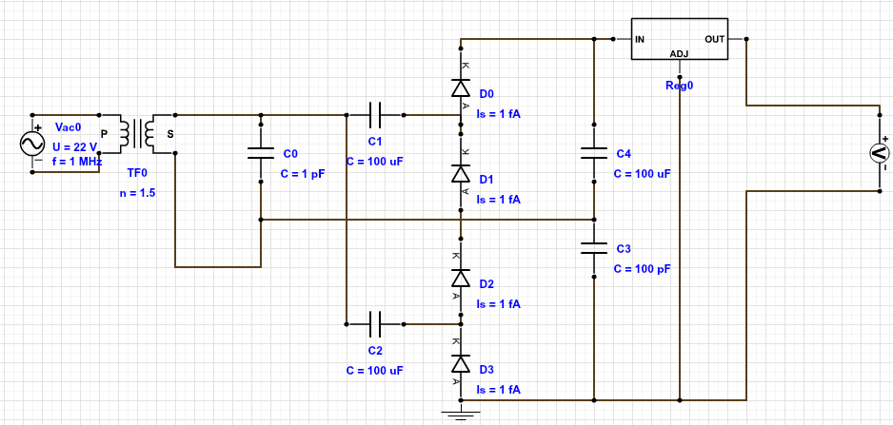
WPT Circuit

Slide 22
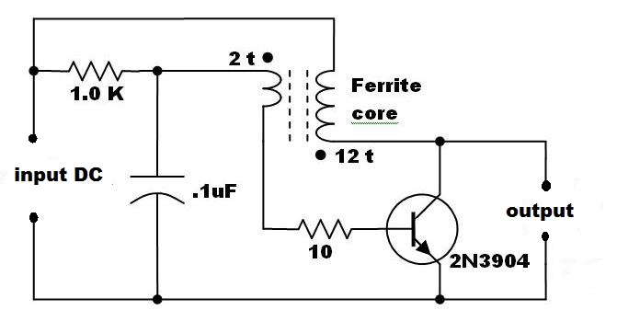
Joule thief circuit

Slide 23
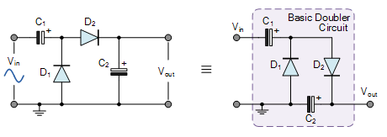
Voltage doupler

Slide 24
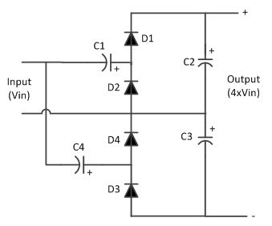
Voltage quadrupler

Slide 25
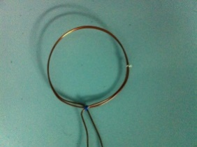
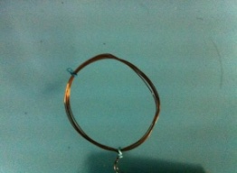
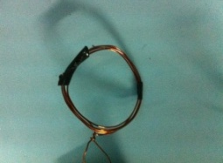
Coils that we used
During the testing process, we experience many coils, and took readings.
Radius (cm)1 | Number of turns | Thickness (mm) | Coils
1 | 2 | 6.5
0.5 | 10 | 6
0.3 | 8 | 3.8
0.8 | 5 | 4.5

Slide 26
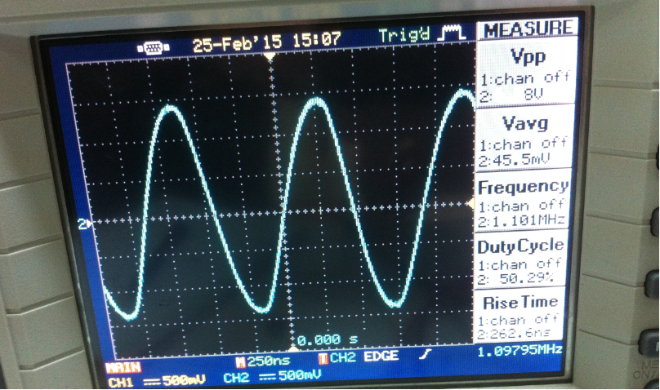
Tx coil input
Sinusoidal 1 MHz and 22 Vp-p .

Slide 27
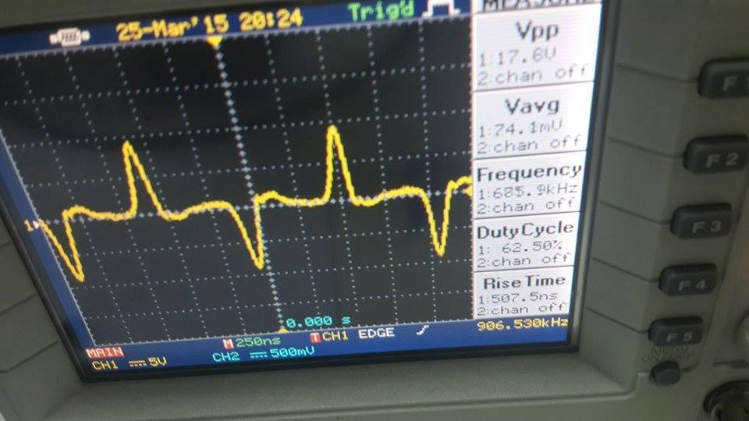
The receiving signal at the Rx coil.

Slide 28
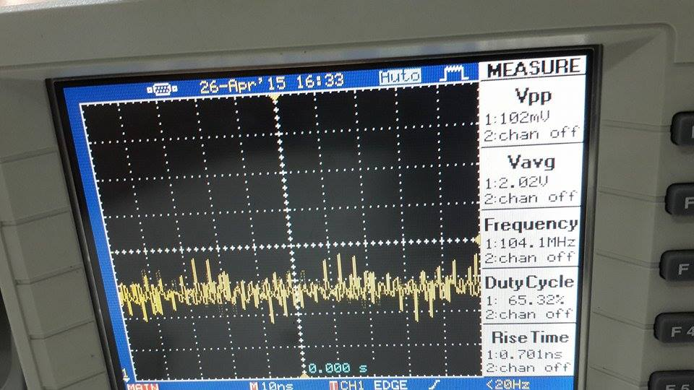
The output after the doubler

Slide 29
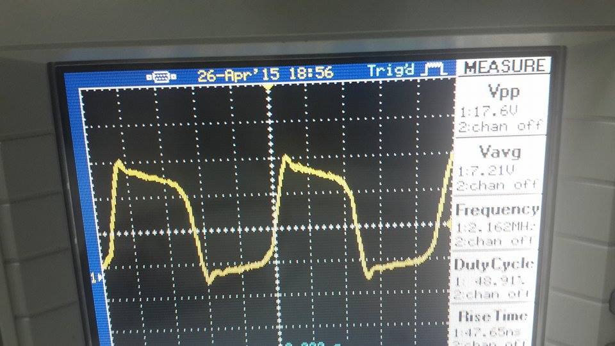
The output after the quadrubler.

Slide 30
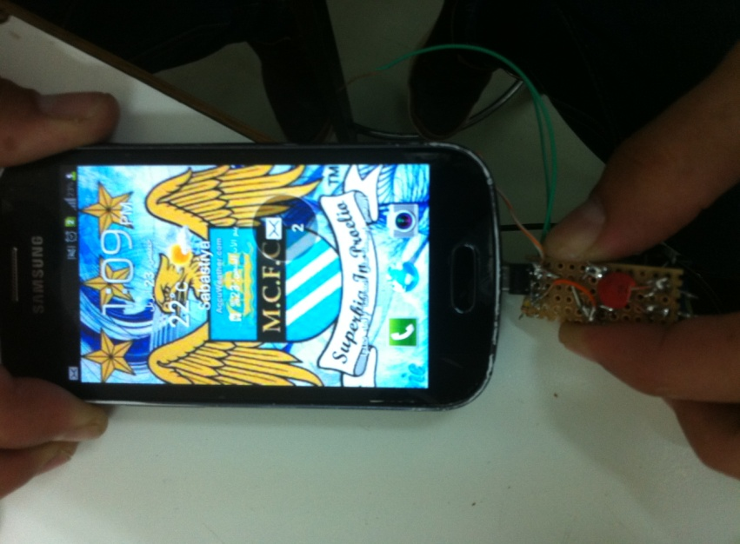
The good news was that we achieved our target which is charging the phone .

Slide 31
Conclusion
Transmission without wires is a reality
Efficient
Better than conventional wired transfer
Energy crisis can be decreased
Low loss
In near future, world will be completely wireless

Slide 32
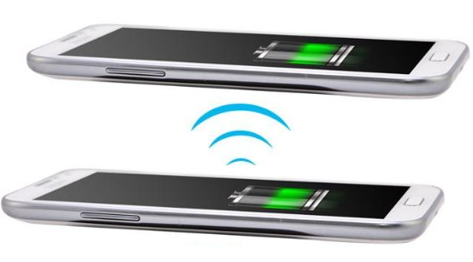
Future
charging the phone from another phone

Slide 33
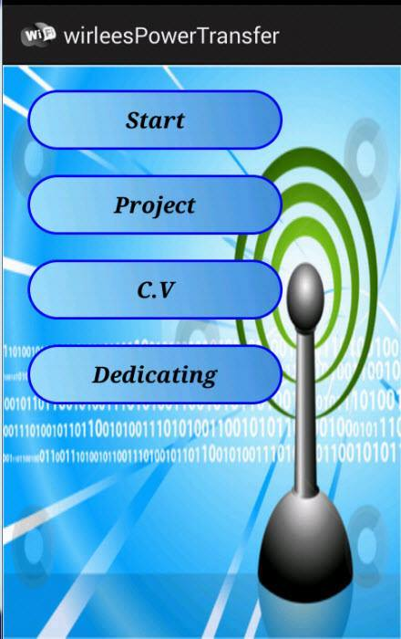
Future cont.
Android application

Slide 34
Future cont.
Improving the efficiency
Increase distance
Design a perfect oscillator circuit

Slide 35
THANK YOU!

