Slide 1

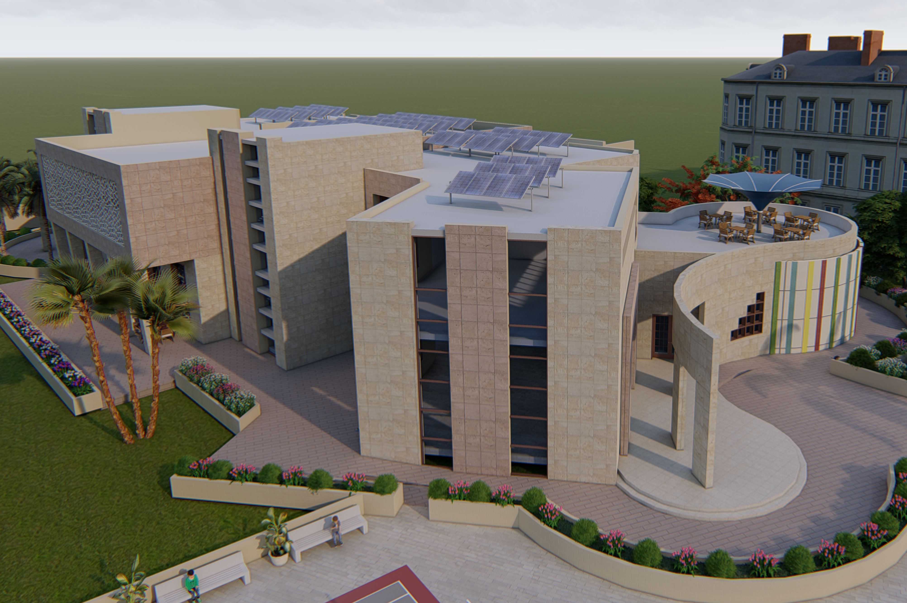
redesign of Good Shepherd Youth Center
Graduation project )2(
An–Najah National University
Faculty of Engineering
Building Engineering Department
Supervisor:
Dr.Muhannad Haj Hussein
Prepared by:
Fayez Maali.
Heba Abualrob.
Rana Neirat.
Nisreen Salman.

Slide 2
Outline
Introduction.
Site description.
Architectural aspect.
Environmental aspect.
Structural design.
Electro-Mechanical design.
Quantity surveying.

Slide 3
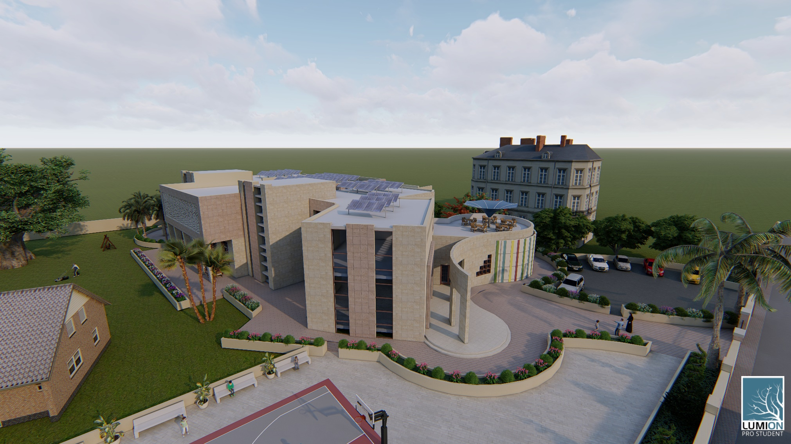
Introduction

Slide 4
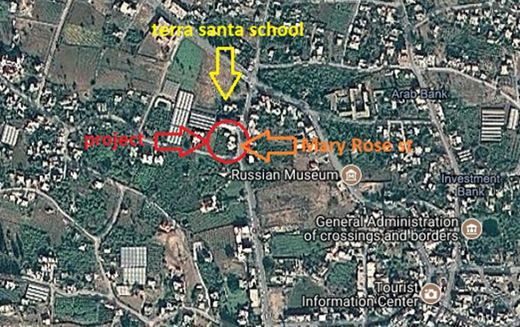
Site description
project location:
This project is located in Jericho city, Mary Rose St., near to Terra Santa school.

Slide 5
Site description
Site climate:
Avg. humidity ratio
40%
Avg. rainfall amount
150 mm/year
Avg. Temperature in winter 15⁰C
Avg. wind speed 12Km/hr
Avg. Temperature in summer 38̊C

Slide 6
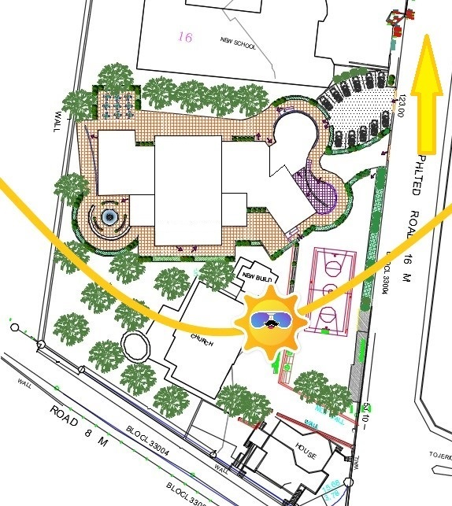
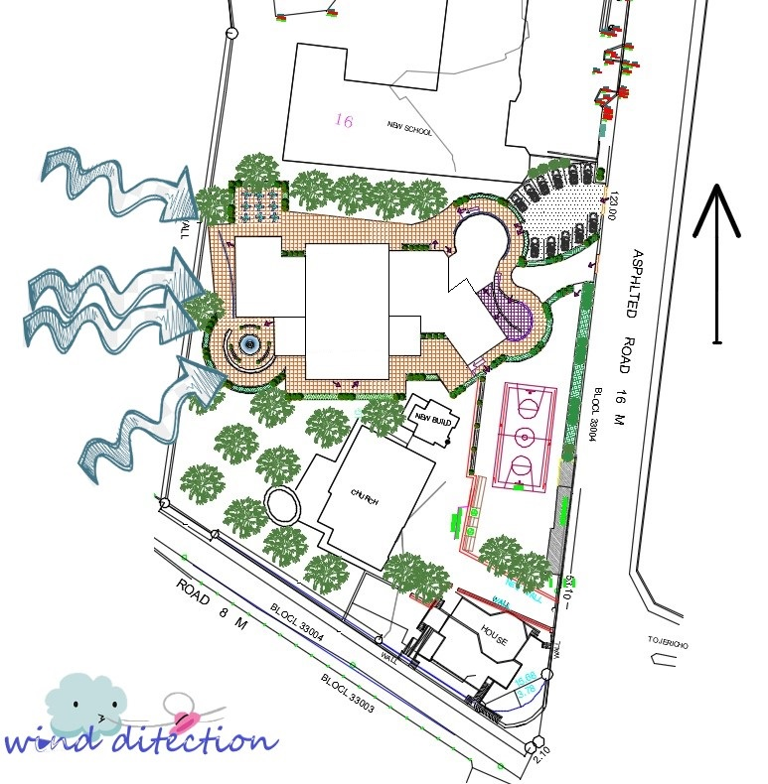
Site description
Sun bath
Wind direction

Slide 7
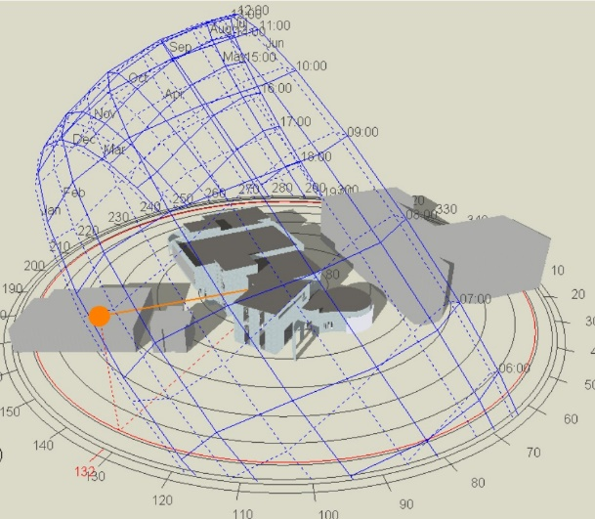
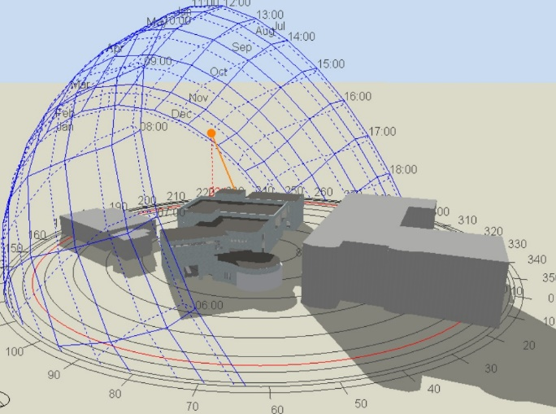
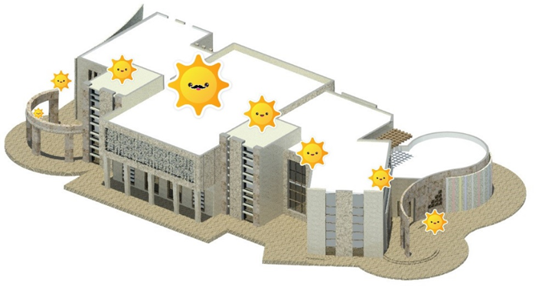
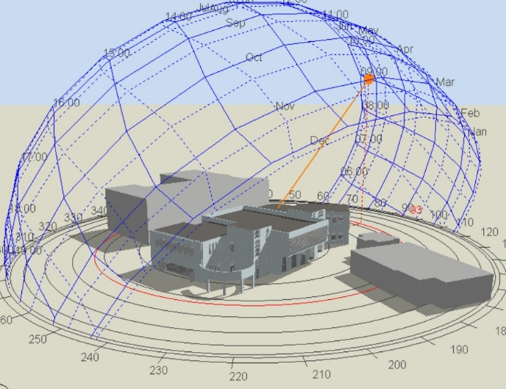
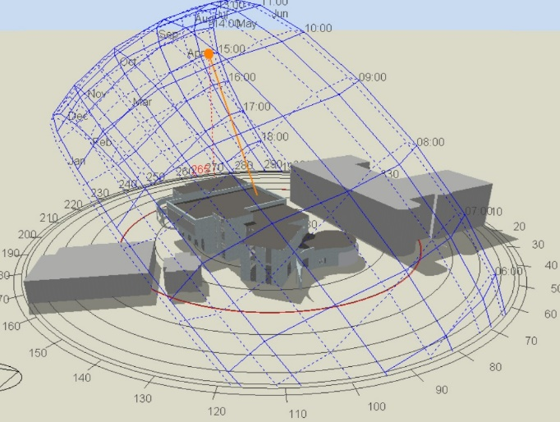
Overshadowing
January.21 at 9:00 AM.
January.21 at 3.00 PM.
July.21 at 9:00 AM.
July.21 at 3:00 PM.

Slide 8
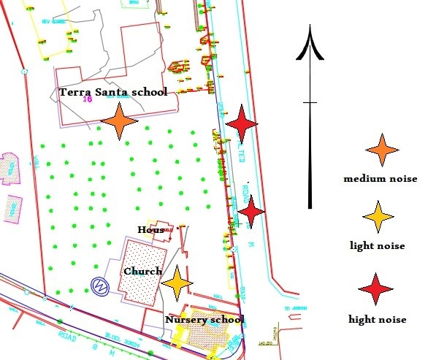
Noise analysis
The average noise levels from the surrounding sources:
Source | Street | Nursery | House | Church | school
Noise level (dB) | 77 | 65 | 40 | 50 | 65

Slide 9
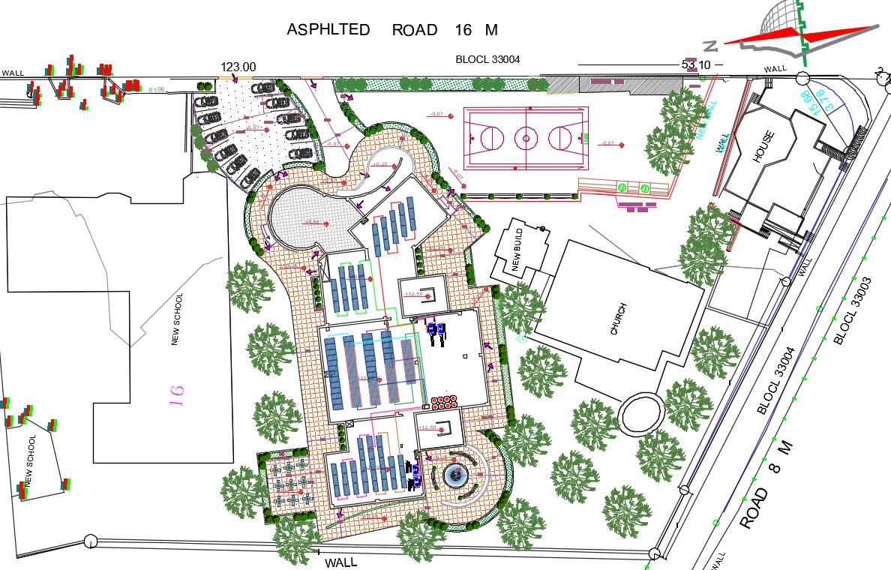
Architectural program

Slide 10
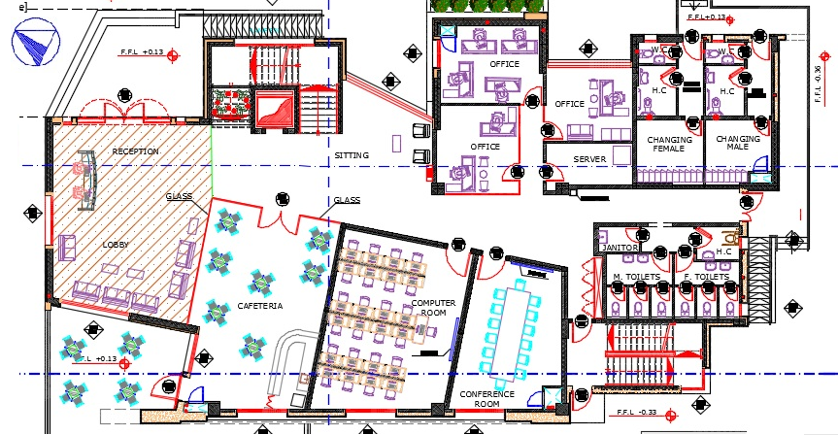
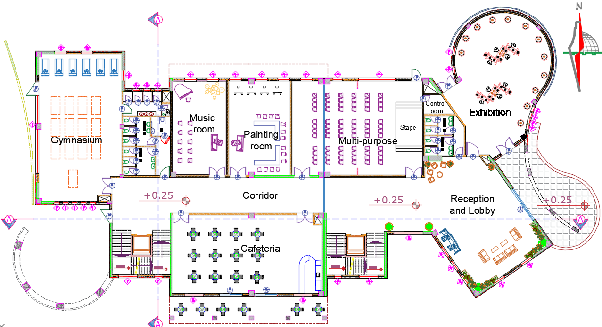
actual building ground floor
Before
After

Slide 11

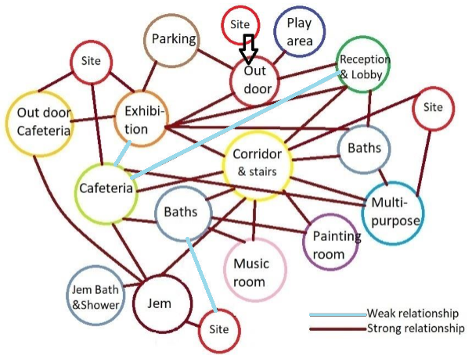
Ground floor plan
designed building
Bubble diagram of ground floor

Slide 12
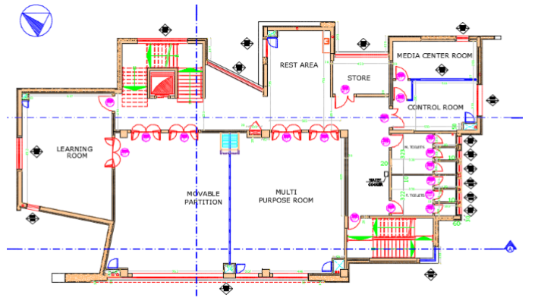
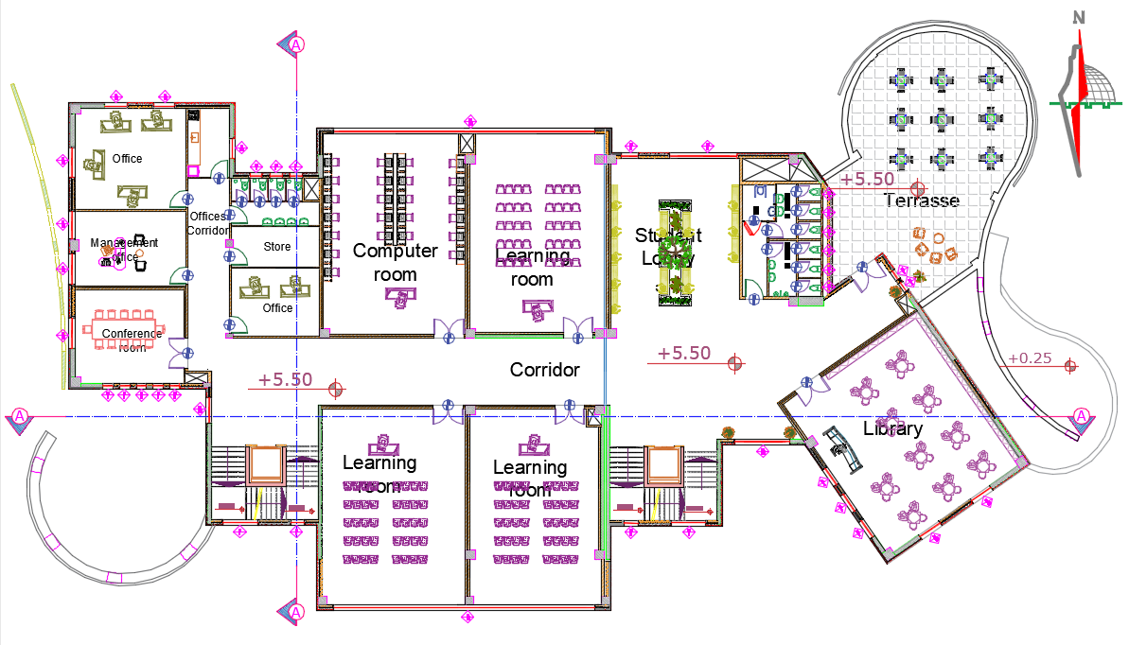
actual building
first floor
Before
After

Slide 13
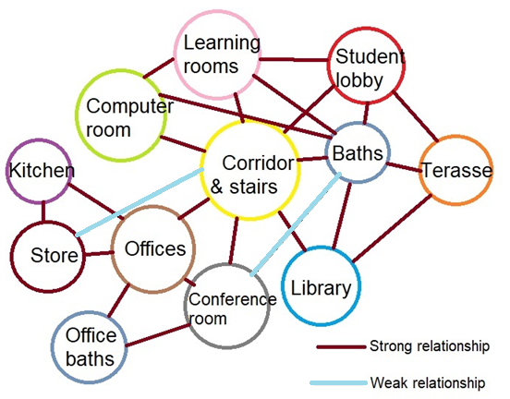
First floor plan
designed building
Bubble diagram of First floor

Slide 14
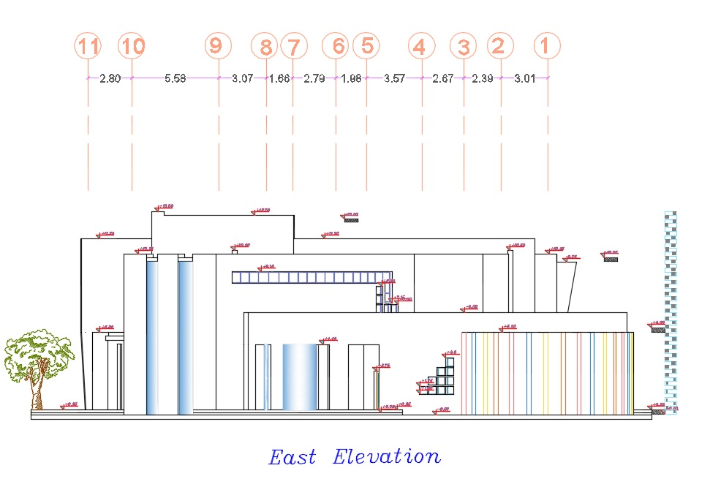
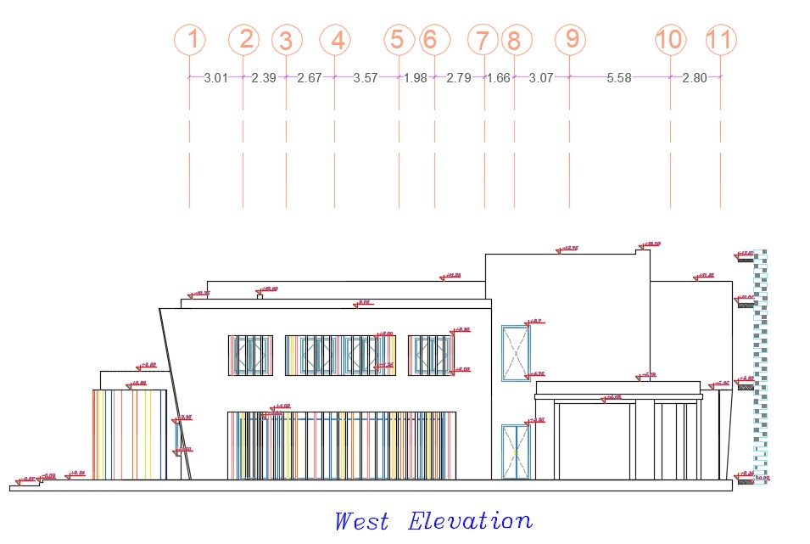
Architectural program

Slide 15
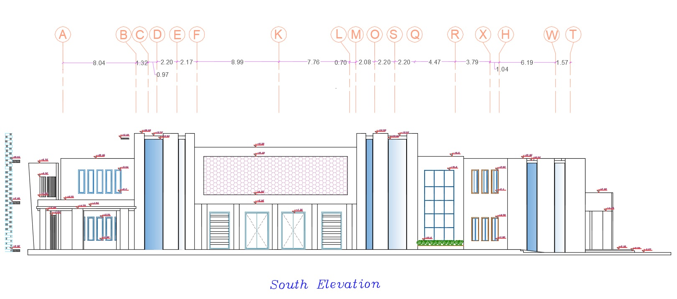
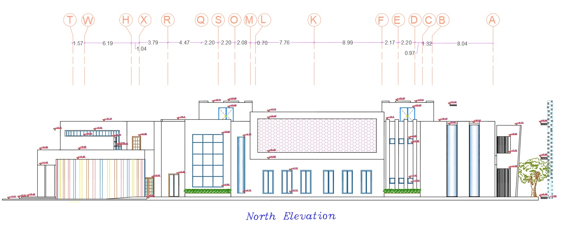
Architectural program

Slide 16
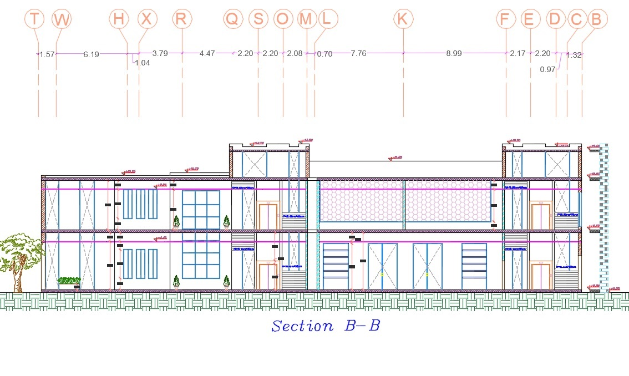
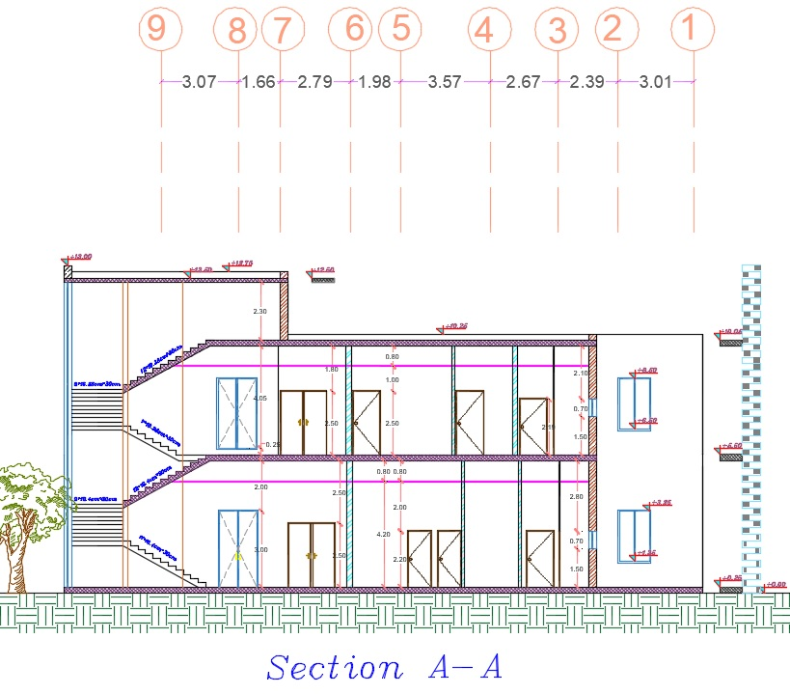
Architectural program

Slide 17
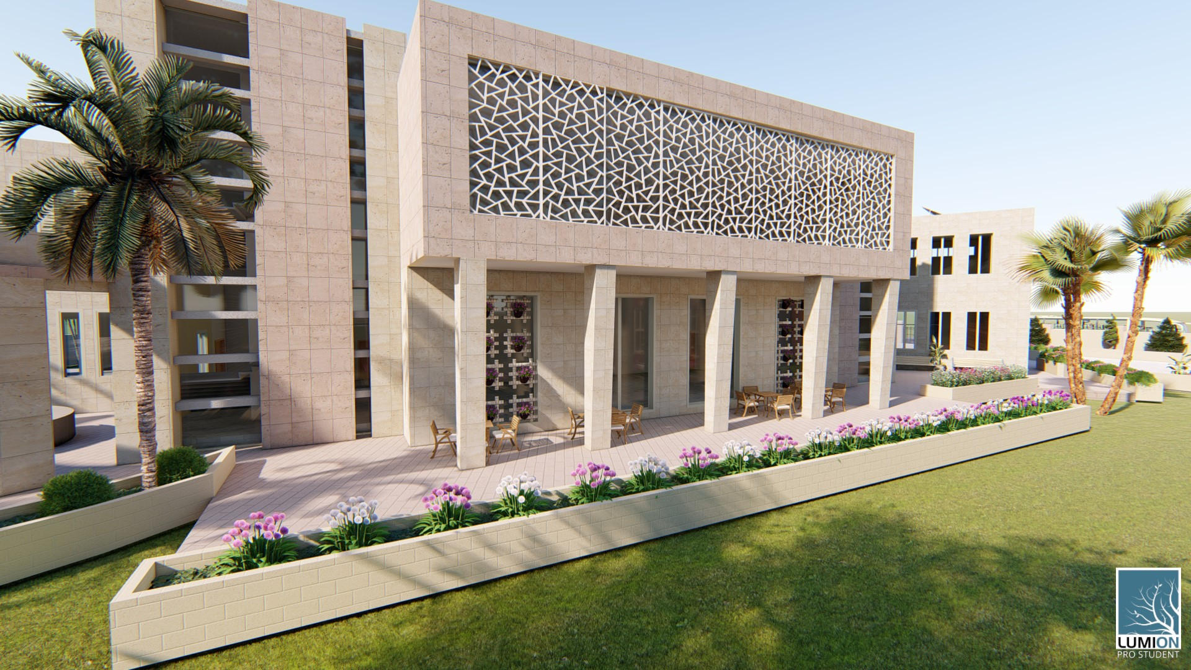
ENVIRONMENTAL Analyses

Slide 18
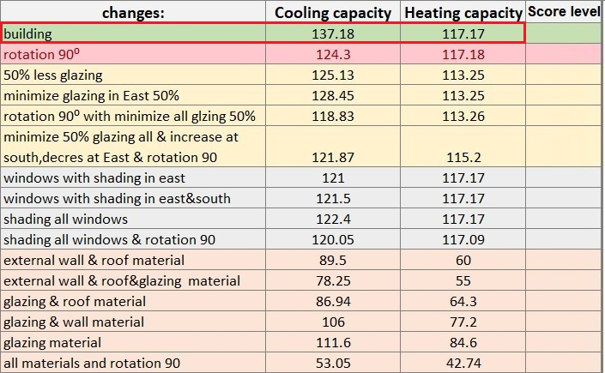
ENVIRONMENTAL ANALYZES

Slide 19
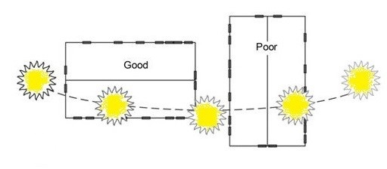
ORIENTATION

Slide 20
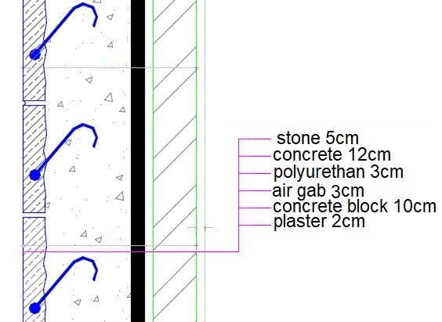
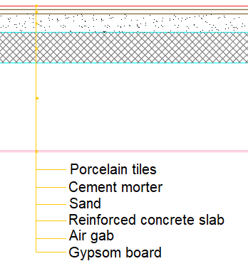
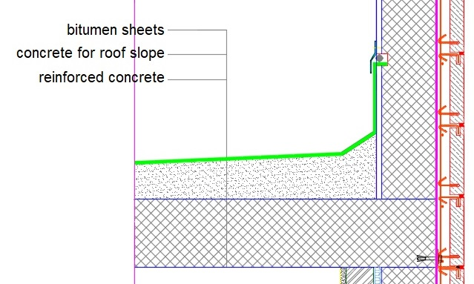
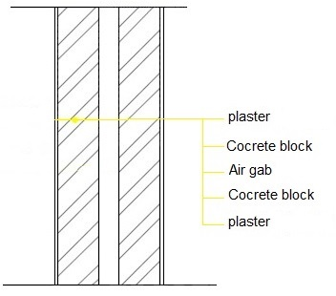
Material used and properties:
External Walls
Internal floor
U value = 0.32 w/m².k.
U value = 1.0
w/m².k.
Internal partition
Roof
U value = 1.13 w/m².k.
U value = 1.21 w/m².k.

Slide 21
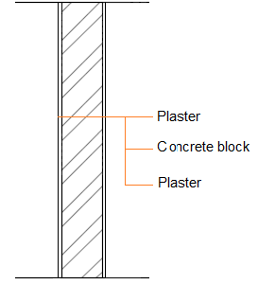
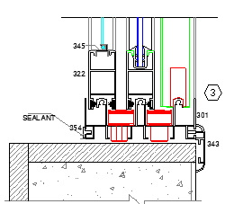
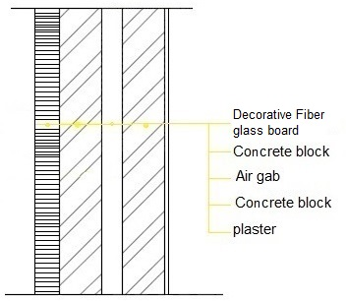
Material used and properties:
Windows
Internal partition
U value
= 1.72w/m².k.
6mm Double glass
with 13mm air gab
Internal partition
U value
= 0.359w/m².k.
U value = 1.77w/m².k.

Slide 22
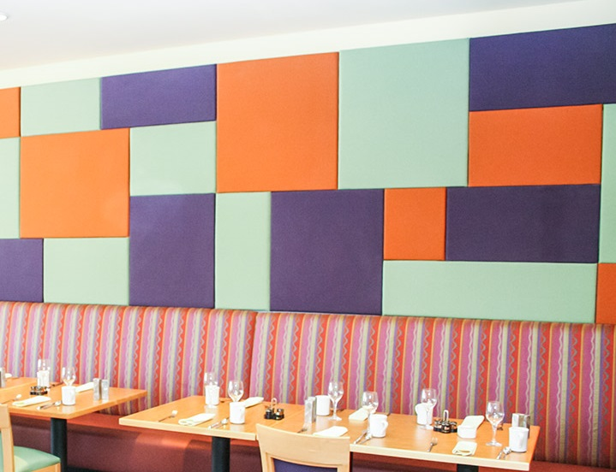
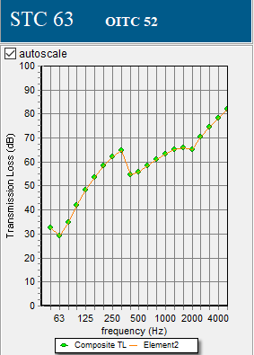
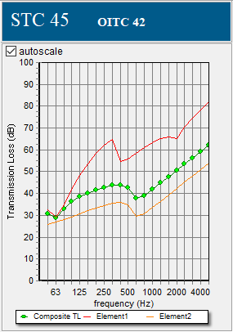
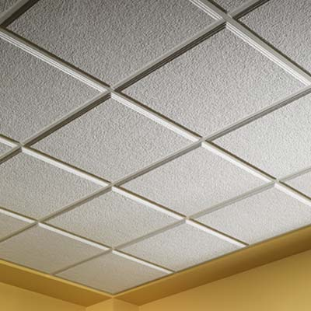
Acoustics Analysis
ENVIRONMENTAL aspect
STC for music room
Acoustical finishes for wall and ceiling.
Adjacent to corridor
Adjacent to practice room
Background level | Adjacent to corridor | Adjacent to practice room
Quite | 45 | 50
Normal | 42 | 45

Slide 23
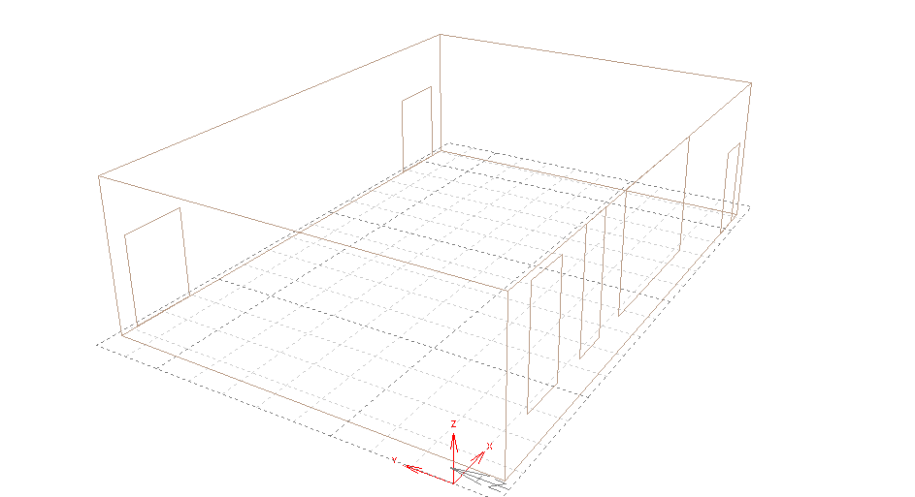
Acoustics Analysis
ENVIRONMENTAL aspect
RT60 for multipurpose room:
Finish
Tiles (porcelain)
Ceiling (plaster board ceiling)
Walls (plaster decorative wall panels)
Windows (double glass lowE aluminum frame)
Doors (hollow plywood)
Frequency | SABINE RT60 (sec)
125Hz | 1.38
250Hz | 1.5
500Hz | 1.75
1KHz | 1.94
2KHz | 1.76
4KHz | 1.11

Slide 24
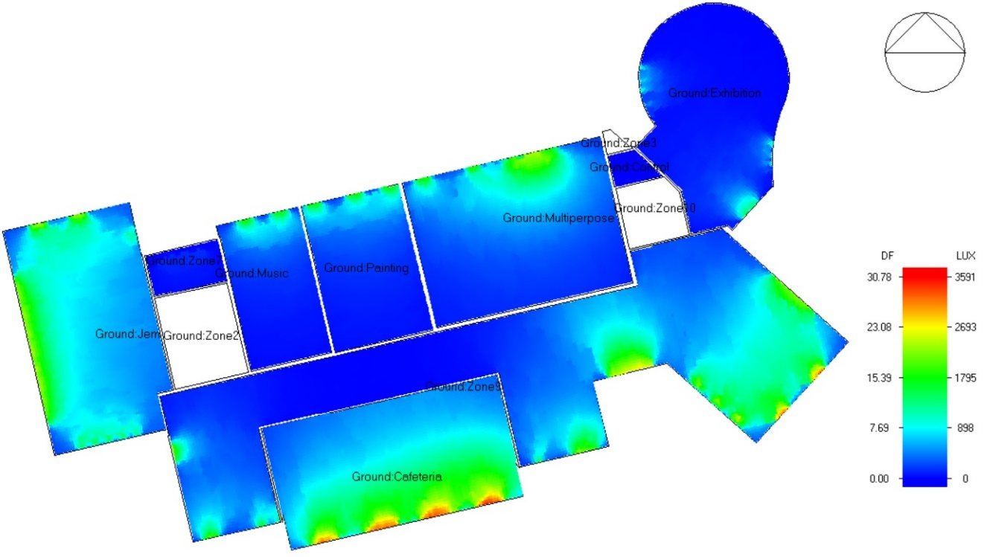
Day lighting performance
ENVIRONMENTAL aspect
Ground floor result:
for Multipurpose
Uniformity ratio = 15 %
DF% = 4 %

Slide 25
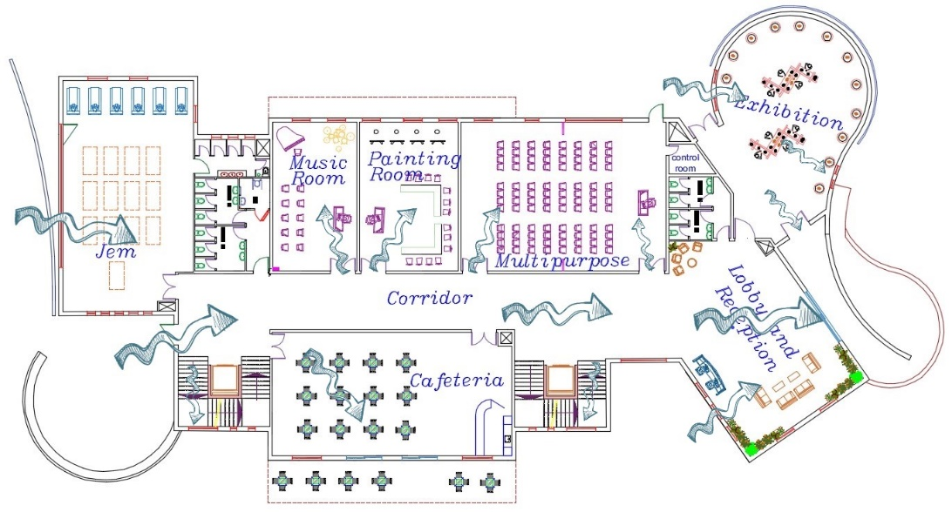
Ventilation Analysis
ENVIRONMENTAL aspecpt

Slide 26
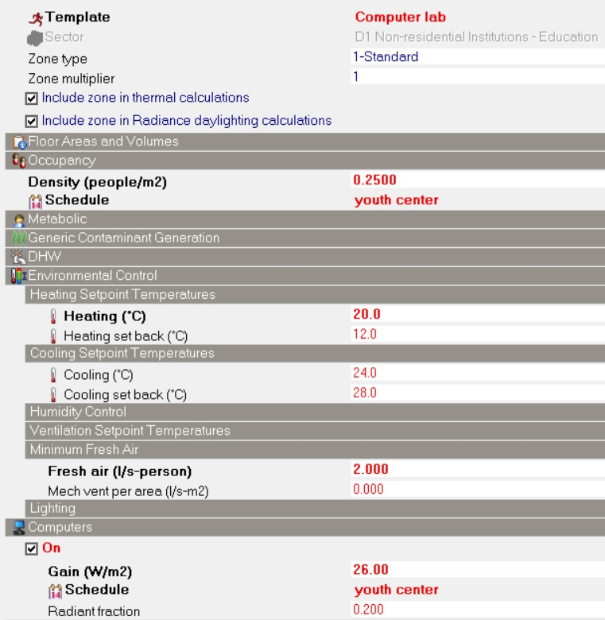
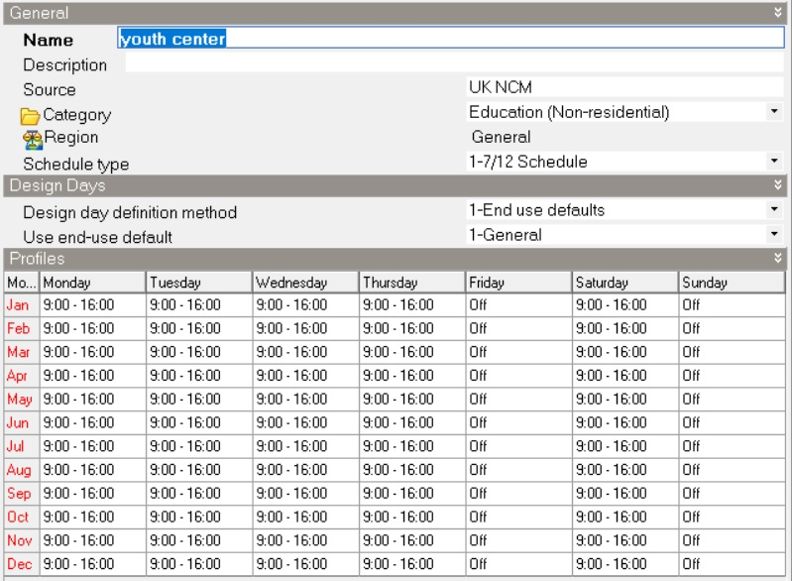
Design builder simulation
ENVIRONMENTAL aspect
Design builder parameters

Slide 27
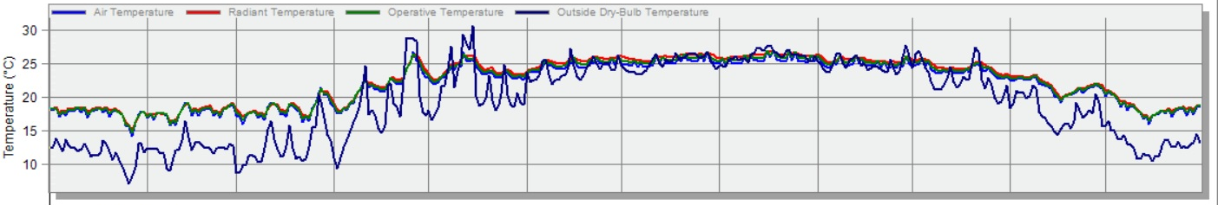
Design builder simulation
ENVIRONMENTAL aspect
Simulation results: using VRV HVAC system
 | Energy per total building area (kWh/m2)
Total site energy | 51.63
Total heating (KWh) | Total cooling (KWh)
7681.5 | 81730.8

Slide 28
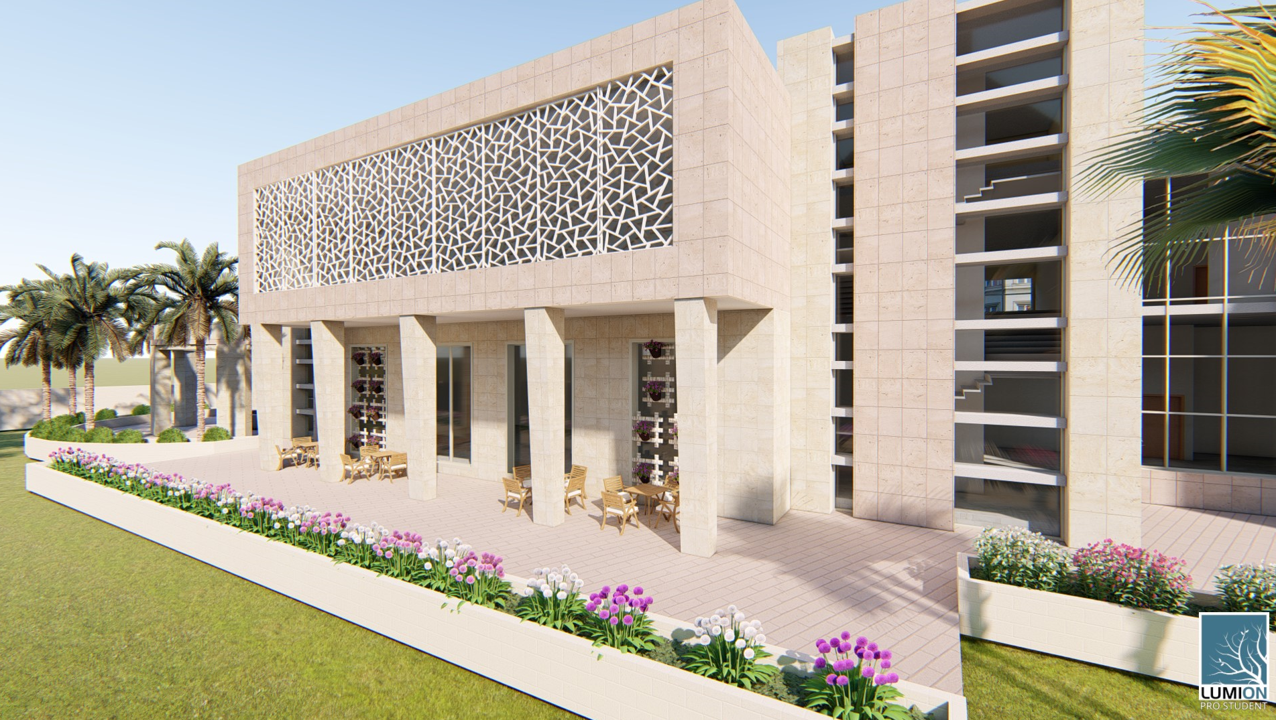
ENVIRONMENTAL aspect
Passive Heating and Cooling
CNC SHADING
LOUVERS

Slide 29
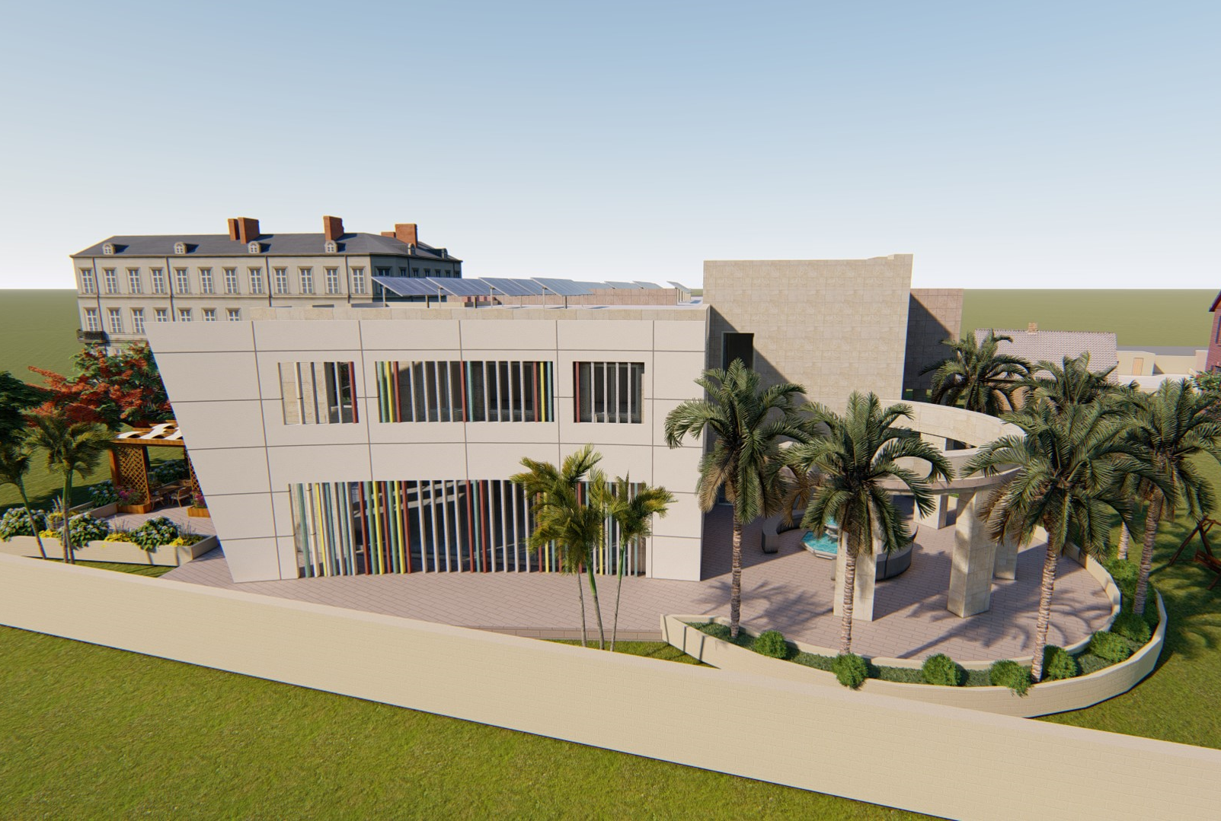
Double skin façade
Vertical louvers

Slide 30
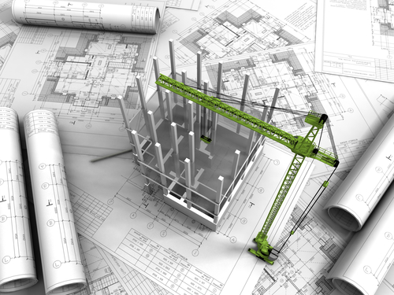
Structural design

Slide 31
Structural Analysis
Codes and Standards:
ACI 318 – 05.
UBC – 97.
Materials:
Concrete strength, f’c = 28 & 24 MPa.
Steel yielding fy = 420 MPa.
Soil Bearing capacity = 2 kg/cm².
Design loads:
Live load = 5 KN/m² .
Super imposed dead load = 3.5 KN/m² .

Slide 32
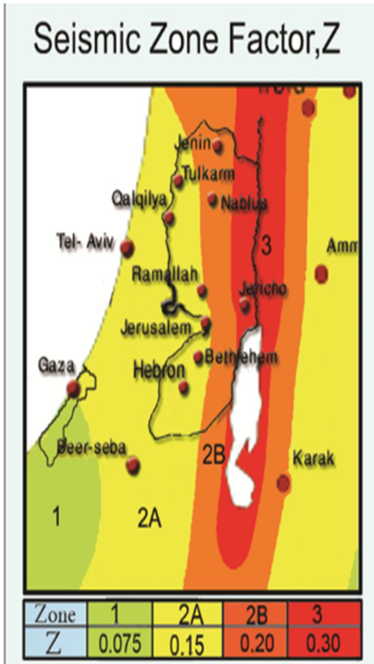
Structural Analysis
Seismic analysis:
Seismic zone : 3.
Importance factor = 1.
Soil profile : SD.
Ca = 0.36
Cv = 0.54
R = 5.5 (IMRF)

Slide 33

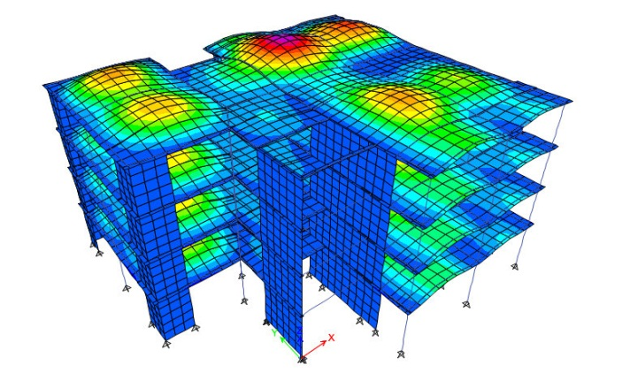
Structural Analysis
ETABS model checks:
1- Compatibility check

Slide 34
Structural Analysis
2- Equilibrium check
Error% | Manual(KN) | ETABS(KN) | load
0.20 | 15100 | 15130 | live
0.87 | 18547 | 18710 | SID
1.10 | 33394 | 33764 | dead

Slide 35
Structural Analysis
3- Internal force check
Columns
Error (%) | ETABS reading (kN) | total load manual (kN) | # of stories | wu load (kN/m2) | Area | Column Label | Floor
3.6 | 4197 | 4350 | 4 | 19.7 | 43 | C18 | First
2.1 | 4854 | 4958 | 4 | 19.7 | 52 | C 9 | First
0.4 | 1213 | 1220 | 4 | 19.7 | 10 | C 13 | First
Beams
Error (%) | Mu ETABS (kN.m) | length(m) | Mu (kn.m) | width(m) | Total Wu | Wu load (kN/m2) | Beam
1.1 | 915 | 8.16 | 925 | 7.55 | 160.7 | 19.7 | Beam 11
3.4 | 1217.7 | 9.14 | 1259 | 8.27 | 175 | 19.7 | Beam 34
-6.7 | 1140.4 | 8.34 | 1063 | 8.4 | 177.5 | 19.7 | Beam 19

Slide 36
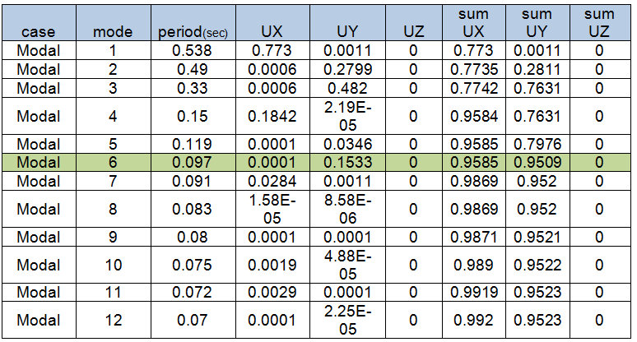
Structural Analysis
Seismic design checks:
1- Modal mass participation ratio

Slide 37
Structural Analysis
2- Time period check.
Time period for part one = 0.54 second < 0.59
Time period for part two = 0.57 second < 0.59
T method "A" = Ct*(hn)^{3/4} ,where Ct =0.0488
  T= 0.0488*(17.9)^{3/4} = 0.424 second.
T method "B" =1.4* T method "A"= 0.594 second .

Slide 38

Structural Analysis
3- Base shear check
Building weight = 56014 KN.
Manual base shear= 9166 KN.
Scale factor for X= 2286.
Scale factor for Y= 3175.

Slide 39

Structural Analysis
4- Drift check
Drift limitation=0.025*H, if T< 0.7
ΔM=0.7*R*ΔS .
ΔS= Ux2-Ux1.

Slide 40

Structural Analysis
Slab system:
Two way solid slab with 25 cm thickness.

Slide 41

Structural Analysis
Beams system:
Drop and hidden beams.
Hidden

Slide 42
Structural Analysis
Beam | Width (cm) | Depth (cm)
B1 | 50 | 80
B2 | 50 | 40
B3 | 50 | 25
B4 | 25 | 60
B5 | 20 | 60
B6 | 50 | 80
B7 | 50 | 80
Beams dimensions used in building.

Slide 43


Structural Analysis
Beam Reinforcement

Slide 44


Structural Analysis
Columns system:

Slide 45

Structural Analysis
Footing system:
The foundation system used is hollow mat with 800 mm depth.

Slide 46

Structural Analysis
Shear walls:
Shear walls distribution
is as follow:

Slide 47

Structural Analysis
Shear wall Reinforcement

Slide 48

Structural Analysis
Stair case

Slide 49

Structural Analysis
Section A-A reinforcement

Slide 50

Structural Analysis
Section B-B reinforcement

Slide 51

Structural Analysis
Seismic joint:

Slide 52




Structural Analysis
Openings reinforcement:
Beam – column joints.
Non-structural elements
(stone fixing(.

Slide 53

Electrical design

Slide 54

Electrical design
socket design
Room | No. of sockets required | Sockets for HVAC system
Music room | 18 | 1

Slide 55





Electrical design
Painting room DIALux evo result:
Thorn Cetus LED
Thorn Beta Office LED

Slide 56

Electrical design
Lighting and Switches distribution

Slide 57




Electrical design
Movable partition
Multi purpose room SPEAKERS
LS1 corned speaker

Slide 58



Electrical design
Multi purpose room SPEAKERS
Movable partition
Extron CS 1226t Ceiling speaker
Speaker

Slide 59

mechanical design
DRAINAGE SYSTEM

Slide 60

mechanical design
WATER SYSTEM

Slide 61

mechanical design
Elevator:
Otis elevator with dimension off (1.4*1.7m)
675 Kg | Capacity
1.5 m/s | Speed
9 person | Number of passengers allowed

Slide 62


mechanical design
Heating ventilation and air conditioning systems (HVAC )
VRV SYSTEM
And Split unit
Ground floor
First floor

Slide 63
mechanical design
Heating ventilation and air conditioning systems (HVAC )
VRV SYSTEM
floor | Fan coil Number. | Fan coil Design capacity (KW) | Design flow rate (Lps) | Number of cassette units | zones
Ground floor | 1 | 11 | 840 | 6 | Exhibition
 | 2 | 7 | 600 | 6 | Reception and lobby
 | 3 | 4 | 240 | 2 | Corridor
 | 4 | 9 | 600 | 5 | Corridor
 | 5 | 11 | 600 | 8 | Jem
 | 6 | 4 | 300 | 6 | Music room
 | 7 | 5 | 300 | 6 | Painting room
 | 8 | 4 | 300 | 6 | Multipurpose
 | 9 | 4 | 300 | 6 | Multipurpose
 | 10 | 7 | 560 | 8 | cafeteria
First floor | 11 | 12 | 800 | 6 | Library
 | 12 | 6 | 400 | 4 | Corridor
 | 13 | 11 | 600 | 6 | Corridor
 | 14 | 6 | 450 | 6 | Office Corridor & office2 & kitchen
 | 15 | 14 | 840 | 8 | Administration & office4 & conference
 | 16 | 10 | 780 | 6 | Computer room
 | 17 | 9 | 600 | 6 | Learning room2
 | 18 | 7 | 500 | 6 | Student lobby
 | 19 | 9 | 600 | 6 | Learning room3
 | 20 | 9 | 600 | 6 | Learning room1

Slide 64








mechanical design
Fire protection
2.FM 200
1.Hose station
3. Fire sprinkler
4. Fire extinguisher

Slide 65


mechanical design
Smoke sensor system.

Slide 66

Emergency exits

Slide 67

mechanical Analysis
Solar PV system:

Slide 68




mechanical design
Solar PV system:
System productivity
System productivity=
75% of building needs

Slide 69
Quantity surveying.
Final BOQ
Number | Descriptions | Total (NIS)
1 | Earth work | 30,810
2 | Concrete and steel | 1,127,050
4 | Finishing work | 1,887,974
5 | Mechanical | 851,146
6 | Electrical | 763,431
Total Cost (NIS) |  | 4,660,410
Total building area = 2654 m².
Total coast of the project = 4,660,410 NIS.
Cost / area = 4,660,410 / 2654 = 1760 NIS/ m².
Total coast without solar system = 3,935,410 NIS.
Cost / area =3,935,410 / 2654 = 1480 NIS/ m².

Slide 70

Thank you for listening

