Slide 1

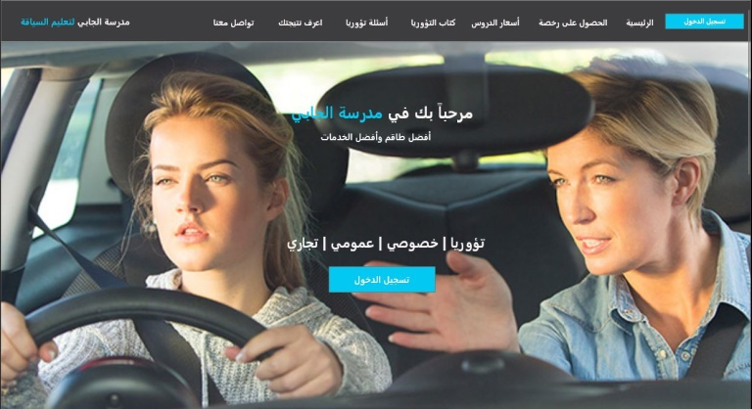
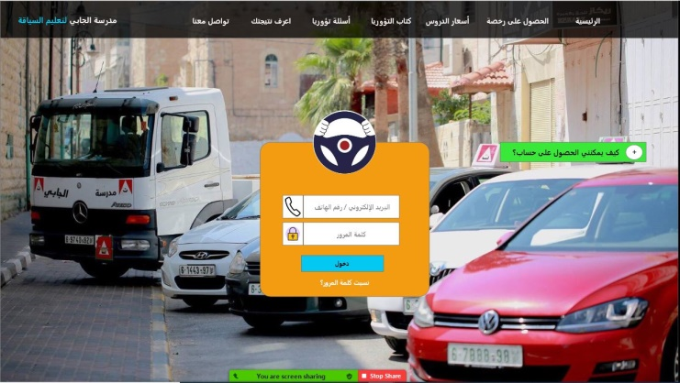
“Computerizing Driving License & Management System in Palestinian Schools”
Prepared by:
Khaleel Thaher Mousa
Mohamad Jawdat Al-Jabi

Slide 2
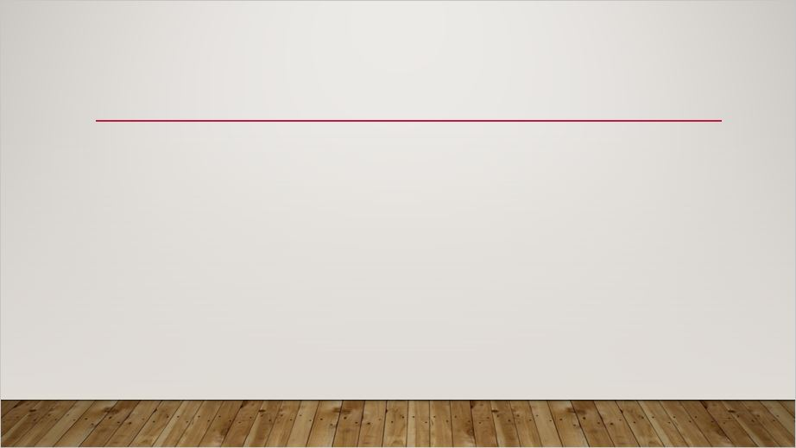



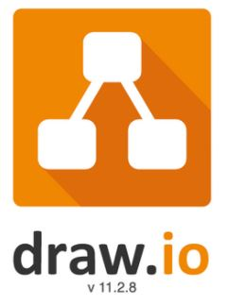

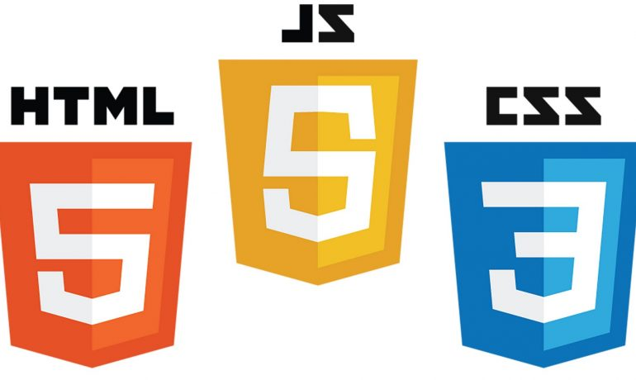


Tools Used in DLMS Project

Slide 3
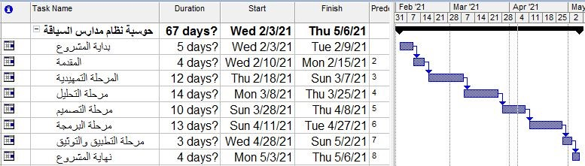
Action Plan for DLMS

Slide 4
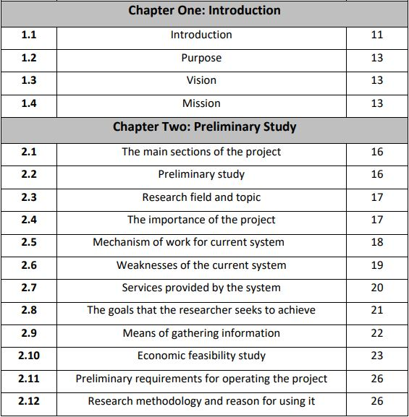
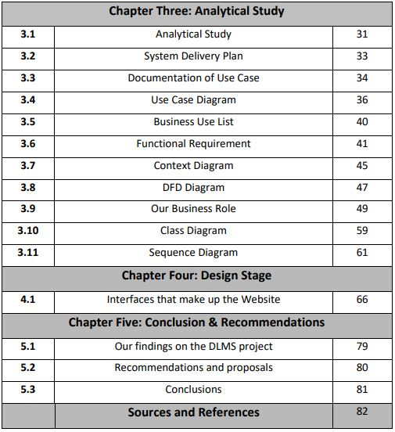

Slide 5
Table of Content

Slide 6
Introduction
Driving schools operate under the supervision of the Ministry of Transport.
The school offers its services to students who have passed the entry requirements.
License type | Lesson Price Per Shekels
Private degree “B” | 90
Light weight truck t degree “B1” | 110
Heavy weight truck degree “B” | 160
Taxi degree “D1” | 90
Bus degree “D” | 160
Trilla “E” | 160
Motorbike “A” | 90

Slide 7
Overview of the DLMS Project
Aims to analyze the mechanism of process of driving schools in Palestine in order to be able to identify the problems and weaknesses they face.
Our purpose is solving problems in the old system.
We solved problems by developed new system will minimize weaknesses that satisfied beneficiaries (students & driving school).

Slide 8

If Schools Will Use DLMS What Will Happen?
The school will be first mover, because all driving schools follow the old system.
DLMS will provide driving schools competitive advantages, and consumes their resources effectively & efficiently.

Slide 9
Gathering information methods
Observation: It was through visits to driving schools, watching the work process, taking notes and documenting it.
Interviews: visit work positions to some driving schools in the Nablus & Ramallah, Al-Jabi Driving School, Al-Manar, ….

Slide 10
Mechanism of Work for Old System
The student goes to the school to query about registration process.
After the admission procedures, the academic examination, etc., the student begins to take practical lessons.
The reservation process is done by attending the school or calling the trainer.
The number of lessons and payments are documented manually on paper.

Slide 11
Mechanism of Work for Old System
After completing the required number of lessons and ready to drive, he takes the practical test.
If he succeeds, he gets a driver's license. If he does not, he must take new practical lessons for at least five lessons.

Slide 12
Problem in the Old System
The process matters inside the school are slow and take a long time, which leads the student to search for a school where the processes are easier and faster.
Problems between the student and the trainer due to an error in the lessons and payments statistics.
Timing conflicts for trainers lessons.
Unavailability of work performance report and statistics.

Slide 13
Problem in the Old System
The student doesn’t know what cars, trainers are in the school, and their marketing reputation.
Sometimes the student hears about a good school, but he doesn’t know its location and how to reach it.
When the student wants to study the To’uriah, he needs the computer, or goes to the school and takes a trial exam.

Slide 14
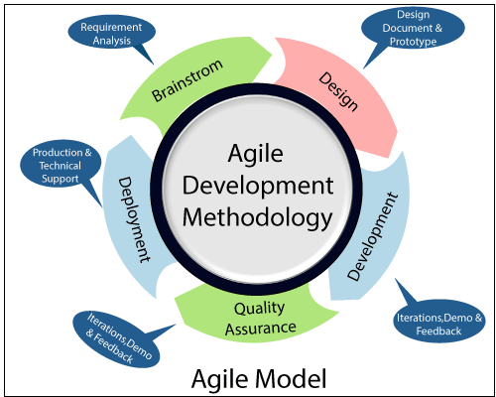
System Development Life Cycle Methodology

Slide 15
Services provided by the DLMS
Go to website: http://jabeschol.000webhostapp.com/
Then to Adobe XD.

