Slide 1

HELLO!
CalmMind
Students:
Dina Mashayekh
Kenana Turabi
Supervised by Dr. Ashraf Armoush
‹#›
‹#›

Slide 2
ROADMAP
Introduction
Technologies
Future work
1
3
5
2
4
Types of users
Features

Slide 3
Introduction
Why CalmMind?
It’s a psychology health application that provides a valuable opportunity for online therapy sessions. This feature is particularly beneficial for individuals who may feel hesitant or ashamed about seeking therapy in a traditional clinic setting.
‹#›
‹#›

Slide 4
Patient
Types of users
Specialist
Admin
‹#›

Slide 5
Technologies
Flutter
Open-Source UI Framework For Developing Cross-Platform Applications.
Node js
Node.js is a server-side JavaScript runtime environment that enables efficient,event-driven programming
1
2
MongoDB
MongoDB is a NoSQL database system that stores data in a flexible, JSON-like format
Github
A platform for hosting Git
repositories,
3
4
‹#›

Slide 6

Features
1
2
3
Book therapy sessions
Online therapy sessions
Diagnosis & treatment plan
4
5
Mood tracking
Chats
‹#›

Slide 7

Features
6
7
8
Darkmode
Rooms
Notifications
9
10
Posts
Admin
‹#›

Slide 8
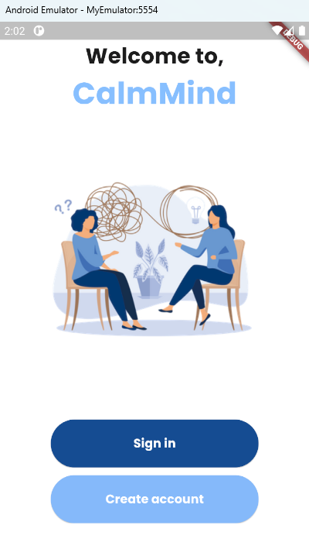
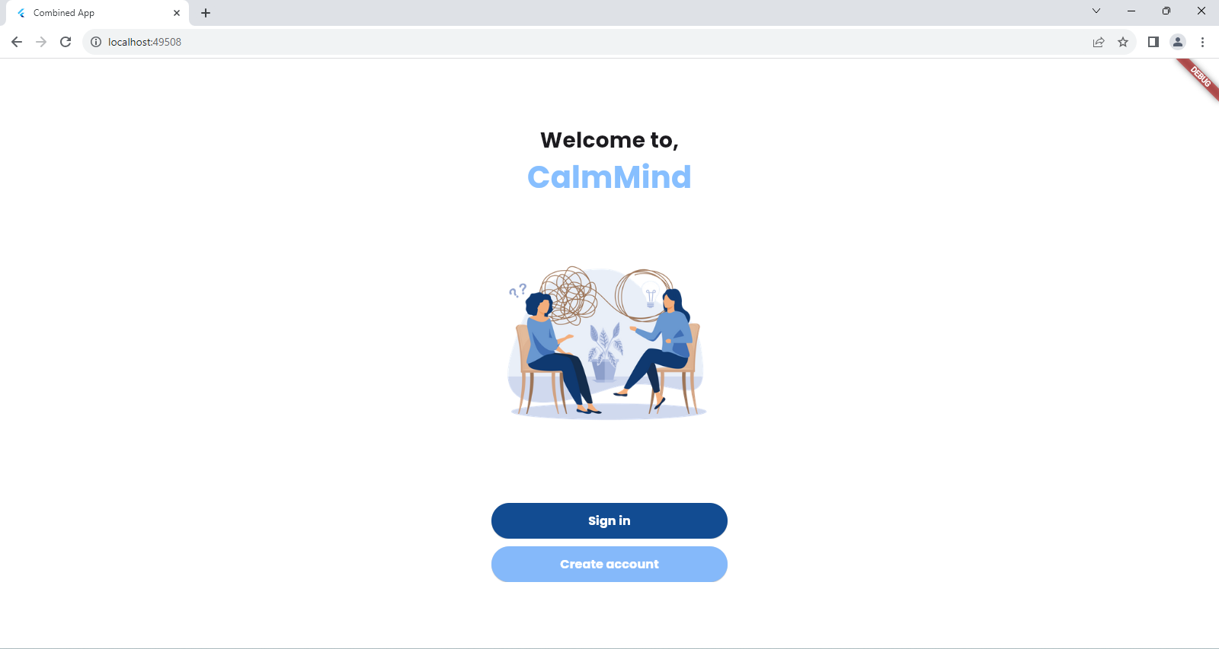

Slide 9
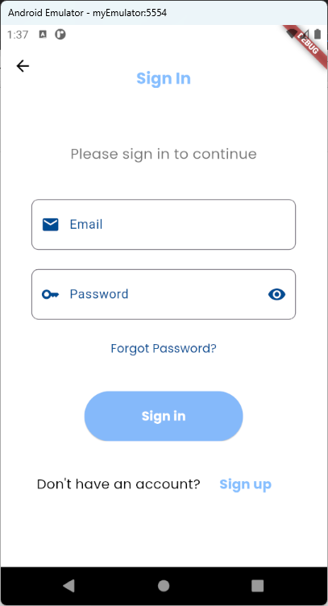
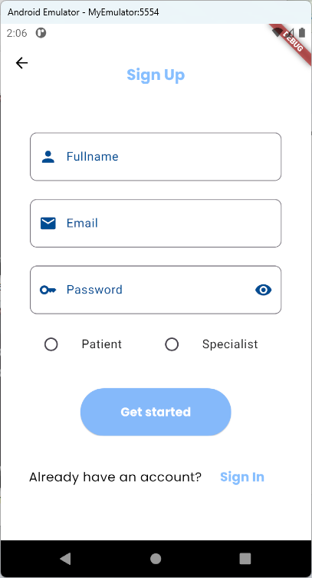
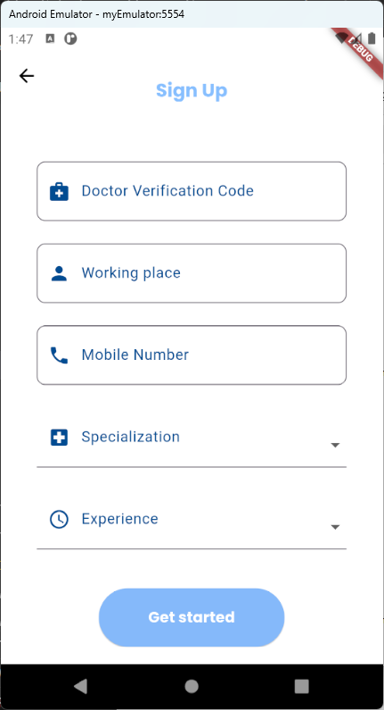

Slide 10
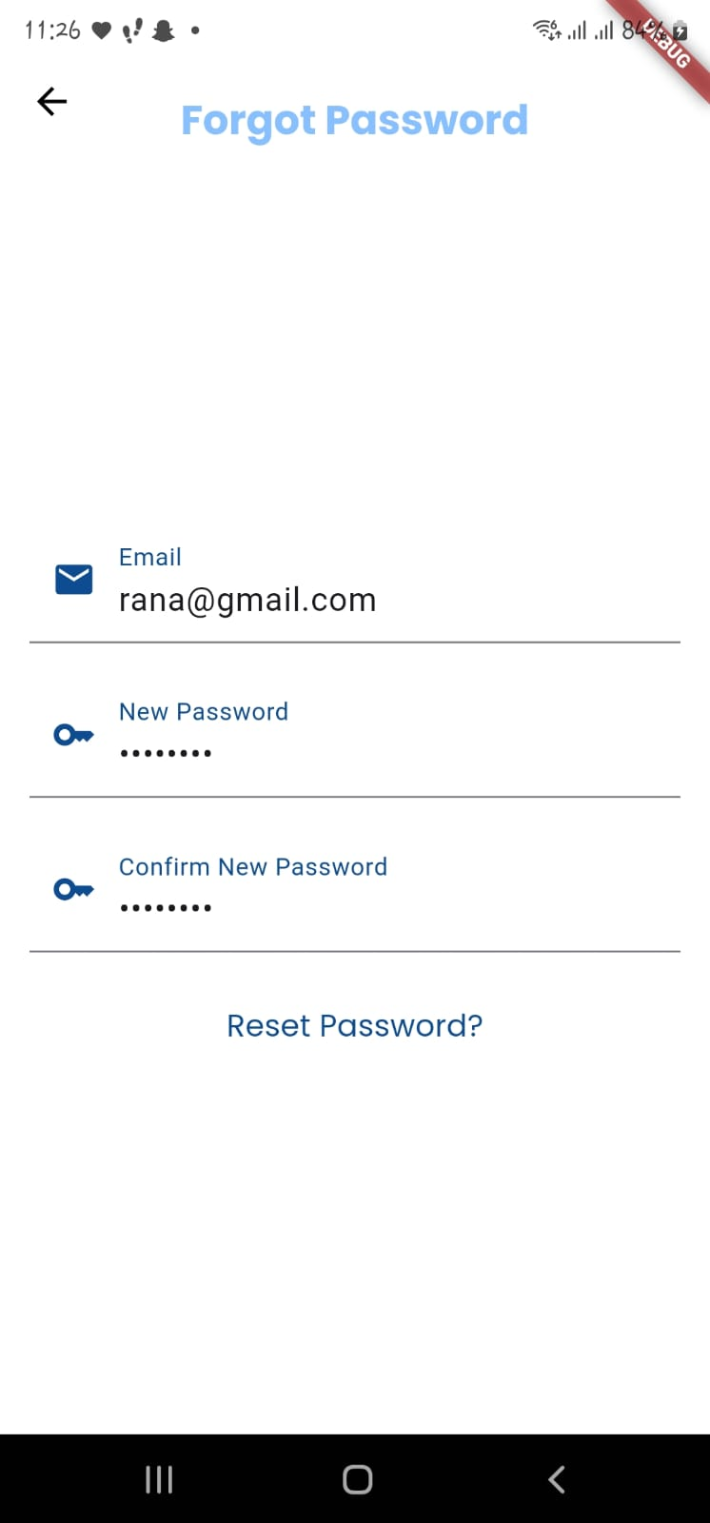
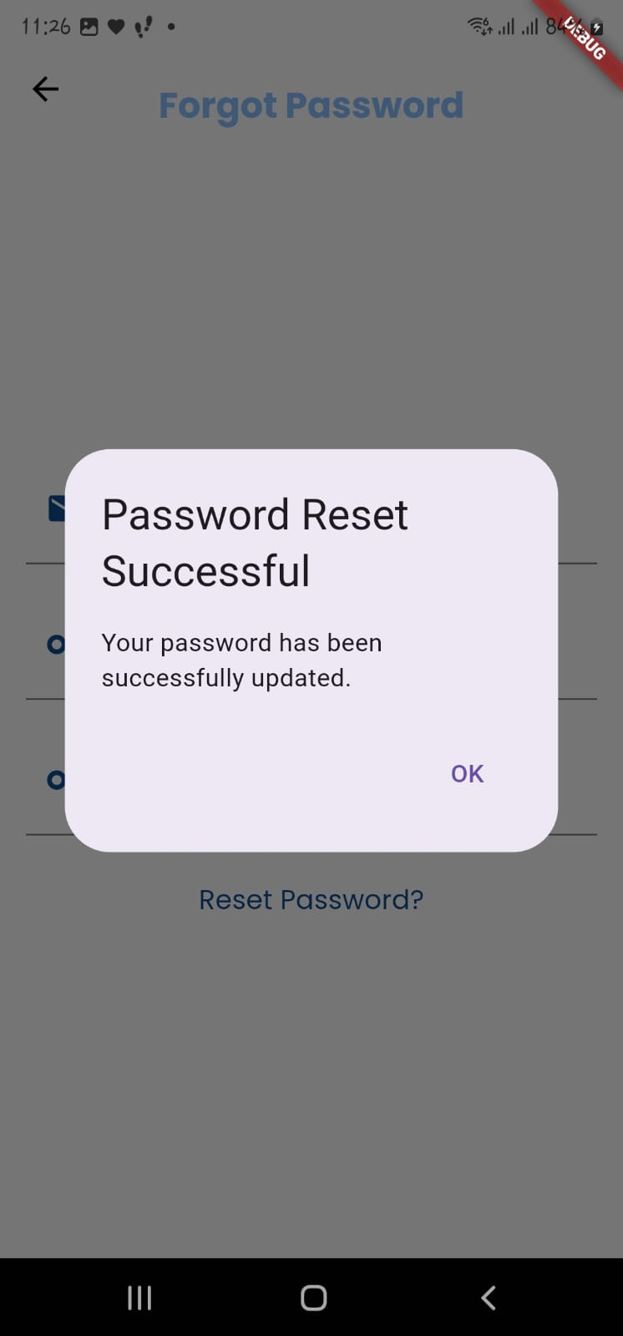

Slide 11
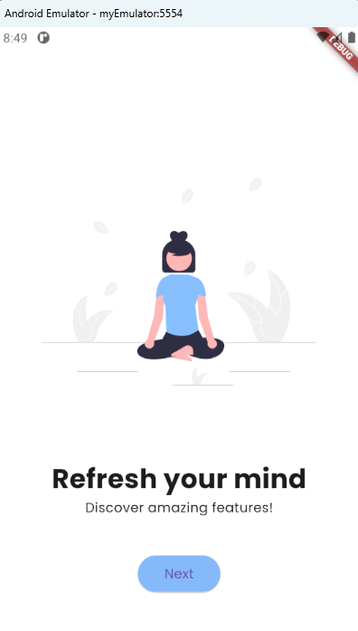
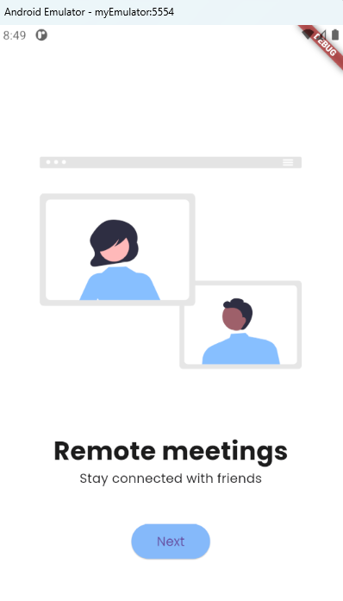
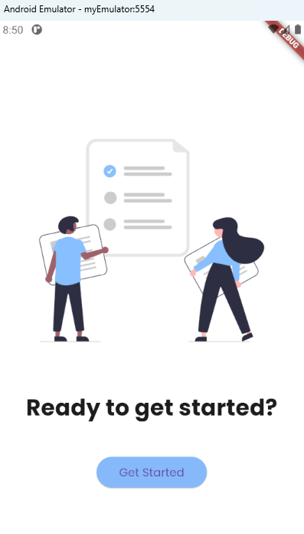
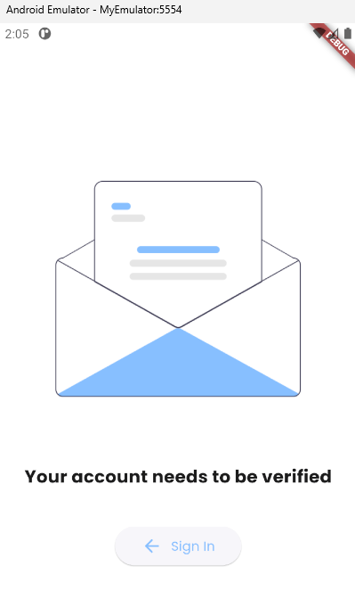

Slide 12
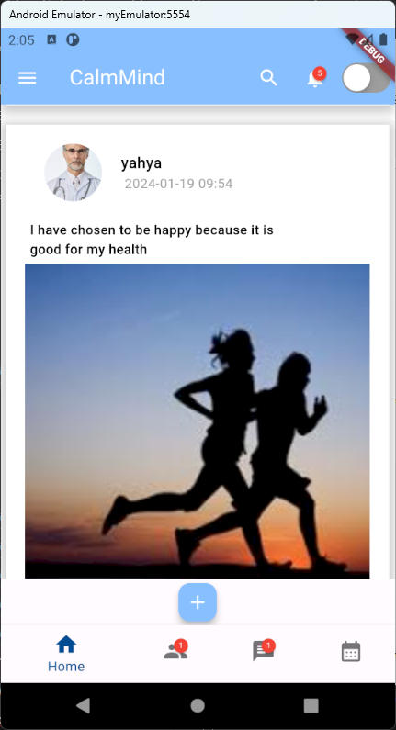
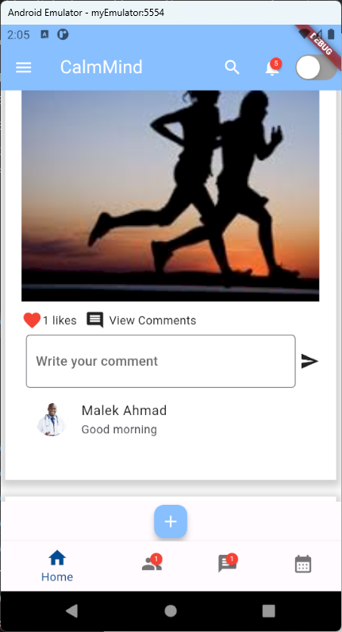
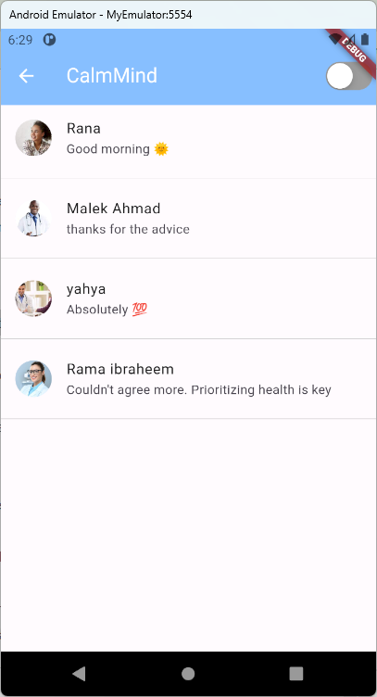
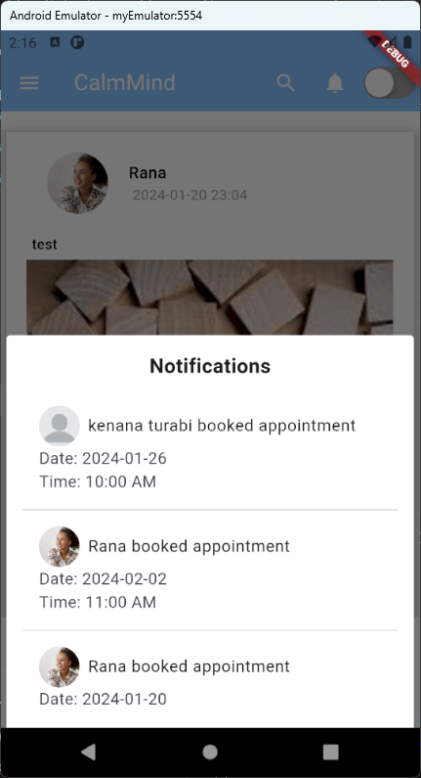

Slide 13
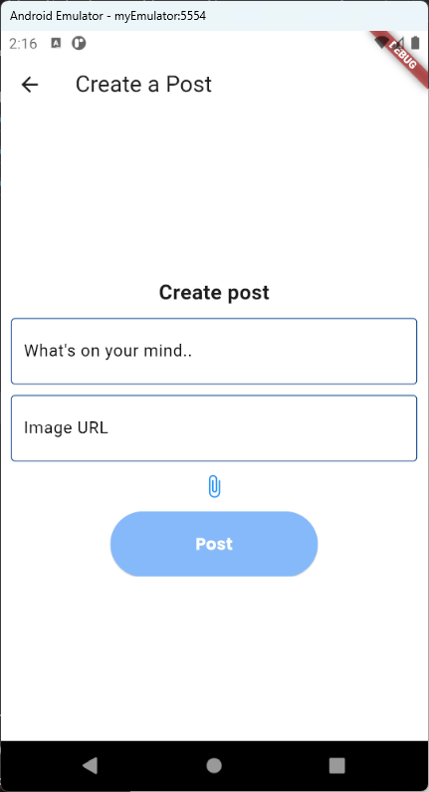
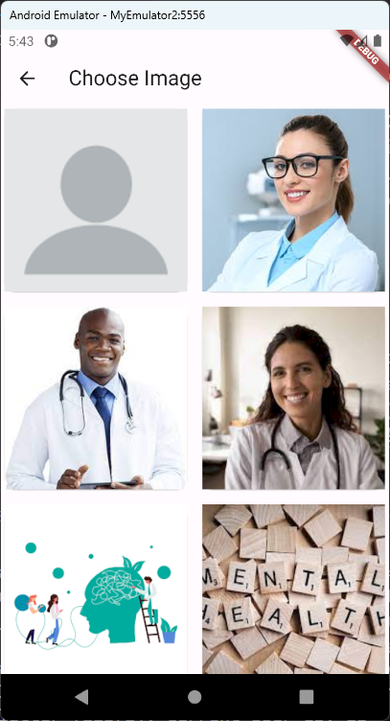

Slide 14
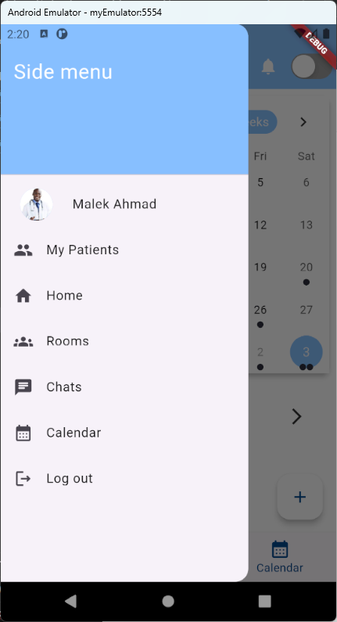
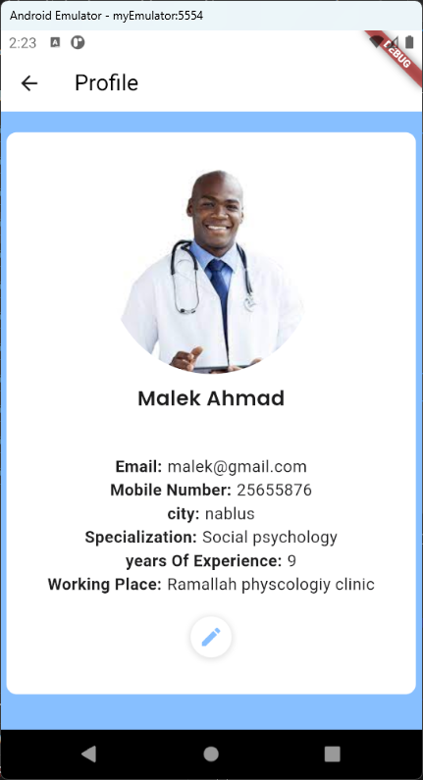
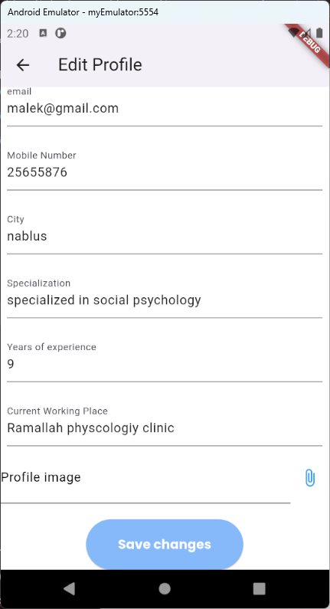

Slide 15
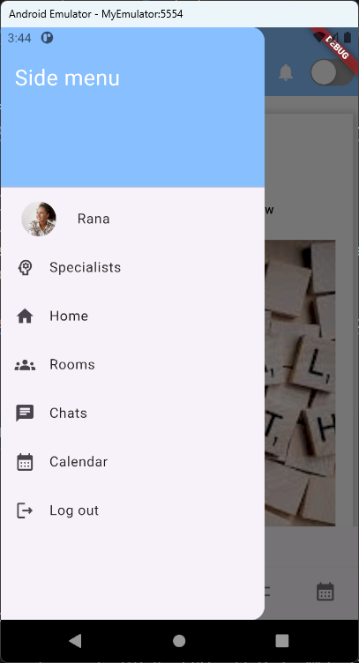
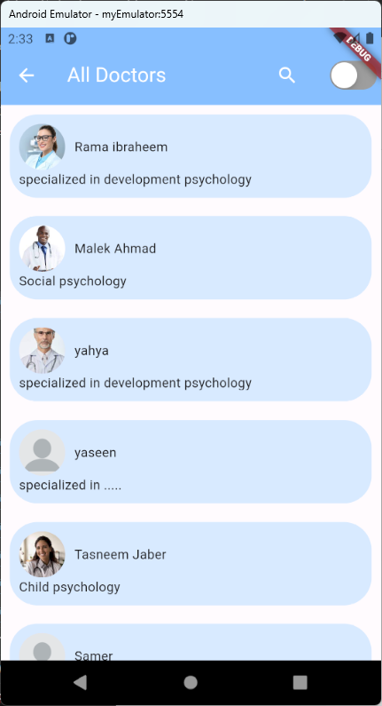
‹#›
‹#›

Slide 16
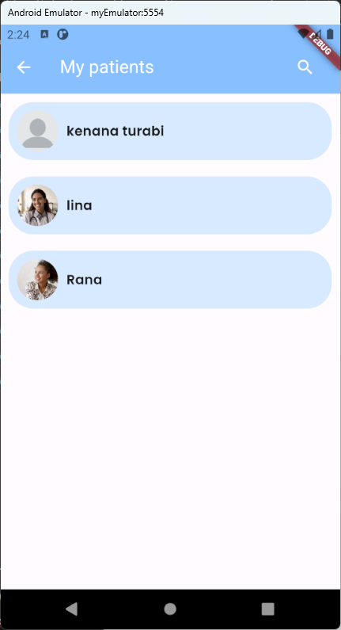
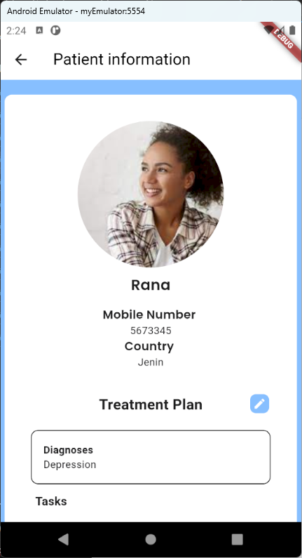

Slide 17
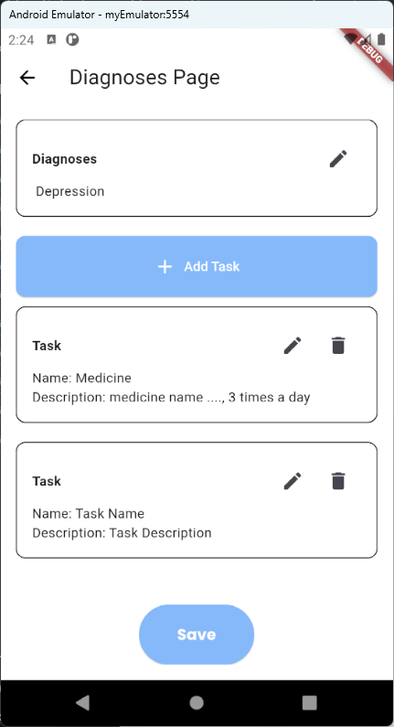
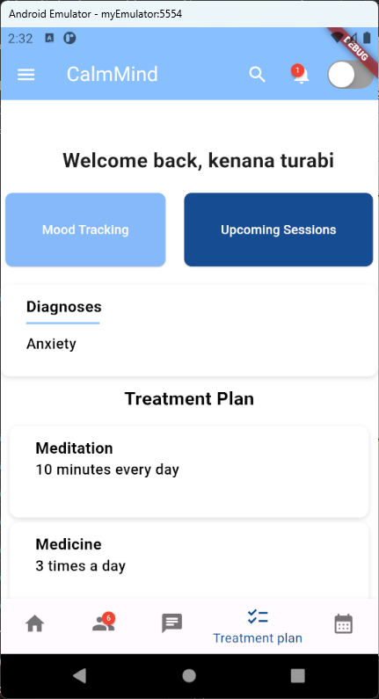

Slide 18
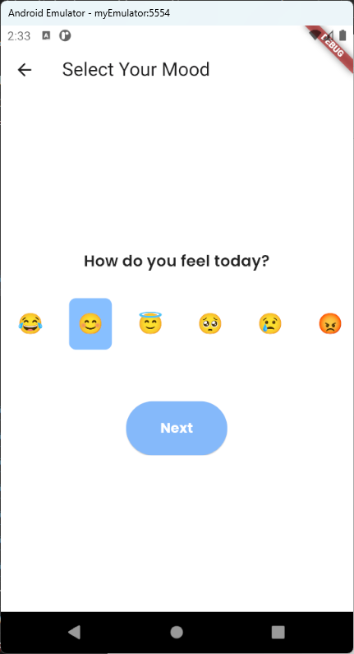
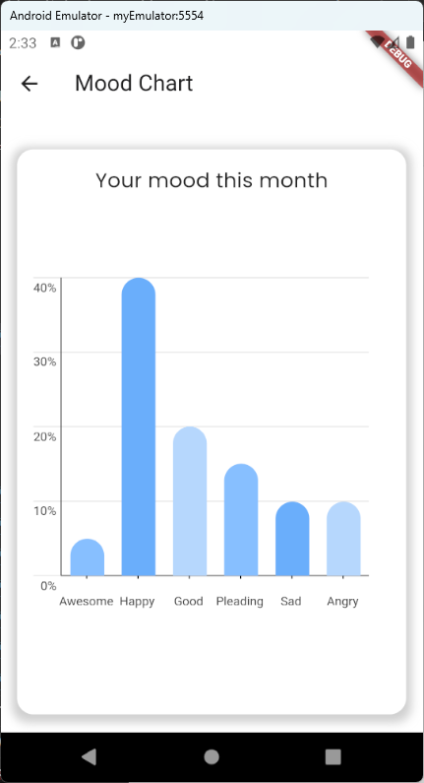

Slide 19
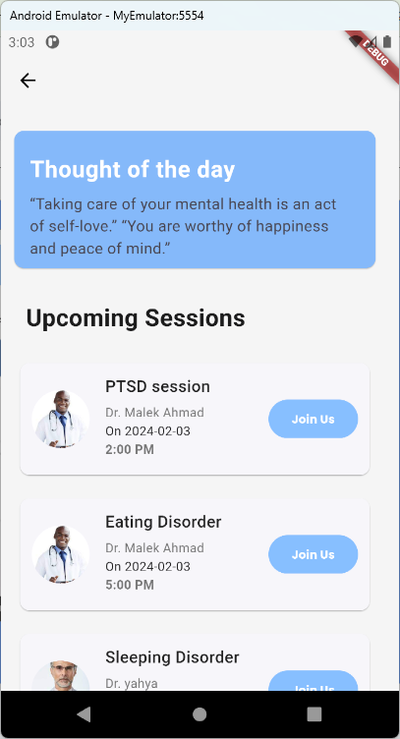

Slide 20
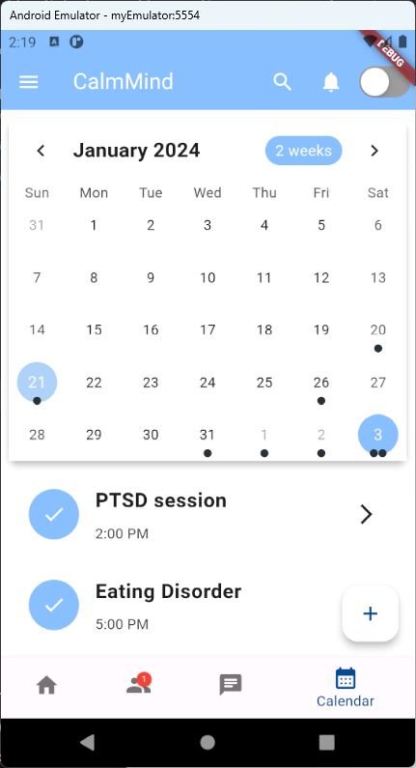
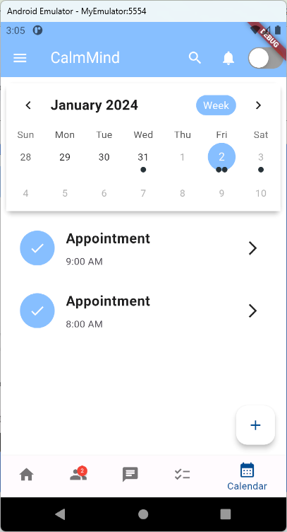
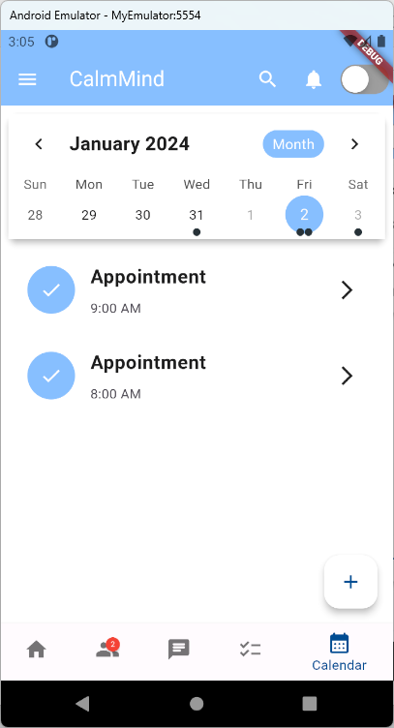

Slide 21
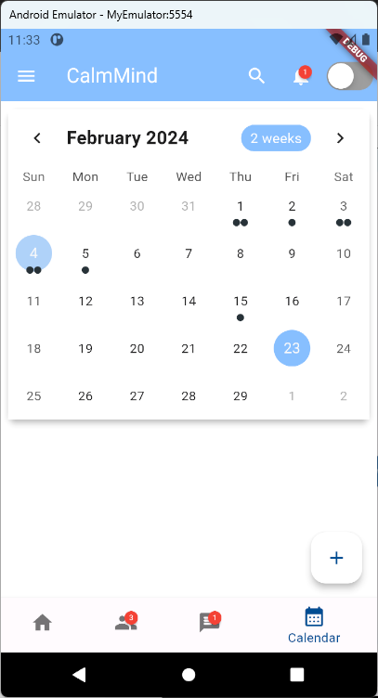
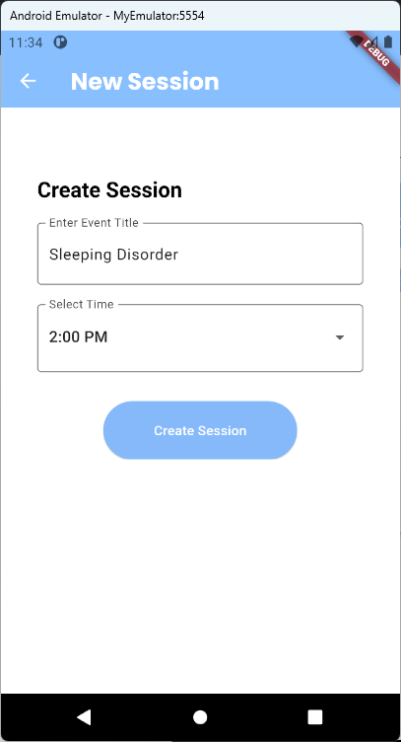
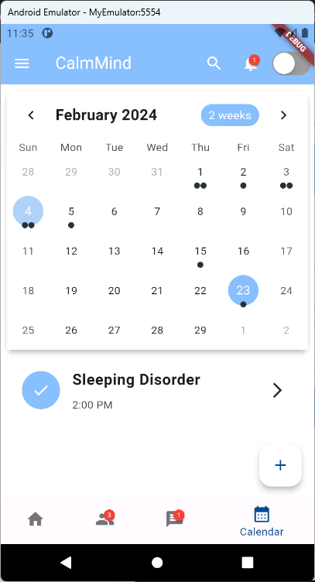

Slide 22
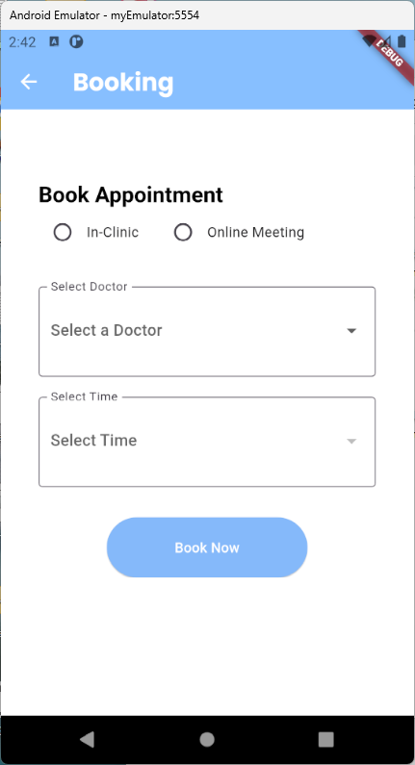
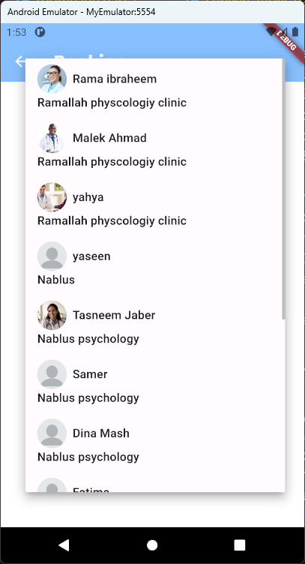
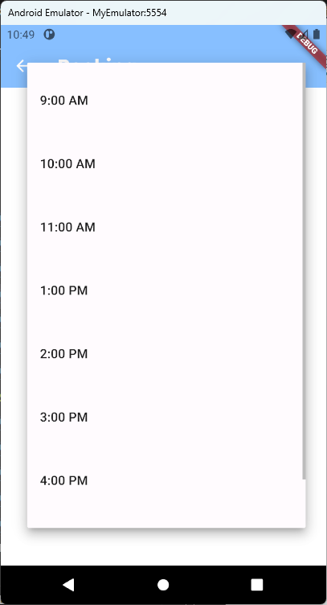

Slide 23
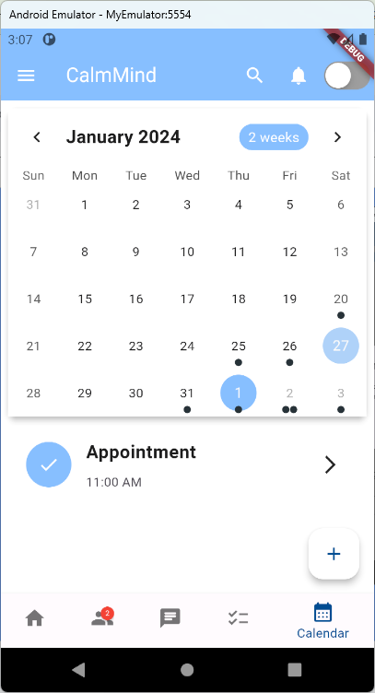
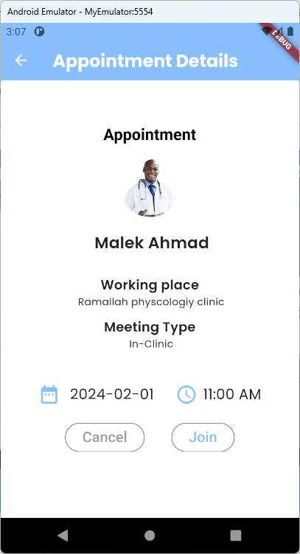
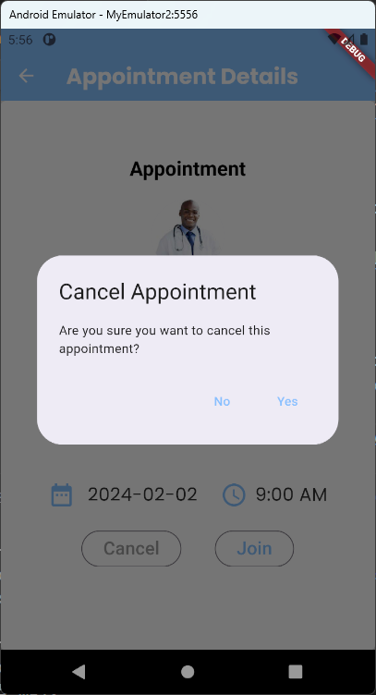

Slide 24
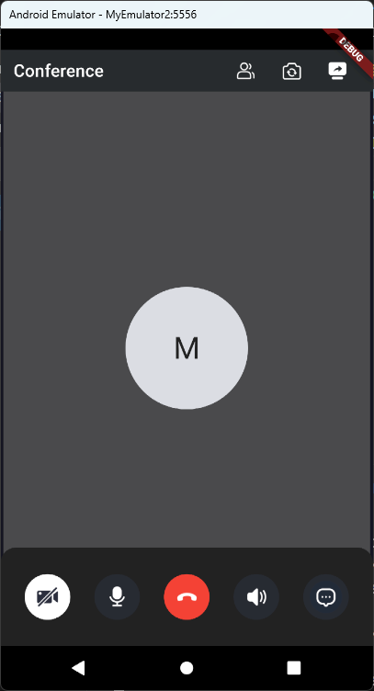
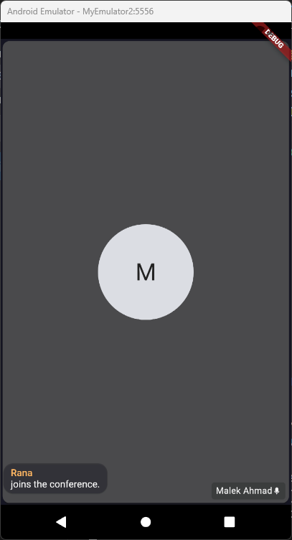
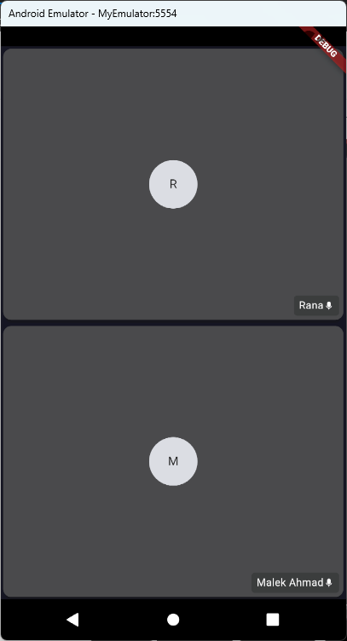

Slide 25
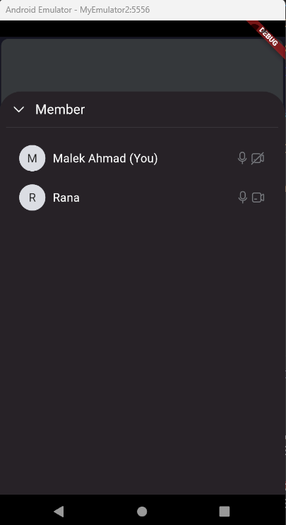
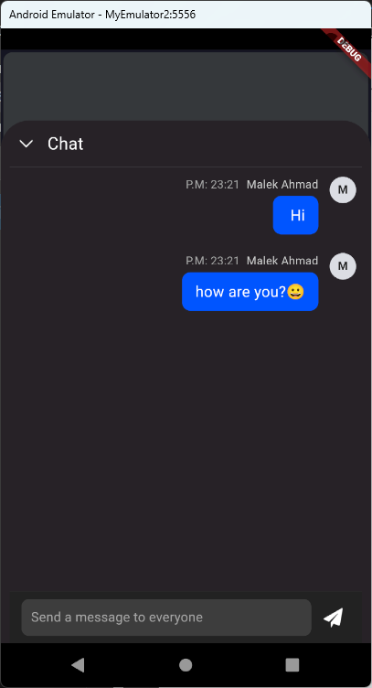

Slide 26
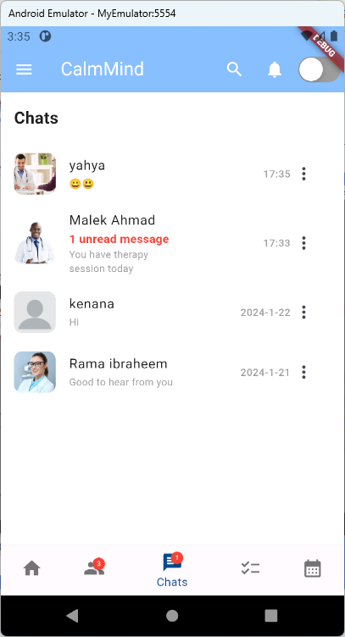
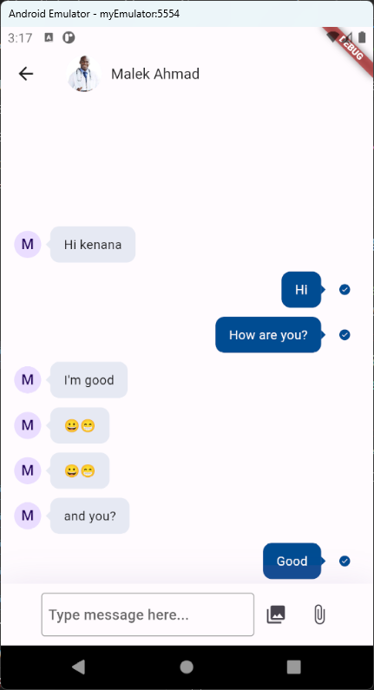
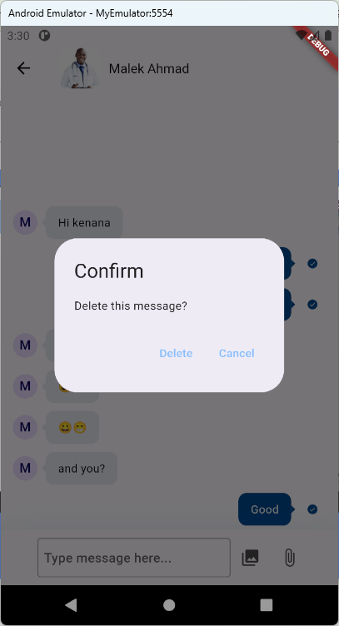
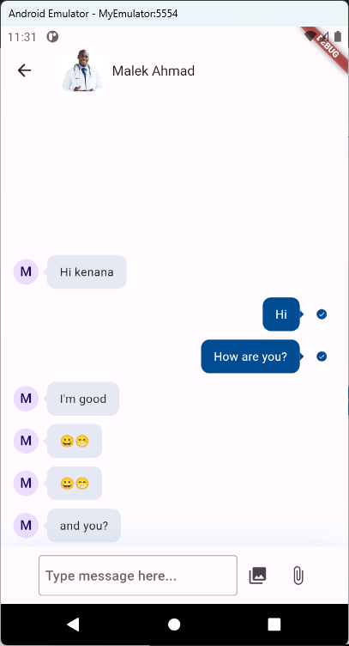

Slide 27




Slide 28





Slide 29




Slide 30



‹#›
‹#›

Slide 31



‹#›
‹#›

Slide 32


Slide 33


Slide 34


Slide 35


Slide 36


Slide 37


Slide 38


Slide 39


Slide 40


Slide 41


Slide 42


Slide 43


Slide 44


Slide 45


Slide 46


Slide 47

‹#›
‹#›
‹#›

Slide 48


Slide 49


Slide 50


Slide 51


Slide 52


Slide 53


Slide 54


Slide 55


Slide 56
Future work
What are we working on for the future?
Expert system
our application should be able to create a treatment plan
Location Services
Users can easily find nearby clinics and therapists, streamlining their journey to seeking the care they need.
‹#›
‹#›

Slide 57
THANKS!
Any questions?
‹#›
‹#›

