Slide 1

Jomi
CodeAnalayzer For Java Language includes many Rules Categories on various Structures
Programmer :
Haneen Qasem Al-Haj Qasem
2009
Jomi.Analyzer@gmail.com

Slide 2
Salam All,
Let’s Begin Our Application Abstraction
Hope Lovely Time ,,

Slide 3
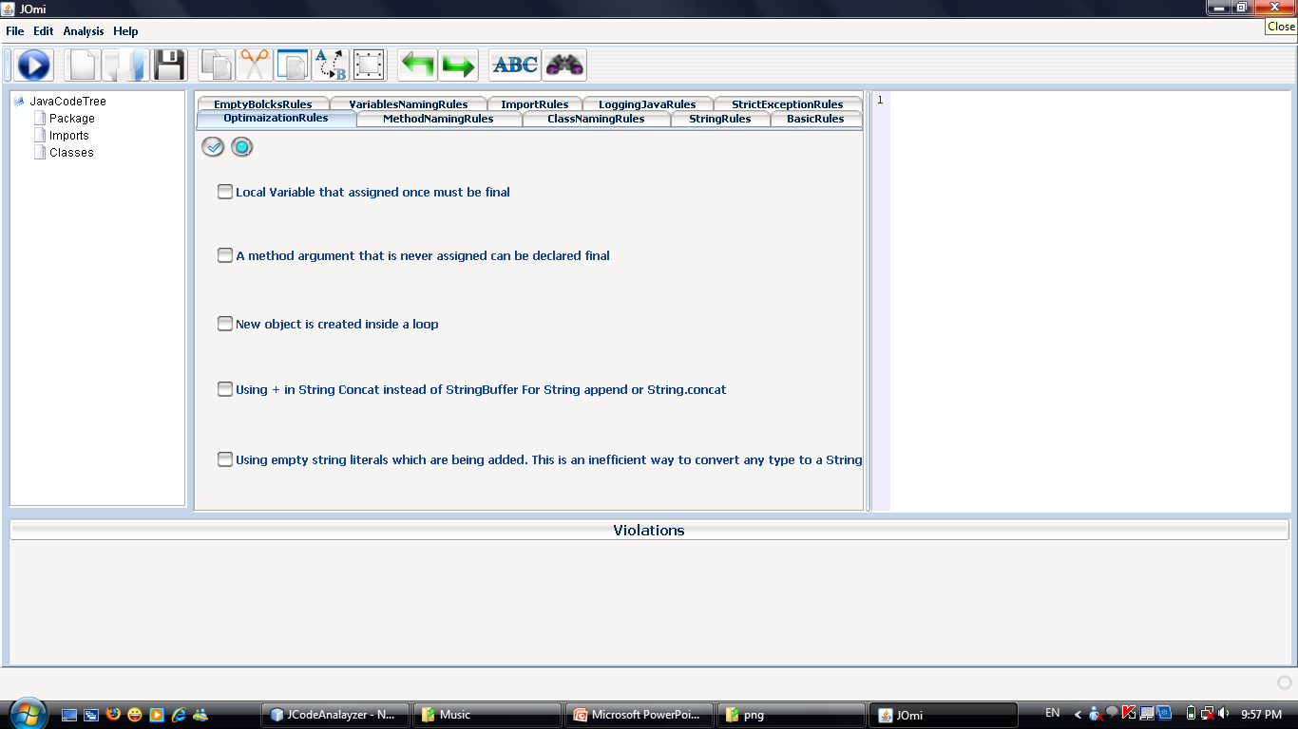
Format and Search Tools
Rules Categories

Slide 4
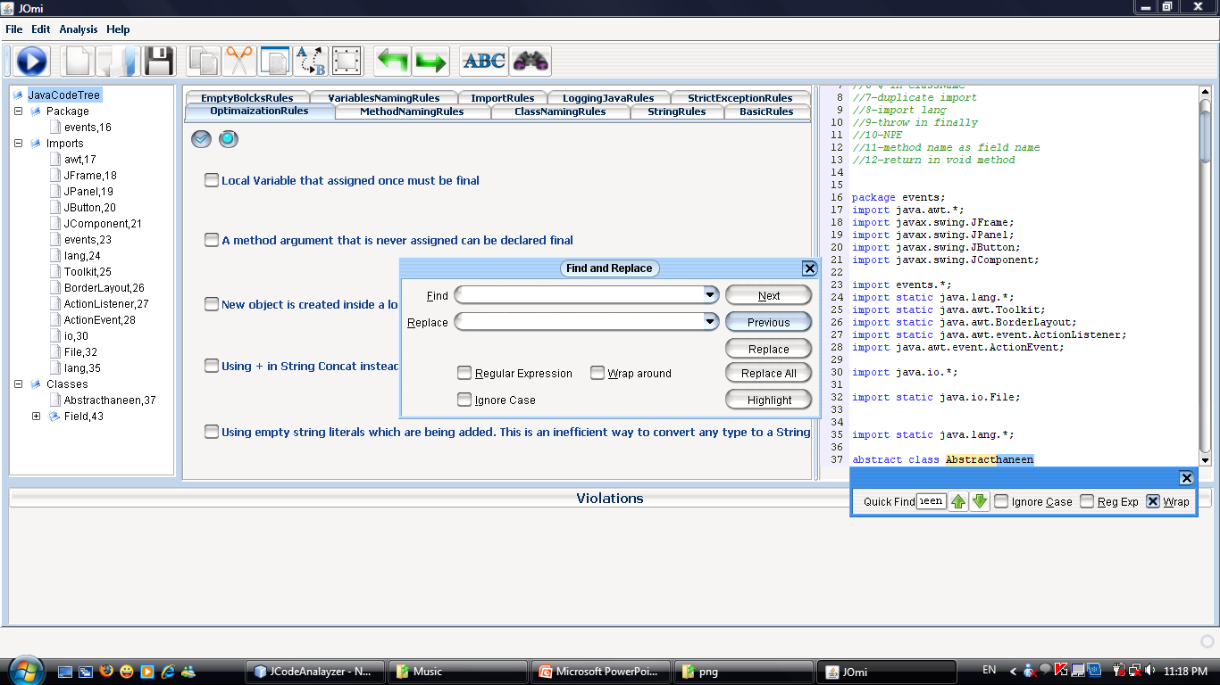
Format and Search Tools
Rules Categories
Search And Replace
Quick Search

Slide 5
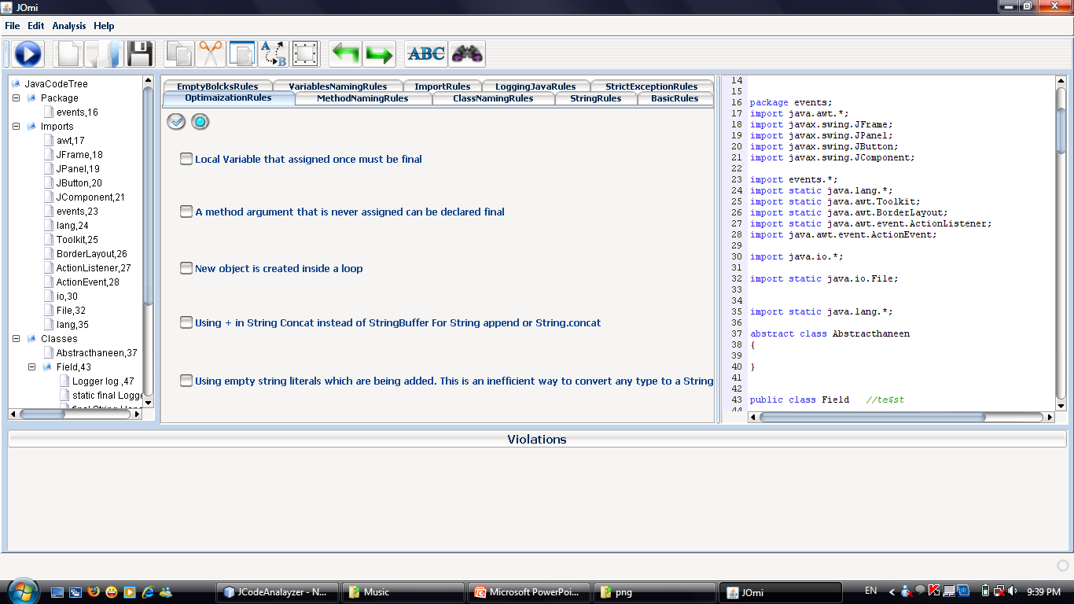
Format and Search Tools
Rules Categories
Code
Tree
Code

Slide 6
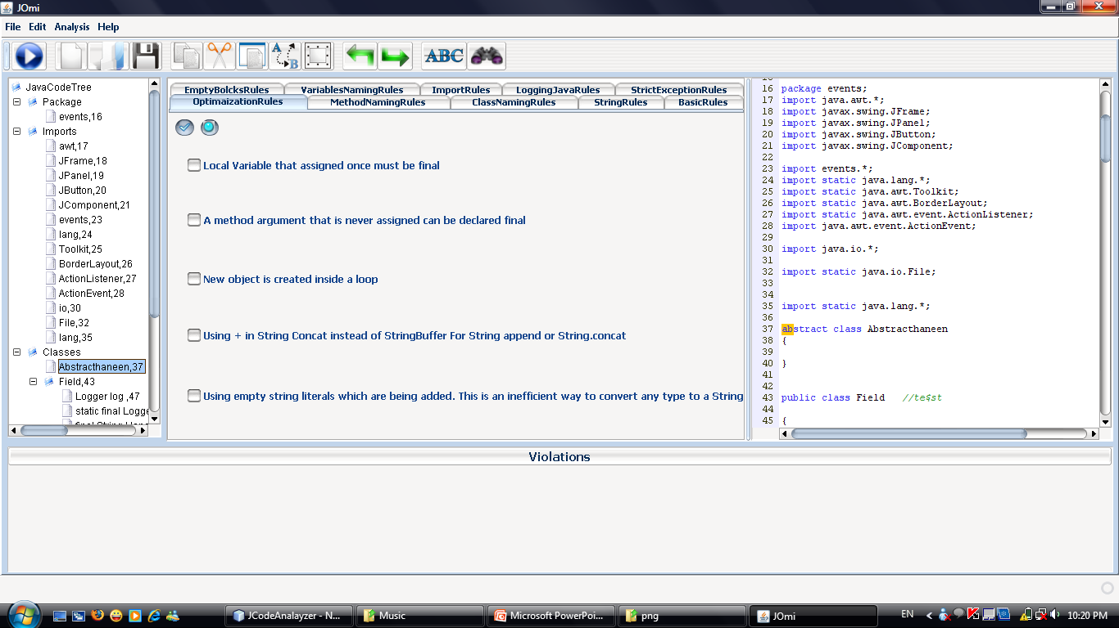
Press on Tree Member
Code Member
Java Code Tree Contains all Code Members …Just Press on any Member then go to code to show it

Slide 7
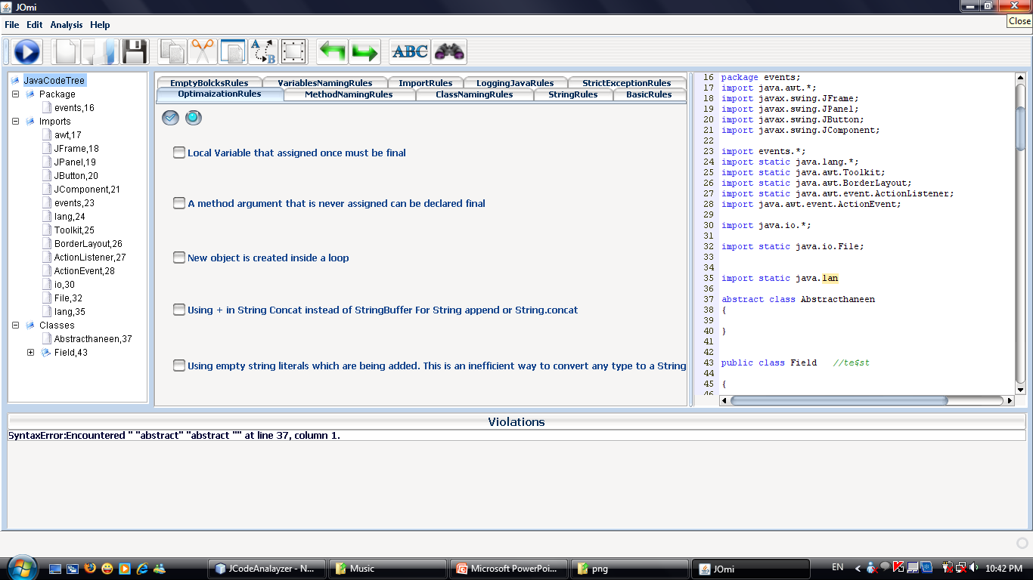
Syntax Error
When You Write Your Code the Application give You the ability to detect Your Syntax Errors immediately…Also when You Click on Error You Can Show the Error on Code
Syntax Error

Slide 8
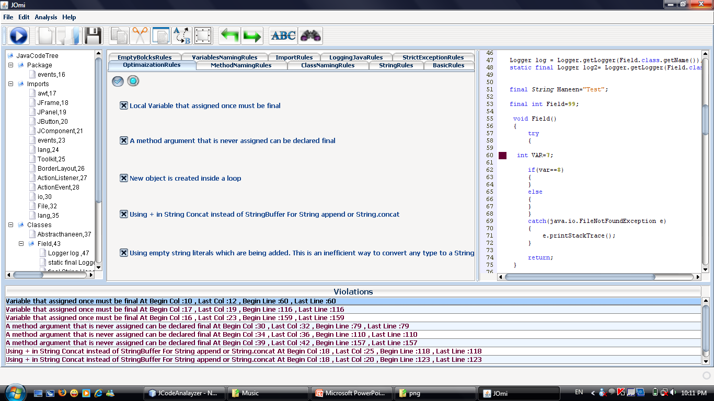
Run
Rule
Location In Code
Choose the Rules You Want to apply on Your Code Form the Rule Categories then press Run Button or F6 key
Then the violations will appear below
Violation

Slide 9
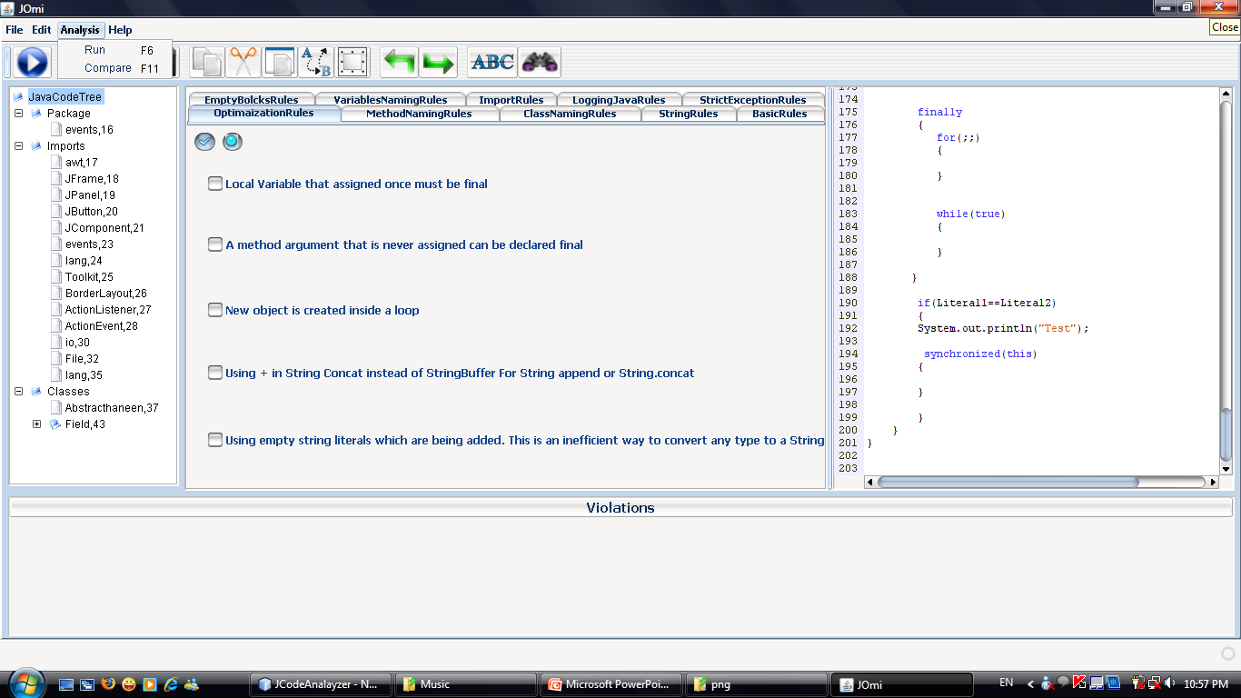
Compare
Between Two Code

Slide 10
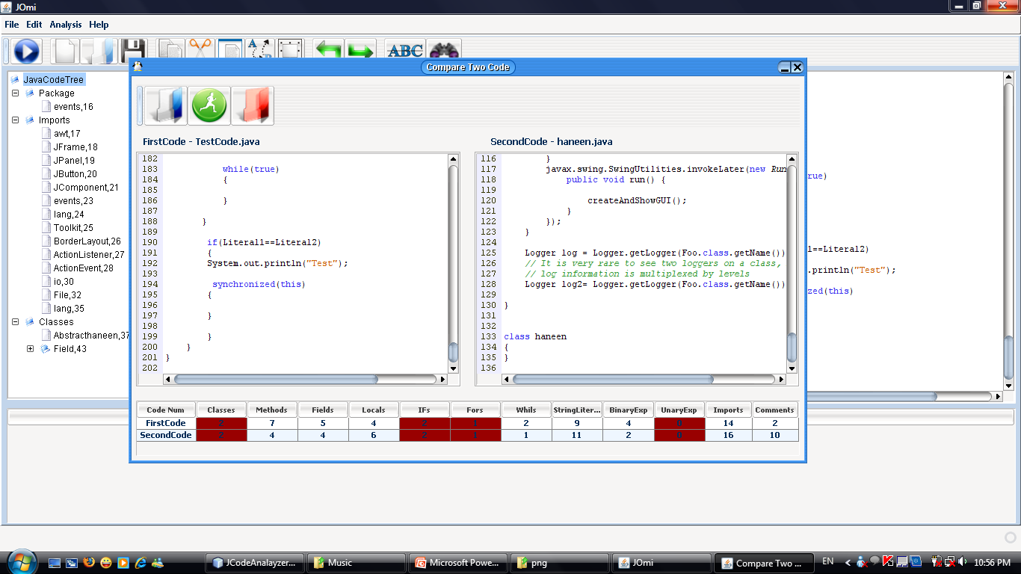
Open First Code And Parse
Open Second Code And Parse
Compare Between Tow Code Strucure Num
Second
Code
First
Code
The Same Structure Num

Slide 11
Best Regards,,
For Any Comments
Please Don’t Hesitate
To Contact With Programmer
Jomi.Analyzer@gmail.com

