Slide 1


An- Najah National University
Faculty of Engineering - Civil Engineering Department
Graduation Project Report I
Structural Reliability Analysis for Live Load Factor Case Study – Al HajeLatifa School
Loay Qabaha
Basel Salama
Under supervision of: Dr. Mahmud M.S. Dwaikat

Slide 2

Outlines:
Introduction
Data Collection & Analysis
Reliability Analysis
Modelling
Summery and Conclusion

Slide 3





Introduction
Problem statement :
The Palestinian agencies are too poor for data that is required for design and analysis in Palestine. So the offices use ACI code for design and it may or may not be suitable for Palestine because its assumptions may not be valid for Palestinian society.
The ACI/ASCE codes use certain value for live load in school classrooms and certain load factors for load combinations. The validity of such values is not established for use in Palestinian society. This idea motivated us to find more appropriate load value and factor which can be used for design, for example used this new factor for redesign some schools in Nablus city.

Slide 4

Objectives:
The prime objective of this study is to determine design value for live load in school classrooms in Nablus that is suitable for design scenarios. Also live load factor to be used in load combinations will be determined through reliability analysis. The scope of this study is the schools in Nablus city- Palestine.
The impact of the new value of live load will be demonstrated through a case study of analysis and design of an existing school building. The study will be based on flexural design of reinforced concrete beams in a typical school building.

Slide 5
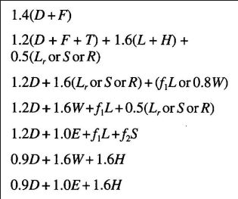
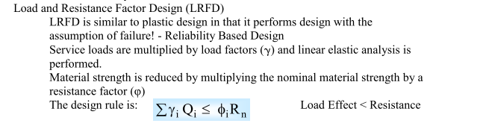
Why LRFD Method
Provides a more rational approach for new designs and configurations.
Provides consistency in reliability.
Provides potentially a more economical use of materials.
Allows for future changes as a result of gained information in prediction models, and material and load characterization
Easier and consistent for code calibration.

Slide 6



Data collection and analysis
Survey Research
Survey research is one of the most important areas of measurement in applied research. The broad area of survey research encompasses any measurement procedures that involve asking questions of respondents and counting according to :
weight of bags , chairs and tables .
weight of students .
Number of students .
Any additional weight in the classroom .

Slide 7

Methodology :
This data was collected from 7 schools in Nablus city to form as total 68 classrooms to satisfy the limitation for the statistical distribution, and this data only for live load as follow:
Al haji latifa secondary school for boys–aljonid
Abdal hameed alsayeh secondary school for boys – rafedia
Jmal almasri secondary school for girls – almakhfia
Omar abdalhadi school –aljonid
Sarem secondary school for boys – almajjen
Mohamad tfaha secondary school for girls –almajjen
Al-Salaheya secondary school for boys –East Nablus
This sample from schools according to site from Nablus to get best distribution and accuracy, this schools have approximately the same area of classrooms 6*8 m² and the grades between “7th to 12^{th.}.

Slide 8
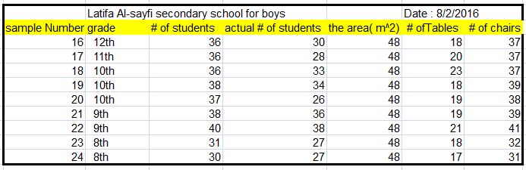
Live load design value
The data was collected from secondary schools from seventh grade to twelve grade as follow example from case study :

Slide 9
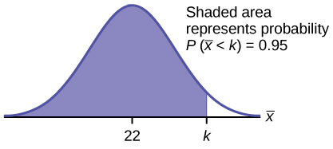
Data analysis
The average weight of the chair and tables were 5 kg and 20 kg respectively, and it was taken from the field study , The average weight of bag was measured in a school and it was about 4 kg.
we went to a group of schools and measured the weights of a sample of about 180 students, after that we did a frequency distribution and took the 95 ^{th} percentile value of the weight for each grade to use it in finding the live load in the classrooms, as follows.

Slide 10
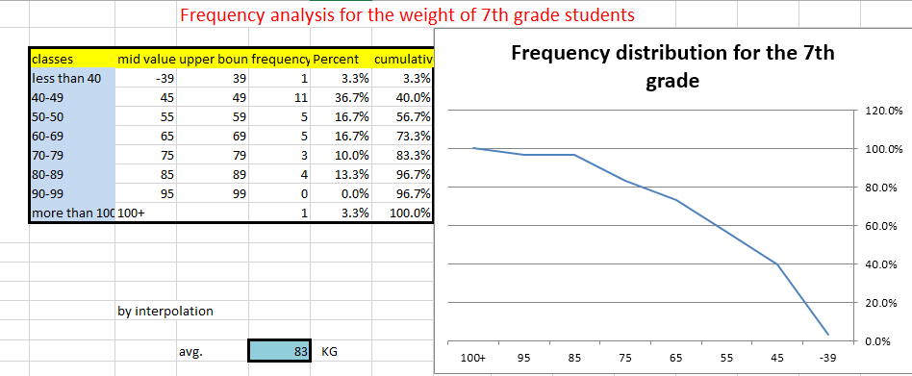
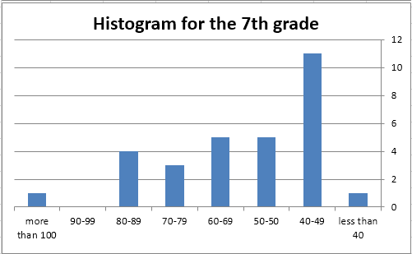
Data analysis

Slide 11
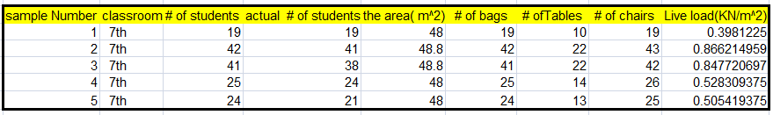

Data analysis

Slide 12
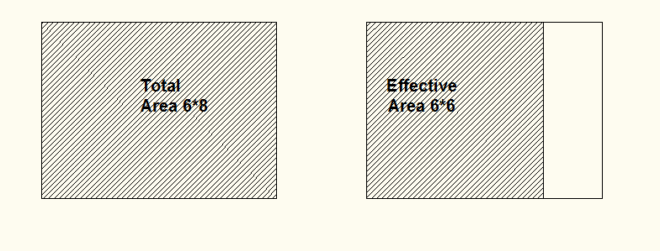
Data Analysis
From this data, we noticed that the maximum live load was about 1 kN/m² and there is a space in the classroom which is not used, so we reduced the total area to the effective area by a factor:
Factor = effective area / total area = (6*6) / (6*8) = 0.75
Or multiply the live load value by 1/0.75 = 1.33
Like this figures:

Slide 13

Reliability analysis
Reliability-based methods have been employed successfully in the development of design codes of reinforced concrete and steel structures In the reliability based limit state design, probabilistic methods are used to guide the selection of load and resistance factors which account for the variability’s in the individual load and resistance parameters.
The design requirement is:
𝛾𝑄m ≤ 𝜙𝑅m
The performance of the system can be thought of as the distance between the two curves in. One method of quantifying this and taking into account all the above variables is to define a reliability index, β.

Slide 14
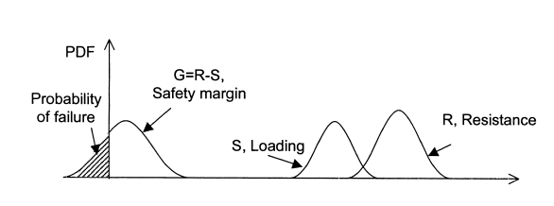
Performance functions
a performance function or failure function, G, can be defined as the resistance minus the loading. The probability of failure refers to the probability that an undesired performance occurs. In addition, both the resistance (R) and the loading (S) are regarded as continuous random variables. Therefore, the failure function:
G = R – S

Slide 15


Performance functions
Structural reliability is measured by reliability index, β, which, for a particular structure, is defined as the inverse of the standard normal distribution function at the probability of failure. Cornell [7] established a relation between β and the statistics of design parameters as follows:
If the reliability analysis focuses on the bending moment of a beam, the performance function is:
In the case of failure, M s >M r (X), leading to the collapse of the beam.

Slide 16

Assumption
In this study, we considered the following variables as probabilistic variables:
Concrete compressive strength, F’c,
Design value = 28 MPa, Normally distributed with mean = 24 MPa and COV = 0.328
Steel yield strength Fy
Design value = 420 MPa, Normally distributed with mean = 410 MPa and COV = 0.05
Live load
Design value = 1.3 kPa, Normally distributed with mean = 0.95 kPa and COV = 0.2
Dead load
Design value = 5 kPa, Normally distributed with mean = 4.7 kPa and COV = 0.2
Beam Span
Design value = 6 m, Normally distributed with mean = 6 m and COV = 0.05
Model uncertainty for flexural resistance
The uncertainty in the flexural formula is neglected at this stage. It will be considered later .

Slide 17
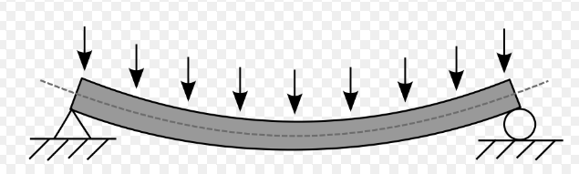
Performance function
Equations for Phi Mn, and Ms :
Ms = W_{u}*(L)² /8
W_{u} = Alpha D + Alpha L
Phi Mn = 0.9*Rho*Bw*(D)^2*Fy*(1-0.59*Rho*Fy/Fc);
Rho=(0.85*FcAv/FyAv)*(1-sqrt(1 2.36*MuAv/(0.9*FcAv*Bw*(D)^2)));

Slide 18
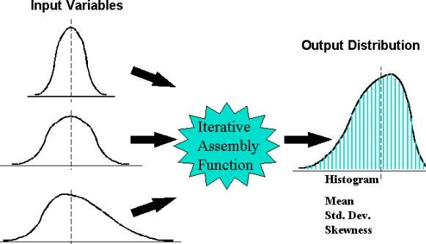
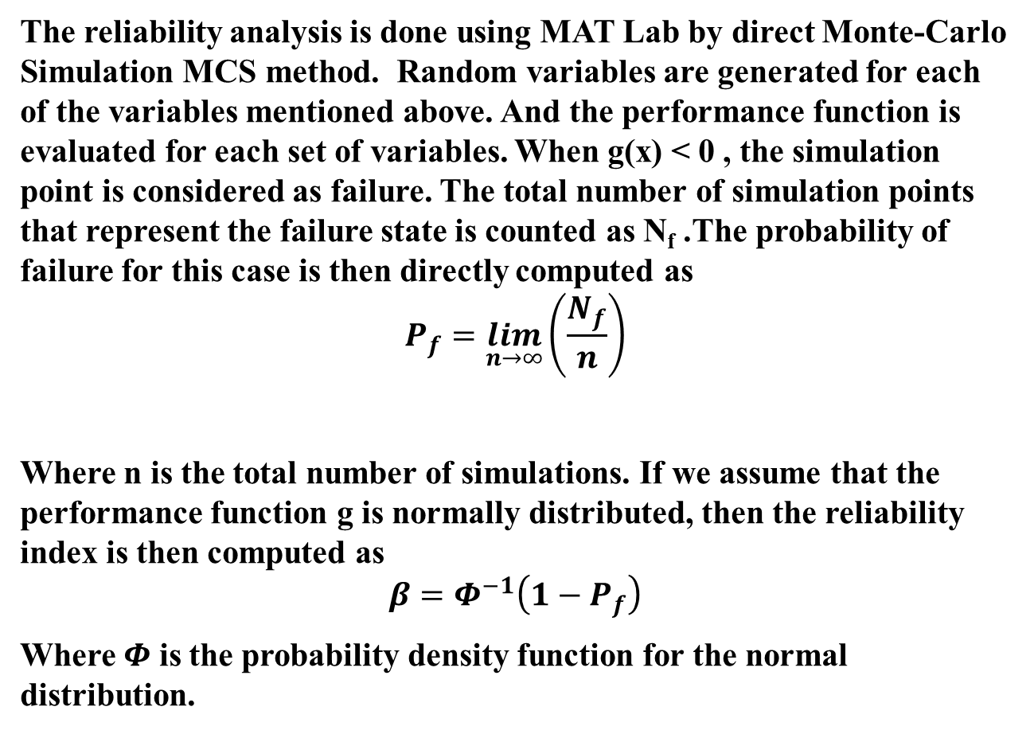
Reliability analysis by Mat lap program
The reliability analysis is done using MAT Lab by direct Monte-Carlo Simulation MCS method. Random variables are generated for each of the variables mentioned above. And the performance function is evaluated for each set of variables. When g(x) < 0 , the simulation point is considered as failure. The total number of simulation points that represent the failure state is counted as N_{f} .The probability of failure for this case is then directly computed as
$$P_{f}=\lim_{n→∞}\left(\frac{N_{f}}{n}\right)$$
Where n is the total number of simulations. If we assume that the performance function g is normally distributed, then the reliability index is then computed as
$$β=Φ^{−1}\left(1−P_{f}\right)$$
Where $Φ$ is the probability density function for the normal distribution.

Slide 19

Code by mat lap
% Generate random ultimate moment
count = 0;FailG = 0;
for i1=1:np;
for i2=1:np
for i3=1:np
for i4=1:np
for i5=1:np
for i6=1:1
for i7=1:1
count = count+1;
wuAv=4*5*1.2+1.6*1.2*4;
wu=1.2*Dead(i1)+1.6*Live(i2);
Mu(count) = wu*(L(i3))^2/8;
MuAv = wuAv*(LAv)^2/8;
rho=(0.85*FcAv/FyAv)*(1-sqrt(1-2.36*MuAv/(0.9*FcAv*Bw(i6)*(D(i7))^2)));
if rho < 1.4/FyAv
rho = 1.4/FyAv;
end

Slide 20
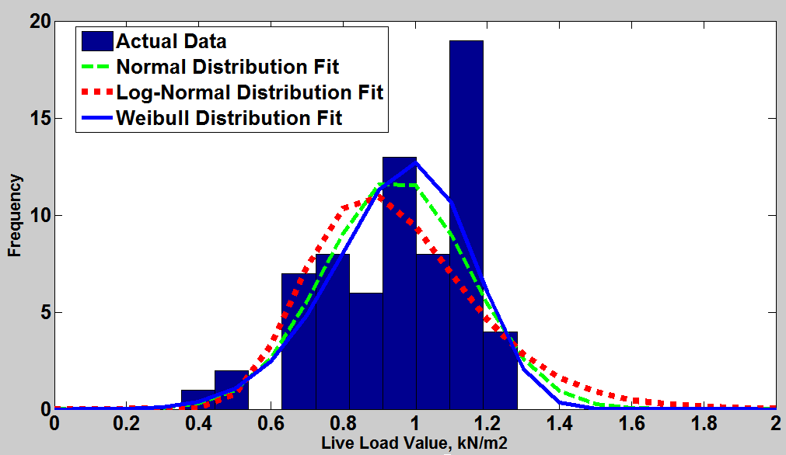
Results from mat lap programming

Slide 21

Results :
As seen from the figure above, the data could be fitted by either Normal, Log-Normal, or Waibill distributions. The fitted distributions are used to obtain a design value for live, which is defined the 95-percentile. The 3 distributions produced approximately equal values for the 95-percentile with the log-normal giving slightly the biggest value of 1.21 kN/m2, while the Normal distribution produced 1.18, and the Waibill gave the smallest value of 1.17kN/m2.
As a final decision, we took the Normal distribution to be representative for the statistical variation in live load values, and the design value of 1.3kN/m² is assumed. The mean value and standard deviation for the Normal distribution was 0.95 kPa and 0.2 kPa, respectively.
The results above give a coefficient of variation COV = 0.2/0.95 = 0.21. This value of COV is not far from the values used in literature. Even though, the value for live load is noticeably smaller than the value specified in the ASCE (1.96 kPa).

Slide 22
APPLICATION of reliability ANAALYSIS CASE study
The objective for the selection of this school were:
The availability of plans and drawings from municipality.
The area of the all classes are the same as the sample that was taken in this case study.
The availability of the analysis and design assumptions .for example, the value of live load = 4 kN/m².
The simplicity of the plan view and layout. Since we used this case study to evaluate the impact of this project.
To do a quantity survey for the beams and slabs and measure the effectiveness of reduction the live load and its factor.

Slide 23
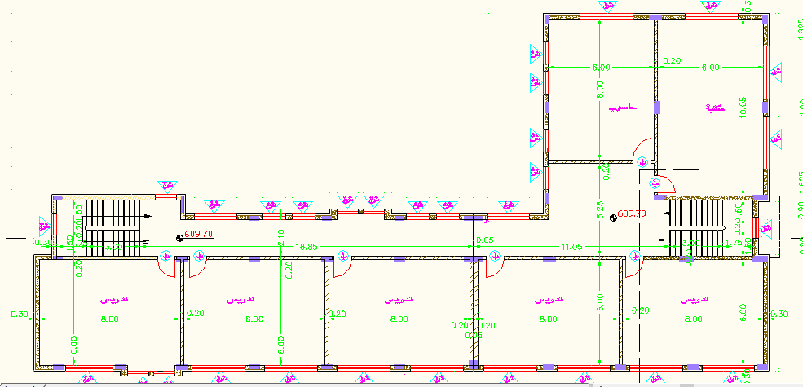
Case study

Slide 24

As-built data
Assumption to design from municipality:
Concrete for Beams, Columns &Slabs,${\acute{f}}_{c}=24 MPa$.
Unit weight of concrete = 25 KN/m³
Steel for Reinforcing Bars and Shear Reinforcement, Fy= 420MPa.
Superimposed dead load is the gravity load of non-structural parts of the building, Superimposed dead load= 4.5KN/m².
Live loads are those loads produced by the use and occupancy of the building or other structure and do not include construction or environmental load such as wind load, snow load, rain load, earthquake load, ﬂood load, or dead load, Live load= 4 KN/m².
Columns: 300*600mm.

Slide 25
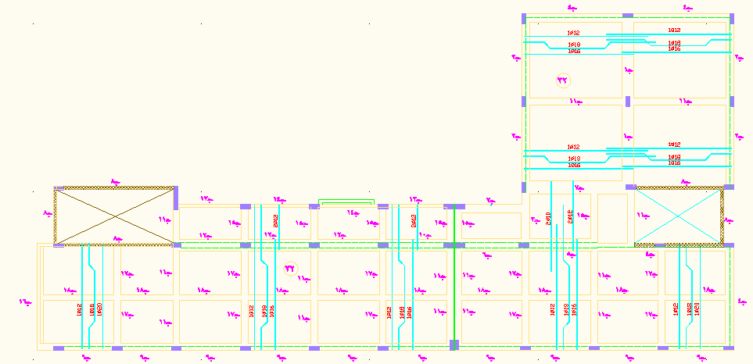
As-built data
The structural system for the slab was one way ribbed slap, as shown below:

Slide 26
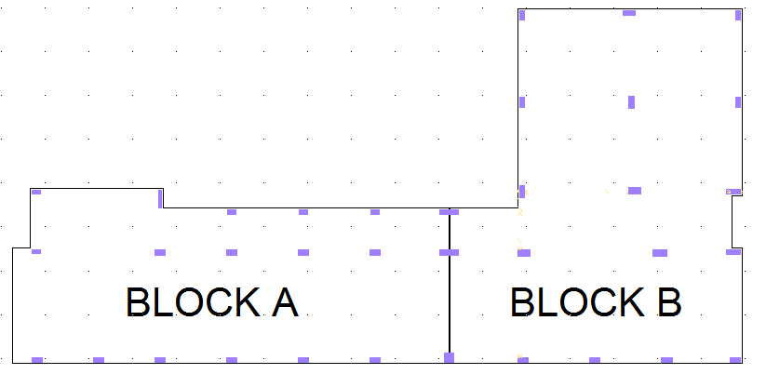
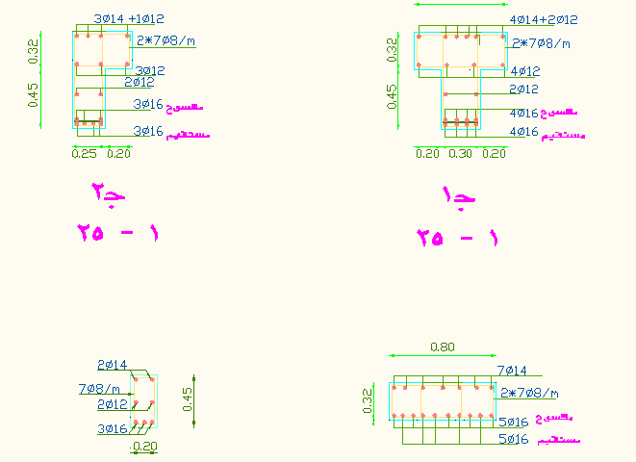
As-built data
Example for a beam details:

Slide 27
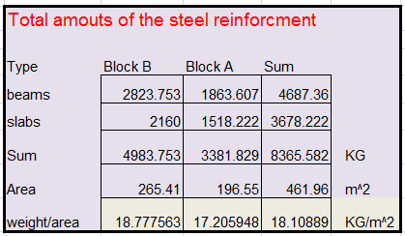
As- built data
Quantity surveying for as built design:

Slide 28
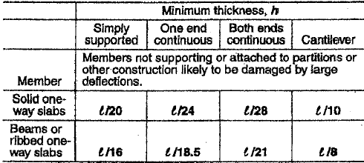
Modelling
This loads were from municipality as assumption,
The total dead load is 9 kN/m² and the live load is 4 kN/m²
The own weight of our slap = h * ¥ =0.18 * 25 =4.5 kN/m²
Thus, the superimposed dead load = 9 – 4.5 = 4.5 kN/m²
Solid slap with 180 mm thickness .

Slide 29

Modelling
h = $\frac{l}{24}=\frac{4}{24}=0.16$ this eq. from the previous table.
We used: h = 0.18 m
Own weight = 0.18*1*25
= 4.5 KN/m²
Wu= 1.2[D] +1.6[L]
= 1.2*[4.5+4.5] + 1.6*[4]
= 17.2 KN/m^²
Check shear:
Max. Clear span = 4 m
V_{u}= $\frac{1.15∗17.2∗4}{2}=39.6 KN$
ɸV_{c}= 0.75*$\frac{1}{6}∗\sqrt{24}$ *1000*180/1000
= 110 KN
$Vu<∅Vc$The check shear is OK, for slap

Slide 30
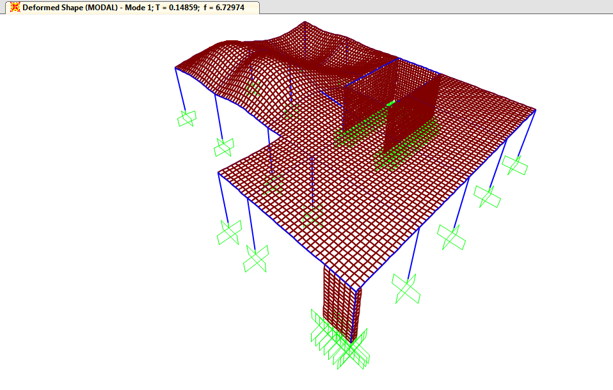
SAP – Analysis
Check compatibility

Slide 31
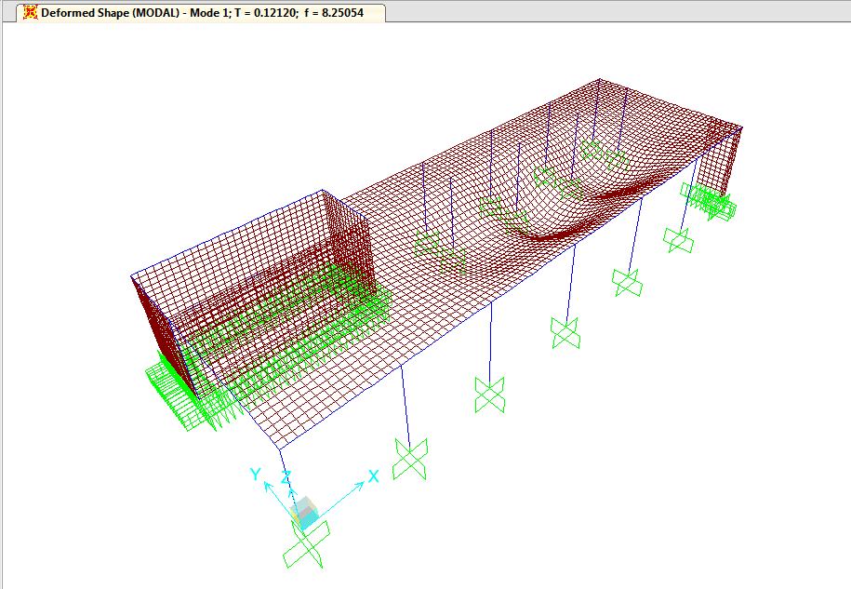
SAP Analysis

Slide 32
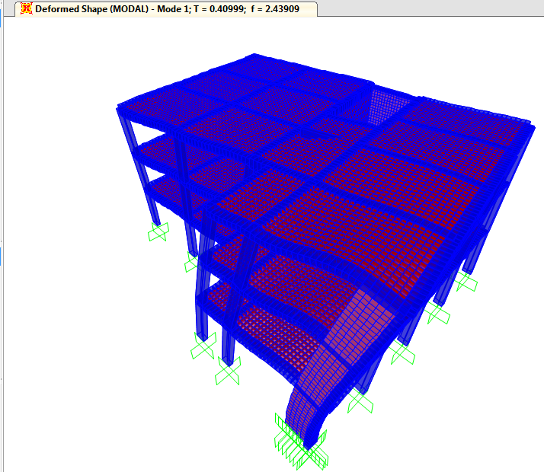
Sap analysis
Block B

Slide 33
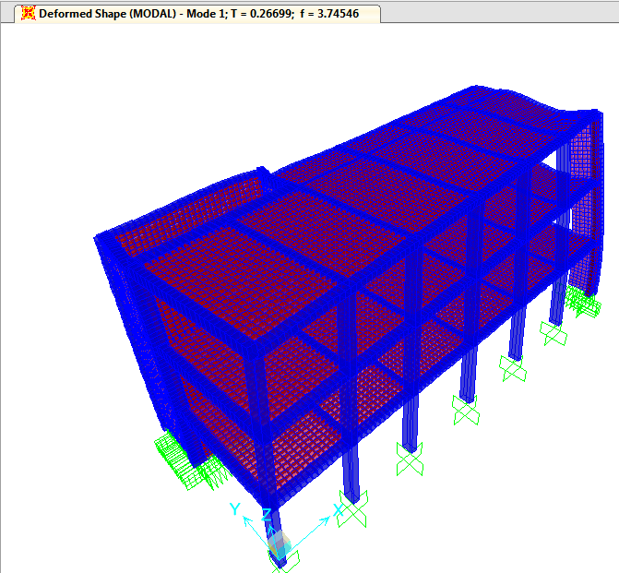
SAP Analysis Block A
Thus, the structure was compatible and the fundamental periods were reasonably acceptable.

Slide 34
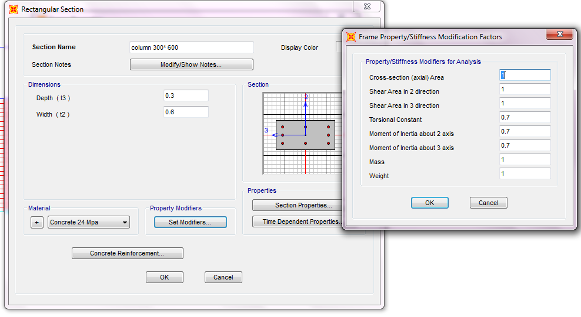
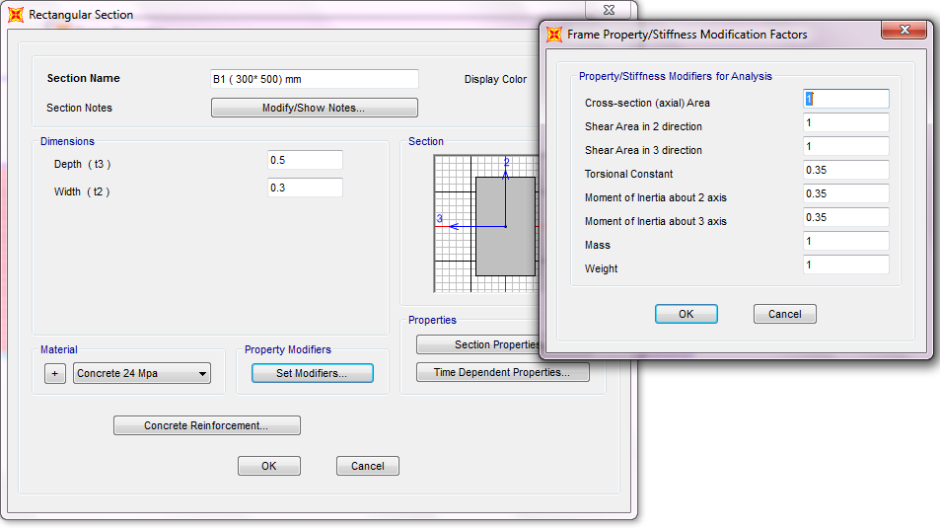
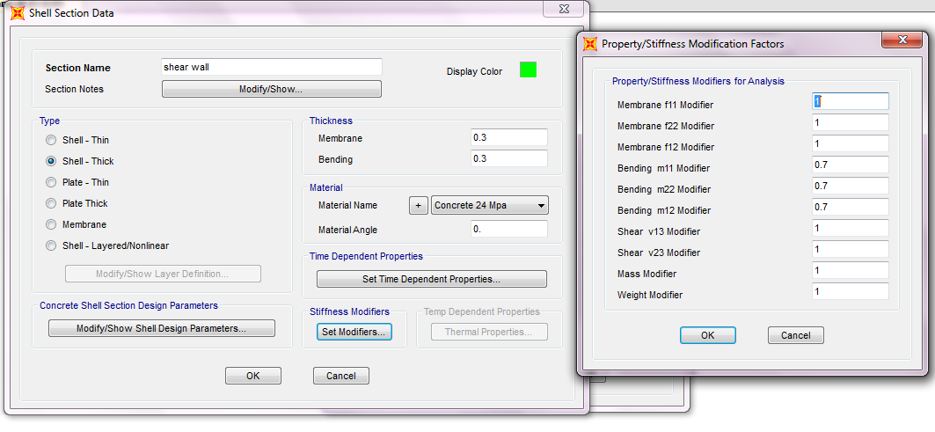
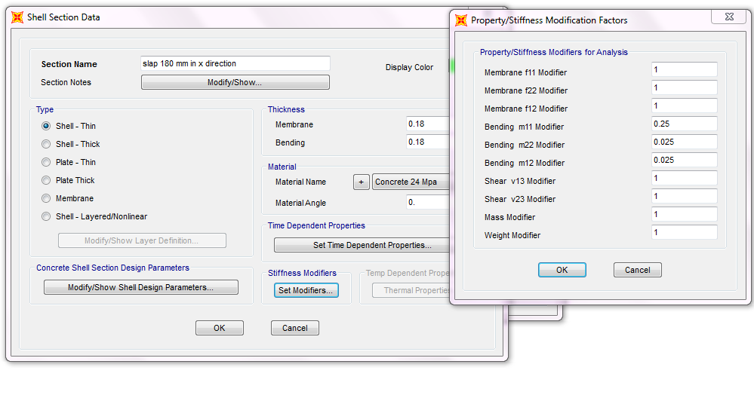
Sap Analysis
Modifiers

Slide 35
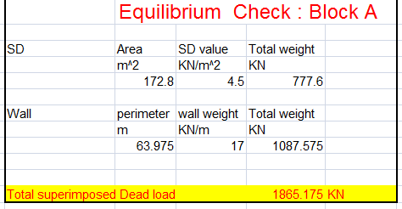
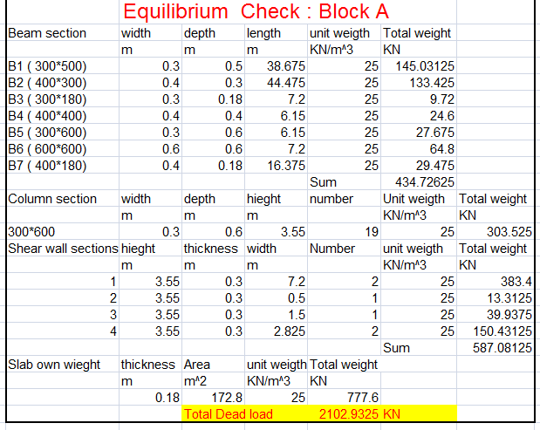
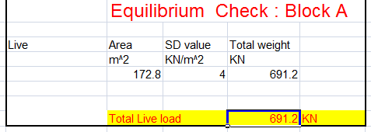
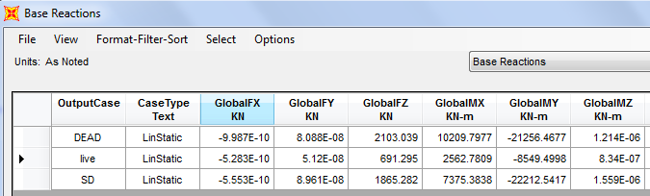
Sap Analysis
Check equilibrium.
Block A

Slide 36
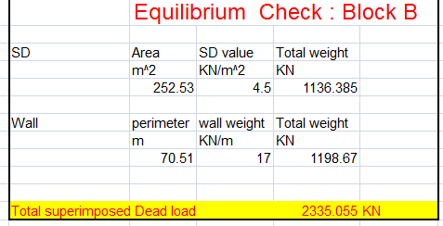
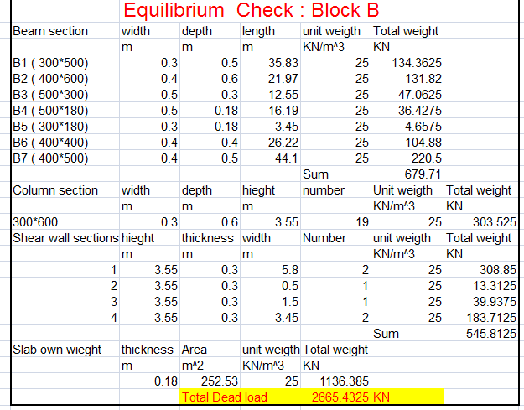
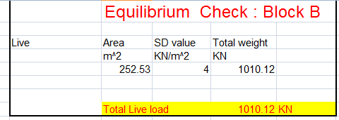
Sap Analysis
Thus, we can see that there is no error in Live and SD load pattern.
But, there is a 3.78% of error in Dead load pattern which is less than 5%
……. OK.

Slide 37
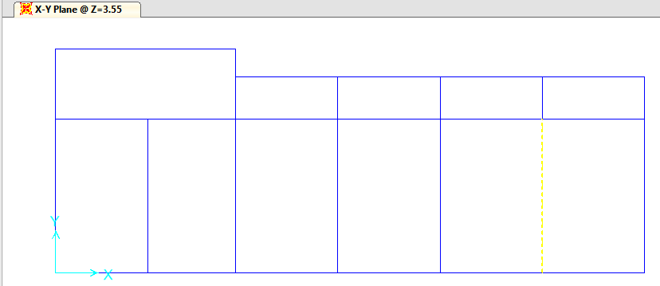
Sap Analysis
Check stress – strain relationship
Select a span in a beam and compute the load on it:
Block A
L = 6.15
Tributary area = {(19.5 – 15.4)\2 + (23.575 -19.5)\2} = 4.08 m²
Super Imposed = 4.5 kN\m²
By hand calculation = wl²\8 = 86.8 kN.m
From sap analysis
M₁+M₃\2 + M₂ = {55.7+49.7 \2} + 31.8 = 84.5 kN.m
% of error = 86.8 - 84.5 \ 86.8 =2.42 % goes to that < 10% …… ok

Slide 38
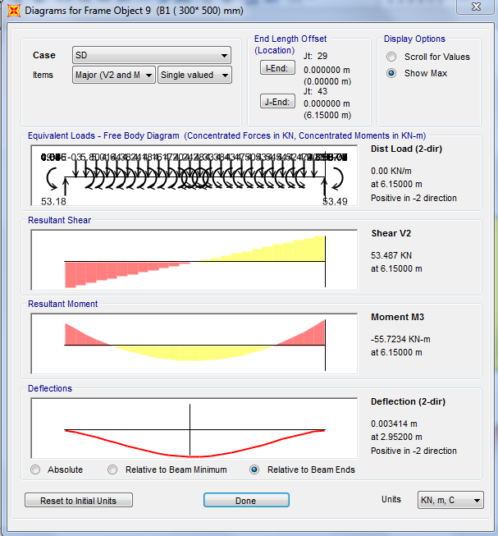
Sap Analysis

Slide 39
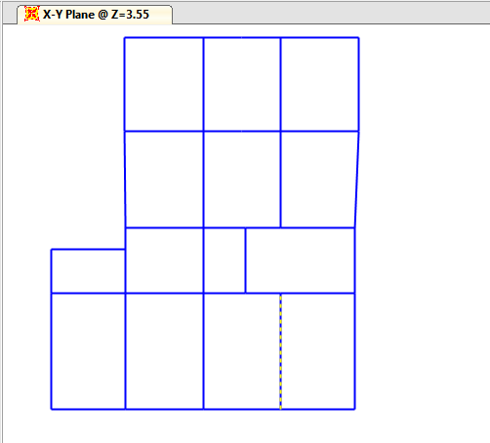
Sap Analysis
Block B
L = 6.16
Tributary area = {(12.49 – 8.19)\2 + (16.19 -12.29)\2} = 4.0 m²
Live load = 4 kN\m²
By hand calculation = wl²\8 = 75.89 kN.m
From sap analysis
M₁+M₃\2 + M₂ = {45.29+43.7 \2} + 29.9 = 74.71 kN.m
% of error = 75.89 - 74.71 \ 75.89 =1.55 % goes to that < 10% …… ok

Slide 40
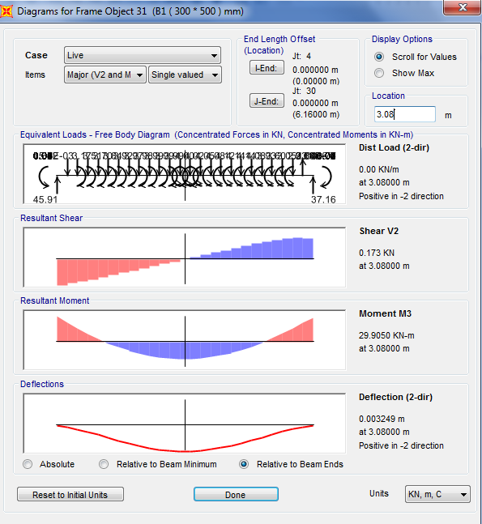
Sap Analysis

Slide 41

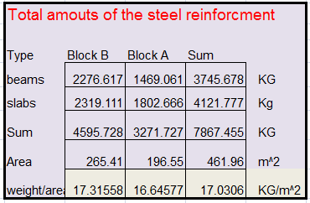
Design using common practice value for live load
After Re-design with solid slap and practice live load = 4 kN/m²

Slide 42


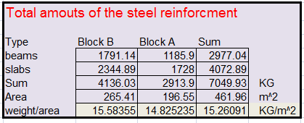
Design using ASCE live load
From this code the live load in schools were:
For classroom , live load = 1.92 kN/m²
For corridor , live load = 4.7 kN/m²

Slide 43
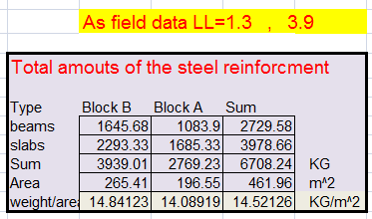
Design using new live load that Resulting from Research
From field data analysis for live load that is :-
For classroom , live load = 1.3 kN/m²
For corridor , live load = 3.9 kN/m²

Slide 44

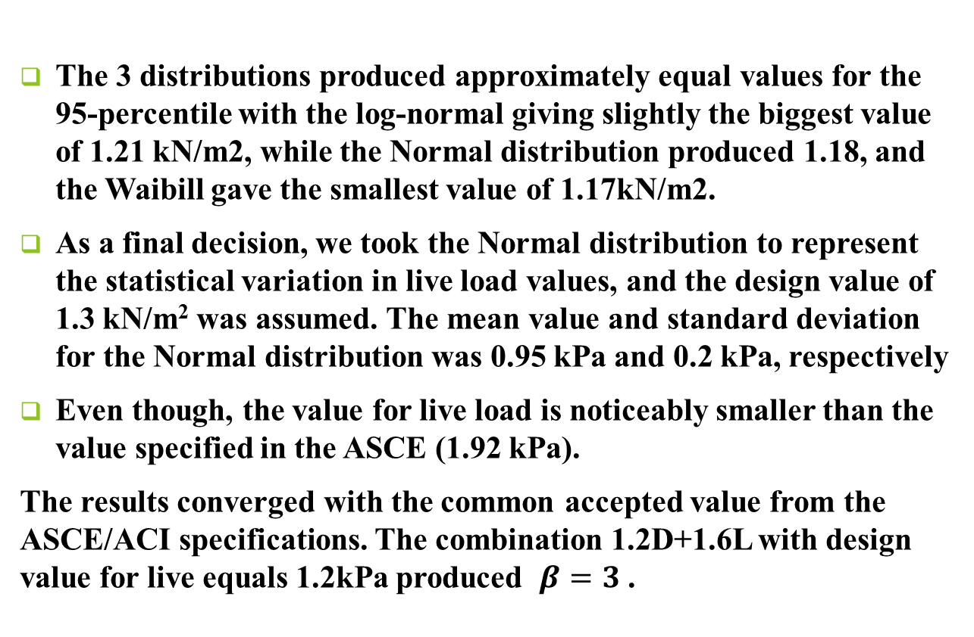
Conclusion
The 3 distributions produced approximately equal values for the 95-percentile with the log-normal giving slightly the biggest value of 1.21 kN/m2, while the Normal distribution produced 1.18, and the Waibill gave the smallest value of 1.17kN/m2.
As a final decision, we took the Normal distribution to represent the statistical variation in live load values, and the design value of 1.3 kN/m² was assumed. The mean value and standard deviation for the Normal distribution was 0.95 kPa and 0.2 kPa, respectively
Even though, the value for live load is noticeably smaller than the value specified in the ASCE (1.92 kPa).
The results converged with the common accepted value from the ASCE/ACI specifications. The combination 1.2D+1.6L with design value for live equals 1.2kPa produced $β=3$.

Slide 45
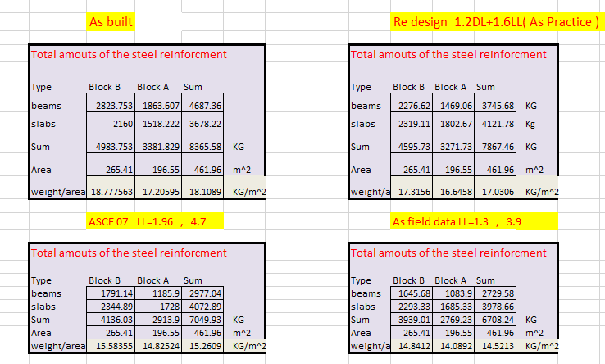
Conclusion
Quantity surveying for all models and factors

Slide 46
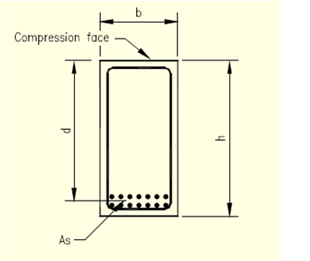
Recommendation
So we recommended that should be more realistic study for Palestinian environment to study the statistical parameters for dead load variations, sections dimensions and geometry, etc.
Because of above This result is not unexpected because the statistical parameters of the data were taken from literature reviews and were approximately similar to the data used to derive the load factors used in the ASCE/ACI specifications. Also, the COV obtained for the live data (COV = 0.2) was not very different from the value used in literature (COV = 0.25).

Slide 47

Recommendation
Also we recommended that to include the worst scenario that the schools will be used as refuge for people in the emergency cases like earthquake, floods and wars and we don’t have the tools to estimate this scenario .

Slide 48
An- Najah National University
Faculty of Engineering - Civil Engineering Department
Graduation Project Report 2
Design Case Study – Al Haje_ Latifa School
Design live load value, and alternate floor system
Loay Qabaha
Basel Salama
Under supervision of: Dr. Mahmud M.S. Dwaikat

Slide 49
Outline:
Introduction
Dynamic Analysis
Dynamic Design
Design of proposed system (Flat Plate )
Summery and Conclusion

Slide 50

Introduction:
Dynamic analysis and design mean the analysis and design of building under the effect of seismic loads that affect the structure when it is subjected to an earthquake.
In this project, we focused on an earthquake checking the resistance of structural elements for internal forces such as bending and shear forces from seismic loads.
Seismic loading depends, primarily, on:
1- Anticipated earthquake's parameters at the site - known as seismic hazard.
2- Geotechnical parameters of the site.
3- Structure’s parameters.
So we should design the building to resist this load because it may causes collapse of the building. So, that will save human’s life.

Slide 51
Objectives:
In Part 2 of the project, we proposed another floor system to replace the commonly used system (of slab-on-drop-beams) for schools in Palestine. The alternate floor system was a flat plate system. All checks and comparisons were done based on the seismic analysis and design of the selected school building.
We found that the steel reinforcement quantities and concrete volumes of the two systems were comparable but with the advantage of flat plate being easier to construct and requires simpler formwork and can lead to savings in the construction phase.

Slide 52
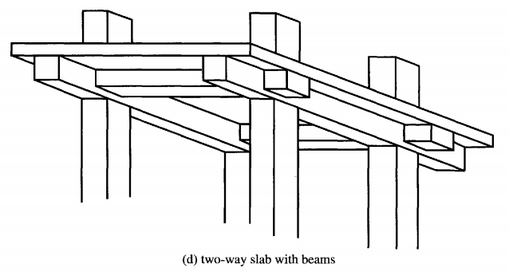
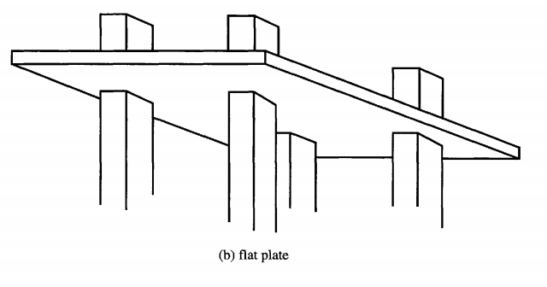
Objective :
All checks and comparisons will be done based on the seismic analysis and design of the selected school building.

Slide 53

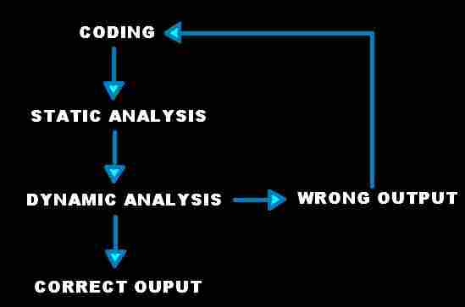
Coding :
The code concerned here is the Uniform Building Code UBC. International Council of Building Officials having their headquarter in California has published this code for the very first time way back in 1927. ICBO was meant to promote Public safety by providing standards and requirements to ensure safe construction.

Slide 54
Dynamic Analysis – The Same Case Study :
Block B
Block A

Slide 55
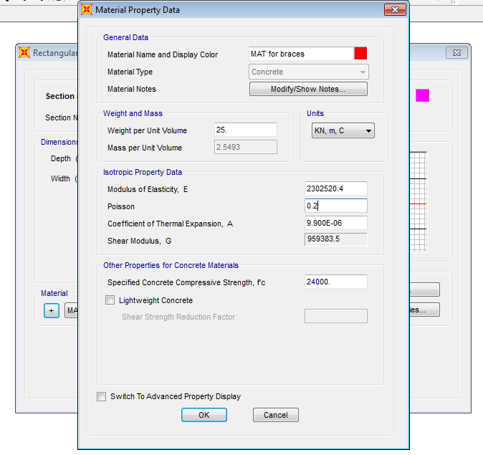
Dynamic Analysis :
First of all, we had to model the structure by using SAP2000 software and then to do a modal analysis and the needed checks to make sure that the model work well. Moreover, we exploited this software to do a response spectrum analysis to design the structure.
1- Bracing :According to the UBC97 code, if the area of the openings are more than 15% of the total area of the panel then its bracing effect is negligible.
The material of the braces section was assumed concrete with an elastic modulus of elasticity of 10% of the elastic modulus of elasticity of concrete material, as shown below:

Slide 56
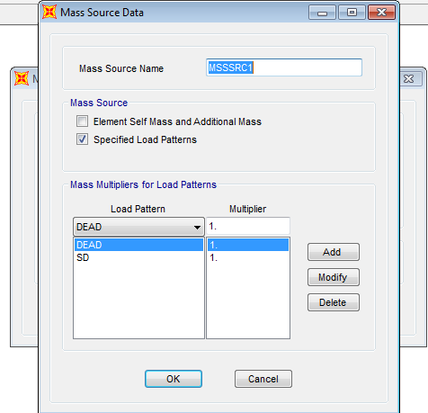
Dynamic Analysis :
2- Mass sources definition:
To make the software accounts for all present mass in the building, we had to define the mass source to be the own weight and the superimposed dead load, as shown below:

Slide 57

Dynamic Analysis:
Model checks –Block A :
Block A:
Modal mass participating ratio:
We used Ritz vectors method to determine the most expected modes of the modal analysis of structure, as shown:

Slide 58

Dynamic Analysis:
Model checks- Block A :
The first 12 modes achieved the target ratio with higher than 90%.

Slide 59

Dynamic Analysis:
Model checks- Block A :
The fundamental period was reasonably acceptable and it was a flexural mode in Y- direction.
The approximate method of determining the period of all structures according to the UBC97 code:
T= Ct * h^(3/4)
T=0.0488* (10.65) ^ (3/4) = 0.287 sec
And it is close to 0.34 sec (from SAP2000) …………. OK

Slide 60


Dynamic Analysis:
Irregularities checks- Block A :
Checks for irregularities:
From table 16-L and 16-M of the UBC 97 code, we checked all of the irregularities types and we ended up by that the block is regular and we had to check the torsional irregularity only.

Slide 61

Dynamic Analysis:
Torsional Irregularity check- Block A
To do that, we put a 100 KN of horizontal force in each floor with an accidental eccentricity of 5% from center of mass and calculated the torsional irregularity.
For example: we took this case of block A and found that:
d₁= 0.9 mm (End 1 displacement)
d₂ = 0.96 mm (End 2 displacement)
d _{avg.} = (d₁+d₂)/2 = 0.93 mm, then d _{max.} = 0.96 mm < 1.2 * d _{avg.} = 1.2*0.93=1.116 mm ………………………….. OK.

Slide 62
Dynamic Analysis:
Model checks- Block A :
Determination of Lateral Resisting Structural System
In Y- direction:
we determined the reactions in y-direction against this 300 KN and find that it was 157 KN in columns. Which is between 25% and 75% of the load ….. So the system was duel system (frames and shear walls).
In X- direction:
we determined the reactions in X- direction against this 300 KN and find that it was 26 KN in columns. Which is less than 25% of the load ….. So the system was shear wall system.

Slide 63


Dynamic Analysis:
Model checks- Block A :
Walls checks:
We had to check if the walls act like a bearing wall or not:
The allowable stress = 0.06 Fc = 0.06 * 24 = 1.44 Mpa = 1440 KN/m^2
The maximum stress = 545 KN/m^2 from the gravity loads (SAP result).
So, the walls can be considered as shear walls only in X- direction.

Slide 64

Dynamic Analysis:
Model checks- Block A :
The weight of the structure (W in the base shear equation): in our case, W = Dead load + Superimposed dead load
W = 11741.886 KN.
The weight of each floor = 11741.886/3 = 3913.962 KN

Slide 65


Dynamic Analysis:
Model checks- Block A :
The weight of block A was calculated manually, as shown below:
% of error = (12266.993-11741.886)/12266.993 = 4.28% < 5% ….. OK

Slide 66

Dynamic Analysis:
Model checks- Block B :
Modal mass participating ratio:

Slide 67

Dynamic Analysis:
Model checks- Block B :
Period :
T= Ct * h^ (3/4)
T=0.0488* (10.65) ^ (3/4) = 0.287 sec …………. OK
And it is close to 0.366 sec (from SAP2000) …………. OK
Checks for irregularities:
d₁= 0.84 mm (End 1 displacement)
d₂ = 0.86 mm (End 2 displacement)
d _{avg.} = (d₁+d₂)/2 = 0.85 mm
D max = 0.86 mm < 1.2 * d _{avg.} = 1.2*0.85=1.02 mm OK.

Slide 68

Dynamic Analysis:
Model checks- Block B :
For the re-entrant corners check:
The corner length = 3.91 m ………. (1)
The whole distance = 19.64 m………… (2)
The ratio = 0.2 with is more than 0.15, but we accepted it because the structure modal analysis is better than what we expected and we got a good results. Moreover, the corner area is small so we cannot divide it in a separate block.
The weight of the structure:
The weight of block A was calculated manually, as shown below
% of error = (15068.877-15062.190)/15068.877 = 0.05% < 5% ….. OK

Slide 69


Dynamic analysis
Base Shear
The total design base shear in a given direction shall be determined from the following
Bearing capacity = 300 KN/m2
Z= seismic zone factor, Table 16-I = 0.2 g
I= importance factor, Table 16K = 1.25
R= numerical coefficient representative of the inherent over strength and global ductility = 5.5
Capacity of lateral- force- resisting systems, Table 16-N = dual system
C a =acceleration seismic coefficient, Table 16-Q = 0.24
C v = velocity seismic coefficient, Table 16-R = 0.32

Slide 70



Dynamic analysis –Base shear

Slide 71


Dynamic analysis –Base shear

Slide 72


Response spectrum method
The design response spectrum as UBC97 is shown in the Figure below
The parameters needed for the response spectrum curve are:
Ca = 0.24
So, 2.5Ca = 2.5* 0.24 = 0.6
Ts = Cv/2.5Ca = 0.32/0.6 = 0.533 seconds
T₀ = 0.2*Ts = 0.2* 0.533 = 0.106 seconds

Slide 73

The design response spectrum as UBC97 from Sap 2000

Slide 74
Load Cases
Because the earthquake loads do not come from one directions, so the structure shall be designed to resist any seismic forces in each direction, then to simulate the reality we added 30% of seismic load in perpendicular direction in addition of the main directions.
𝐸𝑥=𝐸𝑥+0.3 𝐸𝑦
𝐸𝑦=𝐸𝑦+0.3𝐸𝑥
Then, the acceleration of main direction should be multiplied by a scale factor of: scale factor= (𝐼×𝑔)/𝑅= (1.25×9.81)/5.5=2.2295
And the other direction should be multiplied by:
0.3× (𝐼×𝑔)/𝑅=0.3× (1.25×9.81)/5.5=0.7432
Note that: we used the CQC method (complete quadratic compound) to make a combination of modes which is more reasonable.
SAP results of response functions for tow blocks :

Slide 75



Load combinations
Where:
D: dead load
L: Live load
E: Earthquake load effect that include the horizontal and vertical effects.
𝐸=𝜌× 𝐸ℎ±𝐸𝑣
Ρ: redundancy factor depends on seismic design category.
According to UBC97 and for our structure ρ=1
Vertical component = Ev = 0.5*Ca*I*D = 0.5*0.24*1.25* D = 0.15*D
So, E = Eh ± 0.15D

Slide 76



Story Drift:
Block A : The maximum story drift = 1.53938 – 0.96148 = 0.5779 mm
∆ (m) = 0.7*R*∆ (elastic) < 0.025*h
∆ (m) = 0.7*R*∆ (elastic) = 2.225 mm < 0.025*h = 0.02* 3350 = 83.75 mm……OK
Block B : The maximum story drift = 1.85224 – 1.12526 = 0.72698 mm
∆ (m) = 0.7*R*∆ (elastic) = 2.798 mm < 0.025*h = 0.02* 3350 = 83.75 mm……OK

Slide 77

Dynamic design –Seismic expansion joint
One inch (2.54cm) of separation is required for every fifty feet (15.24m) of building height.
The elevation of our structure = 10.65 m
The required separation = 1065*2.54 \ 1524 = 1.78 cm
Displacement from block A = 9.445 mm
Displacement from block B = 8.399 mm
Seismic joint = 1.78+0.9445 +.8399 = 3.5644
So, we took it 4 cm.

Slide 78


Dynamic design –Design of beams

Slide 79


Dynamic design –Design of Torsion And Shear

Slide 80



Dynamic design – Design of beams

Slide 81


Dynamic design – Design of slab

Slide 82




Dynamic design – Design of Columns
So the capacity = 2557.31 KN > P_{u} in C30 from sap 2000= 1612 KN
Assume K = 1.0
The clear column height, L_{u} = 3.0 m
The critical side, r= 0.3 * h = 0.3 * 0.3 =0.09
The first term = 33.3
M₁₌5.4KN, _{and} M₂₌ 6 KN, are very close to zero, so ignore them
So 33.3 < 34
It is short column and braced

Slide 83

Dynamic design – Design of Columns

Slide 84



Dynamic design – Design of footings

Slide 85


Dynamic design – Design of footings

Slide 86


Dynamic design – Design of Shear walls
M_{u} = M₂ = 4073.6 KN.m (The maximum value from left and right side to be more conservative).
V_{u} = Force in direction 1 = 724 KN (The maximum value from left and right side to be more conservative).
Then, we calculated the shear and moment capacities based on the assumptions above:
ϕVc = (0.75*(1/6)* √24* 300*5040)/1000 = 926 KN
ϕMn = ϕ*As*Fy*(d-a/2)
As = ρ*b*d = 0.0025*300*5040 = 3780 mm2
Fy = 420 Mpa Fc = 24 Mpa
a = (As*Fy)/ (0.85*Fc*b) = (3780*420)/ (0.85*24*300) = 260 mm
Then, ϕMn = (0.9*3780*420*(5040-260/2))/1000000 = 7015.6 KN.m
Mu < ϕMn and Vu < ϕVc

Slide 87

Dynamic design – Design of Shear walls

Slide 88

Dynamic design – Design of shear wall footing

Slide 89



Design of flat plate system
Advantages of Flat plate system:
Flexibility in room layout
Reinforcement placement is easier
Ease of Framework installation
Building height can be reduced: As no beam is used,
floor height can be reduced and consequently the building
height will be reduced. Approximately 10% in the vertical
member could be saved Foundation load will also reduce.
5. Less construction time

Slide 90



Design of flat plate system
Actually, we did not use a preliminary slab thickness table or any code to determine the suitable thickness but we used the same models for block A and B in SAP2000 software and deleted the beams except the exterior beams and adjusted the slab modifiers. Then, we started changing the thickness taking into consideration the deflection, punching shear and bending capacity for slab until we ended up with a thickness of 25 cm but we were needed to chance the compressive strength of concrete from 24 MPa to 28 MPa to satisfy the deflection limitations.

Slide 91

Design of flat plate system : Additional design checks ( punching and moment design)
Check for deflection:
The maximum live load deflection in the structure = 1.4 mm and the maximum deflection from dead and superimposed dead load =12.4 mm thus, ∆L =13.8 mm
Allowable deflection from service load:
∆L ≤ $\frac{l}{360}$ = $\frac{6000}{360}$ = 15 mm →since Allowable less than maximum deflection … Check is Ok
From long term deflection, the maximum deflection = 1.4+2*12.4 = 26.2 mm
∆S ≤ $\frac{l}{240}$ = $\frac{6000}{240}$ = 25 mm →since it is close to the deflection limit on this load case is rarely to happen, we accepted this check.

Slide 92


Design of flat plate system : Additional design checks ( punching and moment design)
Check for punching shear in flat plate system with thickness of 25 cm
Section 8.4.2.3.1 in ACI states: “If gravity load, wind, earthquake, or other effects cause a transfer of moment between the slab and column, a fraction of M_{sc}, the factored slab moment resisted by the column at a joint, shall be transferred by flexure in accordance with 8.4.2.3.2 through 8.4.2.3.5.” Later on, section 8.4.3.2.6 states: “The fraction of M_{sc} not calculated to be resisted by flexure shall be assumed to be resisted by eccentricity of shear in accordance with 8.4.4.2.”
Sections 8.4.2.3.2 through 8.4.2.3.5 address the development and proportioning of the M_{sc} force as applied flexural and shear forces originating from the factored slab moment. The distribution of shear stress at the critical perimeter might then follow a pattern as depicted in Figure 53.

Slide 93





Design of flat plate system : Additional design checks ( punching and moment design)
Check punching in a critical interior critical column as shear moment transfer:
B₁ = 0.3+ α/2 = 0.51 such that α = 0.21
B₂ = 0.6 + α = 0.81 Vu = load on column = 605 KN B₀ = 2*b1 +2 b2 = 2.64 m
α_{f1}= 0.56 from this equations
C₁ = b₁/2 = 0.255
J_{c1} = 0.03 m⁴ from this equations
α_{f2} = 0.54 as the first α_{f1}
C₂ = b₂ /2 = 0.405
J_{c2} = 0.055 m ⁴ from this equations
M_{u1} = 45 kN.m
M_{u2} = 27 kN.m
The demand in terms of shear stress is given
from this equations = 1.29 mpa .

Slide 94

Design of flat plate system : Additional design checks ( punching and moment design)
Check punching in a critical interior critical column as shear moment transfer:
V_{n} = V_{u} /0.75 = 1.72 Mpa < V_{c} = 1.8
The fraction of moment transferred by the variation of shear stress about an axis (Muv), is given in terms of the total moment transferred (Mu) as follows. Muv = (1- α)Mu
The fraction for 1 = 0.32 = 1- α_{f1}
The fraction 0f 2 = 0.49 = 1- α_{f2}
c1 = dimension of the column or column capital along axis 1-1 = 0.10125
c2 = dimension of the column or column capital along axis 2-2= b₂ /2 = 0.405
Then demand in terms of shear stress = 1.17 mpa , from this equations
Compute V_{c}:
Β = 0.6/0.3 = 2 α_{s} = 30
So Vc minimum of (1.8, 2.6, 1.8) = 1.8 Mpa
So Vn = vu /0.75 = 1.56
So Vn < Vc no need

Slide 95

Design of flat plate system : Additional design checks ( punching and moment design)
Check punching in a critical interior critical column as shear moment transfer:
For moment to be transferred by flexural is α_{f mu} = 0.68 *45 = 25 kN.m
This moment shall be resist by strip of width equal to width c2 + 3h= 1.35 m (centered with respect to the column) to transfer M_{uf}. The residual moment transferred by flexure (M_{uf}), is given in terms of the total moment transferred (Mu) as follows. M_{uf} = α Mu = 25 km.m Additional non-prestressed reinforcement is provided at the top of the slab over a width c2 + 3h= 1.35 m (centred with respect to the column) to transfer M_{uf}.
ϼ = 0.00049
As = 320 mm2
The existing steel = 1350 /250 = 5.4
Thus, As = 5.4*113 = 610 mm2 >320
Thus, No need for additional flexure
reinforcement.

Slide 96


Design of flat plate system :

Slide 97



Design of flat plate system :

Slide 98

Existing system VS proposed system (drop beams VS flat plate comparison)
Finally, the comparison between two systems are shown below:

Slide 99
Conclusion
In chapter seven, we tried to propose an alternate structural system instead of the solid slab on drop beams system. We hoped that the proposed structural system will reduce the construction costs and time as the construction will of faster and easier. We thought of flat plate system, and then we modeled the structure again as flat plate system. We did the same checks for this system during its dynamic analysis. In addition to that, we checked the deflection and the punching shear as shear moment transfer concept because the shear is not constant over the critical section.
From table 34, we can see that the steel and concrete costs of the two systems is almost similar, however, it is expected that the labor costs will also be decreased for the plat plate system due to lack of drop beams.
Finally, we concluded that the dynamic analysis and design were successfully done. The flat plate system is a good alternative system for our structure and we recommended it.

Slide 100


Any question ?

