Slide 1


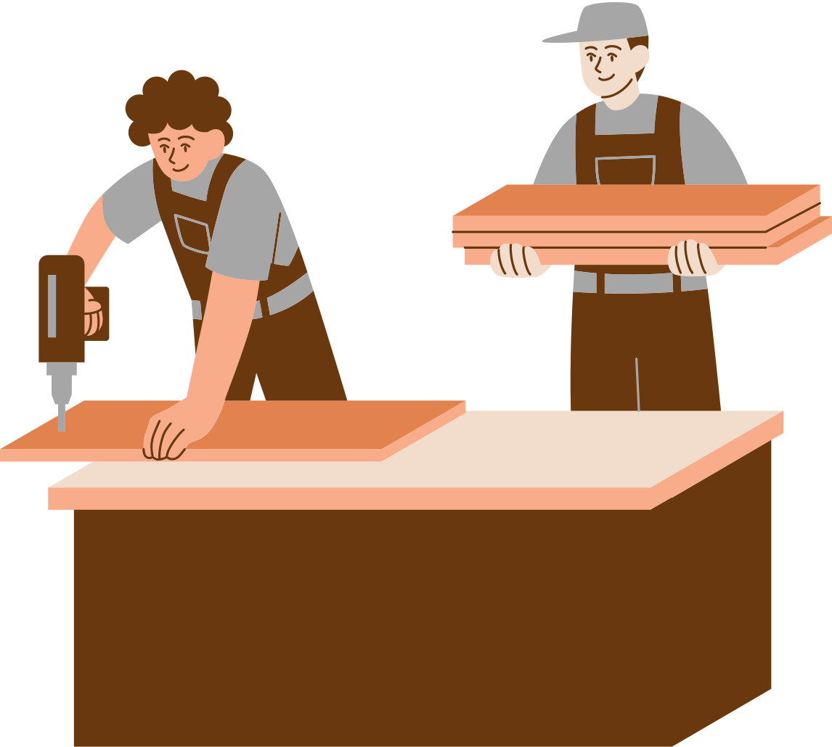
Craft pia
By : Nabeel Jamous & Mahmoud Shouli
Supervised By : Mrs. Haya Samaana

Slide 2

Discussion Topics
Topic 1
Topic 2
Idea
Website
01
02
05
Topic 5
03
Future Work
Topic 3
Mobile Application
04
Topic 4
Tech and External Services

Slide 3
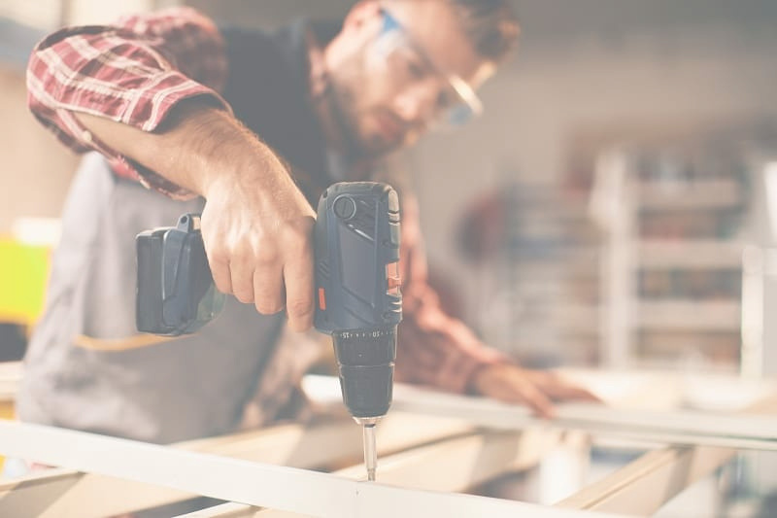
About
Craft pia

Slide 4



Roles
Customer
Crafter
Admin

Slide 5


Website

Slide 6
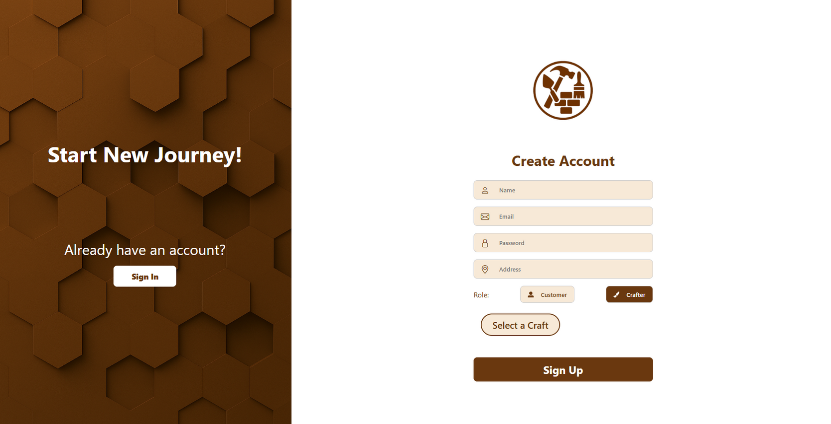
Registration

Slide 7
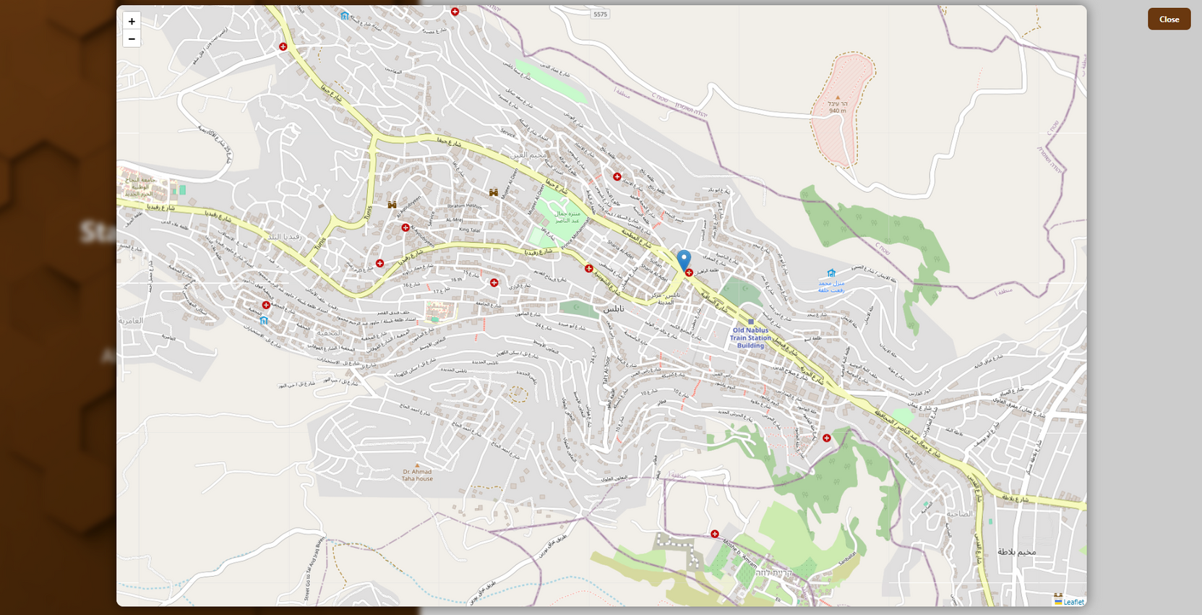
Registration

Slide 8
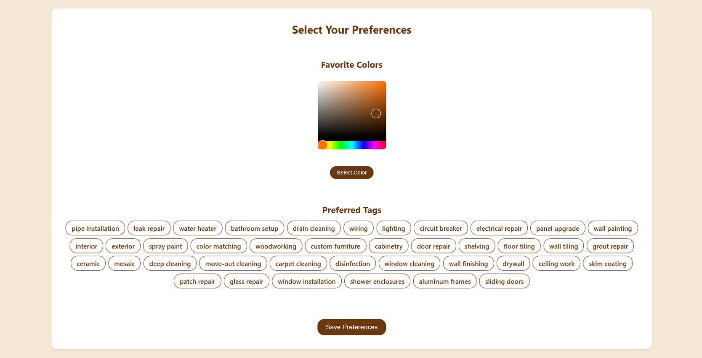
Preferences

Slide 9
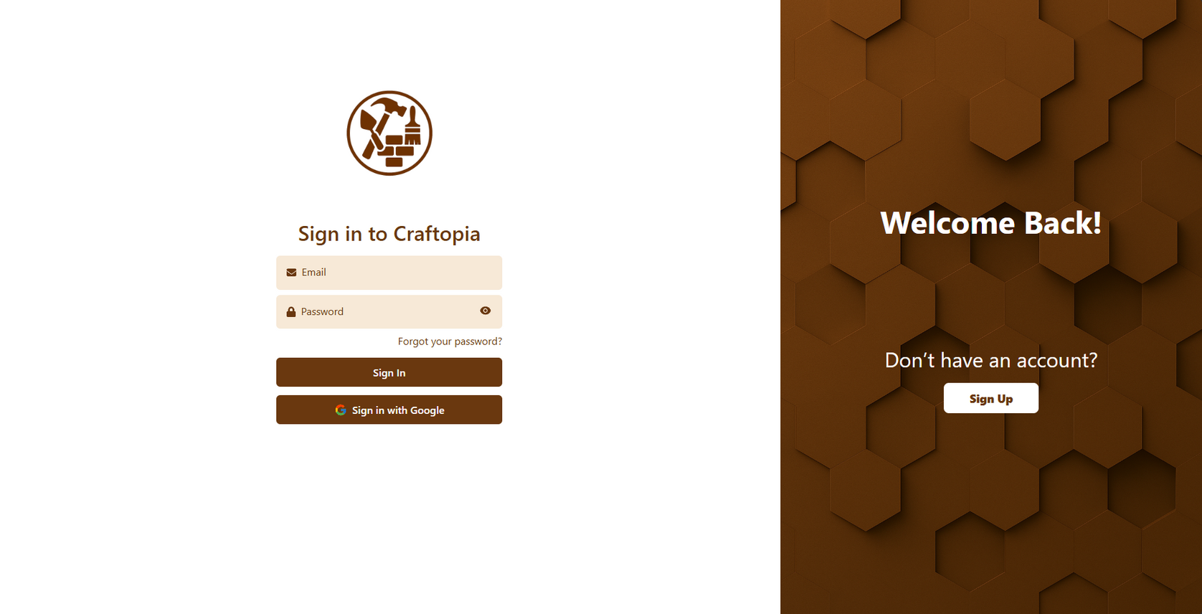
Login

Slide 10
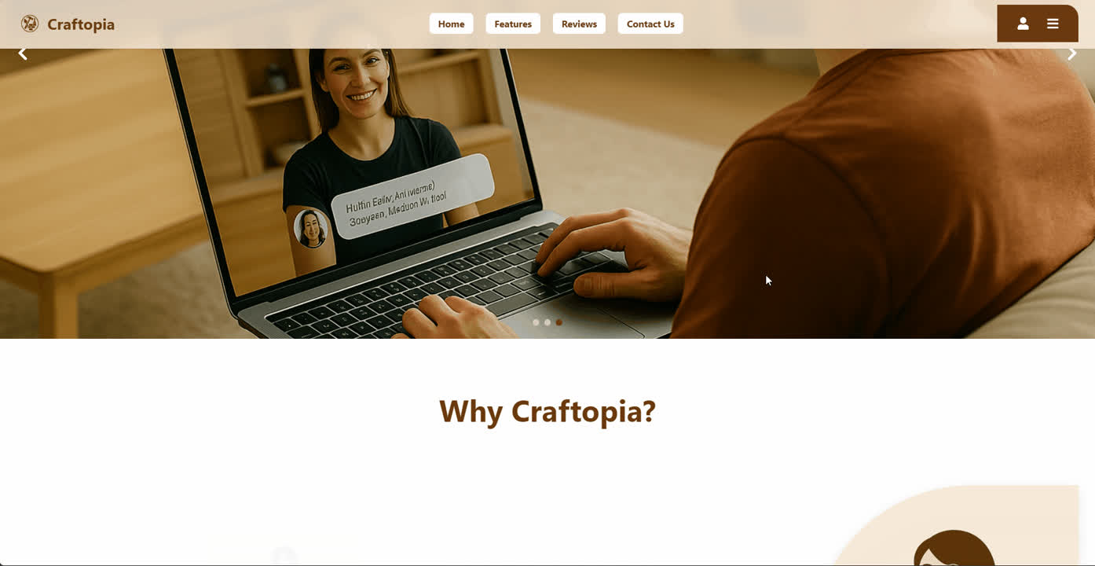
Home Page

Slide 11
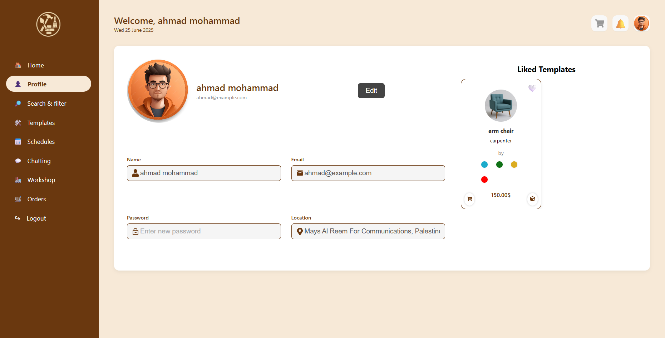
Customer Profile

Slide 12
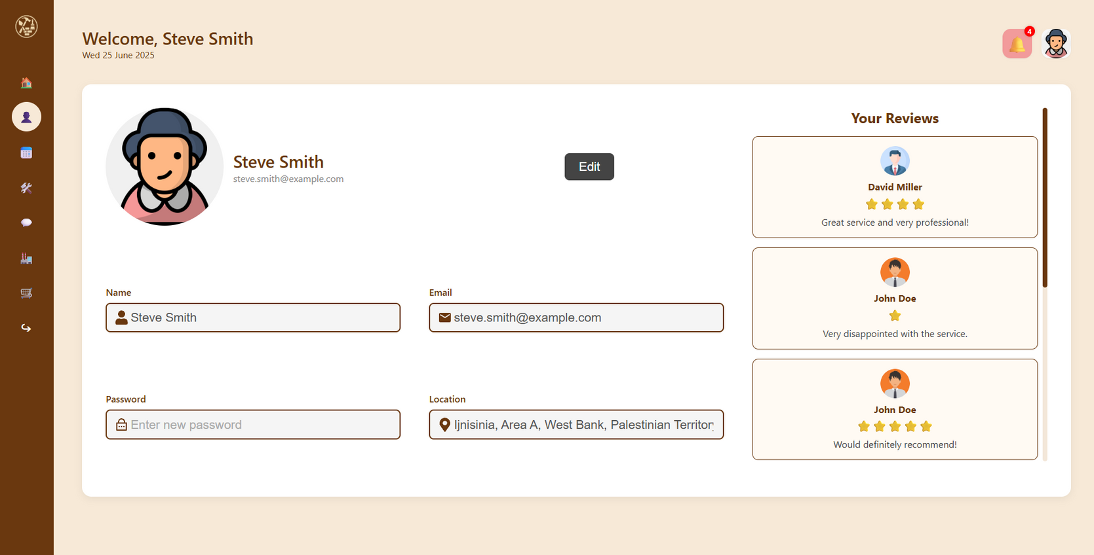
Crafter Profile

Slide 13
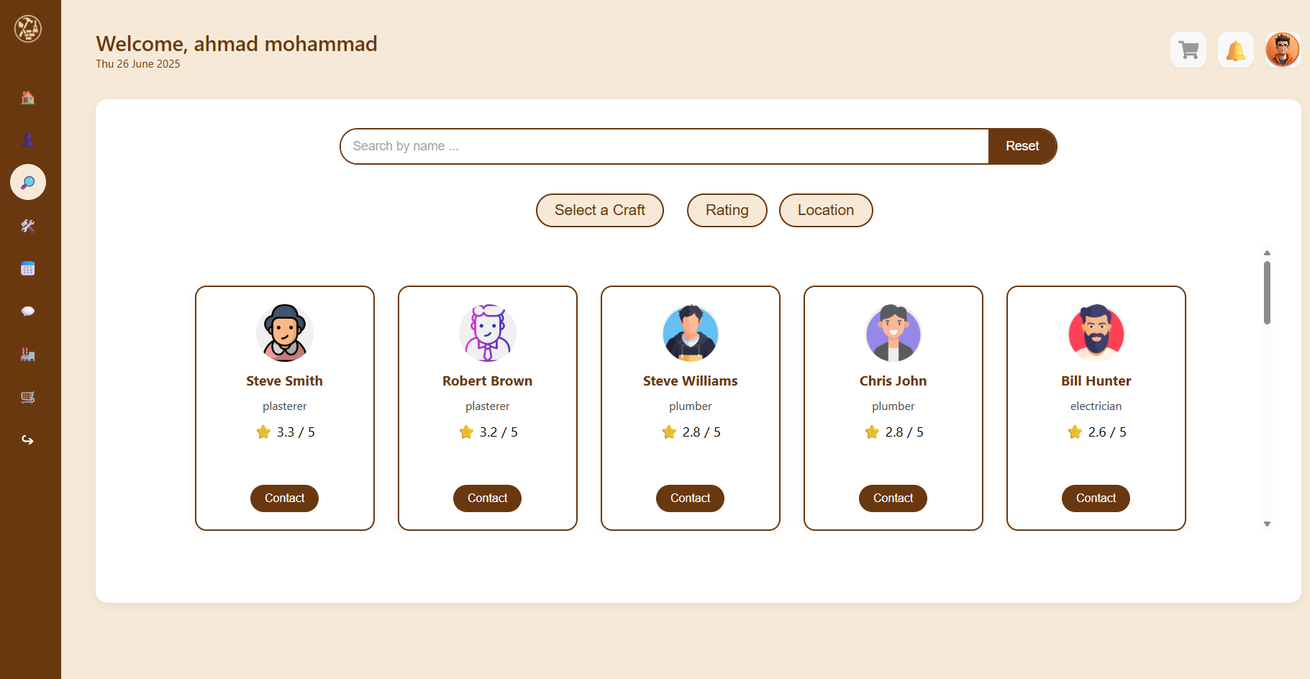
Search

Slide 14
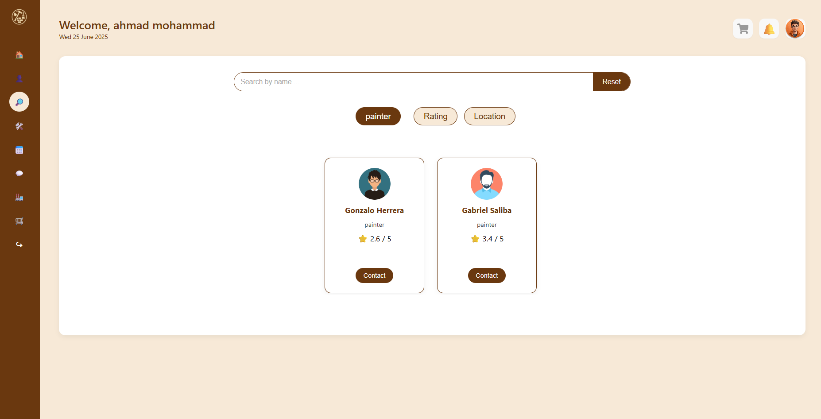
Craft Filter

Slide 15
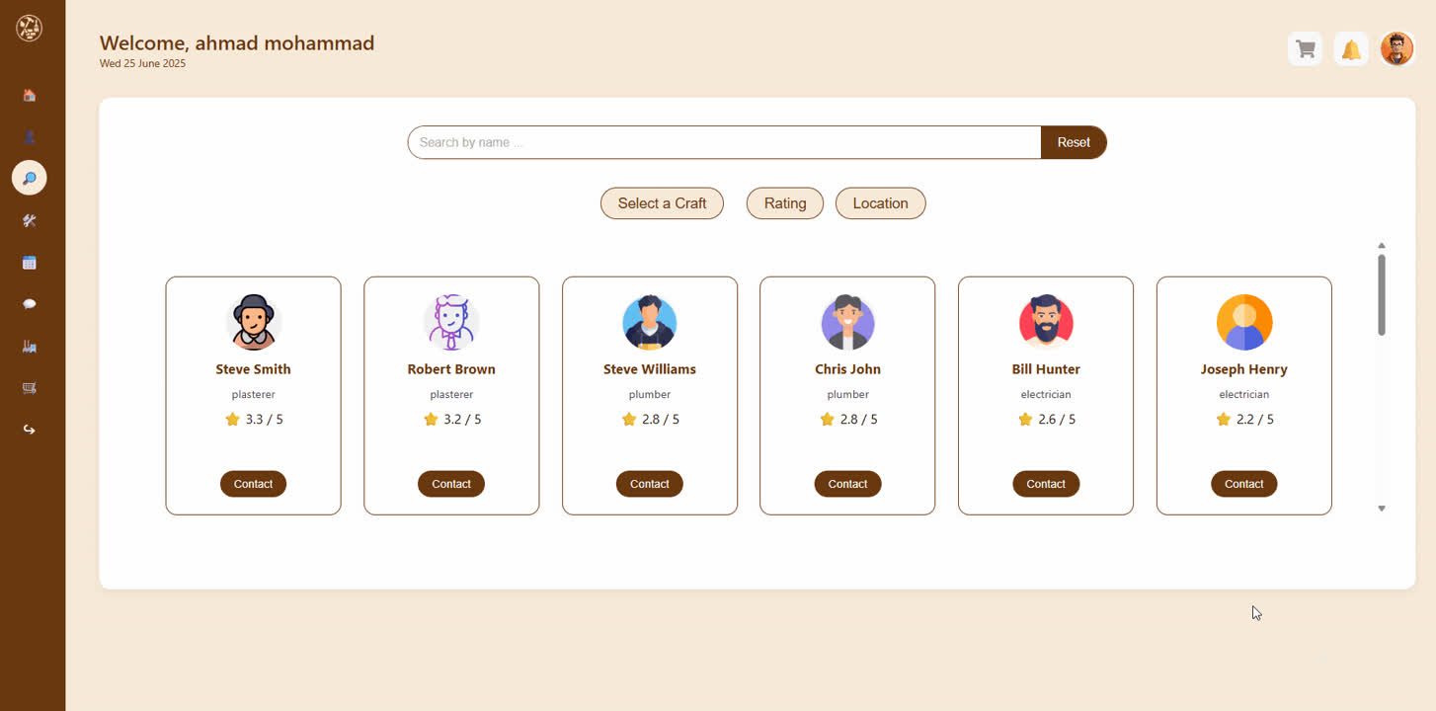
Rating Filter

Slide 16
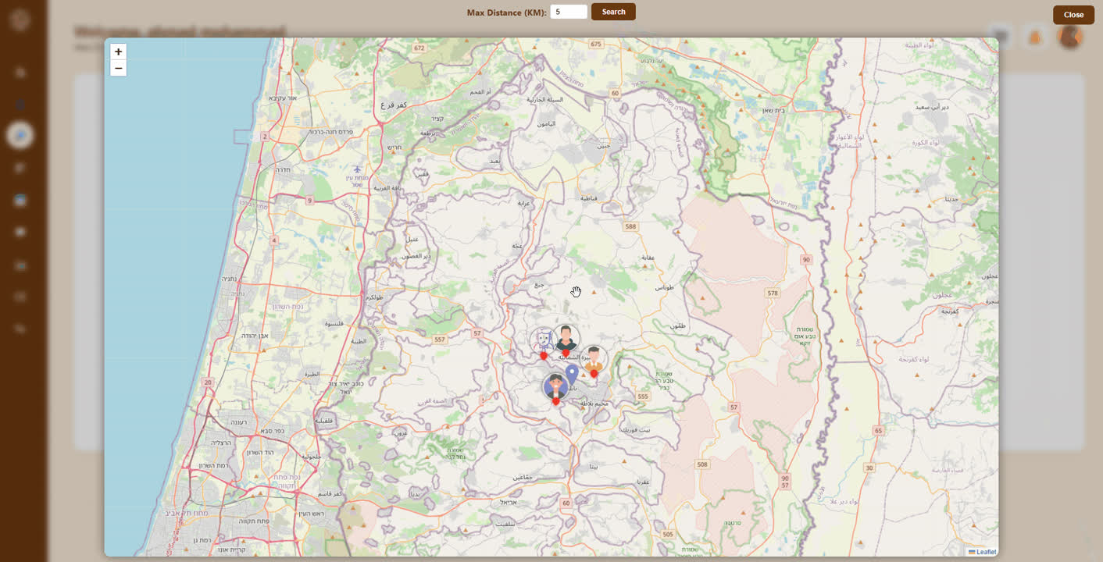
Nearby Crafters

Slide 17
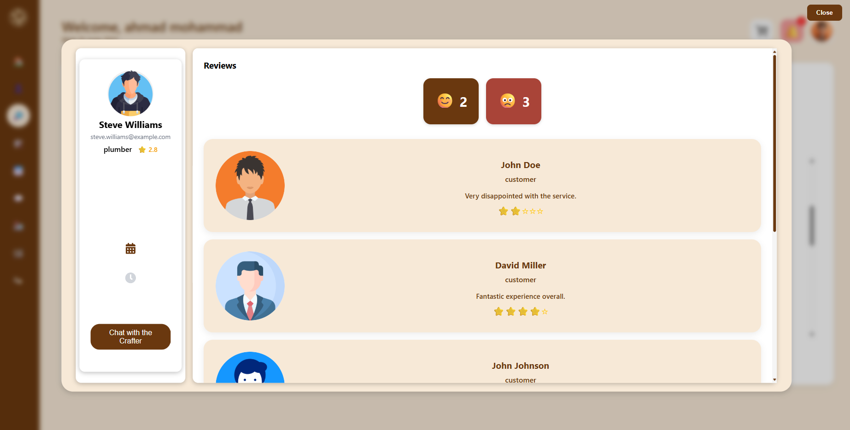
Sentiment Analysis

Slide 18
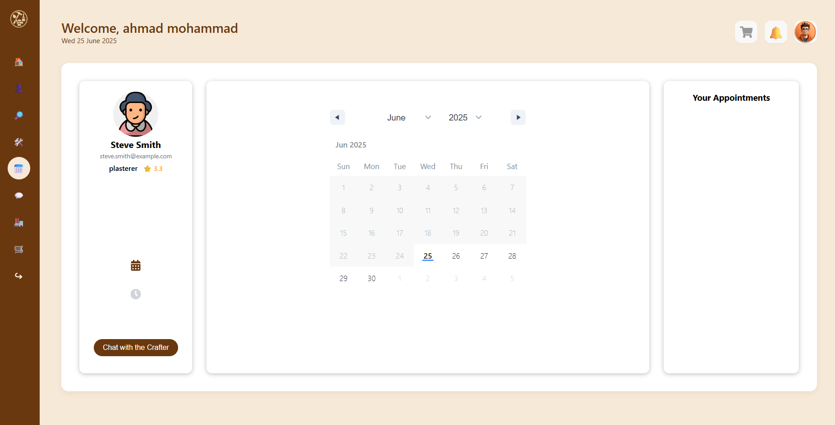
Appointments

Slide 19
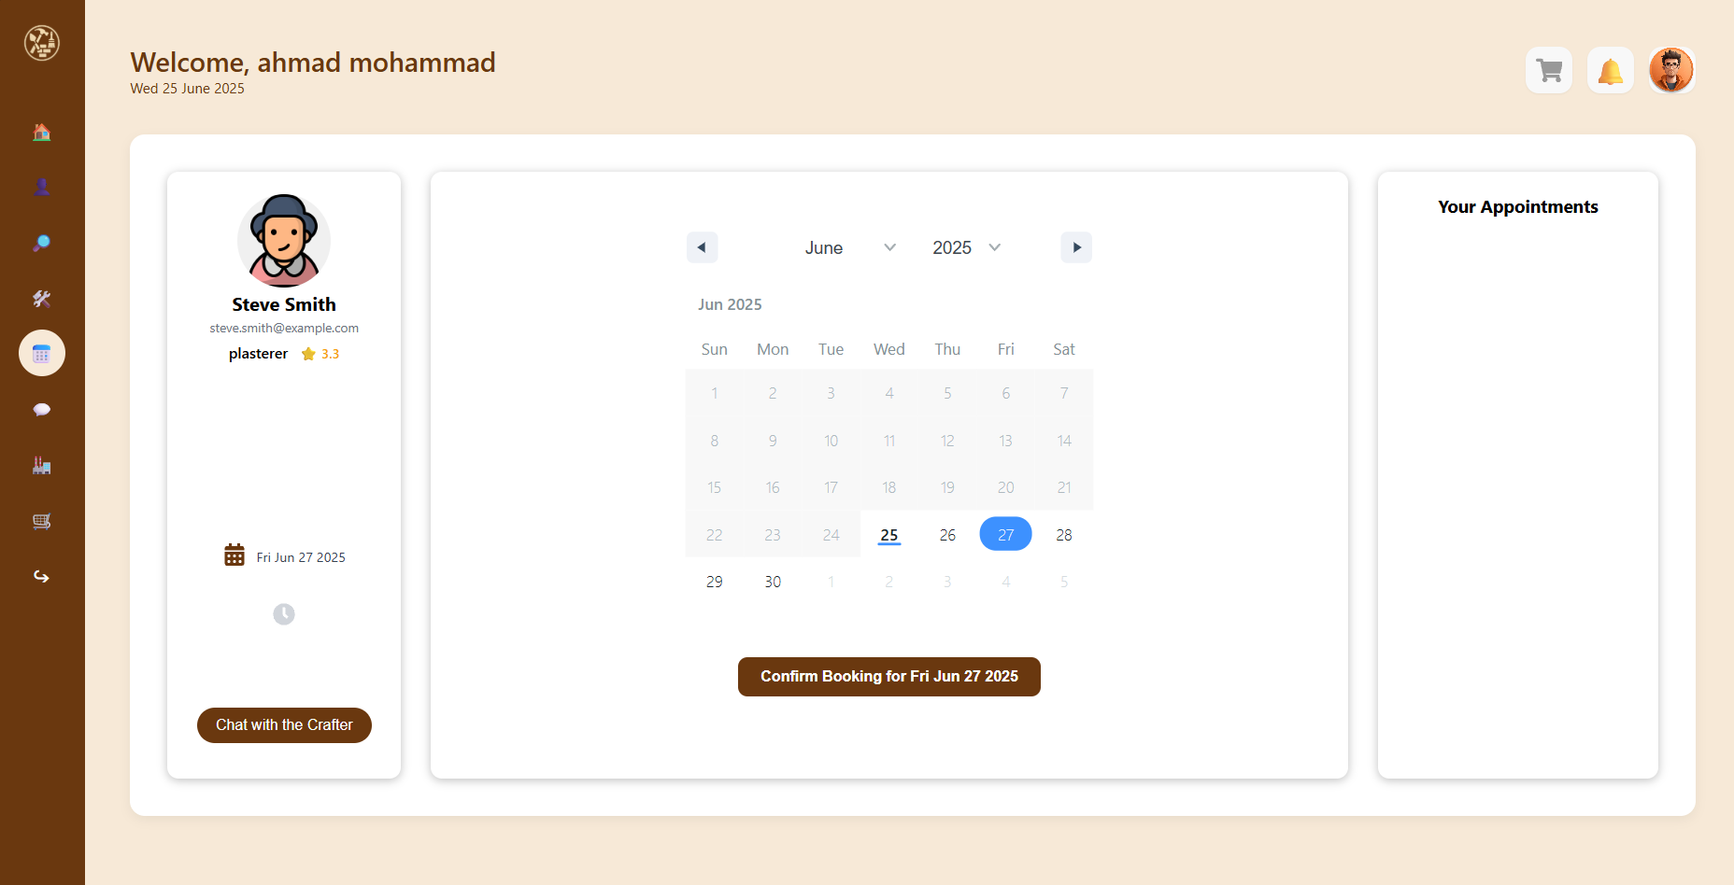
Appointments

Slide 20
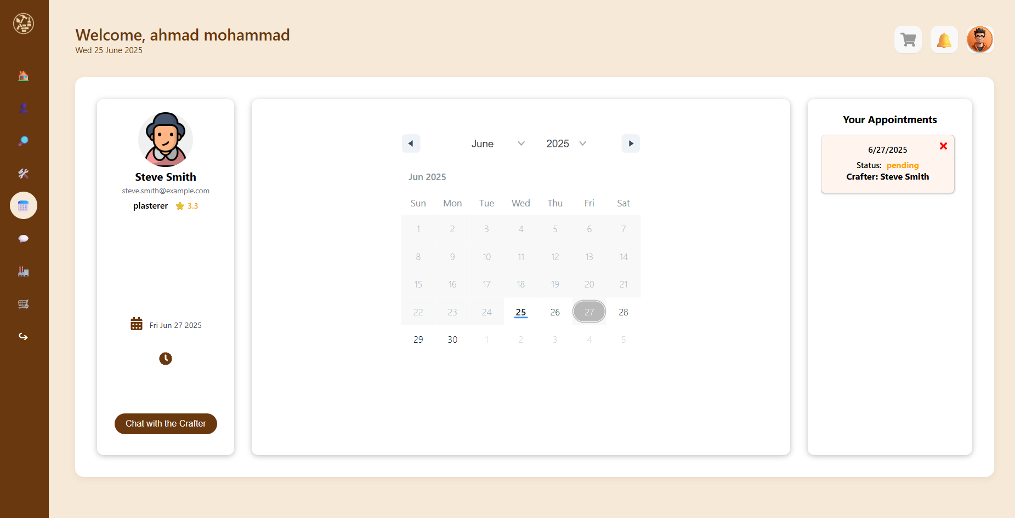
Appointments

Slide 21
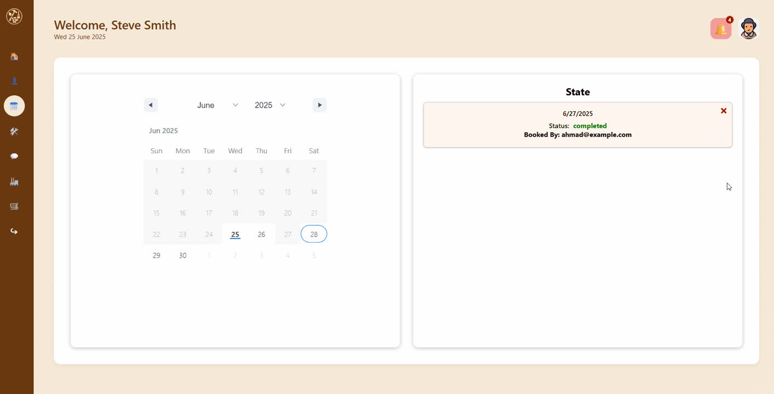
Crafter’s POV

Slide 22
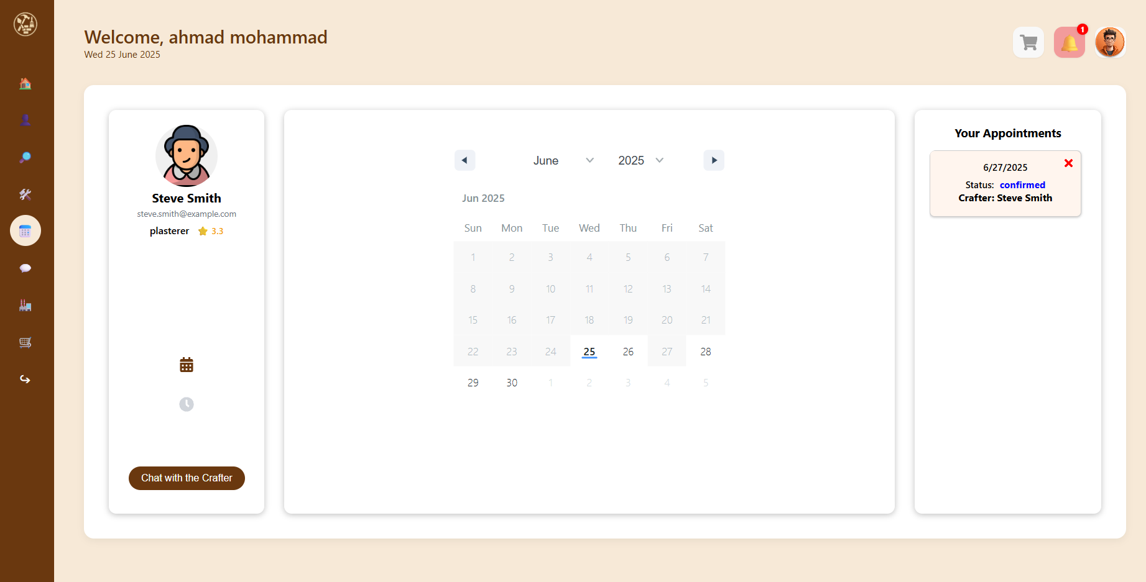
Appointments

Slide 23
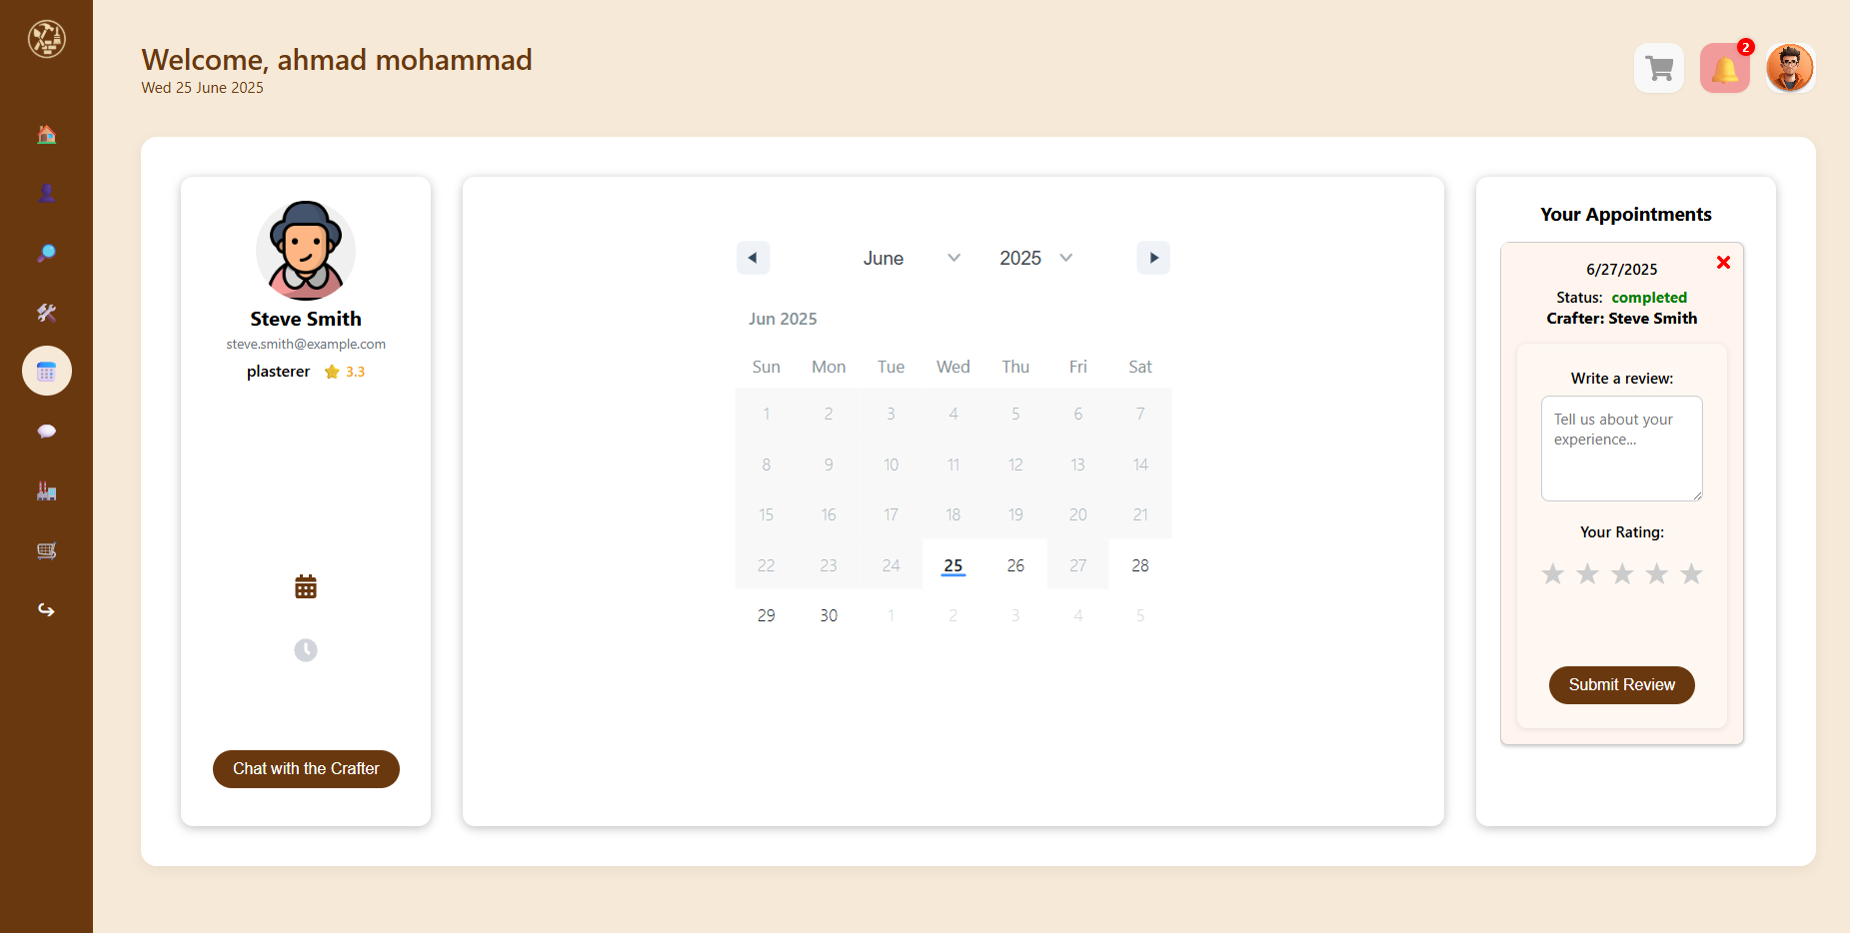
Appointments

Slide 24
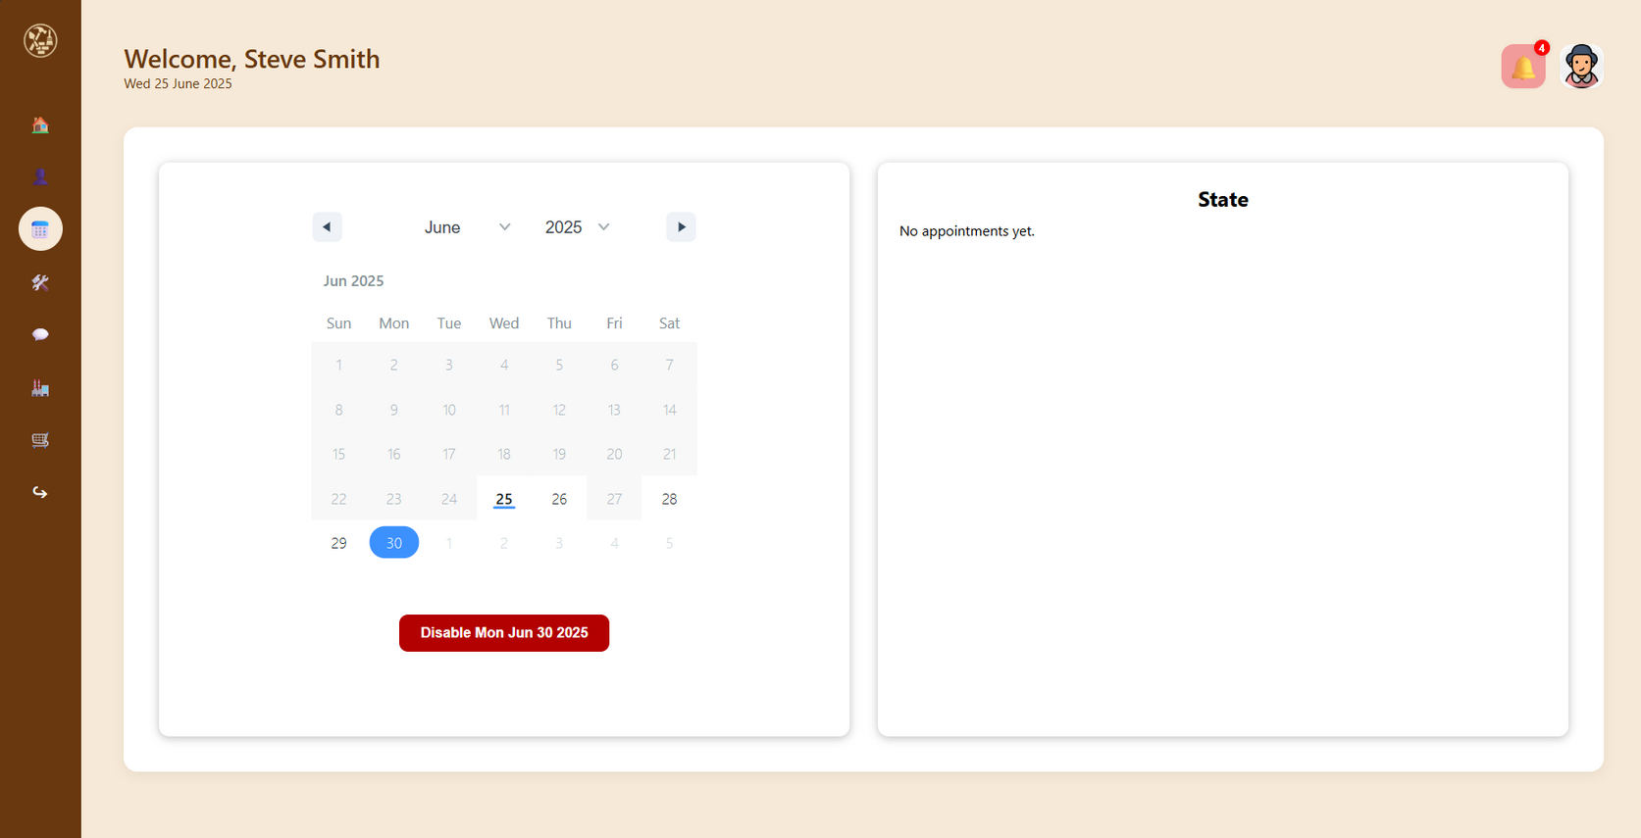
Appointments

Slide 25
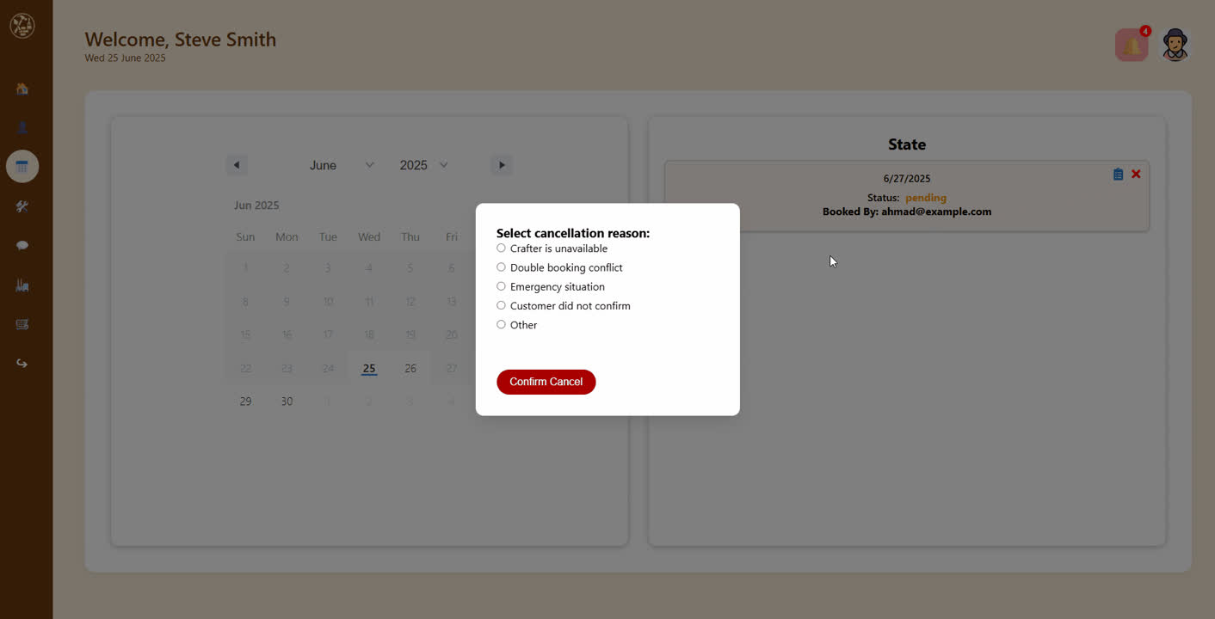
Appointments

Slide 26
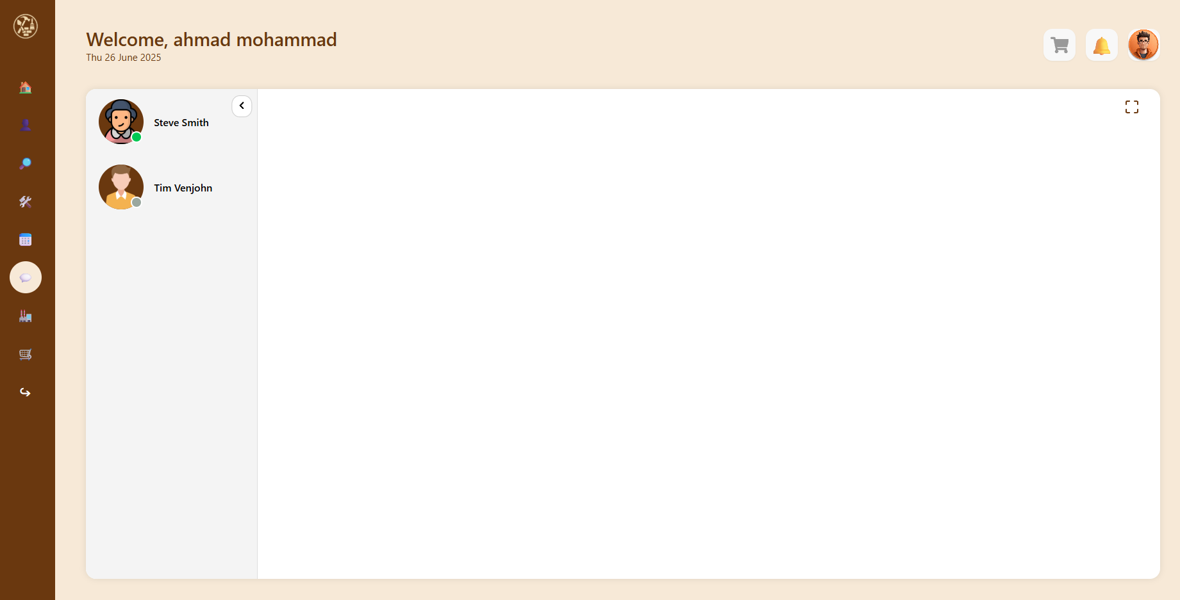
Chatting System

Slide 27
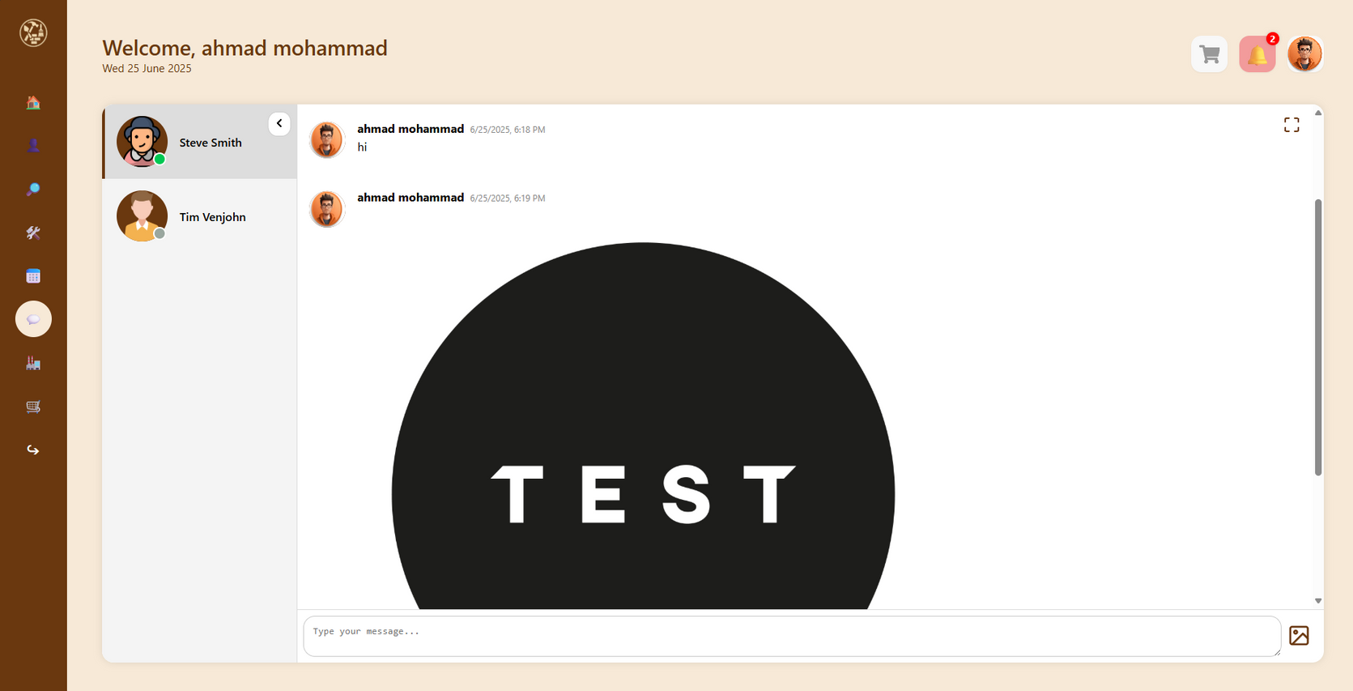
Chatting System

Slide 28
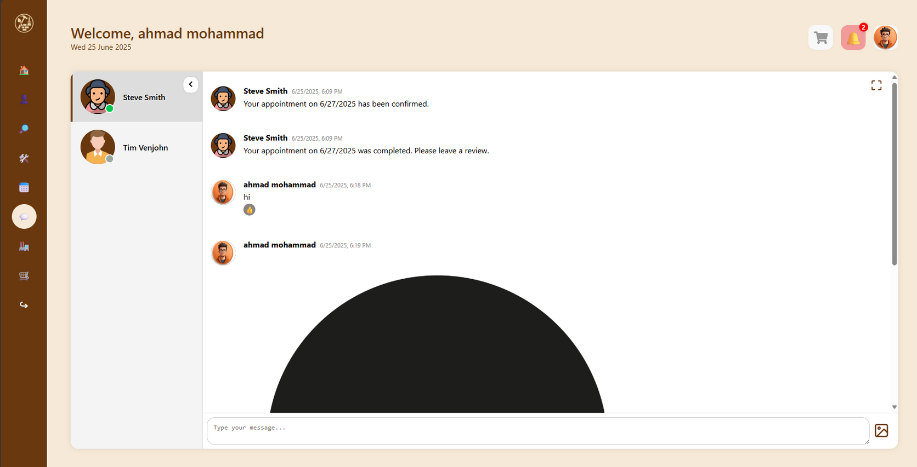
Chatting System

Slide 29
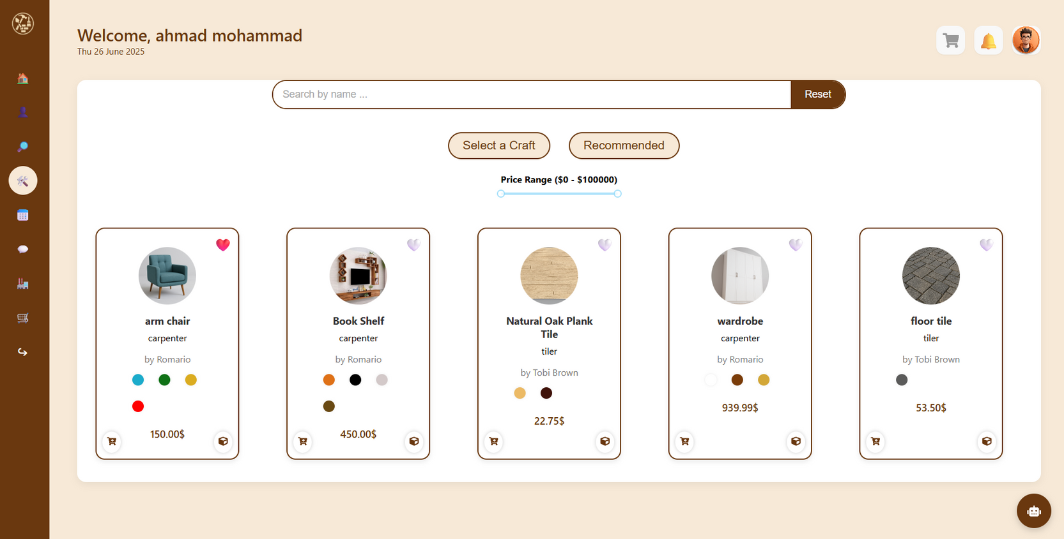
Templates

Slide 30
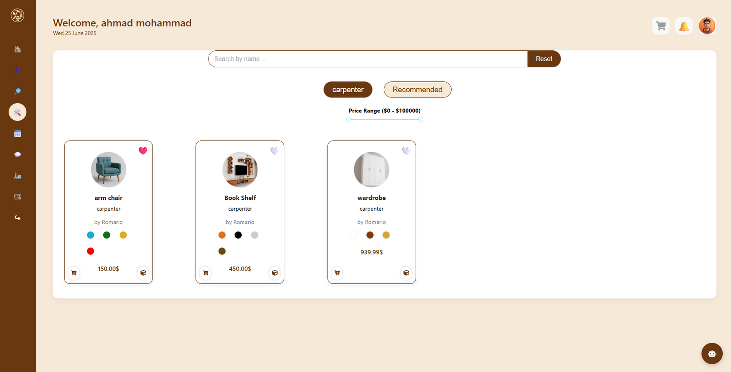
Craft Filter

Slide 31
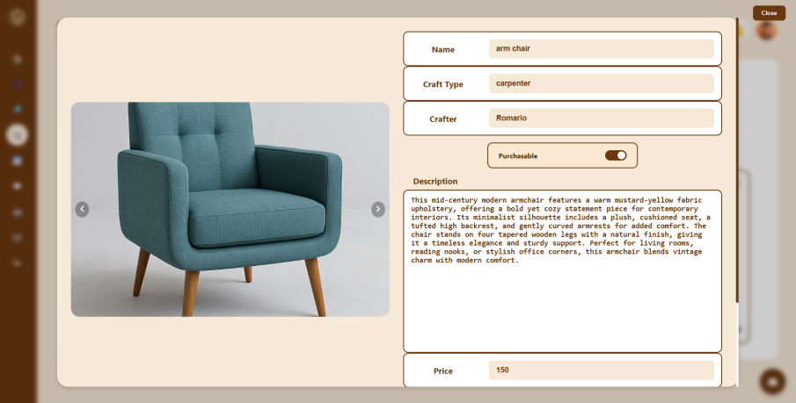
Template Info

Slide 32
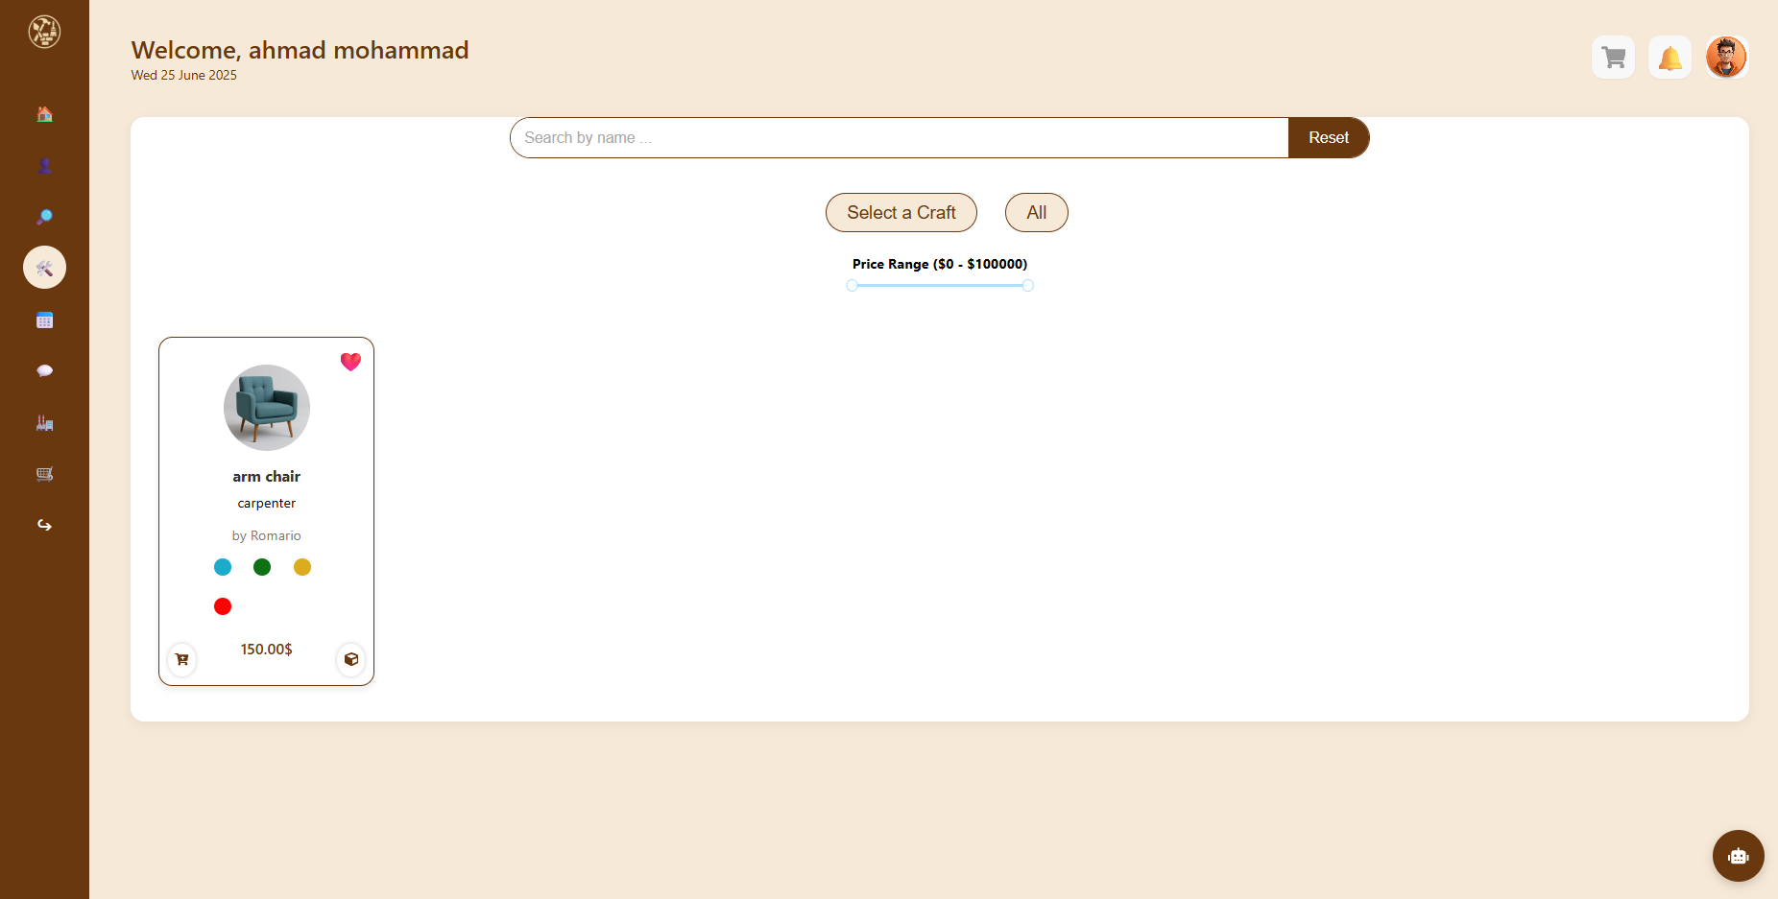
Recommendations

Slide 33
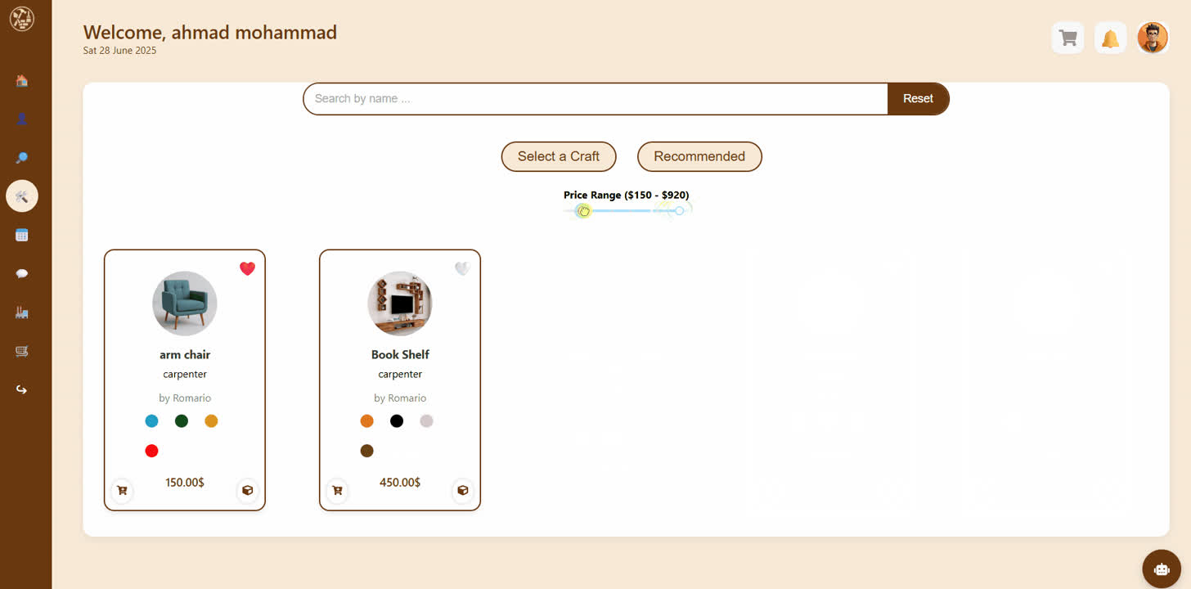
Price Filter

Slide 34
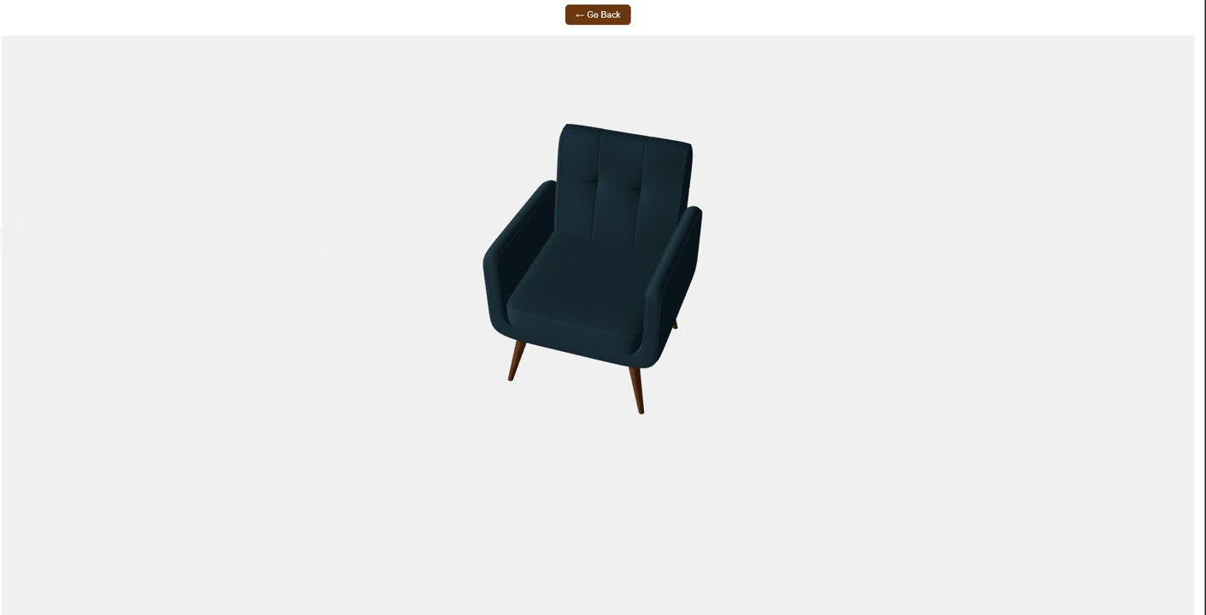
3D Models

Slide 35

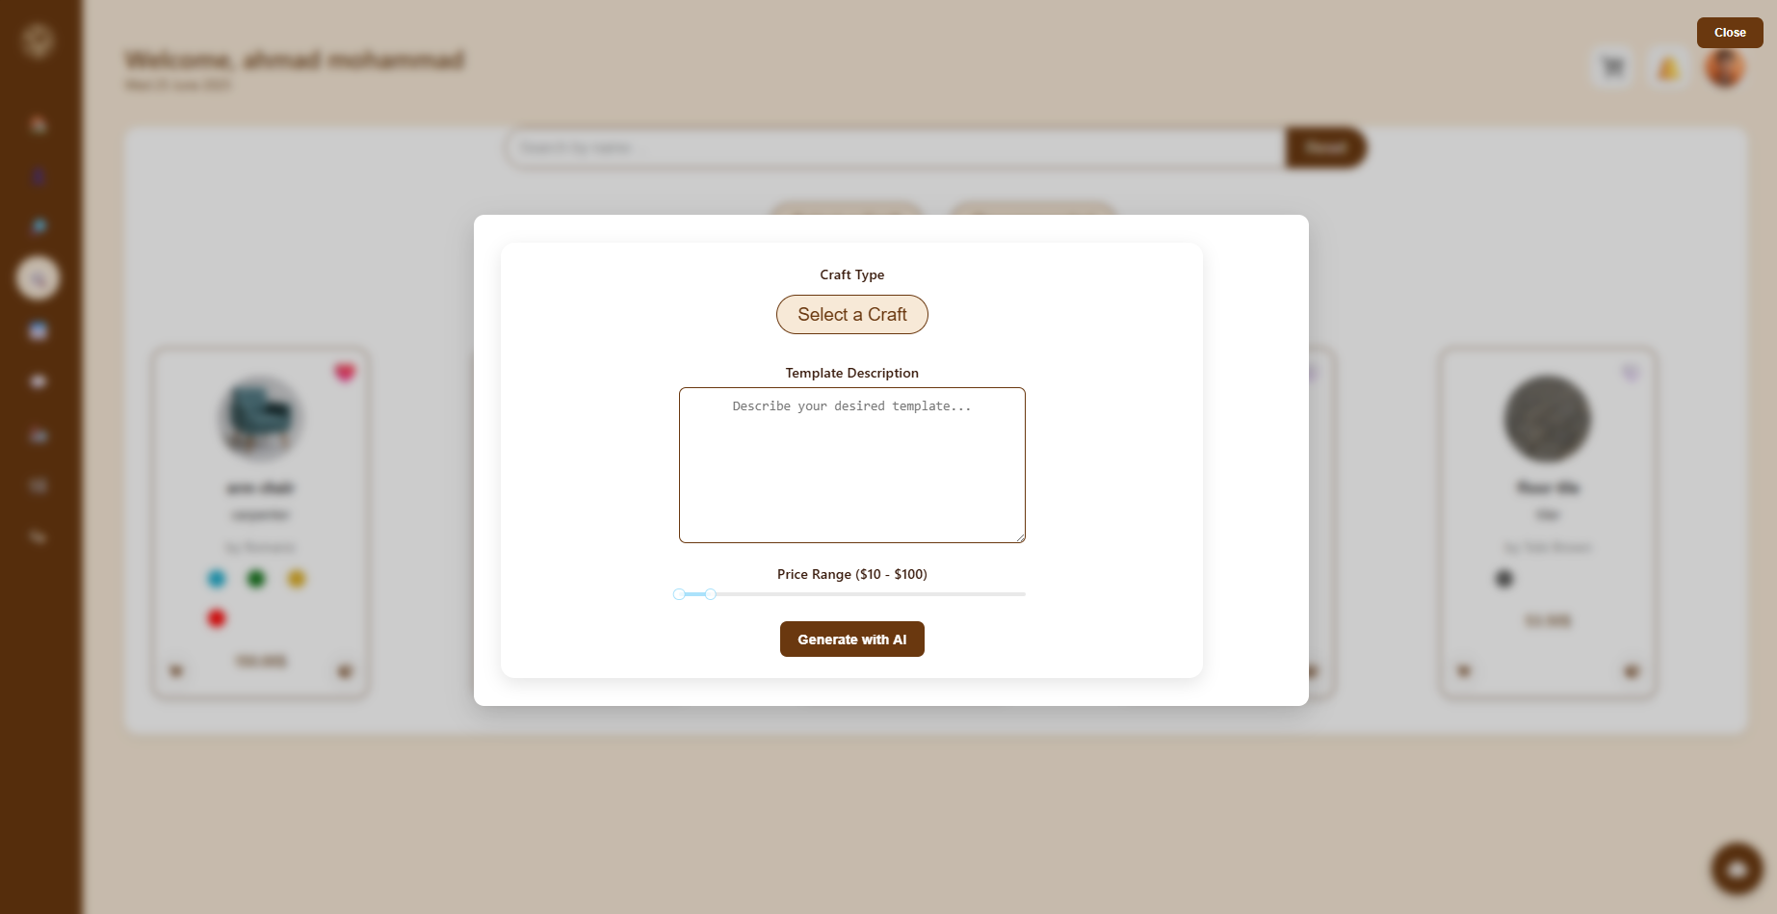
AI Generated Templates

Slide 36
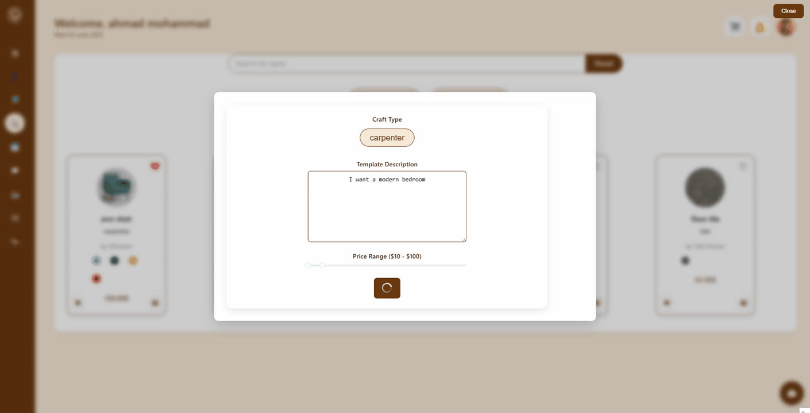
AI Generated Templates

Slide 37
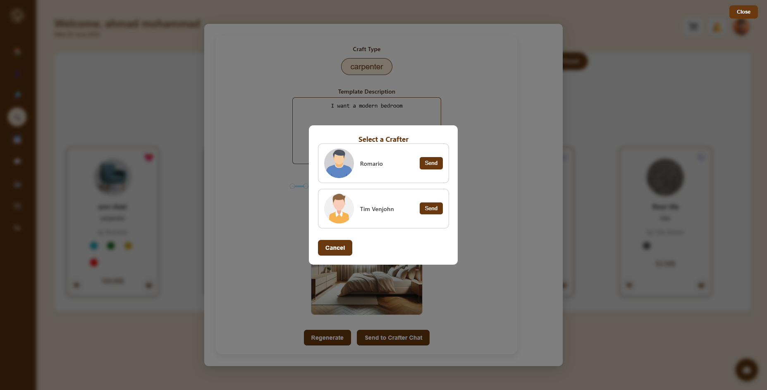
AI Generated Templates

Slide 38
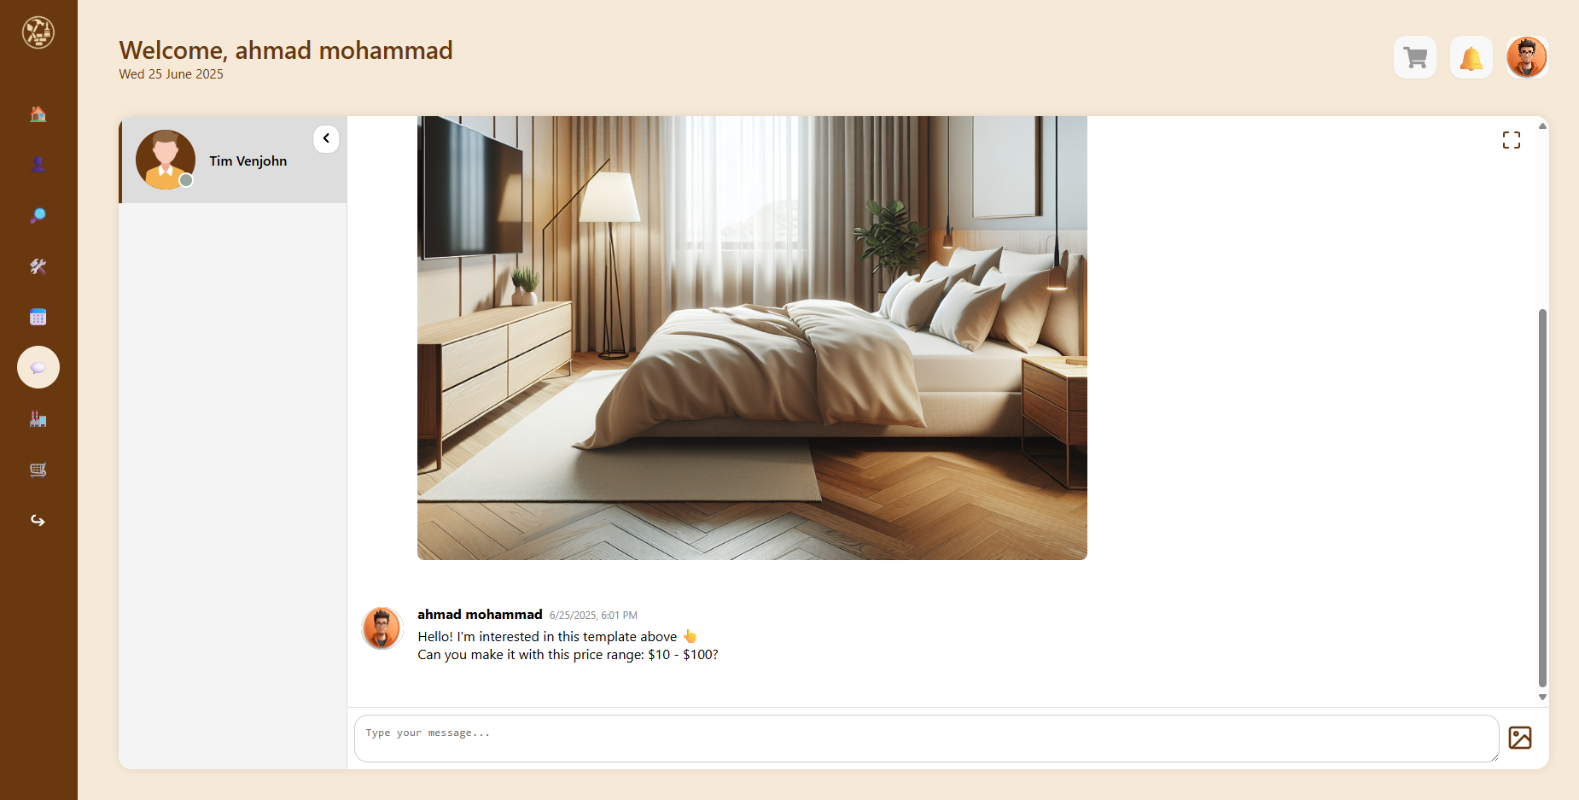
AI Generated Templates

Slide 39
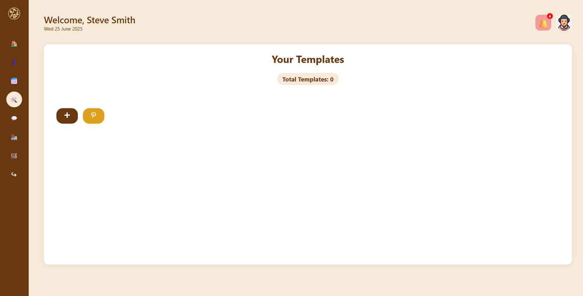
Crafter’s POV

Slide 40
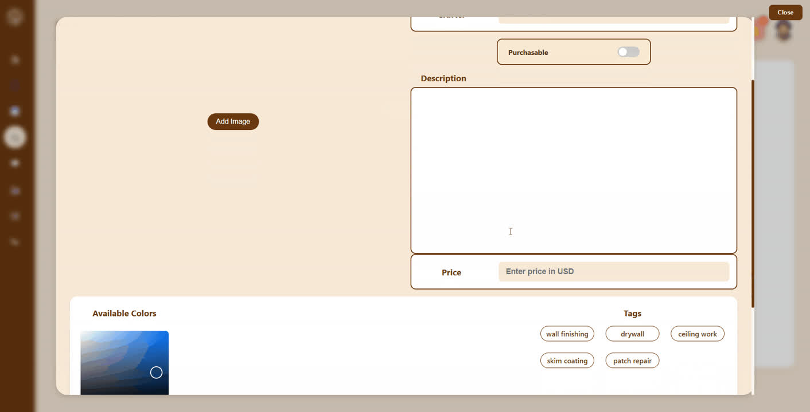
Template Creation

Slide 41

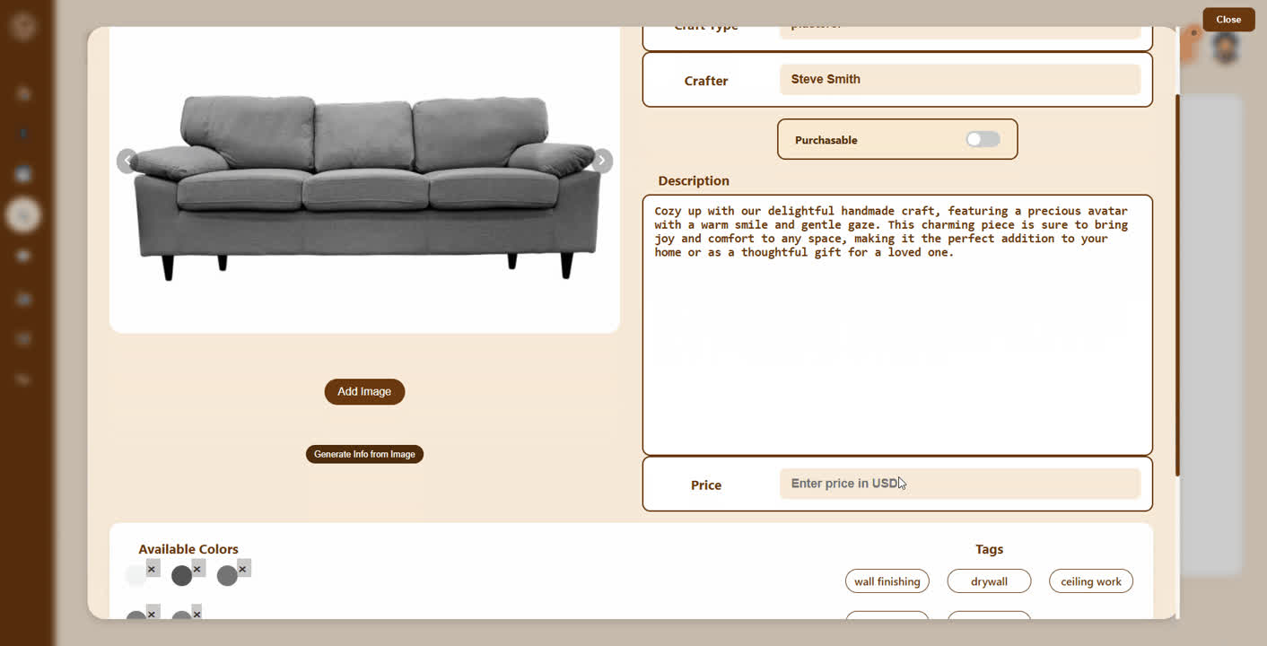
Generating Info Using Ollama

Slide 42

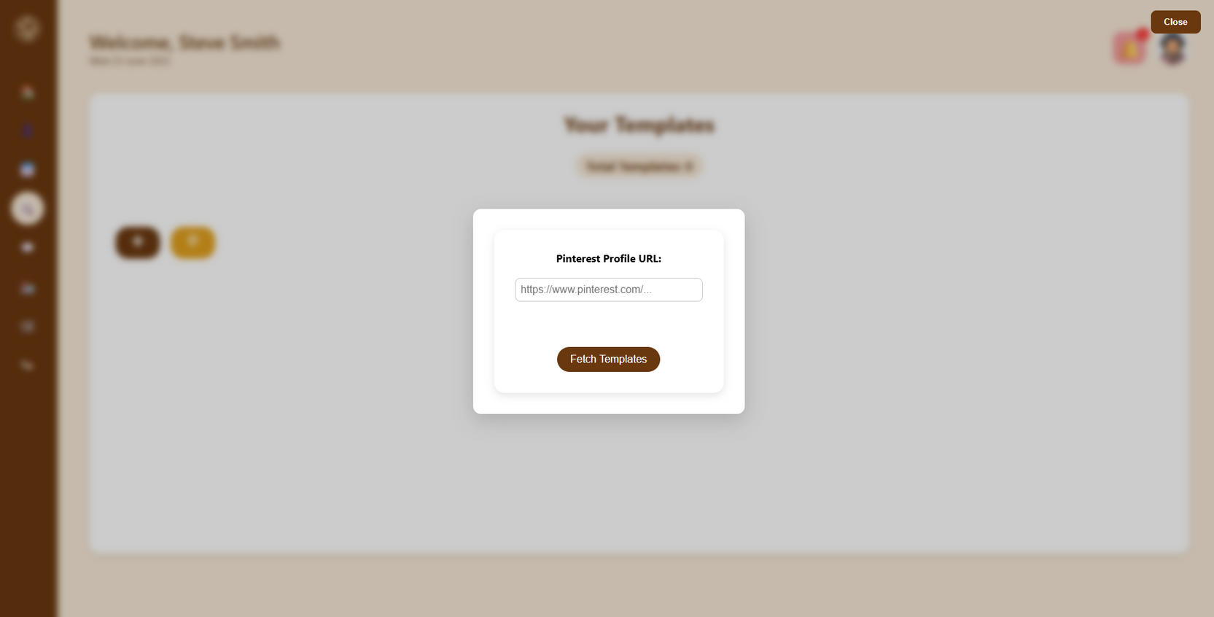
Web Scraping

Slide 43
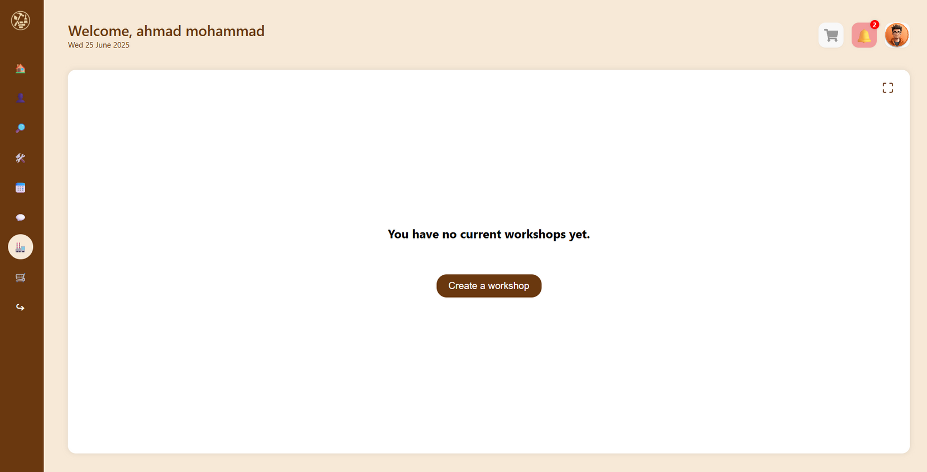
Workshops

Slide 44
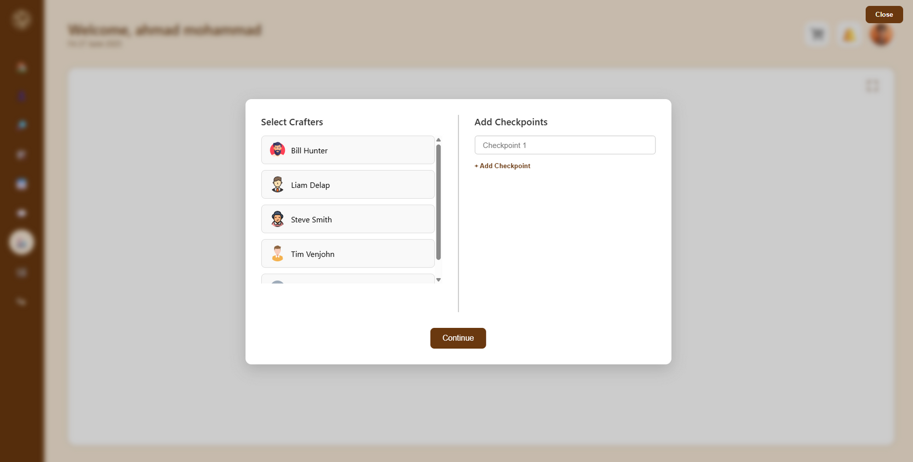
Workshops

Slide 45
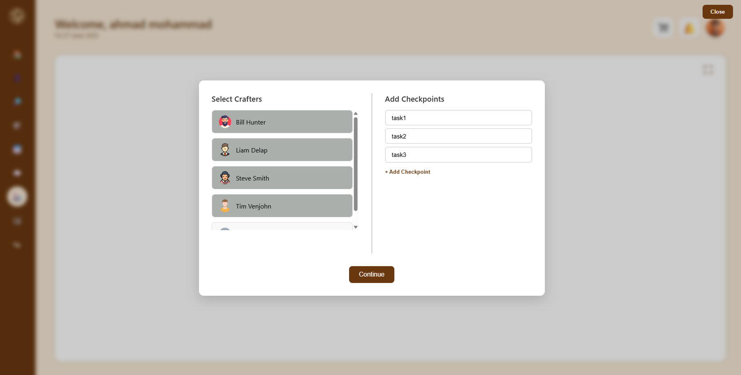
Workshops

Slide 46
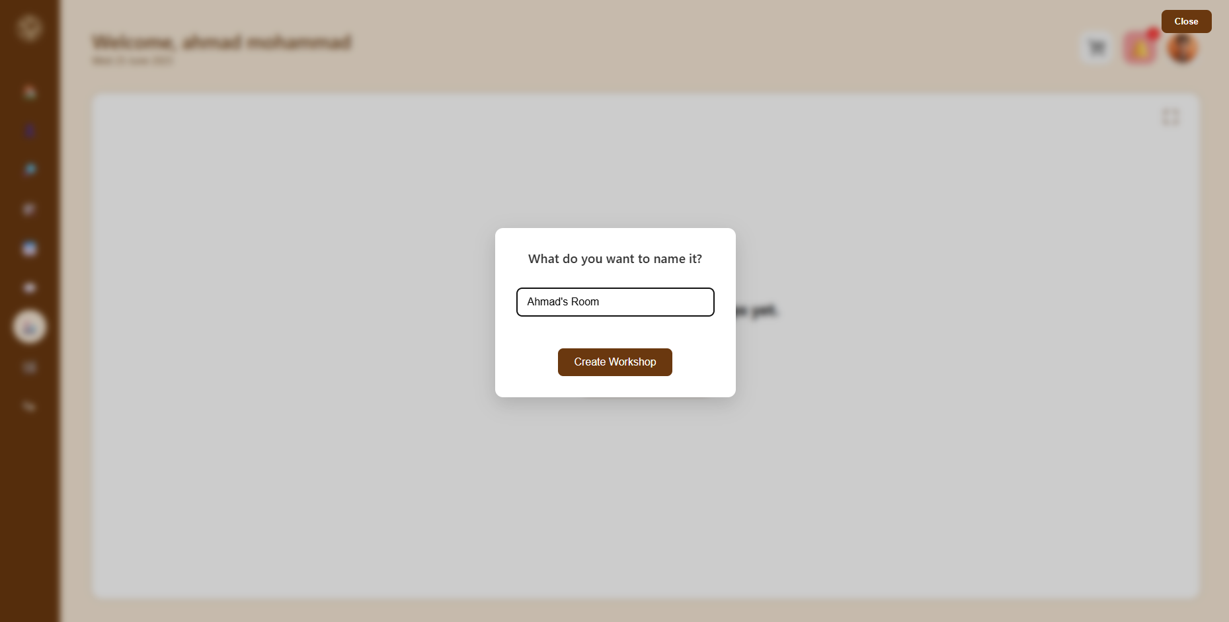
Workshops

Slide 47
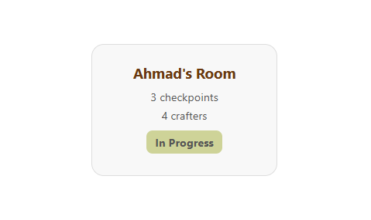
Workshops

Slide 48
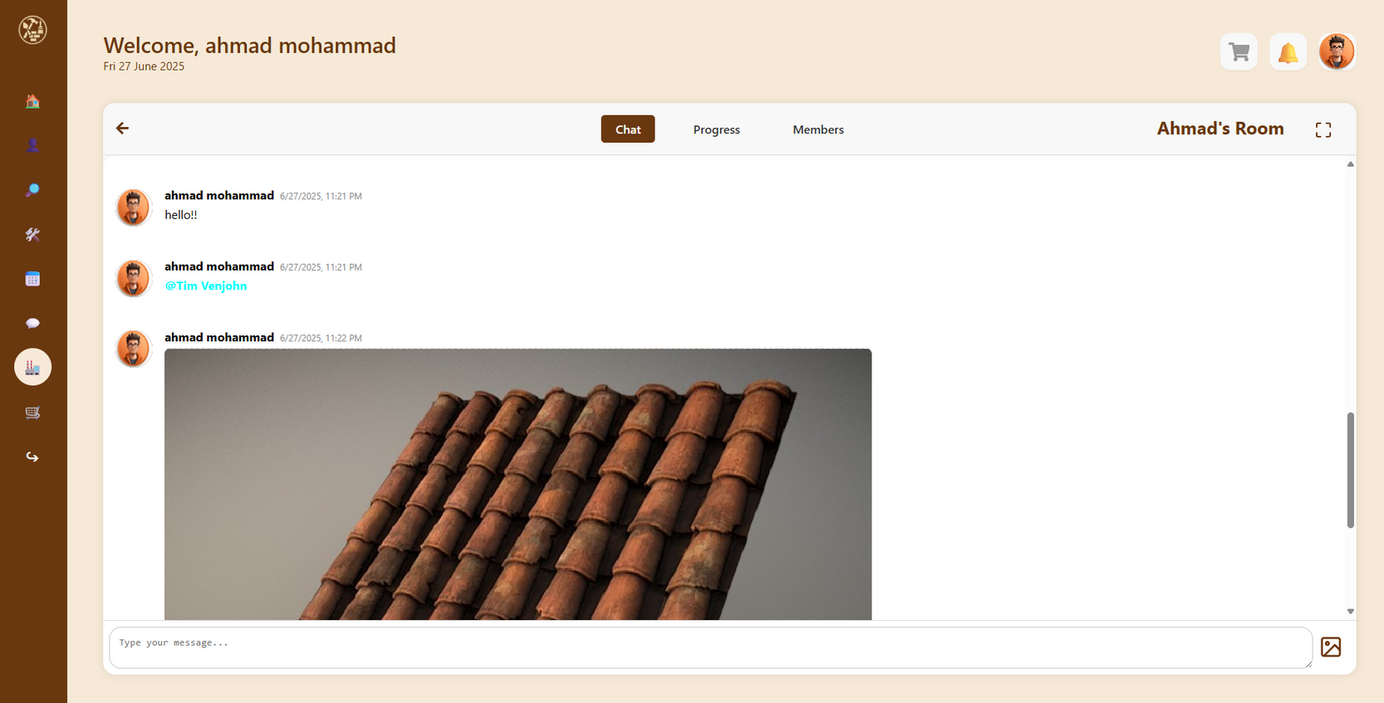
Group Chat

Slide 49
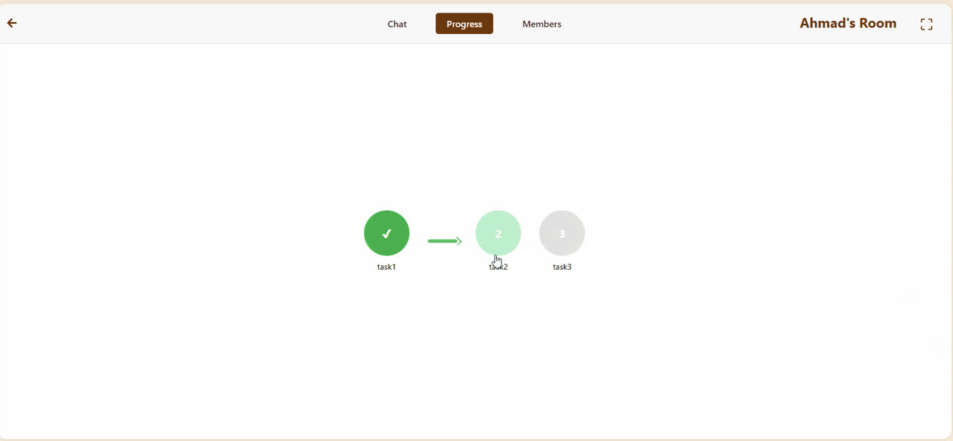
Progress Tracker

Slide 50
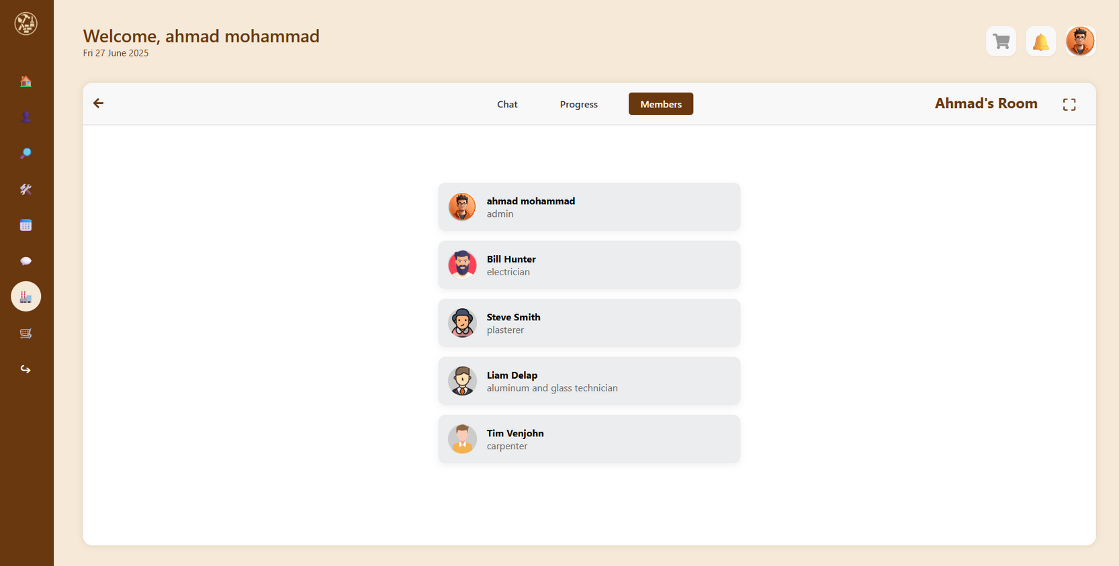
Members

Slide 51
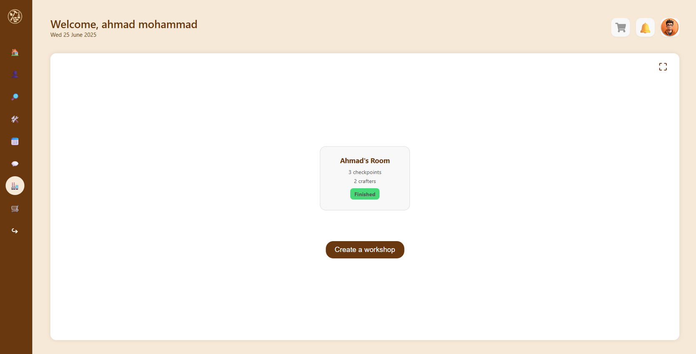
Workshops

Slide 52
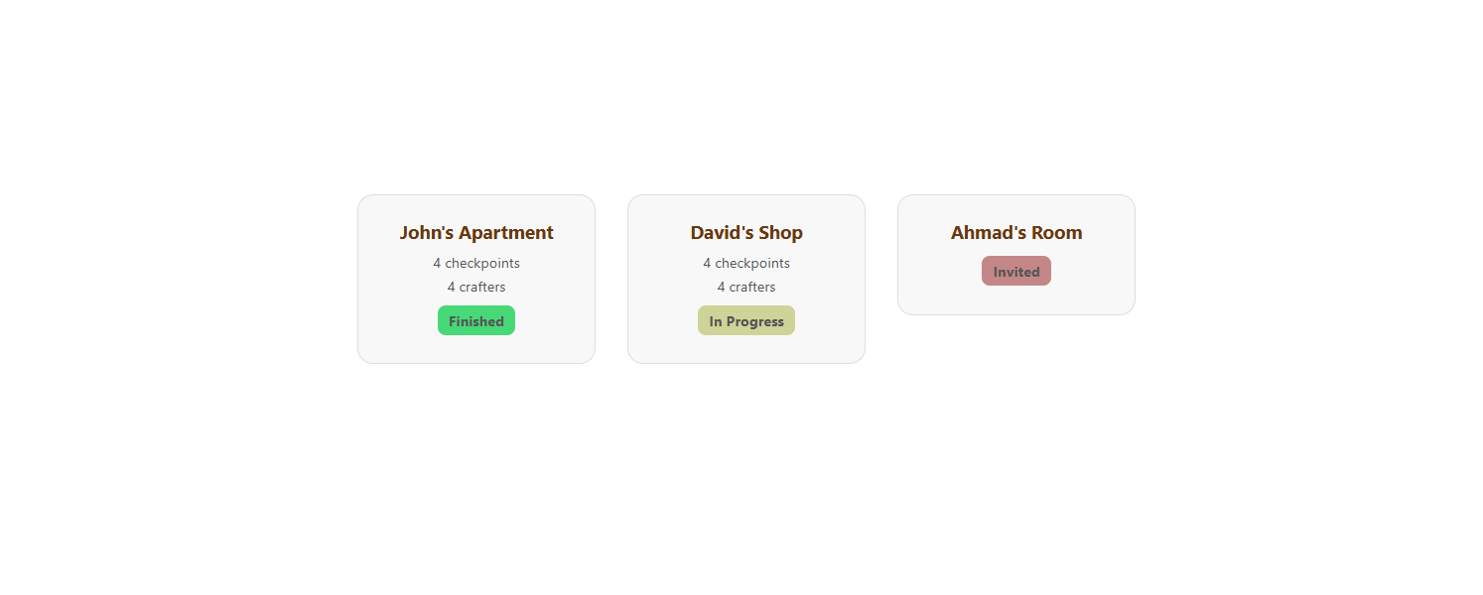
Crafters POV

Slide 53
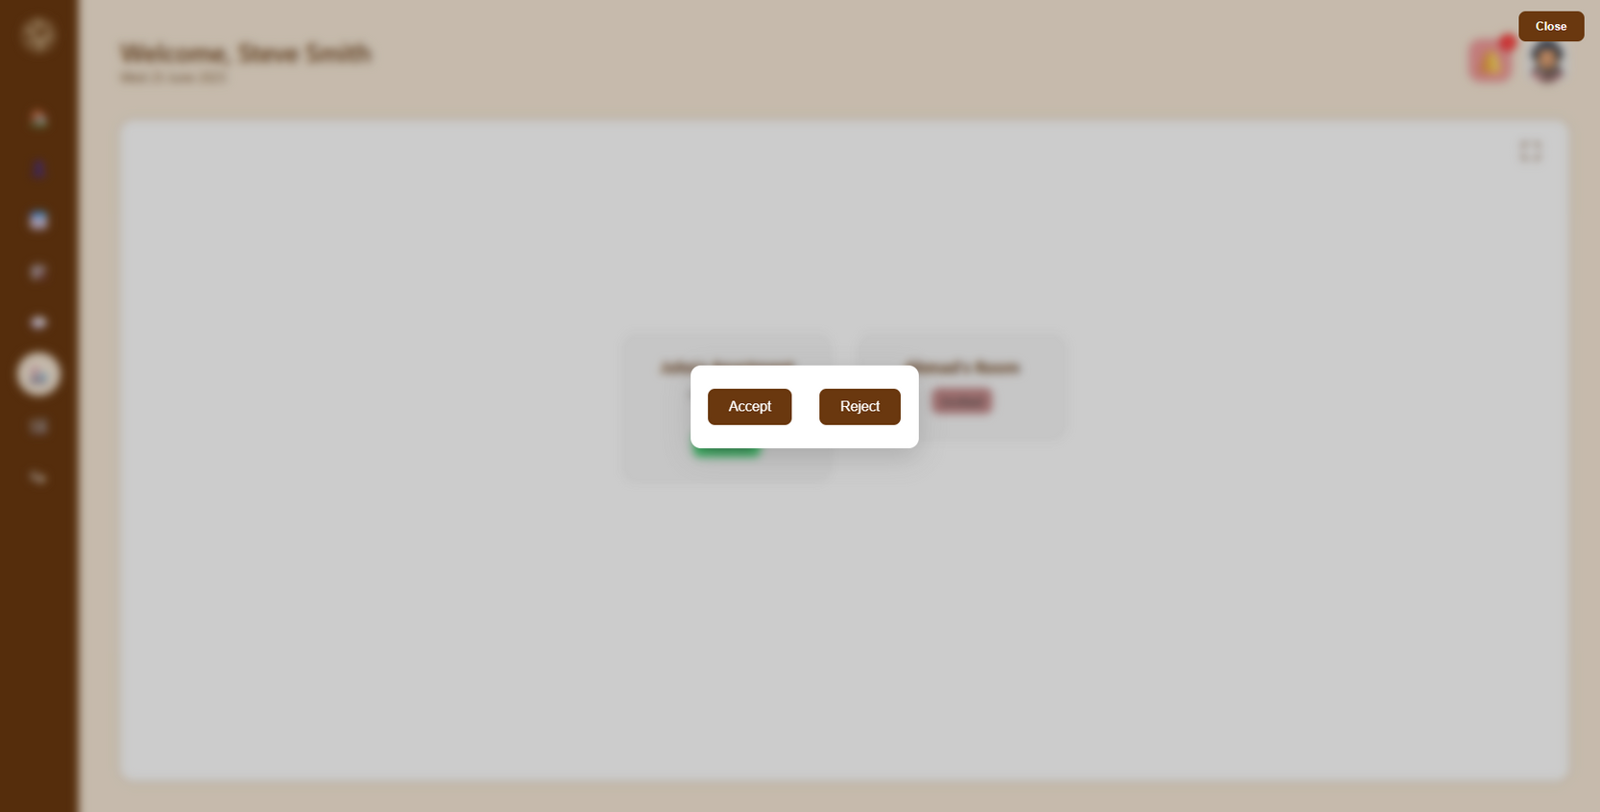
Crafters POV

Slide 54

Orders

Slide 55

Payment

Slide 56

Payment

Slide 57

Orders History

Slide 58

Crafters POV

Slide 59

Custom Orders

Slide 60

Notifications

Slide 61

Notifications

Slide 62

Administrator

Slide 63

Administrator

Slide 64

Administrator

Slide 65

Administrator

Slide 66

Administrator

Slide 67

Mobile App

Slide 68





Slide 69





Slide 70


Slide 71


Slide 72





Slide 73




Slide 74




Slide 75




Slide 76


Slide 77











Tech and External Services

Slide 78
Future Work
-Stripe Integration
-Content Analyzer
-3D Model Generator

Slide 79
Thanks For Watching ♥

