Slide 1

NajahCodeX
Omar Shkokani and Shadi Basha
Supervised by: Dr.Ashraf Armoush

Slide 2
Introduction
What is NajahCodeX ?
Why NajahCodeX ?
What does it offer ?

Slide 3

NajahCodeX
Welcome to Najah Codex, where coding enthusiasts converge to hone their skills and conquer challenges.

Slide 4
Main Features
Enrolling in Plans
Participating in Competitions and Problem Solving
Testing Code
Joining Different Groups
Group Management
Administration
Najah Codex empowers students with diverse features, including plan enrollment, competition participation, code testing, group management, and comprehensive administration.

Slide 5
Literature Review
What is problem solving ?
What other platforms provide this service ?

Slide 6
Problem Solving
PROBLEM SOLVING IS FINDING SOLUTIONS TO CHALLENGES OR PUZZLES, OFTEN IN CODING BY CREATING INSTRUCTIONS FOR A COMPUTER TO EXECUTE TASKS EFFICIENTLY.

Slide 7


Problem Solving Platforms
CODE FORCES
HACKER RANK

Slide 8
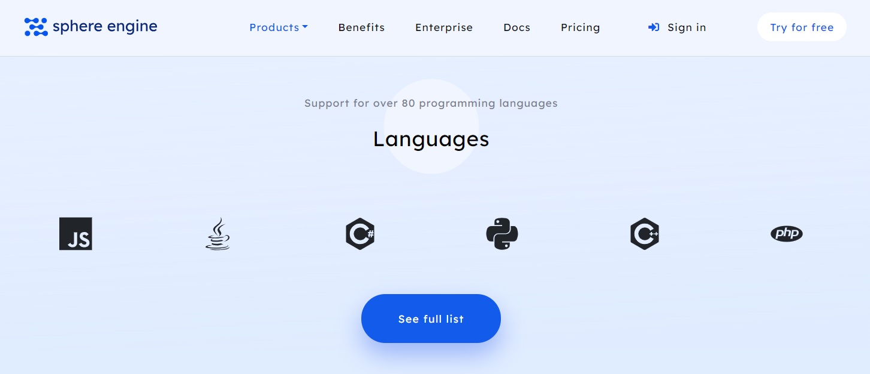
Paid API
Hackerearth API V4
https://rextester.com/

Slide 9
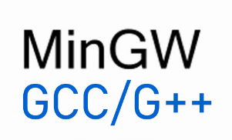
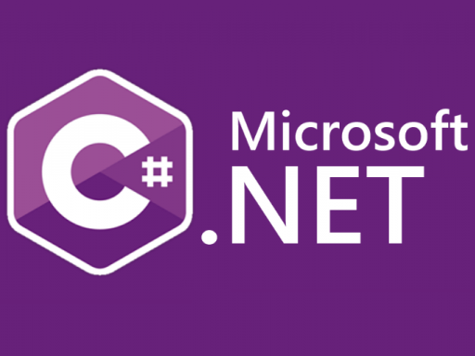


Compilers
Compiled Programming Languages | Compilers
C/C++
C#
Java
Go

Slide 10


Interpreter
Interpreted Programming Languages | Interpreter
Python
JavaScript

Slide 11
Future Work
NajahCodeX has potential for further enhancement in several areas: Notification System: Implementing a notification system to alert users about
New posts, announcements regarding competitions, and other relevant updates can improve user engagement and communication efficiency. Language Coverage: Covering most programming languages.
Security Enhancements: Introducing additional security measures and features
To safeguard user data and ensure the integrity of the platform will enhance user trust and confidence in NajahCodeX.

