Slide 1




PackSort
Automated Package Sorting System
By: Baker Razi Wael Yaeesh & Mohammad Maher Mohammad Himuni
Project Supervisor: Dr. Abdallah Rashed
Notes:
1

Slide 2






Key Project Objectives
Package Identification
Physical Sorting
Versatile Sorting Modes
Dual Control
Safety & Diagnostics
Power Efficiency
Notes:
3

Slide 3
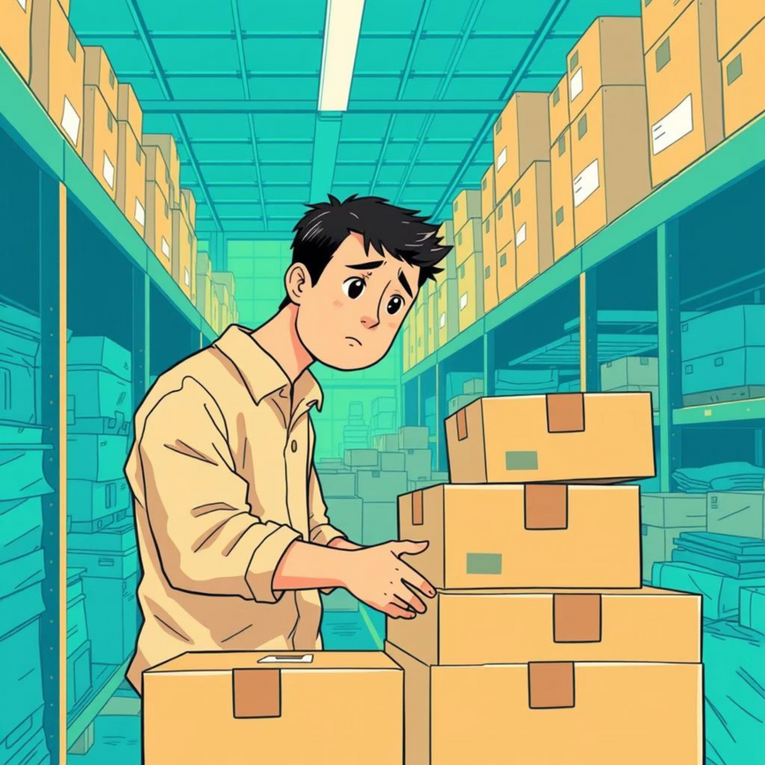

Significance & Impact
Addressing a Critical Need
Our Solution: Flexible Automation
Notes:
4

Slide 4
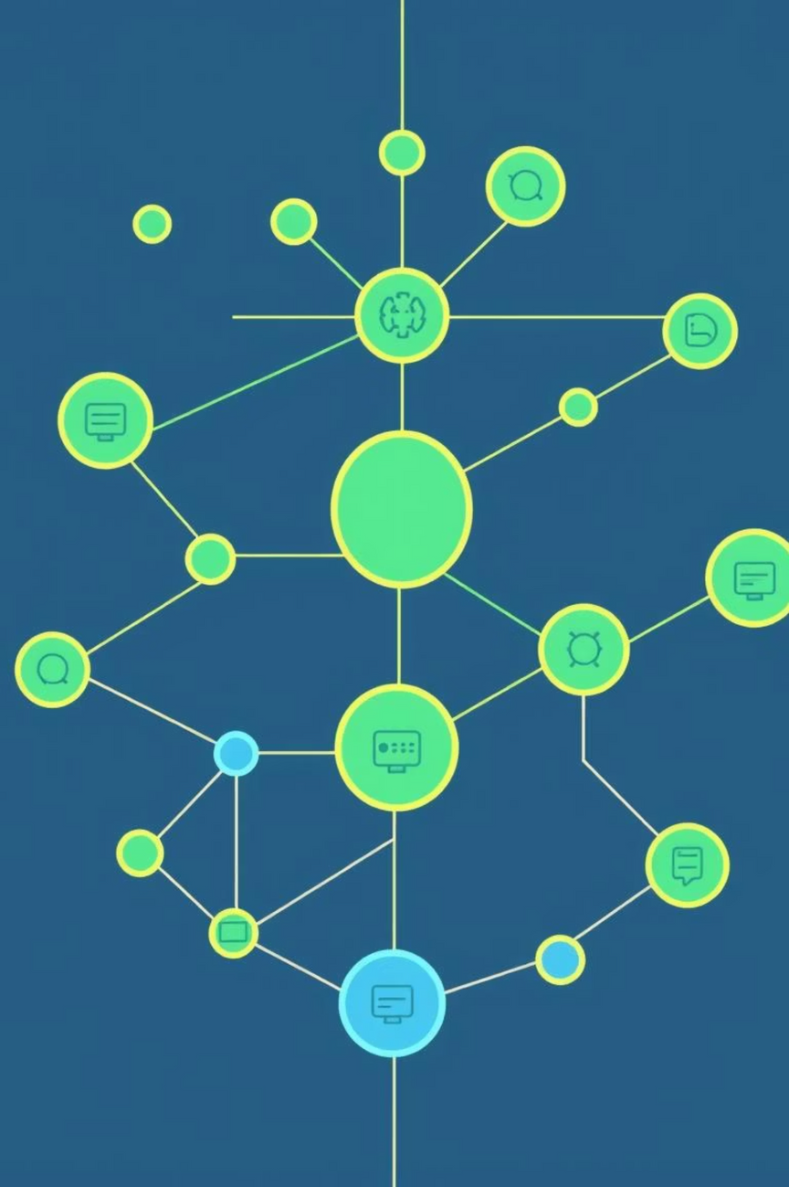




Core System Functionality
Multi-Parameter Sorting
Categorizes packages by barcode, color, and physical dimensions.
Distributed Control
Arduino Mega as central CPU, with Arduino Uno for barcode processing.
Mechanical Sorting
Conveyor belt powered by DC wiper motor; servo-actuated pusher arms for diversion.
Flexible Operation
Seven different criteria combinations: size, color, barcode, or combined.
Notes:
5

Slide 5
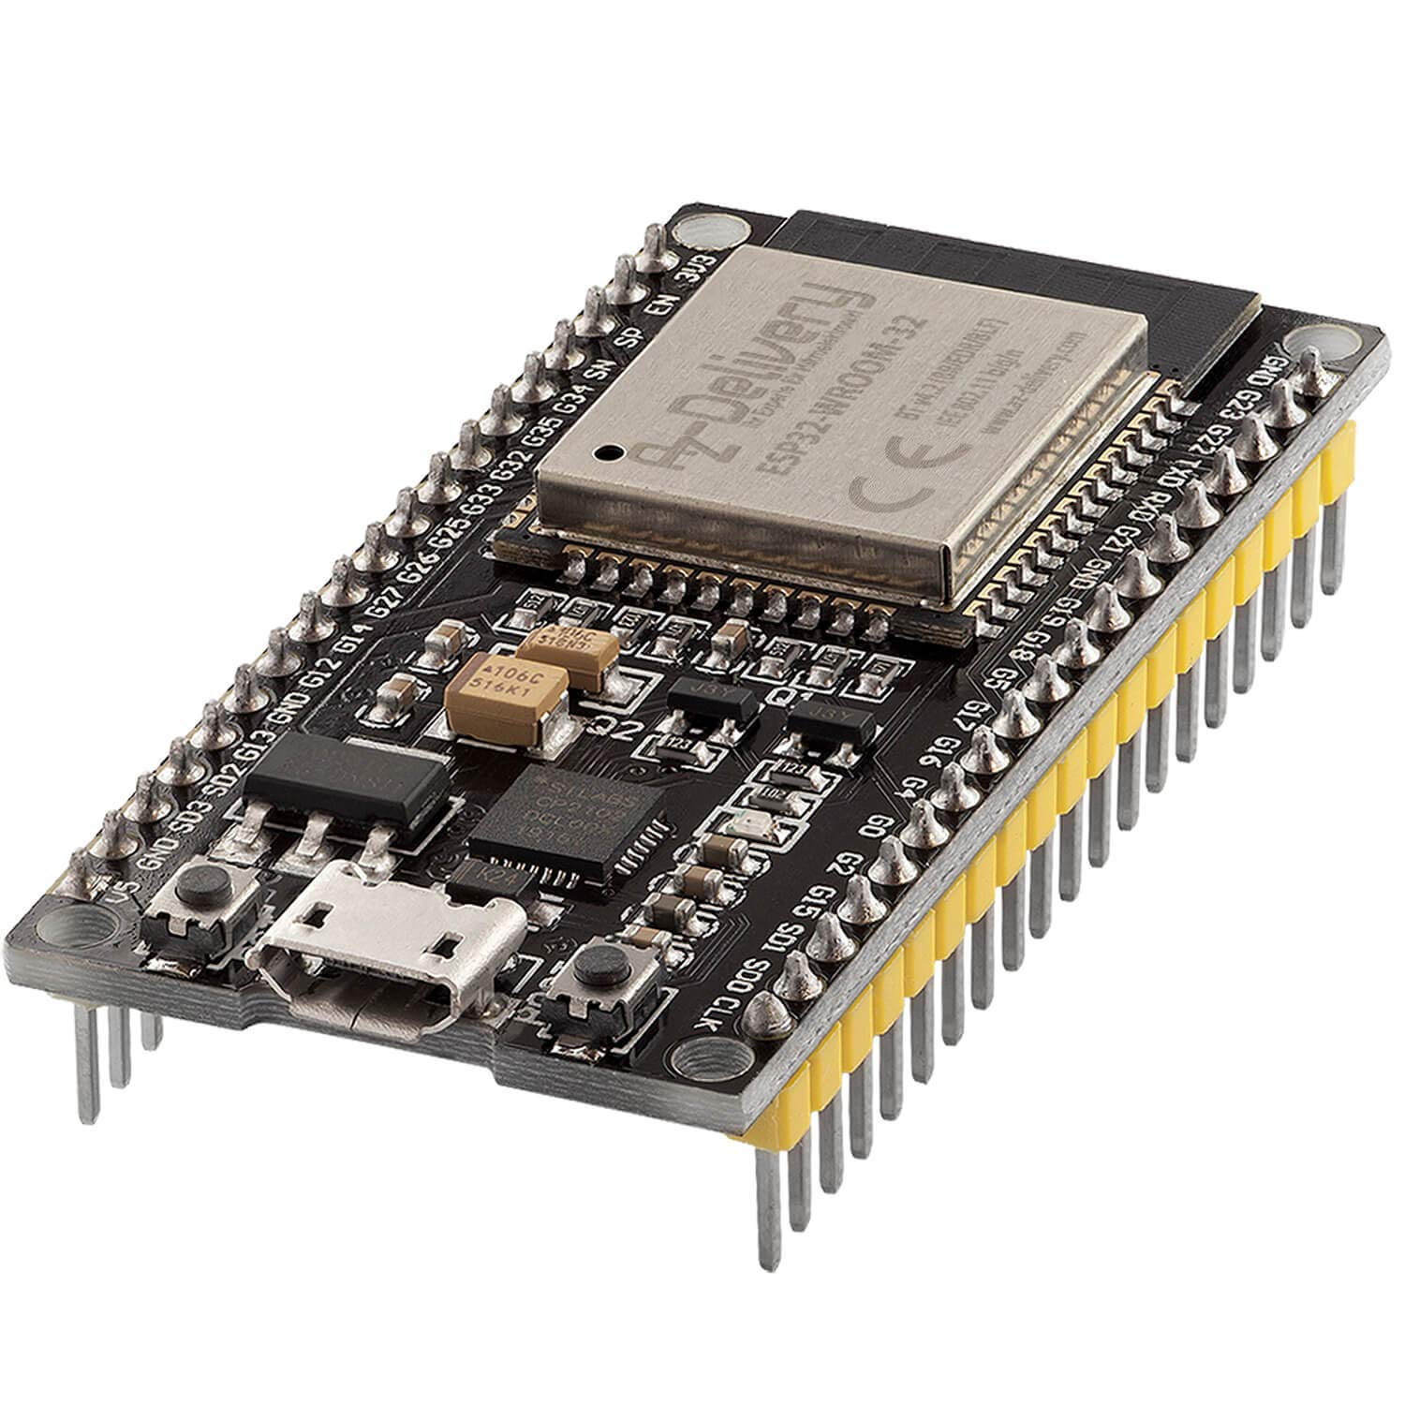
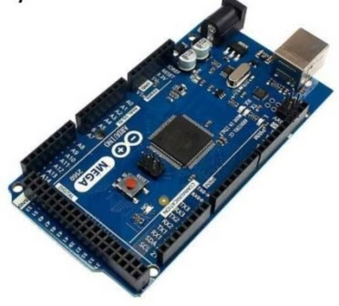
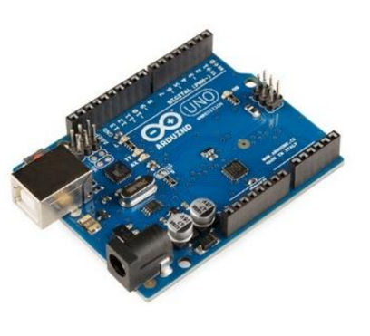
Microcontrollers
ESP32
Arduino Mega
Arduino Uno
Notes:
5

Slide 6
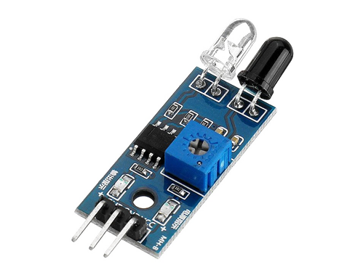
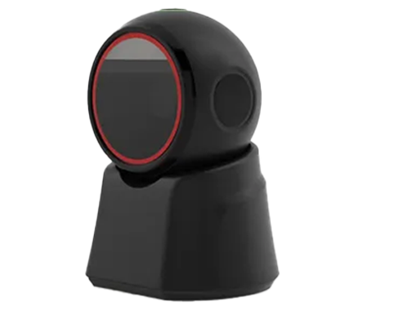
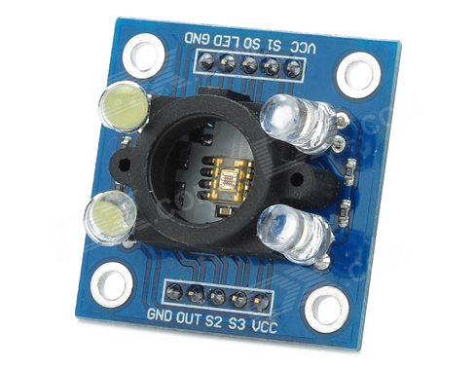
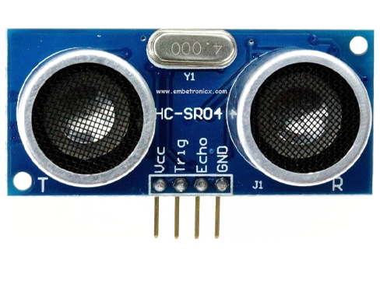
Key Sensing Technologies
IR Sensors
Ultrasonic Sensors
Color Sensors
Barcode Scanners
Notes:
1

Slide 7
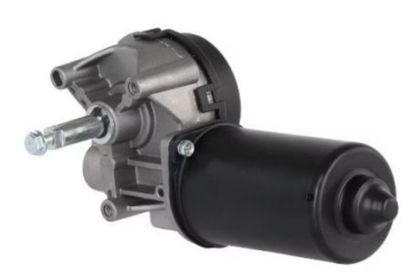
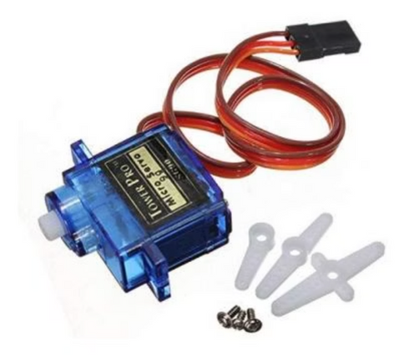
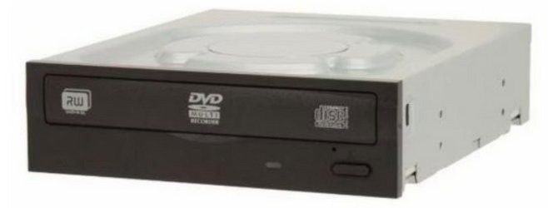
Actuators & Control
DC Motors & Drivers
Car wiper DC motor and BTS7960 driver control conveyor movement and speed.
Servo Motors
Microservo motors with wood sticks operate pushers for precise package diversion.
Repurposed DVDRW Drive
An old DVDRW drive acts as a cost-effective linear pusher for small items.
Notes:
7

Slide 8
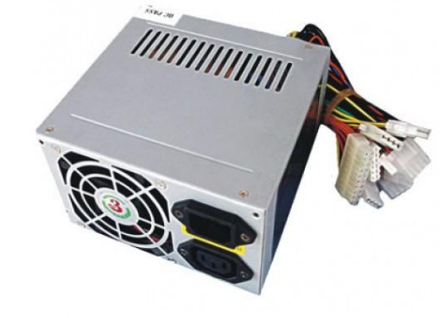
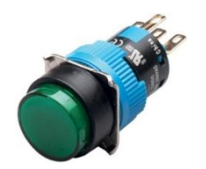
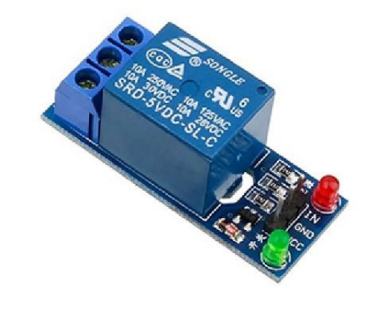
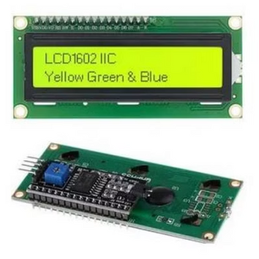
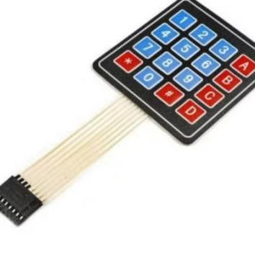
Actuators & Control
Push Button
DC Power Supply
(ATX-P4)
The push button functions as an emergency stop, immediately halting all operations when pressed to ensure safety and prevent damage to packages or the system.
The DC power supply provides the necessary voltage and current t all components, ensuring stable and reliable operation.
Relay Module (1 Channel)
Local Control
The relay module controls the DVDRW drive, allowing it to turn on/off and return to its original position after pushing a package.
Notes:
7

Slide 9
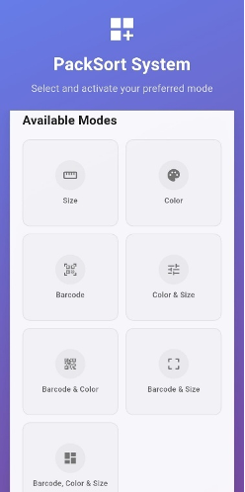
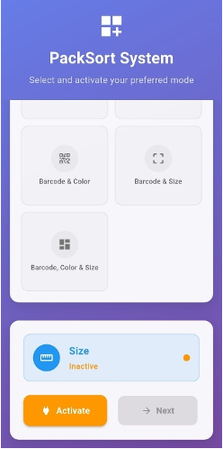
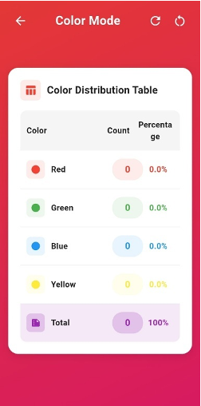
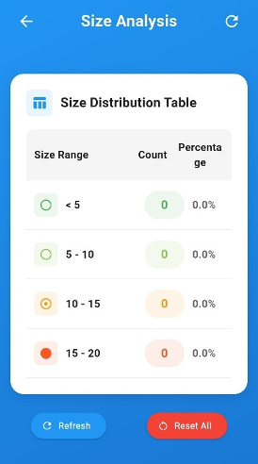
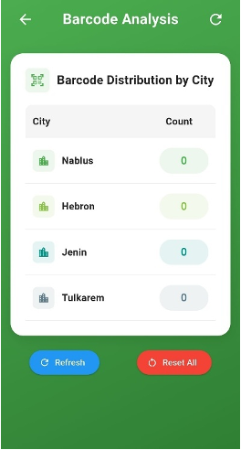
Human-Machine Interface & IoT
Remote Monitoring & Mobile App
An ESP32 microcontroller enables wireless connectivity for remote monitoring and operation via a custom-developed Flutter mobile application. This app provides real-time package statistics and system status updates.
Notes:
8

Slide 10
System Workflow: From Detection to Sort
Initialization & Setup
Package Detection
Versatile Sorting Modes
Data Collection
Monitoring & Safety
Notes:
3

Slide 11
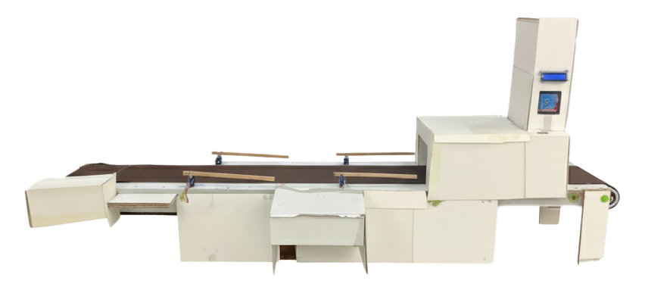
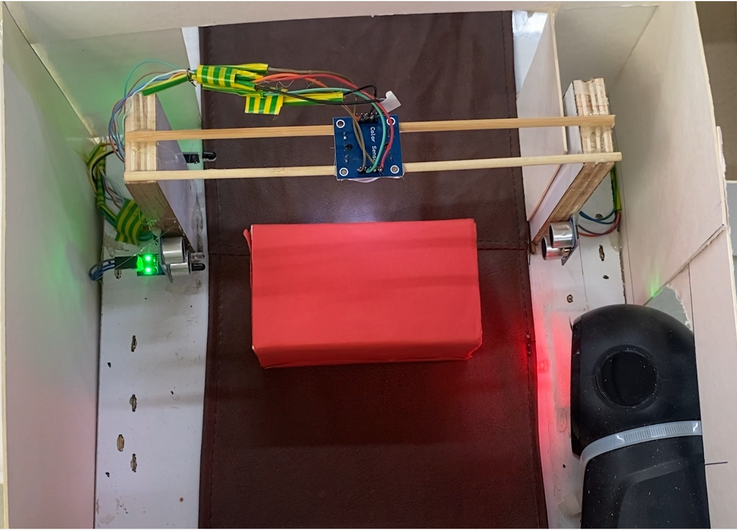
Exterior Design
Interior Design
Notes:
10

Slide 12


Conclusions & Future Directions
Smart, low-cost & reliable sorting machine
Built with recycled parts + IoT mobile control
Success: smooth serial communication
Future Work
Weight Classification
Advanced Barcode/QR Reading
Enhanced Safety Features
Notes:
10

Slide 13
Thank You
Notes:
10

