Slide 1
Video Based car speed measurements and Detection
Made by : - Fadi Hlehel, Ihab Mansour & Ahmad Abu Saan.
Supervised by : - Dr. Naser Abu Zaid.

Slide 2


Slide 3
Overview : -
Problem statement.
Methodology.
Cubic Spline.
curve equations.
detection algorithms.
Python analyses.
conclusion & future work.

Slide 4
Problem statement:-
what’s the problem?
We seek to measure the velocity of the vehicles by recording a video for a while.

Slide 5
Methodology : -
To solve this problem, we record a video of about 40 seconds and collecting some information then analyse it by matlab and python combatable with OpenCV.
We measure the distance of the road and take it as a reference then record samples of videos with different velocities.

Slide 6
Cubic Spline : -
By using matlab, we derive the relationship between the calculated velocity and the detection frames.
The best accurate curve that represents our data is spline function, and by using matlab, we extract the coefficient of the curve.

Slide 7
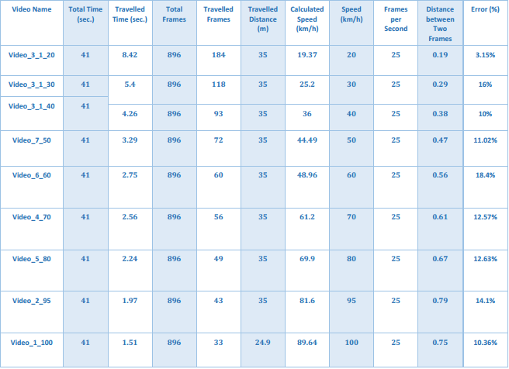

Slide 8
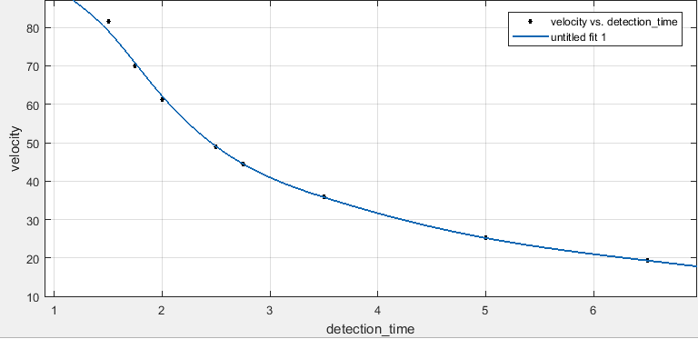

Slide 9
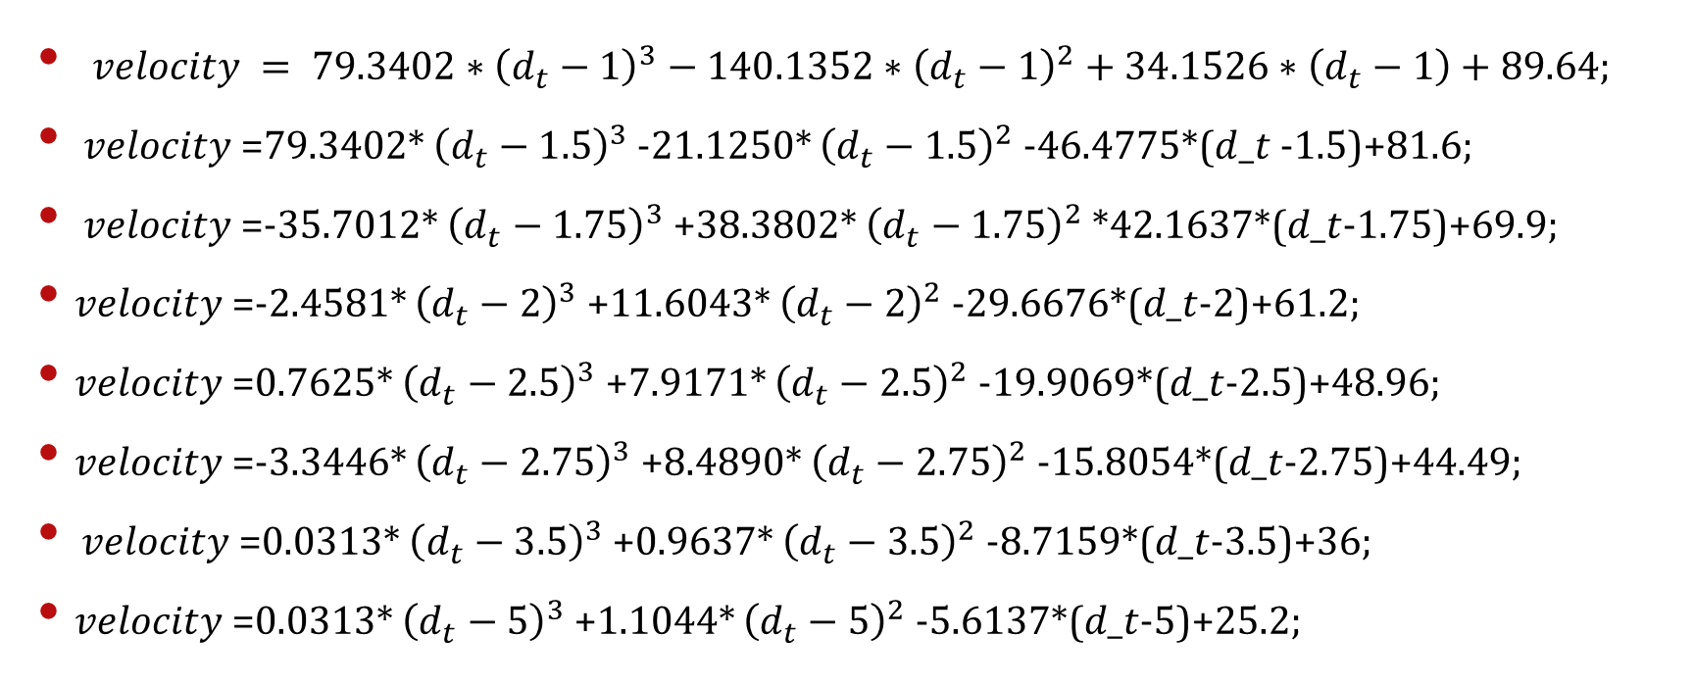
curve equations : -
$velocity = 79.3402∗{\left(d_{t}−1\right)}^{3}−140.1352∗{\left(d_{t}−1\right)}^{2}+34.1526∗\left(d_{t}−1\right)+89.64;$
$velocity$=79.3402* ${\left(d_{t}−1.5\right)}^{3}$-21.1250* ${\left(d_{t}−1.5\right)}^{2}$-46.4775*($d_t$-1.5)+81.6;
$velocity$=-35.7012* ${\left(d_{t}−1.75\right)}^{3}$+38.3802* ${\left(d_{t}−1.75\right)}^{2}$ *42.1637*(𝑑_𝑡-1.75)+69.9;
$velocity$=-2.4581* ${\left(d_{t}−2\right)}^{3}$+11.6043* ${\left(d_{t}−2\right)}^{2}$-29.6676*(𝑑_𝑡-2)+61.2;
$velocity$=0.7625* ${\left(d_{t}−2.5\right)}^{3}$+7.9171* ${\left(d_{t}−2.5\right)}^{2}$-19.9069*(𝑑_𝑡-2.5)+48.96;
$velocity$=-3.3446* ${\left(d_{t}−2.75\right)}^{3}$+8.4890* ${\left(d_{t}−2.75\right)}^{2}$-15.8054*(𝑑_𝑡-2.75)+44.49;
$velocity$=0.0313* ${\left(d_{t}−3.5\right)}^{3}$+0.9637* ${\left(d_{t}−3.5\right)}^{2}$-8.7159*(𝑑_𝑡-3.5)+36;
$velocity$=0.0313* ${\left(d_{t}−5\right)}^{3}$+1.1044* ${\left(d_{t}−5\right)}^{2}$-5.6137*(𝑑_𝑡-5)+25.2;

Slide 10
detection algorithms : -
We use Gaussian mixture model to analyse the frame to detect the Vehicle.

Slide 11
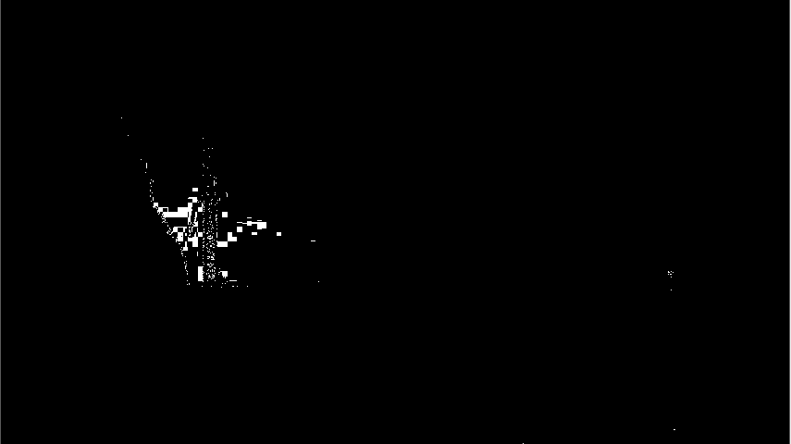
Foreground detector:-

Slide 12

Blob analyses : -

Slide 13
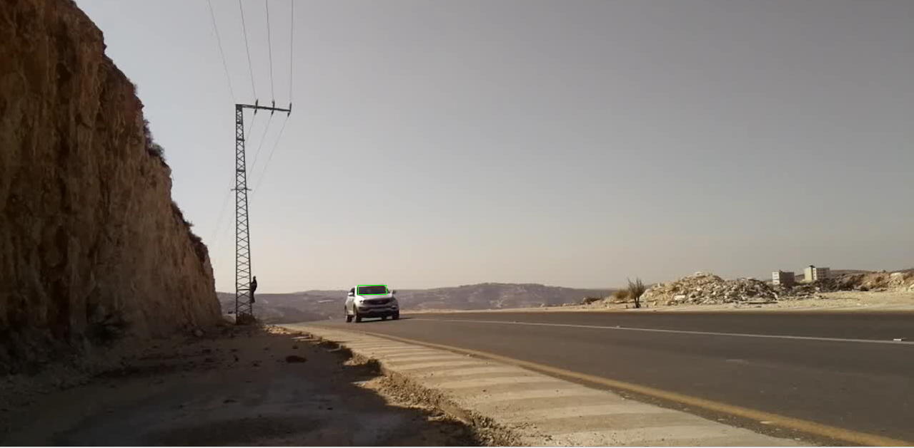
Detecting the car : -

Slide 14
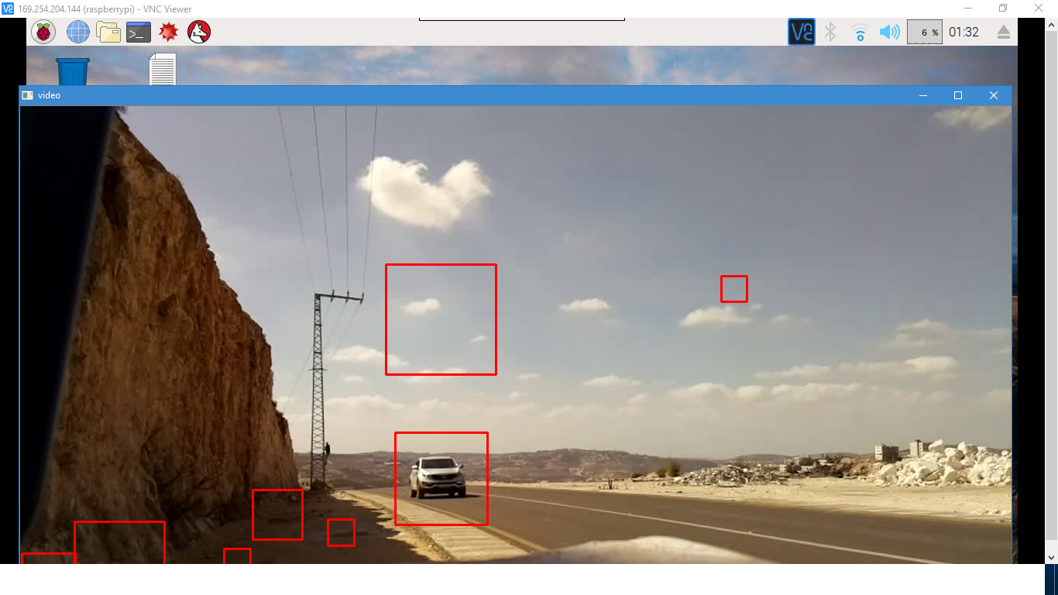
Python analyses : -

Slide 15
Conclusion : -
We achieve this project and implement it totally on Matlab with some errors.
We try converting matlab code to python but we face some problems.

Slide 16
future work & problems to be solved : -
We recommend to improve our project by implementing car plate detection to catch the issued cars that exceed the limit velocity.
We can also use high resolution camera to decrease the percentage of the error.

Slide 17
Thanks for your attendance and attention.

