Slide 1

Faculty of Engineering & Information Technology
Department of Building Engineering
Luxurious villa
Students Name:
Amr Hisham Zidan
Mahdi Imad Jallad
Yazan Imad Sinan
Supervisor : Dr. Mokarram M Abbas

Slide 2
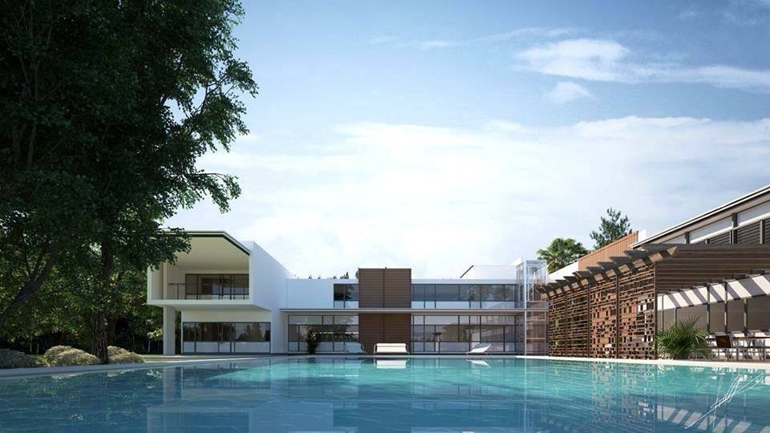
Introduction
The project primary focuses on designing a luxurious villa.

Slide 3
overview
Architectural design
Environmental design
Structural design
Electrical design
Mechanical design
Safety design and cost estimation

Slide 4
Architectural Design
Project description
Site plan
Plans
Elevations
Sections
3D shots for the project

Slide 5
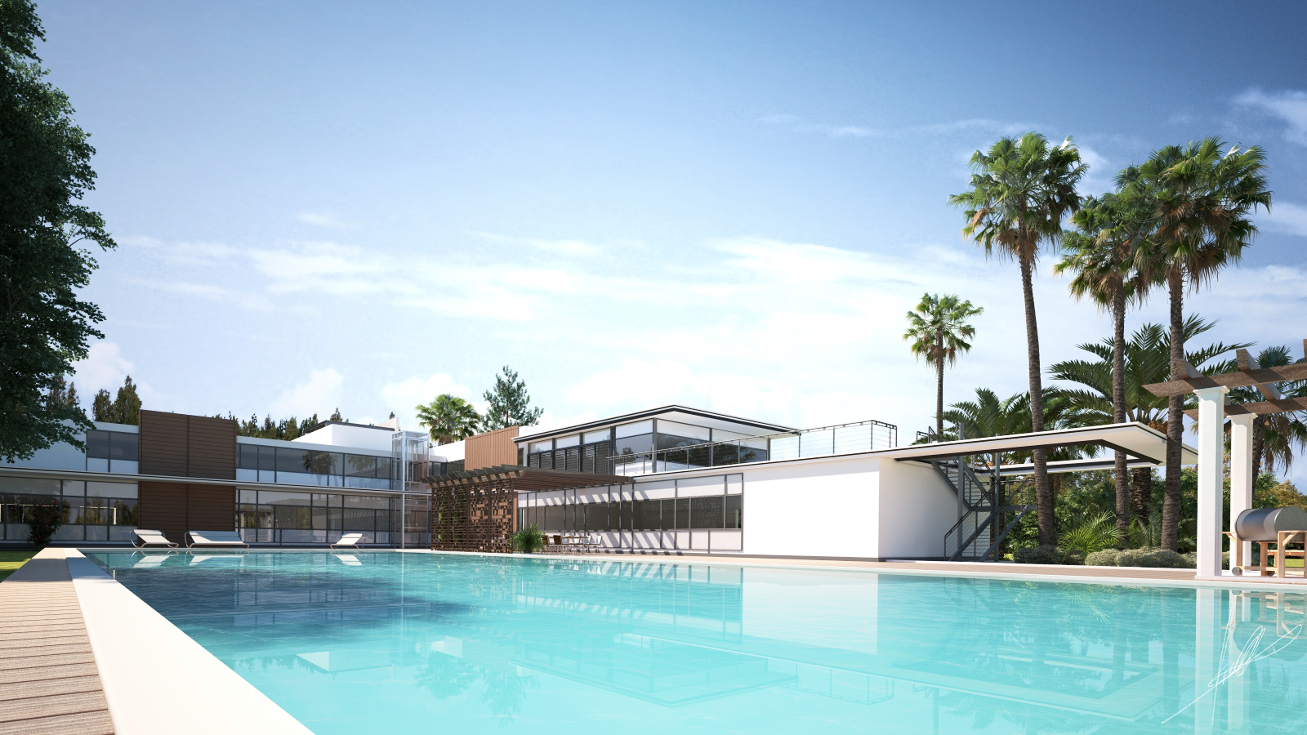
Architectural Design
Project Description :
The villa consists of three floors :
Ground Floor( 825 m² ) ,, , First Floor ( 542 m² ) ,, Basement ( 95 m²)

Slide 6
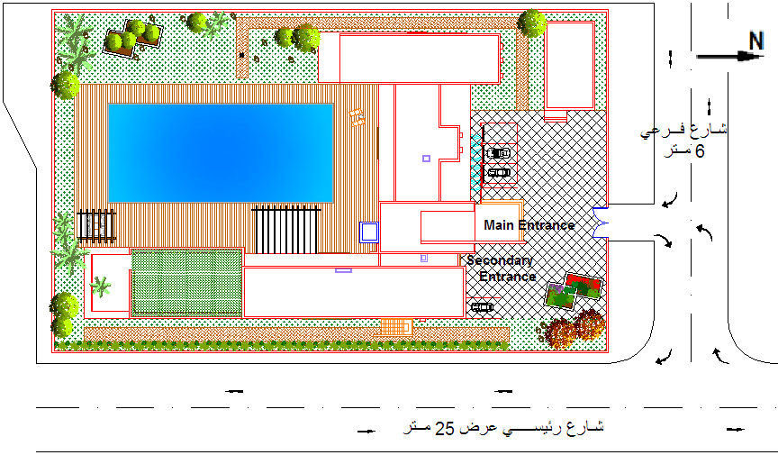
Architectural Design
Site Plan

Slide 7
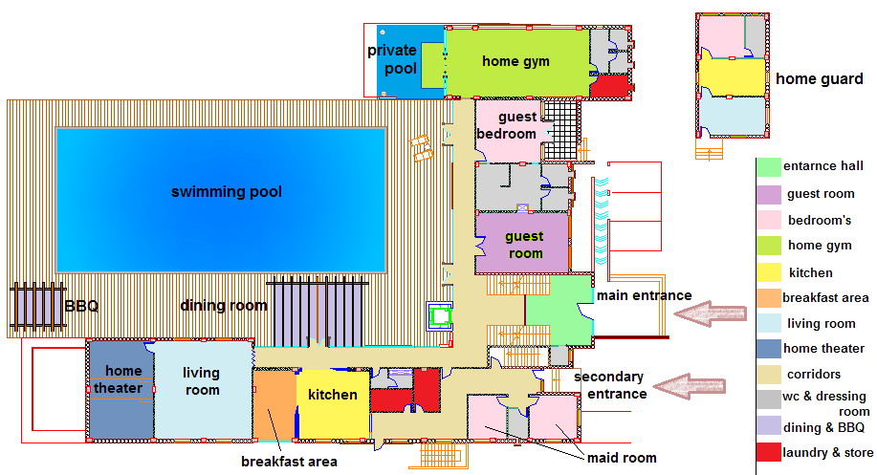
Architectural Design
Ground Floor Plan

Slide 8
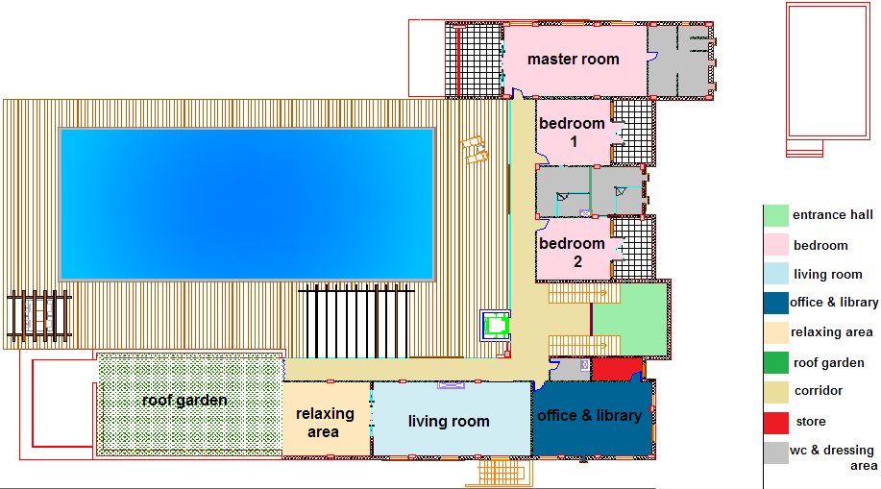
Architectural Design
First Floor Plan

Slide 9
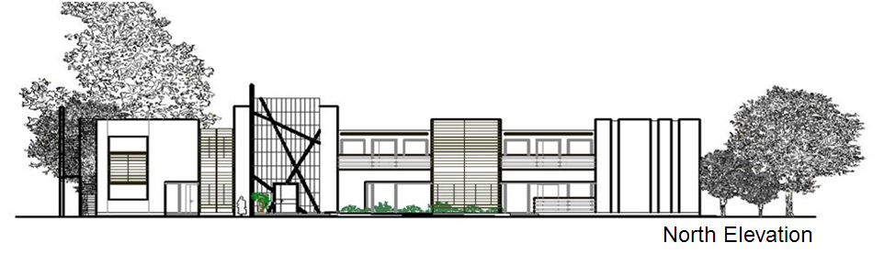
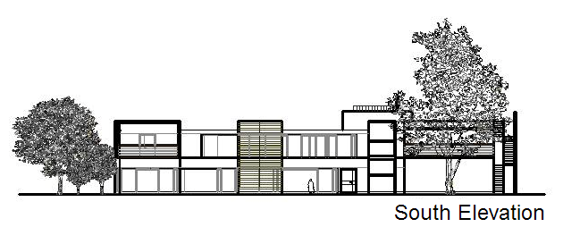
Architectural Design
Elevations

Slide 10
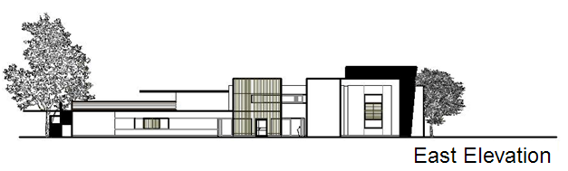
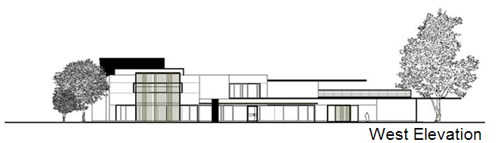
Architectural Design
Elevations

Slide 11
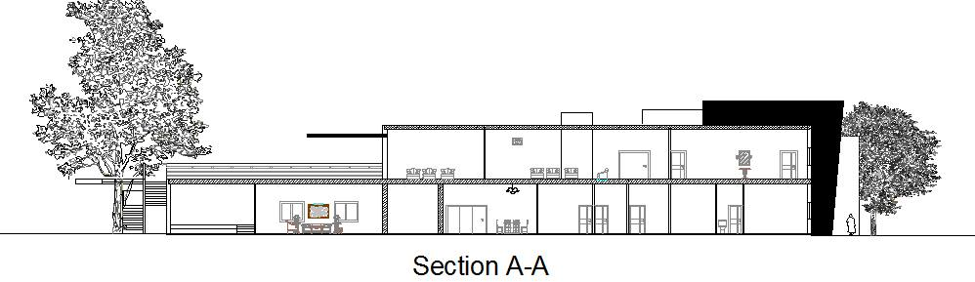
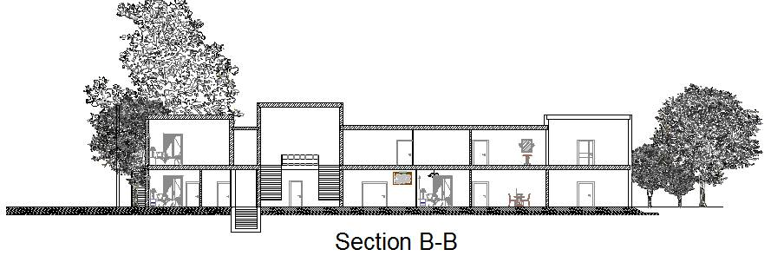
Architectural Design
Sections

Slide 12
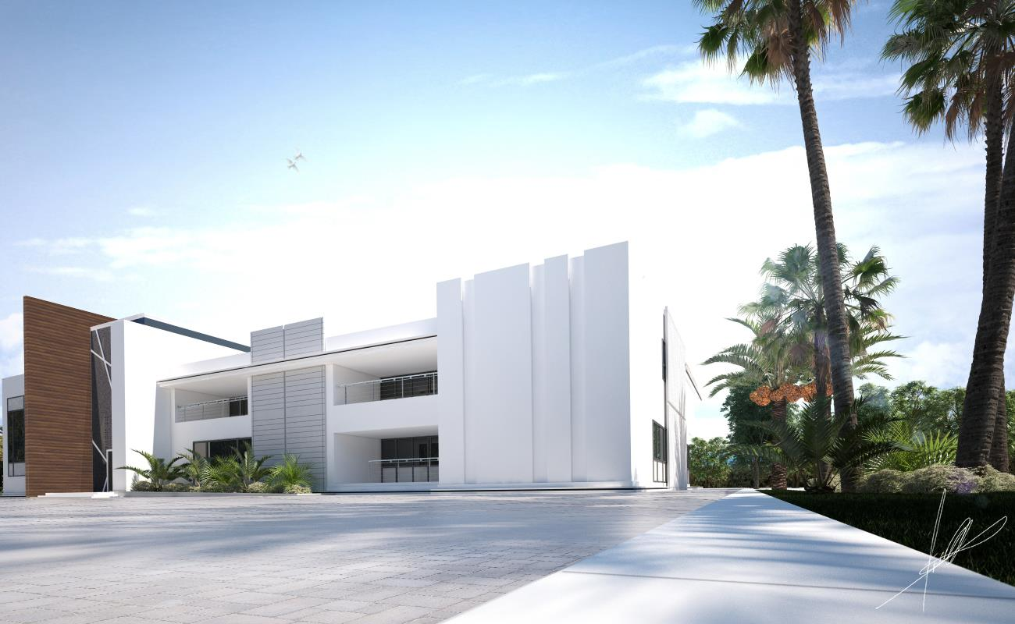
Architectural Design
3D shots

Slide 13
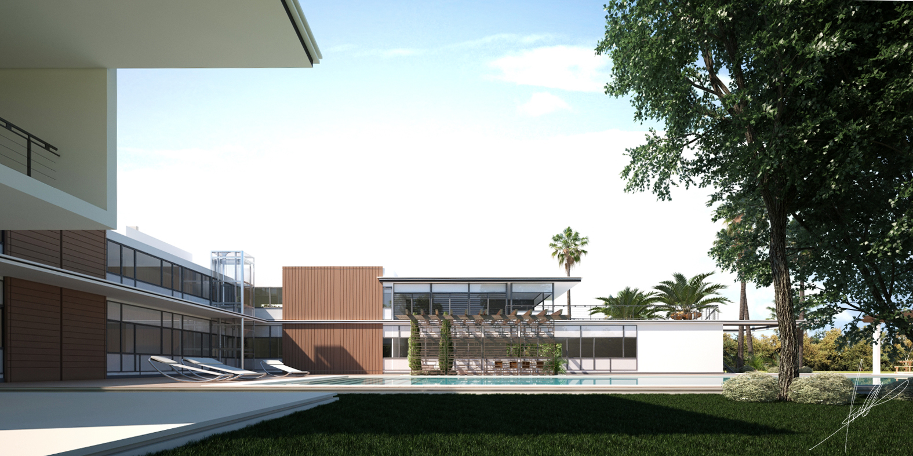
Architectural Design
3D shots

Slide 14
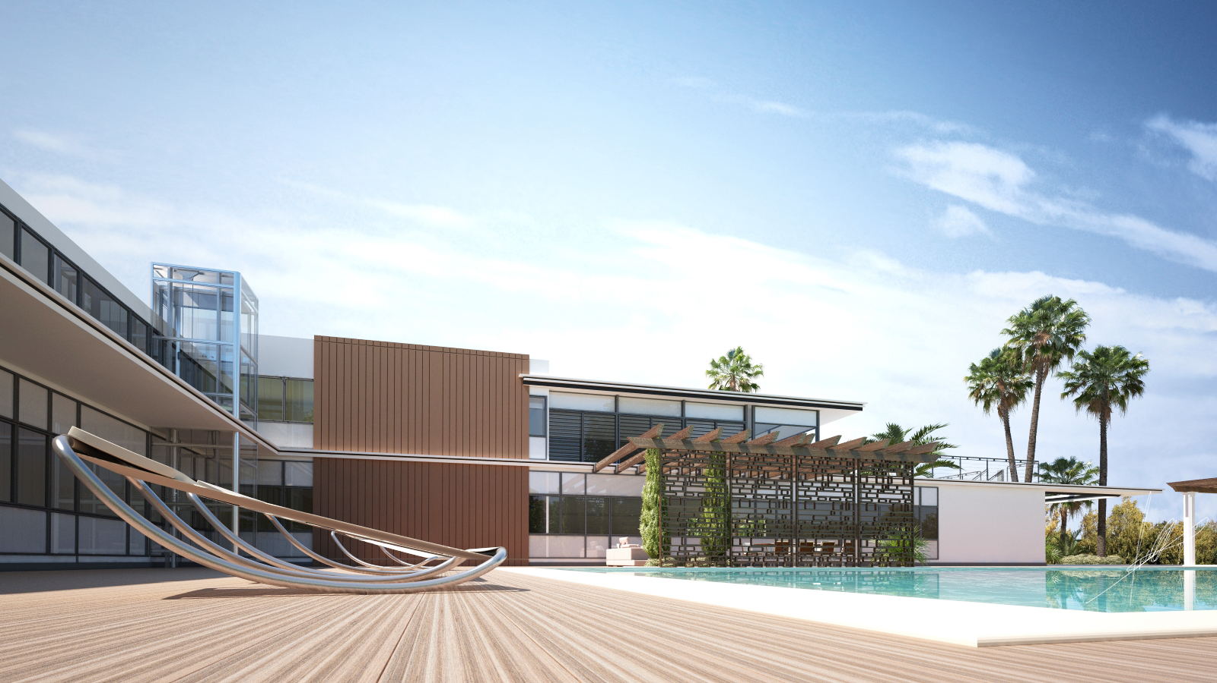
Architectural Design
3D shots

Slide 15
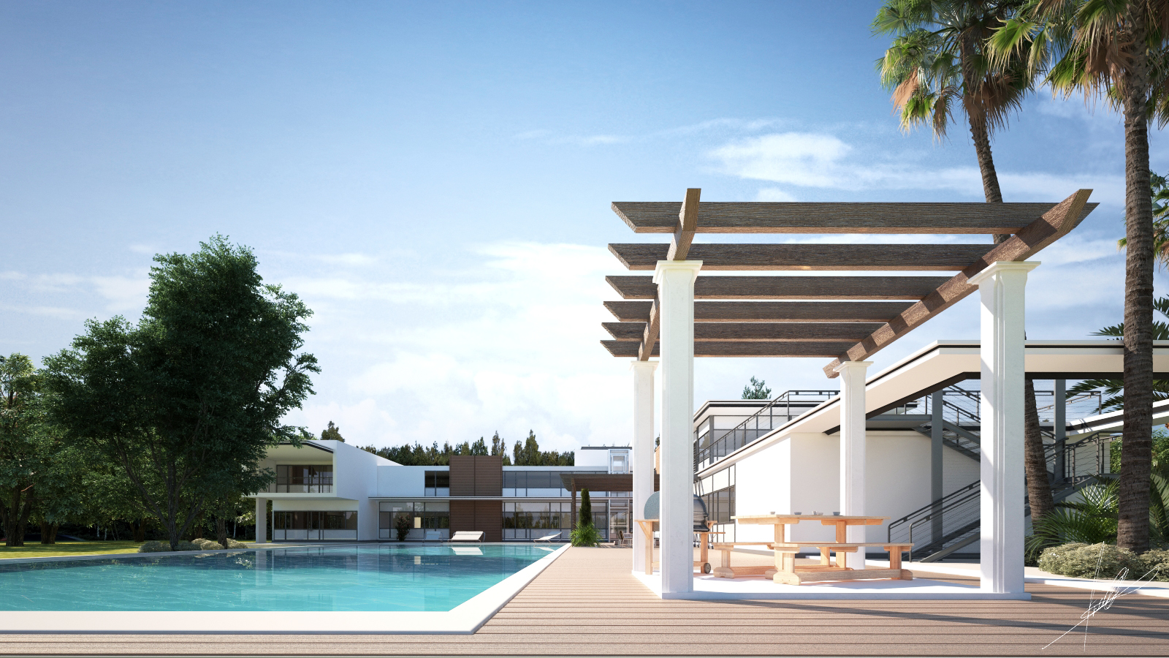
Architectural Design
3D shots

Slide 16
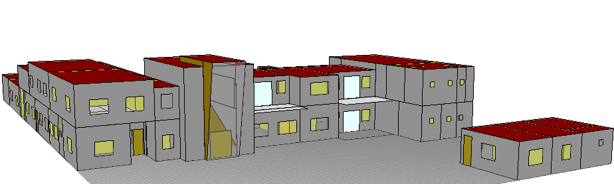
Environmental Design
Environmental design include :
1- Thermal Analysis. 2- Daylight Analysis. 3- Acoustics Design.

Slide 17
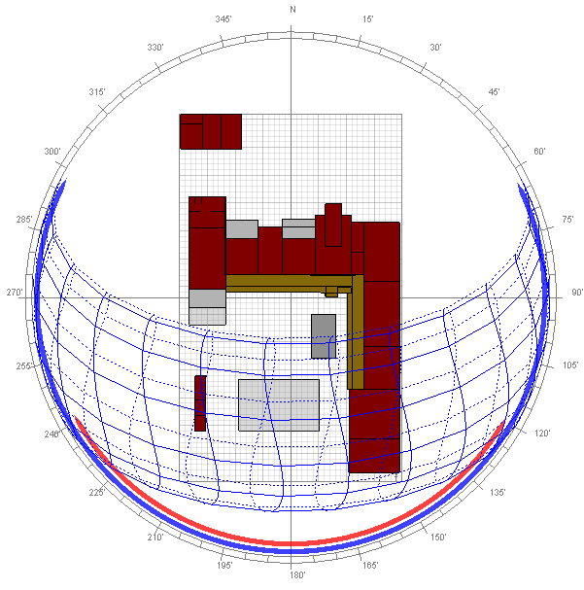
Environmental Aspect
Thermal Analysis include :
Type combination of envelope
element.
Suitable arrangement of glazing
( area and orientation ).

Slide 18
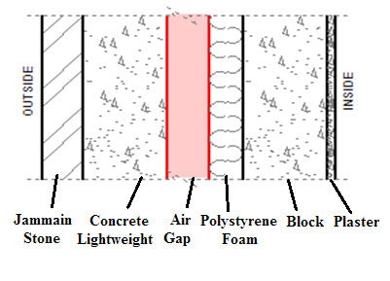
Environmental Design
External wall layers :
Total U-value
For external wall by ECOTECT
= 0.45 W/m²K

Slide 19
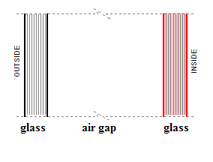
Environmental Design
Window layers :
Total U-value
For windows by ECOTECT
= 2.26 W/m²K

Slide 20
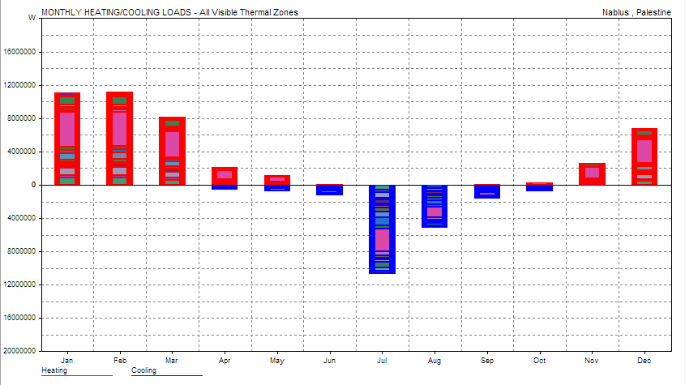
Environmental Aspect
The heating and cooling loads = 49.502 KW.hr/m²

Slide 21
Environmental Aspect
Daylight Analysis includes :
arranging windows.
using a suitable glass type.

Slide 22
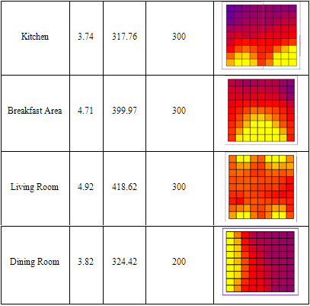
Environmental Aspect
Samples of daylight
distribution in
Ground Floor

Slide 23
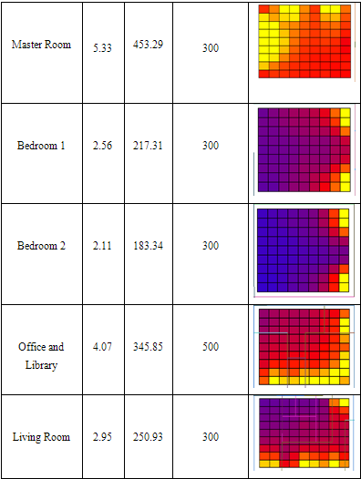
Environmental Aspect
Samples of daylight
distribution in
First Floor

Slide 24
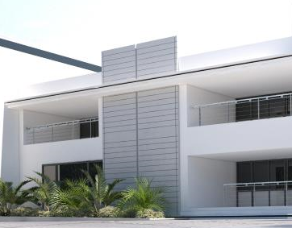
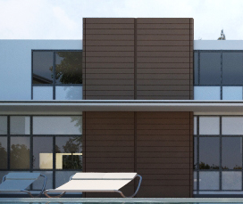
Environmental Aspect
Shading
We have three types of shading used :
Louvers

Slide 25
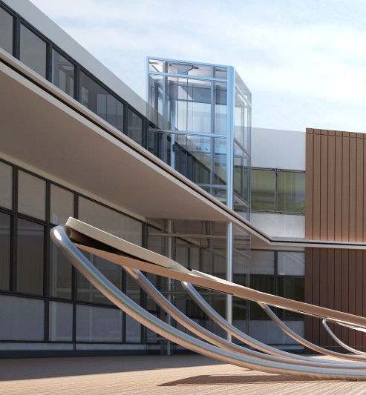
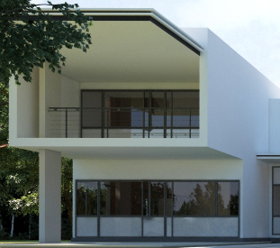
Environmental Aspect
Fixed overhangs :

Slide 26
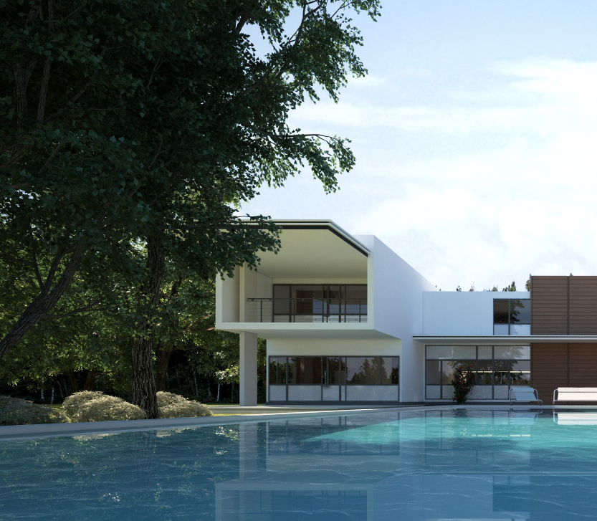
Environmental Aspect
Trees :

Slide 27
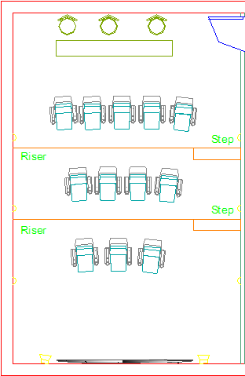
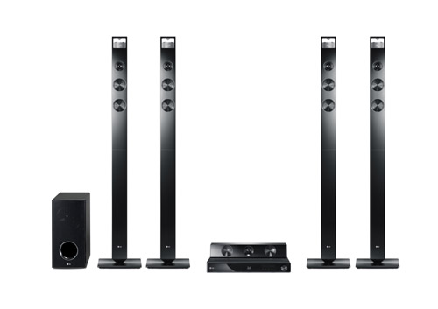
Environmental Aspect
Acoustics Design
Home Theater design using 9.1 speakers system

Slide 28
Environmental Aspect
Acoustics Design
STC calculation :
STC for external wall = 64.7 db
STC for partition = 57 db
STC for Internal Ceiling = 55 db
STC for external roof = 55 db

Slide 29
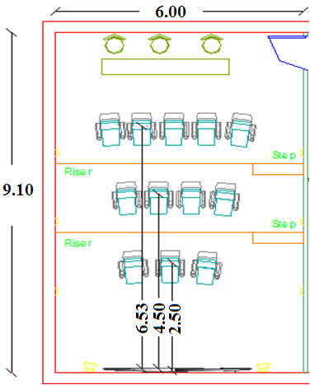
Environmental Aspect
Acoustics Design
In case of the theater is fully occupied.
reverberation time = 1.12 second.
Critical distance = 1.12 second.
SPL at 6.35 = 76.1 db.
S/N = 41.1 db.

Slide 30
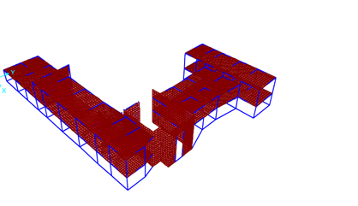
Structural Design
The structural design was made by SAP program

Slide 31

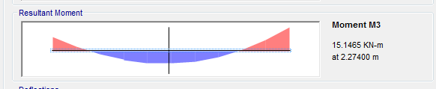
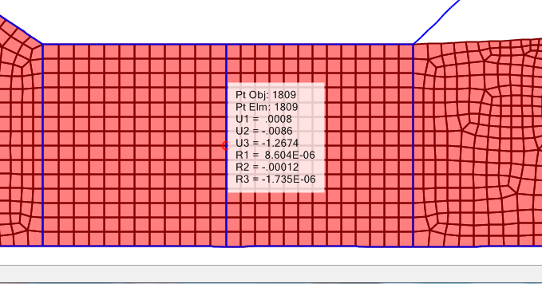
Checks for SAP model
Checks | Sap | %Errors
Compatibility |  | No time is larger than 1 ➔Ok
Equilibrium |  | < 5% ➔ Ok
Stress-strain |  | < 15% ➔ Ok
Deflection |  | Less < Δ𝑚𝑎𝑥 ➔Ok

Slide 32
Structural Design
Design Codes
The structural design will be according to :
ACI -318-2011 for reinforced concrete structural design.
UBC -97 for earthquake load computations.

Slide 33
Structural Design
Design will include the following elements :
slab ( one way rib slab)
common use in our country.
lightweight.
easy for labor to use it.
beams
Used hidden beams due to architectural reasons.
column
We used short columns.
shear wall.
footing.

Slide 34
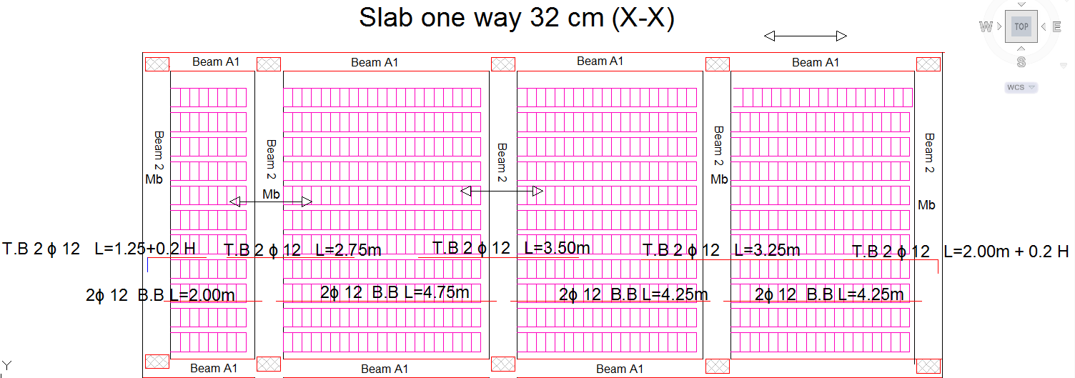
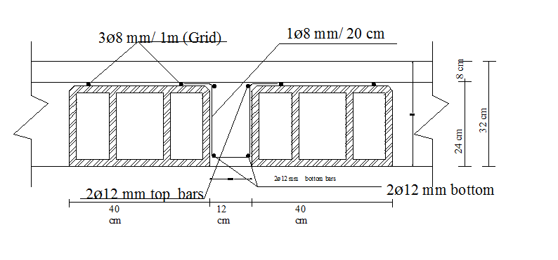
Structural Design
Slab design

Slide 35
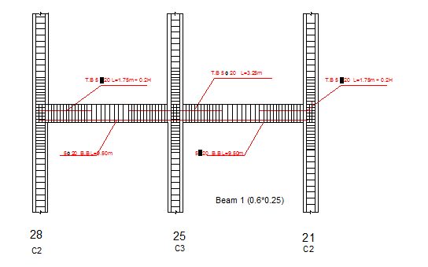
Structural Design
Beams design
Used 5ɸ20

Slide 36
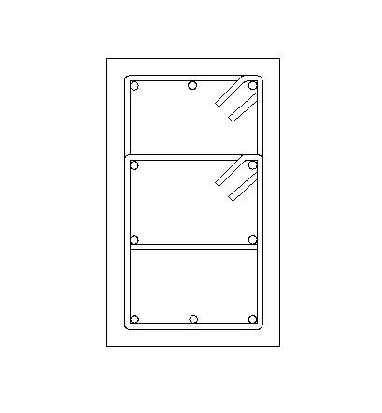
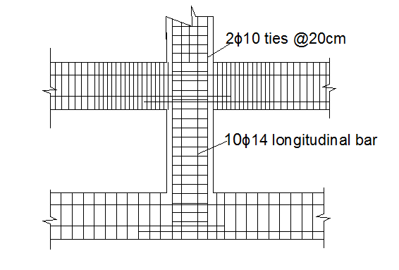
Structural Design
column design

Slide 37
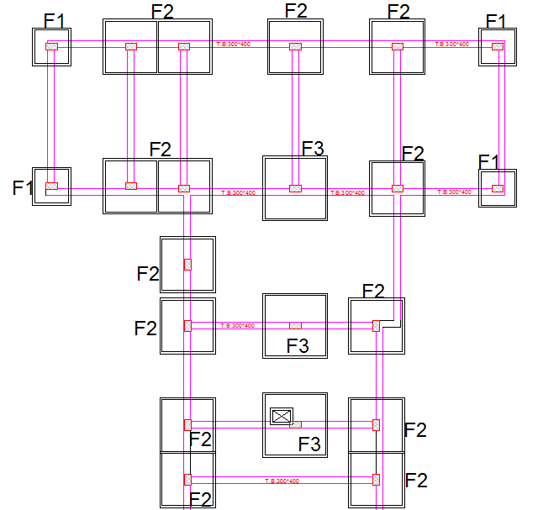
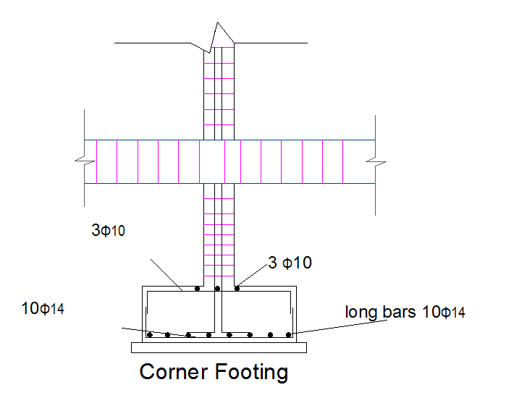
Structural Design
footing design F1
Type of footing ISOLATED

Slide 38
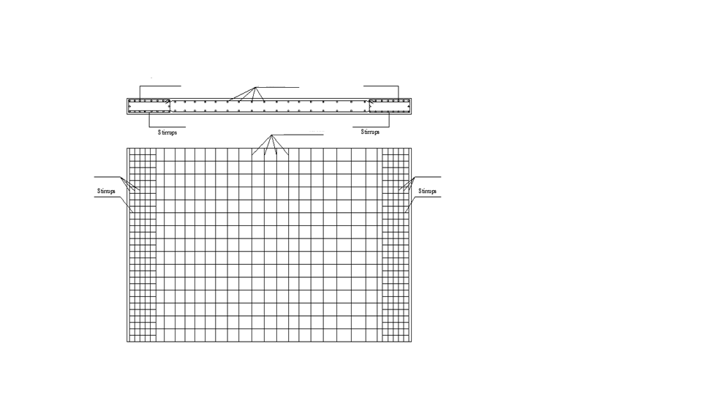
Structural Design
Shear wall design
For vertical:
ρ = 0.3 %
Use 6Ø12 / m for each layer
For horizontal:
ρ = 0.25 %
Use 4Ø12
For boundary:
ρ = 1 % ,
Use 10 Ø16.

Slide 39
Structural Design
Tie beams design
Use 4 Ø12 for positive moment
Use 4Ø12 for negative moment

Slide 40
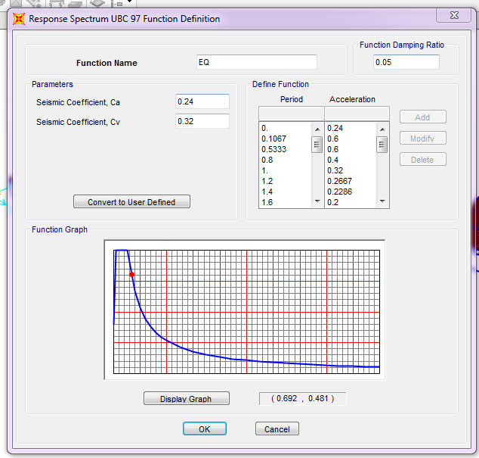
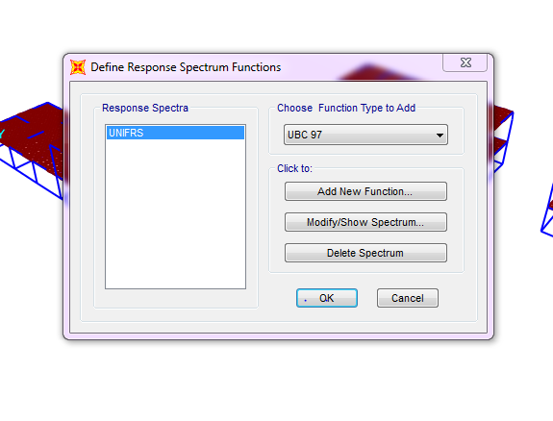
Structural Design
Seismic Design
The project was design to perform the seismeic design

Slide 41
Electrical Design
LIGHTING by DIALUX
Electrical Calculation
Distribution of out lets
Distribution of fixtures
DIALUX software was used to design the lighting system

Slide 42
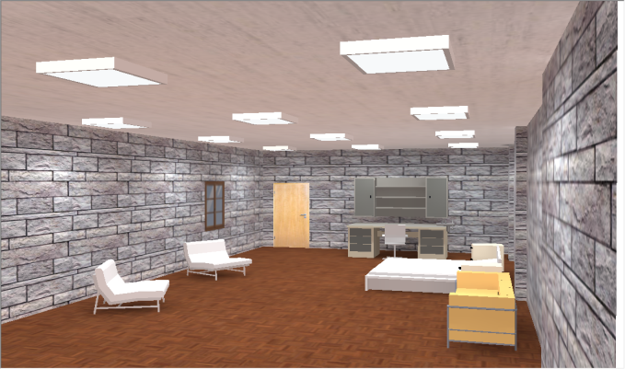
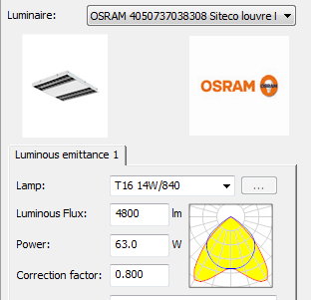
Electrical Design
Lighting design Artificial lighting
(Master bedrooms )
The average lux needed = 300 lux
Number of units used=12
Unit power=63w

Slide 43
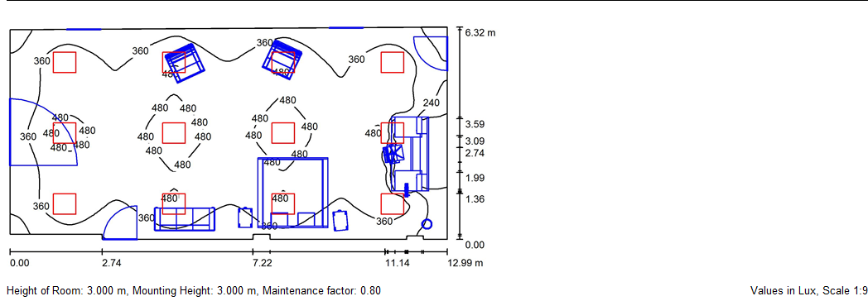
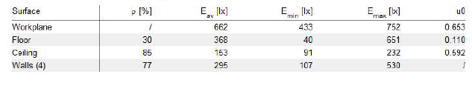
Electrical Design
The uniformity in Master bedrooms:

Slide 44
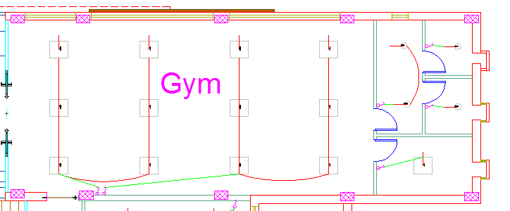
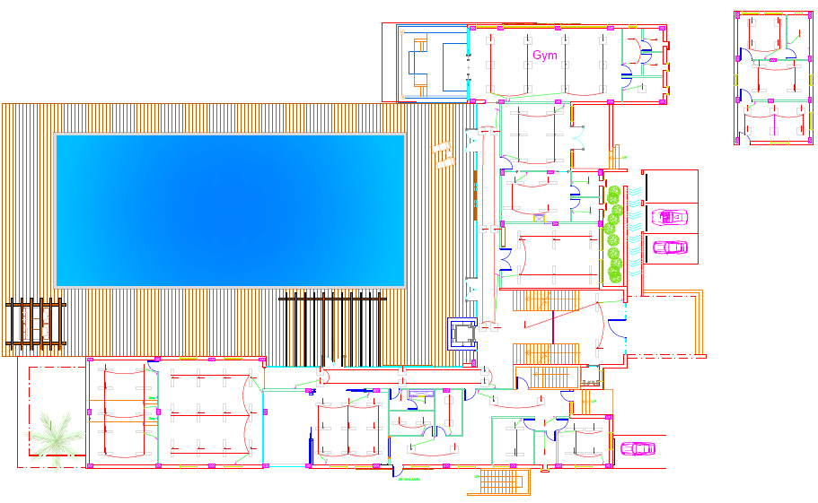
Electrical Design
The plan of lighting(Gf)

Slide 45
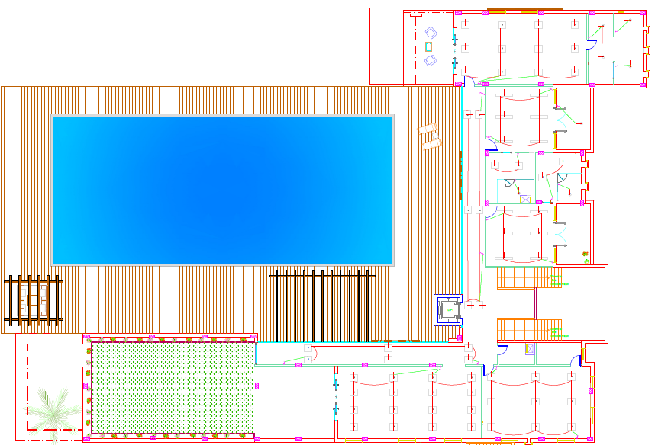
Electrical Design
The plan of lighting(FF)

Slide 46

Electrical Design
    Electrical Calculations:-
Cross section area=6 mm2
Control panel DB1:
Control panel DB2
Cross section area=4mm2

Slide 47
mechanical Design
Mechanical design of the building involves many aspects including:
Water supply system.
Drainage system design.
HVAC system.

Slide 48

Water supply
Water supply system ground floor
mechanical Design

Slide 49

Water supply system first floor
mechanical Design

Slide 50
Drainage system design
mechanical Design
The water piping system for drainage depends on the natural flow and diameter of pipe. To make the villa as an environmentally friendly building, the drainage system in the building is divided into two groups: black water, gray water.
The types of water drainage system in sanitation system are:
Black water: W.C
Gray water: lavatory and kitchen sinks

Slide 51
mechanical Design
Each W.C represents 4Dfu.
Each Lavatory Represent 2 Dfu.
Each kitchen sinks Represent 2 Dfu.
Each bathtub represent 2 Dfu.
The horizontal Line for lavatory which reach to the main drainage = 2" at 1/4"/ft.
The horizontal Line for kitchen sink which reach to the main drainage = 2" at 1/4"/ft
The horizontal Line for W.C which reach to the main drainage = 4" at 1/8"/ft
The horizontal Line for bathtub which reach to the main drainage = 2" at 1/4"/ft

Slide 52

drainage system ground floor
mechanical Design

Slide 53

drainage system first floor
mechanical Design

Slide 54

Black water network
mechanical Design

Slide 55

Gray water network
mechanical Design

Slide 56

mechanical Design

Slide 57
HVAC system
mechanical Design
HVAC system is supposed to be installed in the building using split unit system (VRF) in order to heat and cool the spaces in winter and summer.

Slide 58
mechanical Design
Ground floor
zone | area | Q | tons
 |  |  | 1.5 | 2
Maid bedroom1 | 39.856 | 61528 | - | 1
Maid bedroom 2 | 45.172 | 49389 | - | 1
Kitchen | 86.112 | 45650 | - | 2
Breakfast area | 54.691 | 68394 | 2 | -
Living room | 81.759 | 39041 | - | 2
Home theater | 54.514 | 38720 | 2 | -
Dining room | 34.590 | 41866 | - | 1
Guest room | 88.780 | 48186 | 2 | 1
Guest bedroom | 38.726 | 51363 | - | 1
Gym | 85.217 | 60317 | 3 | -

Slide 59
mechanical Design
First floor
zone | area | Q | tons
 |  |  | 1.5 | 2
Living room | 77.270 | 40887 | 1 |  | 3
Office and library | 68.9 | 37792 | 1 |  | 1
Bedroom1 | 38.563 | 55643 | - |  | 1
Bedroom2 | 38.726 | 49691 | - |  | 1
Masterbedroom | 71.452 | 40887 | 1 |  | 1

Slide 60

mechanical Design
Ground floor

Slide 61

mechanical Design
First floor

Slide 62



Safety Design
in this chapter we will show the technics of safety to be able to control any hazard if happened like fire , and we will use fire extinguishers and fire hoses cabinet , outdoor staircase , and smoke detectors .

Slide 63
Safety Design
Ground floor

Slide 64
Safety Design
Ground floor

Slide 65
cost estimation
Concrete work
type | unit | Quantity | Cost/unit(NIS) With labor | Total cost(NIS)
column | m³ | 260 | 480 | 316800
footing | m³ | 92 | 450 | 131400
Tie beam | m³ | 66 | 450 | 45900
Slabs with beams | m³ | 996 | 420 | 922320
Shear walls | m³ | 93 | 490 | 123970

Slide 66
cost estimation
Steel work
type | unit | Quantity | Cost/unit(NIS) With labor | Total cost(NIS)
column | Kg | 5050 | 3.5 | 140175
Footing | Kg | 748 | 3.5 | 30618
Tie beam | Kg | 1610 | 3.5 | 19635
Slabs with beams | Kg | 2650 | 3.5 | 702275
Shear walls | Kg | 220 | 3.5 | 56420

Slide 67
cost estimation
Finishing work
type | unit | Quantity | Cost/unit(NIS) With labor | Total cost(NIS)
stones | m² | 1920 | 250 | 980000
plaster | m² | 2200 | 30 | 186000
paint | m² | 2200 | 50 | 310000
tiles | m² | 1420 | 300 | 2070000
glasses | m² | 780 | 450 | 351000
doors | # |  | 1200 | 267800

Slide 68
cost estimation
Electrical Work
Total Cost(NIS) | Unit Price with labor | Unit | Quantity | Item
17520 | 40 | # | 135 | Lighting Units
5265 | 27 | # | 75 | Sockets
2375 | 25 | # | 63 | Switches
14400 | 1200 | # | 3 | Control Panels
8500 | 8500 | # | 1 | Earth system
Mechanical work
type | unit | Quantity | Unit PriceWith labor | Total Cost(NIS)
Lavatory | # | 12 | 300 | 39900
Sink | # | 11 | 350 | 3850
Shower | # | 7 | 900 | 40500
W.C | # | 10 | 600 | 48000
4"PVC | m | 1600 | 80 | 128000
6"PVC | m | 220 | 120 | 26400
2"PVC | m | 150 | 25 | 3750
Manholes | # | 23 | 500 | 25000
Water supply | - | - | - | 68200
Outdoor split unit | # | 3 | 20000 | 40000
Indoor Split unit | # | 17 | 1700 | 28900

Slide 69
cost estimation
Safety work
type | number | Cost/unit(NIS)With labor | Total cost(NIS)
Hose station | 2 | 1000 | 2000
Smoke detector | 27 | 65 | 11570
Extinguisher | 15 | 250 | 22500
The total cost of the project is 2,453,380 Nis.
352 JD/m²

Slide 70


