Slide 1

An-Najah National University
Faculty of Engineering
Computer Science Department
جامعة النجاح الوطنية
كلية الهندسة وتكنولوجيا المعلومات
Measuring the Matches Between University Courses: Ontological Comparison Based Approach
By:
Salma Saad Ibrahim
Shahad Basel Hamdan
Supervisor:
Dr. Amjad Hawash

Slide 2
CONTENTS
1
System Architecture
Introduction
4
Problem Specification
Results
2
5
Difficulties
Methodology
6
3

Slide 3
Alternative course

Slide 4
Methodology
Measuring the Matches Between University
Courses: Ontological Comparison-Based Approach

Slide 5
System Architecture Layers
USER
SIDE
SERVER SIDE
DATABASE SIDE

Slide 6
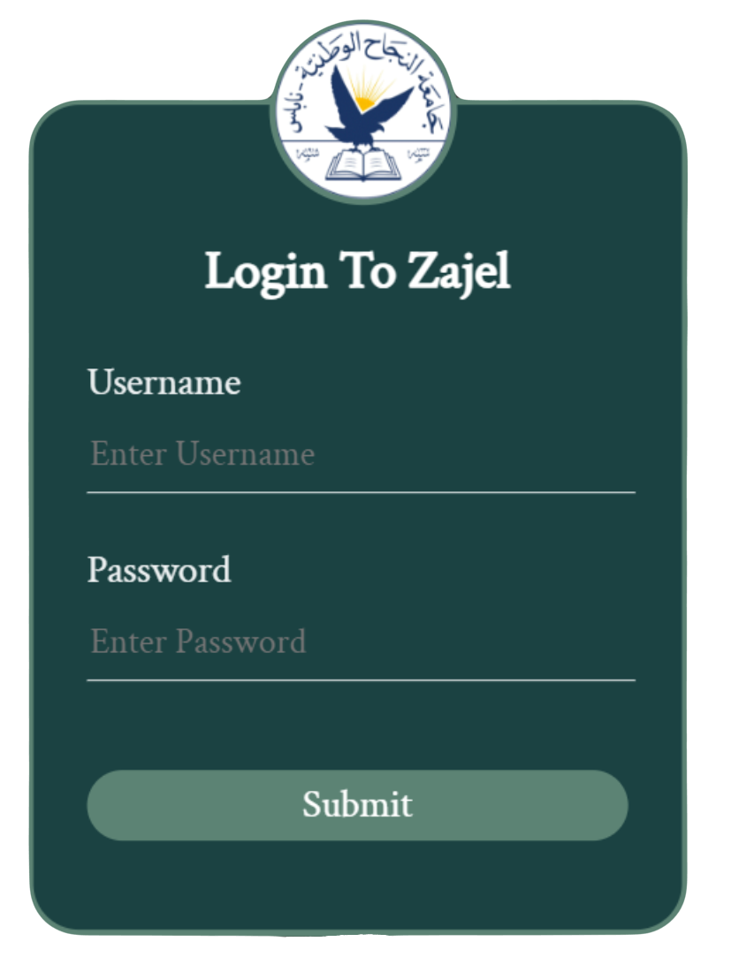
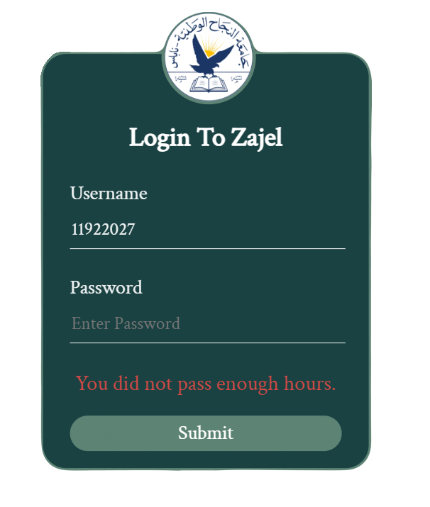
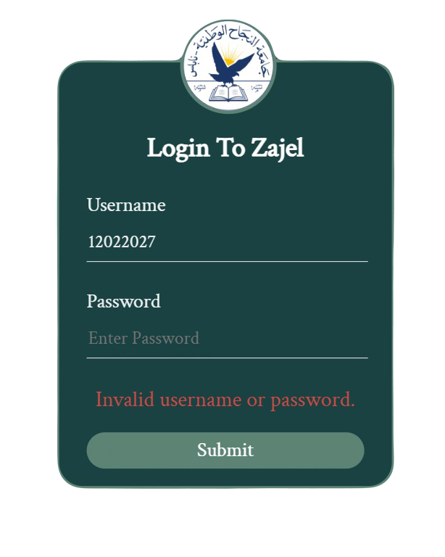
Login Interface
Fig. 1. Login Interface
Fig. 2. Error Login Interface
Fig. 3. Error Login Interface

Slide 7
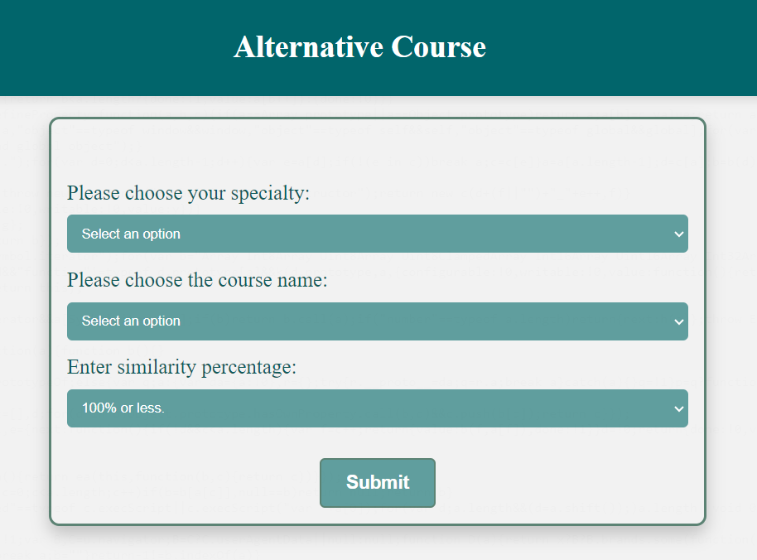
Alternative-Course Interface
Fig. 4. Alternative-Course Interface

Slide 8
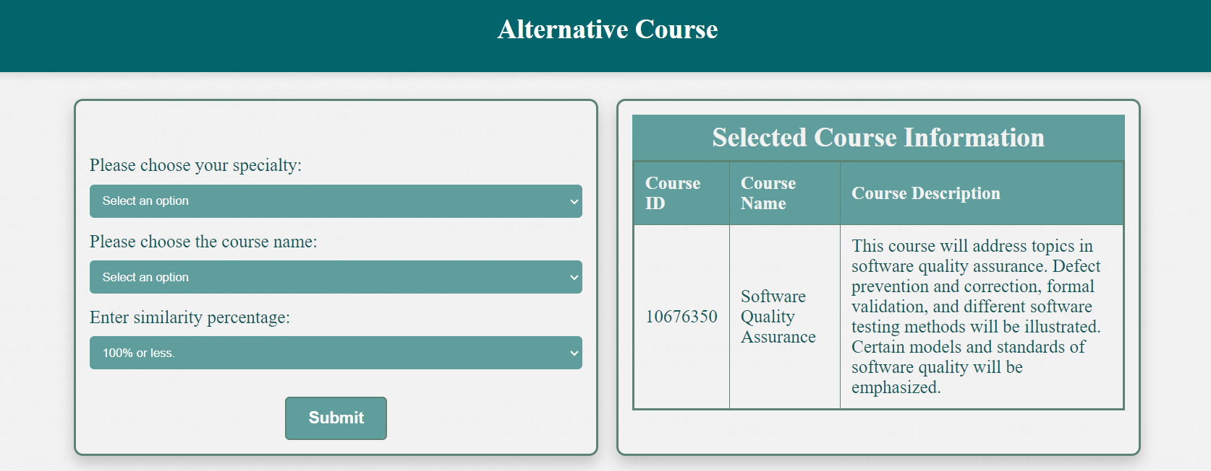

Slide 9
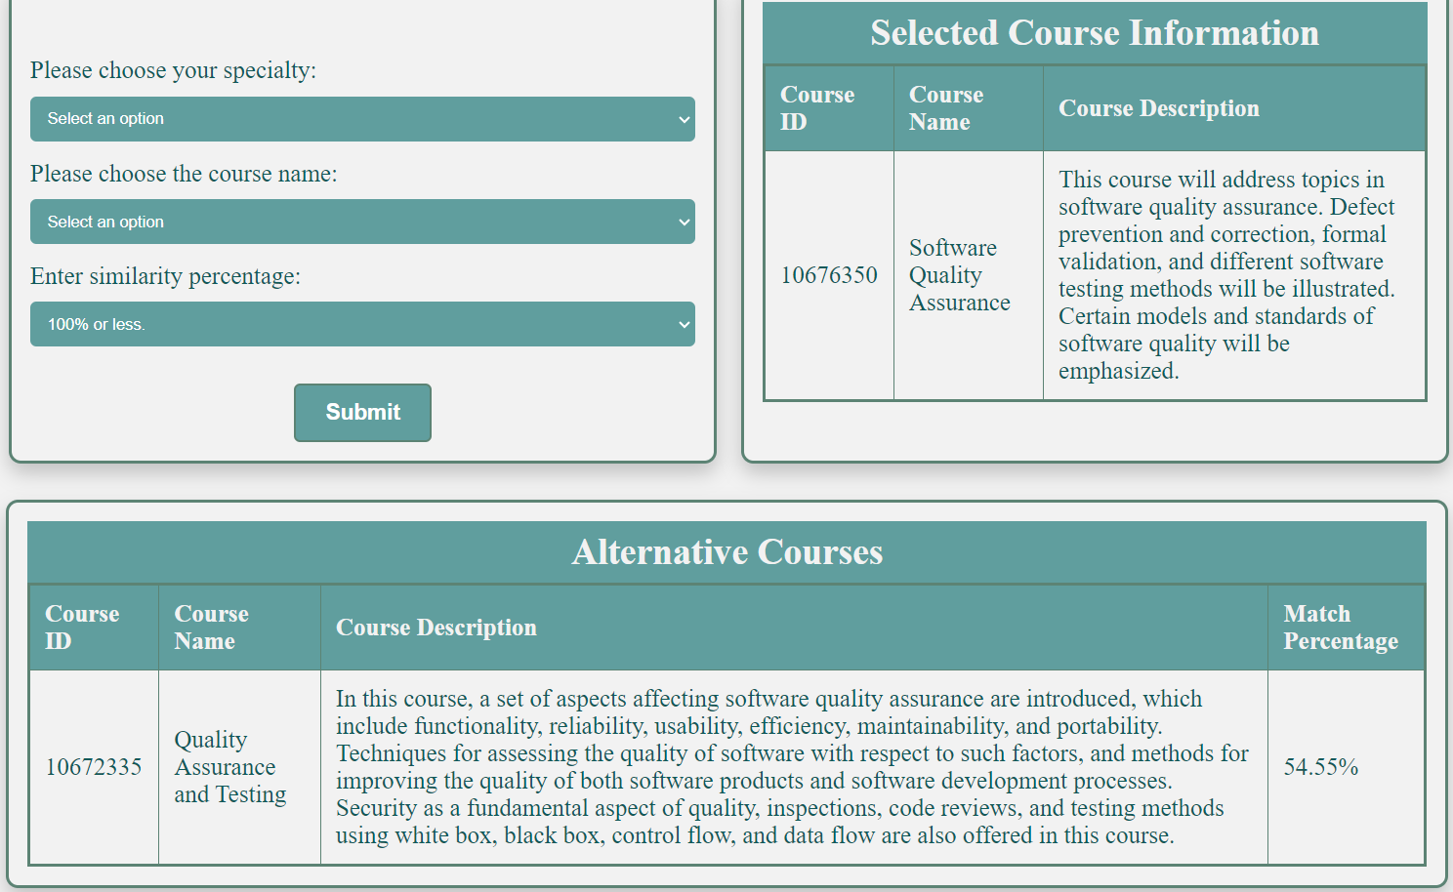

Slide 10
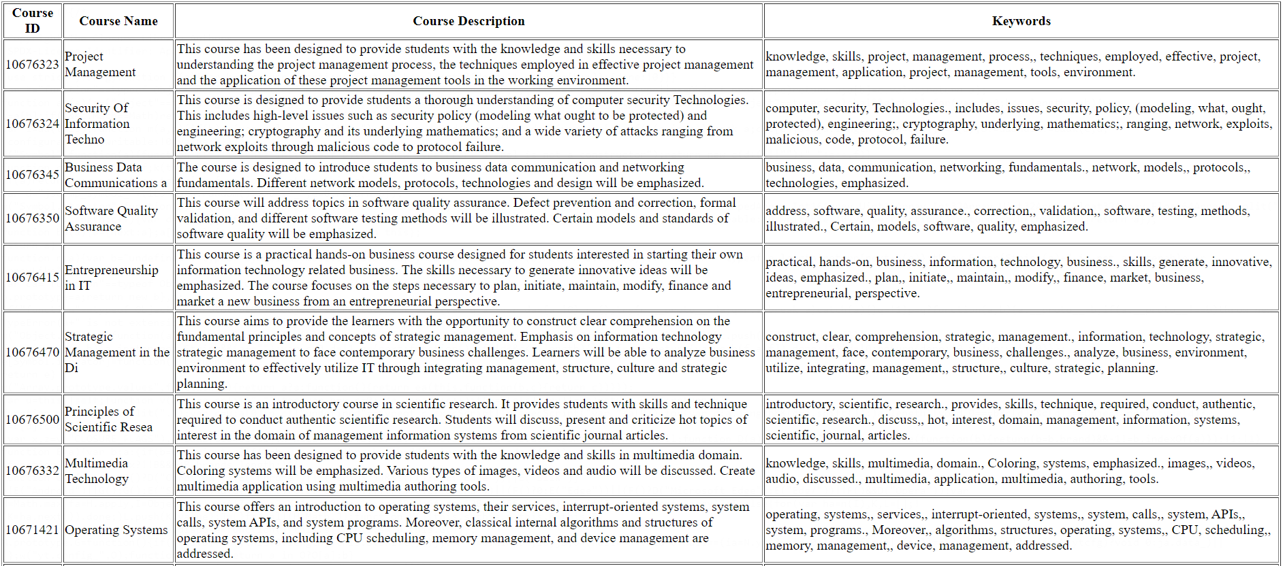
Stop Words Removal
Fig. 5. Stop Words Removal

Slide 11
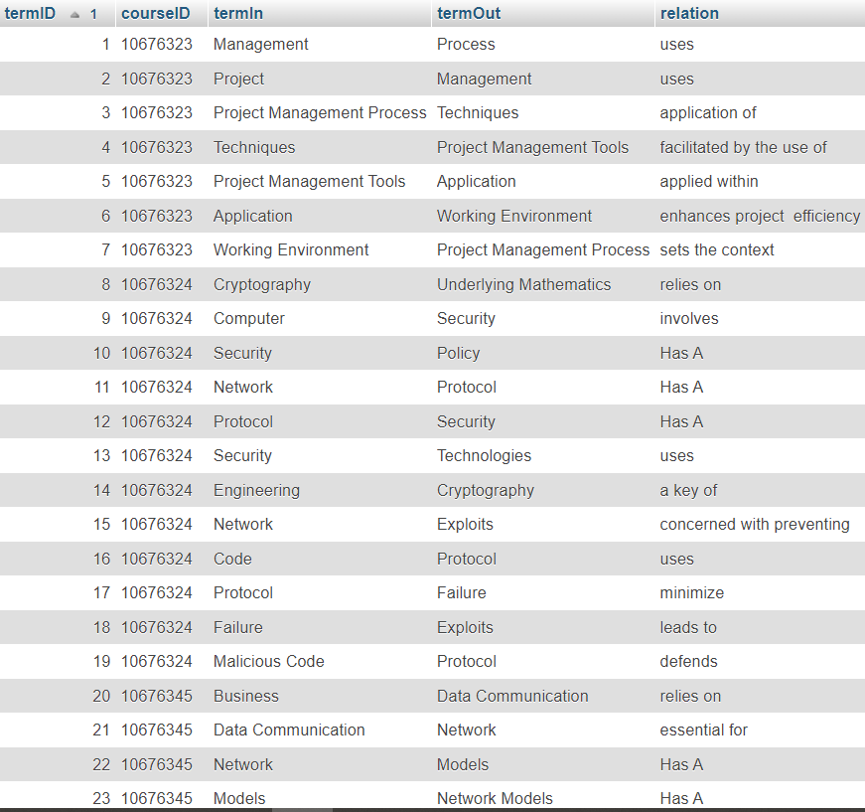
Term Extraction
Fig. 6. Term Extraction.

Slide 12
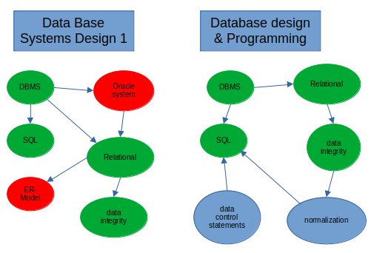
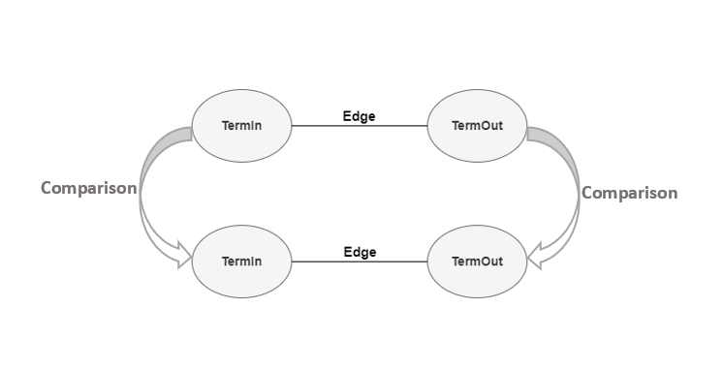
Edges Comparison
Fig. 7. Edges Comparison

Slide 13
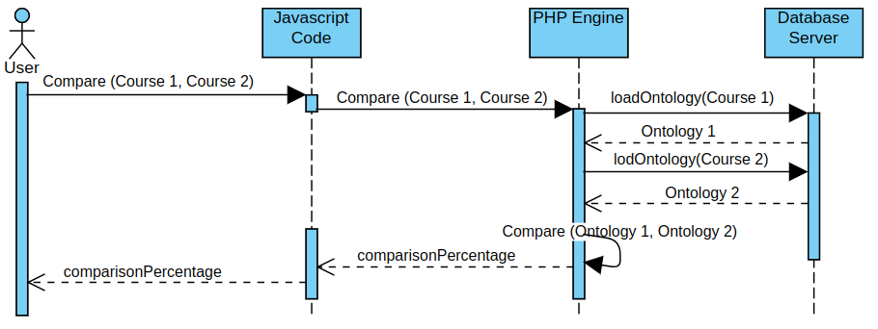
Fig. 8. Alternative-Course Sequence Diagram

Slide 14
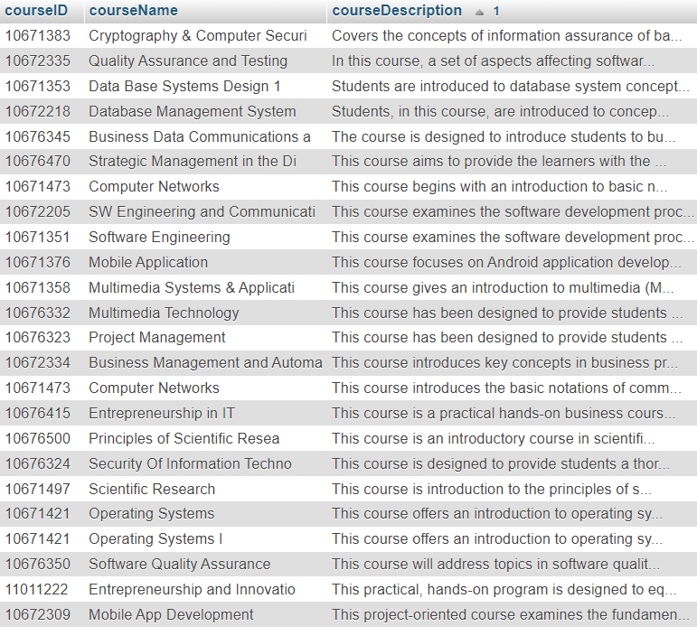
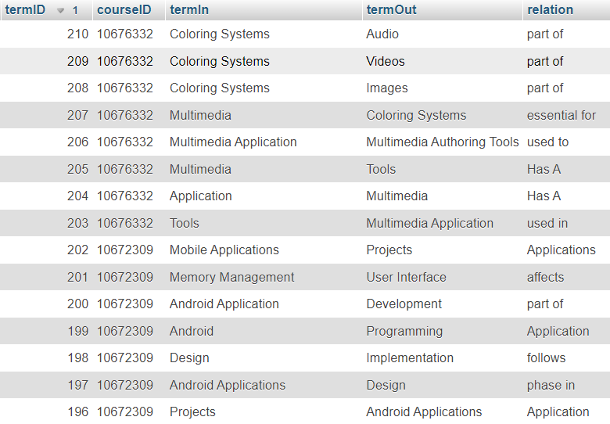
Database Side

Slide 15
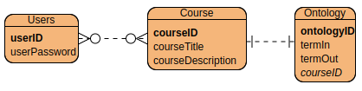
Fig. 4. Alternative-Course ER Diagram

Slide 16
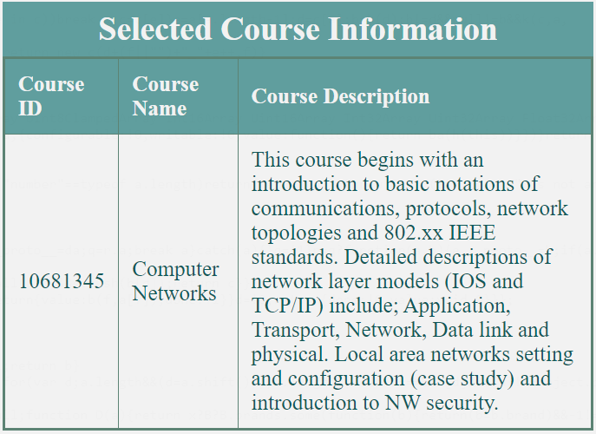
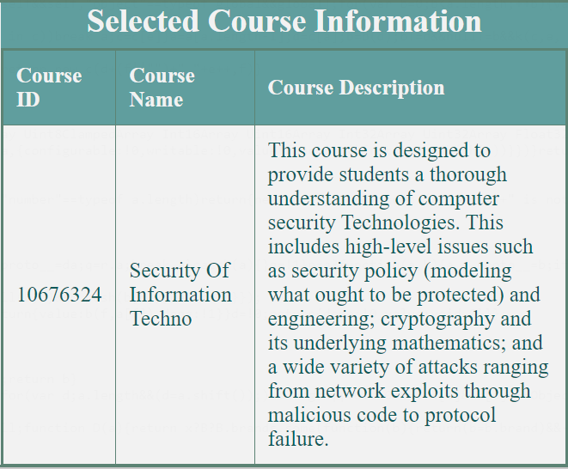
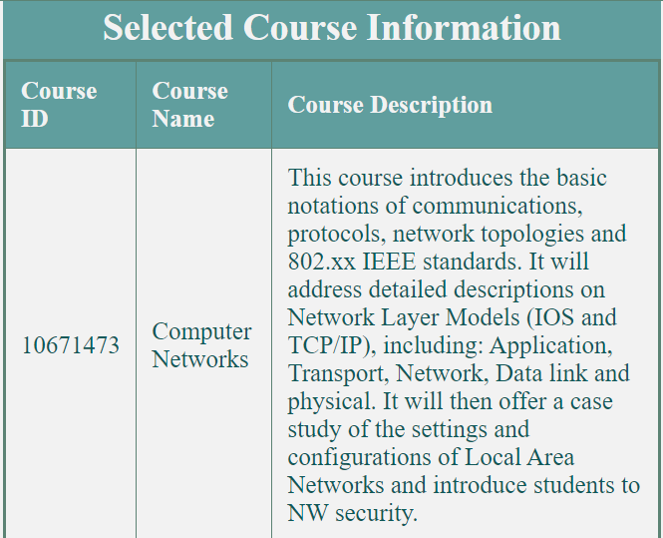
Results
Example:
Selected course:
Another course:
Another course:

Slide 17
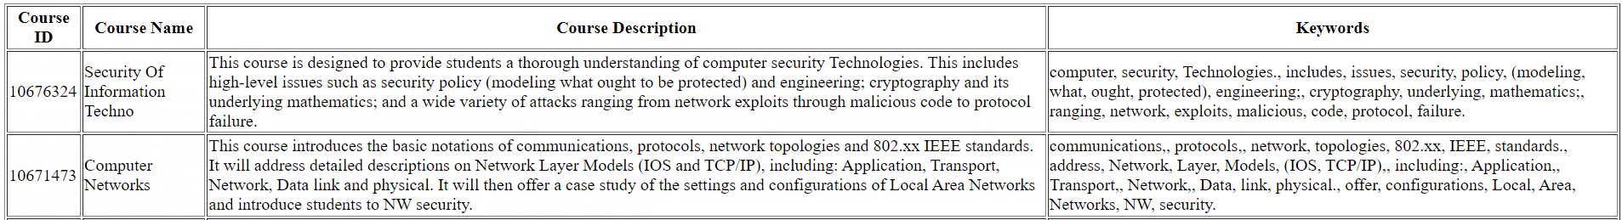
After Stop Words Removing:

Slide 18
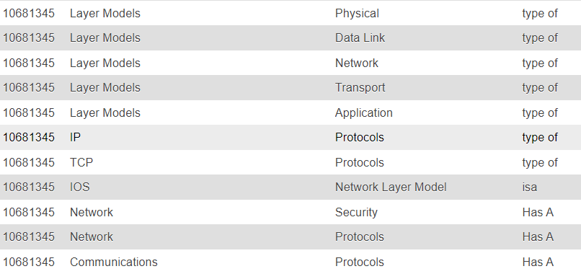
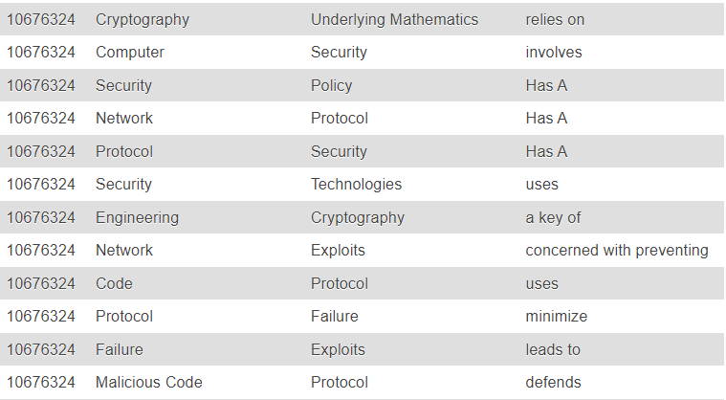
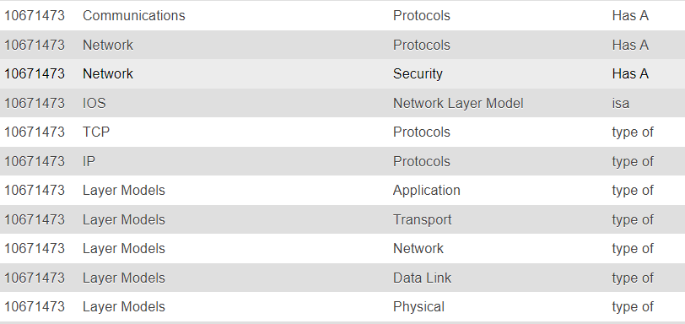
Ontologies:

Slide 19
Calculations:
Matching Percentage % = M(O1, O2) / N(O1) × 100% (1)
Matching Percentage % = M(10681345, 10671473) / N(11) × 100 = (11/11) × 100 = 100%
Matching Percentage % = M(10681345, 10676324) / N(11) × 100 = (2/11) × 100 = 18.18%

Slide 20
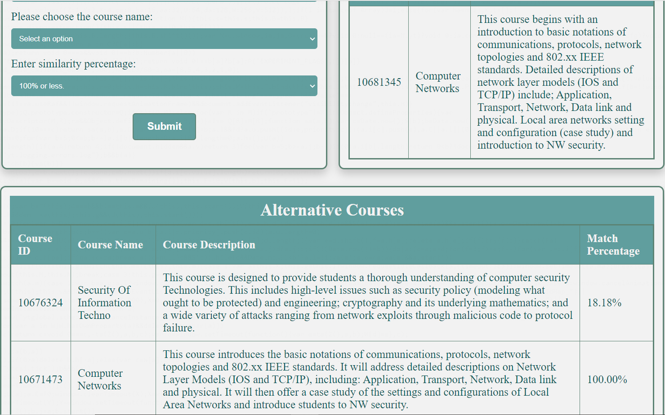

Slide 21
Difficulties
Some course descriptions did not express the course
topics clearly and explicitly but were rather vague.
Some of the course descriptions were short and I was
unable to extract various terms from them.
Some course descriptions were full of stop words.
Sometimes two courses offer the same academic material, but one of them has a weak description.

Slide 22
Thank you for listening
THE END

