Slide 1
Smart Traffic Light System
Yousef Hawwari and yaser nabulsi

Slide 2
Outline
Problem & Solve
Features:
Solar Tracker
Image Processing
Traffic Light
Constrains
Future Work
Demo

Slide 3
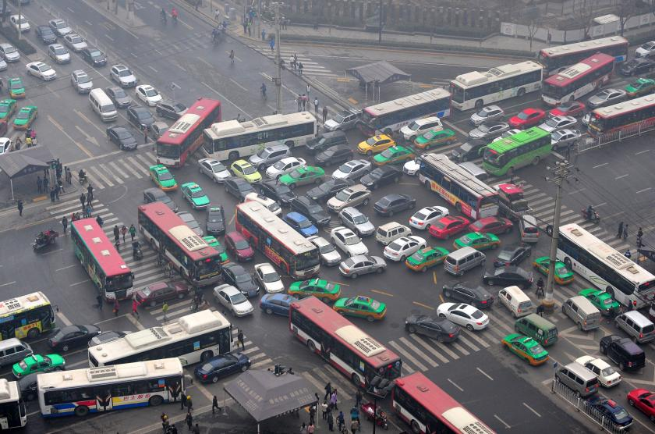
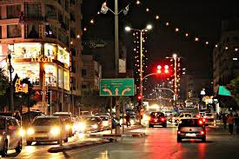
Problem & Solve
Traffic Congestion example : Rafida crossroads

Slide 4
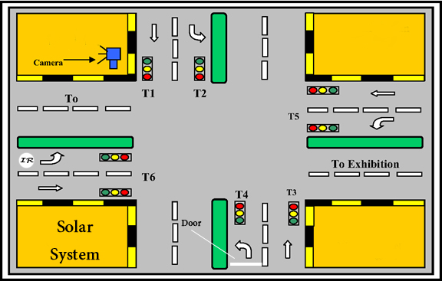
Problem & Solve Cont…
Smart Traffic light system

Slide 5
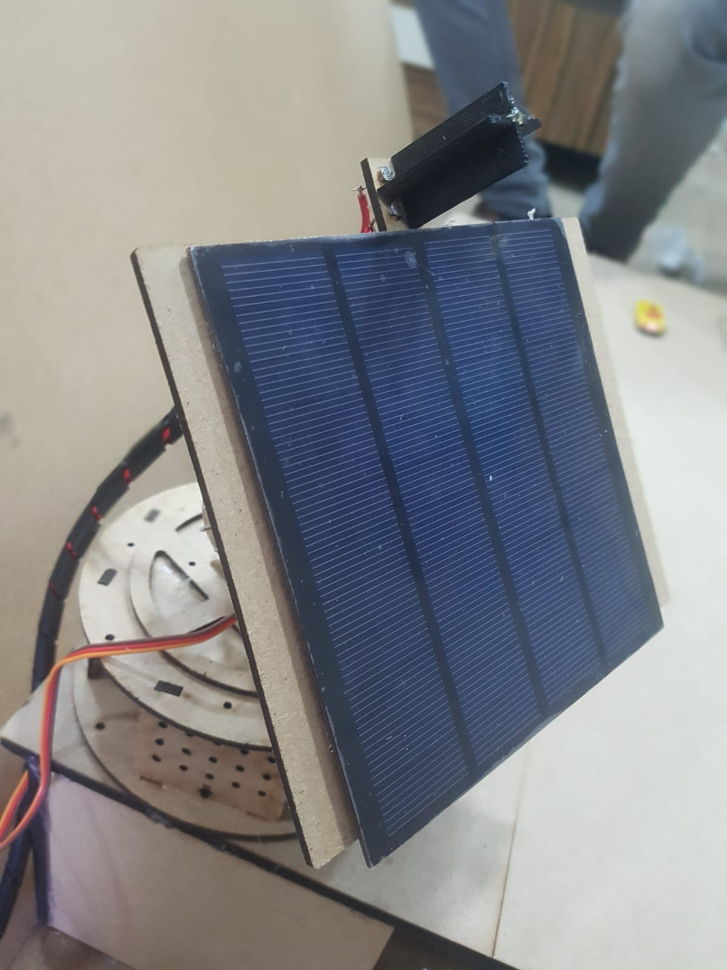
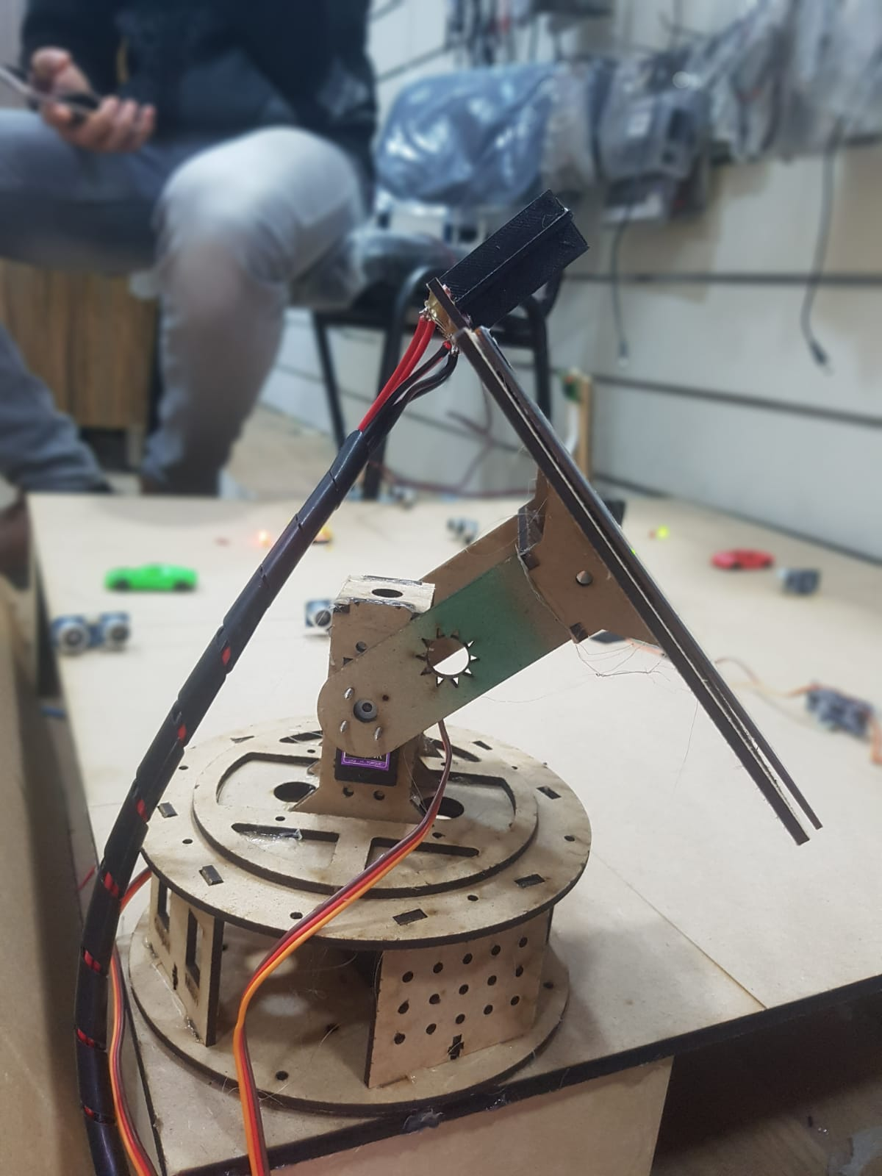
Solar Tracker

Slide 6
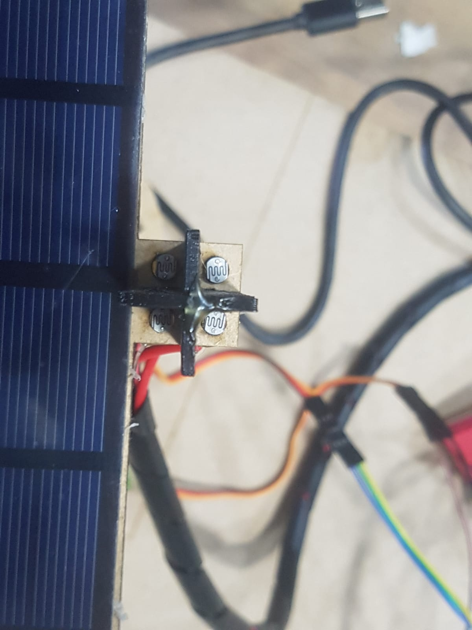
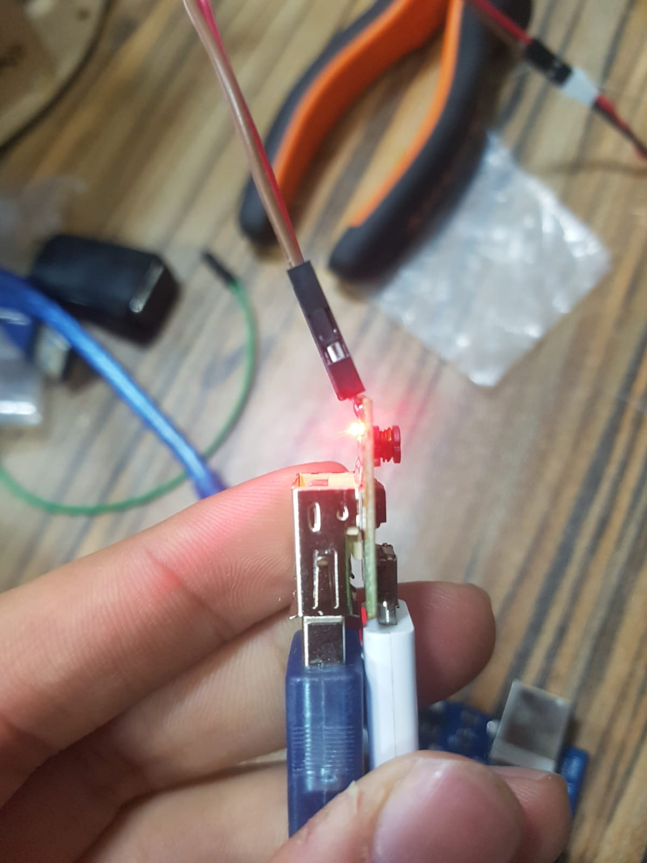
Solar Tracker Cont …

Slide 7
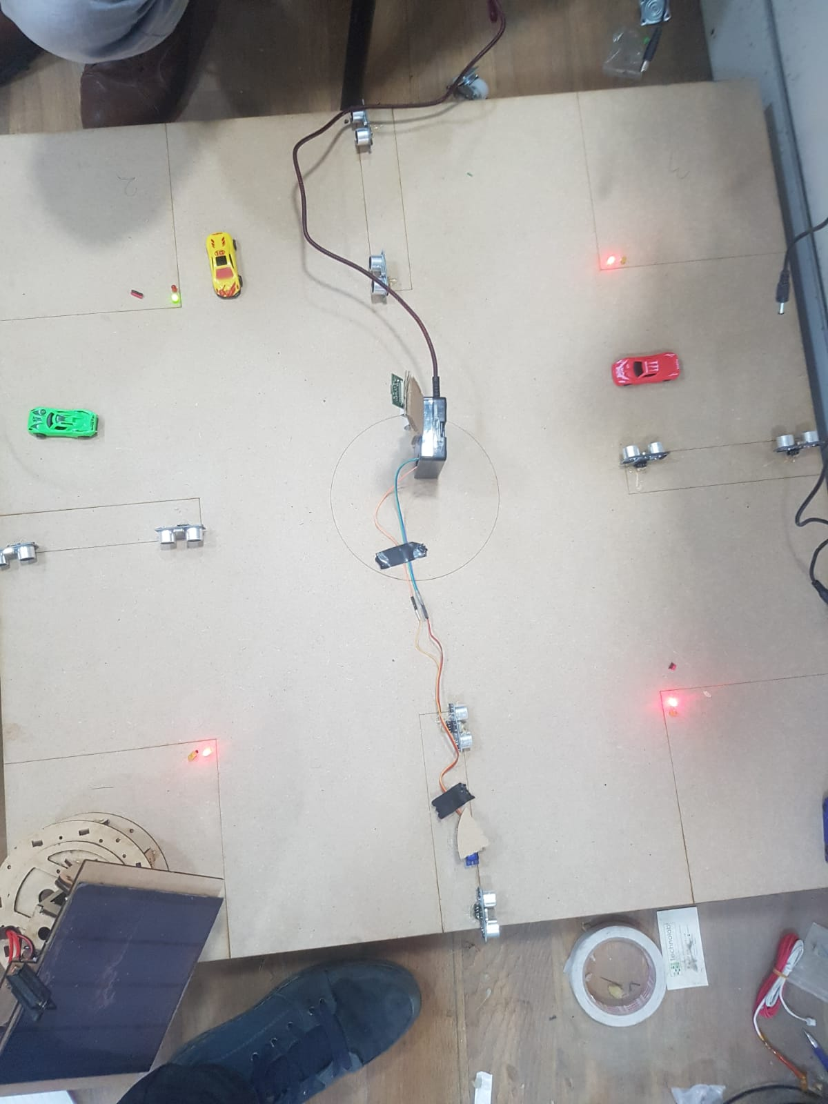
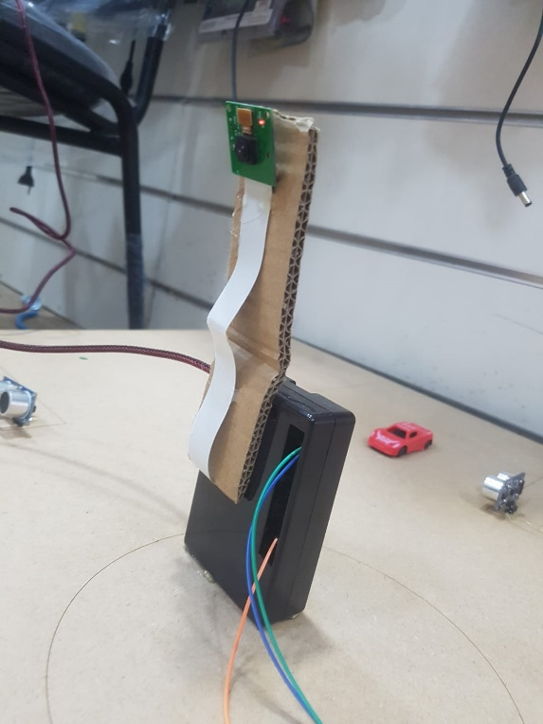
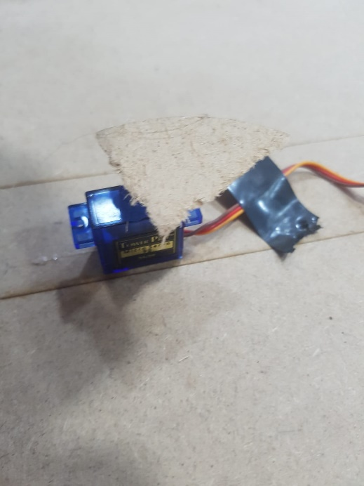
Image Processing

Slide 8
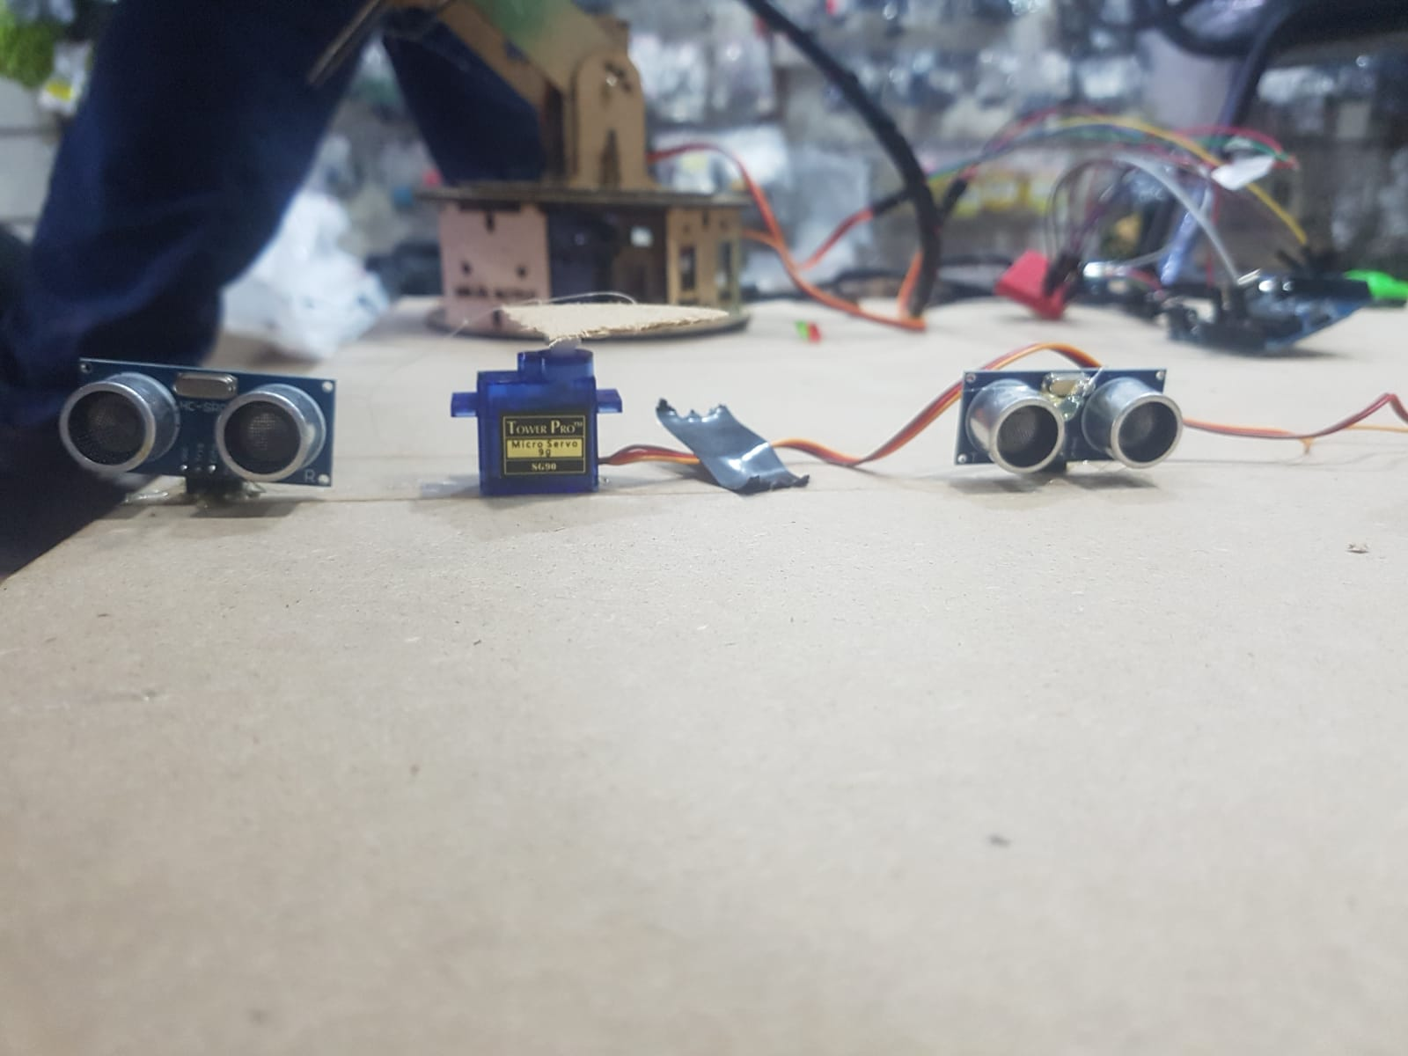
Traffic Light

Slide 9
Constrains
IR Sensor
Raspberry pi
Arduino Uno Limit output

Slide 10
Future Work
Emergence !
Data Collection

Slide 11
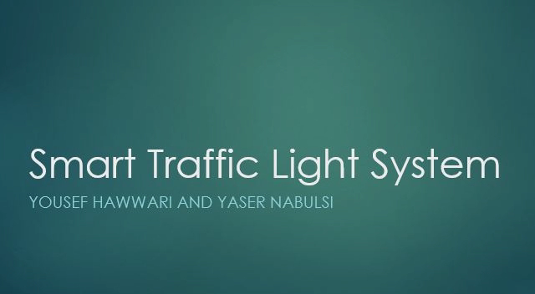
DEMO

Slide 12
Thanks for good listening.

