Slide 1
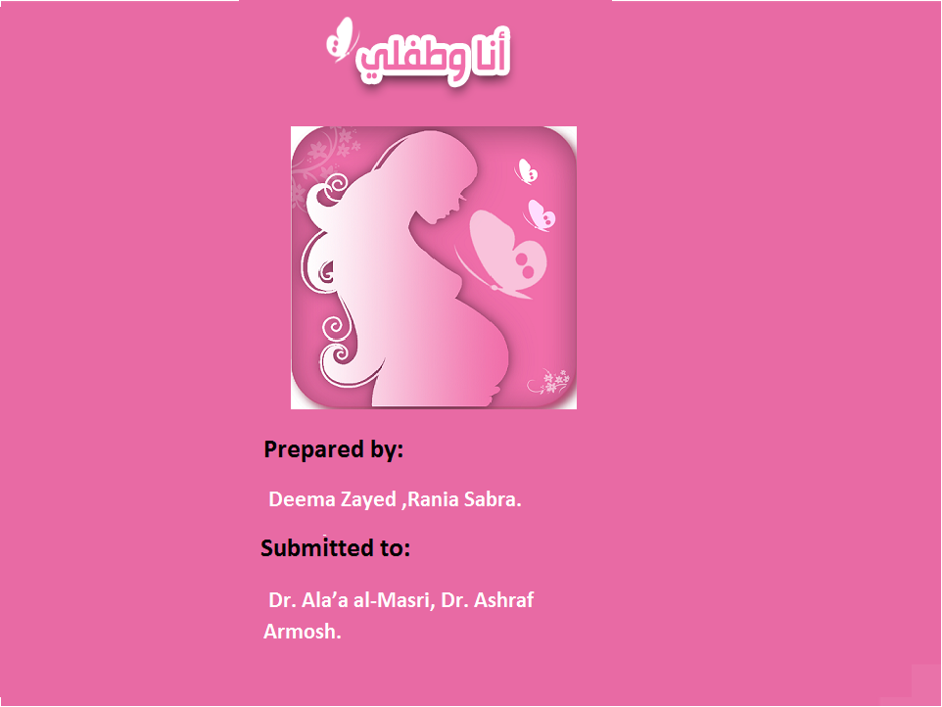

Slide 2

Motivation
Customer Requirements
Features
Problems
Future Work
Conclusion
Demo

Slide 3

Motivation
Pregnant women find it difficult to visit their doctor’s clinic regularly.
Pregnancy is a special experience, specially for new moms.
Some of pregnant women questions are “critical”.
Visits to the doctor’s clinic pose an additional financial burden on pregnant women.
Additional load on doctor to answer “repeated questions” .

Slide 4
Motivation
Pregnant women find it difficult to visit their doctor’s clinic regularly.
Pregnancy is a special experience, specially for new moms.
Some of pregnant women questions are “critical”.
Visits to the doctor’s clinic pose an additional financial burden on pregnant women.
Additional load on doctor to answer “repeated questions” .

Slide 5
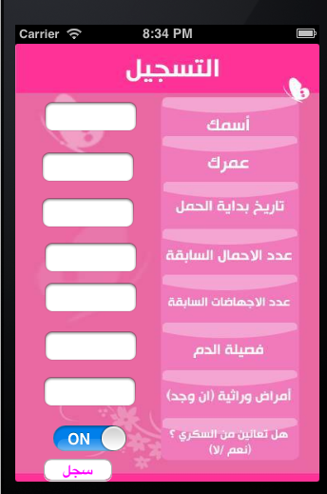
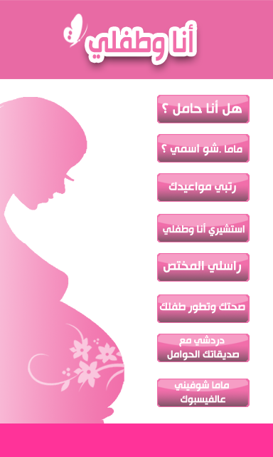
Feature “التسجيل”

Slide 6
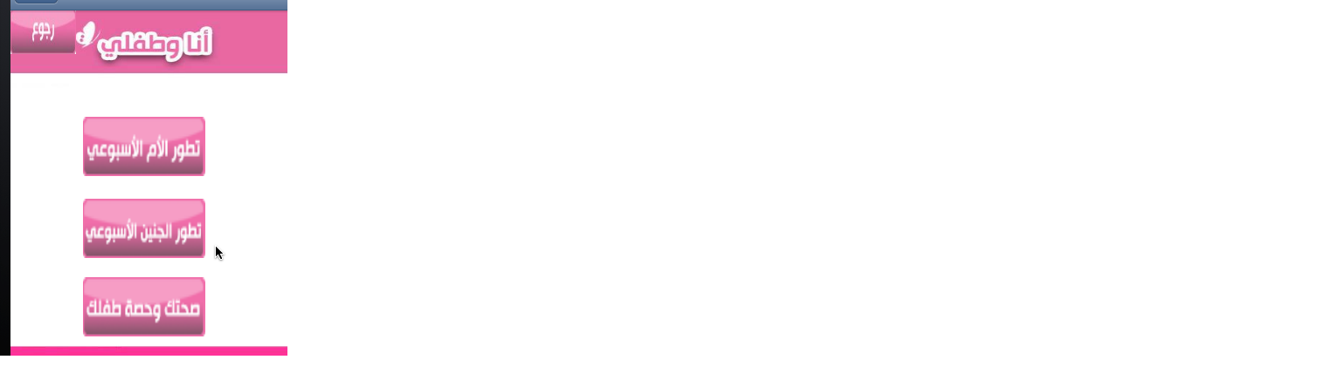
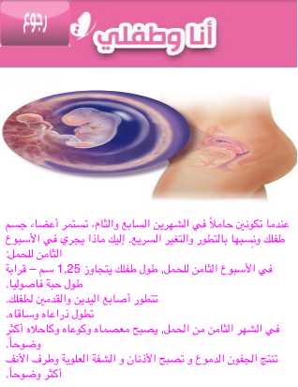
Feature “صحتك وتطور طفلك”

Slide 7
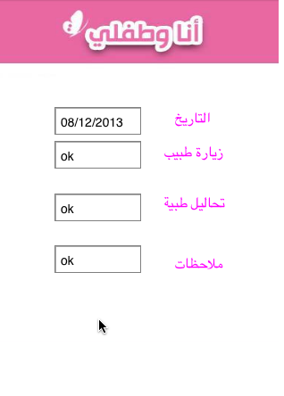
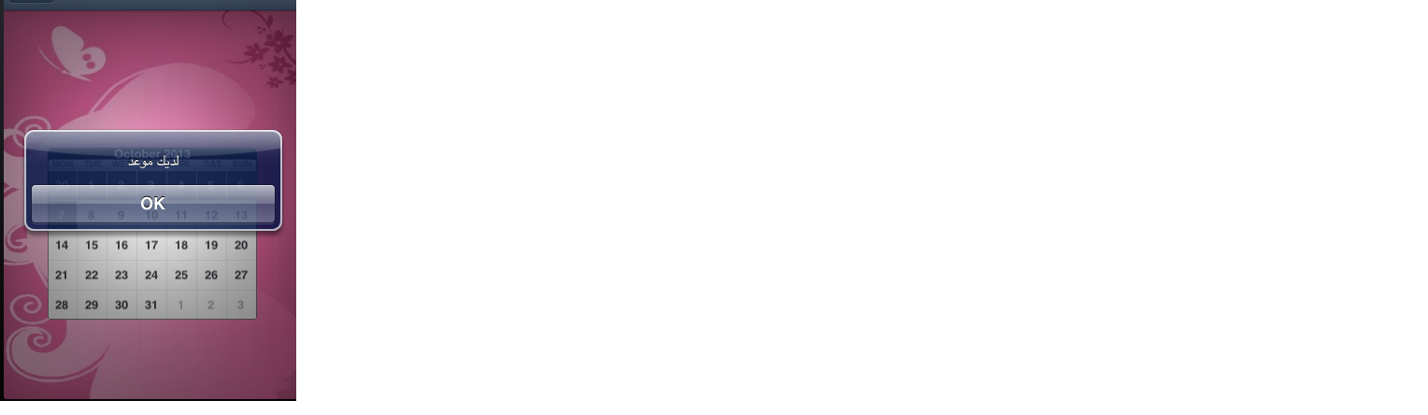
Feature “رتبي مواعيدي”

Slide 8
Feature “هل أنا حامل؟”

Slide 9
Feature “استشيري أنا وطفلي”

Slide 10
Feature “راسلي المختص”

Slide 11
Feature “دردشي مع صديقاتك الحوامل”

Slide 12
Feature “ماما شوفيني على الفيسبوك”

Slide 13
Feature “ماما شو اسمي؟”

Slide 14
Challanges

Slide 15
Conclusion
We’re proud to say that by concluding this integral project, we offer the user an all-in-one application that enables her to download all the mentioned features at one time.
Simple interface so it can easily support large number of audience.

