Slide 1

Robotic Arm Rover
Alaa Bustami

Slide 2
outline
Introduction.
Hardware design.
Software design.
Conclusion.

Slide 3
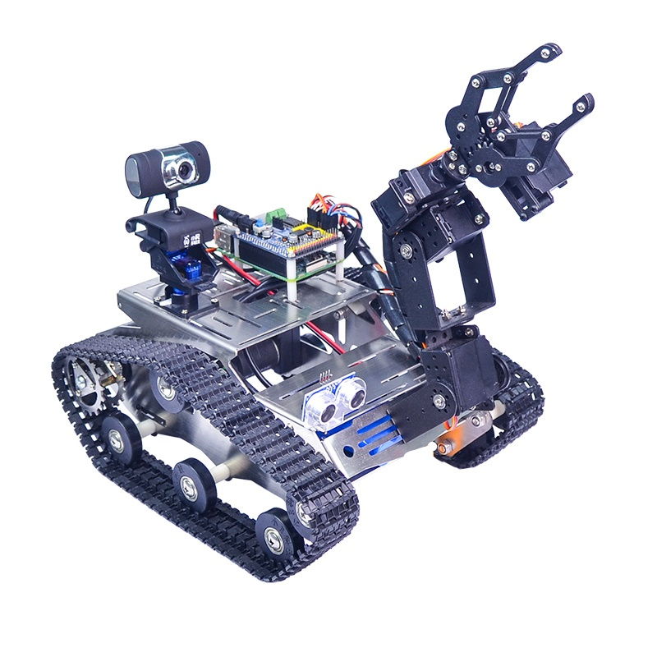
Introduction
*Overview of the project
consist of aluminum chassis in addition to a arm
that has four dofs to catch small objects, both
controlled by a wirelessKeyboard, also we
have a live stream camera streams to the laptop
display , the camera direction controlled by the
remote, also the robot has the ability to avoid
collisions by ultrasonic sensor.

Slide 4
Project use
* helping disables to bring small stuff.
* reach to objects in narrow places.
* reaches to the some dangerous places as in fires.
* carry toxic chemicals.

Slide 5
Constraints and problems
The main problem was the local market prices.
the reason that we had to buy the devices online,
though it takes long time, it saves money to the half.
also the Occupation some devices were prevented
to inter the Palestinian territories then somehow it
has passed.

Slide 6
standards
the main language for coding were used is python language to control GPIO in raspberry pi.
Earlier coursework
* C++ and Microcontroller are employed in programming
the Arduino so it simplifies understanding the raspberry pi.
* Sensors and measurements.

Slide 7
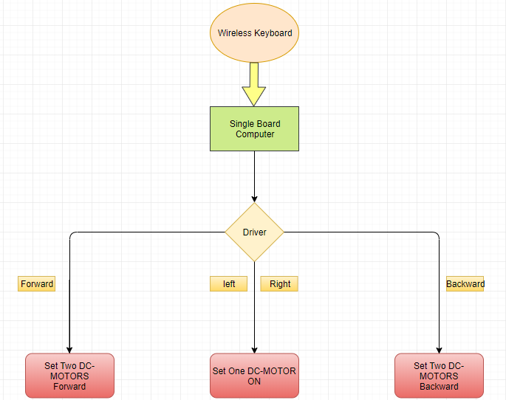
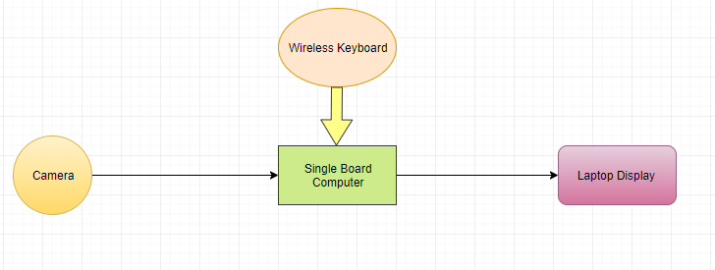
Flow Charts
DC motor and driver
camera

Slide 8
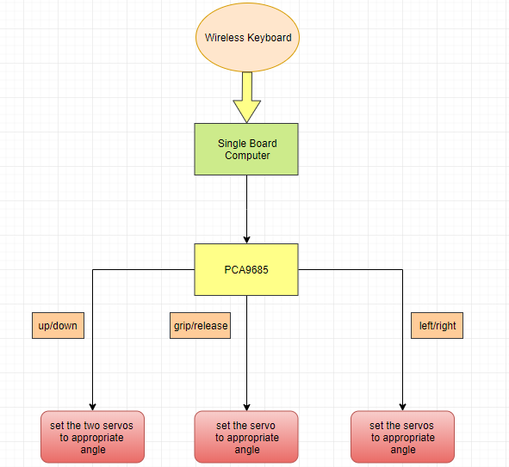
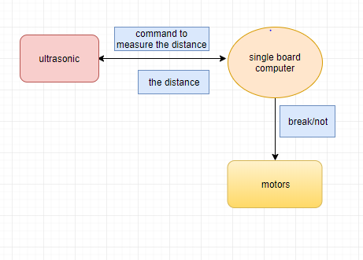
Arm and servos
ultrasonic and motors

Slide 9
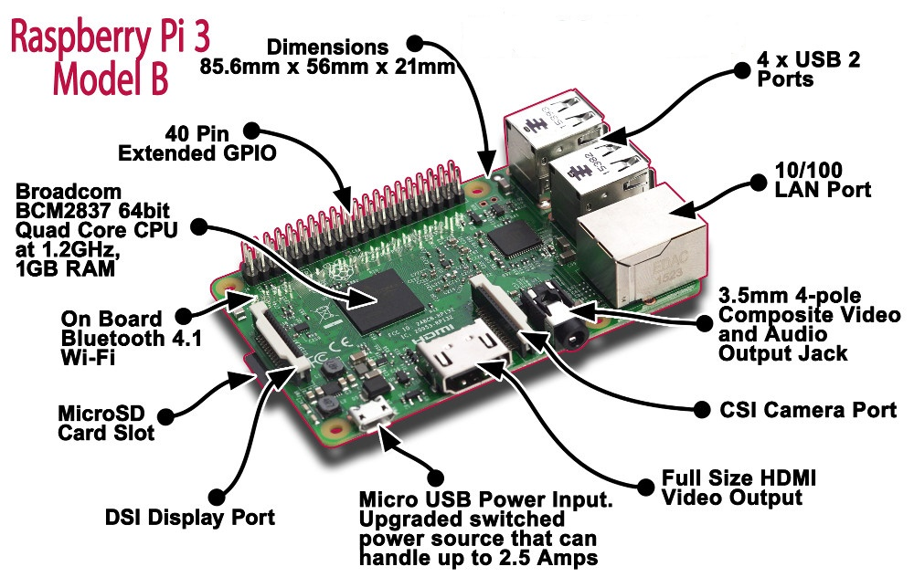
Hardware Design
*Single board computer
The Mastermind for the whole project.

Slide 10
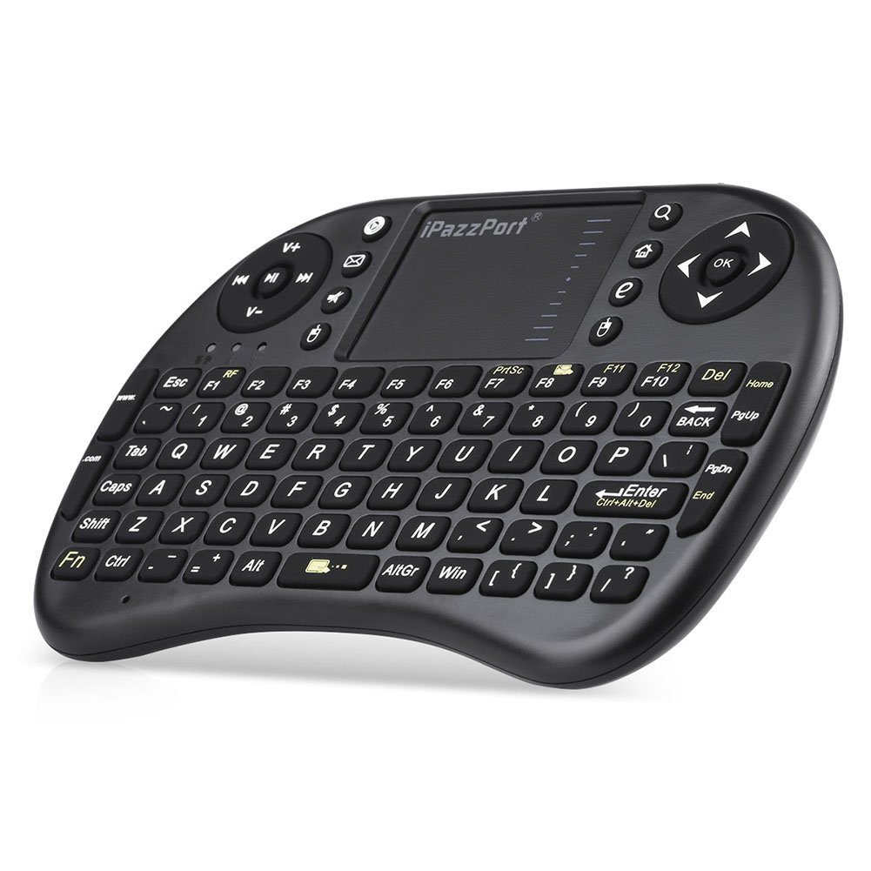
*Wireless Keyboard
The Remote controller

Slide 11
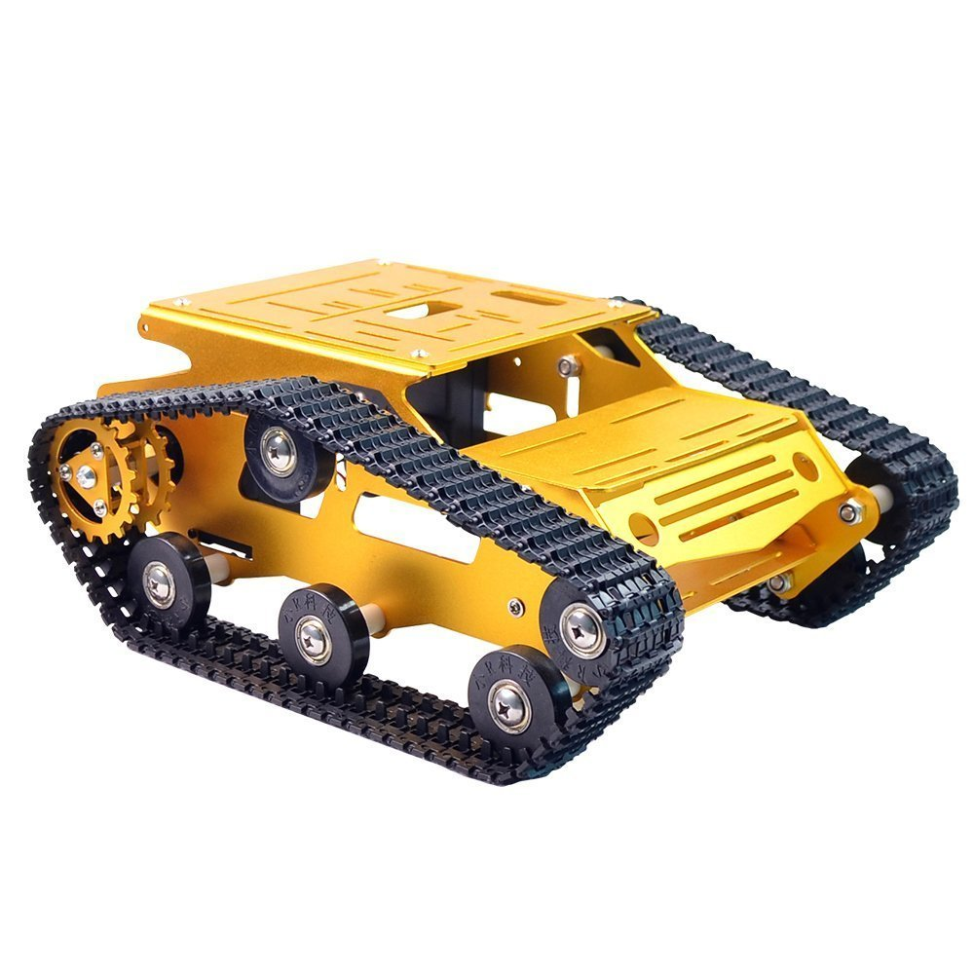
Xiao chassis
The vehicle that carries the whole devices.

Slide 12
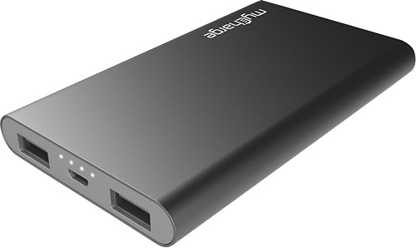
Power bank
supplies the raspberry pi with power.

Slide 13
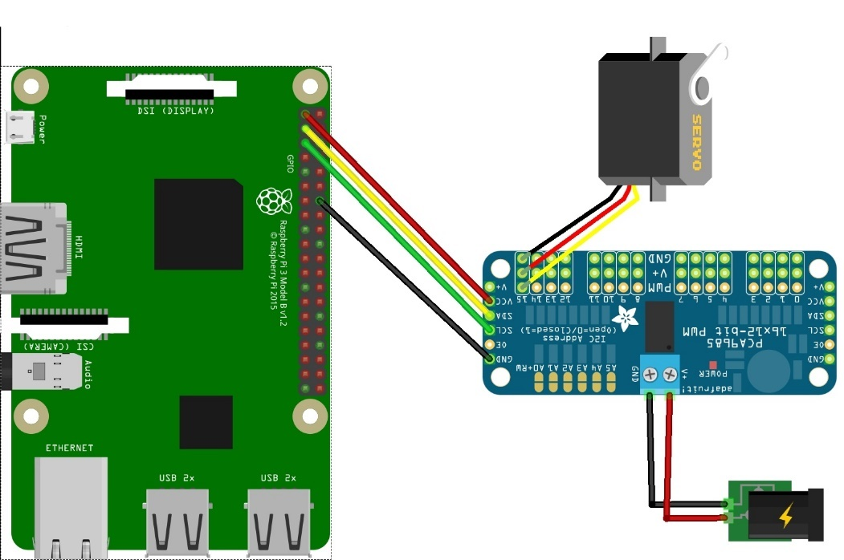
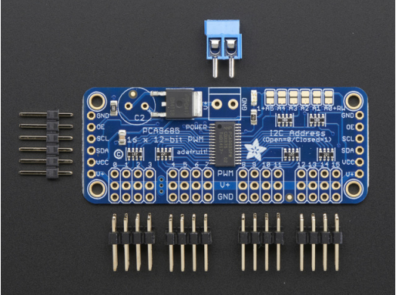
PCA9685 - 16-channel 12bit PWM/Servo driver
It's an i2c-controlled PWM driver with a built in clock. That means you do not need to continuously send it signal tying up your microcontroller, its completely free running.

Slide 14
Servo motor
Dc motor consists of gears and shaft provides high torque and accuracy.
What makes it special is a microcontroller built in the servo.
When the signal is high we called it “on time” and the duty cycle describes the amount of “on time” over an interval.
The period is updated every 20 ms with pulse (1-2)ms or (5-10)%
Duty cycle in 50Hz wave form.
The duration of pulse we send to the motor detects the angle that the motor should take it position.
For example(1.5ms the servo rotates to the 90 degree ,the 1ms rotates to 0 degree and 2ms rotates to 180 degree).

Slide 15
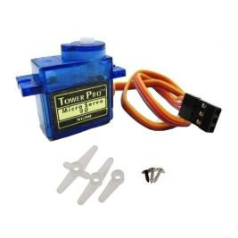
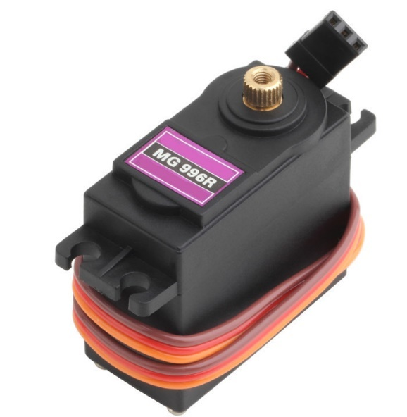
SG90 servo motor
MG996R servo motor

Slide 16
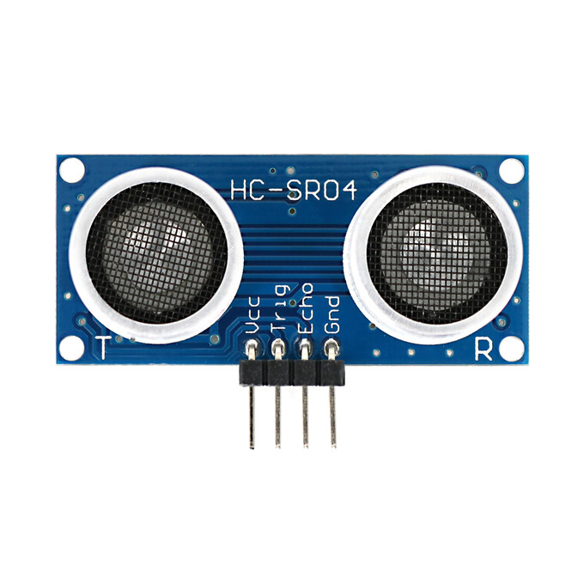
HC-SR04 Ultrasonic
Measures the distance using the
difference of sound transmission time and its reflection
Multiplied by the sound speed giving us the distance.

Slide 17
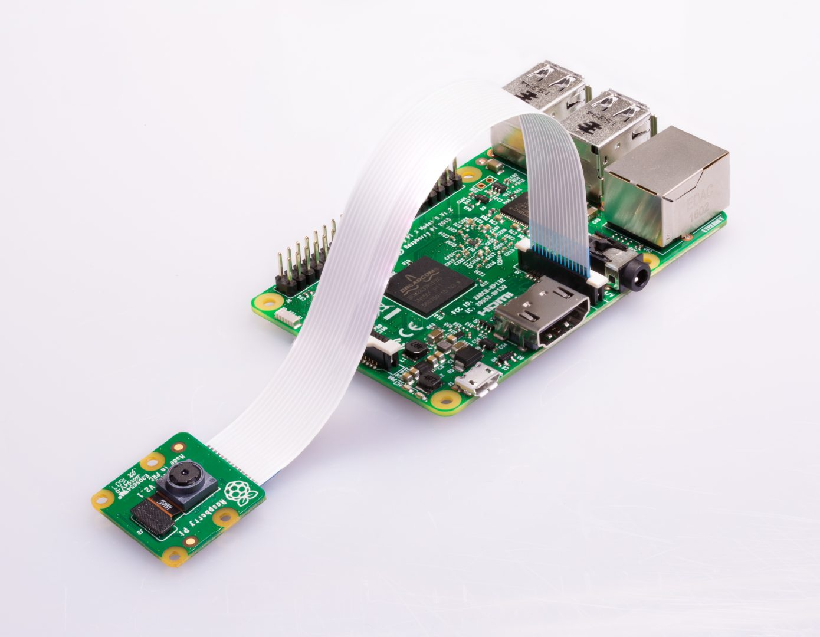
Raspberry pi camera

Slide 18
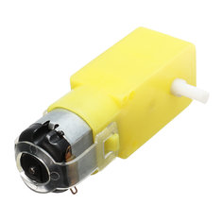
DC-Motor

Slide 19
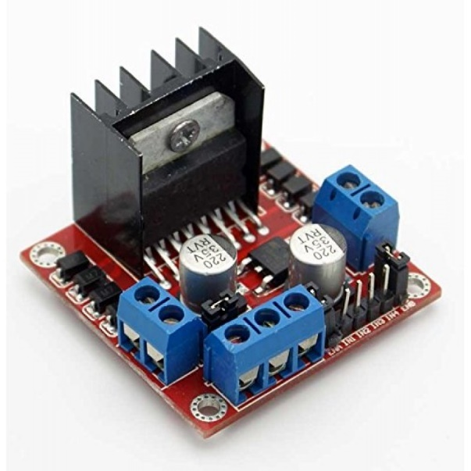
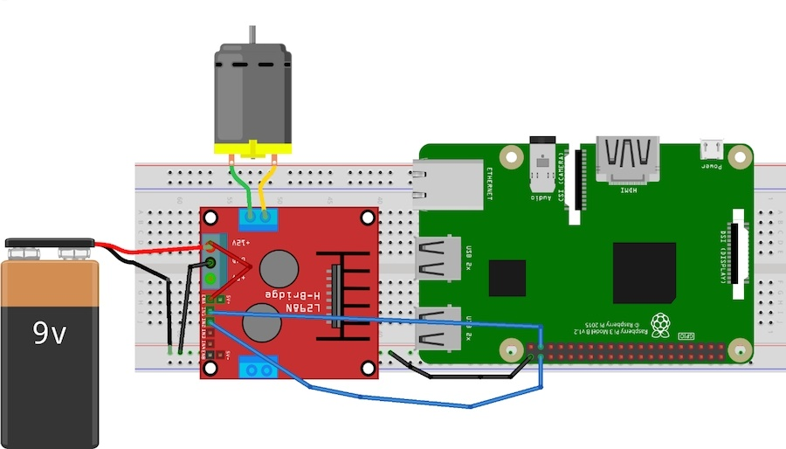
L298n DC Motor Driver
L298n is known as a dual bidirectional motor driver which is based on dual H-Bridge Motor driver IC.

Slide 20
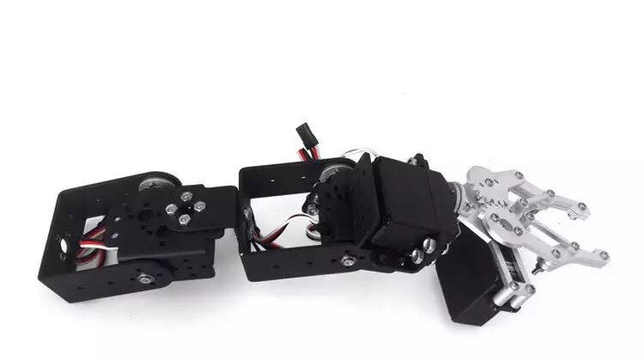
Arm and Gripper

Slide 21
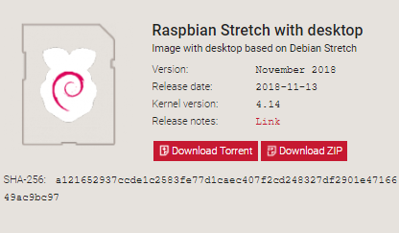
Software design
*Installing software
we have installed raspbian as an operation system for the raspberry pi on the SD Card.

Slide 22
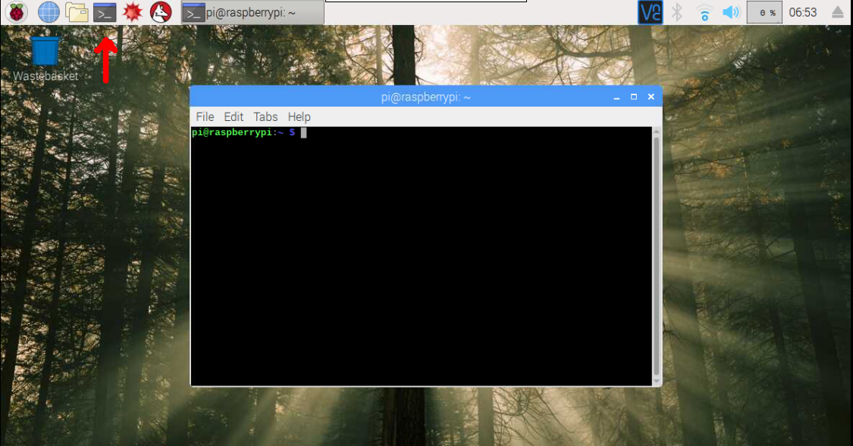
Raspbian system Interface
We put the SD card on the raspberry pi and we connect it to the power supply and with an HDM connect with display that support HDMI, also we connect a mouse and keyboard with raspberry pi USB port.

Slide 23
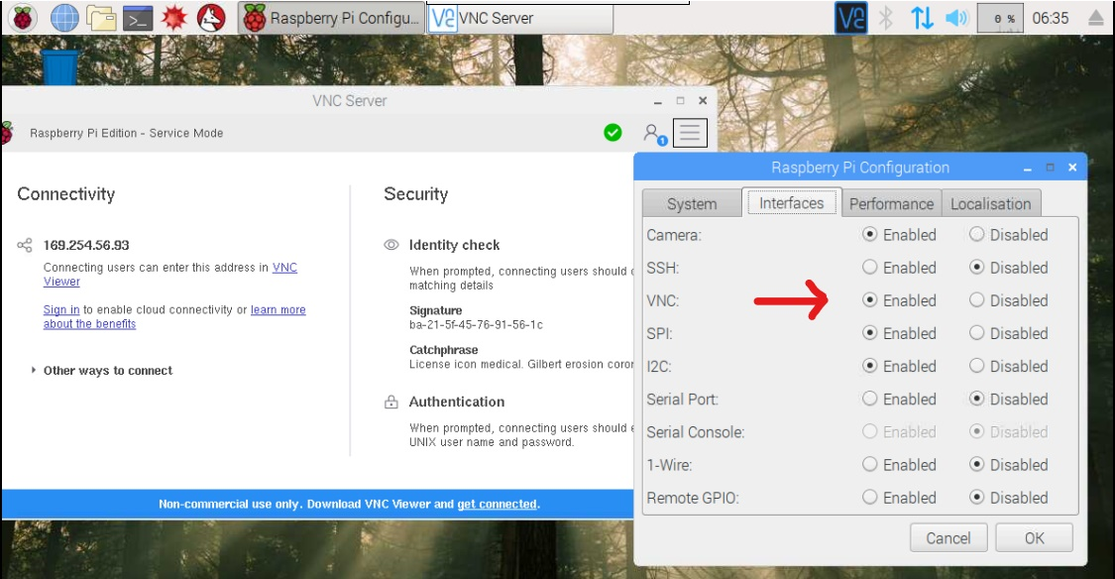
VNC Viewer (Virtual Network Computing )

Slide 24
Programing in Raspberry pi
In programing Raspberry pi we open the Terminal and it is the main program in linux that it make us able to access to anything inside the system.

Slide 25
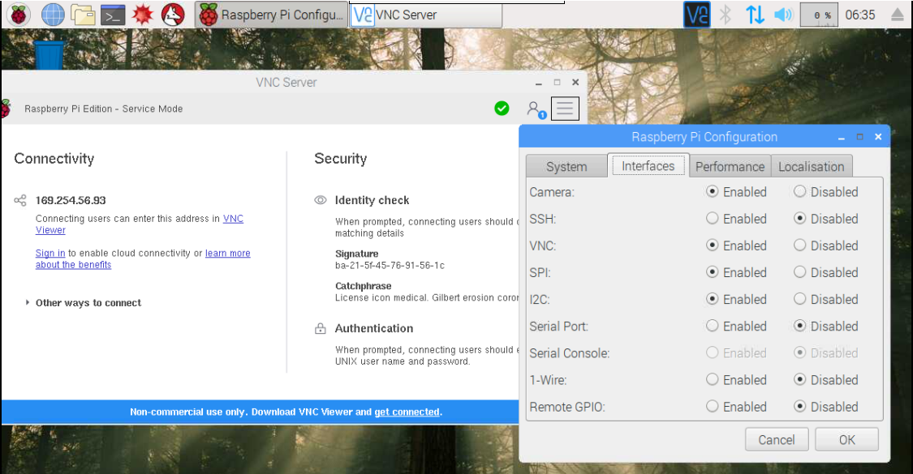
Setting up the camera

Slide 26
Programing in Raspberry pi
In programing Raspberry pi we open the Terminal and it is the main program in linux that it make us able to access to anything inside the system.

Slide 27
Conclusion
Good experience has absorbed in new technology , I wish I can explore more about these smart electronics and getting better by the time .

Slide 28
Thank you

