Slide 1
An-Najah National University
Faculty of Engineering and Information Technology
Department of Mechanical Engineering
Presentation of Graduation Project 2:
Geothermal Energy in Palestine:
(city center mall in Jenin as a case study)
Supervisor:
Dr. Ramez khaldi.
Group members:
Jehad Daraghmeh.
Mansour Jamal.
Omar Hamad.
2020-2021

Slide 2
Abstract
Palestinians today are paying the highest energy prices and the population has increased, and the number of devices, so we have to use energy sources Nature to reduce non-renewable energy consumption and reduce environmental pollution from fossil fuels.
Geothermal energy is environmentally friendly, 24-hour production and long life time, where the heat is transferred from the ground, which has a temperature of approximately 50 degrees.

Slide 3
Contents:
CHAPTER 1: INTRODUCTION.
CHAPTER 2:. CONTSTAINT .
CHAPTER 3:. LITERATURE REVIEW
CHAPTER 4:GEOTHERMAL IN PALESTINE
CHAPTER 5: METHDOLOGY
RESULTS AND DISCUSSION.
CHAPTER 6:COST ANALYSIS
CHAPTER 7:CONCLUSION AND RECOMMENDATION

Slide 4
Chapter one: Introduction.
Because the Palestinian people depend on buy energy from the Israeli occupation, which form a good economic benefits for the Israeli occupation. It has become necessary to search for solutions to find an alternative energy source, so that the geothermal energy system probably a good success in Palestine.
Geothermal energy: Is a renewable and environmentally friendly source of energy, and it is energy stored in the Earth that humans have used as a new source of energy for heating, cooling and electricity.
Geothermal conversion:
The Earth absorbs approximately 50% of the sun's heat and keeps it inside it as a renewable energy source that can be used as stored geothermal energy.
Temperatures rise in every depth of 100 meters at a rate of 3 degrees Celsius so when you dig 2 km the temperature will be 55 degrees Celsius.

Slide 5
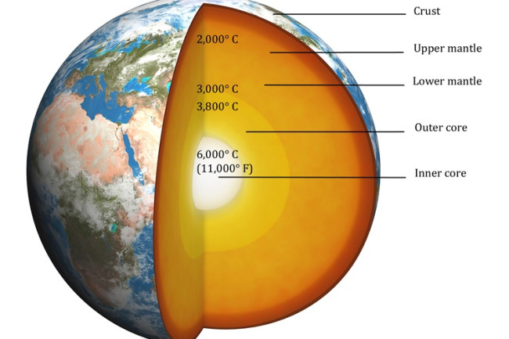
Layers of earth:
The crust: is the outer solid shell of a rocky planet, ranges from 5 to 70 km.
The mantle: constitutes 84% of the total size of the earth, the thickness of the mantle is about 2900 km, The temperature of the mantle varies greatly, from 1000 to 3700 Celsius.
Earth’s core: 2,900 kilometers below the surface of the earth, temperature is between 4500 and 5500 ° C.

Slide 6
Uses of geothermal energy:
There are three main types of geothermal systems:
Direct use and district heating systems: Using hot water underground to heat buildings, grow plants in greenhouses, dry onions and garlic, heat water for fish farming, milk pasteurization, and many other applications.
Geothermal Power plants: Geothermal power plants use steam from hot water tanks a few miles or more below the surface of the earth to produce electricity.
Geothermal heat pumps: Geothermal heat pumps use constant temperatures near the surface of the earth to heat and cool buildings. They work to transfer heat from the ground to the buildings during the winter and transfer heat from the buildings to the ground in the summer, and based on a performance coefficient (COP) of about 3.5.

Slide 7
Advantages and Disadvantages of geothermal system:
Advantages:
1. Saves Cost (saves about 80% of the cost of fossil fuels) and requires little electricity compared to regular heating systems.
2. Geothermal energy uses the Earth's heat as a natural renewable energy source.
3. Its efficiency is 48% higher than the efficiency of gas ovens, and it is much higher than the efficiency of oil furnaces and reaches 75%.
4. Cheap and easy compared to the maintenance of other thermal systems. It just needs to change the air filter inside the heat pumps and replace some damaged tubes.
5. Durability and potential: Underground pipes can last for approximately 50 years.
Disadvantages:
1. Difficulty in choosing the location in addition to high installation costs.
2. Installing a geothermal system is very difficult, and installing in crowded residential areas is sometimes very difficult.
3. The system of obtaining energy by geothermal energy is not very clean due to the presence of heat pumps.
4. The coal used in geothermal heat pumps is not environmentally friendly, as it emits carbon dioxide, which is a major cause of global warming.

Slide 8
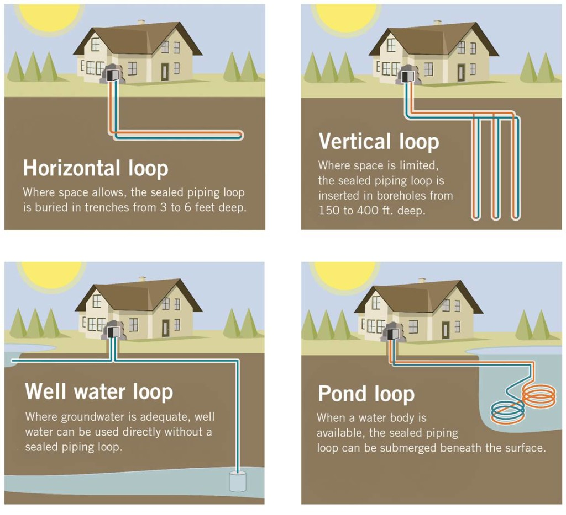
Type of geothermal heat pump system:
Open-loop geothermal systems: They mainly use groundwater, which acts as a coolant for the transfer of thermodynamic energy.
Closed-loop geothermal systems: They differ from open-loop geothermal systems in that they use water that passes through underground pipes instead of using groundwater to transfer heat.
There are three different types of geothermal systems with closed-loop:
1.Horizontally loops.
2.Vertical loops.
3.Pond or lake loops.

Slide 9
Chapter two: Constraint, Stander code
Constraint
We have faced many problems in this project:
Difficulty accessing information due to the entry of the Corona virus
The policy of the Israeli occupation and defining the permitted areas.
A new idea that is hard to convince people to use
geothermal energy is not famous in developing countries.
It is difficult to get accurate information from previous studies due to the different geographical nature.

Slide 10
Stander code
Earlier course work
We have used many of the standard codes in this project including ASHRAE code, Palestinian code.
MATLAB Programming .
Fluid mechanics.
HVAC
Heat transfer.

Slide 11
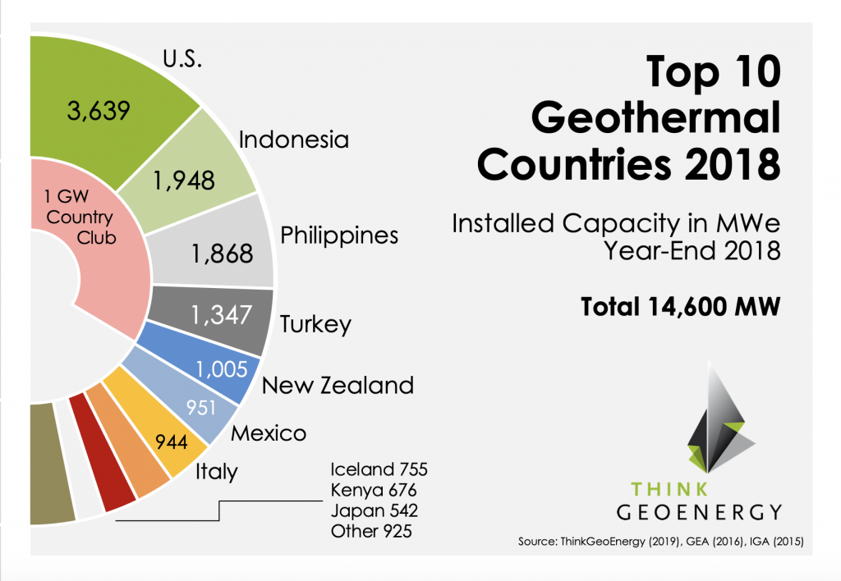
Chapter three: Literature review.
A geothermal literature review is a very important first step in any geothermal exploration activity. Literature reviews are a staple for research in almost any exploration activity because it is important to know what has already been done and what the results were before beginning a new exploration activity. Literature reviews look at previous research, studies, observations.
Here list of the top 10 countries in the geothermal energy field is published at the end of 2018, and the results are as follows:

Slide 12
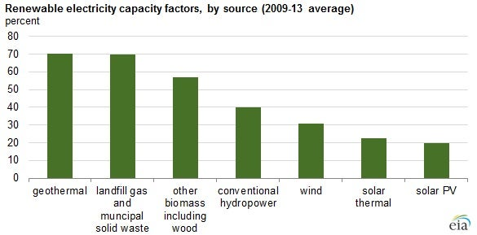
Other countries represent an installed power generation capacity of 925 MW, bringing the total installed geothermal power generation capacity at the end of the year 2018 to 14,600 MW.
European countries generate more than 4000 GWh/year from geothermal sources predominantly in Italy, Iceland, Turkey and Russia . Here are the different energy ratios in some countries, and the geothermal energy has the highest rate nearly:

Slide 13
Chapter four: Geothermal energy in Palestine.
The Palestinian pays the highest price for energy in the Middle East, and do not forget that Palestine has the highest population growth rate in the world 3.99% in Gaza and 2.9% in the West Bank.
Palestine has many natural energy sources, but unfortunately all of them were taken over by the Israeli occupation, and we have become dependent on the Israeli occupation to provide us with energy.
The best solution to reduce this consumption is to use geothermal system to heating and cooling.
Energy prices in Palestine:
The Palestinian people find themselves in dire need of an efficient and economical source of energy that can meet their needs requirements.
0.128 – 0.22 $/kWh | Price of Electricity
1.6 $/liter | Price of Gasoline
1.39 $/liter | Price of Diesel
1.44 $ /Kg | Price of gas
1.3 $/liter | Price of Kerosene
195-334 $ /ton | Price of firewood

Slide 14
Locations of Geothermal Sources in Palestine:
Geothermal energy is available everywhere except it is located at different depths from the ground surface. Figure below shows the temperature of the earth at depth of 6 km from ground surface, the geothermal energy can be used extensively in Palestine especially in Gazza strip and north of Palestine. Those areas are the densest areas in Palestine, and they consume most of the electrical energy produced.
The geothermal energy can be used extensively in Palestine especially in Gazza strip and north of Palestine for that indicates.

Slide 15
Chapter five: Methodology.
The common traditional system used for heating and cooling in Palestine in general and in our project (Jenin mall) is HVAC system consisting of diesel-powered boilers for heating and forced-air spilt unit for air conditioning.
If the geothermal system in this project is operated to maintain a comfortable room temperature all year long it is expected to reduce operating costs.
How to select the correct geothermal system?:
Some of the variables that decide the correct system type to be implanted are:
1- Conditions of the Weather
2- Conditions of Soil.
3- Initial implantation cost
These factors manage the choice of suitable type. So, based on mentioned factors we chose the vertical-loop system to use for this project and that's what our project will talk about

Slide 16
Geothermal system for Jenin mall
The conventional HVAC system which is used at City Center mall in Jenin consist of four chillers every one of them is 229 ton for cooling .the power of every one is 335 kilowatt, and this explain how much the cost of the system.
Also, the system consist of two boilers (1490 ton) for heating (one of them stand by), they consume more than 300-400 liter of diesel per day, and this is really very expensive.
According to this high running cost, we planned to use geothermal system City Center mall in Jenin to minimize the cost

Slide 17
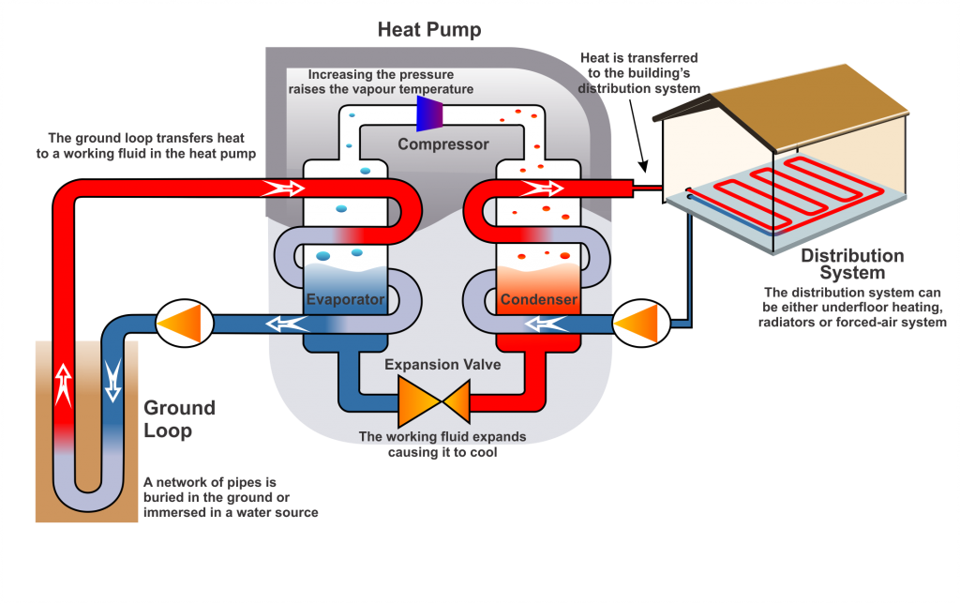
Geothermal heat pump:
Components of a Heat Pump:
• Evaporator.
• Compressor.
• Condenser.
• Expansion Valve.
How heat pumps system works?
The fluid passes through the pipes and its temperature is low, then the heat is absorbed from the ground. Then the fluid reaches the compressor, the temperature and pressure are raised and passed to the space for heating or used to heat the water. The ground which leads to absorption of heat when passing the liquid under the ground.

Slide 18
Heat pump selection
The selection of heat pump needs the following parameter
Type of the system (open, close, etc.)
Building load.
The required of a coefficient of performance (COP).
Pump characteristics (such as reversible or not, water to air, water to water)
In this project, the system which is used is a closed vertical system, with water to air heat pump.

Slide 19
catalog of heat pumps
Given the following heat pump type:
EKW Reversible pump (Models EKW090 & EKW130, 50Hz-R410a) With the following characteristics.
Model | Capacity | Load Liquid Flow (L/s) | Source Liquid Flow (L/s) | Cooling |  | Load Liquid Flow (L/s) | Source Liquid Flow (L/s) | Heating
 |  |  |  | LLT= 18°C LST= 35°C |  |  |  | LLT= 35°C LST= -3°C
 |  |  |  | Capacity KW | COP |  |  | Capacity KW | COP
EKW090 | Full | 5.70 | 4.30 | 1100.1 | 5.2 | 4.30 | 5.70 | 859.8 | 4.1
 | Part | 5.70 | 4.30 | 900.2 | 5.4 | 4.30 | 5.70 | 550.7 | 4.3
EKW130 | Full | 8.50 | 6.80 | 1720.3 | 5.4 | 6.80 | 8.50 | 1560.2 | 4.9
 | Part | 8.50 | 6.80 | 1400.5 | 5.4 | 6.80 | 8.50 | 980.2 | 4.9

Slide 20
Chapter six: Results and Analysis.
The table below compares between geothermal system and HVAC system:
Life-cycle cost | Maintenance cost | Operating Cost | Installation cost | Safety | Compare:
Low | Low | Low | High | Excellent | Geothermal System
High | High | High | Low | Excellent | HVAC system

Slide 21
After making the calculations
initial cost for the geothermal system(1092500$).
initial cost for the normal system (200000$).
The running cost for normal system will be about (108300+275932) =384232$.
The running cost for geothermal system is about (122636+53088) =175724 $.

Slide 22
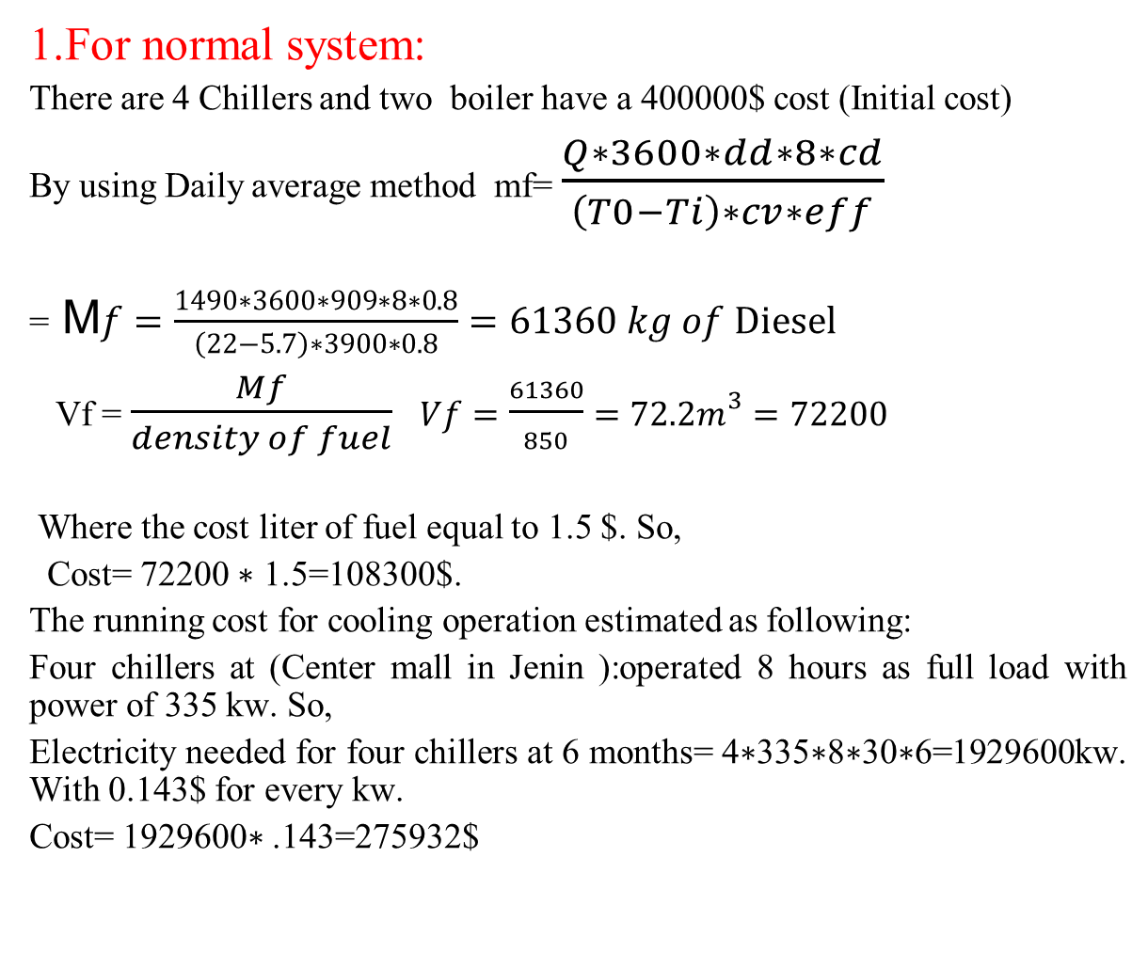
Sample calculations:
1.For normal system:
There are 4 Chillers and two boiler have a 400000$ cost (Initial cost)
By using Daily average method mf= $\frac{Q∗3600∗dd∗8∗cd}{\left(T0−Ti\right)∗cv∗eff}$
= M$f=\frac{1490∗3600∗909∗8∗0.8}{\left(22−5.7\right)∗3900∗0.8}=61360 kg of Diesel$
Vf = $\frac{Mf}{density of fuel} Vf=\frac{61360}{850}=72.2m^{3}=72200$
Where the cost liter of fuel equal to 1.5 $. So,
Cost= 72200 ∗ 1.5=108300$.
The running cost for cooling operation estimated as following:
Four chillers at (Center mall in Jenin ):operated 8 hours as full load with power of 335 kw. So,
Electricity needed for four chillers at 6 months= 4∗335∗8∗30∗6=1929600kw. With 0.143$ for every kw.
Cost= 1929600∗ .143=275932$

Slide 23
2.For geothermal system
The initial cost of the geothermal system is high, due to the holes drilling and pipe system. For vertical system, the initial cost can be estimated as below:
The cost of finishing one borehole (drilling and labor cost, and the pipe installation) will be about 1500$.
The number of boreholes is (675 holes).
The price of the water to water heat pump for (Center mall in Jenin) is about 80000$.
So, the initial cost will be about
(80000) + (1500∗675) = 1092500$.

Slide 24
The running cost of the geothermal system is almost 46% of the running cost for the normal system.
The main disadvantages of the geothermal system are the high initial cost. On the other hand, geothermal system is considered as environmentally friendly. In this project, the difference between the two systems is shown above. As the building load increases, the difference is there so it is more economical for large loads than small loads.

Slide 25
Chapter seven: DISCUSSION
the most important of these advantages represented by low running costs comparing with conventional HVAC systems, environmentally friendly, 24 hour production.
We chose vertical loops instead of horizontal loop because of the needed area of the system whereas, vertical loops need area less than horizontal loops. The initial cost of geothermal system is very high represented by the high cost of drilling holes which everyone costs 1500$.
Vertical loops are generally more expensive to install, but require less piping than horizontal loops because the earth's temperature is more stable farther below the surface. Typical piping requirements range from 400-600 feet of borehole per system ton of heating cooling, depending-as always – on the soil properties and ground temperature conditions. This requirement normally results in 1-2 boreholes per ton of device load, again dictating the exact requirement by the thermal properties of the soil

Slide 26
Geothermal energy in Palestine are Untapped because of the high initial cost, large needed area, weather temperature, little researches, and experience in geothermal energy. So, we need deep researches about this subject to Exploit heat energy.
Many factors must be considered when using geothermal energy:
Geothermal systems need available area for drilling holes.
Weather conditions.
Soil conditions.
The daily use of HVAC system.

Slide 27
Chapter eight: Conclusion and Recommendation.
Geothermal heating has several advantages and disadvantages, so if we are able to bear the high costs of installation and the return over a long period.
The Palestinians are under many constrains from Israeli Occupier. They cannot control their natural resources of energy. Two of the very high sources are in Gazza strip and north Palestine
After applying the geothermal system on Center mall in Jenin , we realized that the initial cost of heat system is very high comparison with conventional HVAC system, but the running cost of geothermal system is very low. So, the payback period will be three years after installing geothermal system at Center mall in Jenin

Slide 28
Examples of places that the geothermal system can be used in:
Hospitals.
Police centers.
Hotels.
Commercial center.
University.

Slide 29
Thank You

