Slide 1


One Tap Trade
OTT
Buy and Fly
Buy & Fly
By Imad & Ameer
Supervised by Dr. Maher Arafat

Slide 2

About Us
OTT Overview
C2C Business
First website for C2C in Palestine
A wide variety of products & Many options
Zero intermediaries

Slide 3
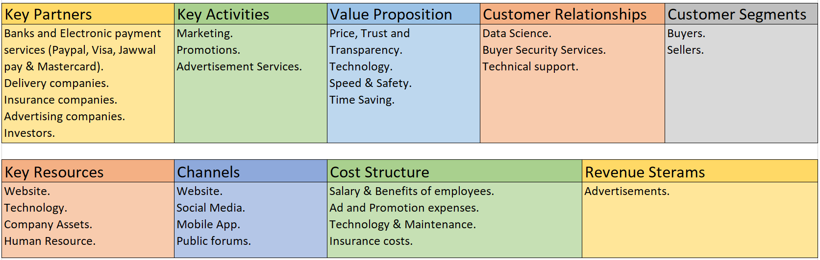
Business Model

Slide 4
Business Model (cont.)
Customer Segments (What is our target audience?)
Value Proposition (What we offer?)
Channels (How we reach customers?)
Customer Relationships (How we engage with customers?)
Revenue Streams (What are our profit sources?)
Key Resources (What are our resources?)
Key Activities (What are our activities?)
Key Partners (Who are our partners?)
Cost Structure (What is our costs & expenses?)

Slide 5

Business Plan
Executive Summary
Project idea centered around the cancellation of the buying and selling process intermediaries who in turn increase the cost to the buyer so that each of these parties puts a certain profit rate on the offered product. We, through this project, will remove all intermediaries between the seller and the buyer so that the customer can buy the product at reasonable prices and without trouble.

Slide 6
The Problem
What are the problems we want to solve?
supply and demand process, where sellers mislead consumers and raise prices.
High products prices.
At the local level there are no companies to address this problem.

Slide 7
Solution
How will we solve the problem?
Through this project, we provided an integrated platform that brings buyers and sellers together in one place.
Transparency and credibility in selling products.
Simplest and ideal for this problem.

Slide 8
Strategic Plan and Focus
Our Vision
One-Tap Trade's vision to be the first destination for people who want to complete their trade in a fast, easy and safe way.

Slide 9
Strategic Plan and Focus (cont.)
Our Values:
Fast delivery
Honesty
Trust
Commitment
Passion
Quality

Slide 10
Strategic Plan and Focus (cont.)
Our Focus Areas:
Improving the company's reputation among people
Improving customer experience and satisfaction
Increase the number of website and application users

Slide 11
Mission
How will we achieve our vision?
One-Tap Trad-e's mission is to provide an integrated platform where people are able to purchase, exchange products and services and interact with each other.

Slide 12
Objectives
The objectives for the first three years of operation include:
To create a service-based company whose primary goal is to exceed customers' expectations.
To increase the number of clients served by 20% per year through superior performance.
To create our own brand, which we aspire to reach to the world.
To change the concept of trade or its current stereotype in order to keep pace with technological and global development.
To develop a sustainable start-up business that is profitable.

Slide 13
Situation Analysis
Opportunity
Competitive Advantages
increase in people's awareness of e-commerce.
Internet development.
majority of people owning smartphones.
People’s tendency to the most comfortable means of doing their daily business.
Customer service 24/7
First mover C2C business
Multiple product varieties
Buying from home

Slide 14
Pricing
prices will be suitable for all segments of society so that there will be high-quality products, medium-quality products and used products at cheap prices, and there will be no additional commission in the buying and selling process

Slide 15
Services
What services do we offer?
hosting services for sellers and buyers to enable them to do their business to the fullest.
Allow advertisers to promote their products and services on the site.
Safety and reliability in the buying and selling process.
Diversity of payment methods on the site and acceptance of many currencies.

Slide 16
Market Analysis
Industry overview
The concept of trade has developed in Palestine in recent years, as people's awareness of e-commerce began to increase and the demand for it increased, as some local companies began selling their products over the Internet, and some emerging companies appeared to sell their products via the Internet, such as Mart.ps, this is an indication of acceptance People love the idea of e-commerce and online selling and this idea people love and it is expected to spread more in the coming years.

Slide 17
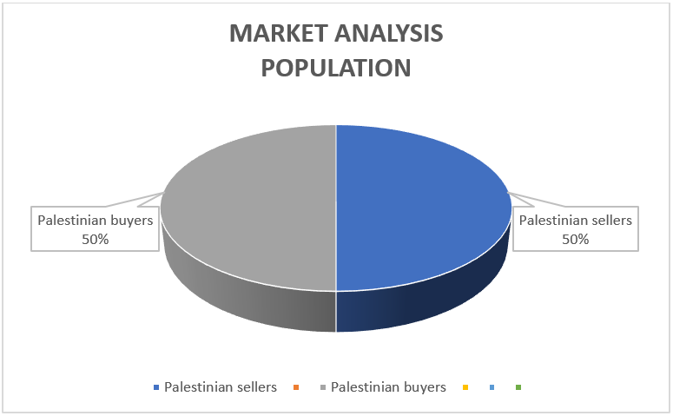
Market Segmentations
The two customer segments that One Tap Trade is targeting are as follows:
Customer Segment | Demographic Factors | Interested Products (sorted) | Market size | Buying Capacity
Palestinian sellers | 18-69 years old male and female | N/A | 4.56 million | Good
Palestinian buyers | Males and females over 18 years old | Food Personal care Household Fashion | 4.56 million | Very good

Slide 18
Competitors Analysis
The five direct and indirect competitors One Tap Trade will be facing are as follows:
Competitors | Type | Similar / Substitute products offering | Stringiness | Weaknesses
Mart.ps | Direct | 35% Similar | Variety of products offered | High prices, payment is only upon receipt and late arrival of orders
Ali express | Direct | 40% Similar | Globally famous and targeting low-income customer segment | Counterfeit products, their quality is poor, and they do not allow many products to be delivered to Palestine, and the delivery period is also relatively long
eBay | Direct | 70% Similar | Globally famous and targeting low-income customer segment | Counterfeit products, their quality is poor, and they do not allow many products to be delivered to Palestine, and the delivery period is also relatively long.
Sbitany Home | Indirect | 20% Similar | Several branches in the West Bank, wide fame and good store location. | High prices compared to market prices and difficult to contest
Maslamani Home | Indirect | 10% Similar | Several branches in the West Bank, wide fame and good store location. | High prices compared to market prices and difficult to contest

Slide 19
Analyzing the internal and external environment (SWOT Analysis)
Strengths | 1. The first application of its kind in Palestine that brings together the seller and the buyer under one umbrella and without mediation
 | 2. Continuous technical support 24/7
 | 3. Presence on all digital platforms, including a strong presence on social media platforms
 | 4. Many and varied options for customers, and the prices are suitable for all classes of society
 | 5. Multiple payment methods
 | 6. Guaranteeing the customer's right by providing a refund period within 72 hours
Weaknesses | Insufficient funding to compete at the global level
 | Insufficient funding to compete at the global level
 | Limited launch of some products due to occupation policies
 | People trusted buying offline more than online

Slide 20
Analyzing the internal and external environment (SWOT Analysis) (cont.)
Opportunities | It is difficult for people to move around and go to buy necessities due to the Corona pandemic and quarantine
 | Benefiting from the difference in the standard of living between the territories of the Palestinian Authority and the occupied lands
 | Institutional partnership with local community institutions
Threats | Online security
 | Competition from global companies (globalization)
 | Weakness of the general economic situation of the people

Slide 21
Marketing and Sales Plan
One Tap Trade will target the customer segments through the following means:
Strong presence on social media and the use of funded ads, (Our potential customers come from advertisements and promotions in social media).
Loyalty system, whereby after every purchase that the customer makes, he earns points that he can later exchange for discounts and other staff.
Making contracts with local companies in the Palestinian market.

Slide 22
Financial Plan
Start-Up Costs
One Tap Trade Start-Up Costs Jan 1,2021
COST ITEMS | DATE DUE | BUDGET | Note
ADMINISTRATIVE/GENERAL |  | $3400
LOCATION/OFFICE |  | $8000
MARKETING |  | $2600
LABOR EXPENSES |  | $700
ESTIMATED START-UP BUDGET |  | $14,700

Slide 23
Pro-Forma Income Statement
One Tap Trade Company First Year Pro-Forma Income Statement Feb 1,2021
REVENUE | FEB | MAR | APR | MAY | JUN | JUL | AUG | SEP | OCT | NOV | DEC | YTD
Net Sales | 500 | 1500 | 2100 | 2000 | 2600 | 2500 | 3400 | 2600 | 3100 | 3000 | 4000 | 27300
Cost of Goods Sold | 0 | 0 | 0 | 0 | 0 | 0 | 0 | 0 | 0 | 0 | 0 | 0
Gross Profit | 500 | 1500 | 2100 | 2000 | 2600 | 2500 | 3400 | 2600 | 3100 | 3000 | 4000 | 27300
EXPENSES | FEB | MAR | APR | MAY | JUN | JUL | AUG | SEP | OCT | NOV | DEC | YTD
Administrative General | 200 | 200 | 200 | 200 | 200 | 200 | 200 | 200 | 200 | 200 | 200 | 2,200
Location/Office | 500 | 500 | 500 | 500 | 500 | 500 | 500 | 500 | 500 | 500 | 500 | 5,500
Marketing | 400 | 400 | 400 | 400 | 400 | 400 | 400 | 400 | 400 | 400 | 400 | 4,400
Labor | 600 | 600 | 600 | 600 | 600 | 600 | 600 | 600 | 600 | 600 | 600 | 6,600
Other | 50 | 50 | 50 | 50 | 50 | 50 | 50 | 50 | 50 | 50 | 50 | 550
Total Expenses | 1,750 | 1,750 | 1,750 | 1,750 | 1,750 | 1,750 | 1,750 | 1,750 | 1,750 | 1,750 | 1,750 | 19,250
Income Before Taxes | (-1,250) | (-250) | 350 | 250 | 850 | 750 | 1,650 | 850 | 1,350 | 1,250 | 2,250 | 8,050
Income Tax Expense (15%) | (-187.5) | (-37.5) | 52.5 | 37.5 | 127.5 | 112.5 | 247.5 | 127.5 | 202.5 | 187.5 | 337.5 | 1207.5
NET INCOME | (-1,063) | (-213) | 298 | 213 | 723 | 638 | 1,403 | 723 | 1,148 | 1,063 | 1,913 | 6,843

Slide 24
Pro-Forma Income Statement (cont.)
Flash Gift Three Years Pro-Forma Income Statement Feb 1,2021
REVENUE | Year 1 | Year 2 | Year 3
Net Sales | 27,300 | 33,250 | 38,600
Cost of Goods Sold | 0 | 0 | 0
Gross Profit | 27,300 | 33,250 | 38,600
EXPENSES | Year 1 | Year 2 | Year 3
Administrative General | 2,200 | 2,200 | 2,200
Location/Office | 5,500 | 5,500 | 5,500
Marketing | 4,400 | 4,400 | 4,400
Labor | 6,600 | 6,600 | 6,600
Other | 550 | 550 | 550
Total Expenses | 19,250 | 19,250 | 19,250
Income Before Taxes | 8,050 | 14,000 | 19,350
Income Tax Expense (Tax Rate 15%) | 1207.5 | 2100 | 2902.5
NET INCOME | 6,843 | 11,900 | 16,448
Operating Margin | 25% | 36% | 43%

Slide 25
Financial Feasibility
We made these analysis to figure out if this investment is a viable business (financially feasible). Net present value, Payback period are used in the evaluation:
Note: time value of the money is considered.
*Interest Rate = 15%
Year | Cashflow | PV | Accum. | When to break even
0 | -14700 | -14700 | -14700
1 | 6843 | 5950.43 | -8749.57
2 | 11900 | 8998.11 | 248.54 | 1.9723
3 | 16448 | 10814.83 | 11063.37
 |  | 25763.37
Net present value for this investment = 25763.37-14700 = $11063.37
Payback period for this investment will be 1.97 years.
We will reach break even point within 1.97 years.
As a result of this evaluation this investment is financially feasible.

Slide 26

Risk Management
What are the risks that you may face and how to deal with them?
معالجة المخاطر (Risk Treatment) |  |  |  | Risk Identification
Date | Risk Owner | Plan | Action | الخطر/ الحدث
Jan 1,2021 | IT technicians | Using information protection systems and protection programs such as anti-virus and others, and making a backup copy of the data | Avoid | Security risks
Jan 1,2021 | Electrical technicians | Putting generators and backing up data | Reduce | Power outage
Jan 1,2021 | Electrical technicians | Put the servers in a cool place free from moisture and other environmental factors | Avoid | High temperatures or humidity that may lead to damage to the hardware
Jan 1,2021 | IT technicians | Setting a backup server to work when there is an increase in traffic on the main server | Avoid | Server does not bear the number of users if it exceeds the limit

Slide 27

Social Media, Website & Application
OTT
Buy & Fly
Highlights

Slide 28
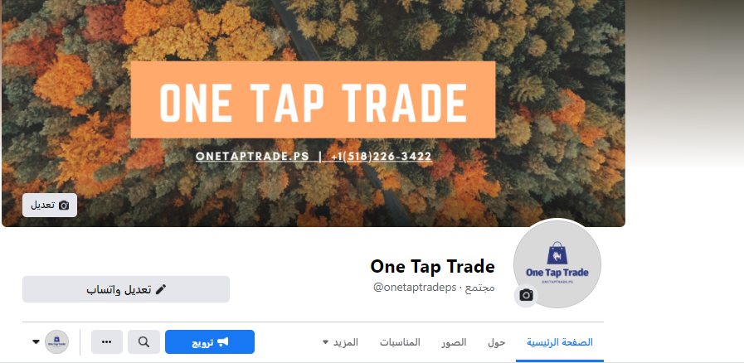
Facebook Page

Slide 29
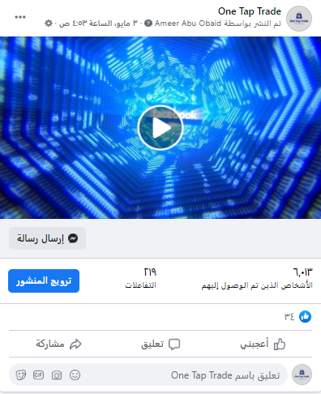
Facebook Page

Slide 30
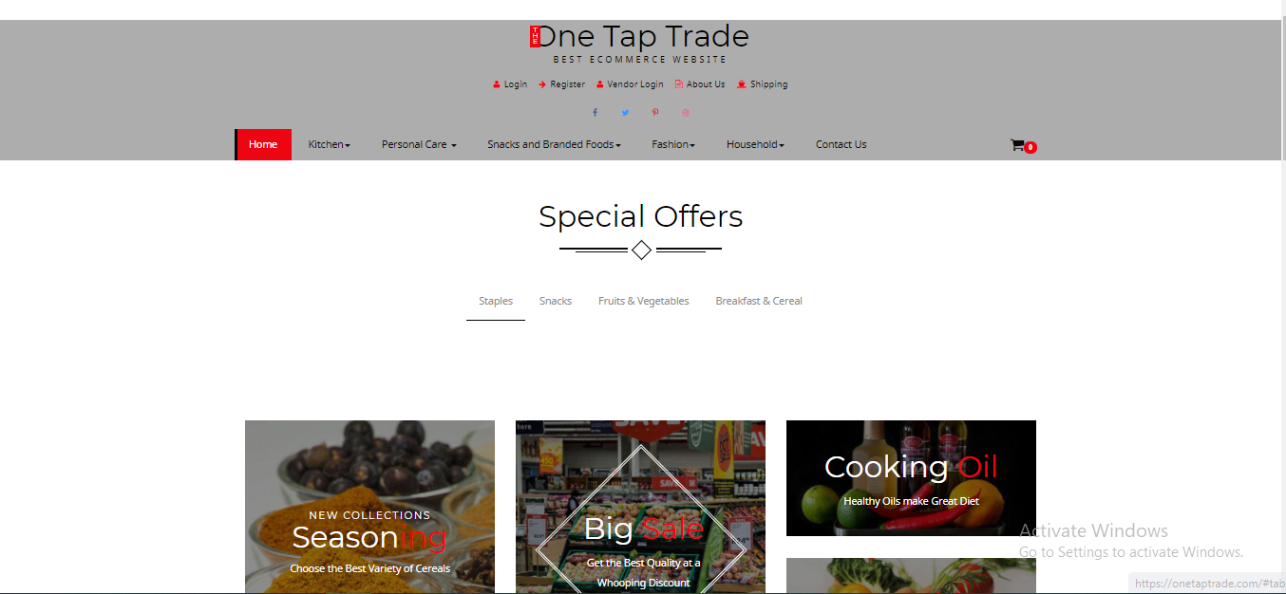
One Tap Trade Website

Slide 31
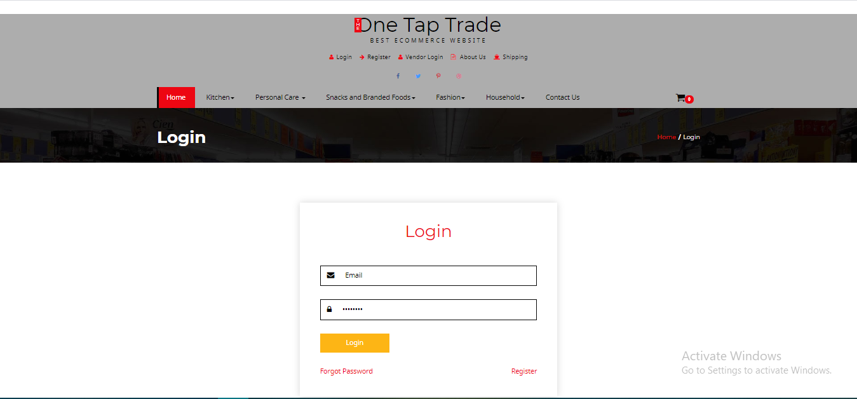
One Tap Trade Website

Slide 32
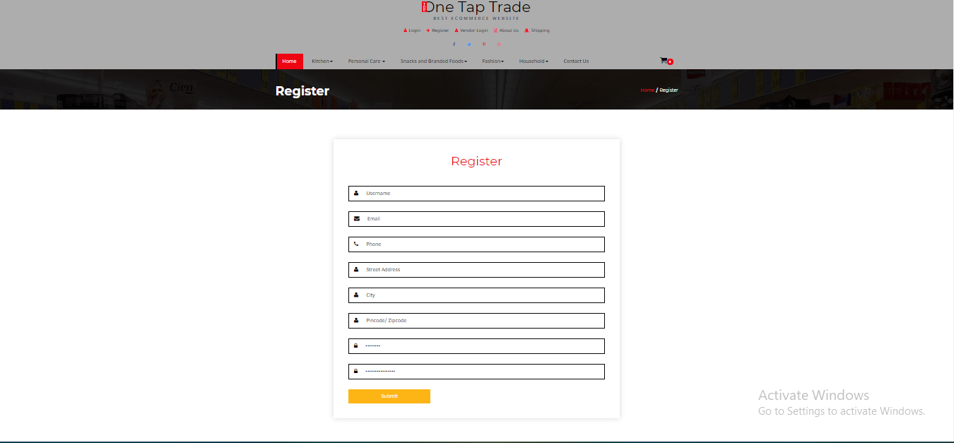
One Tap Trade Website

Slide 33
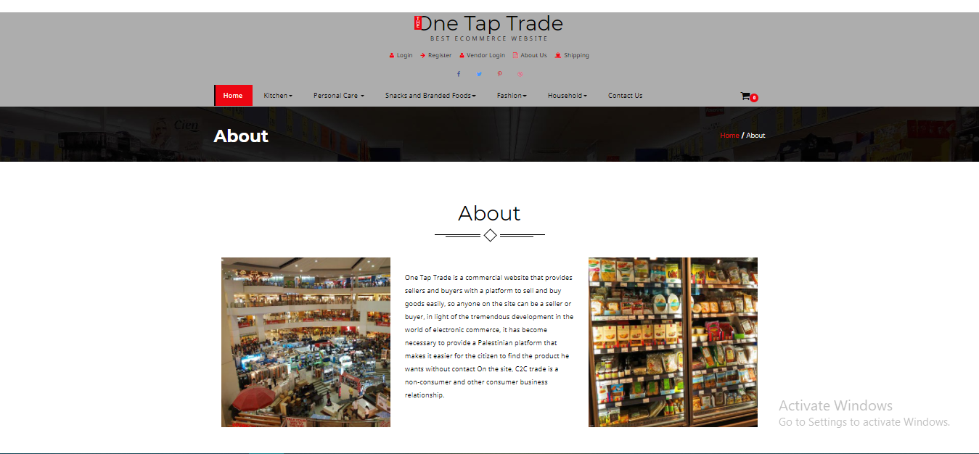
One Tap Trade Website

Slide 34
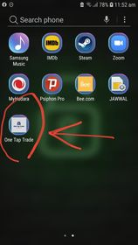
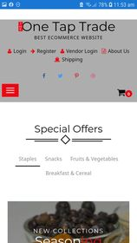
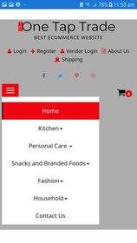
One Tap Trade Application

Slide 35
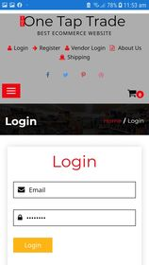
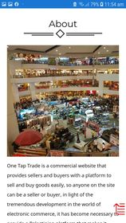
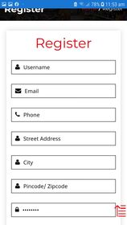
One Tap Trade Application

Slide 36
Thank You.
OTT
Imad Mansour, Ameer Abu Obaid
Buy & Fly
+1 5182263422
onetaptradeps@gmail.com
www.onetaptrade.com

