Slide 1
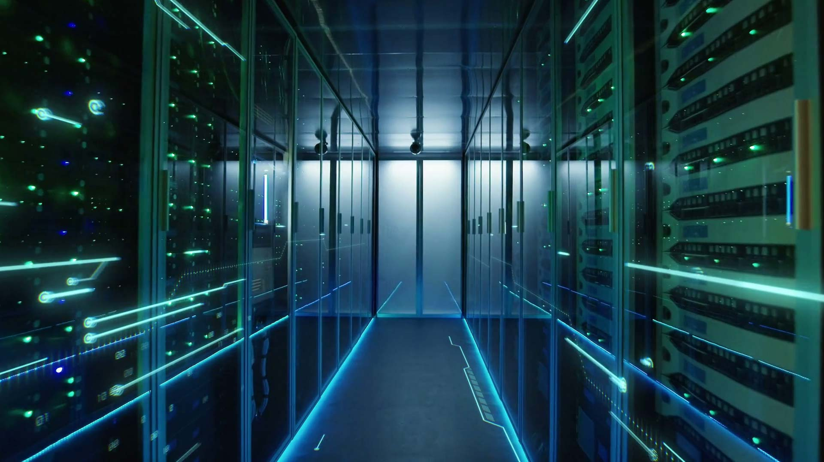
Data Center’s Cooling
Graduation Project 2
Prepared by:
Esraa Barahmeh
Hala Kalbouneh
Masa Shaheen
Tala Saffarini

Slide 2
GOALS
4
01.
Compare different cooling
methods in data centers
Evaluate the cooling loads
of Jawwal Company's
data center
03.
select the most efficient and cost-effective method for Jawwal Company
Compare various cooling system
used in CRAC, then select the
most suitable type for Jawwal
02.
04.
Determine the Break-Even
Point (BEP)
05.

Slide 3
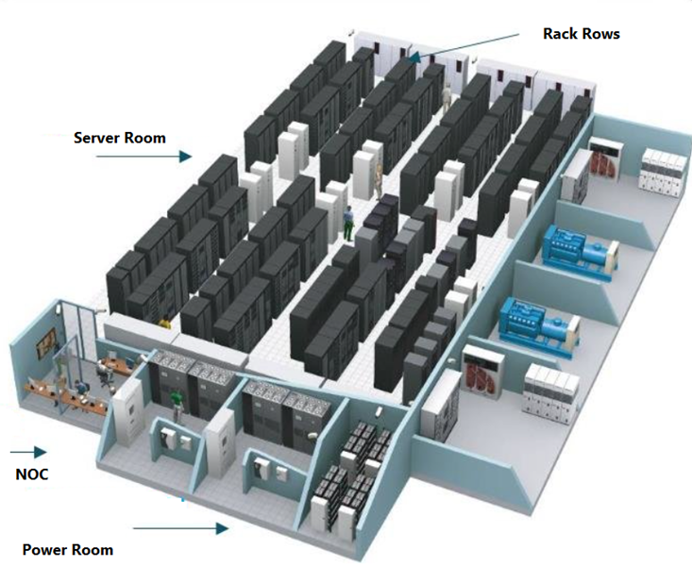
Notes:
As the demands of remote data services keep increasing, both the workload of the data center and its power consumption are rapidly rising. An indispensable part of a data center is the cooling system which provides a suitable operation environment, and accounts for around 50% of the power consumption of the data center. Therefore, optimized energy management of data center’s cooling system is a highly profitable research area.

Slide 4
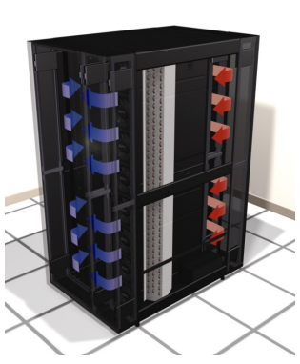
Case study
Jawwal company
Cooling method
Rack level cooling
Problem
Mixing hot and cold air
Notes:
As the demands of remote data services keep increasing, both the workload of the data center and its power consumption are rapidly rising. An indispensable part of a data center is the cooling system which provides a suitable operation environment, and accounts for around 50% of the power consumption of the data center. Therefore, optimized energy management of data center’s cooling system is a highly profitable research area.

Slide 5



01.
02.
Air Cooling
Liquid Cooling
Types of Cooling Technologies in Data center
03.
04.
Aisle
Containment Cooling
Free Cooling

Slide 6
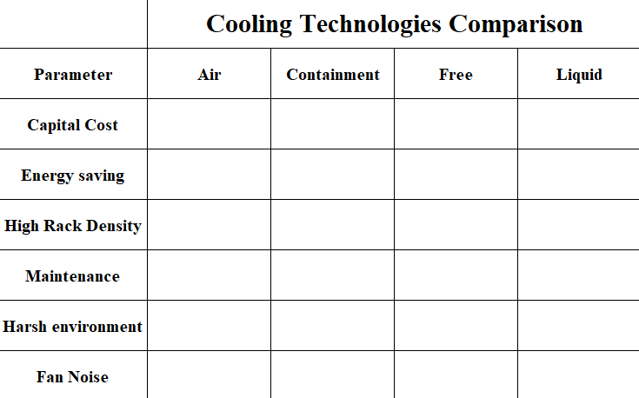






Slide 7
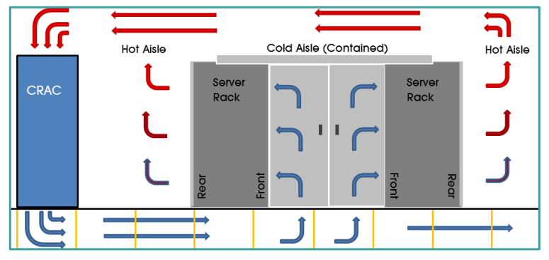
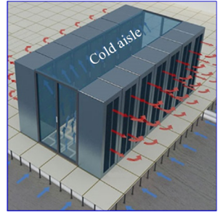
Cold Aisle Containment
Figure 18.1: Layout of CAC
Figure 18.2: CAC

Slide 8
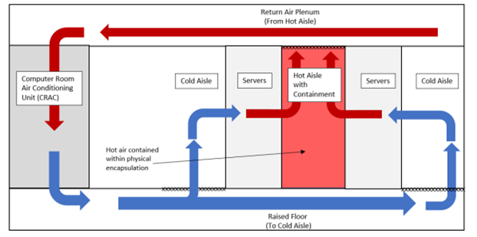
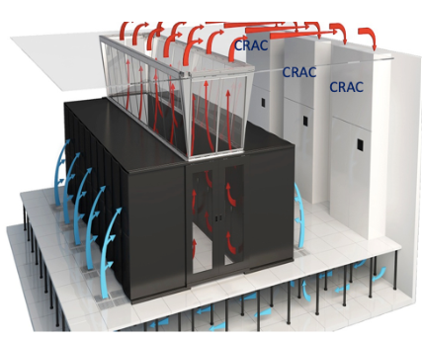
Hot Aisle Containment
Figure 19.1: Layout of HAC
Figure 19.2: CAC

Slide 9
01
Ability to set work environment temperature to 24°C,Acceptable temperature for non-racked equipment
02
Rack power density
Comparison between hot and cold aisle containment
03
Effictiveness
04
Cost
05
Ease of deployment with room cooling

Slide 10
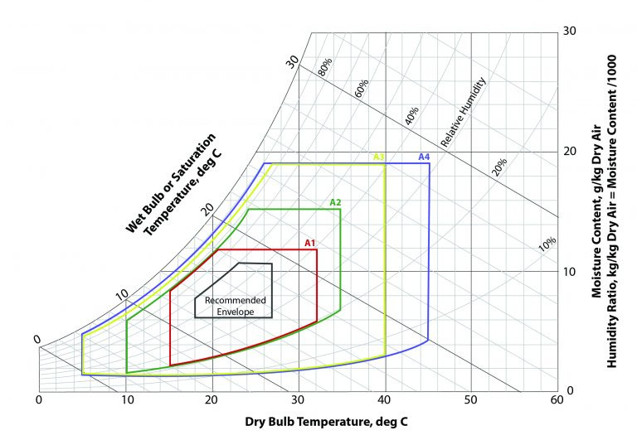
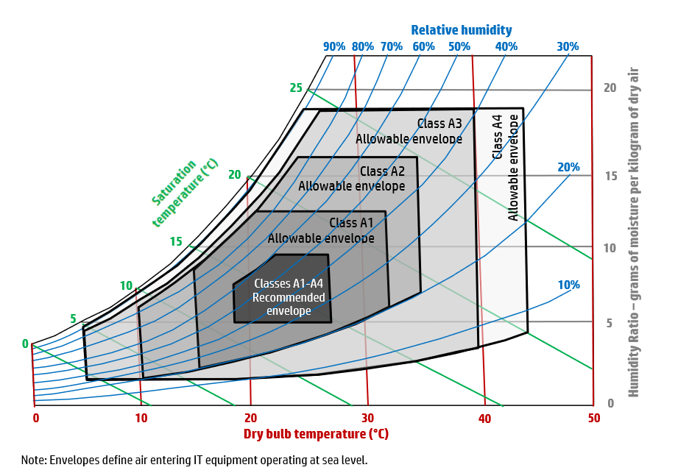
The recommended conditions for data Center

Slide 11

Uptime Institute’s Tier standards
The Uptime Institute is a leading global organization in the design, construction and operation of data centers.
The Institute provides standards, research and certifications to ensure the highest level of data center performance.
The Uptime Institute classifies data centers into four tiers (Tier I to Tier IV) based on infrastructure, reliability, and availability.

Slide 12

Uptime Institute’s Tier standards
Uptime is the annual amount of time that a data center is guaranteed to be available and running.
Downtime is the annual amount of time that a data center and its availability will be interrupted.
01
02
03
Redundancy is a data center component designed to duplicate primary resources and power in the case of failure
04
Fault Tolerant – The ability of a system to continue functioning, even if one or more components fail.

Slide 13
Small Businesses
Medium-Size Businesses
99.671% Uptime
99.749% Uptime
No Redundancy
Tier I
Tier II
Partial Redundancy
29 Hours Downtime /Year
DATA CENTER TIERS
22 Hours Downtime /Year
Large Businesses
Enterprise Corporations
Tier III
Tier IV
99.982% Uptime
99.995% Uptime
1.6 Hours Downtime /Year
26.3 Minutes Downtime Per Year
N+1 Fully Redundant
2N+1 Fully Redundant
72 Hour Power Outage Protection
96 Hour Power Outage Protection

Slide 14
Cooling Systems used in CRAC
DX-Split A/C system -AIR COOLED
Direct Expantion (DX)
DX-Split A/C system -Water COOLED
Chilled water system
glycol cooled
Air Handel Unit(AHU)
Air cooled chiller
Central chilled water system
Water cooled chiller
Glycol cooled chiller

Slide 15

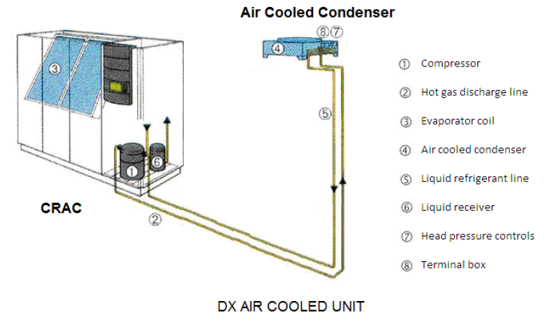

Direct Expantion -Air Cooled

Slide 16

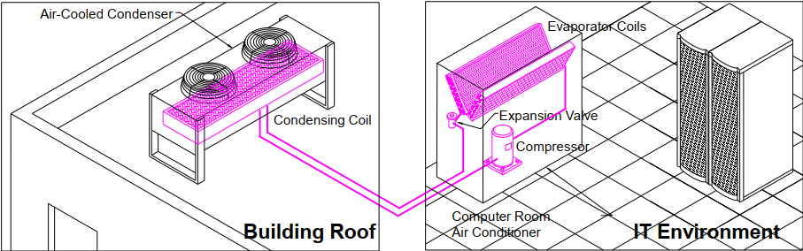
Advantages of Direct Expantion -Air Cooled
Self-contained, Standalone Modules
Maintenance and Reliability
Scalability and low overall cost

Slide 17

Disadvantages of Direct Expantion -Air Cooled
  Refrigerant Piping Requirements:
Traps: The installation of traps is necessary to prevent liquid refrigerant from returning to the compressor, which can cause damage
Complex Installation: Refrigerant piping must be meticulously designed and installed in the field to ensure proper functioning. This includes careful consideration of the distance and height differences between the IT environment and the outdoor condenser units.
  Limited Connectivity
  Pressure Losses

Slide 18
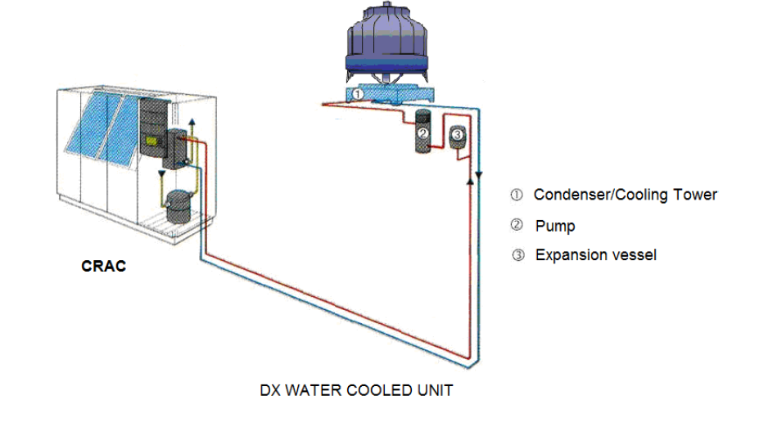
Direct Expantion -Water Cooled

Slide 19
Advantages of Direct Expantion -Water Cooled
  Contained Refrigeration Cycle Components
  Easily Run Piping Loops
  typically servicing multiple CRAC units and other devices from a single cooling tower
  Superior Heat Transfer Properties

Slide 20

Disadvantages of Direct Expantion -Water Cooled
  High Initial Cost
  High Maintenance Costs
  Water Treatment Requirements

Slide 21
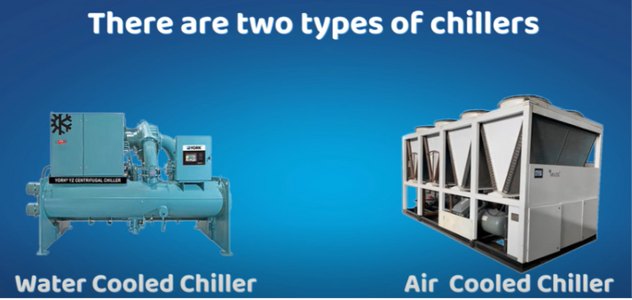
Chillers
. Both do the same job. This means, it lowers the temperature of the water coming from the AHU and then sends it back to the AHU

Slide 22
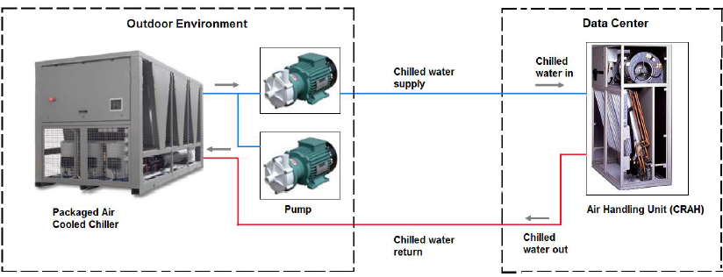
Air cooled chiller

Slide 23
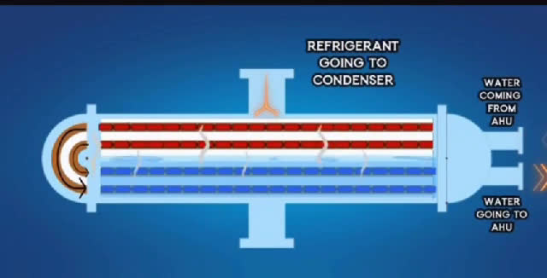
Air Cooled Chiller

Slide 24
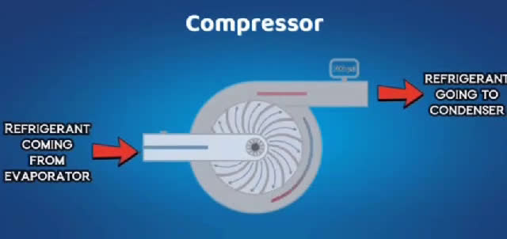
Air Cooled Chiller

Slide 25
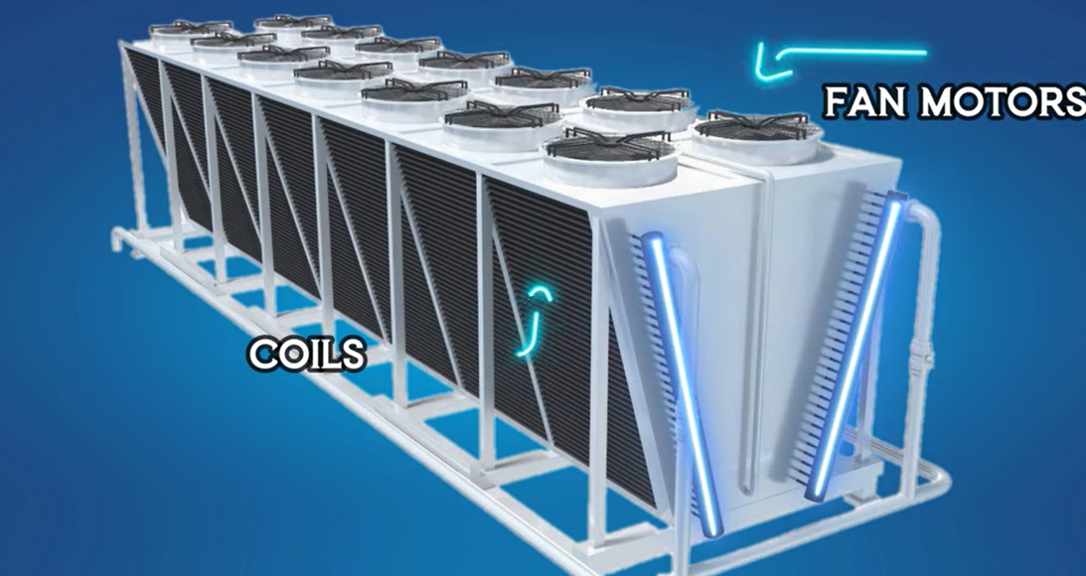
Air Cooled Chiller

Slide 26
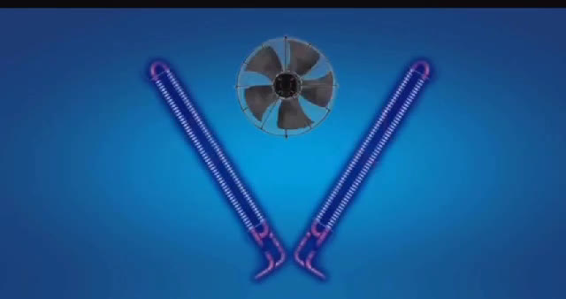
Air Cooled Chiller

Slide 27
Advantages Of Air Cooled Chiller
  No cooling towers.
  Low maintenance expenses.
  Better environmental stability—no water waste
  Chemical costs avoided.

Slide 28
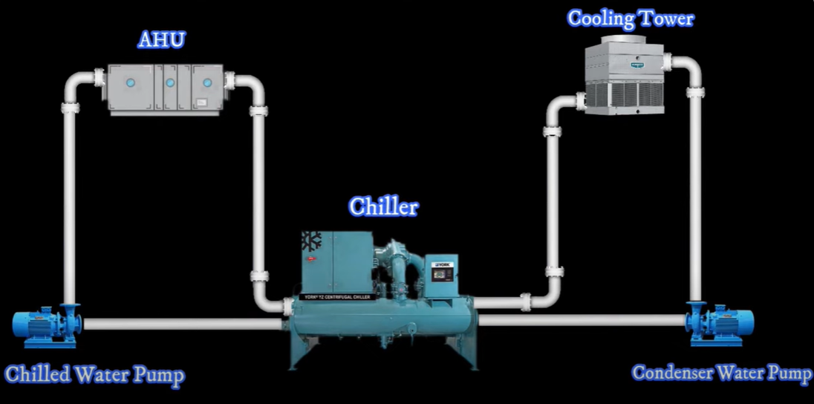
water cooled chiller

Slide 29
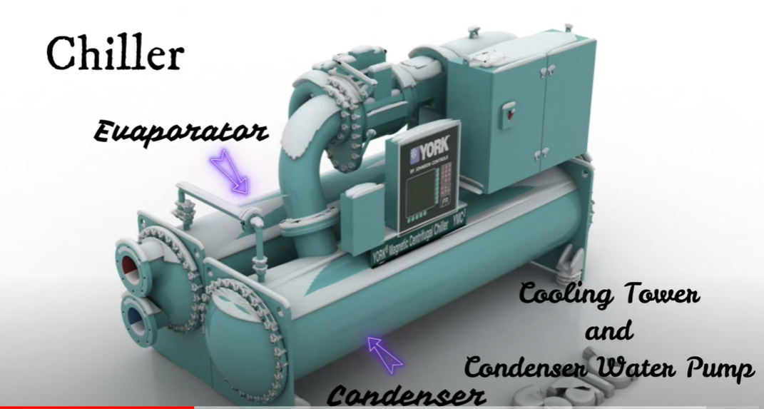
water cooled chiller
AHU&chilled water pupm

Slide 30
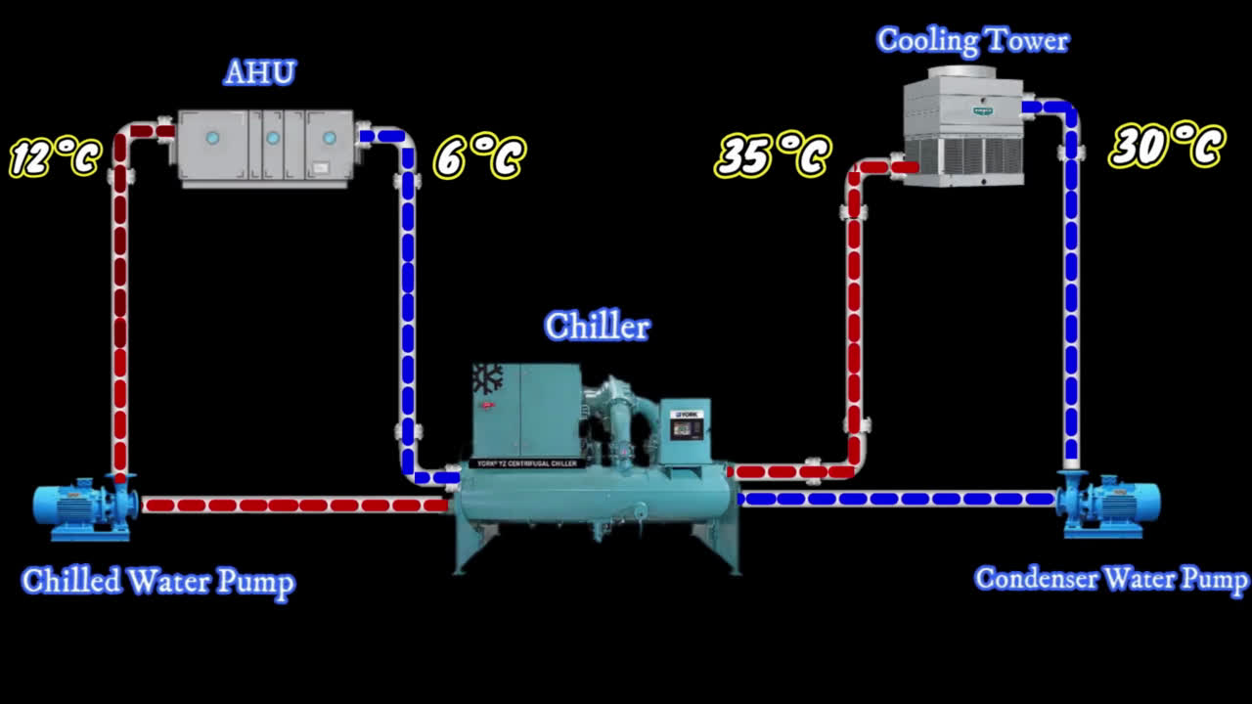
water cooled chiller

Slide 31
Advantages Of Water Cooled Chiller
  The crac unit houses every component of the refrigeration cycle as a factory-tested, sealed system for greatest reliability.
01
• Long-distance condenser water piping loops can be easily raised, and they are nearly always used to supply several computer room air conditioners and other devices from one cooling tower.
02

Slide 32
Dis advantages Of Water Cooled Chiller
  High initial cost for cooling tower, pump, and piping systems.
01
  Very high maintenance costs due to frequent cleaning and water treatment requirements.
02

Slide 33
01
space
02
capital cost
Comparison between Direct expantion &chiller
Energy Cost
03
04
Compressor failure
05
Labor Skills

Slide 34
Direct expantion or chiller?
The recommendation based in capacity as following:
1. Capacities: < 80 tons use CRAC, DX System.
2. Capacities: > 80 tons and < 200 tons use chilled water systems, screw chillers.
3. Capacities: >200 tons use chilled water systems, centrifugal chillers.

Slide 35
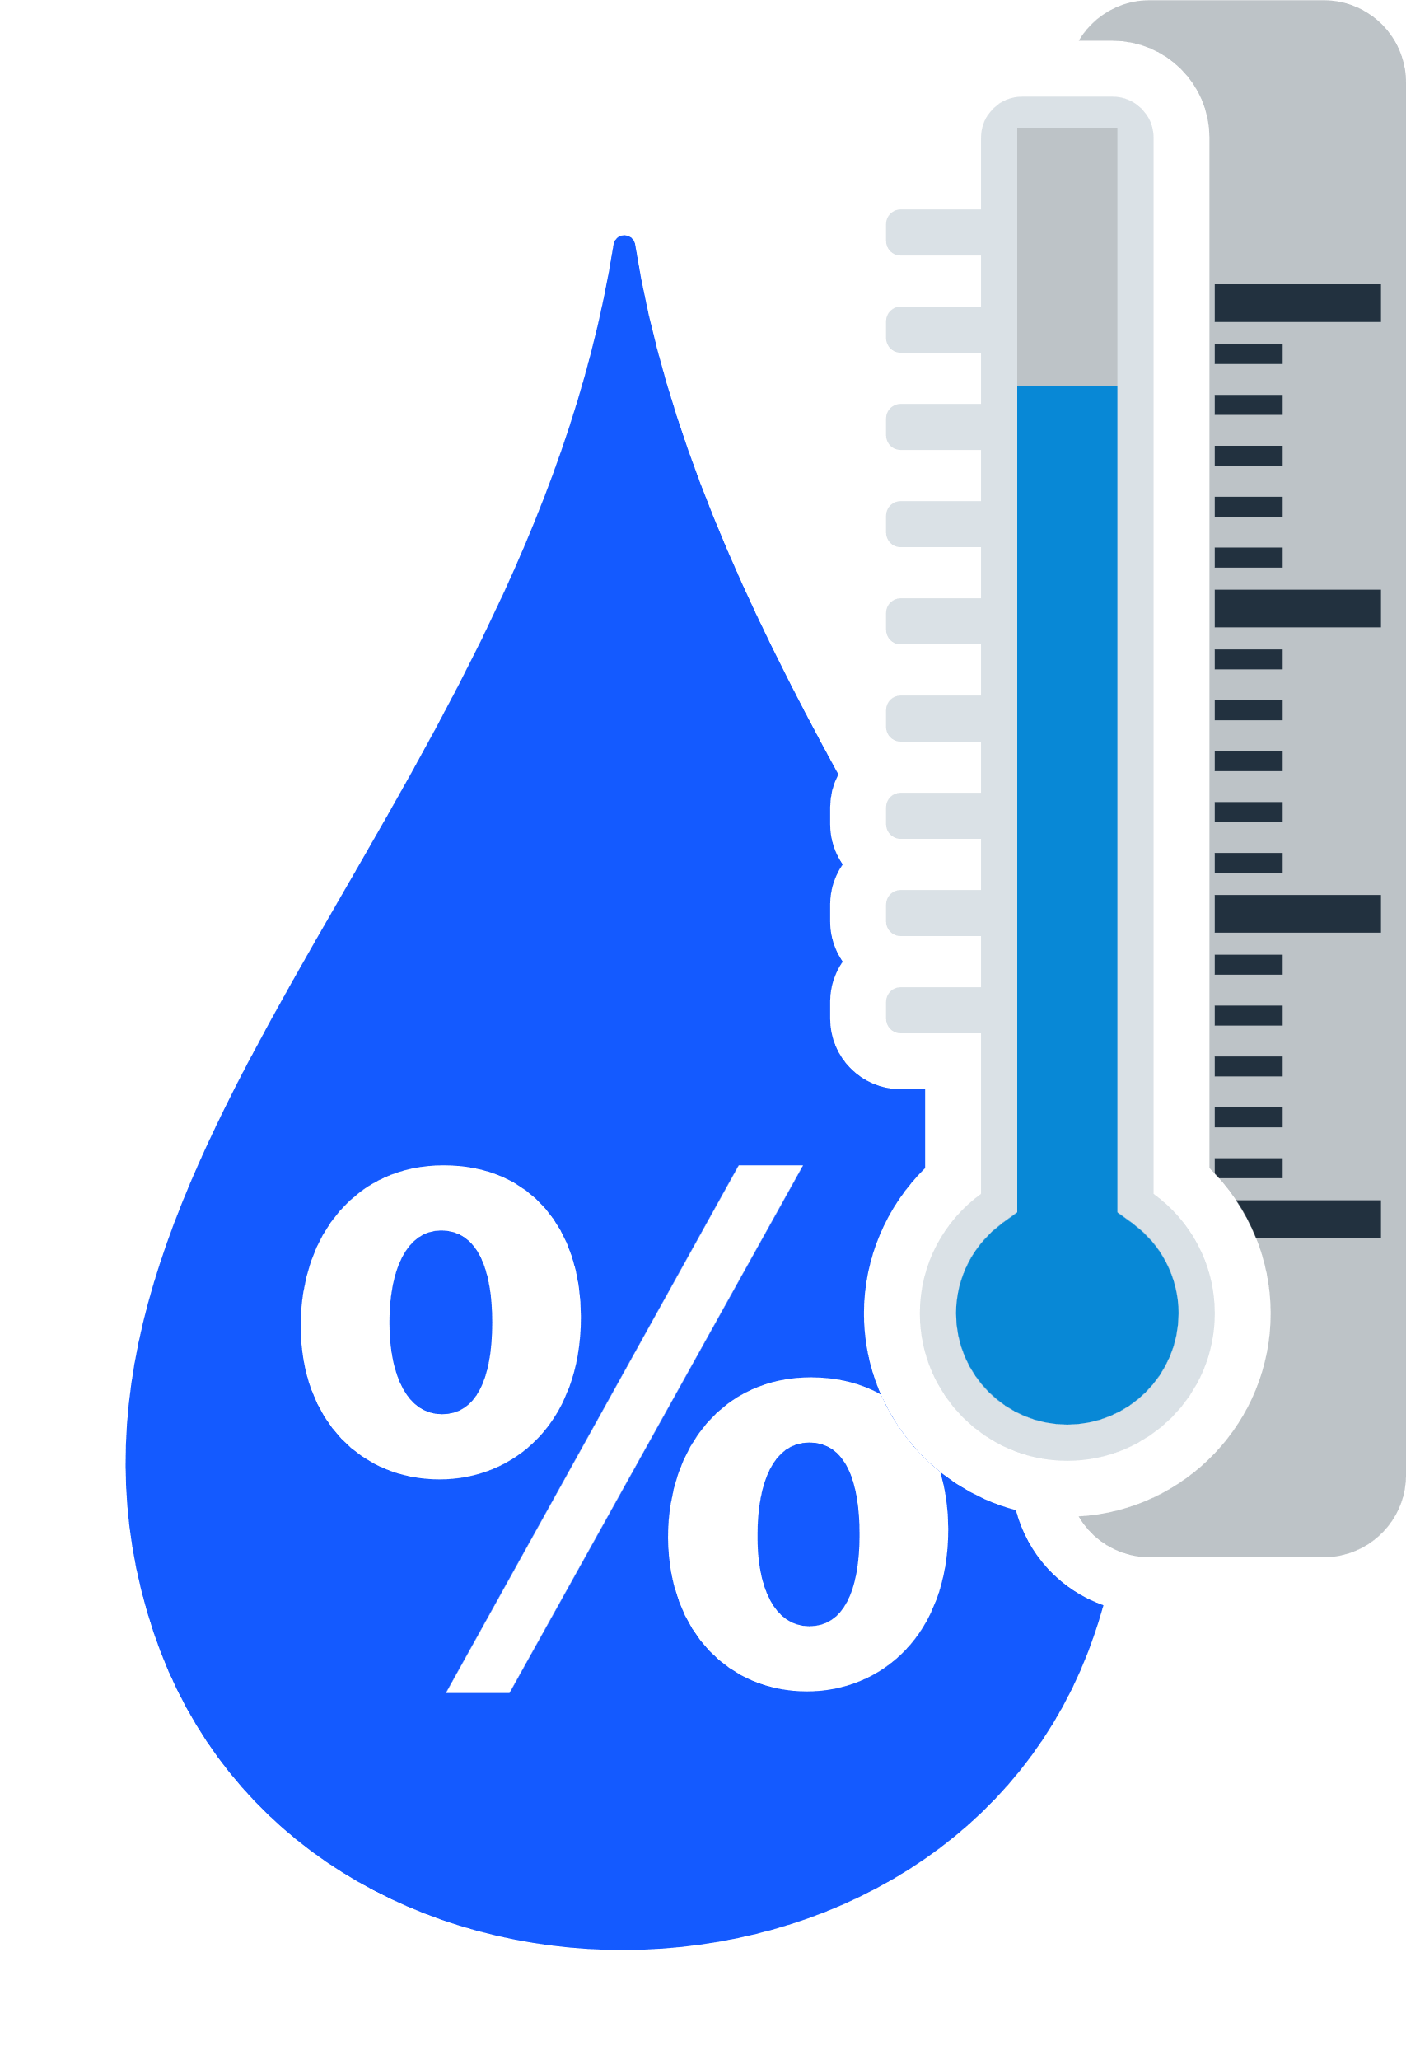
Why We need humidification
on data center?

Slide 36

HIGH
CONDENSATION
Humidification
Humidity
Sensors
Dehumidification
LOW
ESD
How much water Vapor needed

Slide 37
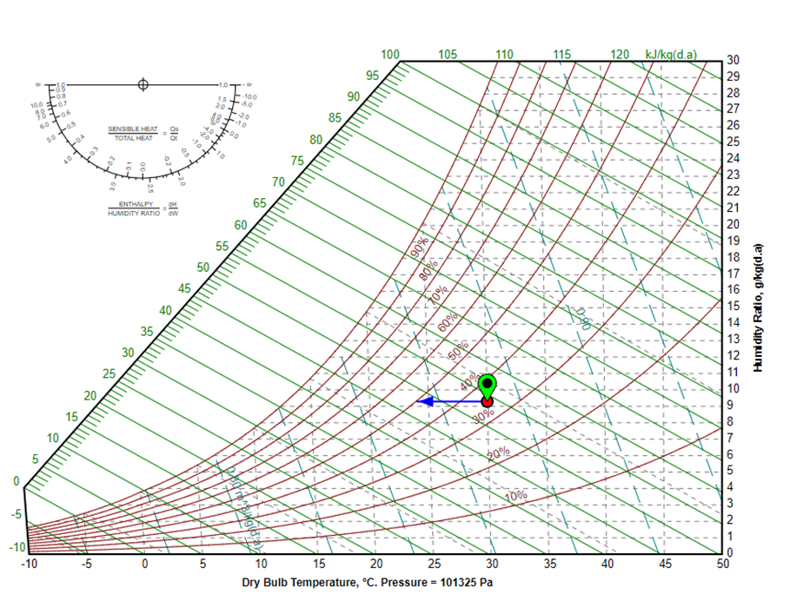
Ideal cooling process at constant humidity ratio.

Slide 38
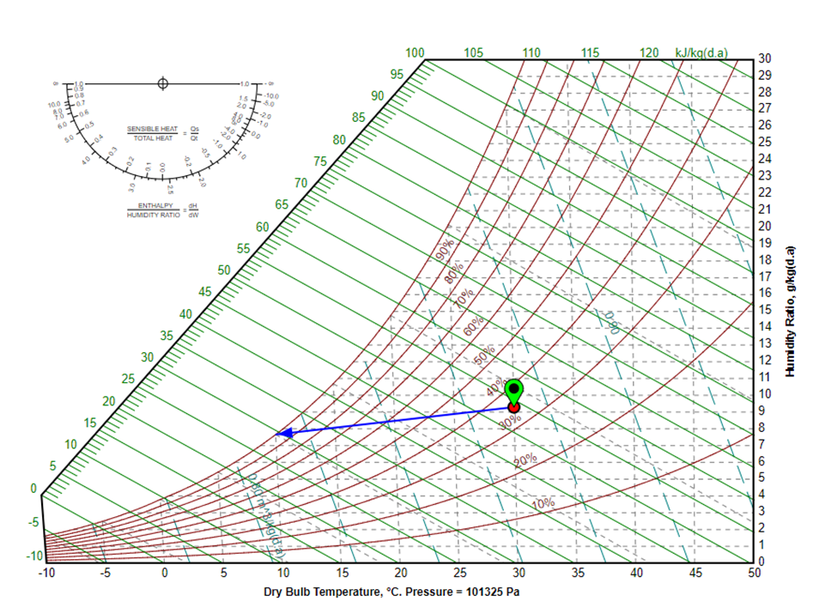
Cooling process to apparatus dew point.

Slide 39
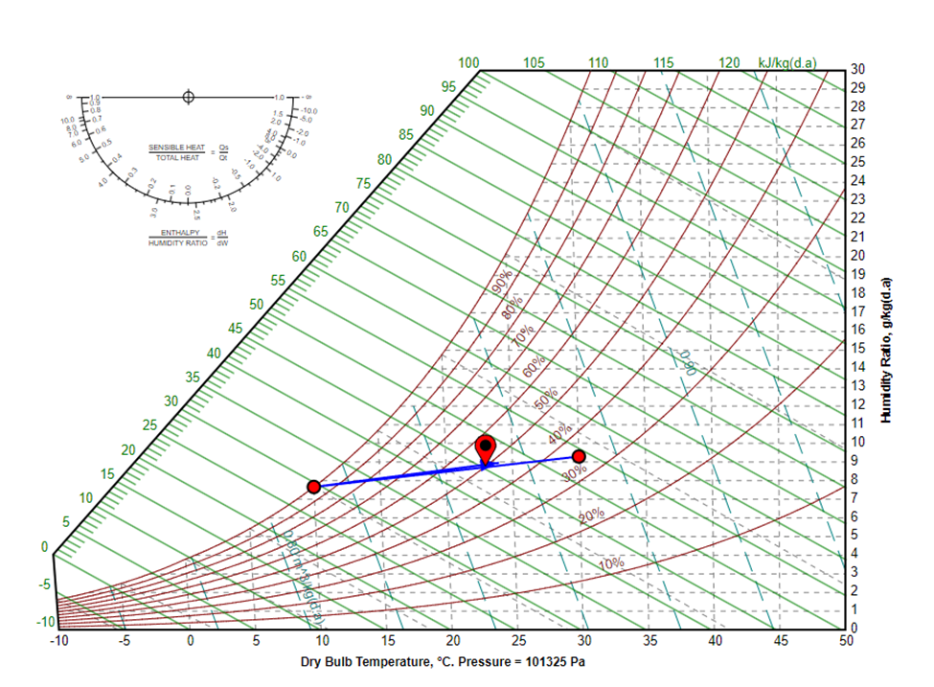
Total cooling process between return air and supply air.

Slide 40
Calculation: 1. Calculation of sensible cooling load
Heat gain | Old System | New System
Equipment Heat Gains | Design for power rack density= 𝑛𝑢𝑚𝑏𝑒𝑟 𝑜𝑓 𝑟𝑎𝑐𝑘𝑠 × 𝑝𝑜𝑤𝑒𝑟 𝑟𝑎𝑐𝑘 𝑑𝑒𝑛𝑠𝑖𝑡𝑦 30 𝑟𝑎𝑐𝑘 × 4 𝑘𝑤 𝐷𝐶 𝑟𝑎𝑐𝑘 + 27 𝑟𝑎𝑐𝑘 × 5 𝑘𝑤 𝐴𝐶/ 𝑟𝑎𝑐𝑘 = 255 kW | = 38 𝑟𝑎𝑐𝑘 × 3.5 𝑘𝑊/ 𝑟𝑎𝑐𝑘 = 133 kW.
Occupancy | The heat output is approximately 100 watts per person. 300 W=0.3 kW | The heat output is approximately 100 watts per person. 300 W=0.3 kW
Building envelope | heat from the roof, walls and windows - neglected | heat from the roof, walls and windows - neglected
Auxiliary Power | located in a separate room. | located in a separate room.
Lighting | Lighting loads are considered 3 watts per sq-ft. 2466 sq. ft = 229.1 𝑚^2 P-lighting=7.398 kW | Neglected
Total | 262.7 kW | 133.3 kW

Slide 41
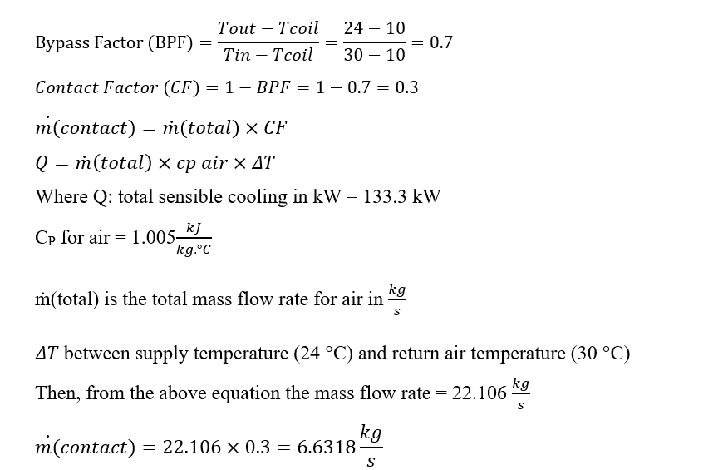
2. Calculation of latent load
  Determine the Dew Point
  Check for Condensation
  Determine the Mass Flow Rate of Air Contacting the Coil (ṁ contact)

Slide 42
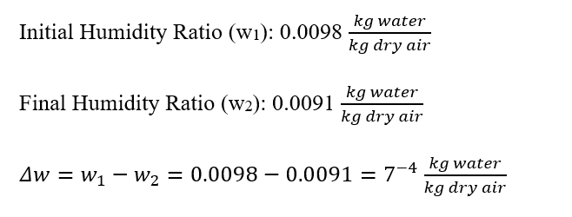
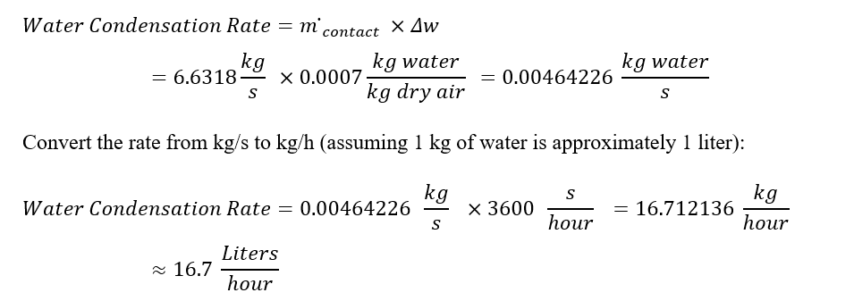
  Calculate the Dehumidification
  Determine the amount of water

Slide 43
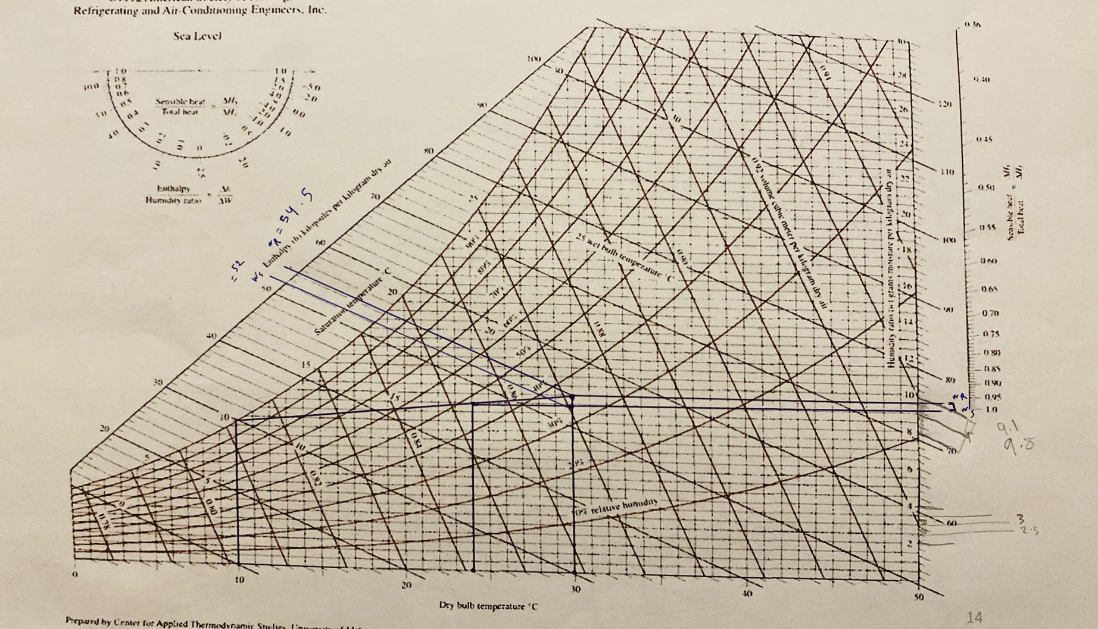

Slide 44
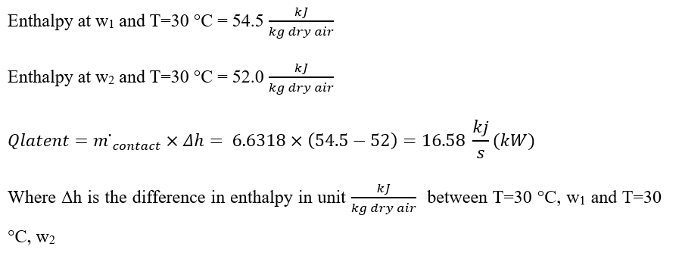

  Calculate the Latent Heat
3.𝑇𝑜𝑡𝑎𝑙 𝑐𝑜𝑜𝑙𝑖𝑛𝑔 load= 𝑠𝑒𝑛𝑠𝑖𝑏𝑙𝑒 ℎ𝑒𝑎𝑡 + 𝑙𝑎𝑡𝑒𝑛𝑡 ℎ𝑒𝑎

Slide 45
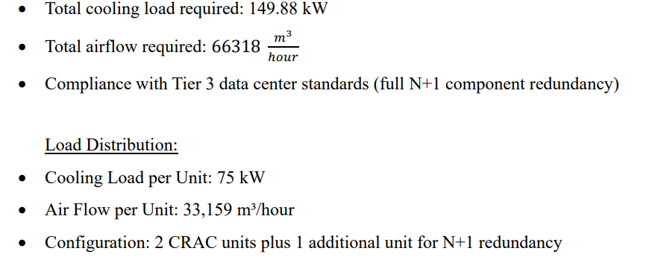
4.CRAC Selection
CRAC Selection Criteria:

Slide 46
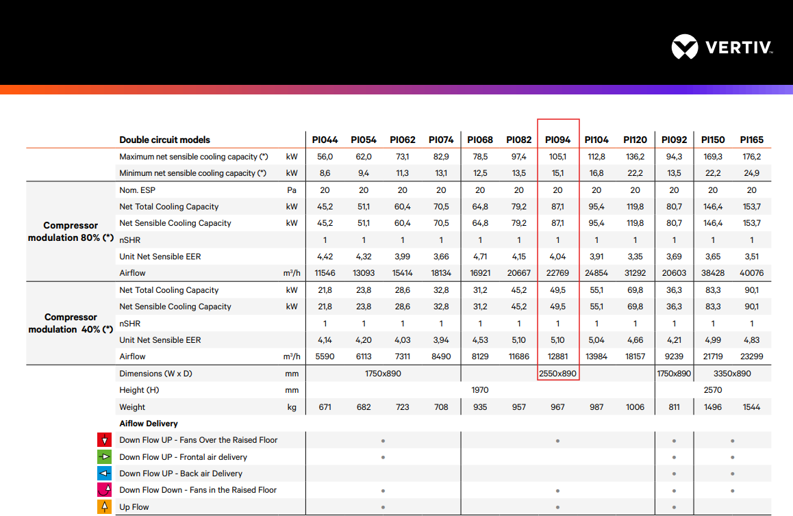


Slide 47
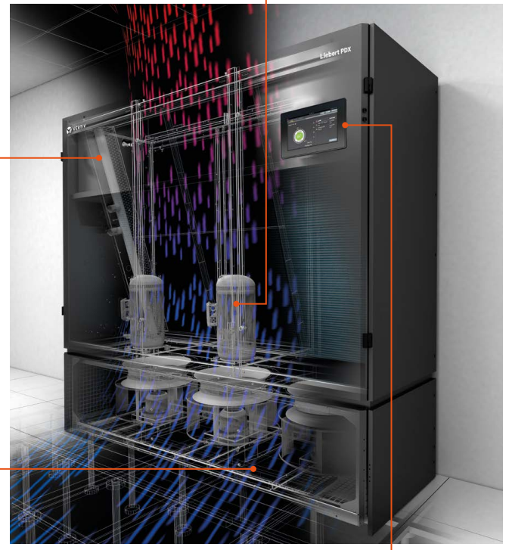
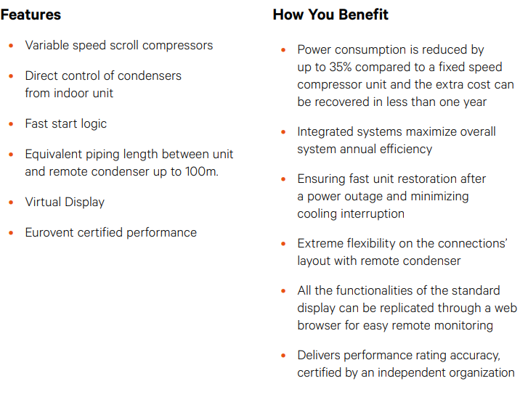

Slide 48
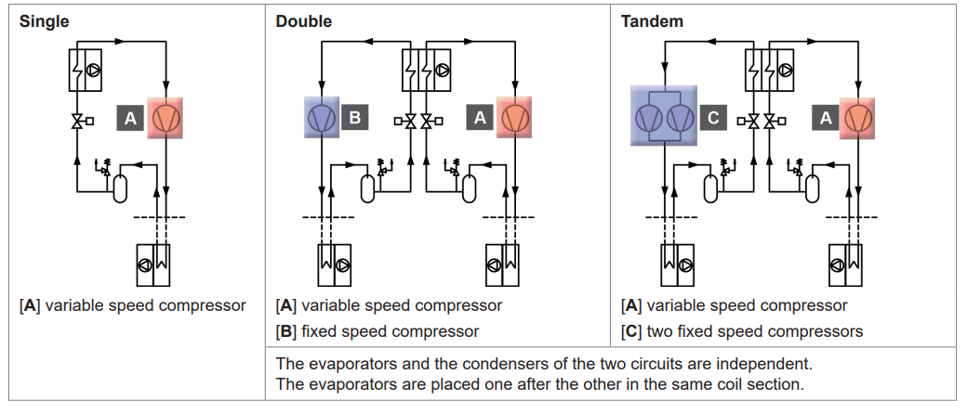
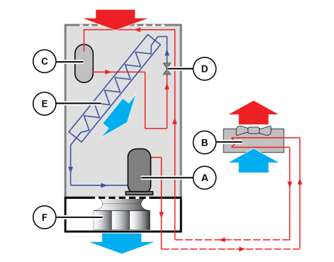
Performance at RAT 30°C / RH 35% - Condensing temperature 45°C - Downflow up air
configuration. CE units - Power supply 400V/3ph/50Hz - High Power EC Fans - Refrigerant
R410A.

Slide 49
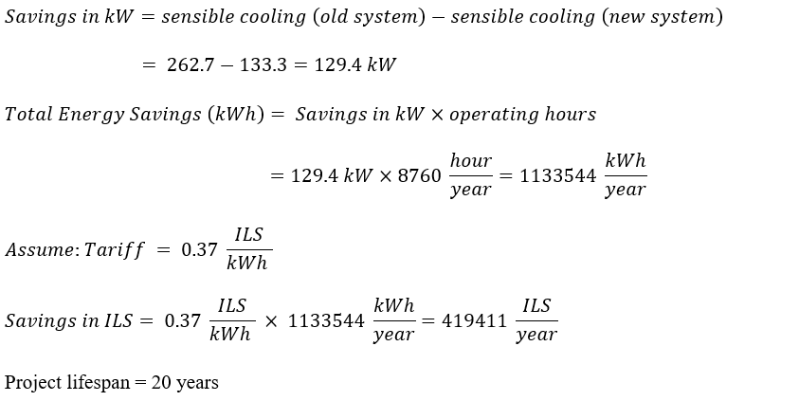

5.Calculate Break Even Point

Slide 50
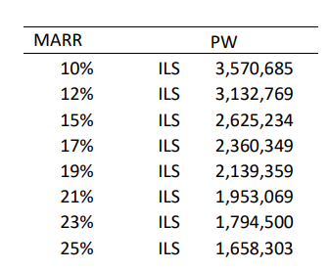
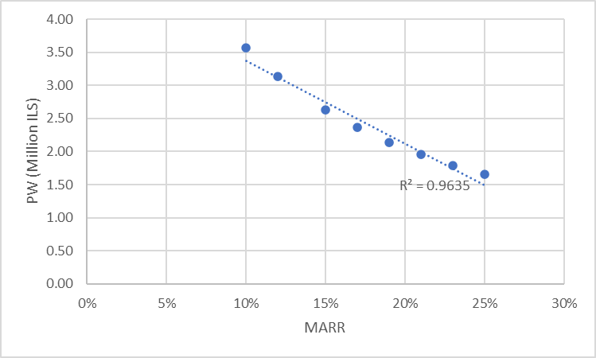
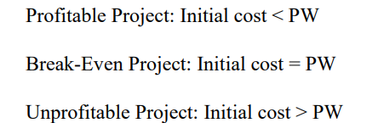

Slide 51

The main causes for a high risk of fire in a data center:
HEAVY POWER load | ELECTRICAL FIRE RISK | INFRASTRUCTURE | VENTILATION
Heavy power loads or a defective piece of equipment can very quickly lead to a ﻿short circuit or overheating | Constant ignition source electricity and combustible materials, such as plastics﻿, in printed circuit boards | Extensive cabling, particularly below raised floors | Comprehensive air cooling, resulting in higher air exchange, increases the risk of spreading the fire

Slide 52


01.
02.
Mitigation
Detection
Good data center fire protection consists of
03.
04.
Suppression
Recovery

Slide 53
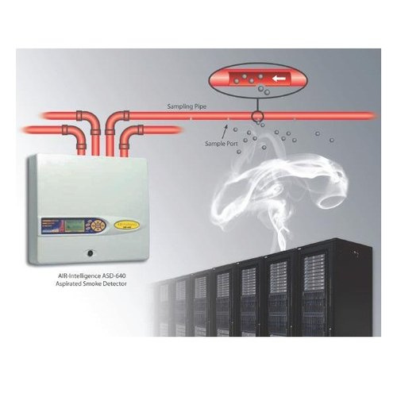
How an air-sampling smoke detector works

Slide 54


1
Clean Agents
Fire suppression
with gas
2
Inert Gases
01.
Fire suppression systems
1
Water Sprinkler
Fire suppression with water
2
Water Mist

Slide 55
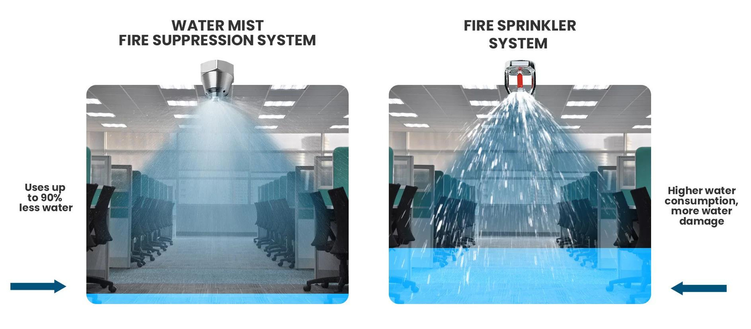
Fire suppression with water

Slide 56
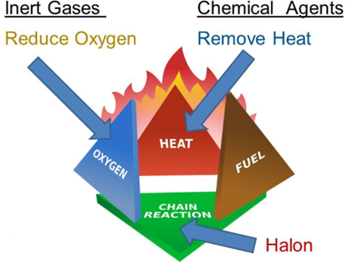
Remove One To Stop Fire

Slide 57
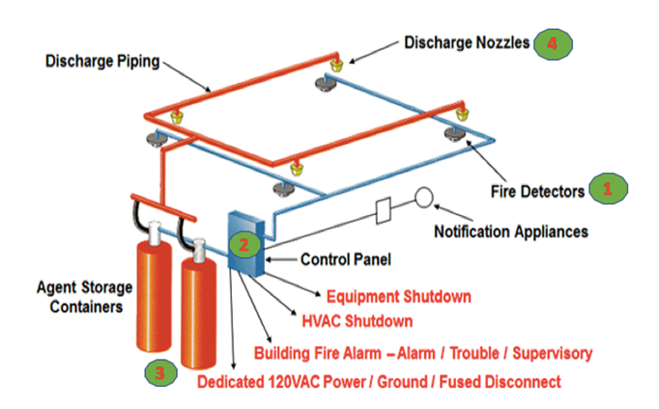
Gas Suppression System

Slide 58

Comparison of fire-extinguishing gases
NOVEC 1230
FM-200
INERT GASES (ARGON, ARAGONITE, INERGEN, AZOTES)
CO2
STAYING IN THE FLOODED ROOM
unlimited possible
unlimited possible
temporary possible
not possible
CONCENTRATION FOR FLOODING
5.8%
8.4%
45…50.5%
47…57%
RESIDUAL OXYGEN
19.6%
19.1%
10.3 ... 11.4%
CO2 is toxic at >8 vol.-%
TIME FOR EFFUSION
Max. 10 sec
Max. 10 sec
60 to 120 sec
60 sec
FORMATION OF CONDENSATION ON THE PIPES
No
No
Yes
Yes
MULTI AREA SYSTEM
limited possible
limited possible
possible
possible

Slide 59
Comparison of fire-extinguishing gases
NOVEC 1230
FM-200
INERT GASES (ARGON, ARAGONITE, INERGEN, AZOTES)
CO2
MAXIMUM PIPE LENGTH
around 60m
around 60m
>> 150m
up to 150m
DANGER FOR HUMAN
No
No
Yes
Yes
REQUIRED SPACE FOR SUPPLY
low
low
high
middle
ENVIRONMENTAL IMPACT
very good
bad
good
very good
EVALUATION
1
2
3
4

Slide 60
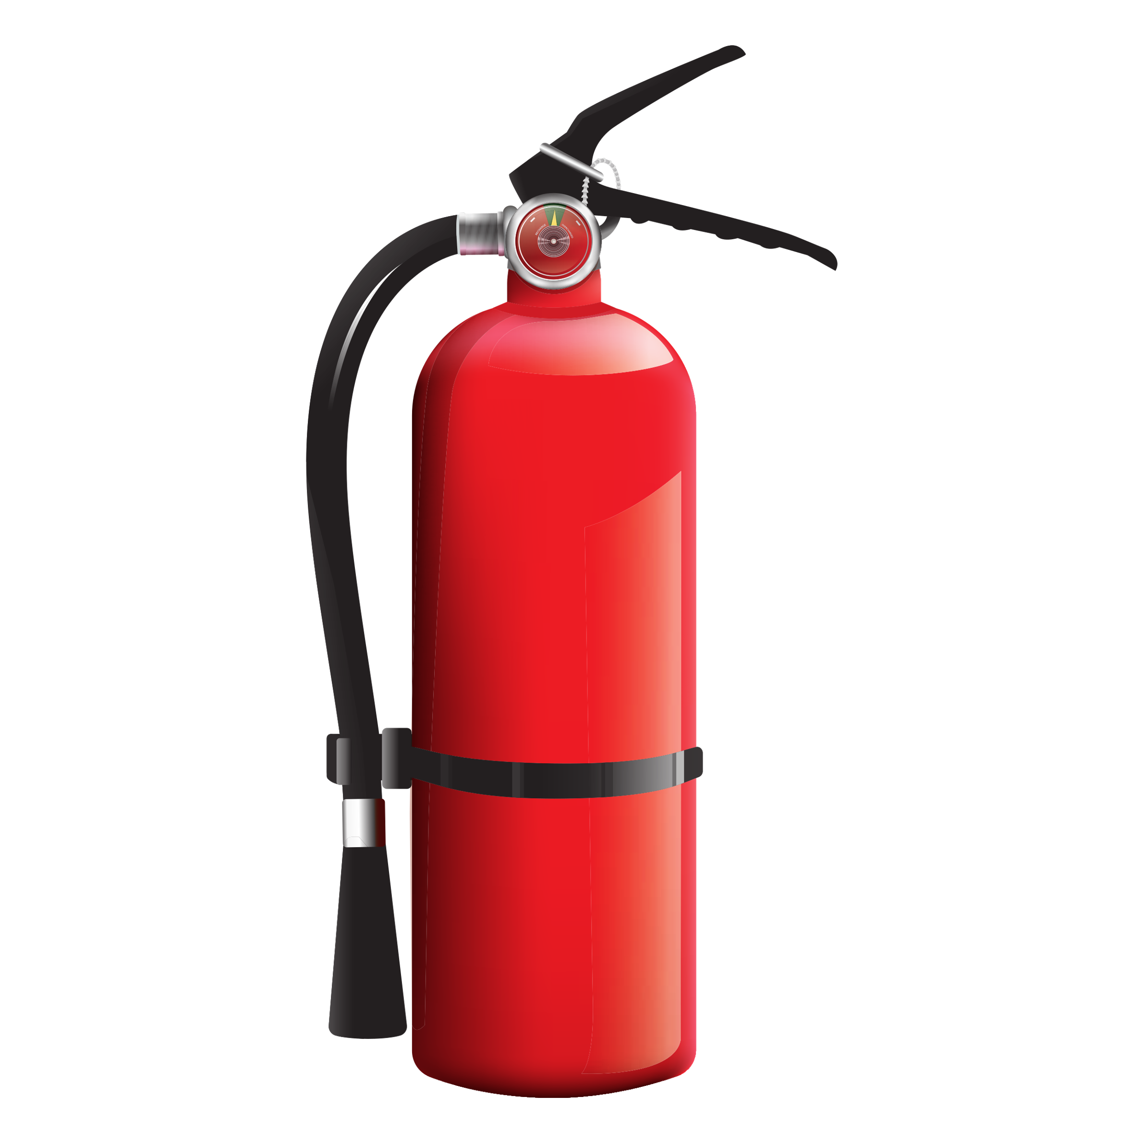
Some advantages of using Novec 1230™
  Fast reaction time, can extinguish a fire before it even starts
  Safe to use in occupied areas
  Works on Class A, B and C fires
  Environmentally friendly
  Does not damage sensitive equipment or valuable assets
  No clean-up required
  Minimal downtime after a fire
  Not electrically conducive

Slide 61
Active IT load
Automation and
monitoring
AI in the Data Center
Electrical powertrain
Cooling systems
How to make the data center more energy efficient?

Slide 62
Heat recovery
load balancing
COOLING SYSTEM
IT load management
virtualization
Aisle containment
choosing cooling technology
ACTIVE IT LOAD
Rack management
AUTOMATION & MONITORING
Regular maintinance
Active monitoring
Energy storage solution
valve-regulated lead acid (VRLA) (Li-ion) batteries
DCIM
ELECTRICAL POWER TRAIN

Slide 63


Power Usage Effectiveness (PUE)
PUE values range from 1.0 to infinity. Current research suggests that many data centers have a PUE of 3.0 or higher, but a well-designed center should aim for a PUE of 1.6 or lower.

Slide 64
Constraints
  Humidity Control: Relative humidity levels must be maintained between 30-60% to prevent damage to sensitive IT equipment.
  Temperature Control: The dry bulb temperature must be maintained between 18-27°C to ensure optimal operatingconditions for the equipment.
  Tier 3 Standards: The system must meet Tier 3 data center standards, including N+1 redundancy for critical components to ensure high availability and reliability.

Slide 65
Recommendations
  Changing the refrigerant from R410A to R32 will improve environmental sustainability. R32, and energy-saving measures can help the data center lower its carbon footprint.
• Implement tandem compressors in the DX air-cooled system for increased efficiency and reliability. Tandem compressors increase load matching, save energy usage, and extend compressor life.
• Stay up-to-date on new cooling technologies and innovations to enhance data center performance and efficiency

Slide 66
Conclusion

Slide 67

Thank You

