Slide 1
Railway controlling
Abir Sabra
Iman Shtayeh

Slide 2
Objectives :
Design a network-controlled railway system
But, allow human interrupt and monitoring

Slide 3
Our project …
Consist of :
Main control station.
n-trains.
Railway (communication medium + power).

Slide 4

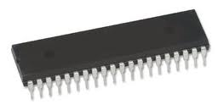
Main control station.
As a hardware we have main microcontroller.
Main M.C have:
Connection to main pc.
connection to each train (I2C protocol).
Connection to Railway direction controller.
Main M.C
(bridge)
I2C
Train
(M.C)
Train
(M.C)
Railway direction controller

Slide 5

Trains.
Then we have microcontroller on each train.
Train M.C have:
- connection to master(I2C).
- connection to RFID reader.
- connection to local motor through H-bridge.
Train(M.C)
Main M.C
local motor

Slide 6
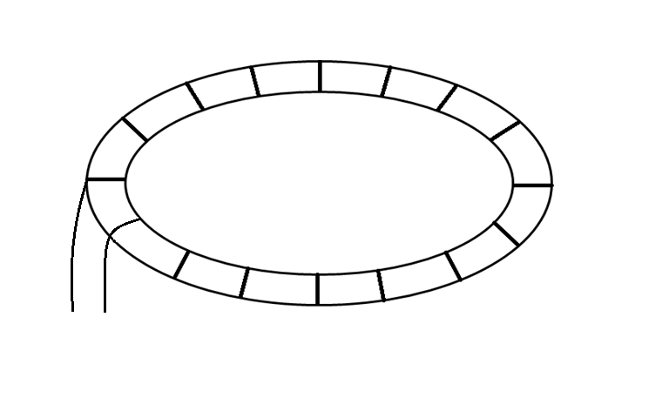
Railway.
-Tags are arranged on some order as shown.
5
4
6
Railway direction controller
Mechanical Switch
3
0
2
1
7

Slide 7
Software
In S.W we consider
One master represents main M.C.
Three slaves each one represents microcontroller for train.
I2C as protocol for communication.
C# application for human main controlling.
Notes:
Note: talk about i2c lines and how master have data.

Slide 8
Overview, communication.
1
2
Master send any new train position .
Master get trains position.
Main PC
Master
Master
Give data
Request data
Slave(A0)
Slave(A4)
Slave(A0)
Slave(A4)
Slave(A2)
Slave(A2)
Send address of slave
3
Send command to trains
Master
address
Main PC
Send command
Send command
Slave(address)

Slide 9
Master.
Master keeps requesting data from each slave through a specific order and gives slave period of time to get data from.
Master send each new position of trains to main PC (serial connection).
Master send each new data about any train to slaves.
Master send command to any train trough our interface on main PC.

Slide 10
Master Flowchart
CmdF
cmdF
Result=6
backF=1
openMotor()
backF =1.
Result=7
openMotor()
ReleaseMotor()
backF = 0
backF =1.
sendCmdToSlave()
ReleaseMotor()
Delay
cmdF = 0.
sendReadyToSlave()
mainF=0.
Result= requestSlave().
sendToAll()
sendToSerial()
newDataF = 0.
Result>=8 &<8
newDataF=1
I++.
mainF = 1|backF=1
i>numSlaves-1
slaveAdd[i] == slaveMainAdd
I=0.
delay

Slide 11
Slave
Give data to master when request it.
- if new data available, then give master the new position.
- if no new data just give master ‘keep a live’.
Get data from master which may be :
- Command from main station, execute command.
- Position of other train, store the position and release the previous position.

Slide 12
Slave Flow chart
SetupPwmDuty(180)
NewPos= 1
MyPos = checkTag()
CheckSpeed().
NewPos = 0.
CmdF = 0.
CmdF = 1
Cmd = T
P
MoveFor(mid)
W
Stop()
D
MoveFor(slow)
M
MoveFor(quick)
R
mainF = 0.
B
MoveFor(mid)
ReadyF = 0.
BackF = 1.
MoveFor(mid)

Slide 13

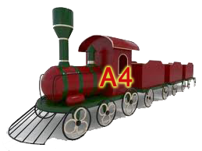
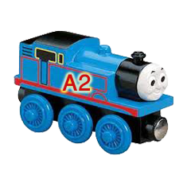
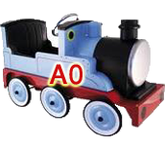
Case.
1
Tag 1,5: stop station.
Tag 0,4: pre stop station.
5
Action: stop.
Tag 2,3,6,7: along the road.
4
6
No action.
3
7
0
2
1
Pre Stop station
Action: slow

Slide 14
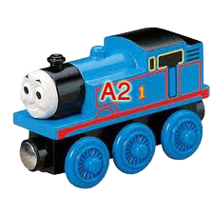
2
Action: stop.
5
4
6
Pre stop station.
Action: slow.
But, next busy
Action: stop.
3
7
0
2
1
Action: stop.

Slide 15
3
5
4
6
Pre stop station.
Action: slow.
But, next busy
Action: stop.
No action.
3
7
0
2
1
Action: stop.

Slide 16
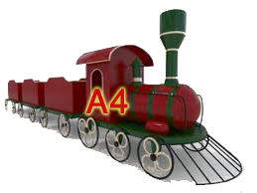
4
Action: stop.
5
4
6
3
7
0
2
1
No action.
Pre Stop station
Action: slow

Slide 17
If maintenance command send to slave A2
5
Train A2 continue until reach tag6 , then stop action.
5
4
6
3
7
0
2
1

Slide 18
6
5
Maintenance is on for A2.
Action: stop.
4
6
No action.
3
7
0
2
1
Action: stop.

Slide 19
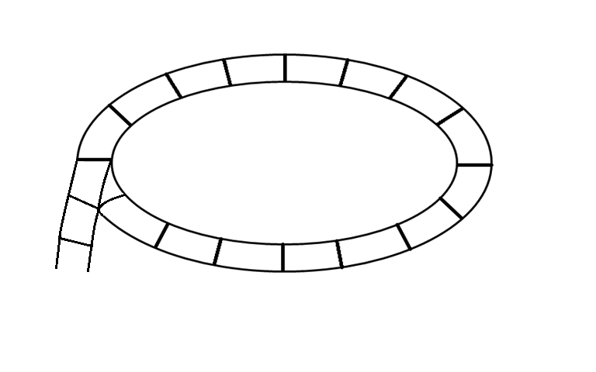
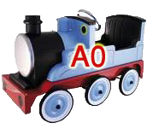
7
5
4
6
Action: change direction of rail.
3
7
0
2
1
Action: stop.

Slide 20
8
5
Pre stop station.
Action: slow.
4
6
Action: move forward.
3
7
0
2
1

Slide 21
9
Action: stop.
5
4
6
3
Action: stop.
7
0
2
1
No action.

Slide 22
10
Action: stop.
5
4
6
Action: return back the rail direction.
3
7
0
2
1

Slide 23
If enter to rail command send to slave A2
11
Before.
Make sure tag6 is empty.
Stop all trains.
Action: stop.
5
4
6
Action: stop.
Action: change direction of rail.
3
7
0
2
1

Slide 24
12
5
4
6
Action: move reverse.
3
7
0
2
1

Slide 25
13
5
4
6
3
7
0
2
1

Slide 26
14
5
4
Action: stop.
6
3
7
0
2
1

Slide 27
15
5
4
6
Action: return back the rail direction.
3
7
0
2
1

Slide 28
16
Action: move forward.
5
Action: move forward.
4
6
Action: move forward.
3
7
0
2
1

Slide 29
Thank you
☺

