Slide 1

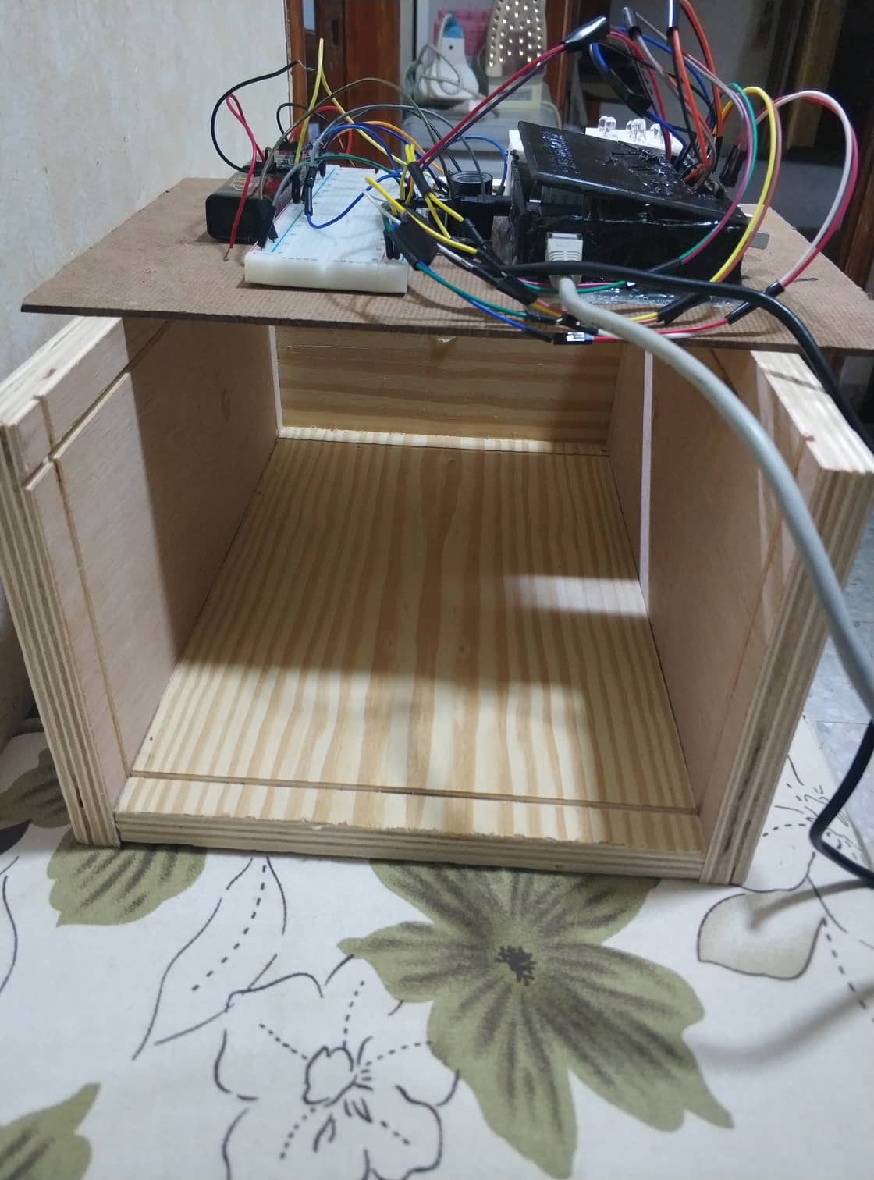
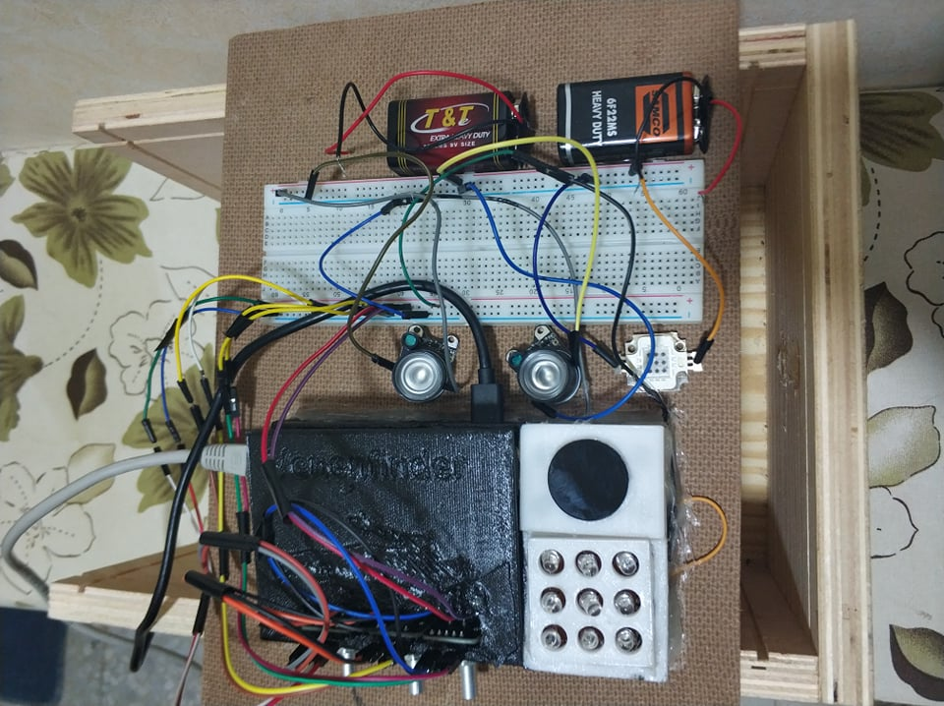
Vein Finder Device
Mussab Hamd, BA; Hazim Seddeh, BA; Amr Hithnawe, BA
An-Najah National University , ²Electrical Engineering Department
Abstract
Introduction
Experimental Equipments & Tools
This project was inspired by one of the problems facing medicine, which is the inaccuracy of finding veins when drawing blood and other needs, causing a lot of pain for the patient and other problems. With the help of technologies of microcontrollers (here we used raspberry pi), and image processing techniques, a device that can show the exact position of the veins has been invented. but it comes with a high price and no availability in local hospitals. so we thought of something similar that comes with a cheaper price and additional features. The device we have developed uses a camera with rotary encoders to specific parameters like brightness, etc. to get the perfect view, while live streaming the image and displaying it after the image processing filters are applied and the location of the veins is obviously shown.
Detection of intra vena is a very important technique in the medical clinic applications. For intravenous detection, some nurses usually make mistakes which can cause a pain or injury to the patient. When the nurses face this problem, it becomes dangerous for the patient. Veins are not only used to take sample of blood, but also as a media of drugs delivery.. Patients who are difficult to trace the vein called the Difficult Venous Access (DVA). Patient with DVA can be caused by fatness or young body likes baby and toddler.
This is especially applicable for obese people, people with dark complexion, old people and for patients whose veins are collapsed. Accuvein, Vein viewer and Veinlite are among the few devices existing in the market that can easily map the vein pattern but high cost makes these devices unfavorable.
Our aim was to develop an assistive technology for venous puncture for diagnostic purposes or for medical drug administration. Easy reproduction and low costs are important criteria for development.
Raspberry Pi 3
The Raspberry Pi is a family of credit card-sized SBCs developed in the United Kingdom by the Raspberry Pi Foundation. The Raspberry Pi Foundation formed in 2009.
Operating System
Raspbian is a free operating system based on the popular Linux distribution, Debian. Raspbian is optimized for the Raspberry Pi family of SBCs
NoIR camera
Features:
● Fixed focus lens on-board.
● 8-megapixel native resolution sensor-capable of 3280 x 2464-pixel static images.
● Supports 1080p30, 720p60 and 640x480p90 video.
Rotary Encoder
Is an electro-mechanical device that converts the angular position or motion of a shaft or axle to an analog or digital signal”. From the appearance it gives a deception of a potentiometer. Although they can be in way called similar but they are not the same.
The Keyes-40 rotary encoder has 5 pins namely
VCC – 5V power supply ,GND – Ground ,CLK – Encoder Pin 1 , DT – Encoder Pin 2 ,SW – Switch (push button) .
Cut-off type colored filter glass(HWB760)
3x3 IR Leds(940nm,850nm)
The need for Leds is to give high power to the wavelengths that are considered so we build out
the build of our project leds and filter will be like in
Our Design
Our design was build using of 3d printing and some of wooden box , the focusing was to get the efficient amount of NIR light so we added 3 high power IR led’s , with 850 nm and 940 nm with batteries because raspberry can supply enough current to these .
The ceiling of the box is flexible and can be opened.
the Raspberry is connected to laptop to do the through Ethernet as you can see , and the access was done using VNC . This was done so we dont have to get a mouse & keyboard every time we need to use raspberry.
Theory
When the wavelength of visible light is 400-700 nm fired onto skin then some light will be absorbed, reflected and diffused into other parts of the skin. Absorption, reflection and light transmission were fired. Colors absorbed by the skin will be forwarded to the subcutaneous layer where a vein is located. Vena will look black on the surface of the skin when exposed to light at these wavelengths. This is because hemoglobin in the blood absorbs the light so that the veins will be looks dark.
With the purpose of providing an automatic detection of the veins and processing the pictures of them, we define the issues that need to be solved as the following:
1. Difficulty in locating subcutaneous veins for Certain groups of people, like: fat people, children and old people.
2. Very expensive vein detectors
See figure (2).
Figure 3: NIR Camera
Figure 4: 40 Rotary Encoder
Figure 2 Light spectrum. HyperCam operates in the visible and NIR bands.
Figure 1 Vein Detection System
Figure 5: 3x3 940nm led’s matrix with HWB760 Filter
Contact
Mussab Hamd
Email:Mousabhamd@gmail.com
Phone:+970597090280

Slide 2
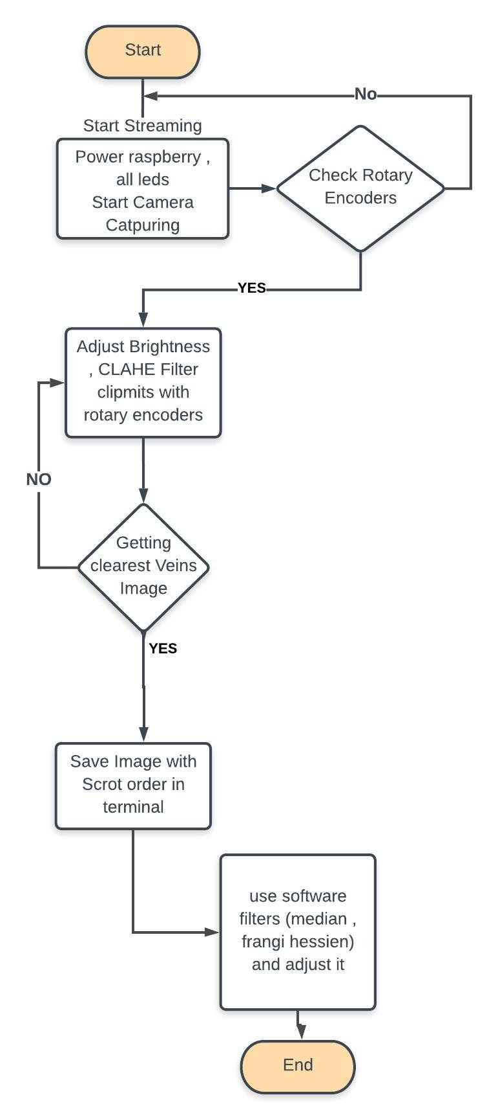
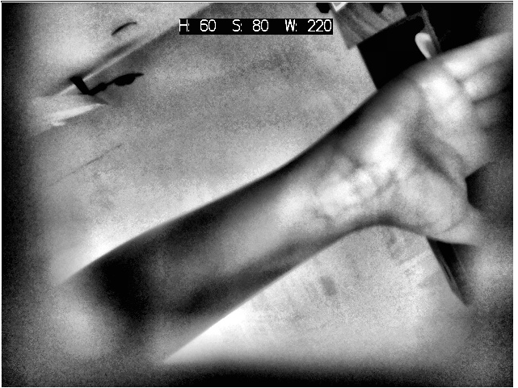
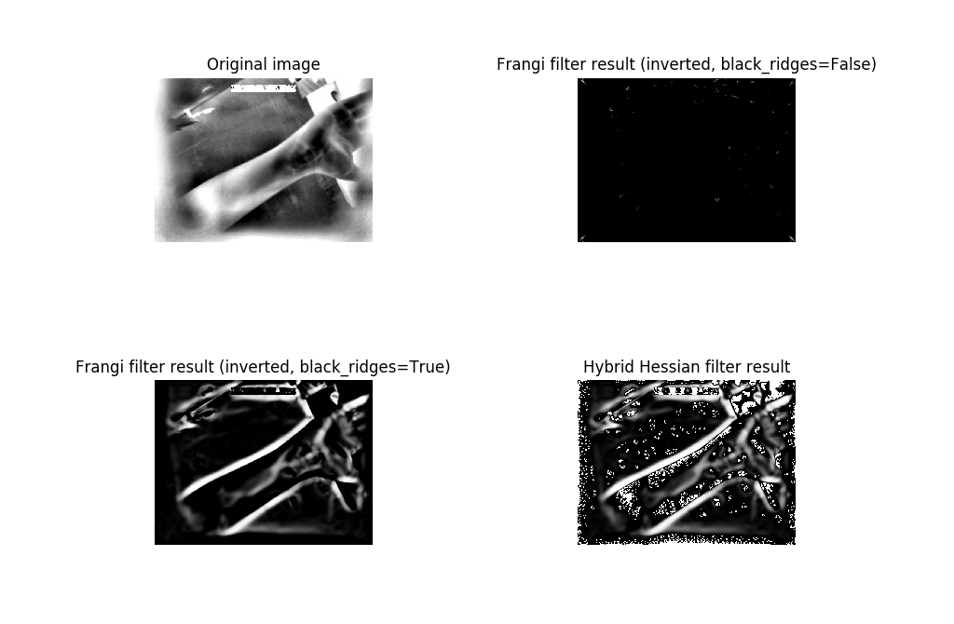
Vein Finder Device
Mussab Hamd, BA; Hazim Seddeh, BA; Amr Hithnawe, BA
An-Najah National University , ²Electrical Engineering Department
Algorithm
Packages
The algorithm of our work is do a stream with an image processing live of CLAHE filter cliplimits parameters and brightness by using three rotary encoders, then when we reach the clearest picture of veins we save it and do others software filters from median to frangi filter and the hessian filter too .
Results
As we said in project 1 we want to use the same operation and same functions as we did in MATLAB but when you come to raspberry there are some packages are not exist , or even not the same way to deal .So, the most important packages in image-processing in Raspberry are Opencv and skimage ,
there are some difference the most difference we had that is Opencv is dealing with images in 8-bits channels while skimage dealing with 16-bit channels.
Table 1 Shows differences between two Packages.
By doing complete code with complete designed we built we were able to get a very good picture from many ages and many weights .
As simple as it is the worst pictured we got is this with the least light of NIR in daylight not in our wooden box .
After we got this from streaming we added it our code that is similar to code of tested image to do other operations and we got a an acceptable result at the end .
Conclusions
As a conclusion, we were able to make and design a good and reliable vein finder device, with really cheap price and costs compared with advanced ones. And we were able to use image processing with Raspberry pi to make the appropriate adjustments one pictures.
Tested Image
Figure 8: Input to AfterSTREAMING code.
Without any streaming and any filter, we took preliminary image and it gave a good result, and we used some filter in from another library.
so let’s study this test.
3x3 Leds (10 w) 940 nm used in this test to implement the picture needed, with dark place.
Discussion
The future work of our project will be adding a robotic arm, this robotic arm will draw the veins we considered by using three algorithms and machine learning called bob.
Bob is a signal-processing and machine learning toolbox originally developed by the Biometrics Security and Privacy Group, the Bio signal Processing Group, and the Research and Development Engineers at Idiap, in Switzerland. Bob is primarily developed through Gitlab. Follow the links bellow to get you started.
Algorithms
Together with that, a broad variety of traditional and state-of-the-art finger vein recognition algorithms such as:
• Maximum Curvature [MNM+05]
• Repeated Line Tracking [MNM+04]
• Wide Line Detector [HDLTL+10]
is provided. Furthermore, tools to evaluate the results can easily be used to create scientific plots,
Figure 9: Output from AfterSTREAMING code.
Comparison | Opencv | Scikit-image
Developers Tools | Computer Vision, Open Source Imaging Machine Learning .Face Detection Great community Realtime Image Processing Helping almost CV problem Image Augmentation | More powerful Anaconda compatibility Great documentation
Using of Companies | Lensley, Plickers. Suggestic., Athento. jemboo, SemanticMD, ikusei, Codemen. Truckaurbus Pvt. Ltd., Ocado Technology . | Mate Labs
Tools to integrate | Amazon Kinesis Video Streams OpenCV biicode | Ludwig
Table 1
Figure 6: Output Frangi-Filter
Figure 7: Input IR Image .
Contact
References
Mussab Hamd
Email:Mousabhamd@gmail.com
Phone:+970597090280
Email:
Website:
Phone:
https://stackshare.io/stackups/opencv-vs-scikit image?fbclid=IwAR2lYSHFv7XPa0nKYm4cutpAZnqcWpTkZsRo6fdXeEAIiOQ8LOtC7B1tVAw
https://projects.raspberrypi.org/en/projects/getting-started-with-picamera/4?fbclid=IwAR01Z2GEArjxaNgjFZ01vYPijJQJpfDUUJeXLOkuRNYO3Zmmm3N7kgELzSw
Raspberry Pi Image Processing Programming: Develop Real-Life Examples with Python, Pillow, and SciPy, Ashwin Pajankar (auth.)
HyperCam: Hyperspectral Imaging for UbiquitousComputing Applications
Mayank Goel1,2, Eric Whitmire1, Alex Mariakakis1, T. Scott Saponas2, Neel Joshi2, Dan Morris2, Brian Guenter2, Marcel Gavriliu2, Gaetano Borriello1, Shwetak N. Patel1,2
Vein pattern recognition. Image enhancement and feature extraction algorithms, Septimiu Crisan Universitatea Tehnica Cluj-Napoca

