Slide 1

Zoomin
Supervisors:
Dr. Manar Qamhieh
Dr.Muhannad Al-Jabi
By:
Suhayb Yahya
Ihab Kahrrosheh

Slide 2


Slide 3

Problem ????

Slide 4



Slide 5
So What ?!
So I need to share my photos to the public
At the same time I don’t want to be robbed
Making money in not bad Also :D

Slide 6
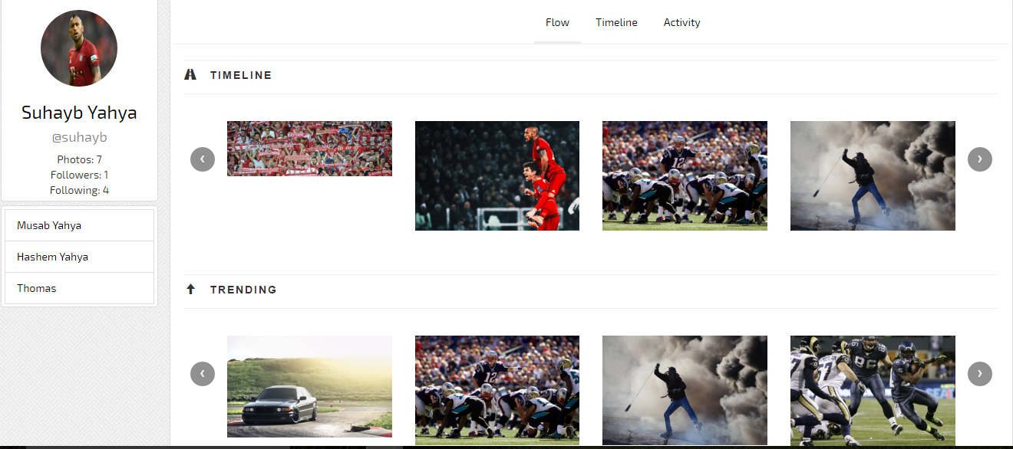
Development Process
      Home page contains the Flow, Timeline and Activity parts.

Slide 7

Development Process
  Trending page

Slide 8
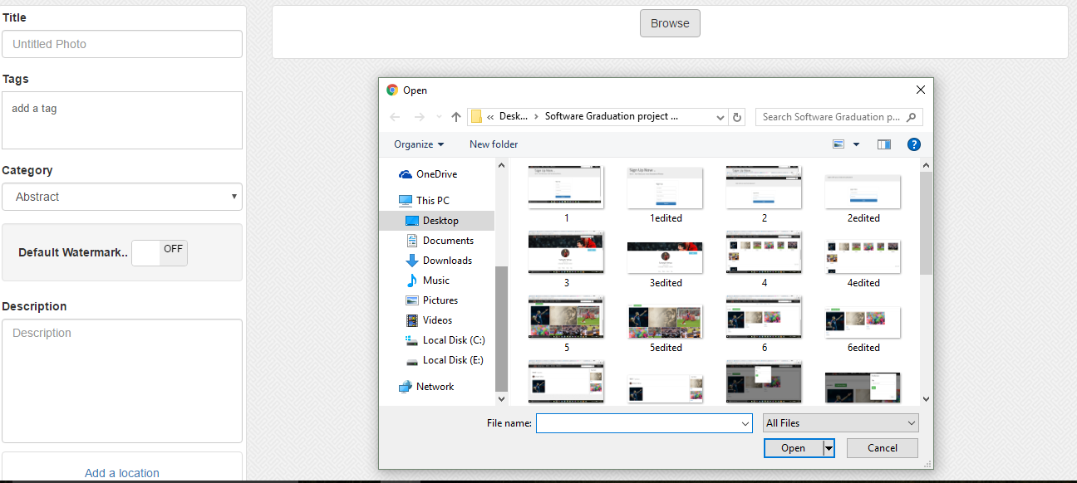
Development Process
  Uploading page

Slide 9
Development Process
  The strategy for protecting the photos downloading or taking snap shots.
  First : When uploading, the user specifies if wants to add watermark.
  Second: Disabling the browser default right click.
  Result: keeping the copyrights for the photos.

Slide 10
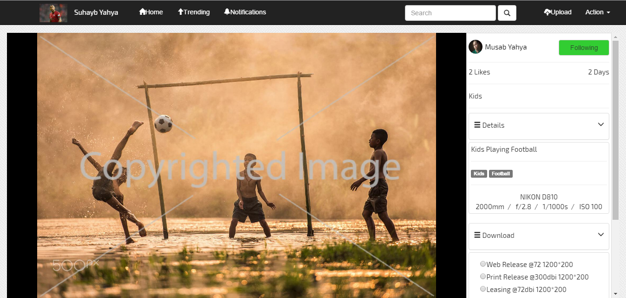
Development Process
  Posts

Slide 11

Android Development
  The Application comes as supporter for the website
  Helps the users to browse and discover more and more photos

Slide 12
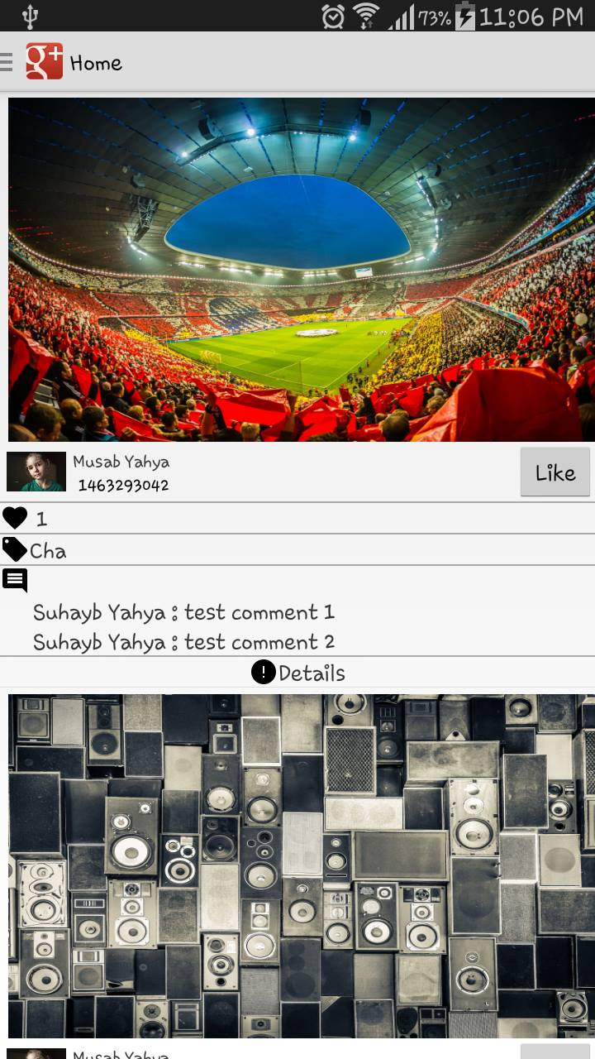
Development Process
      Home page contains the Flow With the Time

Slide 13
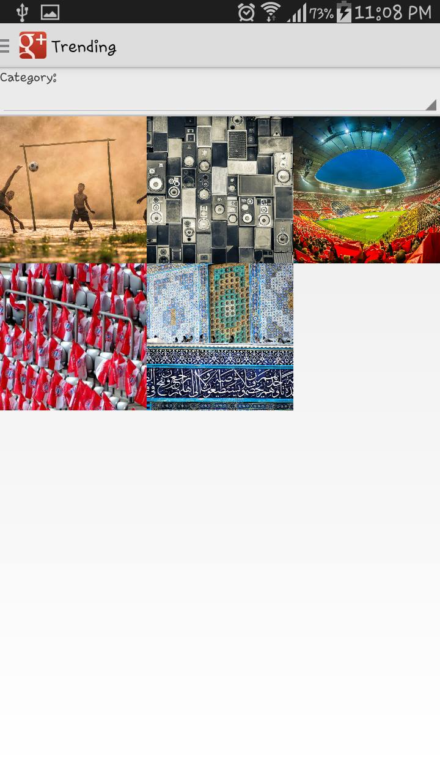
Development Process
  Trending page
  To Show the Most Trending Photos

Slide 14

Tools and Technologies
Web Development
For The Backend We used the Codeigniter PHP Framework
A lightweight open source web application framework that utilizes the MVC architecture

Slide 15

Tools and Technologies
For The Frontend We used the bootstrap
a powerful front-end framework for styling

Slide 16
Tools and Technologies
Libraries
Justified and unite gallery plugins:
  JQuery plugins that are responsive for building Photo Galleries
  GD image processing library:
  For cropping and resizing and copying images
  that are supported with PHP

Slide 17

Tools and Technologies
Android Development
For Android We Used the Picasso Library For loading and Displaying Images
Also the google maps for showing maps and Images markers

Slide 18
Demo Time

Slide 19
Thanks

