Slide 1

An-Najah National University
Faculty of Engineering and Information Technology
Civil Engineering Department
Graduation Project II
Structural Analysis and Design of al-noor Building-ramallah
Prepared by:
Ahmad shqair – Reg. : 11541961
Ameen shaheen – Reg. : 11523700
Under supervision of:
Dr. monther diab

Slide 2
Outline:
Introduction
Preliminary design
Project modeling
Model checks
Type of structural system
Seismic analysis and checks
Soil interaction effects
Final design of the building
Design and design checks

Slide 3
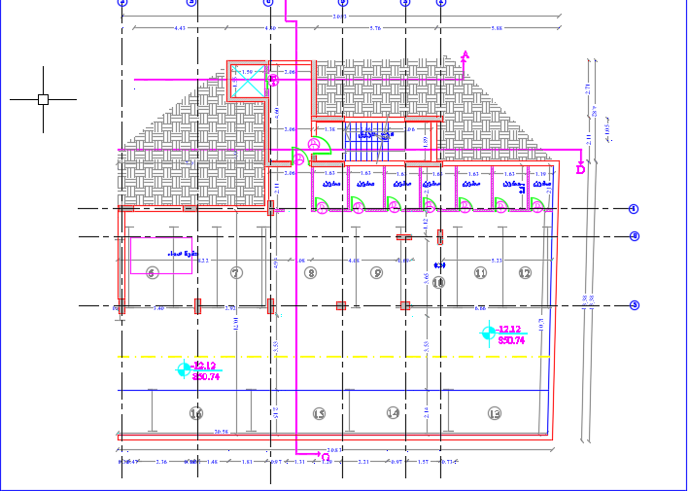
Basement

Slide 4
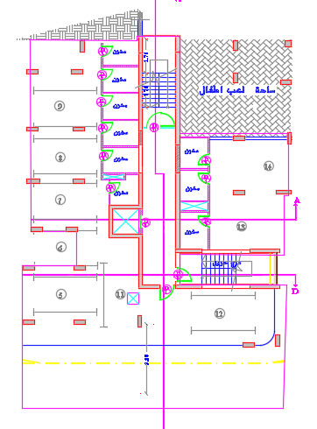
Ground floor

Slide 5
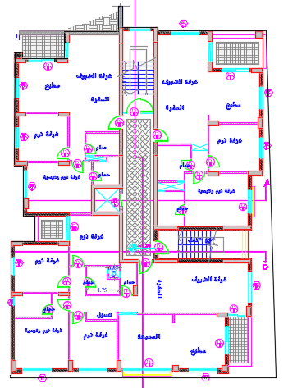
The rest of the floors

Slide 6
Introduction
The project is a residential building. It consists of ten floors, one basement floor level, ground floor level and eight floors above it.
Level | Height (m) | Area ( m² )
Basement floor | 3.12 | 370.94
Ground floor | 3.12 | 400.78
from first floor to the last | 3.12 | 455

Slide 7
Soil investigation
Based on soil investigation report, the foundations are designed for allowable bearing capacity equal to 3.5 kg/cm² at depth not less than 2 m (about 4 m ) .

Slide 8
Codes and standards
The following codes and standards are used in the analysis and design process :
ACI 318-14 : American Concrete Institute’s Building Code Requirements for Structural Concrete
American Society of Civil Engineering (ASCE 7-10): It is used for the seismic design and to determine live loads.

Slide 9
Materials
Reinforced concrete
Property | Value
Compressive strength, fc ( MPa ) | 24
Modulus of elasticity, Ec ( GPa ) | 23
Unit weight (kN/m³ ) | 25
Steel reinforcement
Property | Value
Yielding strength, fy ( MPa ) | 420
Modulus of elasticity, Es ( GPa ) | 200

Slide 10
Non – structural elements
Material | Ɣ in kN/m³
Blocks | 12
Filling Materials | 18
Tiles | 26
Plaster | 23
Aggregate | 13
Concrete Mortar | 23
Masonry Stone | 30

Slide 11
Loads
Gravity loads
Dead loads
Superimposed loads
Live loads
Lateral loads

Slide 12
Gravity loads
Dead loads : represents the own weight of the elements
Live loads :
- 3 kN/m² for basement and ground floor
4.8 kN/m² for the rest of floors
5 kN/m² for staircase
Superimposed loads
1 kN/m² for basement
4.7 kN/m² for the rest of floors
4.7 kN/m² for staircase
16 kN/m for stone walls

Slide 13
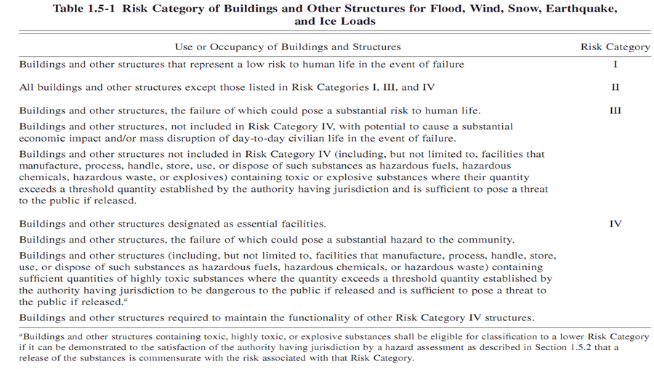
Lateral loads
Select the most appropriate risk category
Risk category ΙΙ

Slide 14
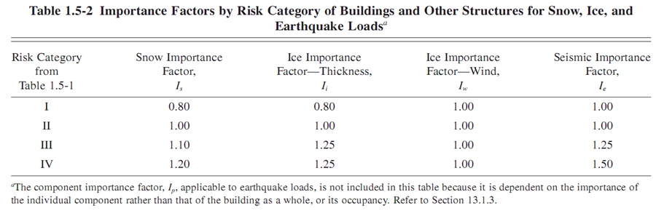
Set the importance factor
I_{e} equals to 1

Slide 15
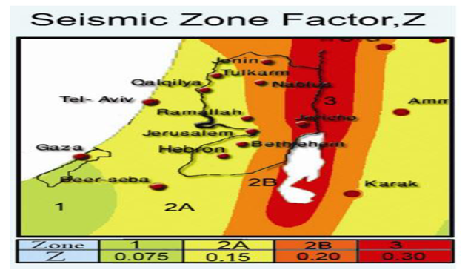
Determination of S_{s} & S₁
For Ramallah, Z = 0.15
S_{s} = 2.5 x 0.15 = 0.375
S₁ = 1.25 x 0.15 = 0.1875
These values are for 10% probability of exceedance, for 2% probability of exceedance:
S_{s} = 1.5 x 0.375 = 0.5625
S₁ = 1.5 x 0.1875 = 0.28125

Slide 16
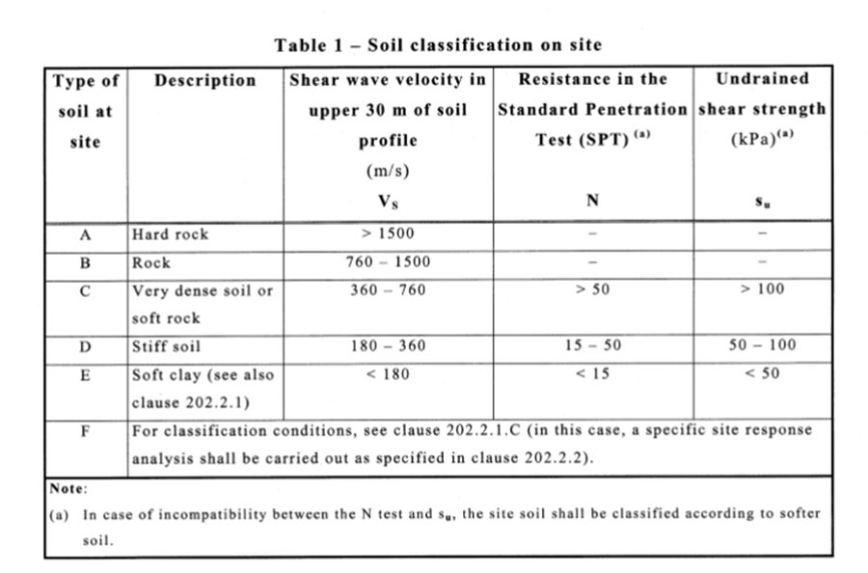
Determination of site classification
Site class is B

Slide 17
Determination of response accelerations S_{ms} & S_{m1}
S_{ms} = 1 x 0.5625 = 0.5625
S_{m1} = 1 x 0.28125 = 0.28125

Slide 18
Calculate the design spectral accelerations S_{DS} & S_{D1}
For 10% probability of exceedance of return period 50 years.
S_{DS} = 2/3 S_{Ms} = 0.375
S_{D1} = 2/3 S_{M1} = 0.1875
Determination the seismic design category
Based on risk category and design spectral accelerations ( S_{Ds} & S_{D1} ), the seismic design category is C

Slide 20
Load combinations
Ultimate load combinations
According to the ASCE7-10, the load factors that are used in the analysis and design are:
a) 1.4 D
b) 1.2D + 1.6 L
c) 1.2D+E+L
d) 0.9D +E
Service load combinations
a) D +L
b) D +0.75L
c) D +0.7E
d) D +0.75L +0.75(0.7E)
e) 0.6 D+ 0.7E

Slide 21

Preliminary design
Slab thickness
Two way solid slab with beams .
Basement slab
h $=\frac{ln (0.8+\frac{fy}{1400})}{36+9β}$
h = 18.1 cm,
use 18.5 cm.

Slide 22
The rest of floors
h = 16.4 cm, use 17 cm in all floors except ground floor

Slide 23
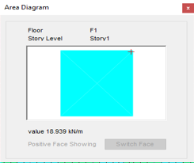

Check shear for slab
Basement floor
$∅Vc=\frac{1}{6}∗0.75bd\sqrt{Fc}$ = 88.8 kN
Where f_{c} =24 MPa, b=1000 mm, and d = 185 – 40(cover) = 145 mm.
Vu (from ETABS model), Vu = 19kN
Since ФVc >> Vu, slab thickness is adequate for resisting shear
So there is no need for shear reinforcement

Slide 24
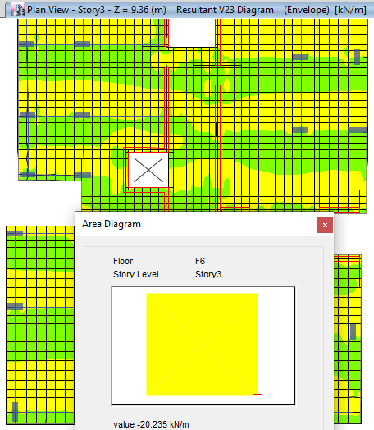
- Rest of floors :
where Fc=24 MPa, b=1000 mm, and d = 175 – 40(cover) = 135mm.
∅Vc = 82.67 kN
Vu the max shear force that could occur in the slab (from ETABS mode) Vu = 20kN
Since Vc > Vu, slab thickness is adequate for resisting shear. So there is no need for shear reinforcement

Slide 25
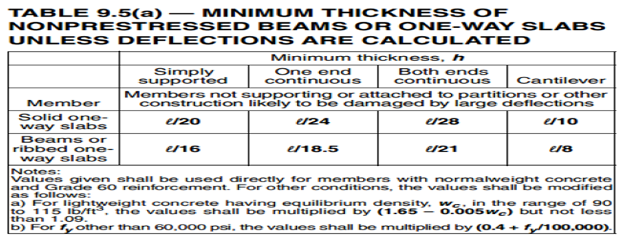
Preliminary design for beams
Group number | Dimension | Location
1 | 400X200 mm | In all floors except the ground floor
2 | 500X300 mm | In all floors and edge beams
3 | 600X400 mm | In all floors
4 | 700X400 mm | In ground floor
Group number | Dimension
1 | 830X350 mm
2 | 630X350 mm
3 | 230X350 mm

Slide 26
Preliminary design for columns
By using tributary area method
Group number | Dimensions
1 | 800X300 mm
2 | 1000X300 mm
3 | 1200X300 mm
4 | 450X450 mm
5 | 700X300 mm

Slide 27
Project modeling
1. Bring the layout of the project from Autocad architectural drawing.
2. Define the materials used in the building (concrete and steel).
3. Define element sections of the structure with their suitable modifiers.
4. Define area section (slabs and shear walls) with their suitable modifiers.
5. Define load patterns on the structure, such as Dead, Superimposed and live loads.
6. Define load combinations according to the code for analysis and design.
7. Draw the structural elements (sections) and slabs (area sections).
8. Assign the loads ( except own weight -dead- ) on structural elements and slabs according to the values of superimposed , and live loads.

Slide 28
Stiffness modifiers
Slabs 0.35
Beams 0.35
Columns and shear wall 0.7

Slide 29
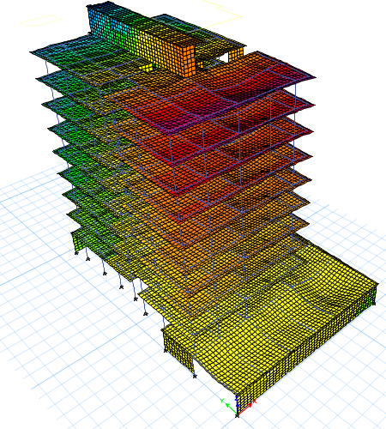
Model checks
Compatibility check

Slide 30
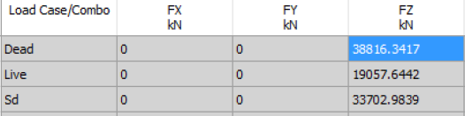
Equilibrium check
 | Hand calculation | Etabs | %Error | <5%
Dead | 38762.723 | 38816.3417 | 0.13 | Ok
SD | 33712.08 | 33702.98 | 0.02 | Ok
Live | 18972.73 | 19057.6442 | 0.45 | Ok

Slide 31
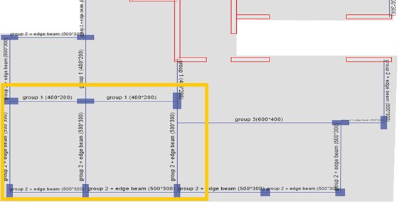
Stress – strain check

Slide 32
For slab in story 5
Total ultimate load in the slab:
Wu = 1.2 (0.17*25+4.7)+1.6x4.8=18.42 kN /m²
So the Total moment in the slab manually equals to:
Total moment in Slab= Wu*ln2/ 8
Where:
Wu= Ultimate Load (kN/m²)
ln= Span length (m)
Total moment in Slab= 18.42*2.752 8=17.4 kN.m
ETABS results
We found that:
Total moment from the program for this slab equals to:
Total moment X frame direction=M2+( M1+M3 )/2
Where:
M1: The moment in the beginning of the frame.
M2: The moment in the middle of the frame.
M3: The moment at the end of the frame.
Total moment frame - X direction=15.3+( 2.846+1.96)/2=17.7 kN.m
%Error100%= 17.7 -17.417.4 x 100% = 1.72% < 10% OK

Slide 33
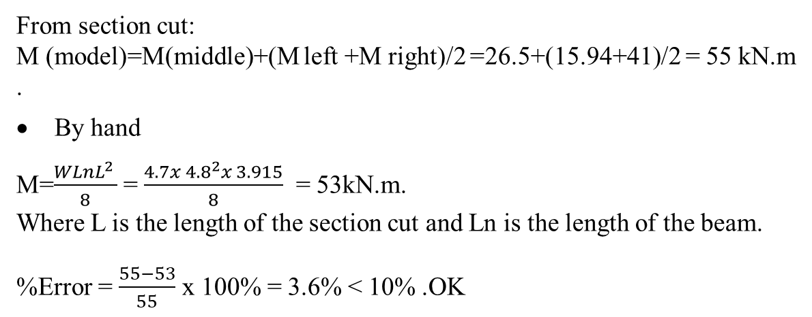
Beam check
From section cut:
M (model)=M(middle)+(M left +M right)/2 =26.5+(15.94+41)/2 = 55 kN.m.
By hand
M=$\frac{WLnL^{2 }}{8}$ = $\frac{4.7x {4.8}^{2}x 3.915}{8}$ = 53kN.m.
Where L is the length of the section cut and Ln is the length of the beam.
%Error = $\frac{55−53}{55}$ x 100% = 3.6% < 10% .OK

Slide 34
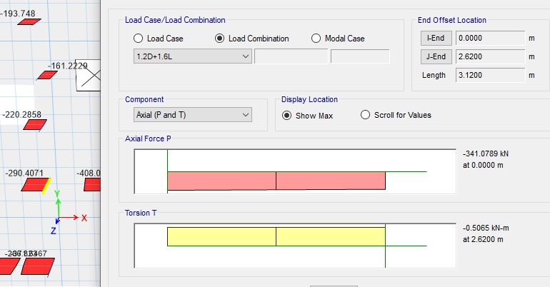

Column check
Manual calculation
A _{Tributary} = ((4.28/2)+(3.55/2)) x ((3.8/2)+(5.45/2)) = 18.1 m²
- Weight of column = 0.3 x 0.8 x 3.12 x 25 = 18.72 kN.
- Weight of slab = 0.17 x 25 x 18.1 = 76.925 kN.
- Weight of live loads = 3 x 18.1 = 54.3 kN.
- Weight of superimposed loads = 4.7 x 18.1 = 85.07 kN
- Weight of beams = (4.28/2+3.55/2+3.8/2)*0.23*0.2*25+(5.45/2)*0.33*0.3* 25 = 13.43 kN.
→ Axial load = 1.2 (18.72 + 76.925 + 85.07 + 13.43) + 1.6 (54.3) = 319.854 kN.
ETABS results
%Error = $\frac{341−319.85}{341}$ x 100% = 6.2% < 10% .OK

Slide 35
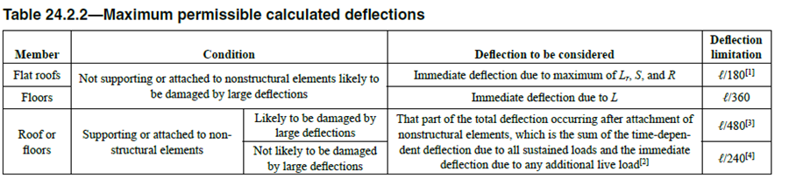
Deflection check
This check is important to check the deflection in the building and make sure that it will not exceed the allowable limits.

Slide 36
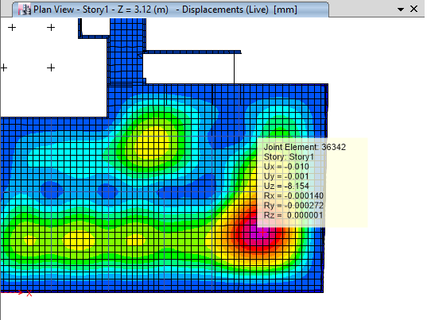
- Basement floor
According to ACI 318-14, deflection due to floors not supporting to nonstructural element likely to be damaged by large deflection shall be less than L/360.
Total deflection = deflection in the middle of the whole panel - average deflection of the four columns
Total deflection = 8.1 mm (neglect corners deflection)
Allowable deflection according to ACI is equal to L/360 = 7.3/360 =20.27 mm.
So we are in the safe zone.

Slide 37
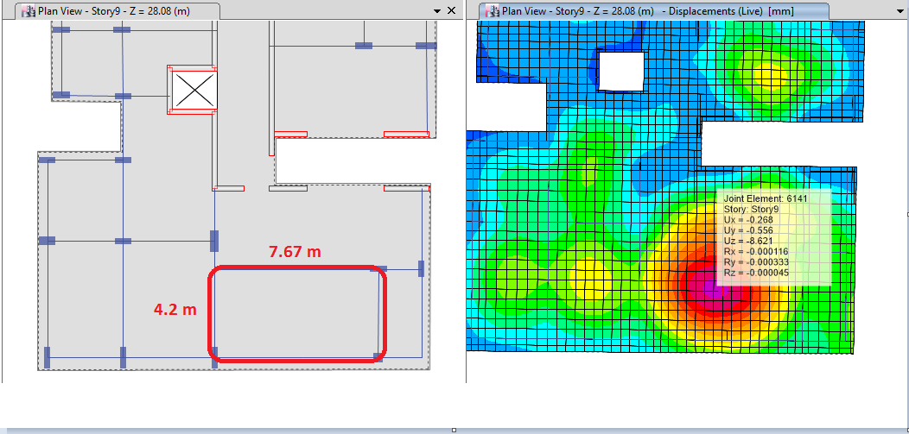
- Rest of floors
Another check is done for a panel attached to non-structural system that is not likely to be damaged by large deflection
This panel is the critical panel for all floor except the basement floor
Total deflection = deflection in the middle of the whole panel - average deflection of the four columns
Total deflection = 8.62 mm (neglect corners deflection)
Allowable deflection according to ACI is equal to L/360 = 4.2/360 =11.67 mm.
So we are in the safe zone.

Slide 38
Type of structural system
Our expectation is Building Frame Systems and to ensure that, forces that are taken by walls shall be > 75 % of lateral loads.
Using ETABS it appears that walls takes approx 97% of lateral loads and
the rest to frames, which means that our expectation is right.

Slide 39
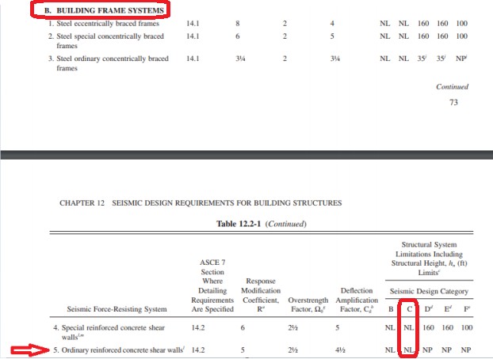
The response modification coefficient ( R ) = 5
Over strength factor ( Ω_{o} ) = 2.5
Deflection amplification factor ( C_{d} ) = 4.5 .
The design of frames and shear walls will be ordinary frames

Slide 40
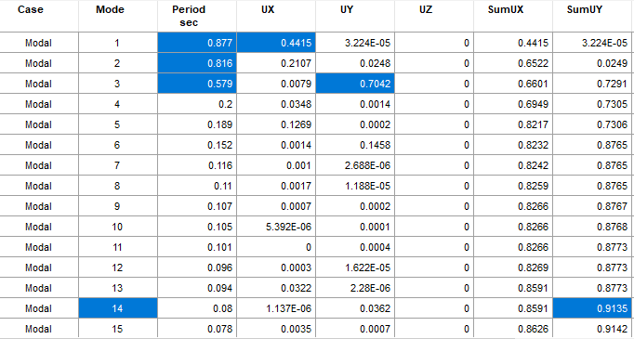
Seismic analysis and checks
  Modal Mass Participation Ratio
From the table above, it obvious that the summation of modes are more than 0.9, which is mean that most masses of the structure move in these modes ( the main motion are in X and Y direction ) .

Slide 41
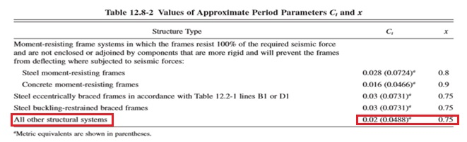

Period calculations
Ta = C_{t}×${hn}^{x}$
Ta =0.0488×${\text{34.32}}^{0.75}$ = 0.691 sec.

Slide 42
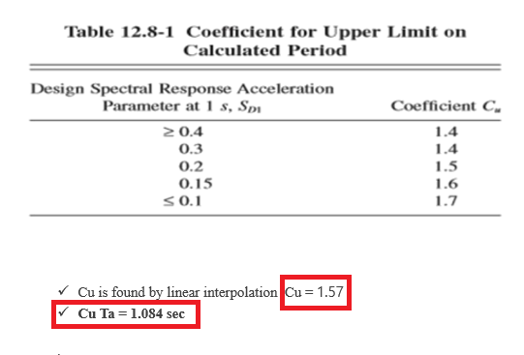

Slide 43
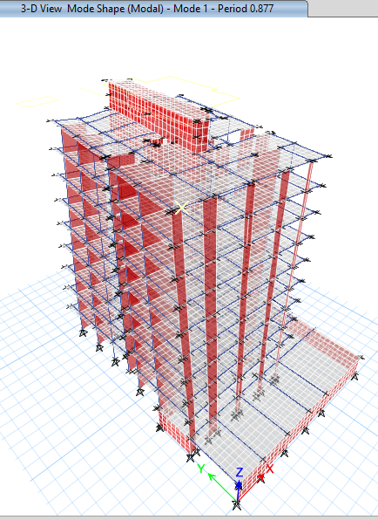
Fundamental period for the structure = 0.877 sec which is less than 1.084 sec
.

Slide 44
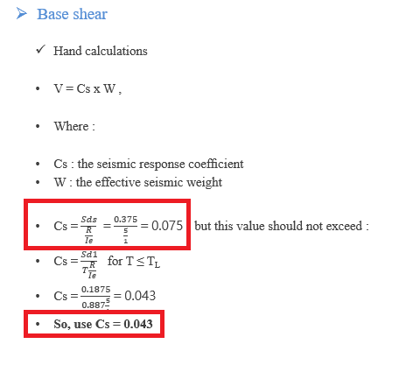

Slide 45
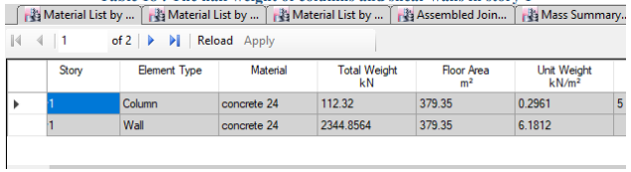
W = Dead load + Superimposed load. + 0.25 live
where :
Superimposed load = 18121.8kN
Dead load = 41354.4kN
0.25 * live = 64133.7 kn.
The half weight of columns and shear walls in ground floor should be abstracted from the total dead load.
So, the effective weight ( W ) =64133.7 –(112.32+2344.8564)= 61676.58 kn
Vx= 0.043 × 61676.58 = 2652 kN
Vy= 0.064 × 61676.58 = 3947 kN

Slide 46
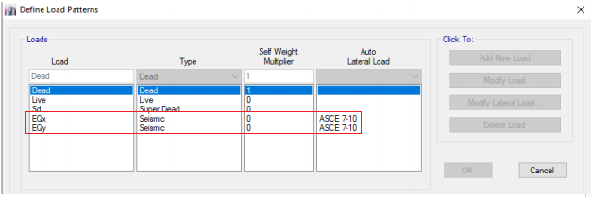
Definition of ELF in ETABS

Slide 47
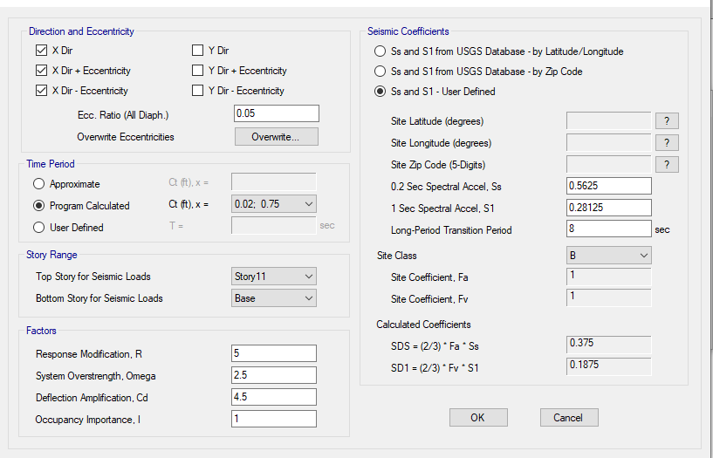
ELF in X – direction

Slide 48
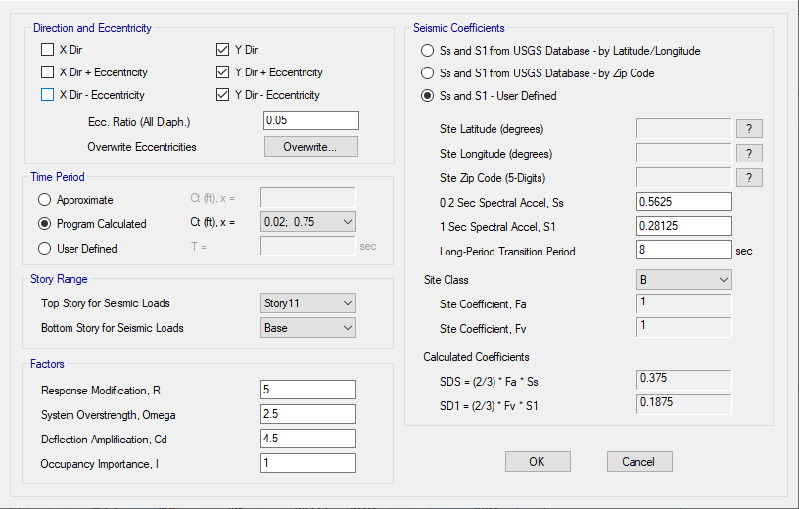
ELF in Y – direction

Slide 49
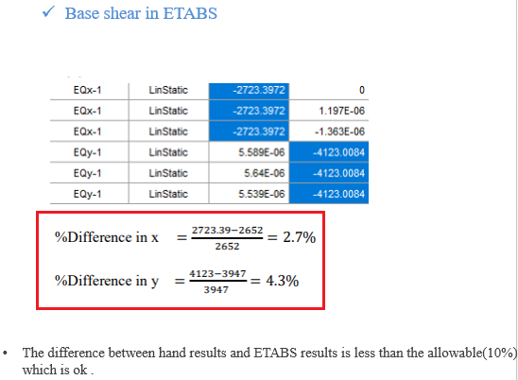

Slide 50
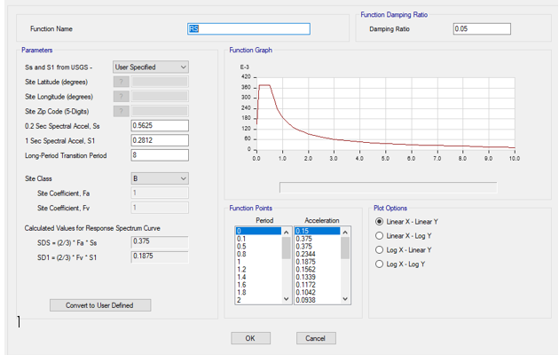
DEFINITION OF RESPONSE SPECTRUM

Slide 51
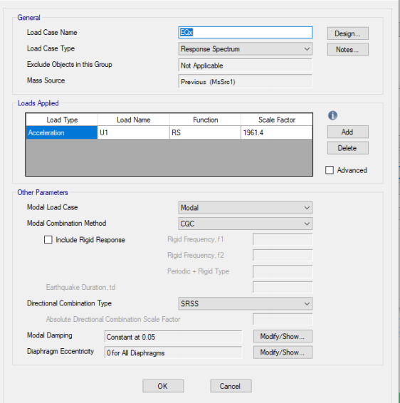
Response spectrum in X – direction

Slide 52
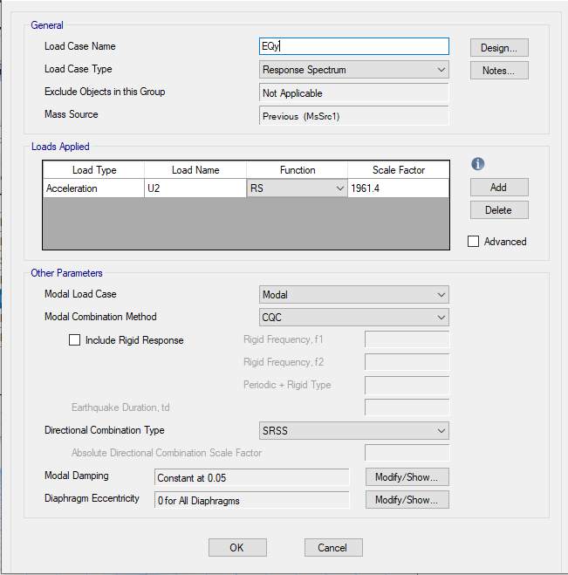
Response spectrum in Y – direction

Slide 53
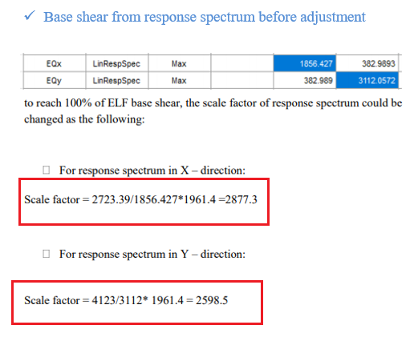

Slide 54
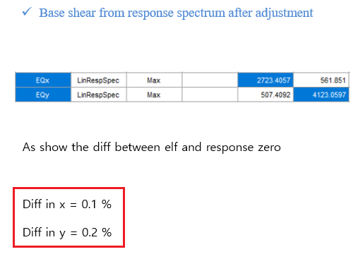

Slide 55
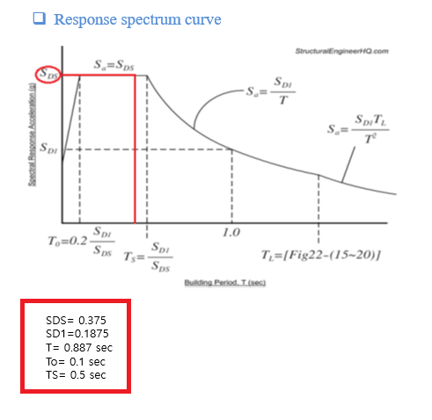

Slide 56
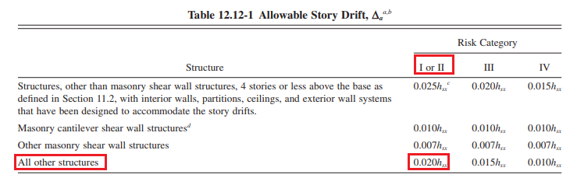
Seismic checks
Drift check
The design story drift (Δ) shall not exceed the allowable story drift ( Δa) as obtained from Table 12.12-1 in ASCE 7-10 for any story which is ≤ 0.02h_{x}.

Slide 57
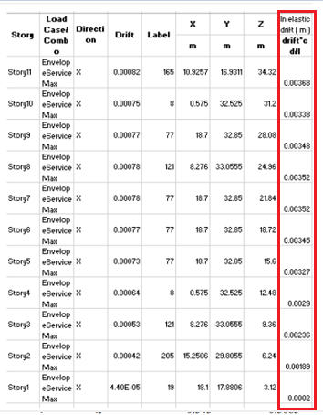
Drift in X – direction

Slide 58
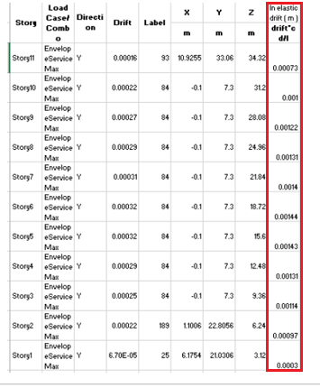
Drift in Y – direction

Slide 59
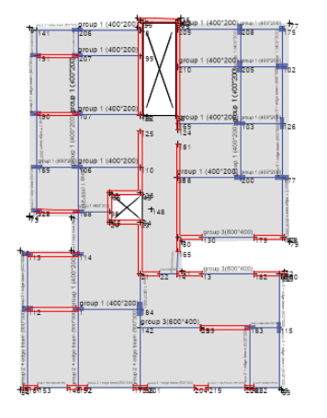
Torsional irregularity
Horizontal torsional irregularity

Slide 60
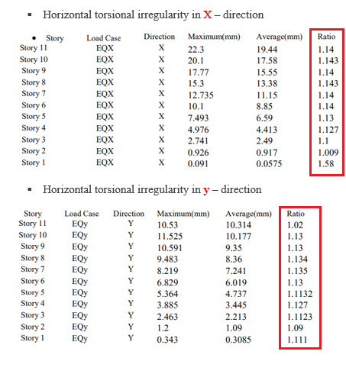
So according to all ratios, there is no torsional irregularity or extreme torsional irregularity

Slide 61
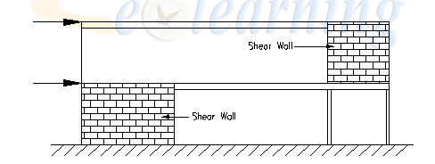
Vertical structural irregularity
1-In-plane discontinuity in vertical lateral –force-resisting element
2-Discontinuity in Lateral Strength–Extreme Weak Story Irregularity
all stories have approximately the same strength, so Extreme Weak Story does not exist.

Slide 62
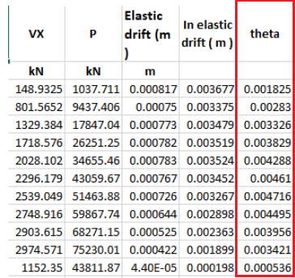

P – Delta check
$θ$ = $\frac{P ∆ Ie}{V h Cd}$
X – direction

Slide 63
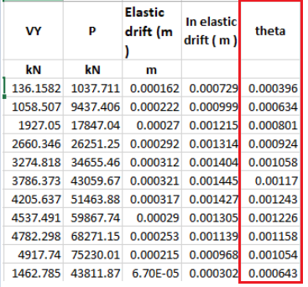
Y – direction

Slide 64
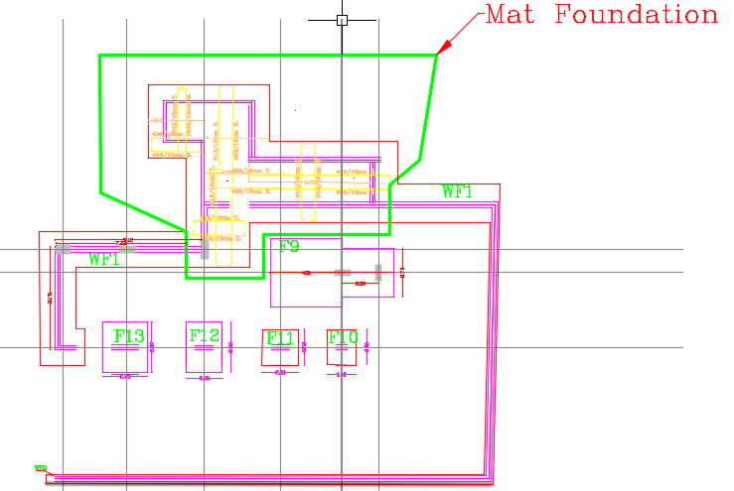
Footing in level 1
Design check
Footings

Slide 65
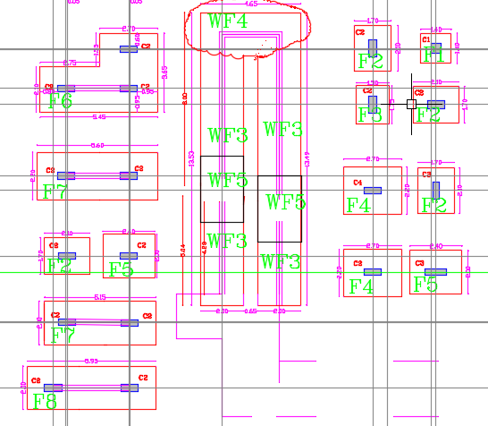
Footing in level 2

Slide 66
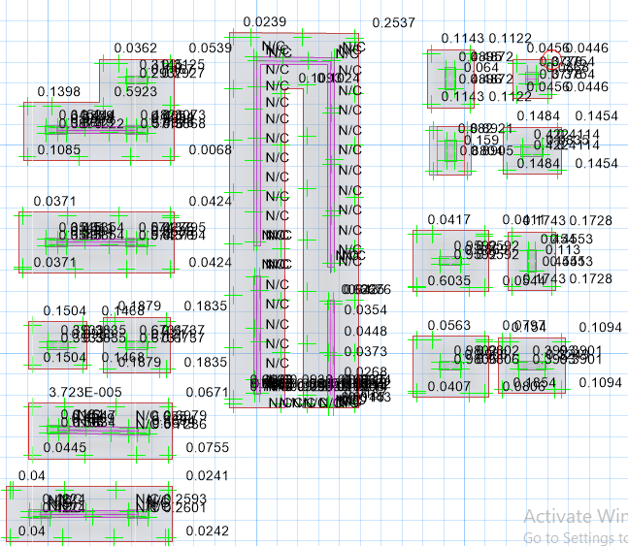
Footing checks
Shear check

Slide 67


Slide 68

Soil pressure

Slide 69


Slide 70

Wide beam shear (one way shear)
For single footing type F4, maximum shear between V13 and V23 is found under column-208 at distance d from face of column as the following
Maximum value for V13 is 290KN/m and allowable 526 KN. Then, no need for shear stirrup.

Slide 71
Staircase design
Dimensions of staircase
The width of single flight is 1.1 m
Riser = 17 cm
Tread = 30 cm
Span of staircase = 3.33 m
Slab waist as 15 cm.

Slide 72
Loads
Dead = average height of steps x width of steps x 25
=(15+17/2) x 1.1 x 25 =12 kN/m.
Superimposed dead = width of steps x 4.7 = 1.1 x 4.7 = 5.17 kN/m
Live= width of steps x 5=1.1 x 5=5.5 kN/m .
Wu=1.2 x (12+5.17) + 1.6 x 5.5 = 29.404 kN/m.

Slide 73

Flexural design
M = $\frac{W L^{2}}{8}$= 41.6 kN.m
𝜌 = $\frac{0.85 fc}{fy}$ ( 1- $\sqrt{1−\frac{2.61 Mu}{bd^{2}fc}}$ )
ρ = 0.007 > 0.0033
ρ_{max}= 0.375 β $\frac{0.85 fc}{fy}$ = 0.015 ( where $β$= 0.85 for f_{c} $≤$ 28 MPa )
A_{s} = 0.007 x 130 x1000 = 910 mm², 6Ø14/ m in longitudinal direction.
A_{smin} = ρ_{min} x b x h = 492 mm², 4Ø14/ m in transverse direction

Slide 74

Shear design
V_{u}= $\frac{W L}{2}$ = 69.26 kN.
V_{n} = V_{u}/∅ = 69.26/0.75 = 92.3 kN
V_{c} = $\frac{\sqrt{fc} }{ 6}$ bd = $\frac{\sqrt{24} }{ 6}$ x 1000 x 130 = 106 kN
V_{c} > V_{n} , so use minimum shear reinforcement .
( Av/s )_{min} = max. (0.062 $\sqrt{fc}$ $\frac{bw}{fyt}$ , $\frac{0.35 bw}{fyt}$) = 0.833 mm²/mm
S = Av/0.833 = 2 x 79/ 0.833 = 185 mm
Shear reinforcement (stirrups) : 5Ø10/ m

Slide 75


Slide 76



The ultimate load combination used in the design

Slide 77

Beam design
Flexural design

Slide 78




Slide 79

For shear design

Slide 80


Column design

Slide 81


Slide 82



Slide 83


Slide 84

Shear wall design

Slide 85


Wall dimensions and forces
Length of wall: Lw = 1.45 m
Thickness of wall: h = 0.25 m
Height of wall: hw = 3.12 m

Slide 86

Forces from each load combination

Slide 87


Slide 88


Slide 89


Slide 90

In plane moment :
Pu = 2571 kN
M3-3 = 131 KN.m

Slide 91

ETABS results
Minimum vertical reinforcement is required 1$∅12$/35 cm

Slide 92


Slide 93



Slide 94

THANK YOU FOR LISTENING

