Slide 1
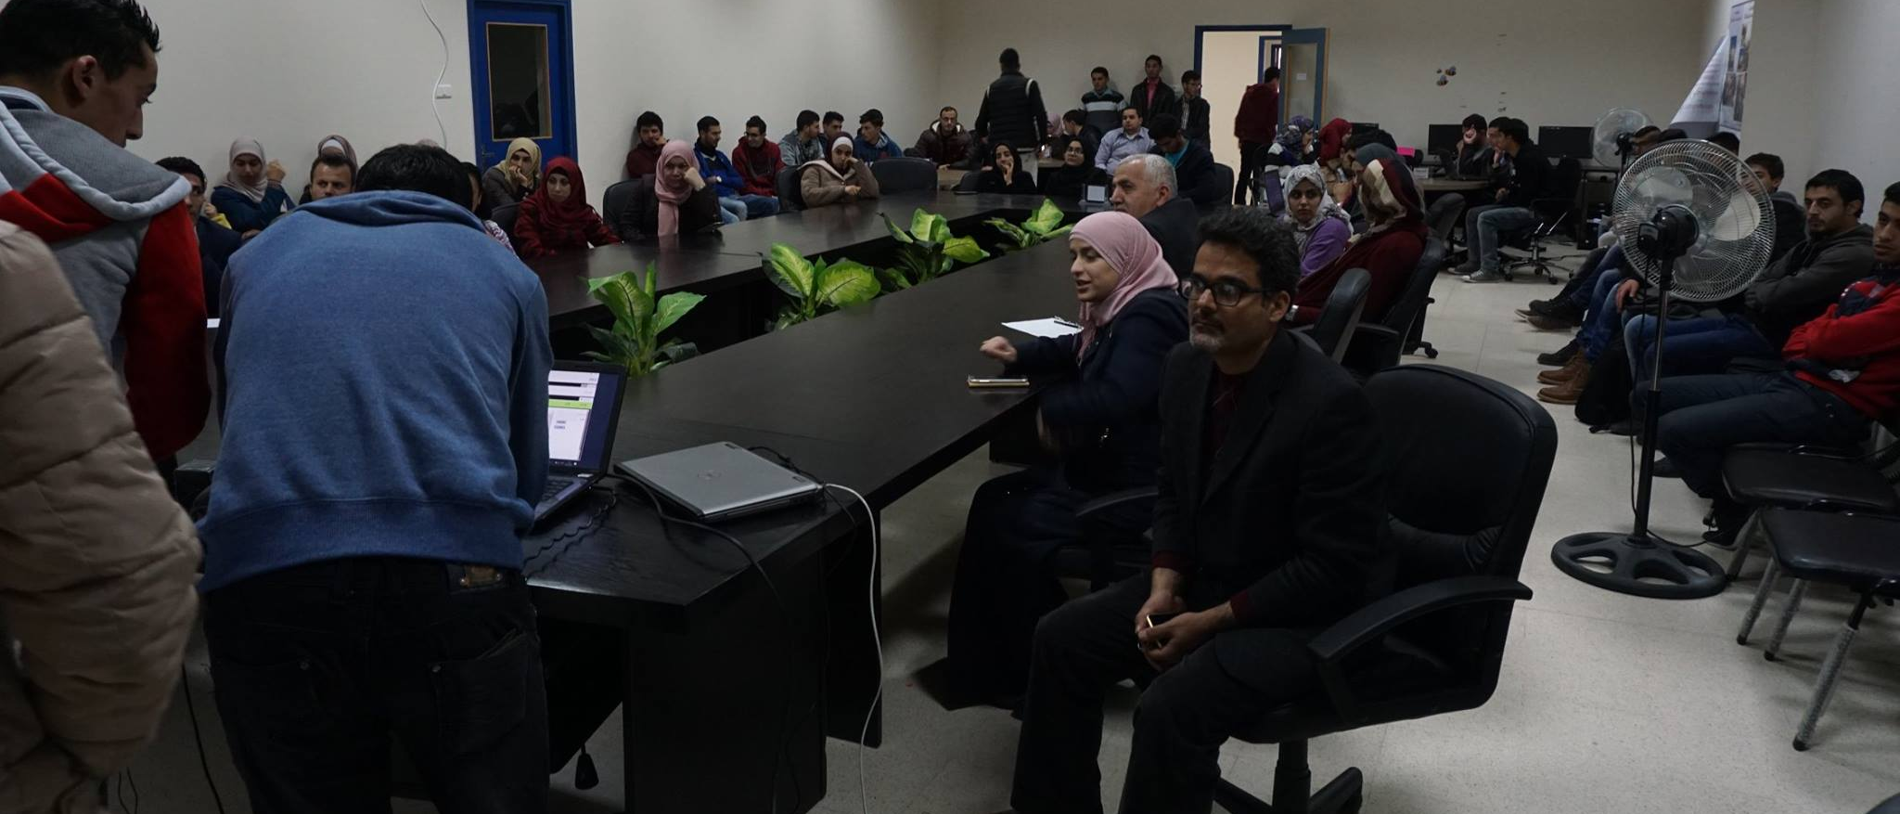
COMMUNITY BASED LEARNING
Management System
Anas Salah Malak Aljedi Riham Kharoub

Slide 2
CBL Program
CBL Manual System
AGENDA
Development Process
Future Work
Demo

Slide 3


CBL PROGRAM AT AN-NAJAH UNIVERSITY
What is the CBL unit?
The Community Based Learning-CBL is a unit at An-Najah National University.
What is the CBL goal?
Improving the education methods through engaging students in the work field.
CBL unit suffers from
Manual management for all transactions related to the CBL administration.

Slide 4



CBL
Program
Definition
Meeting

Slide 5
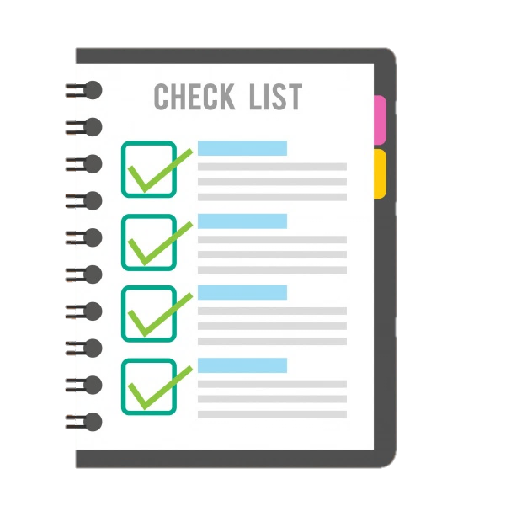
Course
Enrollment
Meeting

Slide 6



Course
Design

Slide 7
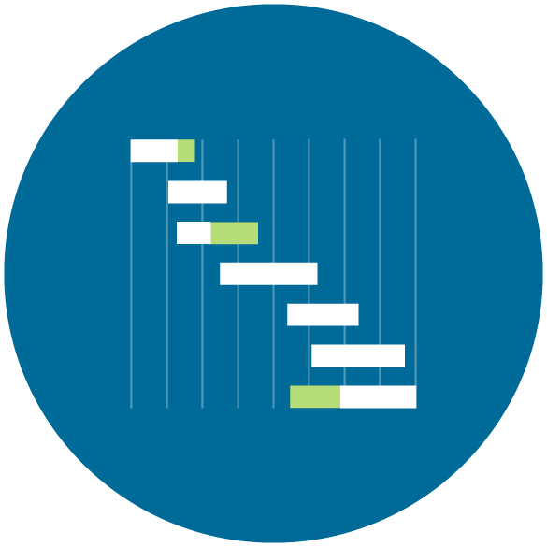
Course
Tracking

Slide 8

Course
Reflection

Slide 9

Data
Gathering

Slide 10
SOLUTION
Extensive elaboration about the CBL program and its goal
Design module for submitting the course outline
The second part of the design module includes the action plan design
Step-by-step instructions for applying in the CBL program
Any feedback by the admin is given through this module using a commenting system
Lecturers will be able to plan activities and lectures for the semester through a calendar interface
Notification system for informing the lecturer about the confirmation of the his/her course

Slide 11
SOLUTION
Implementation Stage
Reflection Stage
Dashboard
The system shows the 16 weeks of the semester with all stages, activities, lectures and evaluations planned in the design stage
Lecturer will be notified when the semester is about to end to fill the reflection form.
The admin will be able to observe statistics by three levels, summative, by semester and by course statistics
As an example of statistics an admin can observe is: female/male student and lecturers number, challenges faced by lecturers, ratio of partner’s commitment and ratio of lecturer’s commitment
Form designed for lecturers which is divided into the following indicators; challenges | community partner commitment | theory-practice balance | students’ involvement
The system closes and disables passed weeks

Slide 12


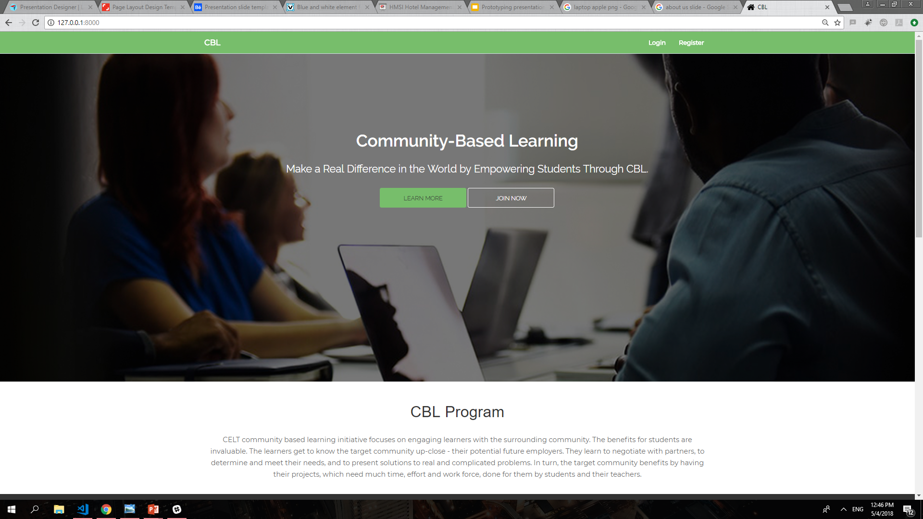
Requirement Gathering
Design
Requirement gathering
Converting requirements
Agile Software Development
Reviewing the deliverables
sessions before each
into operational source
User interface design
Unit testing
code
iteration
using photoshop
with stakeholders
Determining ways to
Laravel framework
Real stakeholders
Database design
Integration testing
improve the practices
used
Observations of the users
MVC framework
Track and Monitor
UML Design
workflow
Bootstrap
Development
Test

Slide 13
DEPLOYMENT
You can access the website at:
www.najah-cbl.com

Slide 14
FUTURE WORK
Recommendation System
Recommend services from community based on the requirements of the enrolled courses.
Completed CBL Courses
Community Services
Recommended Project
Keywords

Slide 15
THANK YOU.

