Slide 1
Integrated Redesign of Al-Quds Open University-Salfeet
Prepared by:
Mohammad H. Al-Jawhary
Mo’men S. Qutqut
Razan A. Tobasi
Wa’ed A. Seirafy
Supervisor:
Dr. Monther B.M. Dwaikat

Slide 2
Introduction
Architectural Design
Environmental Design
Electrical Design
Quantity Surveying
Mechanical Design
Structural Design
Outline

Slide 3
Introduction

Slide 4
Introduction
Al Quds Open University:
Established in 1991, Jerusalem
22 branches in West Bank
Offers 5 specializations
In Salfeet, an unqualified building is already utilized as an open university
This building will be replaced as per a ministerial decree

Slide 5
Architectural Design

Slide 6
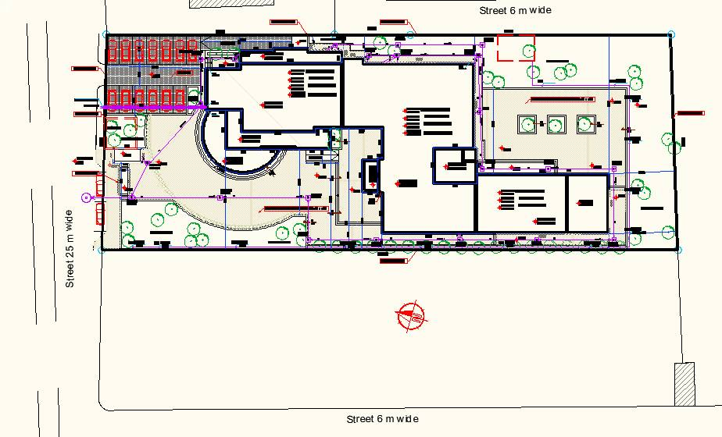
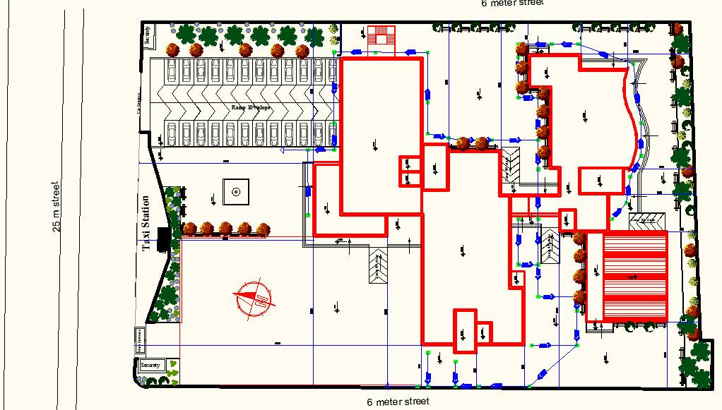
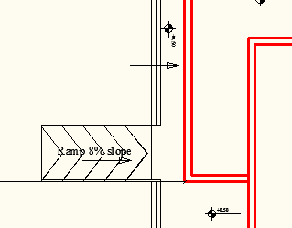
Architectural Design
Site Plan
Original
Design
Our
Design

Slide 7
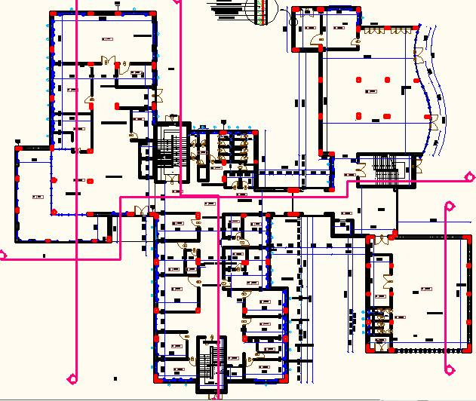
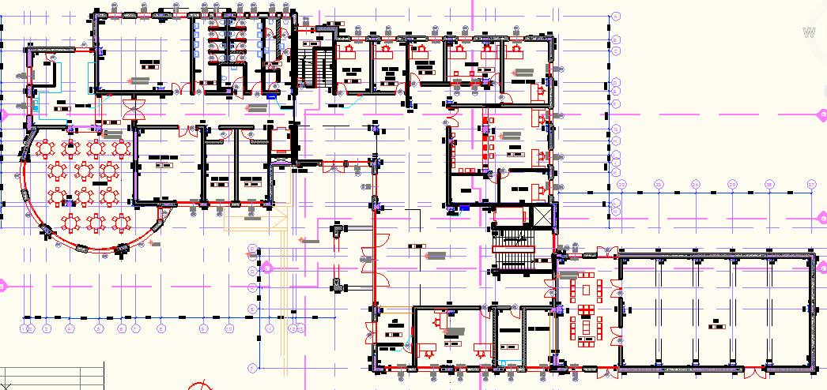
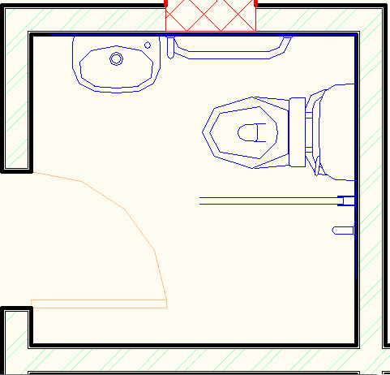
Architectural Design
Ground Floor
Original
Design
Our
Design

Slide 8
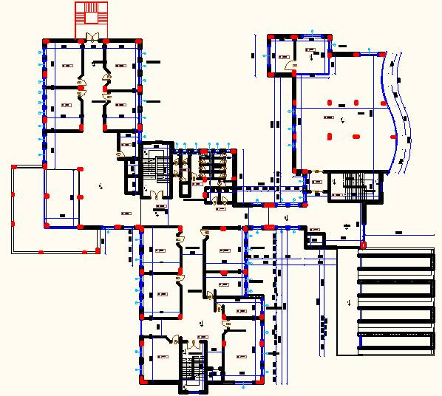
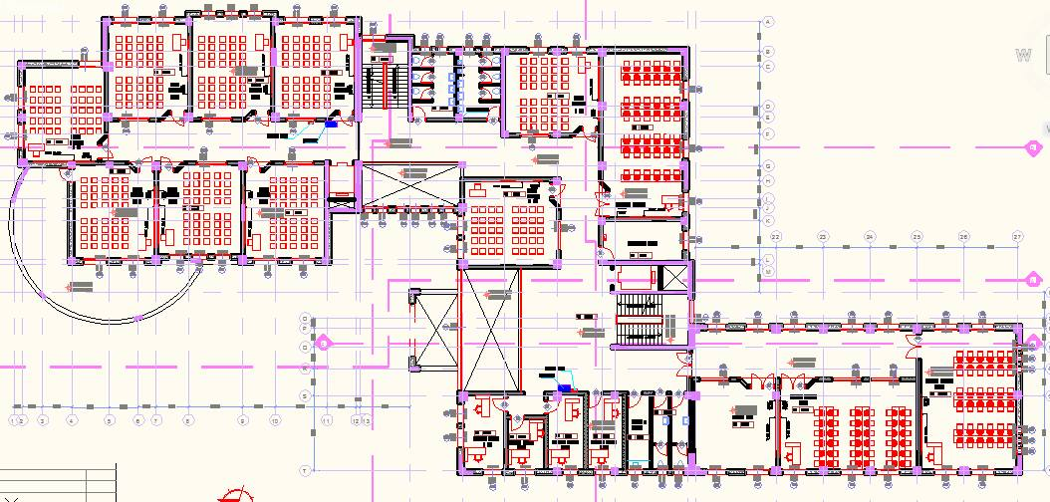
Architectural Design
First Floor
Original
Design
Our
Design

Slide 9
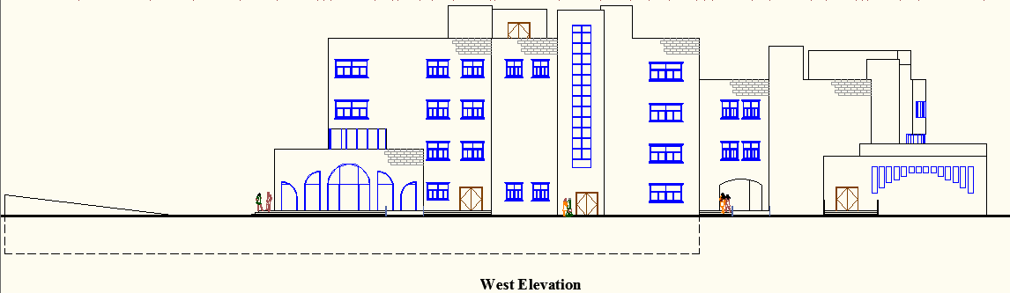
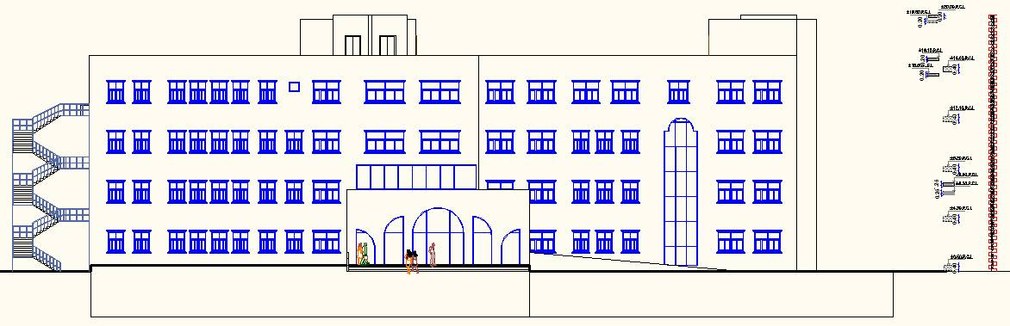
Architectural Design
West Elevation
North Elevation

Slide 10
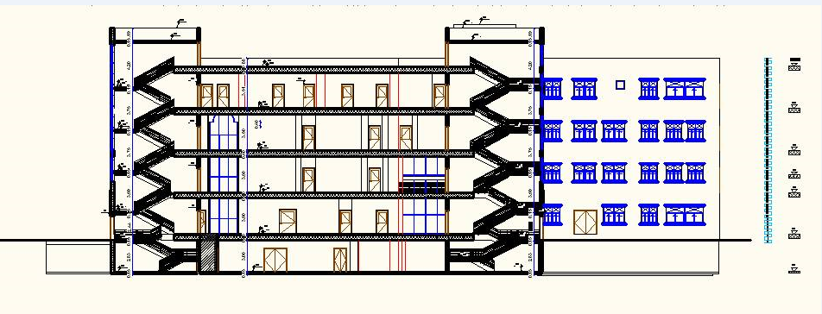
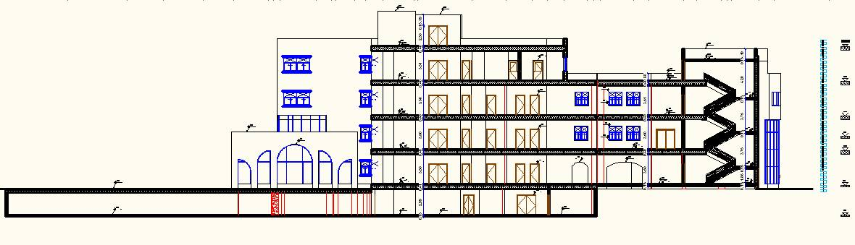
Architectural Design
Sections
Section
A-A
Section
B-B

Slide 11
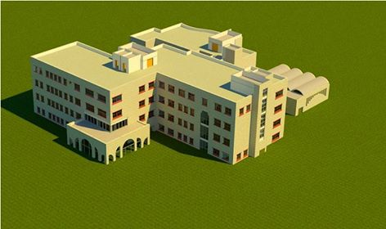
Architectural Design
3D model

Slide 12
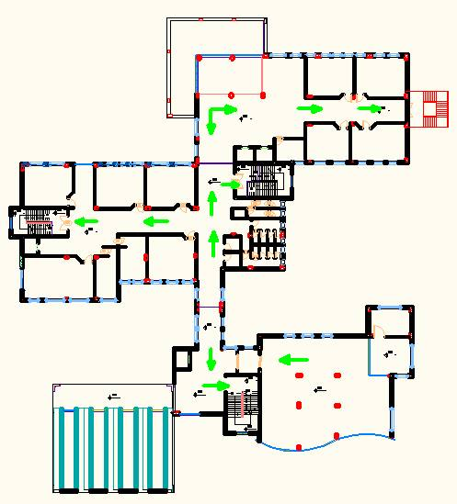
Architectural Design
Egress Routs in F1

Slide 13
Environmental Design

Slide 14
Environmental Design
Shading
Daylight
Thermal Design
Acoustics

Slide 15
Environmental Design
Shading
East and West windows (vertical louvers)
South windows (horizontal shading)

Slide 16
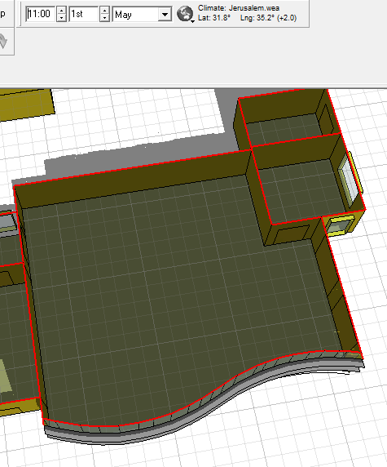
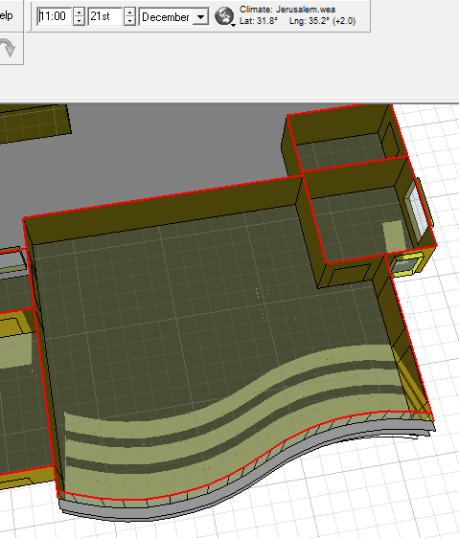
Environmental Design
Shading
South windows
Summer
Winter

Slide 17
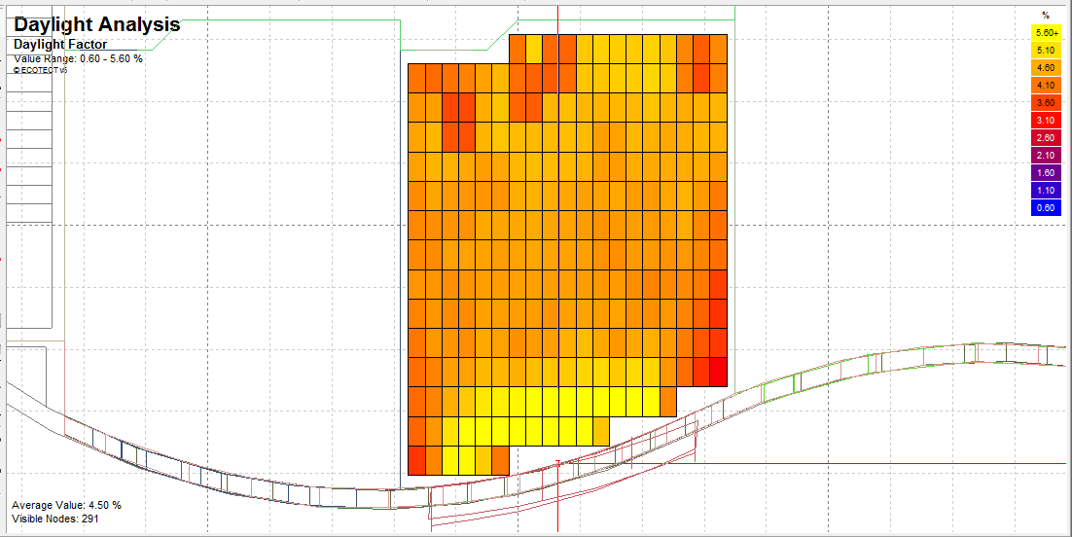
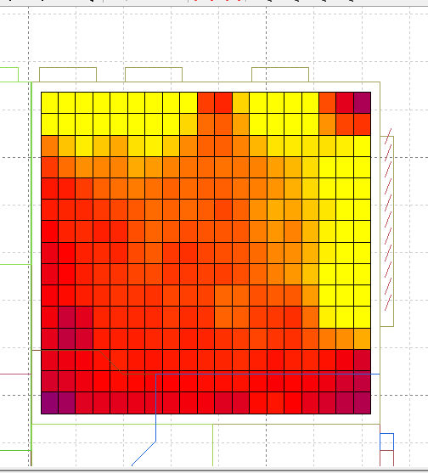
Environmental Design
Daylight
DF =
4.5%
Uniformity
=0.87
DF =
4.85%
Uniformity
=0.74
Classroom
Meeting Room

Slide 18
Environmental Design
Thermal Design
Start
Materials
Solutions
PMV, PPD
New PMV, PPD
Internal Temperatures
No
OK?
Yes
No
Yes
OK?
Passive Gains Breakdown Analysis
End

Slide 19
Environmental Design
PMV and PPD (Classroom)
Before
Month | 1 | 2 | 3 | 4 | 5 | 6 | 7 | 8 | 9 | 10 | 11 | 12
PMV | -1.75 | -0.77 | -1.52 | -4.20 | 0.49 | 0.48 | -0.89 | 0.49 | -0.79 | 2.82 | 0.13 | -2.08
PPD (%) | 64.42 | 17.56 | 51.88 | 100 | 10.11 | 9.81 | 21.84 | 9.98 | 18.09 | 97.69 | 5.60 | 80.05
After
Month | 1 | 2 | 3 | 4 | 5 | 6 | 7 | 8 | 9 | 10 | 11 | 12
PMV | -0.53 | 0.05 | -0.08 | -0.48 | -0.03 | -0.68 | -0.27 | 0.40 | 0.43 | 0.63 | 0.20 | -0.44
PPD (%) | 10.9 | 5.0 | 5.1 | 9.8 | 5.0 | 14.7 | 6.5 | 8.3 | 8.9 | 13.5 | 5.8 | 9.1

Slide 20
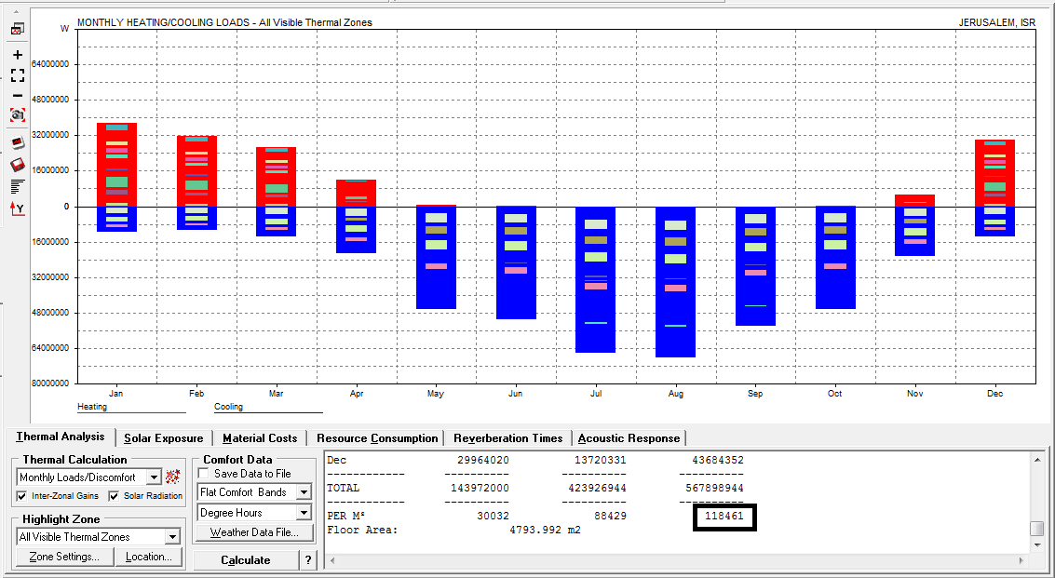
Environmental Design
New and Original Designs Comparison
Original
Design
118 KW/m²

Slide 21
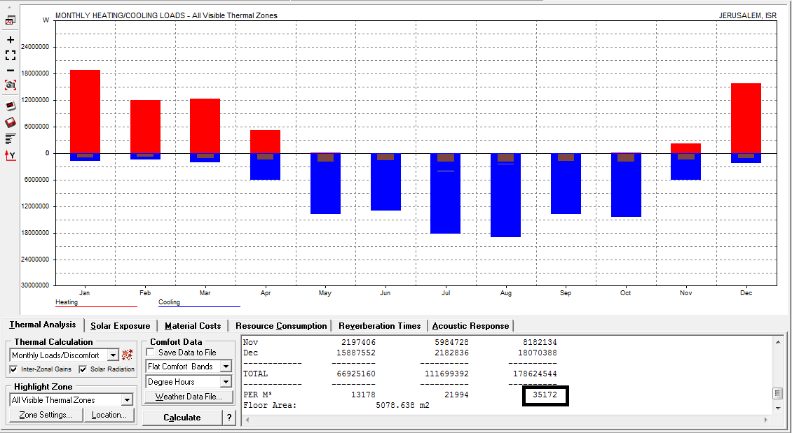
Environmental Design
New and Original Designs Comparison
New
Design
35 KW/m²

Slide 22
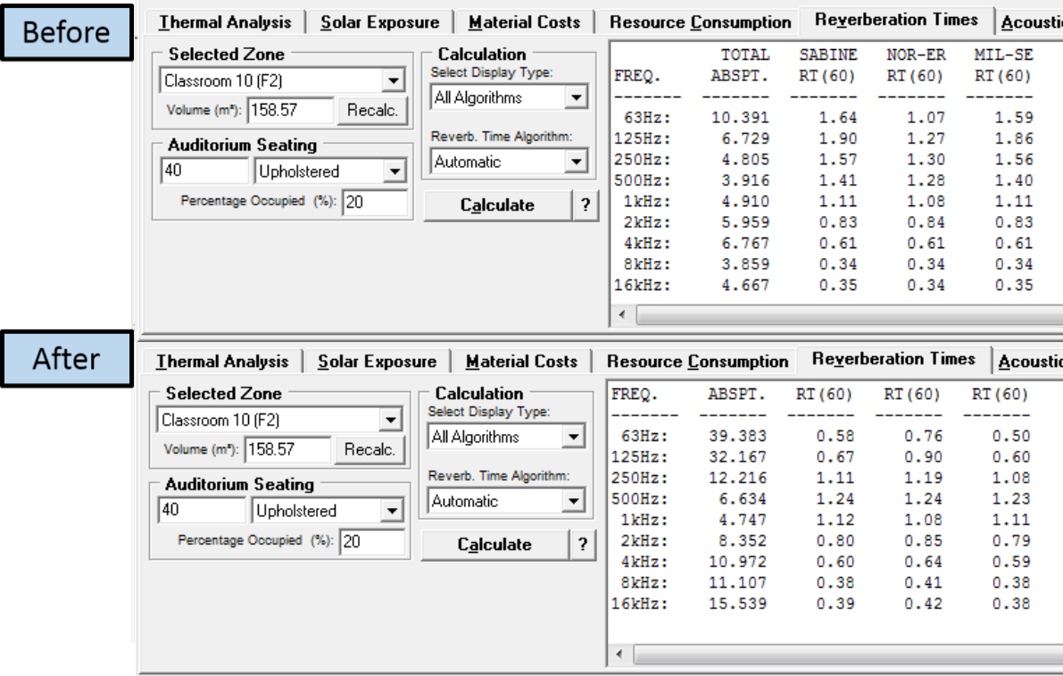
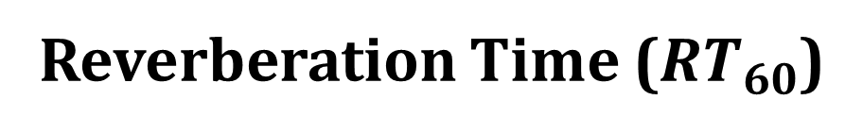
Environmental Design
Acoustics
Reverberation Time ($RT_{60}$)
Classroom
(0.6-1.4 s)

Slide 23
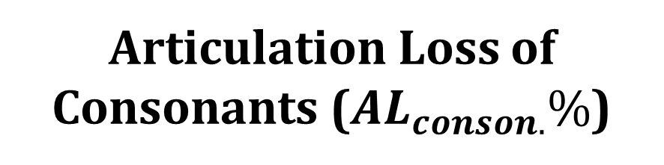
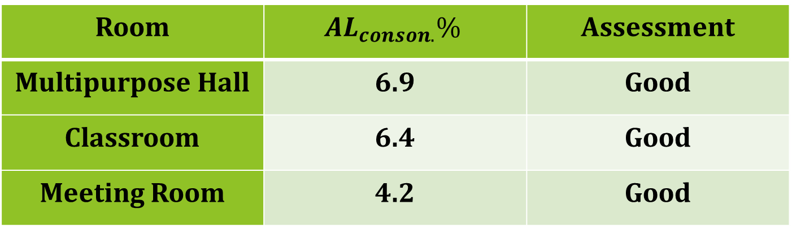
Environmental Design
Acoustics
Articulation Loss of Consonants ($AL_{conson.}\%$)
Room | $$AL_{conson.}\%$$ | Assessment
Multipurpose Hall | 6.9 | Good
Classroom | 6.4 | Good
Meeting Room | 4.2 | Good

Slide 24
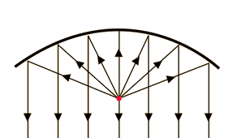
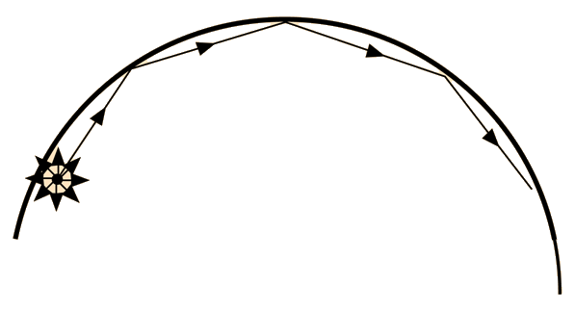
Environmental Design
Acoustics
Creep and Focus
Creep
Focus

Slide 25
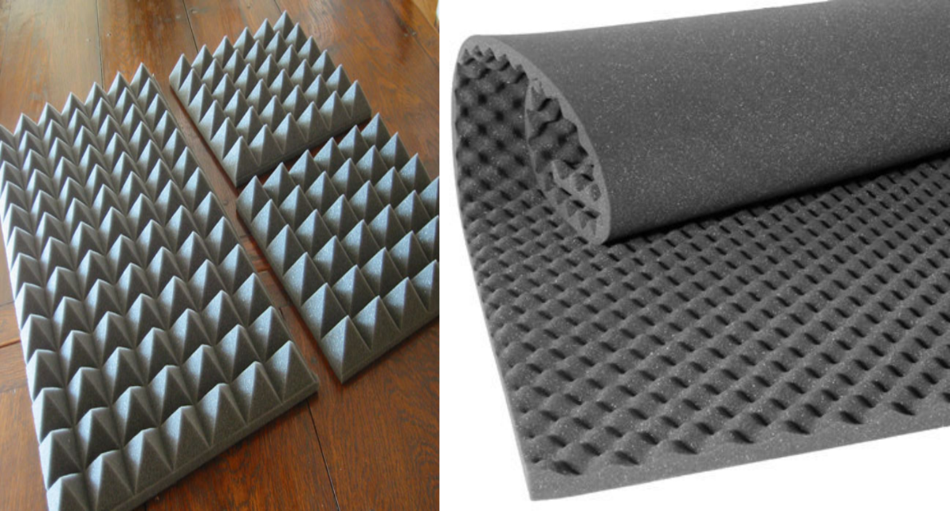
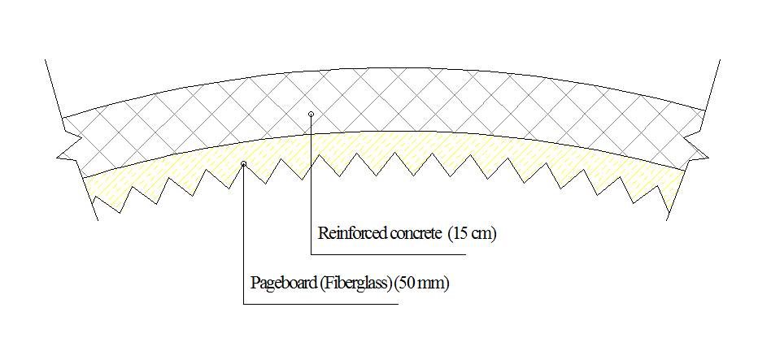
Environmental Design
Acoustics
Creep and Focus
Acoustical Foam Panels
Section in a Shell

Slide 26
Structural Design

Slide 27
Structural Design
Codes
(ACI 318) for RC Structures Design
(ACI 350.3-06) for Water Tanks Loads
(UBC 97) for Earthquake Loads
(ASCE 7 2010) for loads computations

Slide 28
Structural Design
Loads
Live Load = 5 KN/m2
SID= 4 KN/m2
EQ Loads:
I= 1 Cv=0.4
R= 4.5 Ca=0.28
Z= 0.2 Ct= 0.0488

Slide 29
Structural Design
Material
Concrete B250 , B300 , B350, B500
Primary Design Assumptions
Columns 0.6*0.3
Main Beam 0.4*0.6
Secondary Beam 0.4*0.4

Slide 30
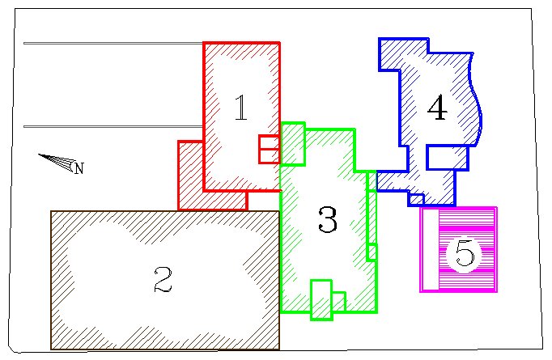
Structural Design
Blocks of the Building

Slide 31
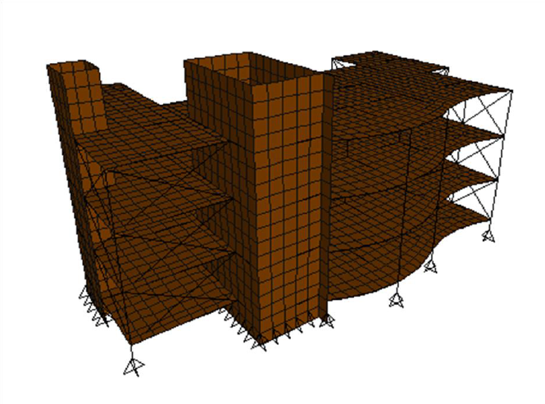
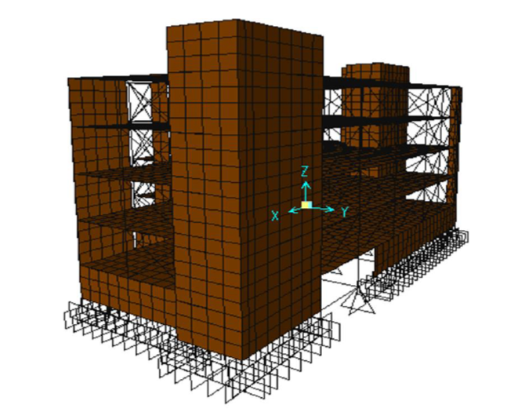
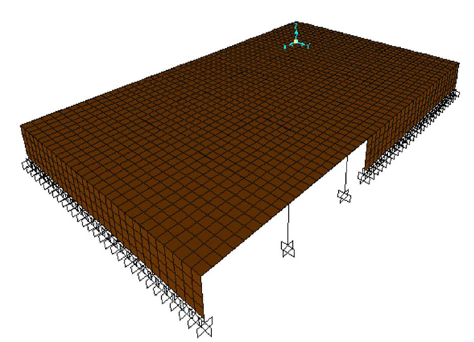
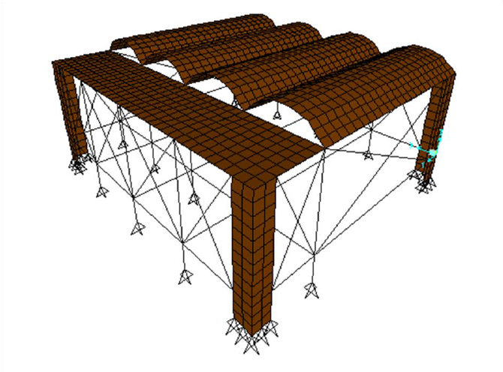
Structural Design
B4
B2
B3
Blocks of the Building
B5
B3

Slide 32
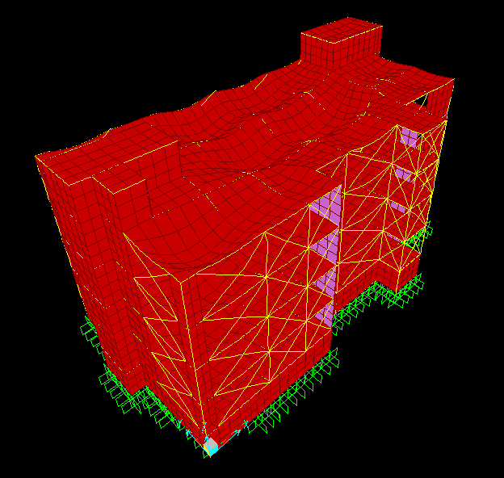
Structural Design
Compatibility Check

Slide 33
Structural Design
Load | Manual calculations (KN) | Calculations from SAP (KN) | Difference (%)
Dead load | 63000 | 62000 | 1.44
Live load | 17000 | 16600 | 1.82
Superimposed dead load | 13600 | 13700 | 0.59
Equilibrium Check
Internal Forces Check
Element | Hand calculations | Calculations from SAP | Difference (%)
Slab 1 | 110 KN.m | 110 KN.m | 0.54
Beam 5 | 670 KN.m | 620 KN.m | 8.7
Column 2 | 4600 KN | 4800 KN | 3.9

Slide 34
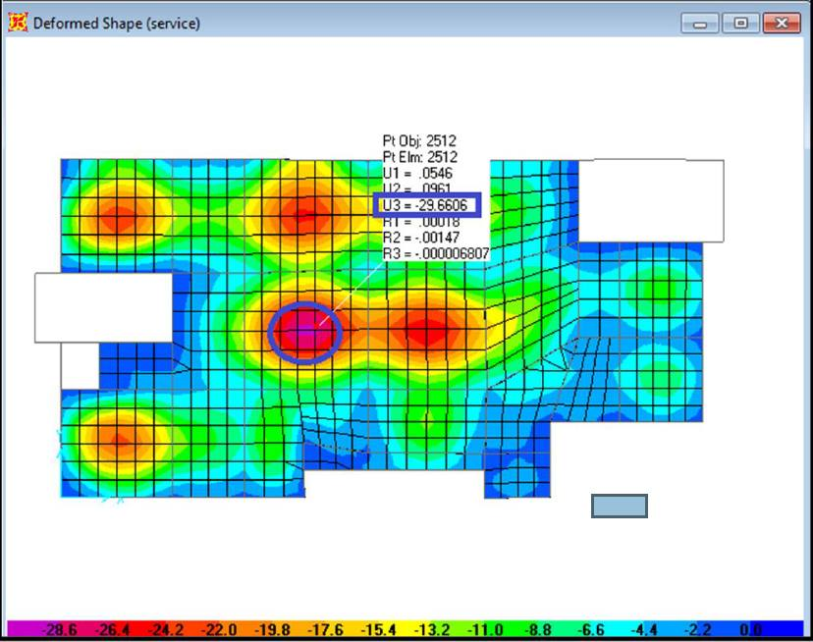
Structural Design
Deflection

Slide 35
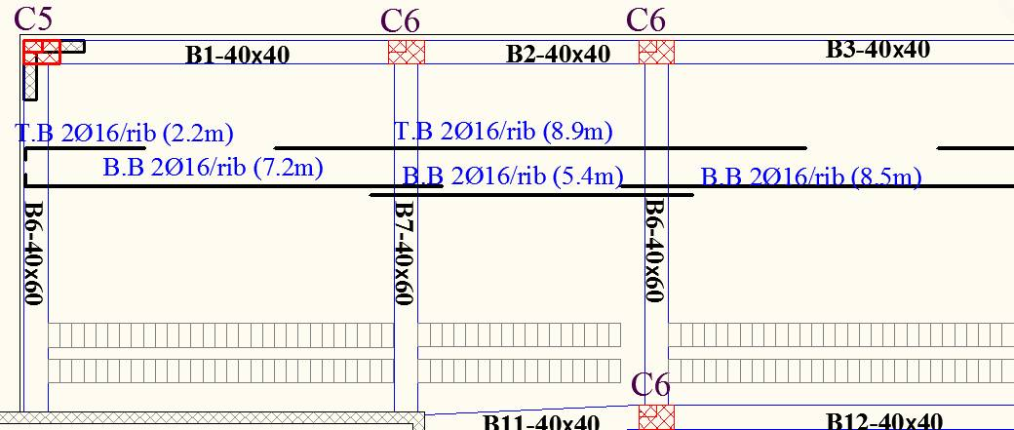
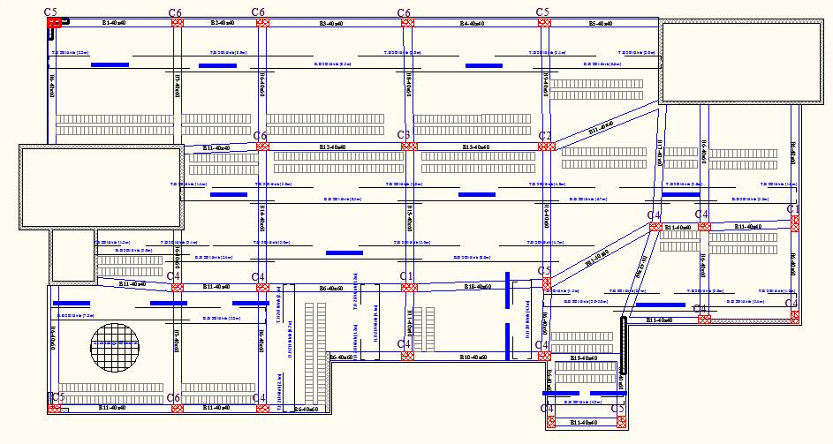
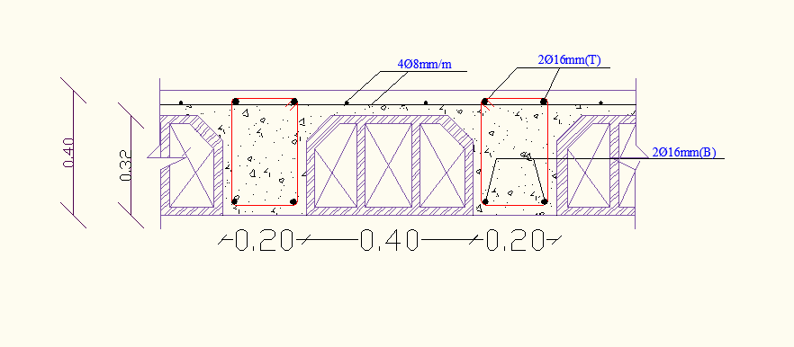
Structural Design
Slab:
One-Way Ribbed Slab

Slide 36
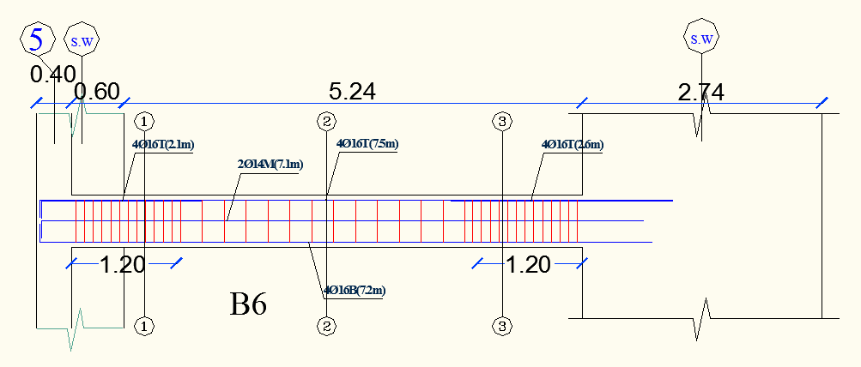
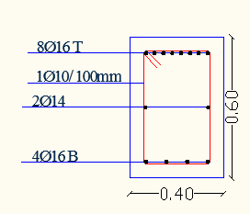
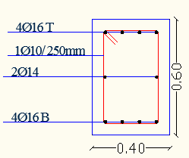
Structural Design
Beam Design
Section 1-1
Section 2-2

Slide 37
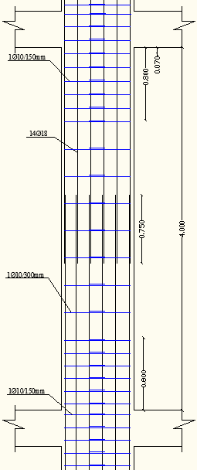
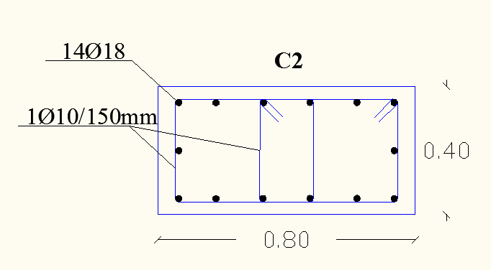
Structural Design
Column Design
Column | Dimension (m)
C1,C2,C3 | 0.8*0.4
C4,C5,C6 | 0.6*0.3

Slide 38
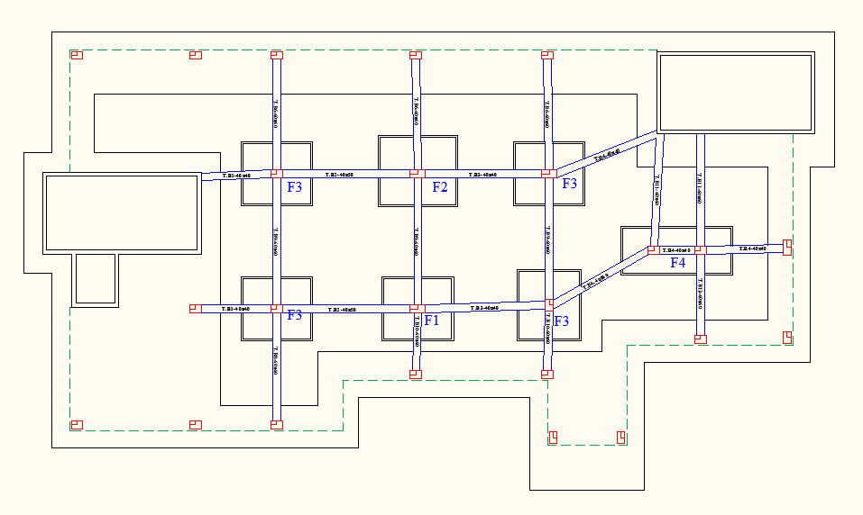
Structural Design
Footing Design

Slide 39
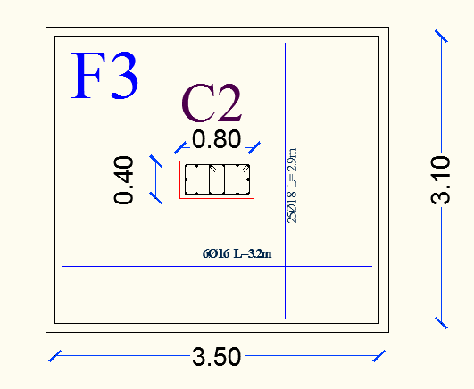
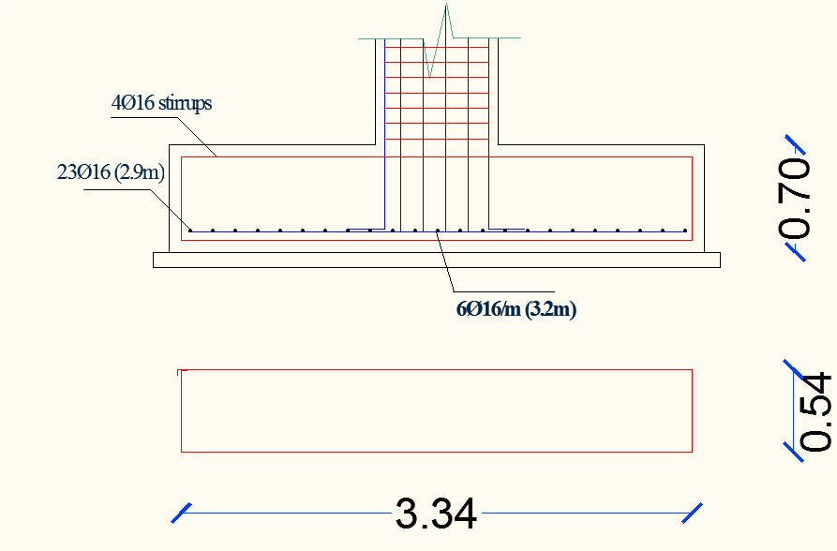
Structural Design
Footing Design
Footing | Dimension (m)
F1 | 3.5*3.1
F2 | 3.9*3.5
F3 | 3.5*3.1
F4 | 5.6*2.3

Slide 40
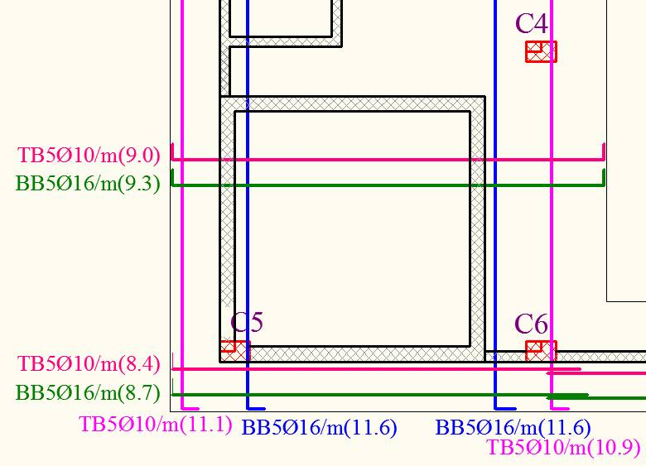
Structural Design
Conations footing Design

Slide 41
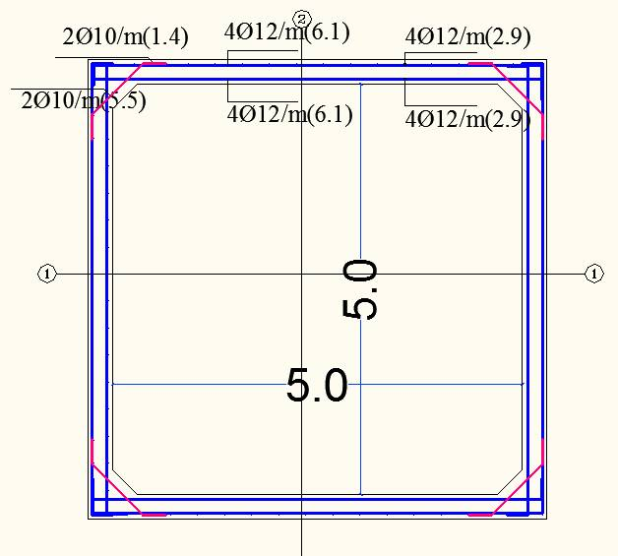
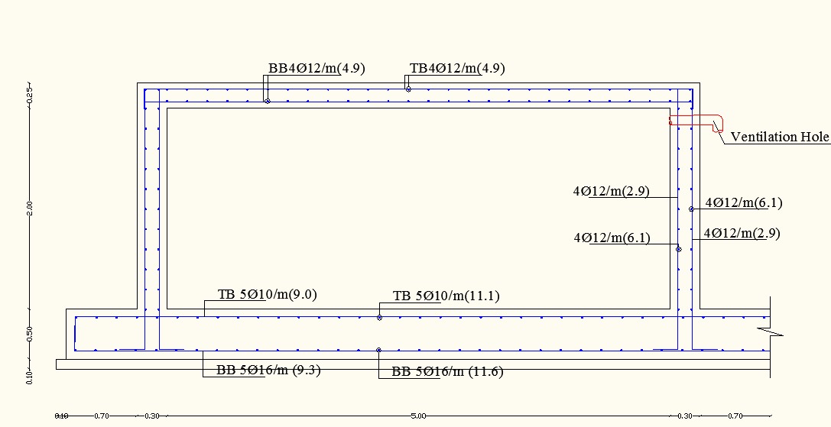
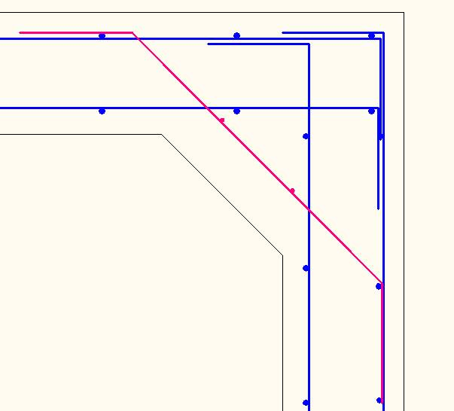
Structural Design
Water Tank Design

Slide 42


Structural Design
Shear Wall Design

Slide 43

Structural Design
Stair

Slide 44
Electrical Design

Slide 45


Electrical Design
Computer
Laboratory
Uniformity =0.76
E (avg.) =605 LUX

Slide 46
Mechanical Design

Slide 47

Mechanical Design
Water Supply System

Slide 48

Mechanical Design
Drainage System

Slide 49


Mechanical Design
Rain Water Drainage

Slide 50

Mechanical Design
Radiators System

Slide 51

Mechanical Design
Emergency System

Slide 52
Quantity Surveying

Slide 53
Quantity Surveying
Concrete :
B250= 754 m^3
B300= 1847 m^3
B350= 697 m^3
B500= 715 m^3
Blocks: 26384
stone: 2861m^2
Masonry blocks 10 cm: 3038
Masonry blocks 15 cm: 2520
Steel: 1001 ton

Slide 54
Quantity Surveying
Total Cost for Architectural Design = 1134000$
Total Cost for Structural Design = 1200000$
Total Cost for Mechanical Design = 400000$
Total Cost for Electrical Design = 333000$
Total Cost for Project =3067000$ (460$/m2)

Slide 55

Thank You

