Slide 1

College of Engineering and Information Technology.
An-Najah National University
graduation project
May -24-2023
Dropshipping (e-commerce and marketing)
Students:
Esraa Hamad
Nehal Azem
Supervisor: Dr. Ahmad Shraideh

Slide 2
DropShipping
- What is dropshipping
- The practical application of dropshipping
- Results

Slide 3
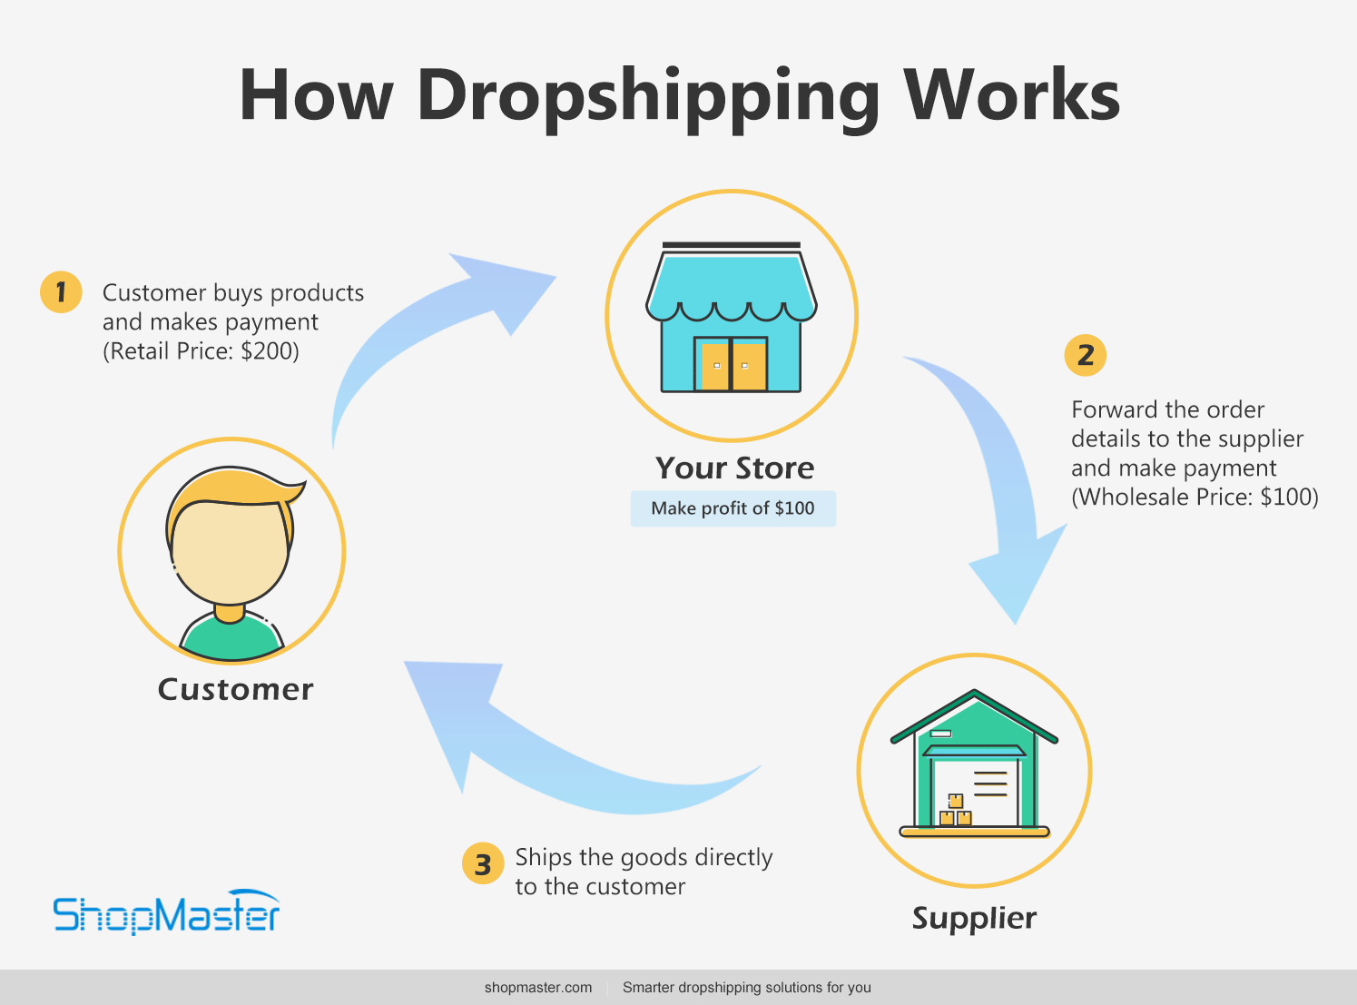

Slide 4
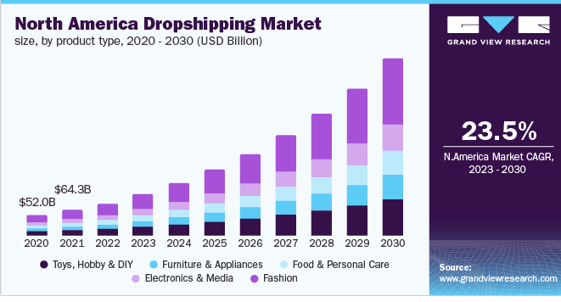
03
The history of dropshipping :
Grand View Research)2018)

Slide 5
Mechanism of Action :
1- Who is the target country and why?
2-What is the niche that we chose?
3-What products have been added to the site and why?

Slide 6
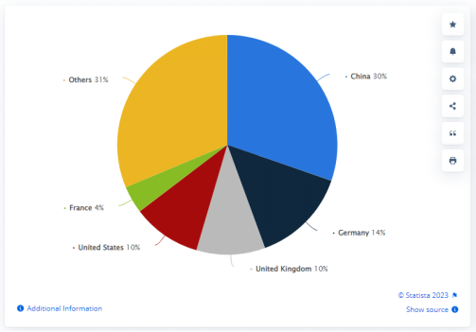
The target country :
Through a study Published by Marina Pasquali, Apr 20, 2023 on the Statista website

Slide 7
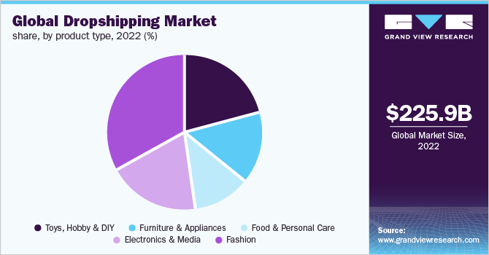
The niche :
Care and makeup products have been targeted
1-nichescraper
2- ecomhunt
Grand View Research (2018)

Slide 8

Website name and logo :

Slide 9
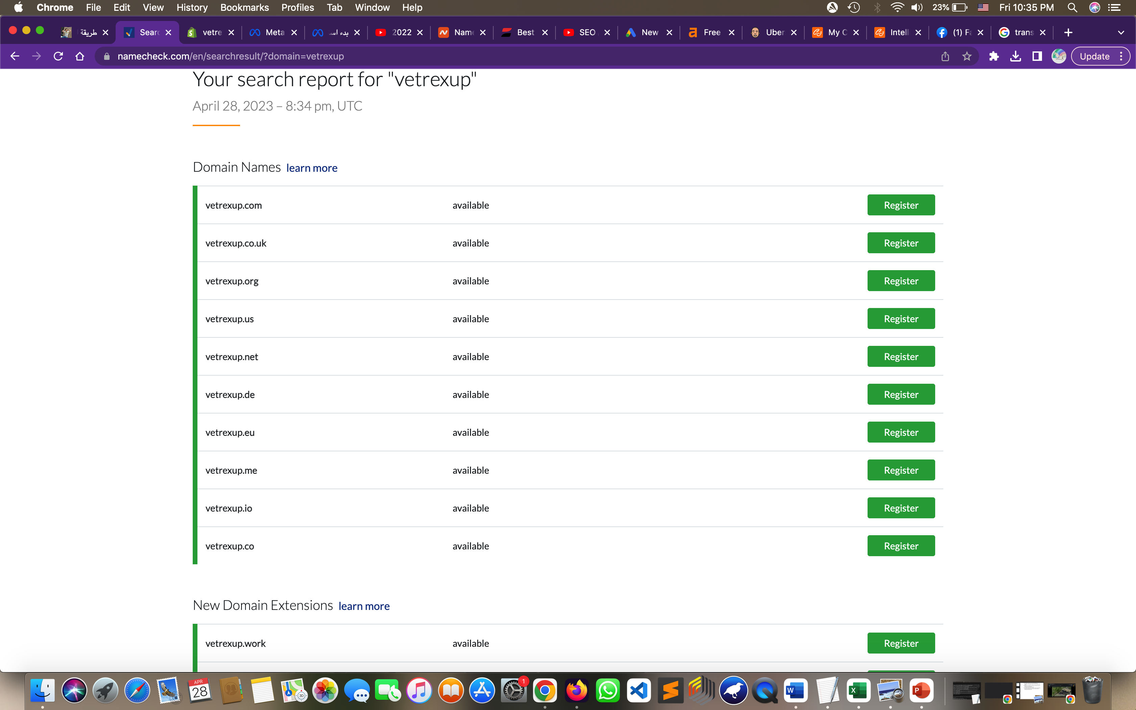
Vetrexup
namecheck.com

Slide 10

Shopify features :
Various business plans: a 120-day free plan is available
Compatibility with SEO standards
Responsive and compatible with all screens
It provides a lot of necessary and important tools, reports, and capabilities
No need to purchase external hosting in order to create an online store
Provide many free applications

Slide 11
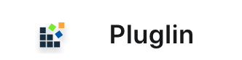
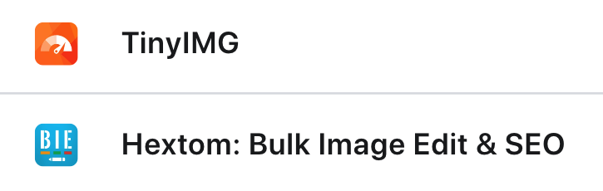







Applications

Slide 12
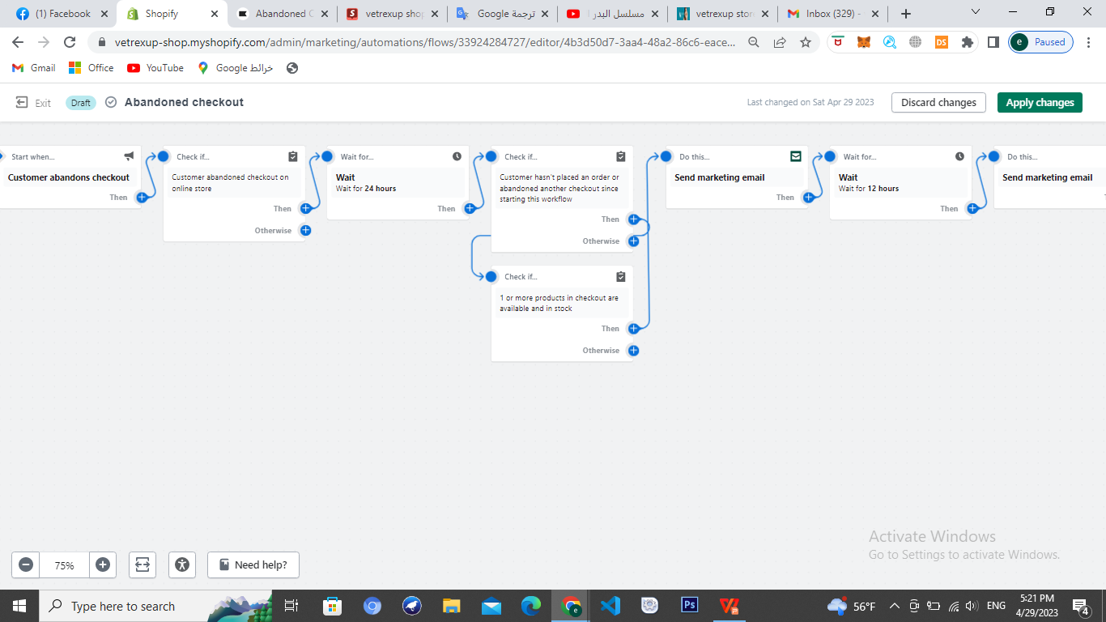


Slide 13
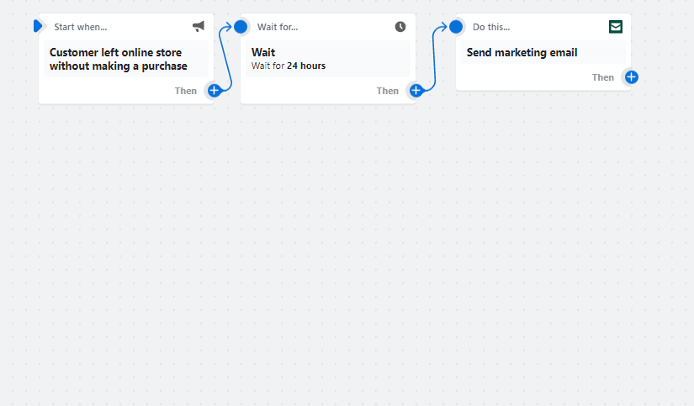
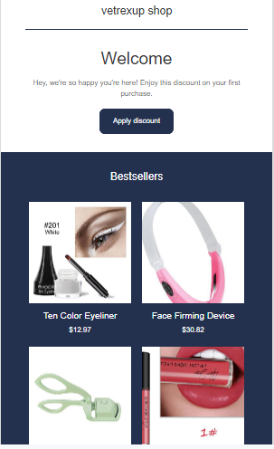
If the customer enters the site and does not perform any operation, he will receive this email

Slide 14
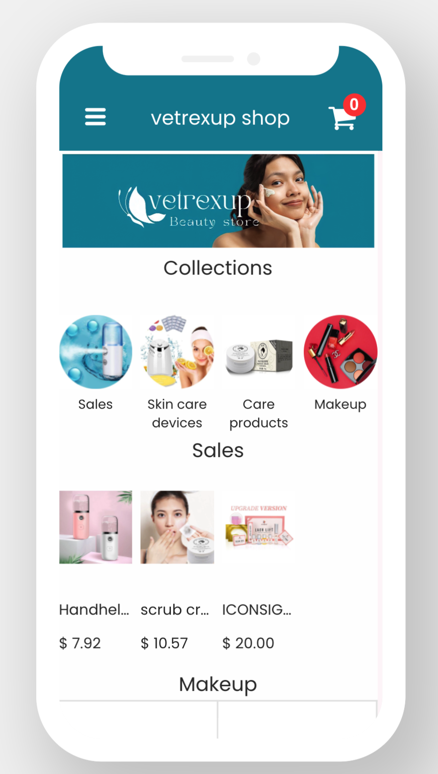
Vajro ‑ Mobile App Builder
Through it we can create an application for the website

Slide 15
Cons of choosing a supplier from AliExpress :
-Products do not arrive at the same time
-You will incur additional shipping charges
- Difficulty communicating with them in the event of problems or delays in delivering products
-Difficulty putting a trademark on products

Slide 16

Supplier :
The possibility of ordering products from Ali Express or Amazon
Putting the trademark on the products
Technical support and the ability to Communicate with a real person
Ease of communication in the event of problems or delays in delivery

Slide 17
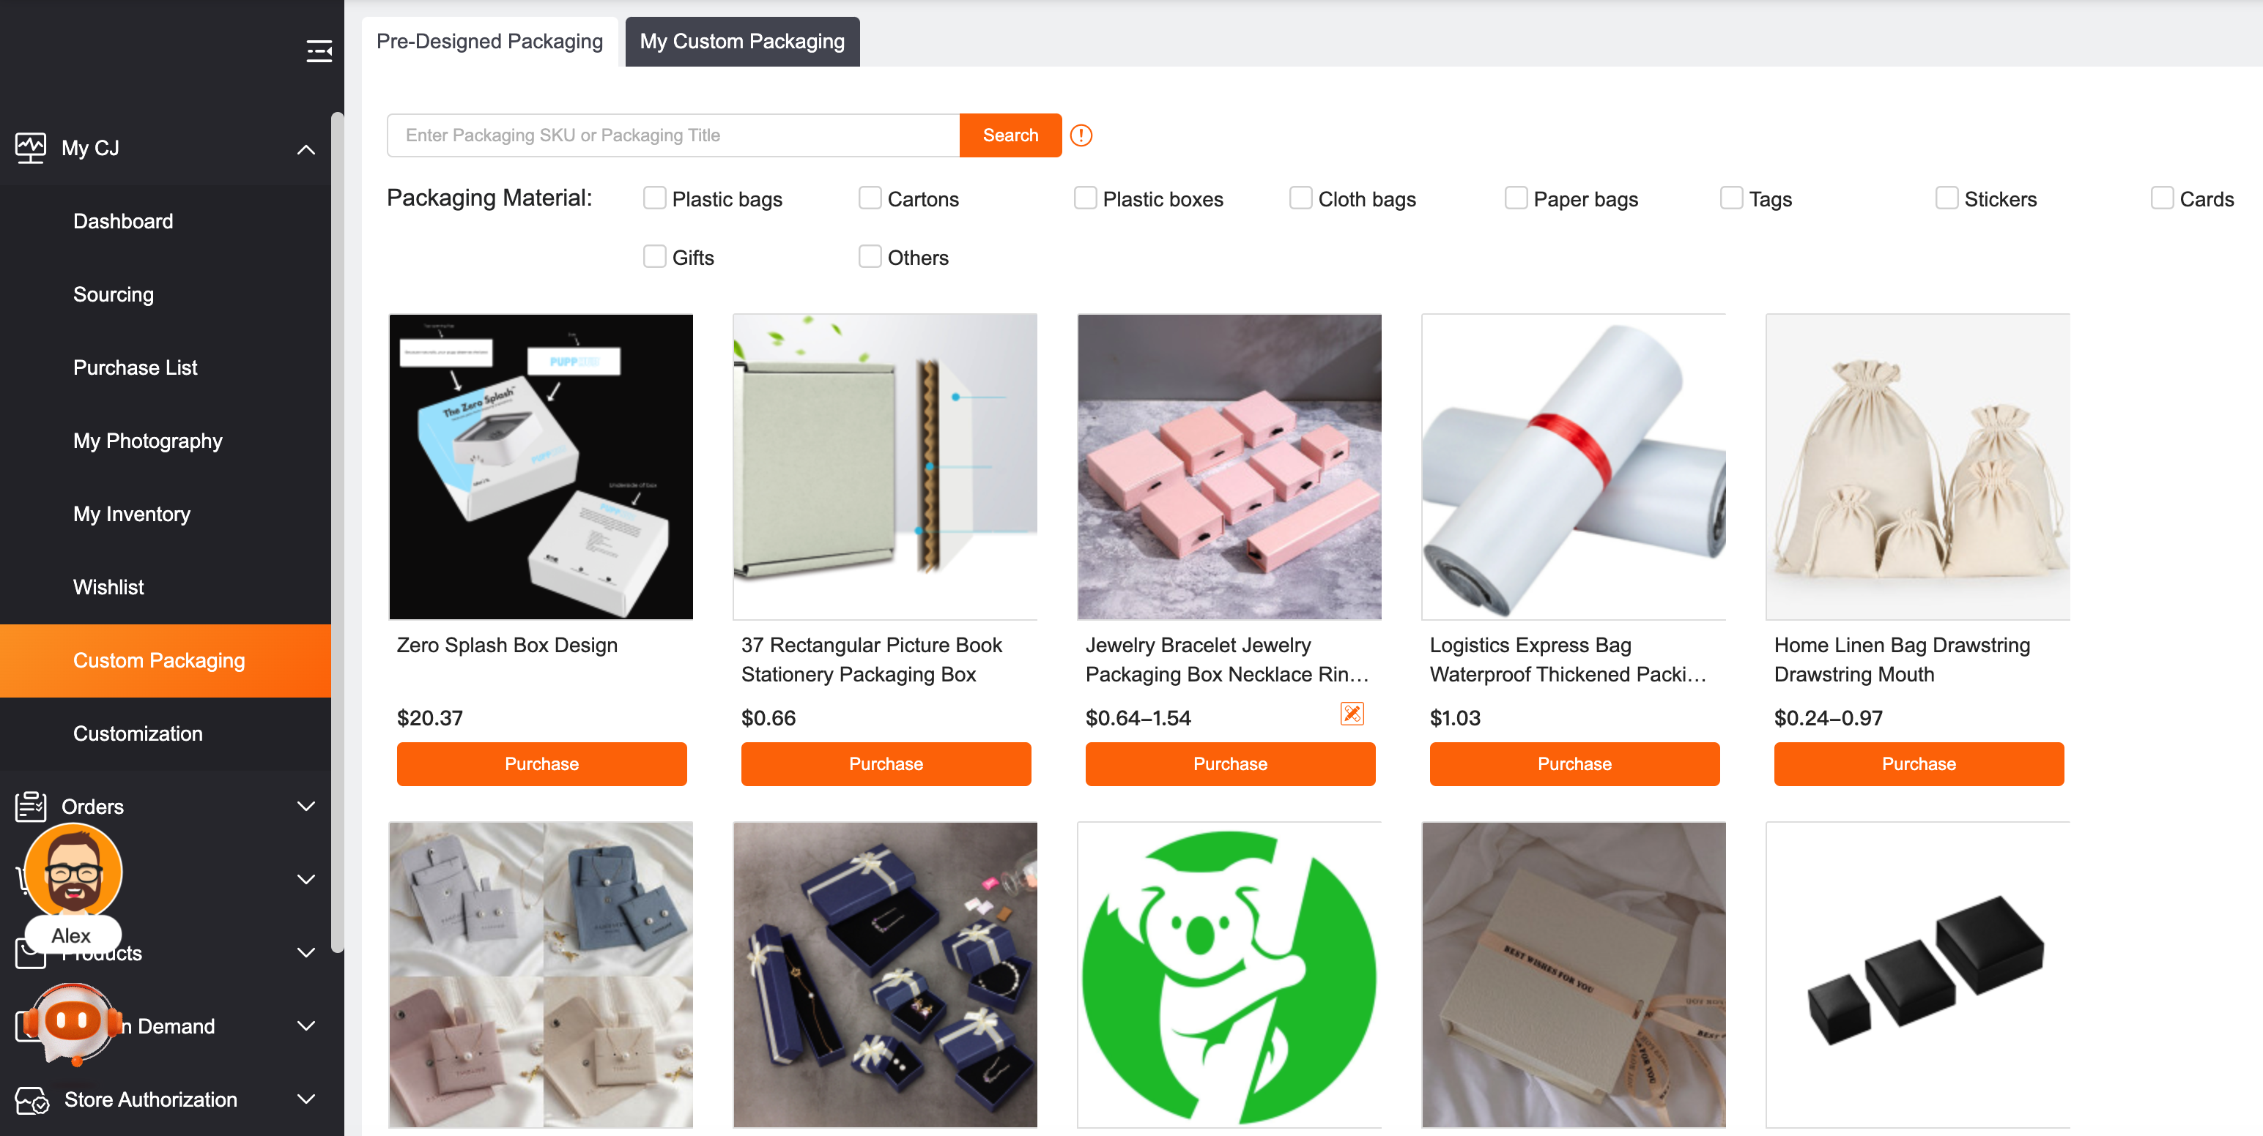
Putting the trademark on the products

Slide 18
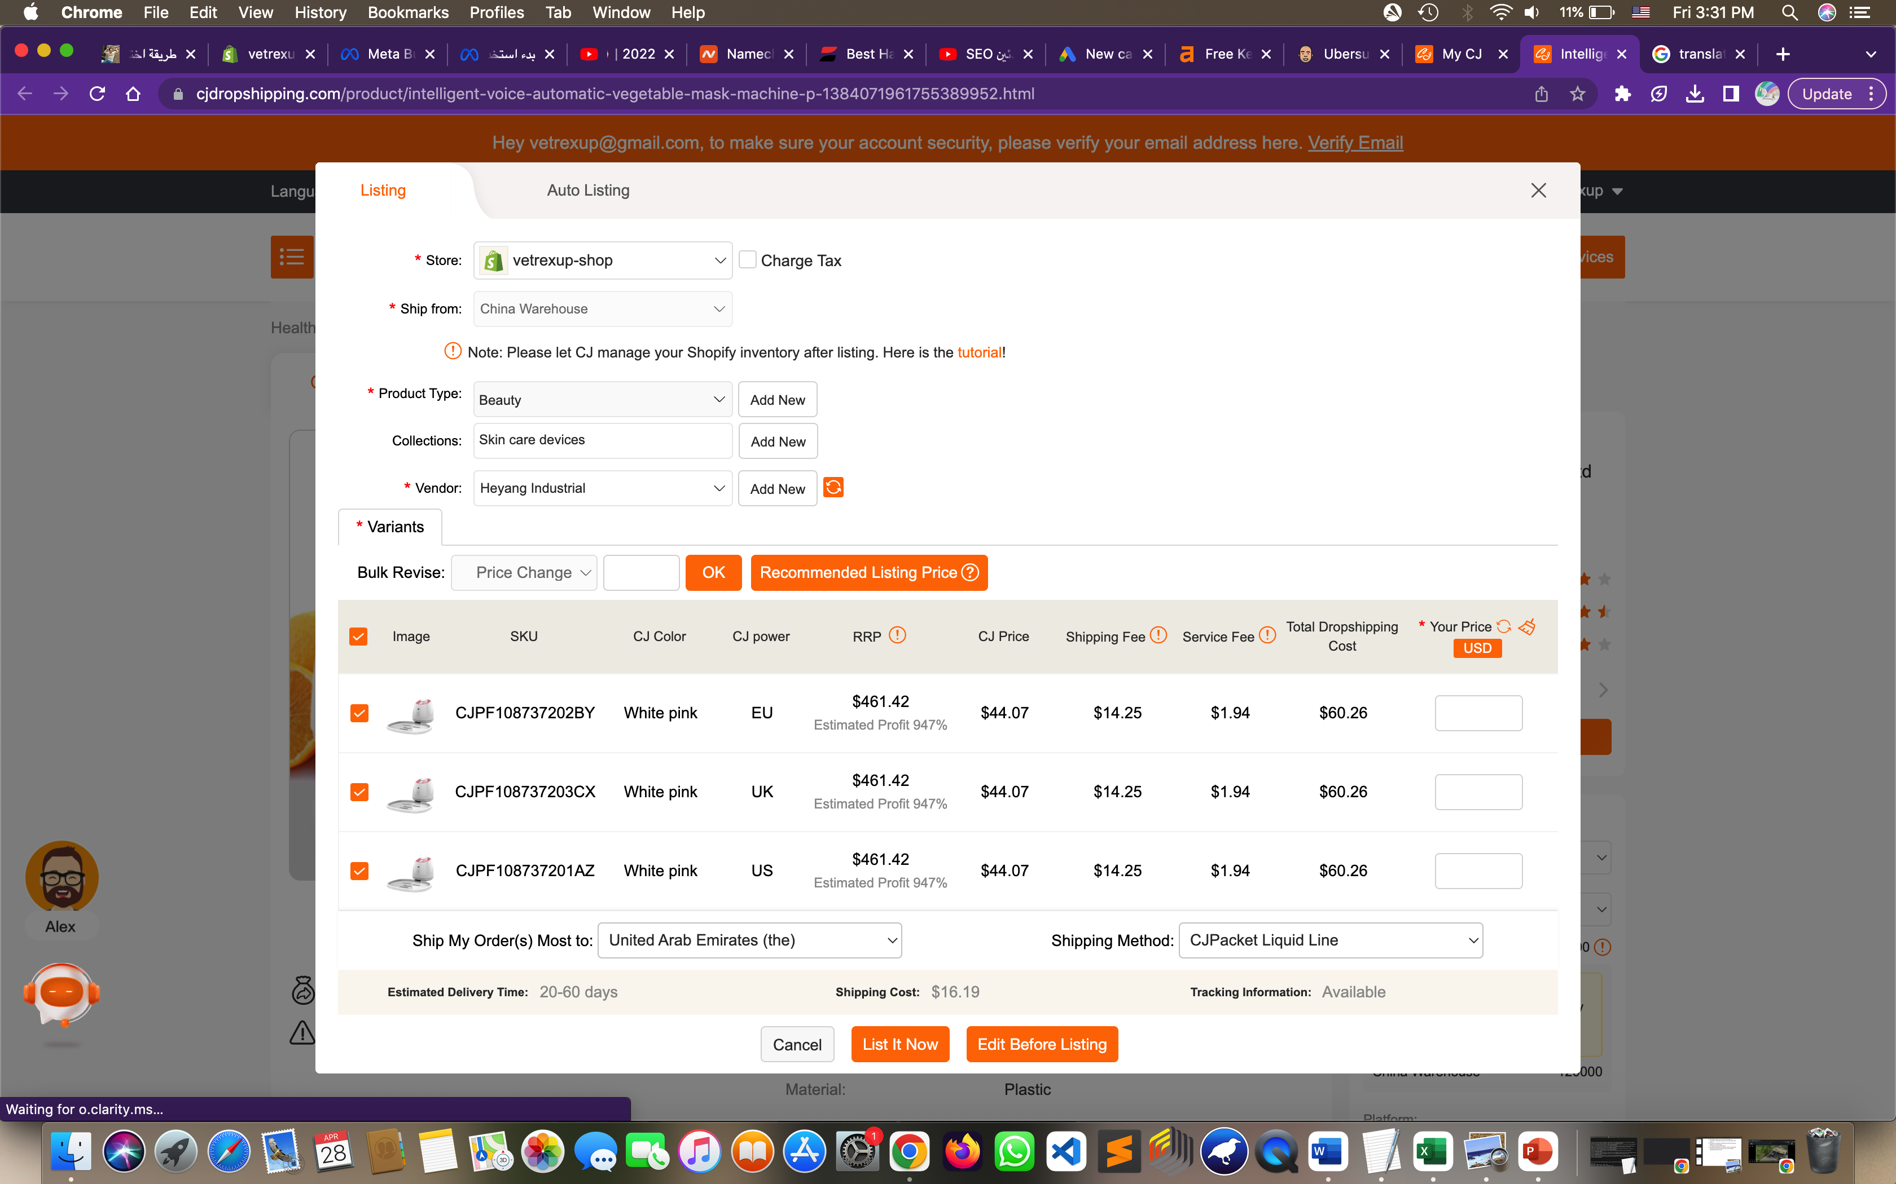
Adding products to the site:
The price of the product in our store
The price of the product on other sites
And then it is automatically added to the site

Slide 19
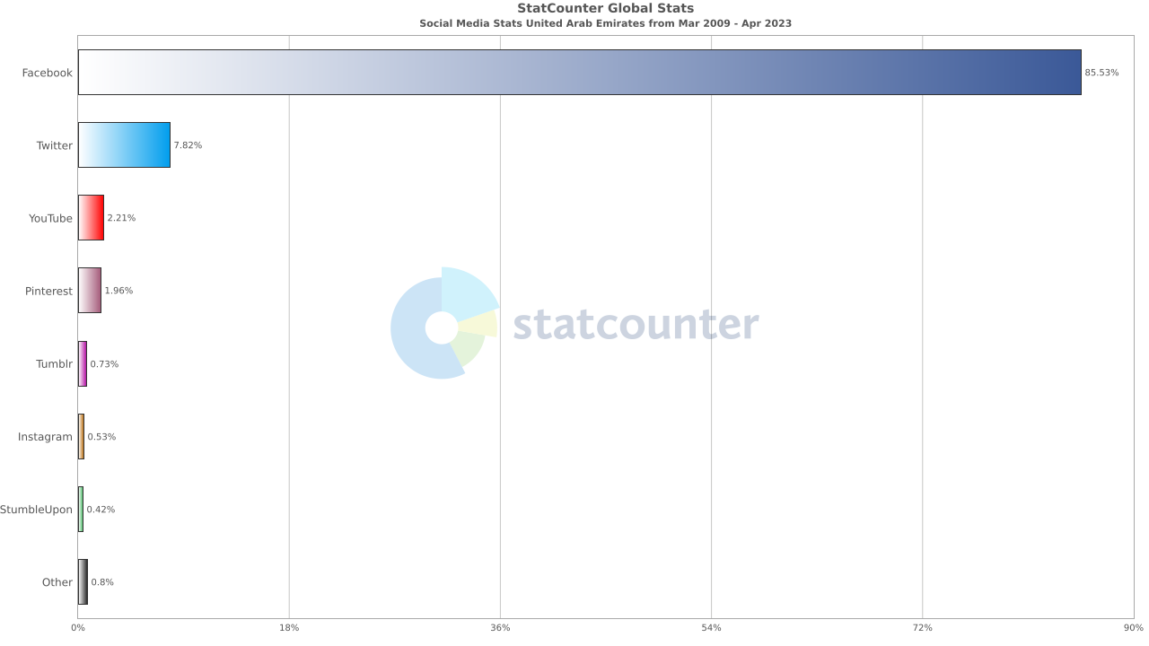
The target country :
Social media statistics in United Arab Emirates :
using “Statcounter” tool

Slide 20
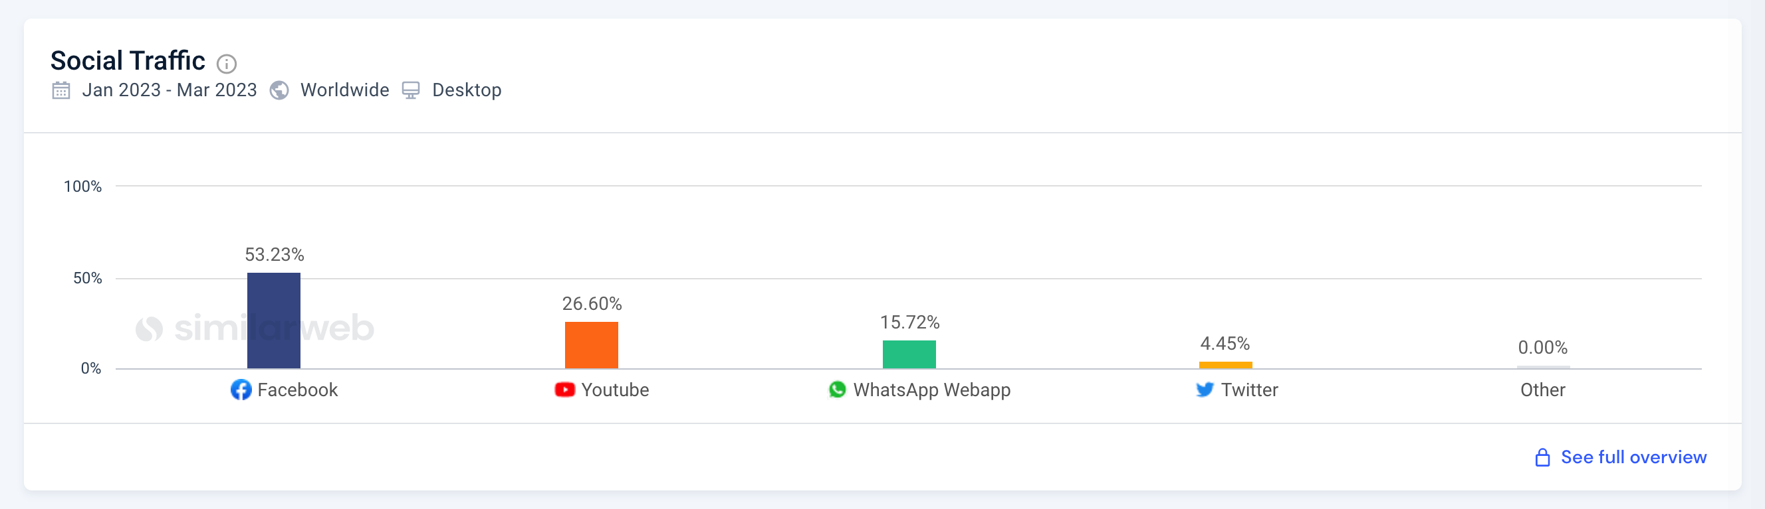
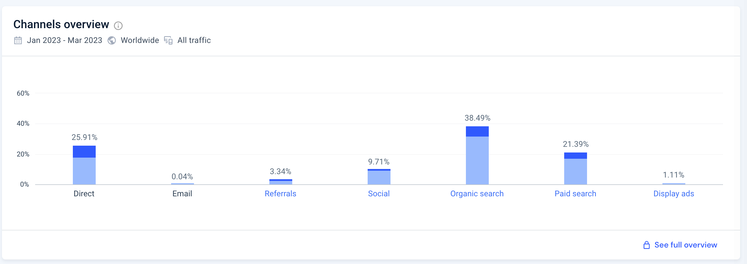
Similarweb :
Using the Similarweb.com , We used it to analyze competitor sites in the Gulf countries

Slide 21
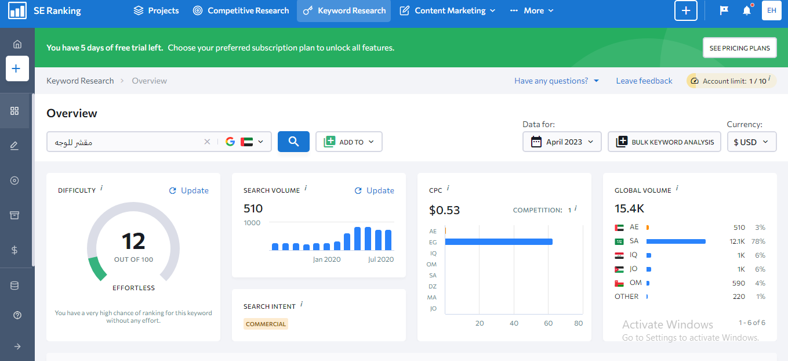
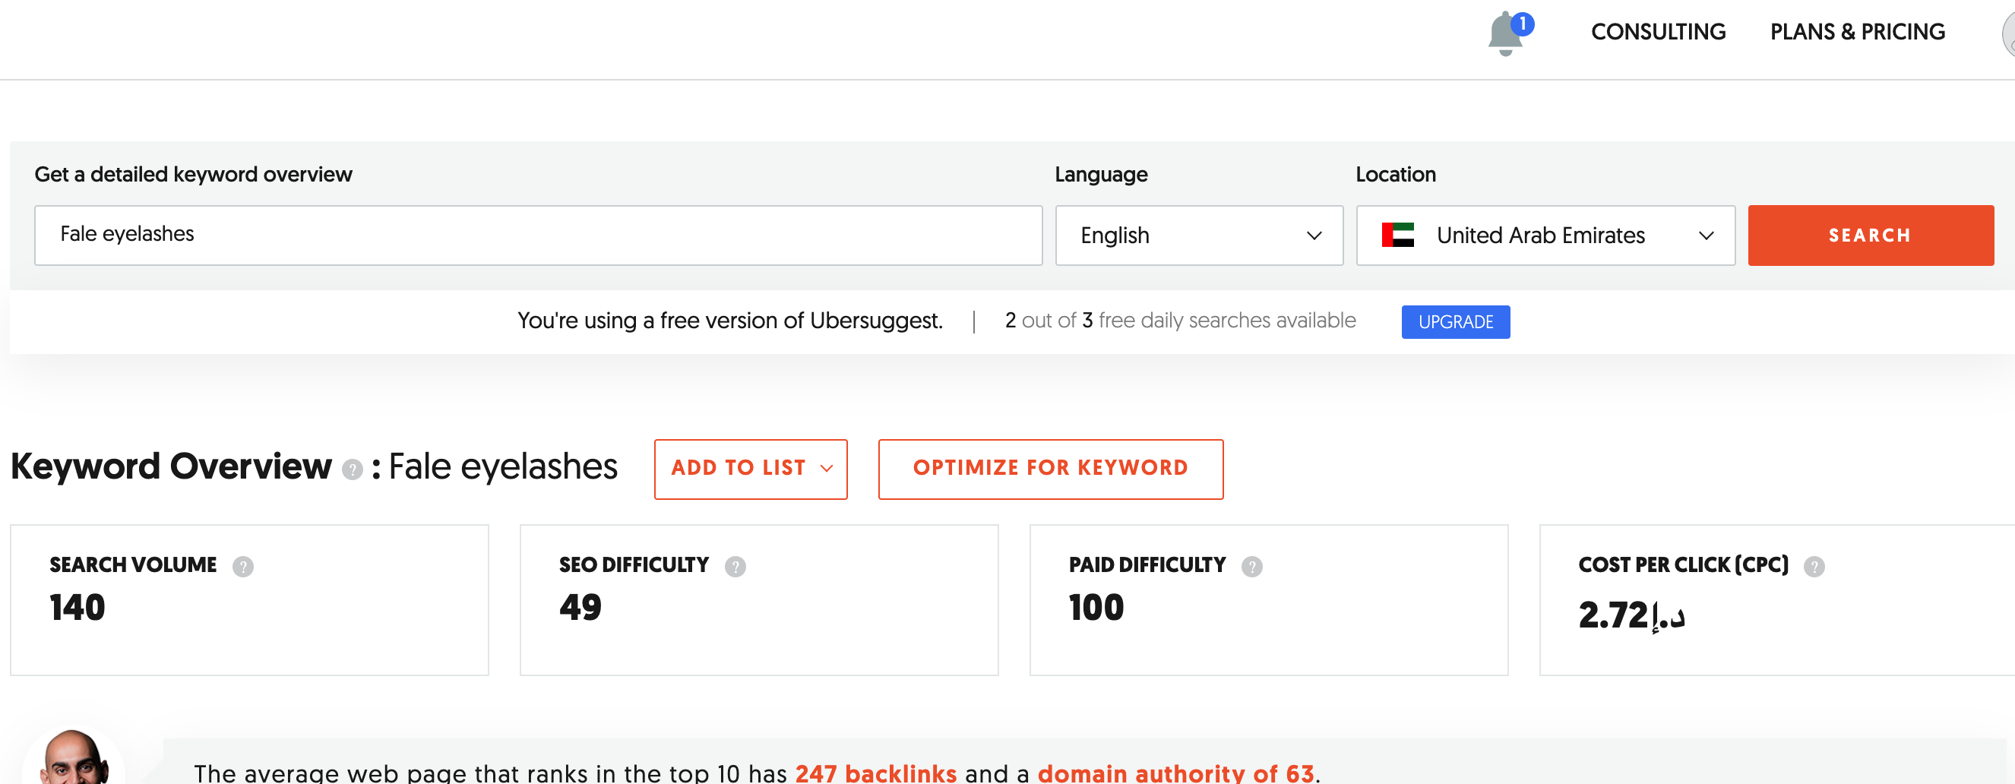
SEO :
Websites used to find out what keywords are :
seranking.com
- seranking.com
ads.google.com
- ahrefs.com

Slide 22
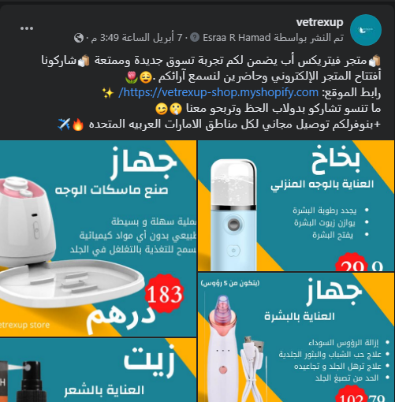
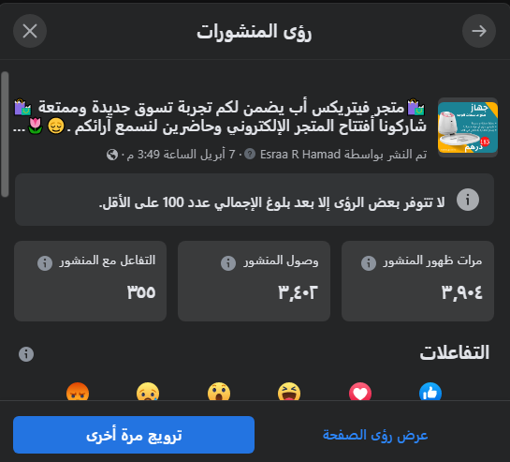
Funded ads :
Result

Slide 23
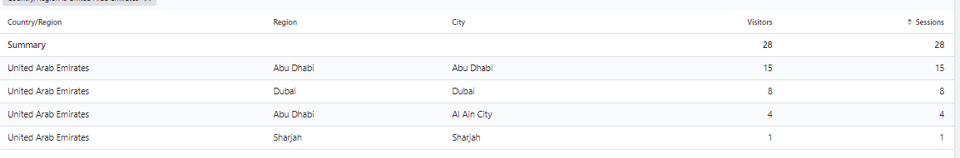
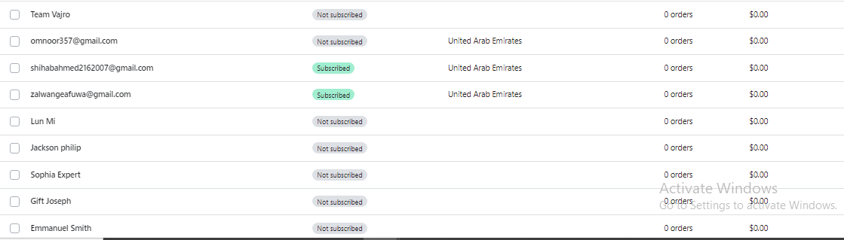
Funded ads :
Results in shopify :

Slide 24
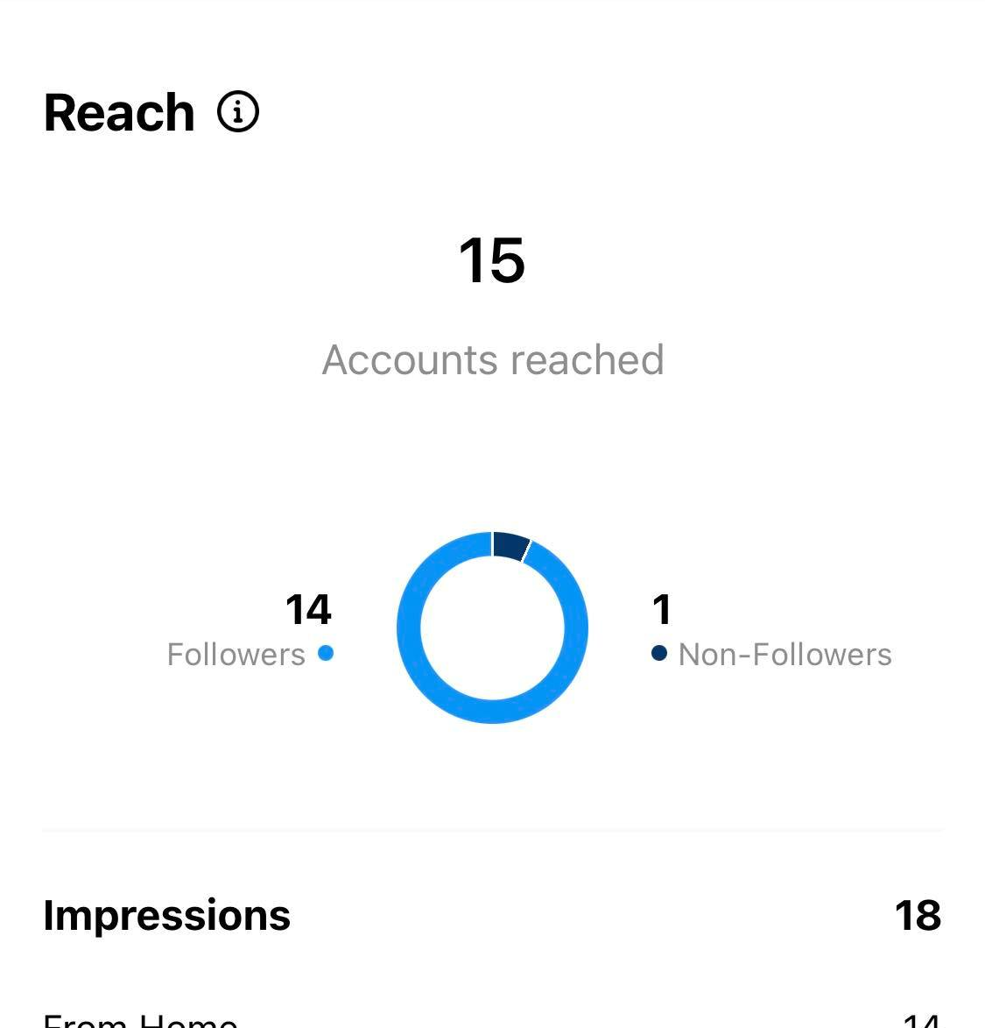
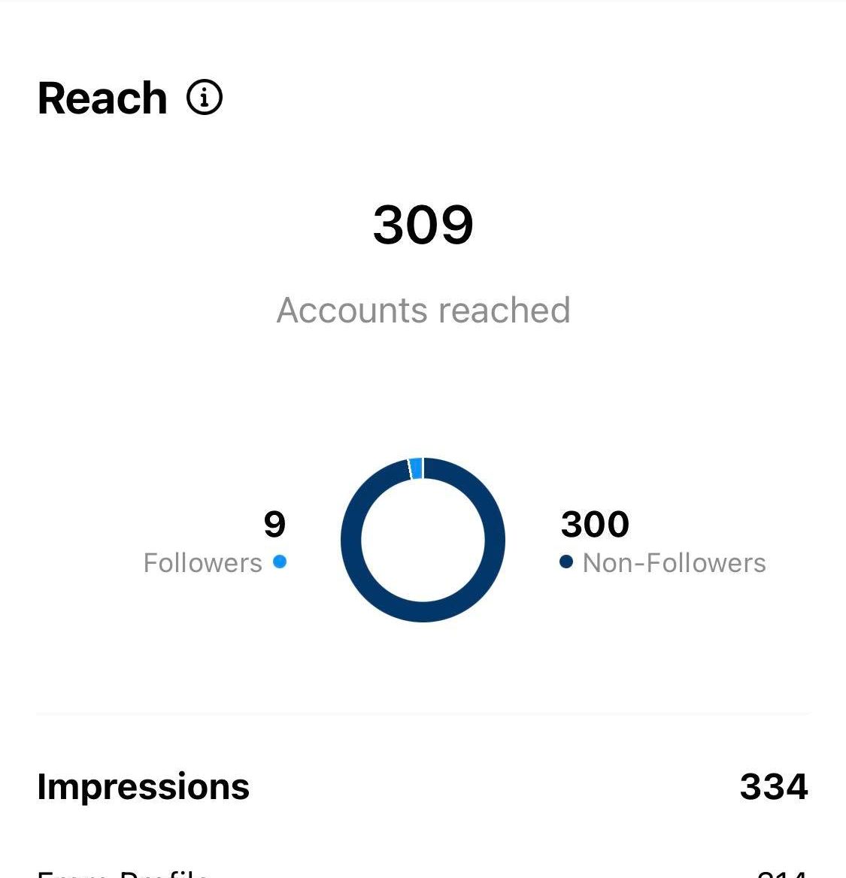
Hashtag :
inflact.com - displaypurposes.com
Before using hashtag
After using hashtag

Slide 25
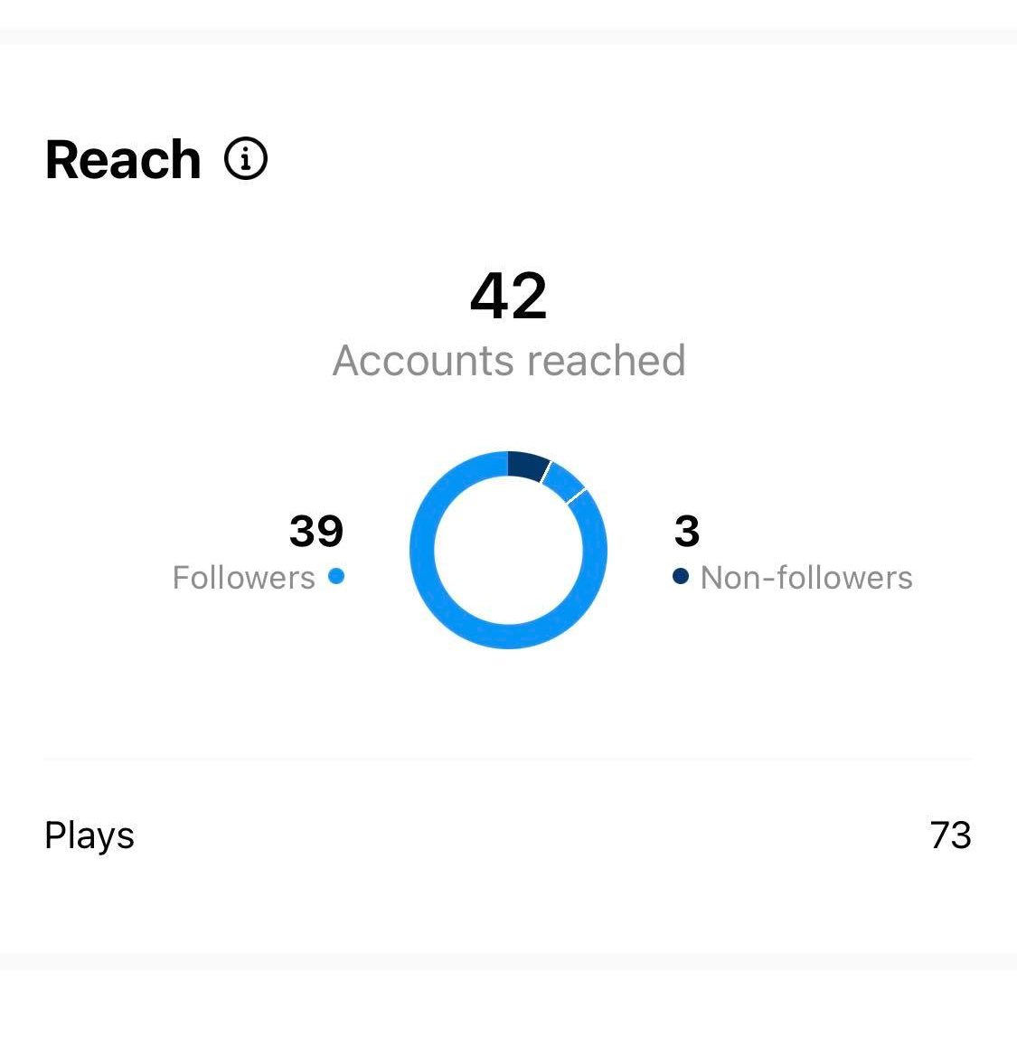
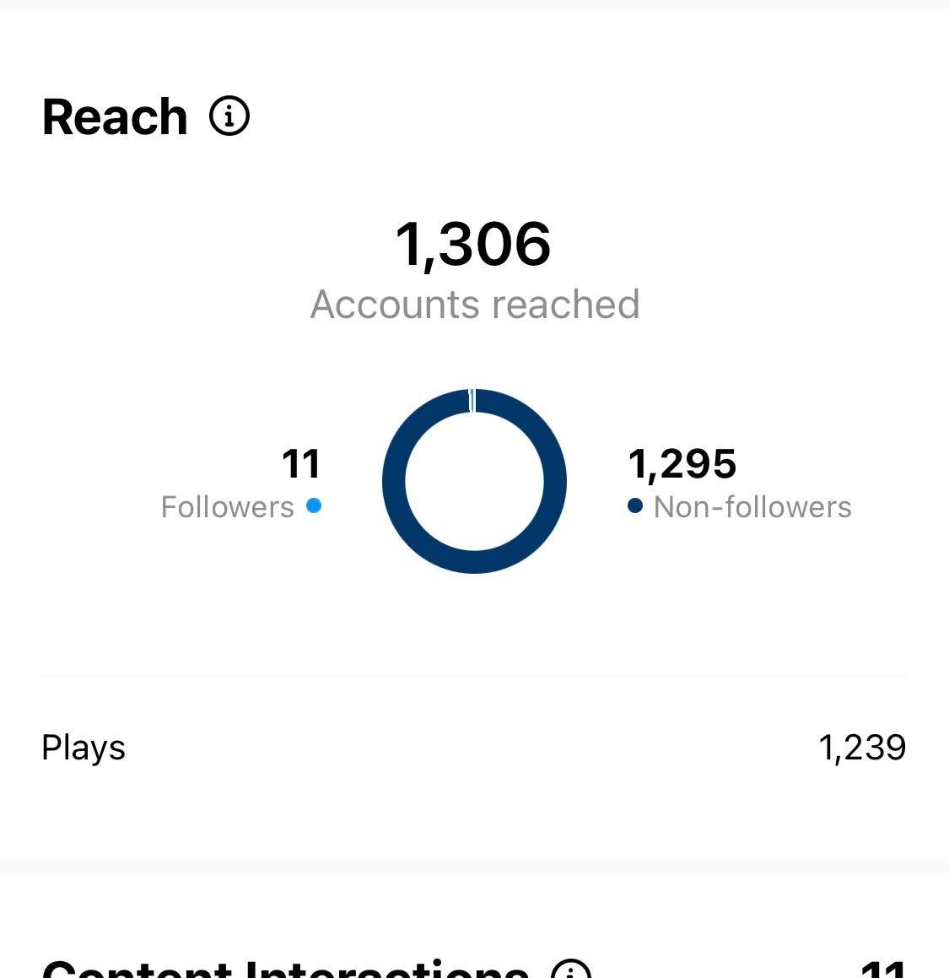
Hashtag :
Also, the same thing on Reels :
Before using hashtag
After using hashtag

Slide 26
Thank you

