Slide 1
ARIS
The Augmented Reality Studio

Slide 2
Outline
Background
Problem definition
Proposed solution
System design
Functionalities
Comparison with existing work
Problems we’ve faced
Future work
Conclusion
Demo

Slide 3
Background
What is AR ?
Augmented reality (AR) is a live, real-world environment whose elements are augmented by computer-generated sensory input such as text, video, graphics or GPS data.

Slide 4
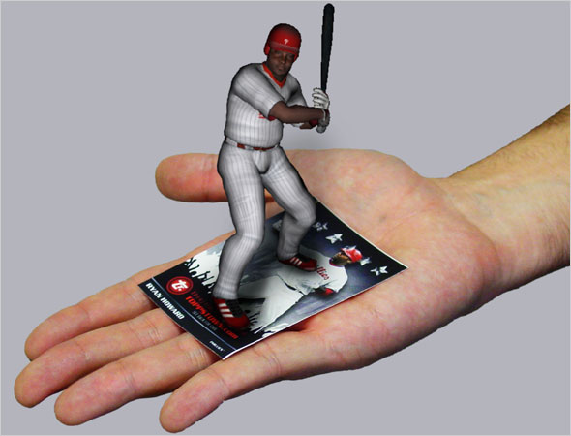
Background – Cont.

Slide 5
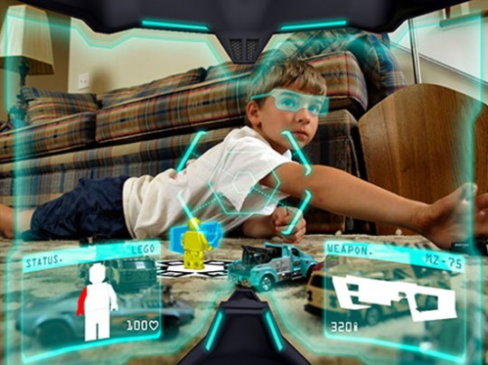
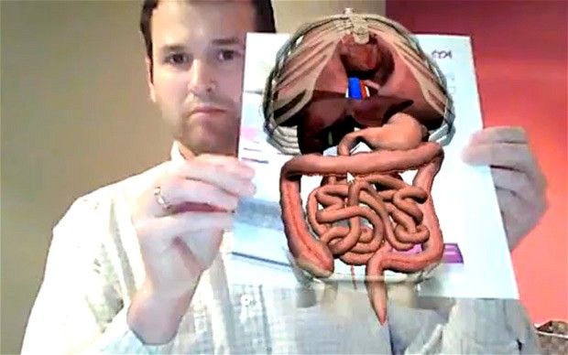
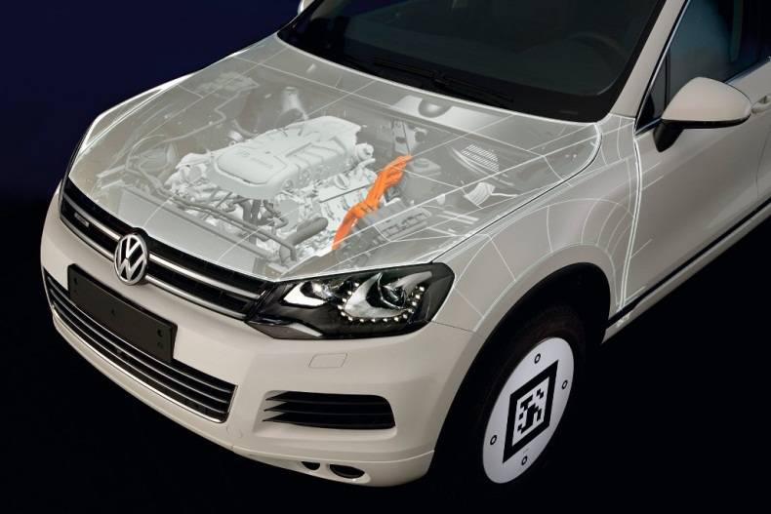
Uses?
Gaming
Medical
Industry

Slide 6
Problem Definition
AR becomes widely used, various applications.
Hard to develop.
Model and Target unreachable by non-developers (can’t specify their own Targets and models).

Slide 7
Solution ?
A framework with proper GUI (Studio)
Easy to add, view and control components
Offers high performance
Portable
Generate multi- platform mobile apps

Slide 8
Where to start ?
Is there any off-the-shelf components to be used ?
  Yes ! Many SDK’s
What is the best?
  Vuforia SDK, by Qualcomm.
  Free, most powerful, but restricted access to computer vision functions.
  Supports many types of targets, the model is user’s responsibility.

Slide 9
System design
User Interface (Studio)
Java
Java3D
XML File
Data about the target
Data about the model
Dynamic Android loader file (.APK file)
Controlled access to the SDK
OpenGL ES
Native C
JNI
Java

Slide 10
Studio Structure
Main control unit
Model Loader
3D canvas
XML Builder
Target Loader

Slide 11
Studio functionality
Targets supported
Cylindrical target
Cubic target
Virtual buttons
Models supported
3D model
Video model
Animation
Translation
Rotation
Image target

Slide 12
APK Loader Structure
Control functions
Target loader
XML Reader
SDK
Model Loader
Renderer

Slide 13
APK loader functionality
3D model & video rendering
Animation supported
Virtual buttons
Direct click
Screen tap
Interactive with models
Scaling
Swapping

Slide 14
Existing work - comparison
 | Unity | Bring to life | ARIS
Compilation | Yes | No | No
Stability | Yes | No | Yes
Speed | High | Low | High

Slide 15
Challenges & Problems
Generating the data set of the target
  Has to be uploaded to the Vuforia website.
  Unresolved !
Vuforia SDK, OpenGL and Java3D are new technologies for us
  Took a long time to learn & understand.
Java 3D is not the best 3D engine to be used !
  Nearly depreciated
  Many functionalities missing
  We discovered that after a period of time, hard to go back.

Slide 16
Future work
Support iOS application
Build 3D games engine to use instead of native openGL ES.
Use another input sources other than visual scenes or images, like GPS data or voice recognition.

Slide 17
Conclusion
Solved the problem of creating AR apps for non-developers
Structured AR framework, where we can change any part without affecting the other parts.
XML-controlled android loader.
Notes:
In conclusion, this project has solved the problem of creating augmented reality application for non-developers and it has the advantage of portability since the code doesn’t have to be compiled.
In addition, this project is flexible enough to change the technologies used in it if needed, like changing the AR SDK or changing the 3D engine for the android, or even changing the 3D engine used in the Studio for viewing the model and the target.
//********************************//
We’ve proposed the concept of structured AR framework, where we can change any part without affecting the other parts.

Slide 18


Slide 19
Thank you ☺
Any Questions ?

